Slide 1
References for “The K” logo

Slide 2
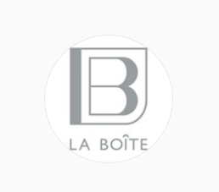




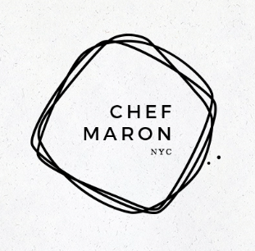



1. Preferred Logo design examples
I would like to have either a circular or a square form of a logo as shown above. No bright colors please. White logo on black background is also fine.

Slide 3
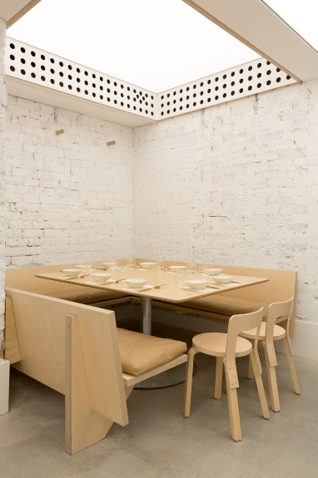
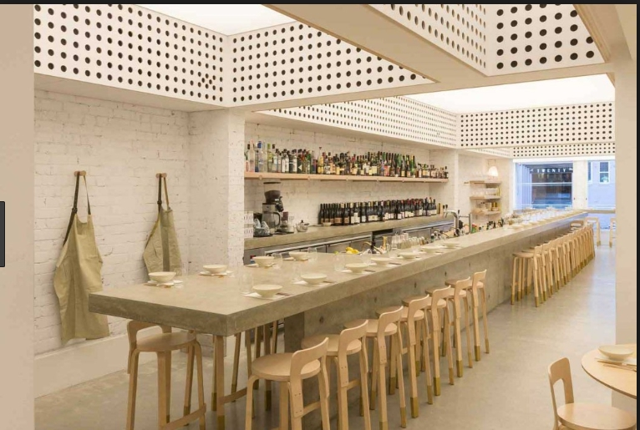
2. Preferred Interior styles
http://chochosan.com.au/

Slide 4
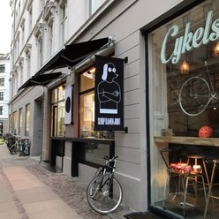
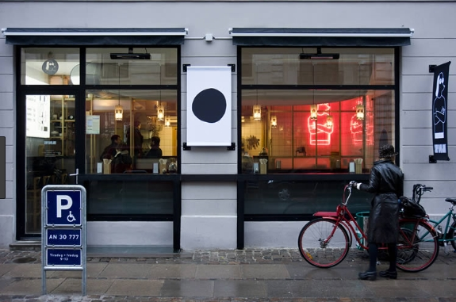
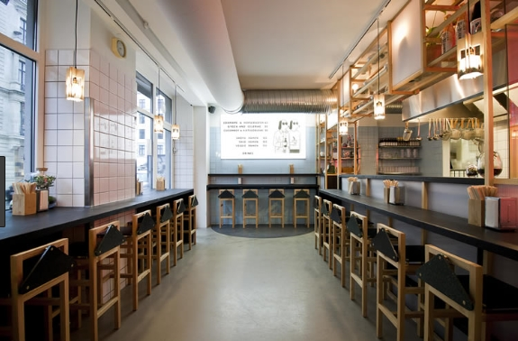
Preferred Interior styles #2
http://slurpramen.dk/

Slide 5
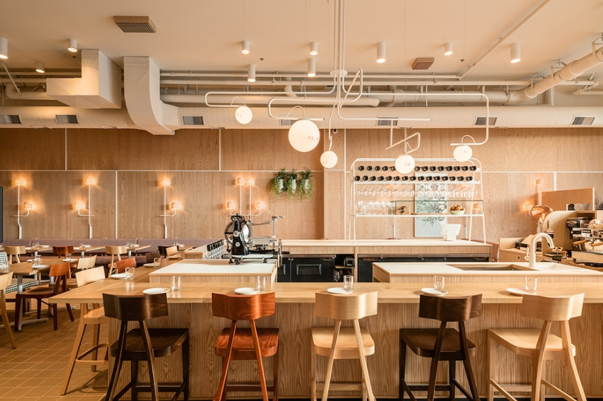
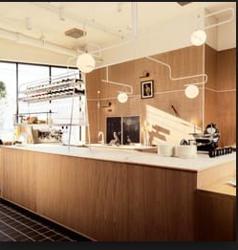
Preferred Interior styles #3
http://www.saviovolpe.com/

Slide 6
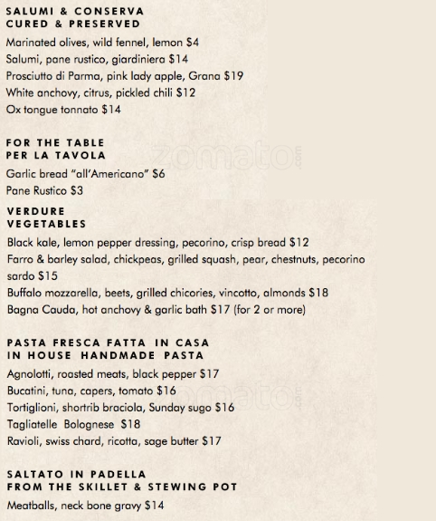
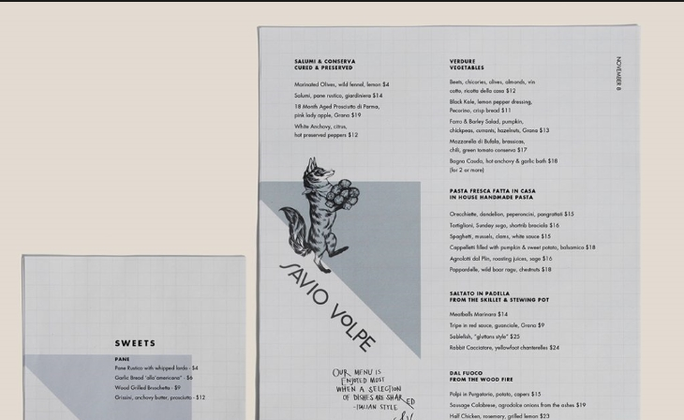
3. Preferred font styles for menu

Slide 7
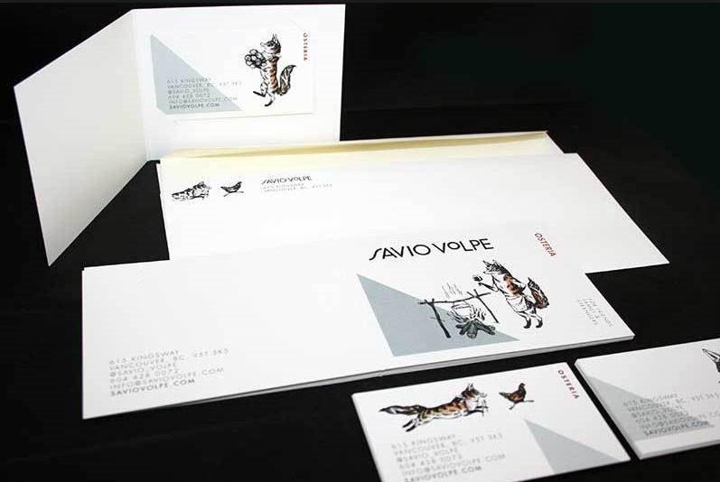
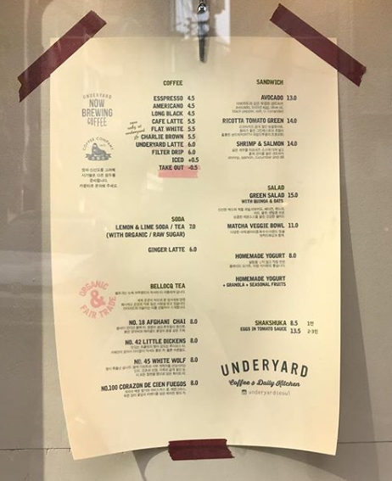

Slide 8
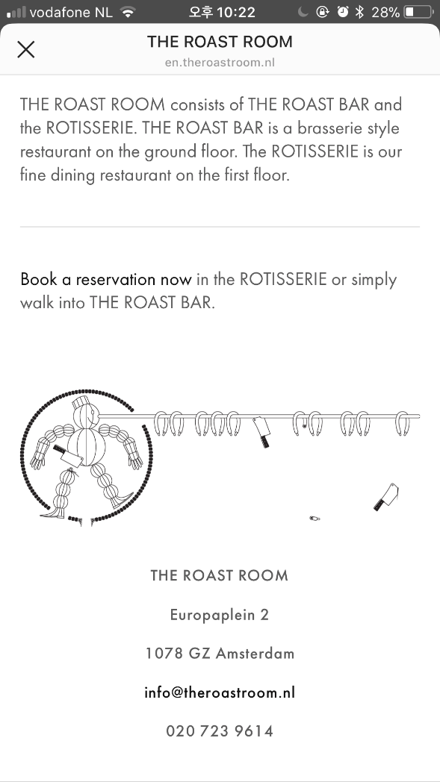

Slide 9
4. Menu (More to be added later)
Beef Bulgogi xx
Marinated BBQ Beef
Pork Bulgogi xx
Marinated BBQ Pork - Spicy
Chicken Bulgogi xx
Marinated BBQ Chicken - Spicy
Yukkejang xx
Spicy Beef Soup w/ etc…
Kalbitang xx
Spare-rib Soup
Kori Gomtang xx
Oxtail Soup
Kimchi Chike xx
Kimchi soup with pork and tofu - Spicy
Denjang Chike xx
Soybean paste soup with beef and tofu
Soon Tofu Chike xx
Soft tofu soup with seafood and eggs - Spicy
Beef Fried rice xx
Shrimp Fried rice xx
Kimchi Fried rice xx
Kimchi xx
Steamed Rice xx
Side Dishes xx

Slide 10
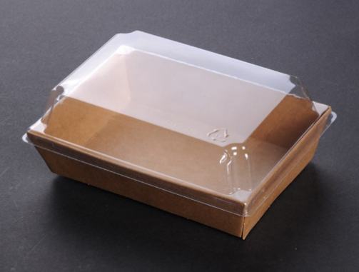

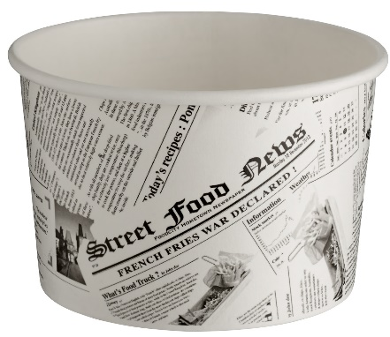
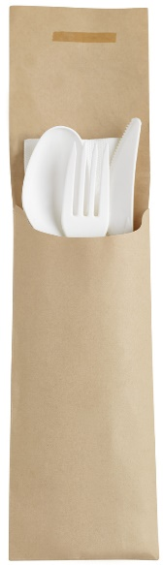
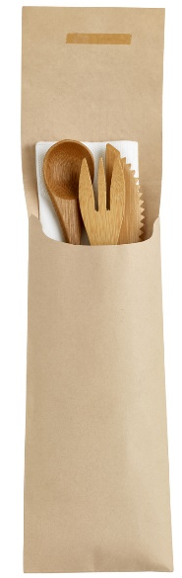
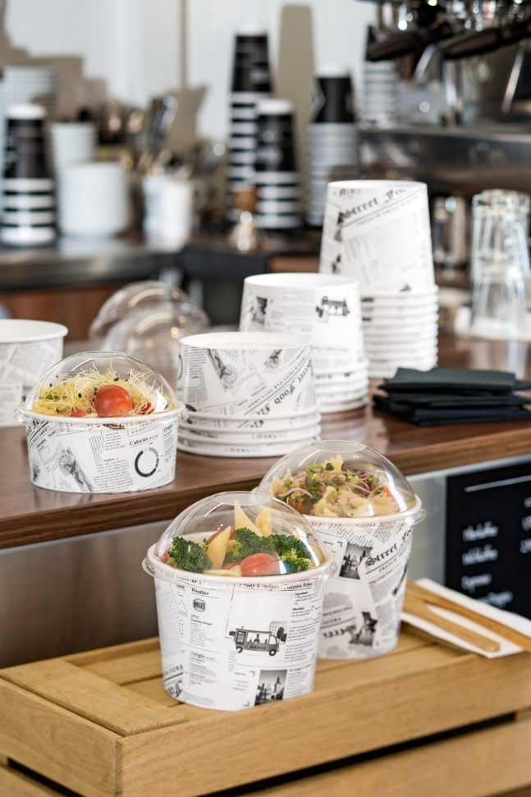

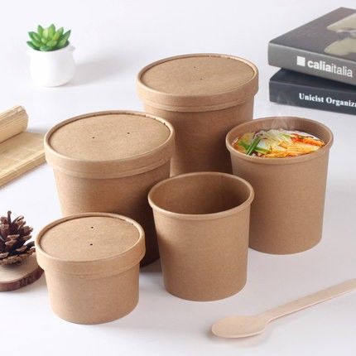
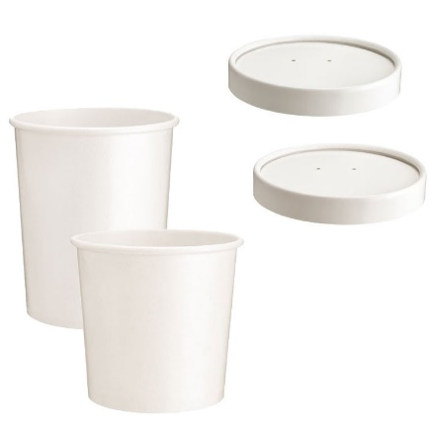
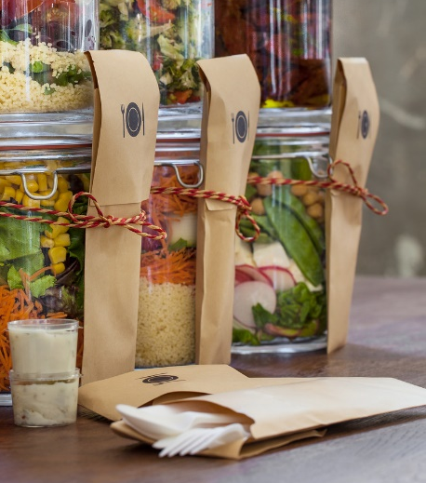
5. Take out containers to be used

