Slide 1
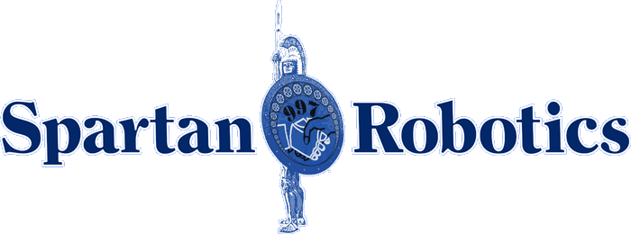
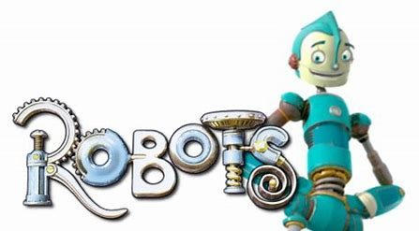
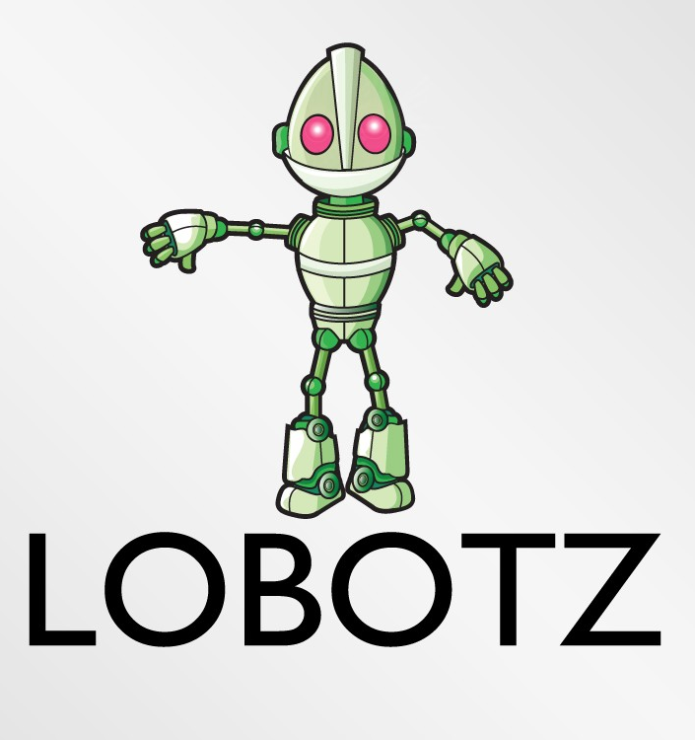
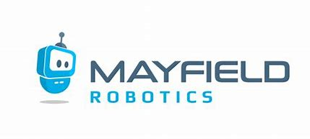
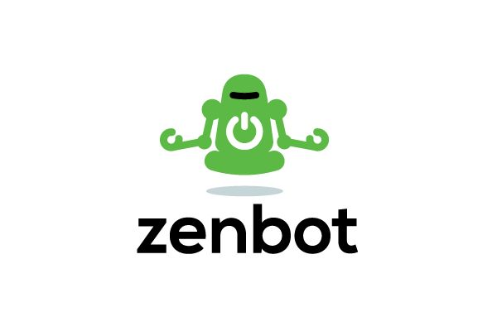
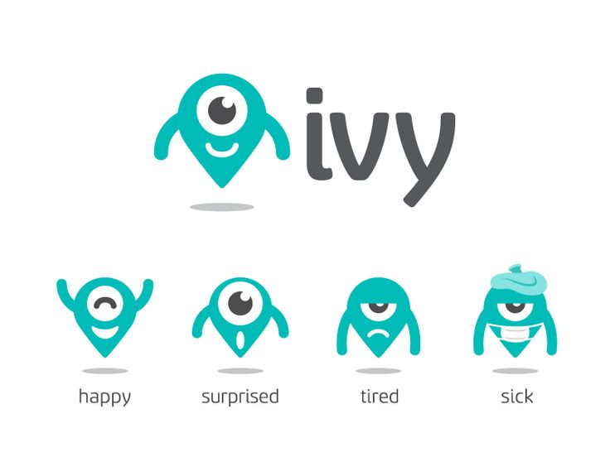
Colour Palate
Example Logos I don’t like
Or
These logos are too complex and detailed in comparison.
Character is too complex
Text in “Robots” is also too complex
Preferred colour scheme
Like “Envision” in Grey as it stands out more.
Example Logos I like
Like the text font, colour scheme
Like that it incorporates a playful character/image which could also be used on t-shirts, something like this
Like that it relatively simple (not too detailed with fine lines, complex features, etc.)
Logo and name will be used on outside sign (above store, road entrance sign) so simplicity will help in easy recognition from a distance too)
Again, like the simple character and simple aspect to the logo
Like that the character is not too integrated into the text as it is easier to separate out and use alone (vs always having to use both).
Like the character too is a solid colour vs thin lines which may be harder to see
Like simplicity of text and also character
Also like that the character could be altered w expressions, especially since audience is kids - almost like an emoji
Character incorporates both colours but not overwhelming
Tend to like too the character on the left vs on top

