Slide 1
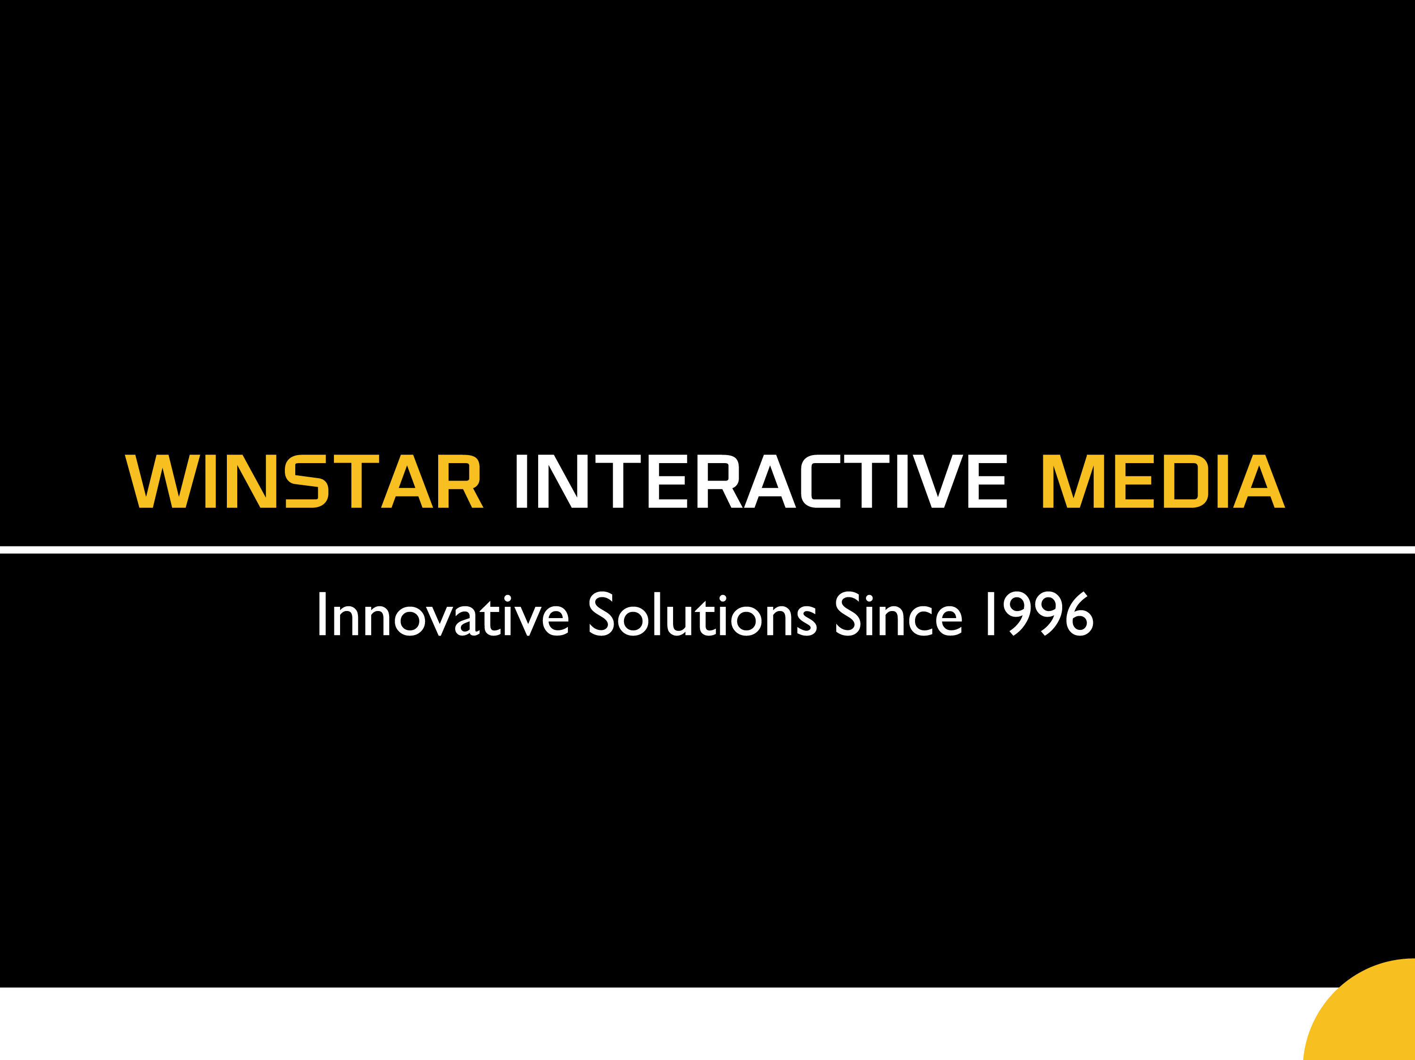

Slide 2

Winstar Platform Omnichannel Marketing

