Slide 1
Allmark Website Mock-up

Slide 2
Homepage

Slide 3
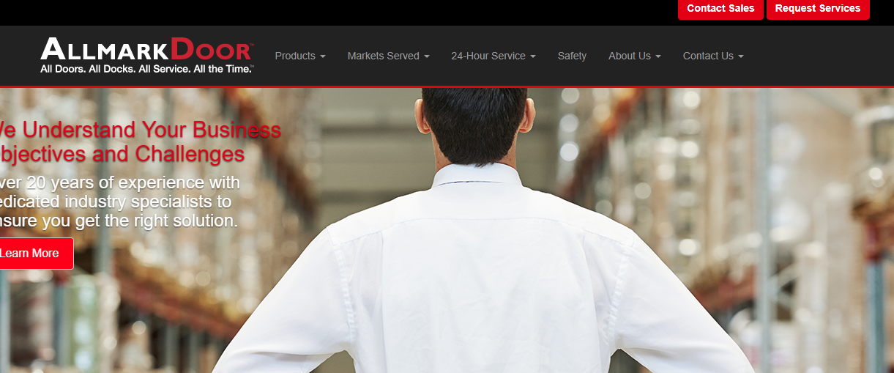
Call us now 1-800-417-9995
Products
Industries
Services
Projects
Resources
About
Get A Demo
High Speed Doors
Rubber Doors
Pedestrian Doors
Insect Barrier Doors
Overhead Doors
Cold Storage Doors
Safety Products
Dock Equipment
Food and Beverage
Pharmaceutical
Heavy Industry
Utilities
Logistics and Distribution
Transportation
24 Hour Support
Preventative Maintenance
Fire Testing
Asset ID Tracking
Our Work
Product Guides
Case Studies
Videos
Blog
Who We Are
Careers
Contact Us
Banner

Slide 4
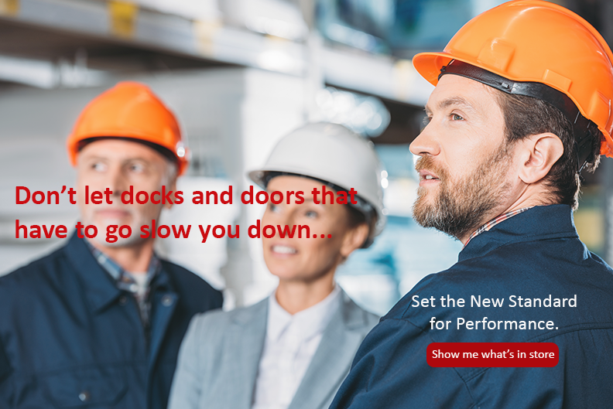

Slide 5
Your Problems. Our Solutions. The Right Decision.
Meeting productivity demands and safety standards for your facilities is hard enough. So, when your door and loading dock equipment wear down and need upgrading, it’s critical to have a trusted industrial and commercial door partner to get you back to full working capacity in no time. However, finding the right partner with the industry credentials and end-to-end experience you’re looking for can be problematic when the majority of providers only offer piecemeal solutions at best.
That’s where Allmark Door™ is a game changer. We take a project-based approach to not only provide you with high performance door technology and equipment – designed to exceed OSHA and other industry-specific safety standards – but also deliver foolproof turnkey solutions that make planning, implementing, and maintaining your equipment across facilities simple.
Just leave all the heavy-lifting and fine-tuning to us while you get a finished product you can be proud of for years to come.
100 Yrs.
200K+
90%
Combined
Industry Experience
Installations
Across the Northeast
Client
Retention Rate

Slide 6






A Few Industries We Excel In
Food & Beverage
Pharmaceutical
Heavy Industry
Utilities
Logistics & Distribution
Transportation
Notes:
Link to corresponding industry pages

Slide 7
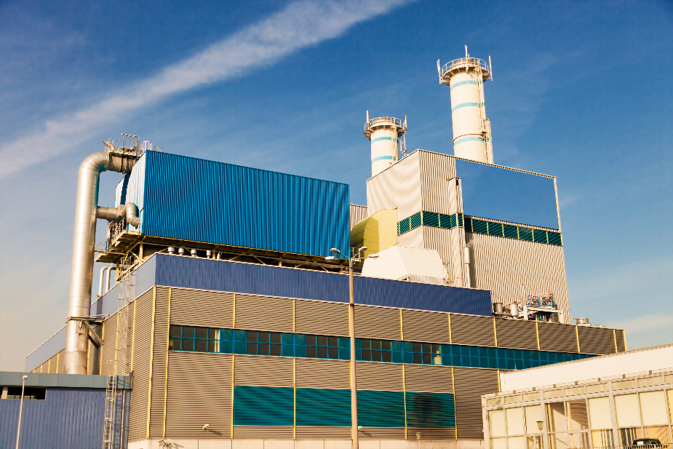
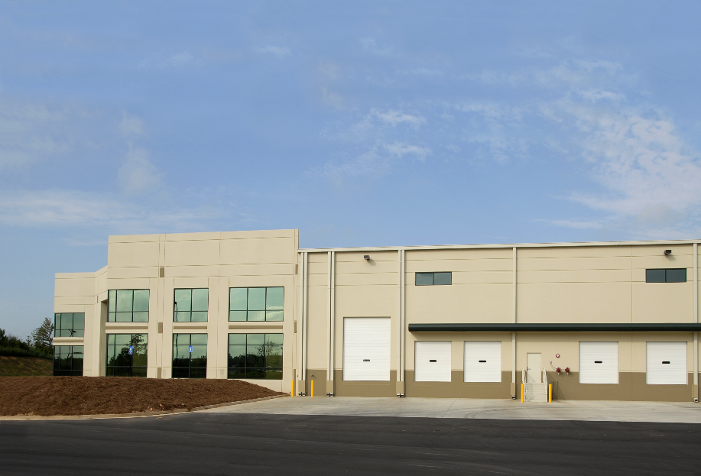
Ultimate Impact Delivered By Leading Innovation
Industrial Facilities
Commercial Facilities
That’s Me
That’s Me
Notes:
Link to corresponding pages

Slide 8

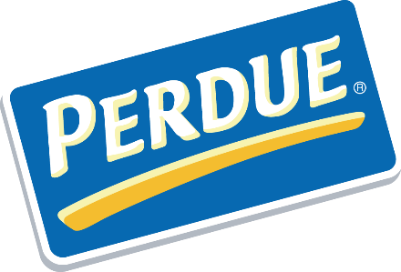
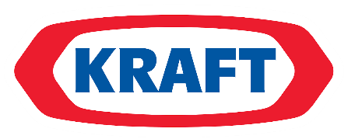

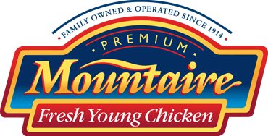

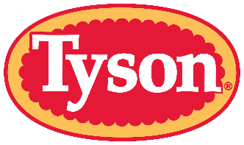




A Few Clients Who Trust Us
Notes:
Would be ideal to have client logos scrolling

Slide 9








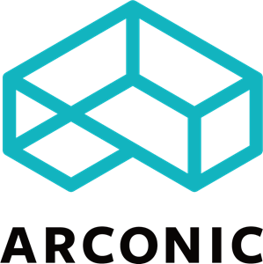




Slide 10



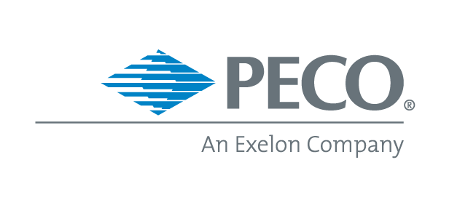




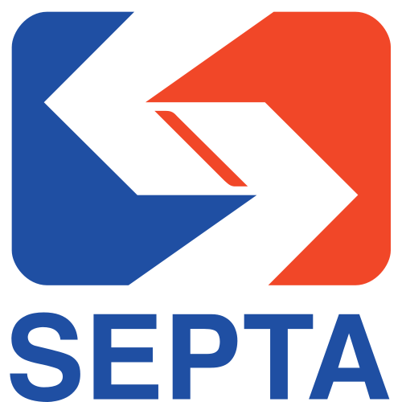


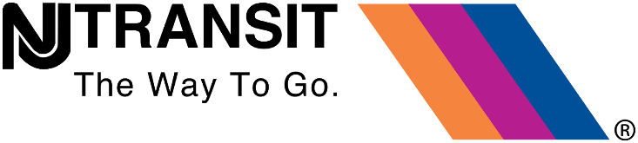

Slide 11
Can We Help With Your Unique Situation?
Let’s have a friendly chat to find out
GIVE US A CALL: 1-833-438-9400
Or
GET A FREE CONSULTATION

Slide 12
Industries

Slide 13
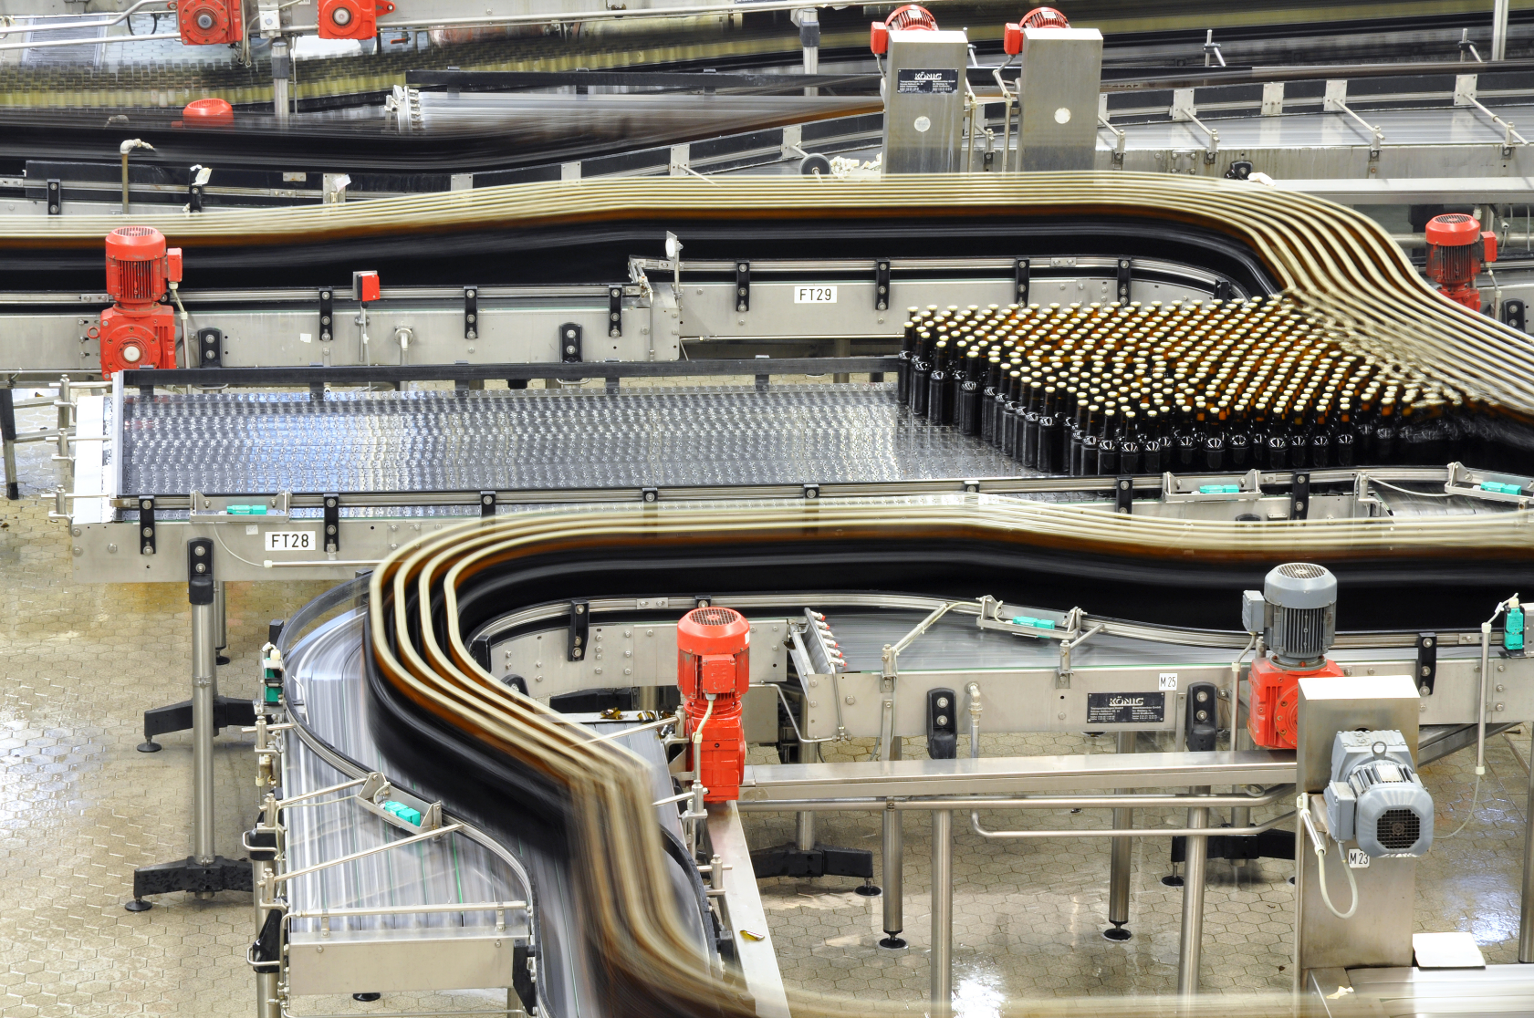
Food & Beverage
Notes:
223

Slide 14
High Performance Doors Keep Freshness and Quality at a Premium
Industrial/Commercial Door and Dock Solutions for Food and Beverage Facilities in NJ, NY, PA, DE and MD
Whether you operate a food processing plant, a brewery, or a major foodservice distribution center, it can be a challenge to satisfy or exceed production demands, while dealing with the long list of stringent regulatory guidelines imposed by the FDA, USDA, OSHA and others.
In working with some of the most distinguished and recognized companies across the Food & Beverage industry, not only do we bring a deep understanding of what works and what doesn’t, but we’re also able to deliver innovative and and quality-backed solutions that: guarantee the safety of controlled environments, diminish airborne pollutants, and keep your labor and energy costs low.
Dedicated to helping you get the ideal solution for your needs, our industry specialists and technicians have the experience and expertise to make sure your project is delivered on time and on budget so you can focus on delivering world-class food and beverage products.
All of our products come with 24 hour emergency support, preventive maintenance, fire testing, and asset ID tracking so you never have to worry about our door and dock equipment being slowing you down.

Slide 15
Food & Beverage Clients Who Trust Us

Slide 16
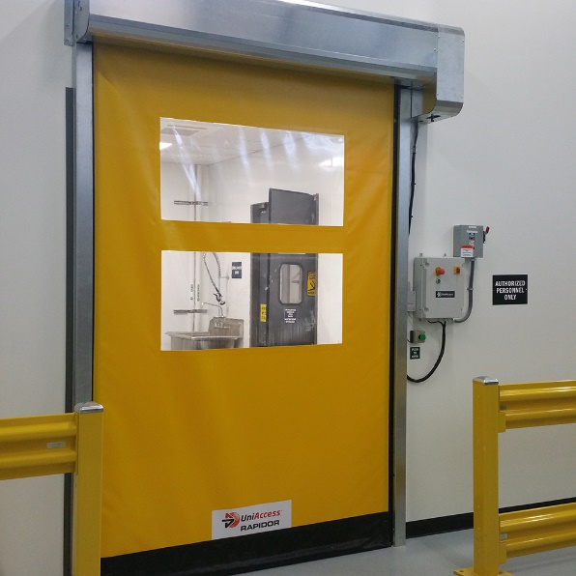
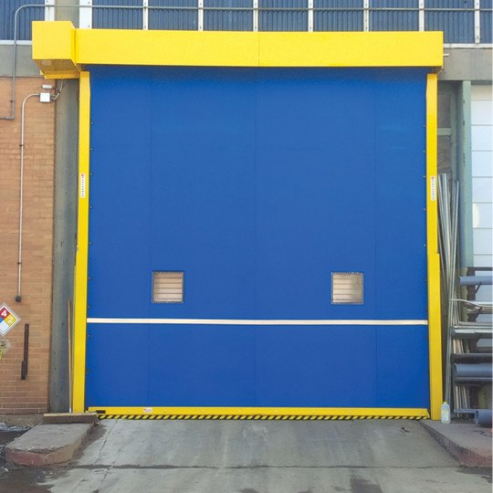
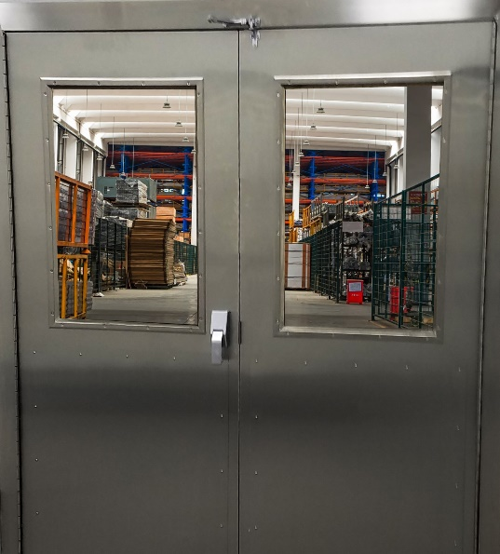
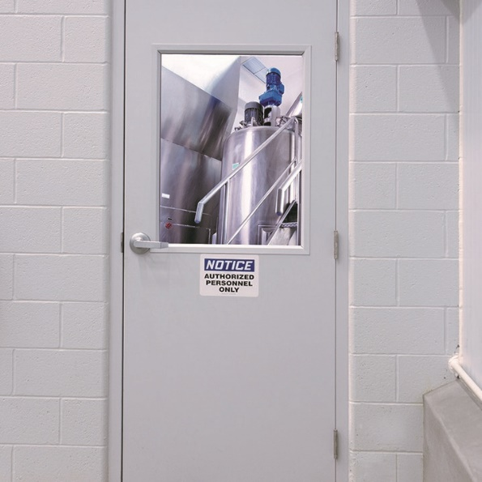
High Efficiency, Low Maintenance Food & Beverage
Door Solutions
High Speed Doors
Boost operational efficiency and earn dramatic savings in energy costs
Rubber Doors
Eliminate downtime associated with unexpected door emergencies
Metal Doors
Maximize the longevity of doors shielding special environments
Pedestrian Doors
Achieve door-to-door excellence in areas with high-usage and visibility
Learn More
Learn More
Learn More
Learn More

Slide 17
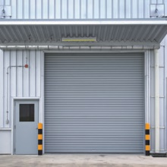
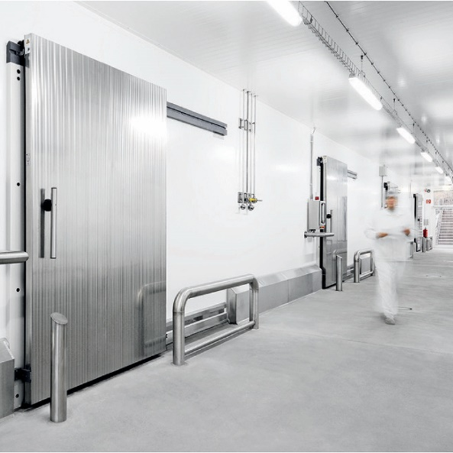
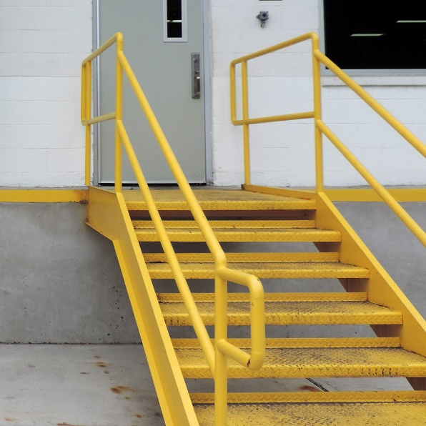
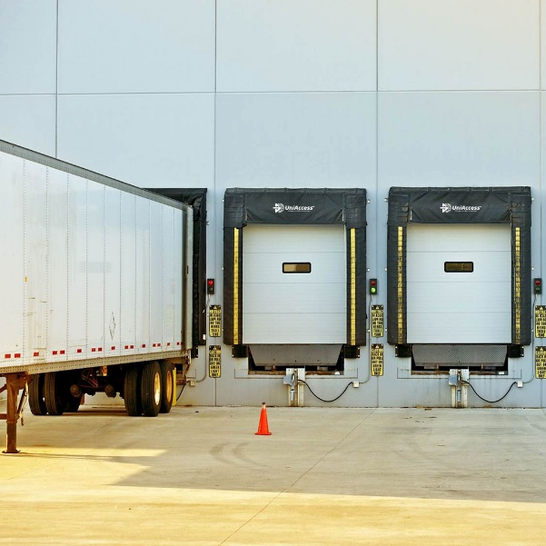
Overhead Doors
Increase the dependability and performance of critical access points
Cold Storage Doors
Preserve products and ingredients in temperature-controlled environments
Safety Products
Ensure employee well-being and the security of facility assets
Loading Dock Equipment
Optimize the productivity and safety of loading zones
Learn More
Learn More
Learn More
Learn More

Slide 18
Our Expedited End-to-End Delivery Process
Asses & Evaluate
Design & Implement
Test & Deliver
Monitor & Maintain

Slide 19
Can We Help With Your Unique Situation?
Let’s have a friendly chat to find out
GIVE US A CALL: 1-833-438-9400
Or
GET A FREE CONSULTATION

Slide 20
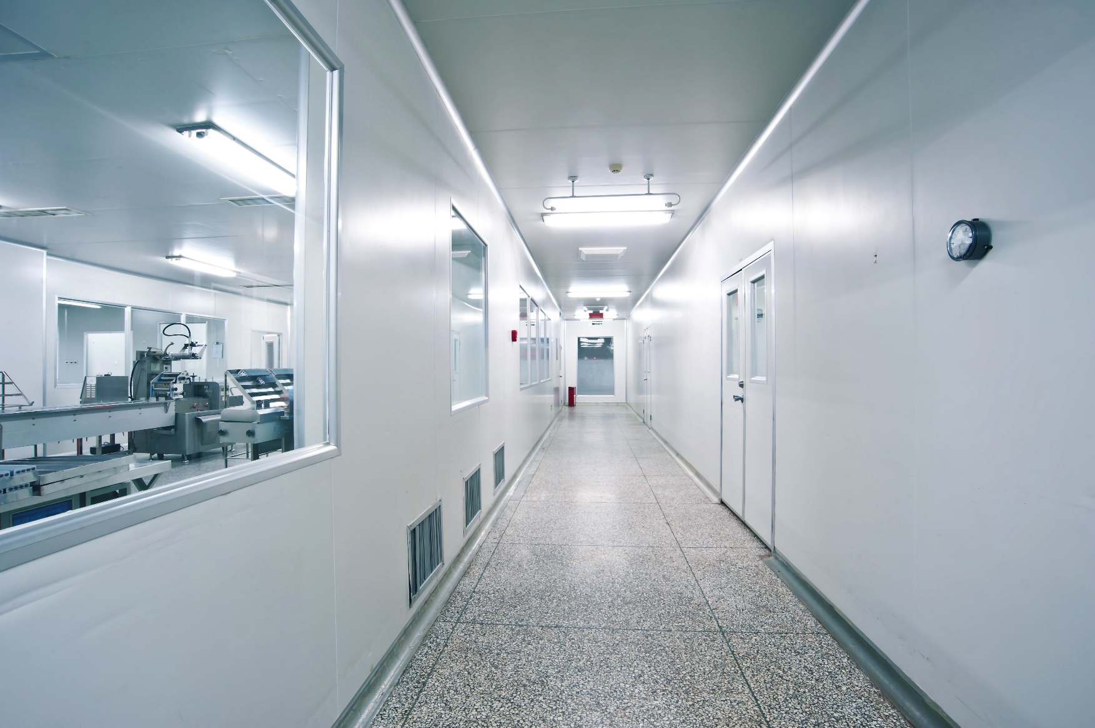
Pharmaceutical
Notes:
223

Slide 21
High Performance Doors Provide Clean and Controlled Lab Access
Industrial/Commercial Door and Dock Solutions for Pharmaceutical Facilities in NJ, NY, PA, DE and MD
Whether you operate a pharmaceutical lab, a drug manufacturing plant, or a medical devices facility, it can be a challenge to make the necessary improvements to product quality and operational efficiency, while facing continuous regulatory pressure from the FDA and OSHA.
In working with some of the most distinguished and recognized companies across the Pharmaceutical industry, not only do we bring a deep understanding of what works and what doesn’t, but we’re also able to deliver innovative and and quality-backed solutions that: guarantee the safety of controlled environments, prevent cross contamination, and significantly reduce your labor and energy costs.
Dedicated to helping you get the ideal solution for your needs, our industry specialists and technicians have the experience and expertise to make sure your project is delivered on time and on budget so you can focus on delivering pharmaceutical products that change lives.
All of our products come with 24 hour emergency support, preventive maintenance, fire testing, and asset ID tracking so you never have to worry about our door and dock equipment slowing you down.

Slide 22
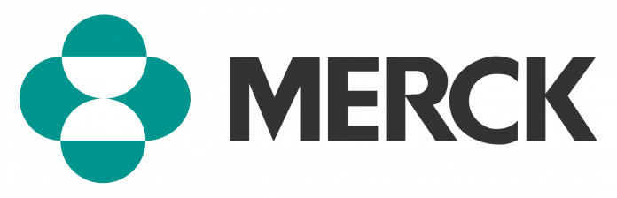
Pharmaceutical Clients Who Trust Us

Slide 23
High Efficiency, Low Maintenance Pharmaceutical
Door Solutions
High Speed Doors
Boost operational efficiency and earn dramatic savings in energy costs
Rubber Doors
Eliminate downtime associated with unexpected door emergencies
Metal Doors
Maximize the longevity of doors shielding special environments
Pedestrian Doors
Achieve door-to-door excellence in areas with high-usage and visibility
Learn More
Learn More
Learn More
Learn More

Slide 24
Overhead Doors
Increase the dependability and performance of critical access points
Cold Storage Doors
Preserve products and ingredients in temperature-controlled environments
Safety Products
Ensure employee well-being and the security of facility assets
Loading Dock Equipment
Optimize the productivity and safety of loading zones
Learn More
Learn More
Learn More
Learn More

Slide 25
Our Expedited End-to-End Delivery Process
Asses & Evaluate
Design & Implement
Test & Deliver
Monitor & Maintain

Slide 26
Can We Help With Your Unique Situation?
Let’s have a friendly chat to find out
GIVE US A CALL: 1-833-438-9400
Or
GET A FREE CONSULTATION

Slide 27
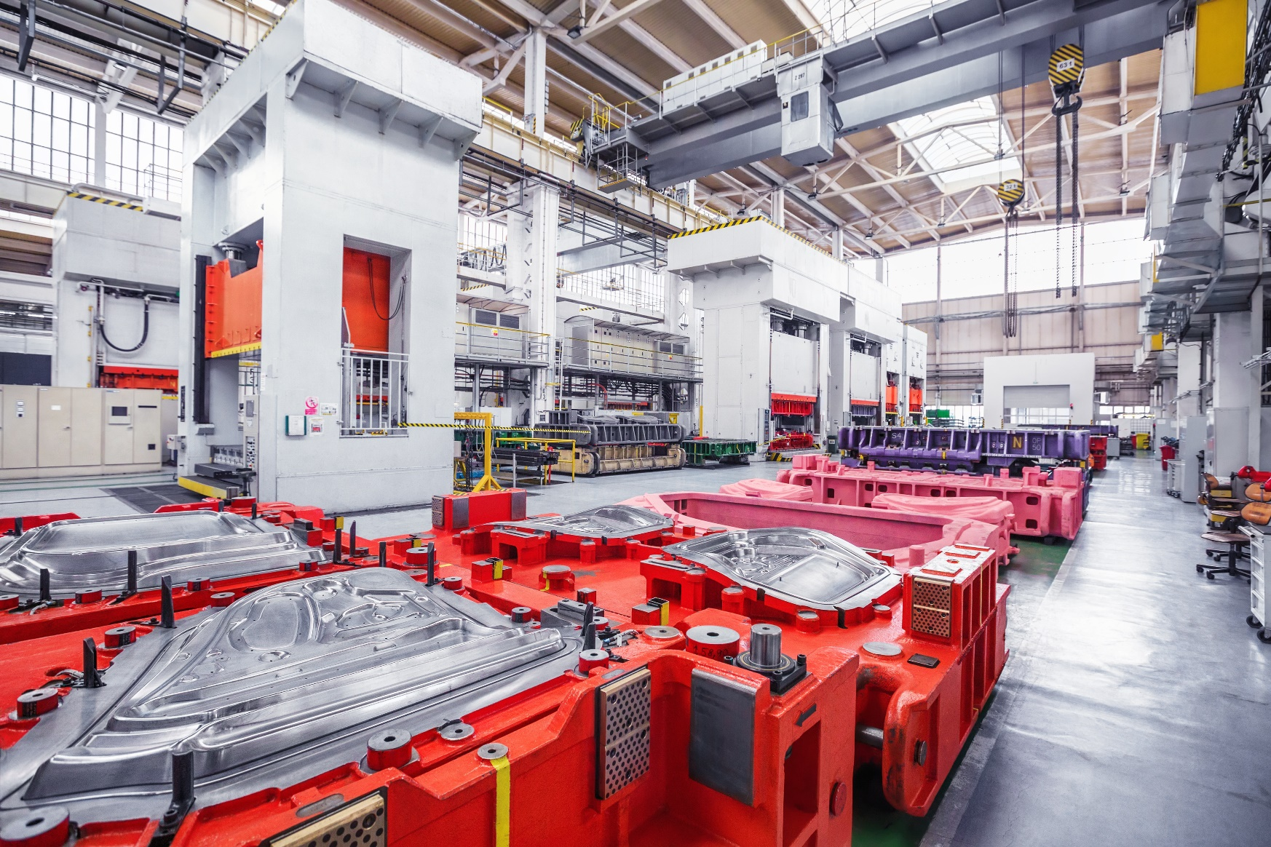
Heavy Industry
Notes:
223

Slide 28
High Performance Doors Provide the Path to Operational Success
Industrial/Commercial Door and Dock Solutions for Heavy Industry Facilities in NJ, NY, PA, DE and MD
Whether you manufacture heavy equipment or are in the business of refining raw materials, it can be a challenge to boost performance levels and gain ground on the competition, while being in strict compliance with environmental and safety standards enforced by the EPA and OSHA—just to name a few.
In working with some of the most distinguished and recognized companies across Heavy Industry, not only do we bring a deep understanding of what works and what doesn’t, but we’re also able to deliver innovative and quality-backed solutions that: guarantee the safety of controlled environments, optimize operational efficiency, and curb your labor and energy costs.
Dedicated to helping you get the ideal solution for your needs, our industry specialists and technicians have the experience and expertise to make sure your project is delivered on time and on budget so you can focus on creating the building blocks that move economies forward.
All of our products come with 24 hour emergency support, preventive maintenance, fire testing, and asset ID tracking so you never have to worry about our door and dock equipment slowing you down.

Slide 29


Heavy Industry Clients Who Trust Us

Slide 30
High Efficiency, Low Maintenance Heavy Industry
Door Solutions
High Speed Doors
Boost operational efficiency and earn dramatic savings in energy costs
Rubber Doors
Eliminate downtime associated with unexpected door emergencies
Metal Doors
Maximize the longevity of doors shielding special environments
Pedestrian Doors
Achieve door-to-door excellence in areas with high-usage and visibility
Learn More
Learn More
Learn More
Learn More

Slide 31
Overhead Doors
Increase the dependability and performance of critical access points
Cold Storage Doors
Preserve products and ingredients in temperature-controlled environments
Safety Products
Ensure employee well-being and the security of facility assets
Loading Dock Equipment
Optimize the productivity and safety of loading zones
Learn More
Learn More
Learn More
Learn More

Slide 32
Our Expedited End-to-End Delivery Process
Asses & Evaluate
Design & Implement
Test & Deliver
Monitor & Maintain

Slide 33
Can We Help With Your Unique Situation?
Let’s have a friendly chat to find out
GIVE US A CALL: 1-833-438-9400
Or
GET A FREE CONSULTATION

Slide 34
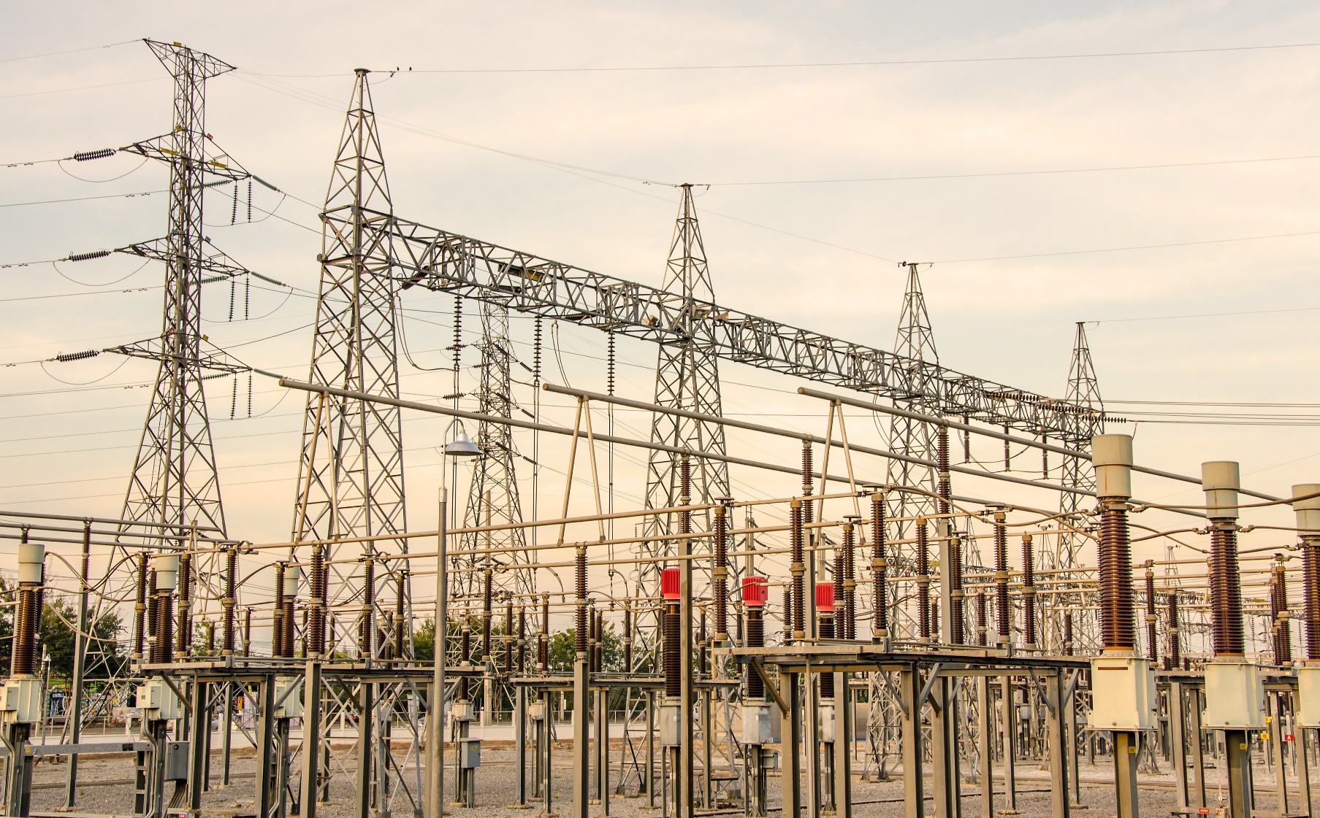
Utilities
Notes:
223

Slide 35
High Performance Doors Pave the Way for Surges in Productivity
Industrial/Commercial Door and Dock Solutions for Utility Facilities in NJ, NY, PA, DE and MD
Whether you operate an electrical power plant, an oil and gas utility, or a waste management facility, it can be a challenge to manage large coverage areas and keep up with pricing demands, while adhering to human health and safety regulations set forth by the various utility commissions, as well as OSHA.
In working with some of the most distinguished and recognized companies across the Utility industry, not only do we bring a deep understanding of what works and what doesn’t, but we’re also able to deliver innovative and and quality-backed solutions that: guarantee the safety of controlled environments, minimize downtime, and drastically reduce your labor and energy expenses.
Dedicated to helping you get the ideal solution for your needs, our industry specialists and technicians have the experience and expertise to make sure your projects is delivered on time and on budget so you can focus on keeping communities up and running.
All of our products come with 24 hour emergency support, preventive maintenance, fire testing, and asset ID tracking so you never have to worry about our door and dock equipment slowing you down.

Slide 36




Utility Clients Who Trust Us

Slide 37
High Efficiency, Low Maintenance Utility
Door Solutions
High Speed Doors
Boost operational efficiency and earn dramatic savings in energy costs
Rubber Doors
Eliminate downtime associated with unexpected door emergencies
Metal Doors
Maximize the longevity of doors shielding special environments
Pedestrian Doors
Achieve door-to-door excellence in areas with high-usage and visibility
Learn More
Learn More
Learn More
Learn More

Slide 38
Overhead Doors
Increase the dependability and performance of critical access points
Cold Storage Doors
Preserve products and ingredients in temperature-controlled environments
Safety Products
Ensure employee well-being and the security of facility assets
Loading Dock Equipment
Optimize the productivity and safety of loading zones
Learn More
Learn More
Learn More
Learn More

Slide 39
Our Expedited End-to-End Delivery Process
Asses & Evaluate
Design & Implement
Test & Deliver
Monitor & Maintain

Slide 40
Can We Help With Your Unique Situation?
Let’s have a friendly chat to find out
GIVE US A CALL: 1-833-438-9400
Or
GET A FREE CONSULTATION

Slide 41
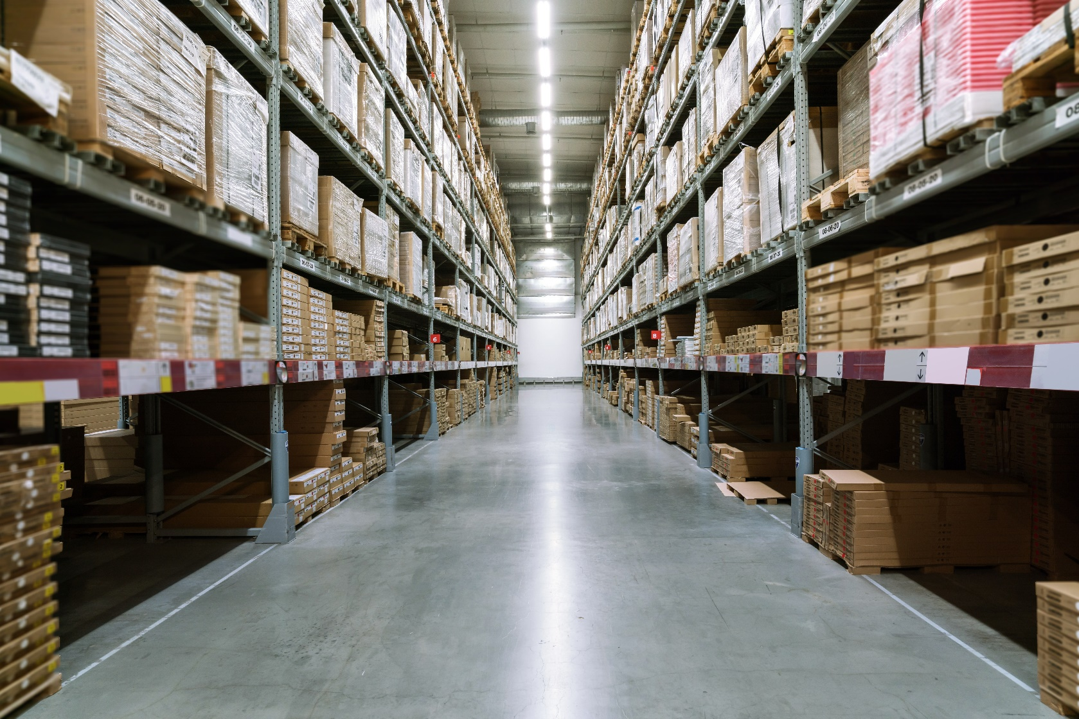
Logistics & Distribution
Notes:
223

Slide 42
High Performance Doors Deliver Improved Workflows for Customer Convenience
Proven Door and Dock Solutions for Logistics and Distribution Facilities in NJ, NY, PA, DE and MD
Whether you operate a courier service, an intermodal freight warehouse, or a distribution center, it can be a challenge to expedite order fulfillment processes and deliver valuable merchandise on time, while adhering to quality assurance and safety standards enforced by SLAs and OSHA.
In working with some of the most distinguished and recognized companies across the Logistics & Distribution industry, not only do we bring a deep understanding of what works and what doesn’t, but we’re also able to deliver innovative and and quality-backed solutions that: guarantee the safety of controlled environments, minimize downtime, and optimize employee productivity.
Dedicated to helping you get the ideal solution for your needs, our industry specialists and technicians have the experience and expertise to make sure your project is delivered on time and on budget so you can focus on delivering seamless end-user experiences.
All of our products come with 24 hour emergency support, preventive maintenance, fire testing, and asset ID tracking so you never have to worry about our door and dock equipment slowing you down.

Slide 43

Logistics & Distribution Clients Who Trust Us

Slide 44
High Efficiency, Low Maintenance Logistics & Distribution Door Solutions
High Speed Doors
Boost operational efficiency and earn dramatic savings in energy costs
Rubber Doors
Eliminate downtime associated with unexpected door emergencies
Metal Doors
Maximize the longevity of doors shielding special environments
Pedestrian Doors
Achieve door-to-door excellence in areas with high-usage and visibility
Learn More
Learn More
Learn More
Learn More

Slide 45
Overhead Doors
Increase the dependability and performance of critical access points
Cold Storage Doors
Preserve products and ingredients in temperature-controlled environments
Safety Products
Ensure employee well-being and the security of facility assets
Loading Dock Equipment
Optimize the productivity and safety of loading zones
Learn More
Learn More
Learn More
Learn More

Slide 46
Our Expedited End-to-End Delivery Process
Asses & Evaluate
Design & Implement
Test & Deliver
Monitor & Maintain

Slide 47
Can We Help With Your Unique Situation?
Let’s have a friendly chat to find out
GIVE US A CALL: 1-833-438-9400
Or
GET A FREE CONSULTATION

Slide 48
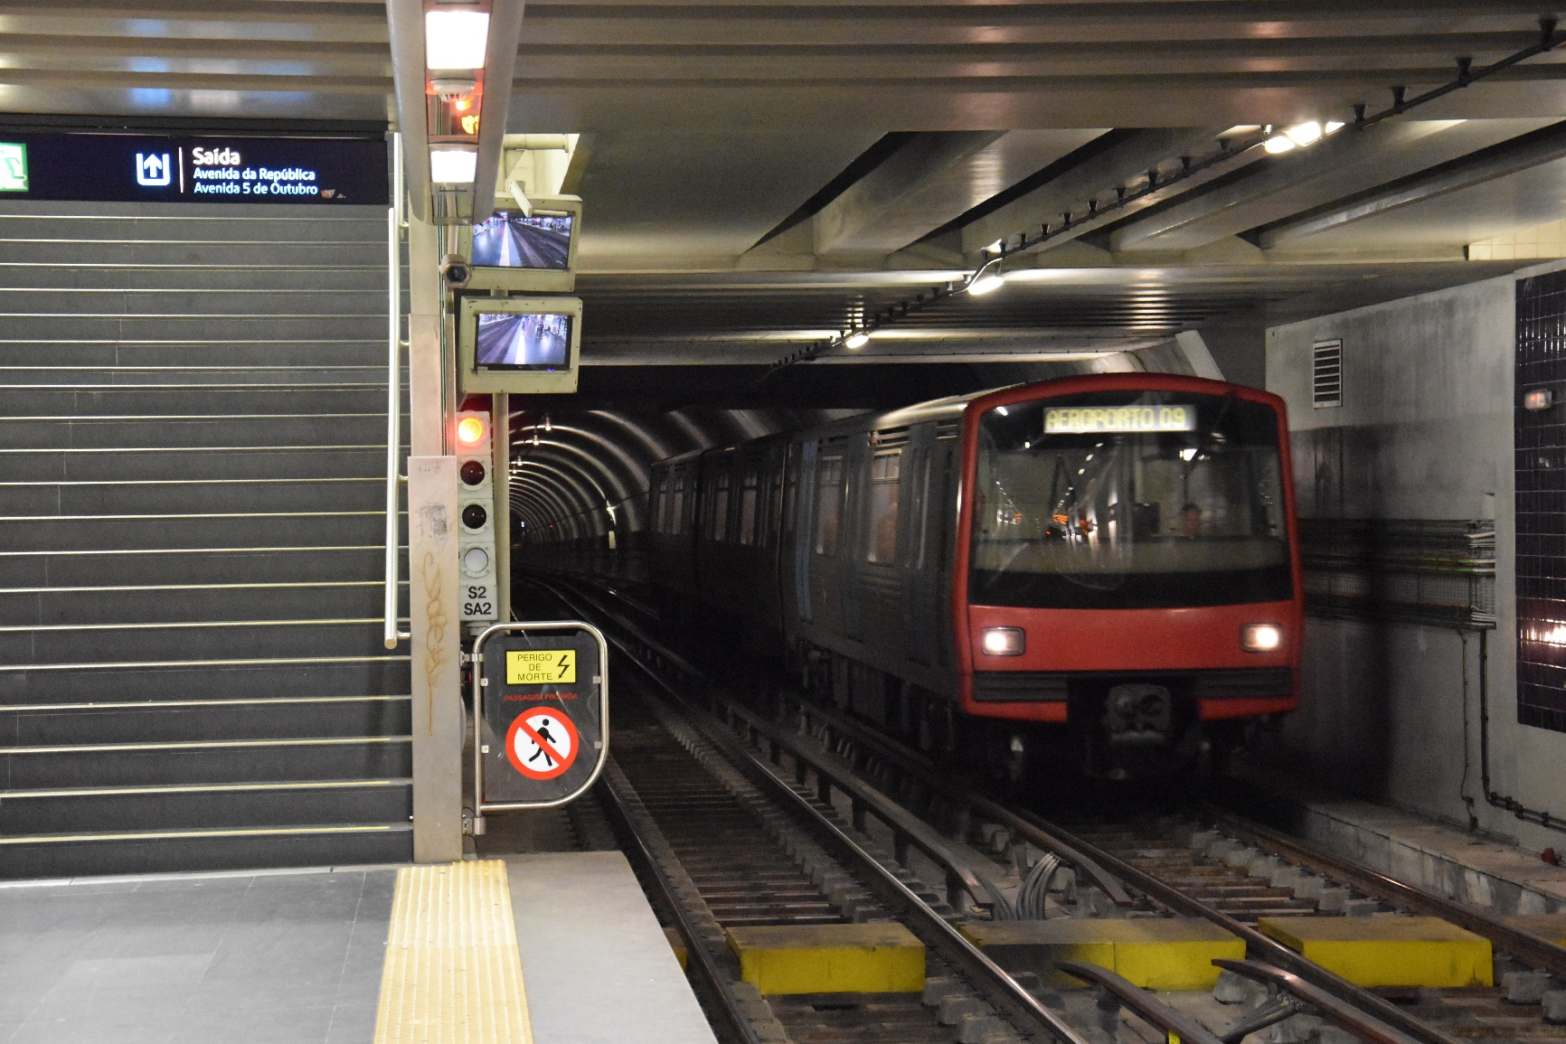
Transportation
Notes:
223

Slide 49
High Performance Doors Lead Passengers to Their Destination
Industrial/Commercial Door and Dock Solutions for Transportation Facilities in NJ, NY, PA, DE and MD
Whether you operate an airport or a mass transportation system with bus terminals and train stations, it can be a challenge to monitor potential security breaches and maintain the integrity of your infrastructure, while staying up to date on safety and quality standards enforced by the USDOT, TSA, and OSHA—among others.
In working with some of the most distinguished and recognized companies across the Logistics & Distribution industry, not only do we bring a deep understanding of what works and what doesn’t, but we’re also able to deliver innovative and quality-backed solutions that: guarantee the safety of controlled environments, minimize downtime, and provide seamless user experiences.
Dedicated to helping you get the ideal solution for your needs, our industry specialists and technicians have the experience and expertise to make sure your projects get delivered on time and on budget so you can focus on getting passengers to their destination.
All of our products come with 24 hour emergency support, preventive maintenance, fire testing, and asset ID tracking so you never have to worry about our door and dock equipment slowing you down.

Slide 50

Transportation Clients Who Trust Us

Slide 51
High Efficiency, Low Maintenance Transportation
Door Solutions
High Speed Doors
Boost operational efficiency and earn dramatic savings in energy costs
Rubber Doors
Eliminate downtime associated with unexpected door emergencies
Metal Doors
Maximize the longevity of doors shielding special environments
Pedestrian Doors
Achieve door-to-door excellence in areas with high-usage and visibility
Learn More
Learn More
Learn More
Learn More

Slide 52
Overhead Doors
Increase the dependability and performance of critical access points
Cold Storage Doors
Preserve products and ingredients in temperature-controlled environments
Safety Products
Ensure employee well-being and the security of facility assets
Loading Dock Equipment
Optimize the productivity and safety of loading zones
Learn More
Learn More
Learn More
Learn More

Slide 53
Our Expedited End-to-End Delivery Process
Asses & Evaluate
Design & Implement
Test & Deliver
Monitor & Maintain

Slide 54
Can We Help With Your Unique Situation?
Let’s have a friendly chat to find out
GIVE US A CALL: 1-833-438-9400
Or
GET A FREE CONSULTATION

Slide 55
Facilities

Slide 56

Industrial Facilities
Notes:
375

Slide 57
Strong and Reliable Doors Built For Rugged Demands
Leading Industrial Door and Dock Solutions Made for a Full Range of Exterior and Interior Facility Applications
Industrial facilities of the 21st century and beyond no longer just bear the burden of meeting production demands. To stay ahead of increasingly rigorous compliance protocols and quality assurance standards, they must also continually improve operational excellence in the areas of safety, cost reduction, and energy efficiency.
With our innovative and quality backed industrial door solutions, we help you do exactly that and much more by offering a vast array of door and dock equipment made for leaders of industry who place a premium on peak performance to drive real impact for their bottom line and corporate reputation.
How can we prove it? Well, we’ve been in the trenches with some of the most prominent Fortune 500 companies across the Food & Beverage, Utilities, Heavy Industry, and Transportation industries As a result, we’ve not only come to understand their toughest challenges, but we’ve also developed a knack for delivering proven solutions under the highest stakes.
Since we know you can’t tolerate frequent malfunctions or interruptions caused by defective and subpar equipment, we make sure to partner with only the most respected manufacturer brands in our industry to provide you with an ultra-reliable finished product built for the most rugged demands. We also offer a complete package of specialized services that include: 24 hour emergency support, preventive maintenance, fire testing, and asset ID tracking to keep you up and running, no matter your circumstances.

Slide 58
Industrial Facility Solutions To Meet Your
Performance Needs
High Speed Doors
Boost operational efficiency and earn dramatic savings in energy costs
Rubber Doors
Eliminate downtime associated with unexpected door emergencies
Metal Doors
Maximize the longevity of doors shielding special environments
Pedestrian Doors
Achieve door-to-door excellence in areas with high-usage and visibility
Learn More
Learn More
Learn More
Learn More

Slide 59
Overhead Doors
Increase the dependability and performance of critical access points
Cold Storage Doors
Preserve products and ingredients in temperature-controlled environments
Safety Products
Ensure employee well-being and the security of facility assets
Loading Dock Equipment
Optimize the productivity and safety of loading zones
Learn More
Learn More
Learn More
Learn More

Slide 60
A Few Clients Who Trust Us

Slide 63

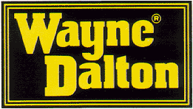







Some Premier Manufacturer Brands We Partner With

Slide 64
Our Expedited End-to-End Delivery Process
Asses & Evaluate
Design & Implement
Test & Deliver
Monitor & Maintain

Slide 65
Can We Help With Your Unique Situation?
Let’s have a friendly chat to find out
GIVE US A CALL: 1-833-438-9400
Or
GET A FREE CONSULTATION

Slide 66

Commercial Facilities

Slide 67
Functional and Efficient Doors Made For Swift Delivery
Leading Commercial Door and Dock Solutions Made for a Full Range of Exterior and Interior Facility Applications
Cutting-edge commercial facilities are not just responsible for maintaining quality distribution and availability standards. To stave off competitors and strict regulators, they must also continually improve operational excellence in the areas of safety, cost reduction and workflow efficiency.
With our innovative and quality backed commercial door solutions, we empower you to do that and much more by offering a dynamic suite of door and dock equipment made for world-class providers who place a premium on peak performance to deliver real impact for their bottom line and corporate reputation.
How can we prove it? Well, we’ve served countless Fortune 500 companies spanning the Food & Beverage Pharmaceutical, Transportation, and Logistics & Distribution industries. As a result, we’ve not only come to understand their most pressing challenges, but we’ve also developed a knack for delivering proven solutions under the highest stakes.
Since we know you can’t tolerate facility interruptions or frequent equipment malfunctions, we make sure to only work with the top manufacturer brands our industry has to offer. This ensures you receive a highly functional and efficient finished product that optimizes delivery times. We also provide a complete package of specialized services that include: 24 hour emergency support, preventive maintenance, fire testing, and asset ID tracking to keep you up and running, no matter what.

Slide 68
Commercial Facility Solutions To Meet Your
Performance Needs
High Speed Doors
Boost operational efficiency and earn dramatic savings in energy costs
Rubber Doors
Eliminate downtime associated with unexpected door emergencies
Metal Doors
Maximize the longevity of doors shielding special environments
Pedestrian Doors
Achieve door-to-door excellence in areas with high-usage and visibility
Learn More
Learn More
Learn More
Learn More

Slide 69
Overhead Doors
Increase the dependability and performance of critical access points
Cold Storage Doors
Preserve products and ingredients in temperature-controlled environments
Safety Products
Ensure employee well-being and the security of facility assets
Loading Dock Equipment
Optimize the productivity and safety of loading zones
Learn More
Learn More
Learn More
Learn More

Slide 70
A Few Clients Who Trust Us

Slide 73
Some Premier Manufacturer Brands We Partner With

Slide 74
Our Expedited End-to-End Delivery Process
Asses & Evaluate
Design & Implement
Test & Deliver
Monitor & Maintain

Slide 75
Can We Help With Your Unique Situation?
Let’s have a friendly chat to find out
GIVE US A CALL: 1-833-438-9400
Or
GET A FREE CONSULTATION

Slide 76
Product Categories

Slide 77
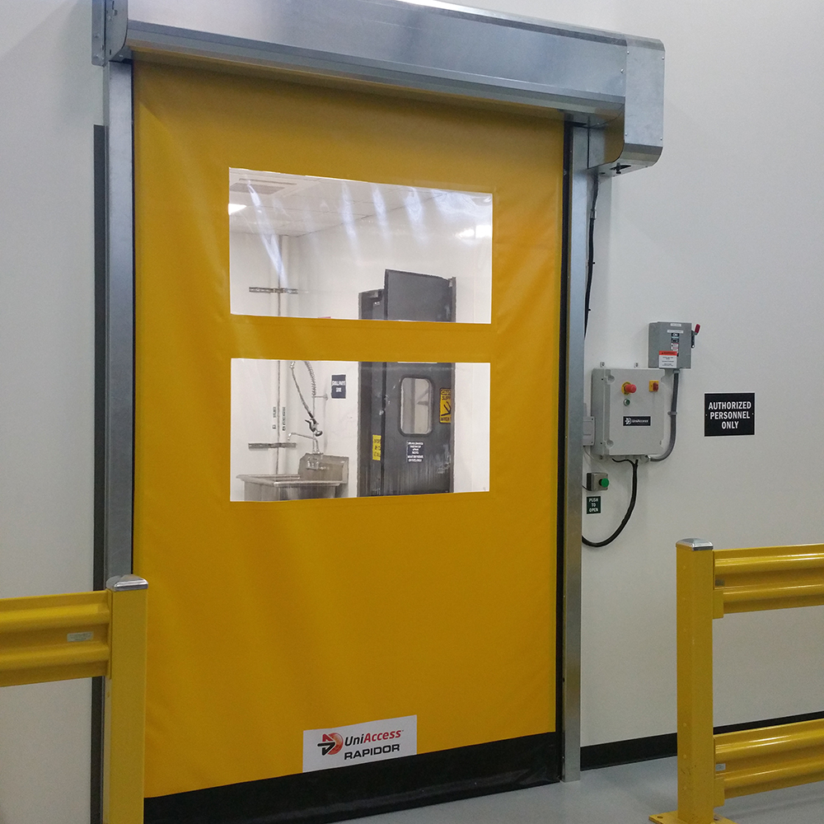
High-Speed Doors
Think Big. And Fast.
With opening and closing speeds that are up to 10X faster than standard doors, high-speed doors are an excellent choice to keep your operation booming. They are also engineered to break away when struck by forklifts and other traffic objects. This ensures minimal maintenance, which virtually eliminates any downtime caused by unexpected door impacts.
When it comes to optimizing operational efficiency, improving work conditions, and saving money on the cost of labor, time, utilities and energy, it’s hard to find a door that delivers more impact than a high-speed door. For your convenience, we offer a wide range of styles and materials suitable for high-use in rugged exterior and interior industry-specific applications.
Get a Quote
Notes:
210

Slide 78

Energy Efficient
Automatic Reinsertion System
Corrosion Resistant
Typically pays for itself in energy savings within 24 months
Technology guides curtain back in place without the use of tools
Withstands harshest conditions without signs of rusting or discoloration

Slide 79




High Speed Doors Backed By Full Service Support
24/7 Emergency Support
Preventive Maintenance
Fire Testing
Asset ID Tracking

Slide 80
Additional High-Speed Door Features
Just-in-time closing speeds of up to 100 inches per second that can be adjusted for safety
Photo eyes and soft bottom edges protect inventory and staff from damage or injury
Wide variety of vision panels made to increase employee awareness
Selection of curtain and guide materials can be customized to fit your facility’s production process

Slide 81
Our Expedited End-to-End Delivery Process
Asses & Evaluate
Design & Implement
Test & Deliver
Monitor & Maintain

Slide 82
Can We Help With Your Unique Situation?
Let’s have a friendly chat to find out
GIVE US A CALL: 1-833-438-9400
Or
GET A FREE CONSULTATION

Slide 83
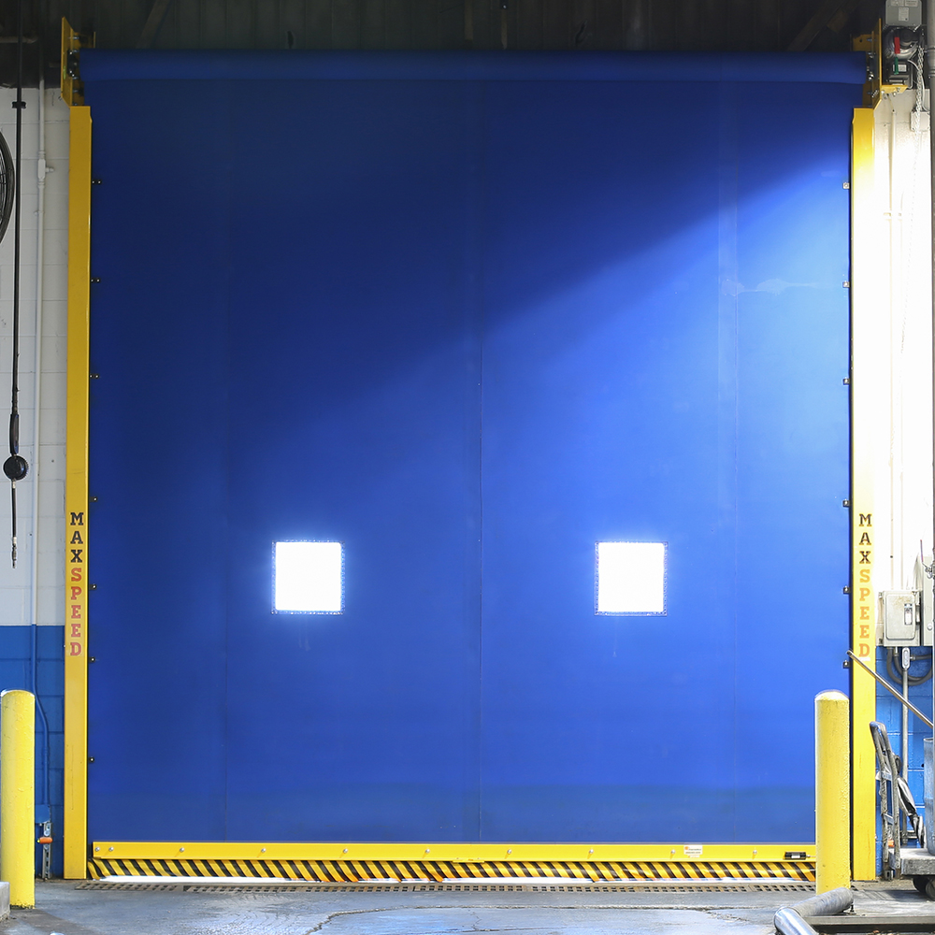
Rubber Doors
Durable. Flexible. Simple
Nearly indestructible, performance rubber doors are built to stand up to the most demanding environments. They also only have 5 moving parts—thanks to their direct drive engineering—which enables them to seamlessly combine strength and flexibility with the utmost simplicity. This makes them a prized asset in high traffic areas for manufacturing and distribution facilities, as well as loading docks.
So whether you need speed, durability or both, let the PerforMax MaxSeries be the solution that provides your facility with extreme endurance and performance suited for rugged use in high impact areas. Our high performance rubber doors come standard with lifetime warranties, are rated for a million cycles, and are available in a wide variety of sizes and styles for your unique applications.
Get a Quote
Notes:
195

Slide 84
Low Cost of Ownership
Easy to Use
Longevity
Automatic reinsertion system keeps maintenance to a minimum
Simple, springless engineering with no hinges, cables, or pulleys
Reinforced with galvanized steel, powder-coated bottom bar, and head plates.

Slide 85
Rubber Doors Backed By Full Service Support
24/7 Emergency Support
Preventive Maintenance
Fire Testing
Asset ID Tracking

Slide 86
Additional Rubber Door Features
Flexible curtain releases from guides upon accidental impact with breakaway system
Self-diagnostic display and direct variable frequency drive control panel
Designed to withstand extreme temperatures ranging from -40F to 180F
Rubber curtains are specifically designed to resist high speed winds

Slide 87
Our Expedited End-to-End Delivery Process
Asses & Evaluate
Design & Implement
Test & Deliver
Monitor & Maintain

Slide 88
Can We Help With Your Unique Situation?
Let’s have a friendly chat to find out
GIVE US A CALL: 1-833-438-9400
Or
GET A FREE CONSULTATION

Slide 89
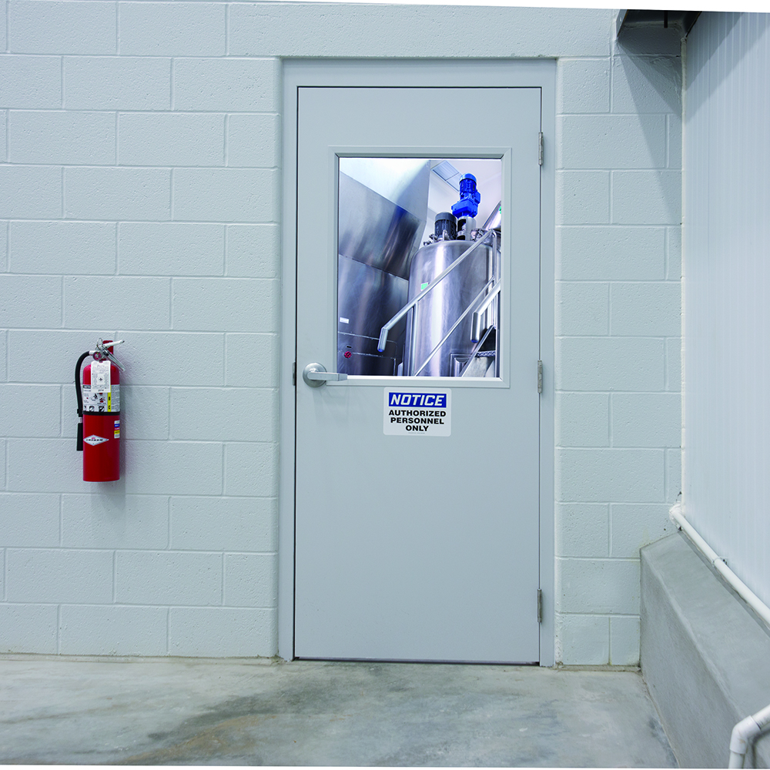
Pedestrian Doors
High Value, High Performance.
Smooth, seamless, and totally seal proof, specialty pedestrian doors can meet a wide variety of application needs for companies that take pride in the quality of their doors. But don’t let their appearance fool you, since they are also remarkably durable in their ability to withstand heavy traffic and adverse environmental conditions.
Depending on your specific application, whether it be high-use, architectural or special environment, we can provide you with the ultimate pedestrian door that delivers performance and functionality you can count on for years to come. Keep in mind that with a lifetime warranty against corrosion, our specialty pedestrian doors are designed to resist moisture, bacteria, and harsh chemicals.
Get a Quote

Slide 90
Seamless
Fire rated
Maintenance Free
Thrive in wash down environments, and are resistant to cracking
Can be customized to comply with NFPA codes and requirements
Specialty pedestrian doors are backed by a lifetime warranty

Slide 91
Pedestrian Doors Backed By Full Service Support
24/7 Emergency Support
Preventive Maintenance
Fire Testing
Asset ID Tracking

Slide 92
Additional Pedestrian Door Features
Specialty pedestrian doors come with pebble grain finish and aluminum to withstand the harshest environments
Everline Fiber-Tek doors are available in standard colors, eliminating on-site painting
Only require routine cleaning with soap and water to maintain fresh appearance
Can be paired with an automatic operator, include vision panels, or come with custom hardware

Slide 93
Our Expedited End-to-End Delivery Process
Asses & Evaluate
Design & Implement
Test & Deliver
Monitor & Maintain

Slide 94
Can We Help With Your Unique Situation?
Let’s have a friendly chat to find out
GIVE US A CALL: 1-833-438-9400
Or
GET A FREE CONSULTATION

Slide 95
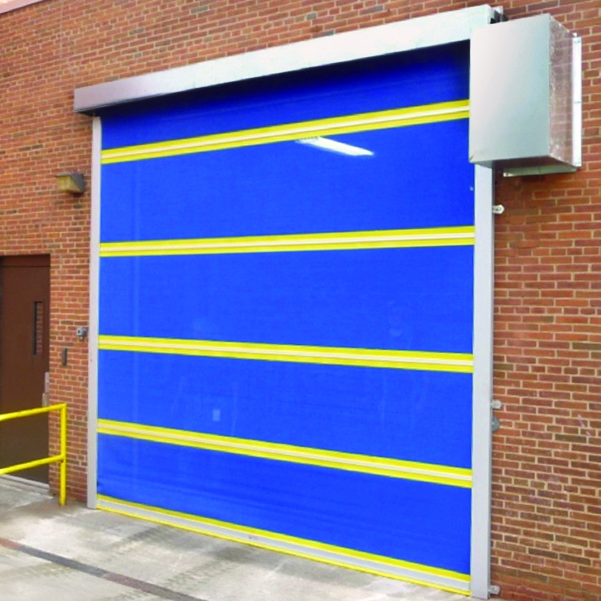
Insect Control Barriers
Defend Your Doors.
Insect control screen doors prevent rodents, bugs, and birds from entering areas where food, beverages, or pharmaceuticals are being packaged or prepared. Yet, they provide the advantage of optimal ventilation for employee comfort, and help you meet critical FDA/AIB requirements regarding safety, pest control, as well as airborne contamination.
Manufactured to fit virtually any size opening, our tight-insect control barriers can be readily installed on dock doors, dumpster areas, and warehouse openings. If improving the sanitation of controlled environments that keep your products and employees safe is a priority for you, our wide variety of sliding or rolling insect control screen doors may be just what your facility needs.
Get a Quote
Notes:
203

Slide 96
Versatile
Customizable
Improved Safety
Made to accommodate a wide range of facility applications
Screen doors are available in Manual, Automatic, and High Cycle
Screen doors are designed to exceed regulatory compliance standards

Slide 97
Insect Control Barriers Backed By Full Service Support
24/7 Emergency Support
Preventive Maintenance
Fire Testing
Asset ID Tracking

Slide 98
Additional Insect Control Barrier Features
Weather stripping is angled to provide a tighter seal preventing bugs and insects easy access or entry
Fiberglass windbars are available for doors that require added stability
Includes heavy-gauge, galvanized steel sliding , which work with bearing trolleys for easy opening
Keeps plant facilities cooler by providing 65% more shade, while still allowing sufficient daylight

Slide 99
Our Expedited End-to-End Delivery Process
Asses & Evaluate
Design & Implement
Test & Deliver
Monitor & Maintain

Slide 100
Can We Help With Your Unique Situation?
Let’s have a friendly chat to find out
GIVE US A CALL: 1-833-438-9400
Or
GET A FREE CONSULTATION

Slide 101
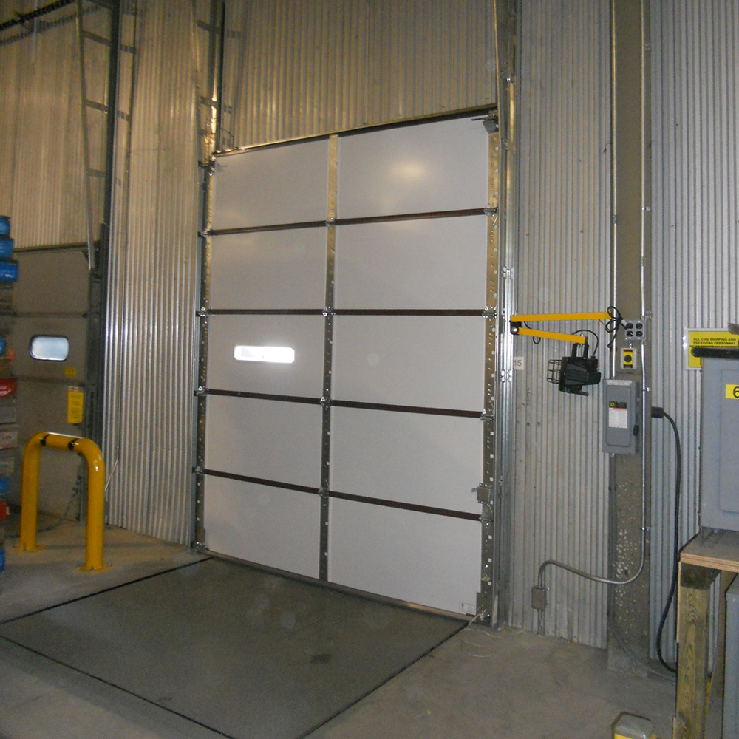
Overhead Doors
Overhead Worth Adding.
Overhead doors have formed the bedrock of our industry for decades upon decades. The reason is simple. They combine industrial strength with quality and are more efficient than ever before. Built for the long haul, our overhead doors also come with: annual fire testing certificates and insulation options to protect your people and property, as well as high-cycle packages for top-of-the-line performance you can count on all-year-round.
In keeping with your exact needs and specifications, we offer a vast selection of overhead doors that include rolling doors, fire doors, and sectional doors. All our overhead doors are available in a wide variety of widths, operating speeds, finished material and window features.
Get a Quote

Slide 102
Minimal Maintenance
Improved Safety
Custom Colors
Can be connected to your alarm system by our certified technicians
Choose from a variety of colors to match the look of your facility
Painted inside-and-out and come with 10 year warranty against rust

Slide 103
Overhead Doors Backed By Full Service Support
24/7 Emergency Support
Preventive Maintenance
Fire Testing
Asset ID Tracking

Slide 104
Additional Overhead Door Features
Feature hot-dipped, galvanized steel that has been painted with primer and finished with a tough, oven-baked polyester top coat
Guaranteed against delamination for a 10-year period
Feature polyurethane foam that is CFC and HCFC free
Come complete with sections, brackets, counterbalance mechanisms, and a range of hardware options

Slide 105
Our Expedited End-to-End Delivery Process
Asses & Evaluate
Design & Implement
Test & Deliver
Monitor & Maintain

Slide 106
Can We Help With Your Unique Situation?
Let’s have a friendly chat to find out
GIVE US A CALL: 1-833-438-9400
Or
GET A FREE CONSULTATION
Notes:
207

Slide 107
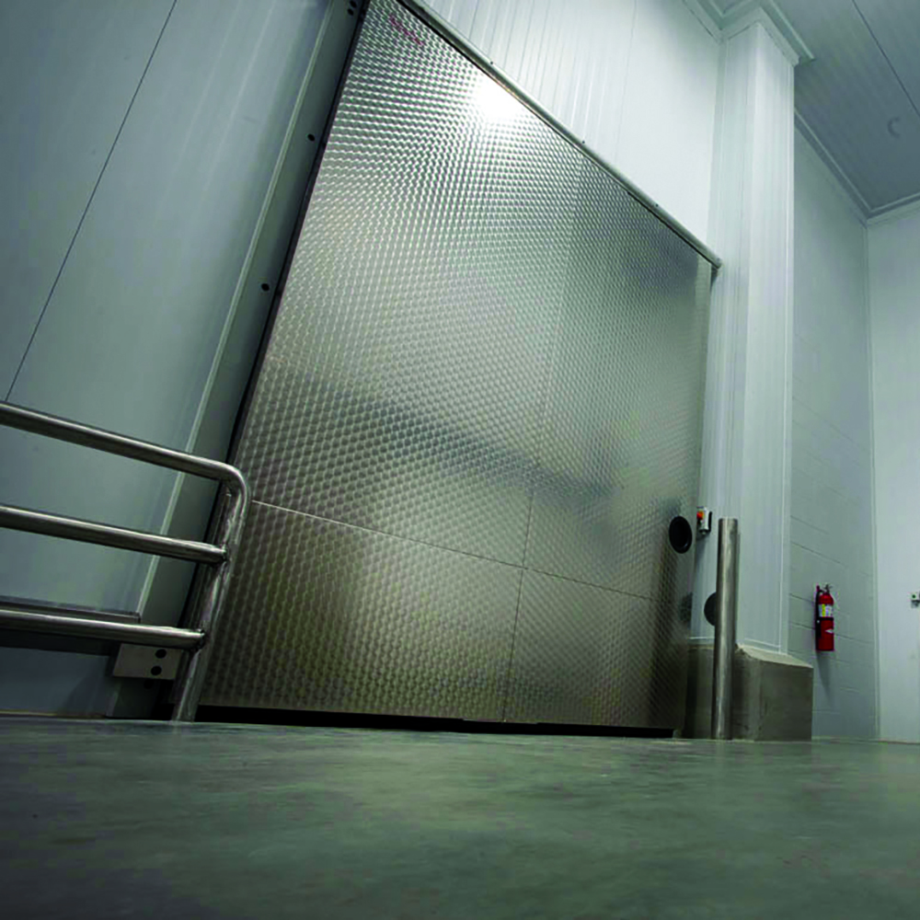
Cold Storage Doors
Secure Thermal Access.
For climate control that’s clean and efficient, it’s best to have cold storage or freezer doors that not only provide a secure thermal barrier between temperature-contained environments, but also resist harsh chemicals to keep up with sanitary demands. Our cold storage doors do both while requiring minimal maintenance, since they’re specifically built to withstand constant heavy-duty operations.
Because we focus on delivering a solution-driven product, we offer a diverse selection of sliding, roll-up, swinging, and even sectional cold storage doors for your special needs. No matter the temperature requirement, our technology and equipment will optimize efficiency and save you money on labor and energy costs needed to protect your products and processes.
Get A Quote
Notes:
198

Slide 108
Sanitary
Automated
Energy-efficient
Cold storage doors assist in preventing cross-contamination
Non-contact modes eliminate touch-points in your process
Combine insulation, gaskets and weather stripping technology

Slide 109
Cold Storage Doors Backed By Full Service Support
24/7 Emergency Support
Preventive Maintenance
Fire Testing
Asset ID Tracking

Slide 110
Additional Cold Storage Door Features
Speed can be automated to minimize airflow, and keep subzero temperatures consistent
Automatic controls range from induction loops, pull cords, push buttons, to interlock systems
Have available ergonomic manual models that can be opened and closed with minimal effort
Diversity of product includes complete systems in addition to single solutions

Slide 111
Our Expedited End-to-End Delivery Process
Asses & Evaluate
Design & Implement
Test & Deliver
Monitor & Maintain

Slide 112
Can We Help With Your Unique Situation?
Let’s have a friendly chat to find out
GIVE US A CALL: 1-833-438-9400
Or
GET A FREE CONSULTATION

Slide 113
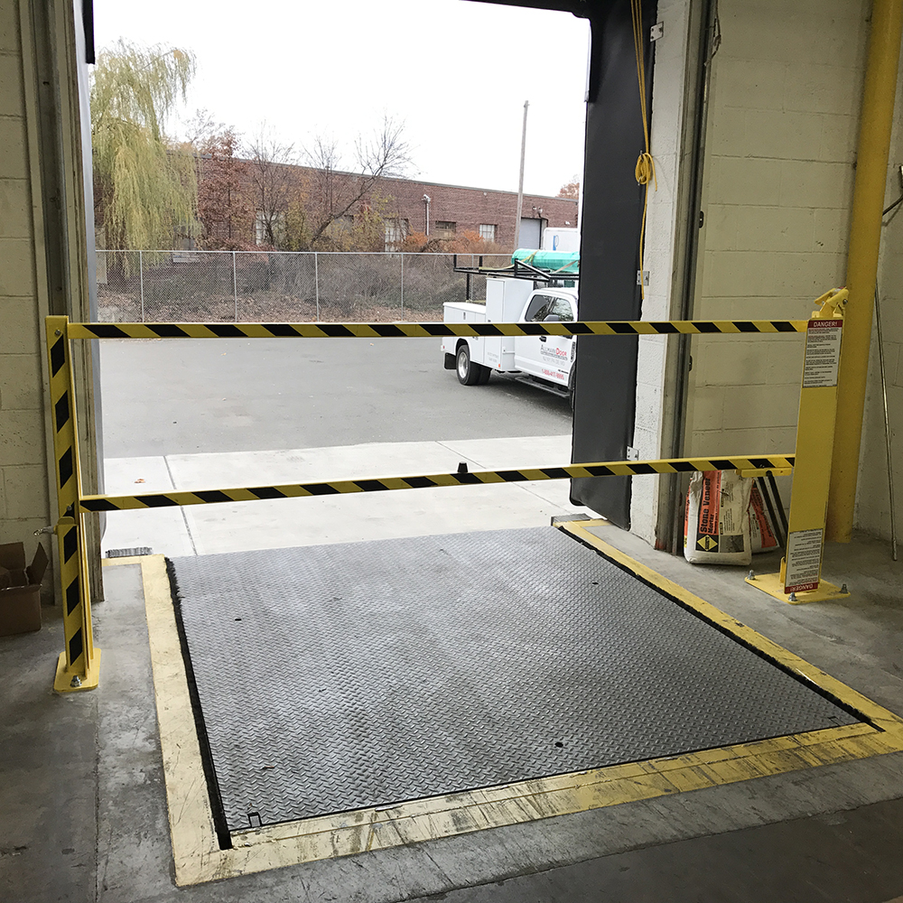
Safety Products
Better Safe, Then Sorry.
Companies that fail to install safety equipment and enforce safety policies put people, products and equipment at risk. This could result in costly damage, serious injury or even death. Fortunately, our wide range of safety products and accessories can help protect your organization’s most valuable investments and assets—including your reputation.
We prioritize safety above all else in loading dock and warehouse areas, where heavy equipment and machinery are moving faster and faster to keep up with the pace of business. So let us help you minimize the risk of accidents in your facilities by taking advantage of the most durable and reliable safety products in the industry.
Get a Quote
Notes:
231

Slide 114
Communication Controls
Barrier Systems
Handrails
Barrier Systems that prevent your employees from falling from a loading dock and can withstand various levels of impact.
Handrails can neutralize injuries in the workplace and can create a safer environment by controlling the flow of traffic.
Panel reduce risk by communicating if the loading dock is occupied or vacant. High-efficiency lighting is also available for safer cargo handling

Slide 115
Bollards
Trailer Stands
Barrier Arms
Bollards protect people and property by communicating vehicle traffic routes and establishing safety barriers.
Trailer stands keep trailers from tipping, and provide support and stability to ensure smooth transition from trailer to dock
Barrier arms protect company assets by minimizing the risk of forklift and employee accidents

Slide 116
Safety Products Backed By Full Service Support
24/7 Emergency Support
Preventive Maintenance
Fire Testing
Asset ID Tracking

Slide 117
Our Expedited End-to-End Delivery Process
Asses & Evaluate
Design & Implement
Test & Deliver
Monitor & Maintain

Slide 118
Can We Help With Your Unique Situation?
Let’s have a friendly chat to find out
GIVE US A CALL: 1-833-438-9400
Or
GET A FREE CONSULTATION

Slide 119
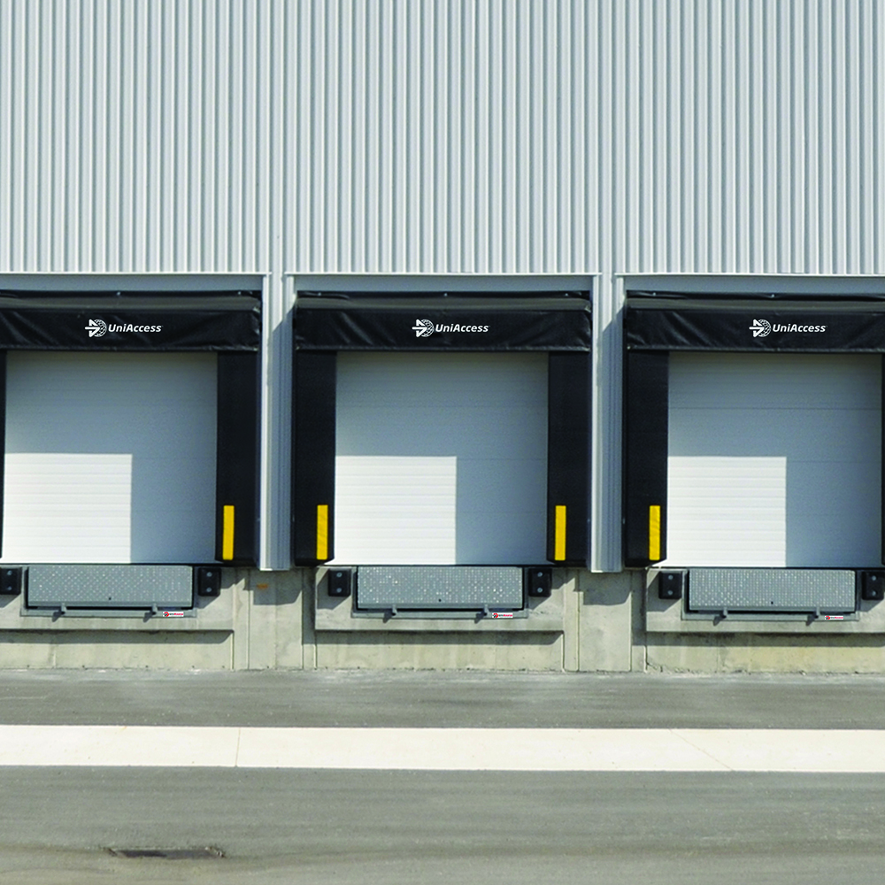
Loading Dock Equipment
Safe Shipments and Departures.
For effective and reliable loading dock solutions, it’s critical to have the right partner who can not only deliver on quality, but also experience and expertise. That’s why we offer a full range dock equipment and accessories designed to meet the challenges of today’s busy warehouses and cargo handling facilities. Our models are easy to operate, come in a variety of configurations to fit any application, and have a low lifetime ownership cost.
If maximizing the safety and productivity of your loading dock, while conserving energy and preventing precious cargo and adverse elements from slipping through the cracks is what you’re looking for, our industry-leading dock solutions and equipment are up to the job.
Get a Quote
Notes:
222

Slide 120
Dock Levelers
Dock Safety Systems
Seals and Shelters
Dynamic hydraulic and mechanical dock levelers that operate with the touch of a button
Extra safety systems that provide an additional line of defense against injury and property damage
High performance seals and shelters conserve energy and improve environmental conditions

Slide 121
Loading Dock Equipment Backed By Full Service Support
24/7 Emergency Support
Preventive Maintenance
Fire Testing
Asset ID Tracking

Slide 122
Additional Dock Equipment Features
Welded steel members maximize deck strength and improve product longevity
Hydraulic deck cylinders increase operating efficiency and reduce maintenance requirements
Heavy-duty main lift springs have a lifetime warranty
Yieldable dock leveler lips safely collapse if struck while extended
Seals and shelters come with available foam-filled top-of-trailer rainguards and galvanized snow hoods

Slide 123
Our Expedited End-to-End Delivery Process
Asses & Evaluate
Design & Implement
Test & Deliver
Monitor & Maintain

Slide 124
Can We Help With Your Unique Situation?
Let’s have a friendly chat to find out
GIVE US A CALL: 1-833-438-9400
Or
GET A FREE CONSULTATION

Slide 125
Services

Slide 126

24/7 Emergency Support
When You Need Us, Call.
Even though all of our work is guaranteed and comes with extended manufacturer warranties, there are times when equipment stops working for a variety of different reasons. Under these circumstances you shouldn’t have to wait to get your problem fixed. You deserve fast service when you need it most.
That’s where our 24/7 emergency services kick in. With around the clock access to our service and repair helpline, you can rest assured that help is on the way, and our certified technicians will come equipped with the necessary tools to quickly diagnose and resolve any challenge or issue you are facing. No matter your circumstance, the time of day, or piece of equipment that needs repair, count on us to get you back to full working capacity the very same day.
Get Services
Notes:
214

Slide 127



How it Works
Notify us about your emergency
Confirm your equipment’s Asset ID information
Let our technicians to service equipment
Resume your operations hassle-free

Slide 128
Benefits of 24/7 Emergency Services
All industrial and commercial door projects, including installation, repair, and emergency situations.
Parts and accessories needs, as well as warranty needs, and planned maintenance.
We can meet all your door needs, including loading dock installation, repair and maintenance.
We offer same-day service and will always strive to meet your schedule requirements.

Slide 129
Can We Help With Your Unique Situation?
Let’s have a friendly chat to find out
GIVE US A CALL: 1-833-438-9400
Or
GET A FREE CONSULTATION

Slide 130
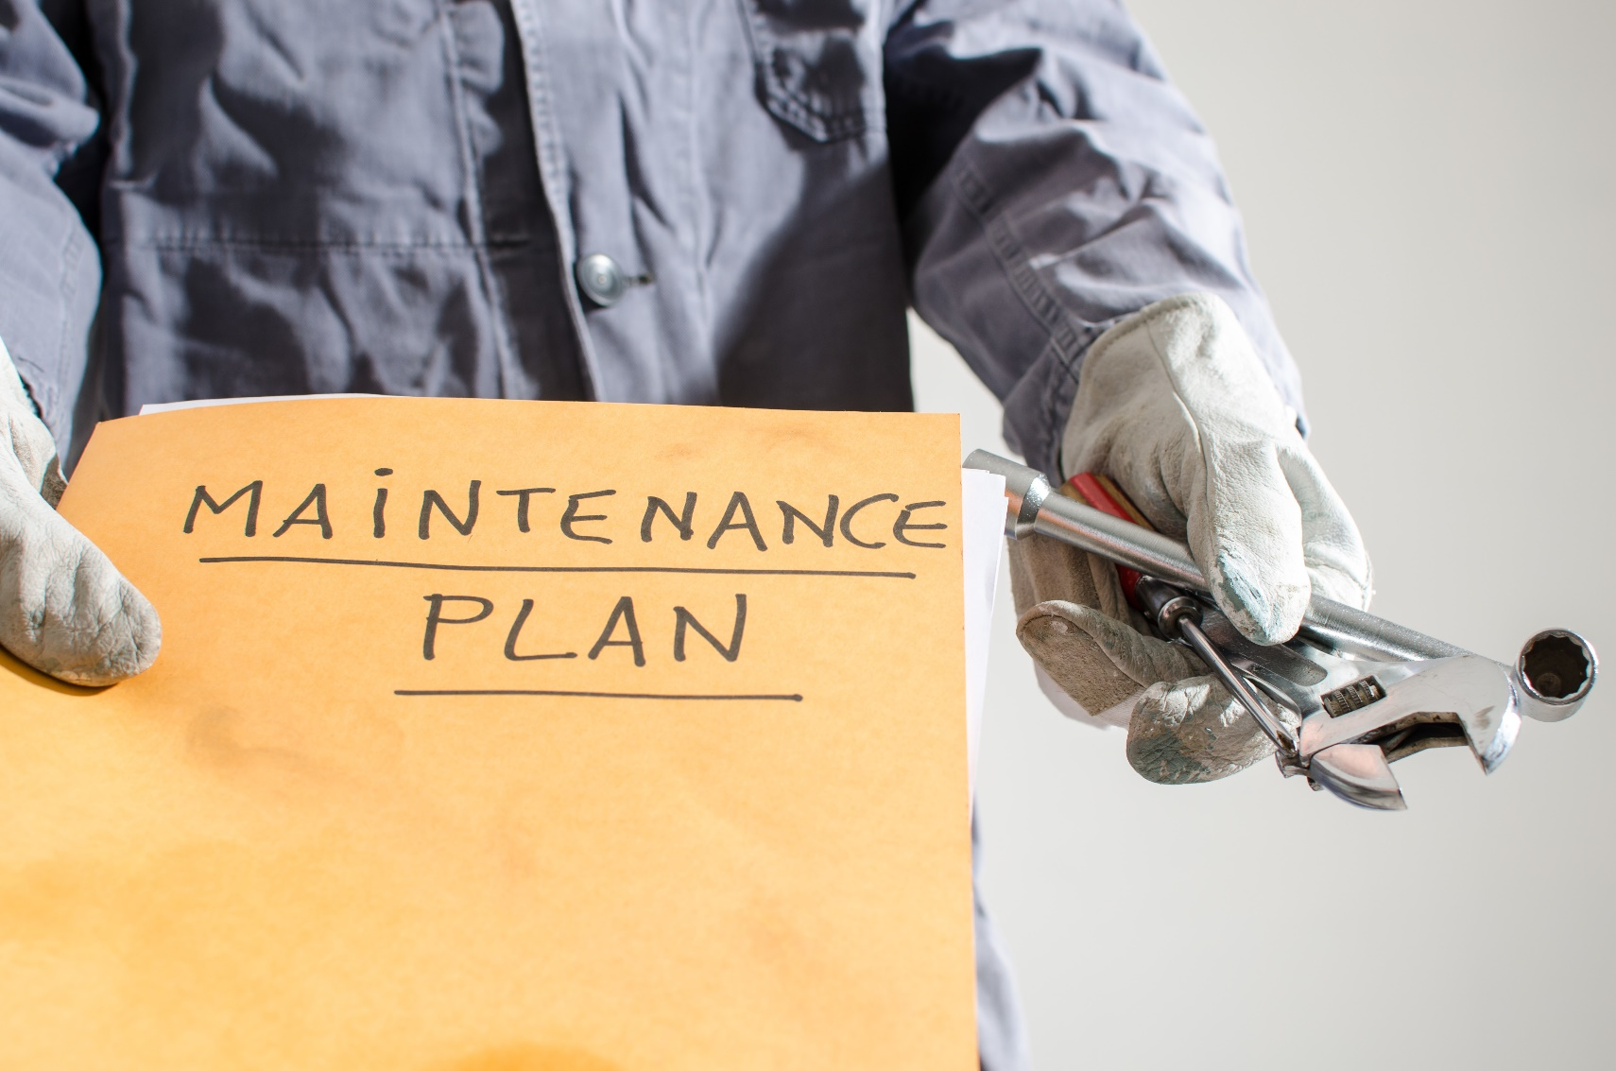
Preventive Maintenance
Make Preparation Standard.
Every door and piece of dock equipment requires regular and thorough maintenance throughout it’s lifetime to increase longevity. In most cases, failure to perform routine service checks can lead to unexpected downtime, exorbitant expenses, and even accidents in the long run.
Fortunately, we offer you a special preventive maintenance plan known as LongLife that not only guarantees your door and dock equipment operate at peak performance all-year-round, but it also ensures you get a prime return on your investment. Services include scheduled visits and comprehensive inspections on behalf of our certified technicians, who will take care of every aspect of your equipment and make sure to prioritize sensitive spots that are prone to wear and tear to give you complete peace of mind.
Get Services
Notes:
190

Slide 131



How it Works
Choose your preventive maintenance package
Confirm scheduled inspections
Receive your detailed maintenance reports
Approve appropriate equipment servicing

Slide 132
Additional Features of LongLife
Account-specific pricing on replacement parts, service calls, and hourly rates
Quarterly, bi-annual and annual inspection and servicing intervals
Guaranteed response times and online service requests
Full inspection reports on each piece of equipment, as well as service certificates
Dedicated Account Manager

Slide 133
Can We Help With Your Unique Situation?
Let’s have a friendly chat to find out
GIVE US A CALL: 1-833-438-9400
Or
GET A FREE CONSULTATION

Slide 134

Fire Testing
Prove You’re Fireproof.
Failure to keep up with industry and facility specific fire standards, doesn’t just put your people, property and equipment in danger, it’s also illegal and can lead to severe penalties and fines. But thanks to our Fire Testing Program, you never have worry about fire-related issues when it comes to doors and docks. We’ve got you covered.
As part of our services, we make sure to perform annual fire inspections that will protect you from compliance risks at all times. After every successful inspection, you receive written documentation and certifications to let the authorities know you’re equipment is up to par. If for any reason you’re unable to pass inspection, we will help you resolve any issues immediately by discussing a range of options that are in line with your goals and objectives.
Get Services
Notes:
190

Slide 135



How it Works
Confirm fire inspection visit
Technician administers fire door checklist
You receive written fire testing certifications
Authorities receive notification of your status

Slide 136
Additional Benefits of Fire Testing
NFPA 80 Compliance
Detailed inspection and service at agreed intervals
Full inspection reports for each piece of equipment
Equipment certification demonstrating that fire testing has been performed
Improved safety

Slide 137
Can We Help With Your Unique Situation?
Let’s have a friendly chat to find out
GIVE US A CALL: 1-833-438-9400
Or
GET A FREE CONSULTATION

Slide 138

Asset ID Tracking
We’ll Find It. We’ll Fix It.
Without a proper tracking system that automatically identifies and locates impaired equipment, facility managers and engineers often experience frustration tied to lapses in communication when requesting repair services from vendors. This can lead to unnecessary delays and even multiple visits just to get their problem fixed.
To eliminate all the uncomfortable back-and-forth during equipment troubleshooting, we offer you our very own proprietary Asset ID Tracking System that allows you to simply verify the Asset ID tag on the pieces of equipment that you need repaired. From there, our specialized technicians can easily diagnose, locate, and service your equipment to have you up and running with only one hassle-free visit.
Get Services
Notes:
190

Slide 139

How it Works
You place a service request by verifying your equipment’s Asset ID
Technician accepts your request upon Asset ID verification
Technician identifies and locates your equipment using tracking system
Technician quickly diagnoses and fixes your problem on the first visit

Slide 140
Additional Benefits of Asset ID Tracking
Gain insight into aging equipment that may need replacing
Avoid potential safety violations
Have a clear understanding equipment quantities and types
Prove ROI for past equipment purchases
Forecast capital requirements for equipment

Slide 141
Can We Help With Your Unique Situation?
Let’s have a friendly chat to find out
GIVE US A CALL: 1-833-438-9400
Or
GET A FREE CONSULTATION

Slide 142
Projects

Slide 143
Our Work
Client Type
Client Type
Client Type
Client Type
Client Type
Client Type

Slide 144
Client Type
Image
Image
Image
Image

Slide 145
Resources
Product Guides
Case Studies
Videos
Blog

Slide 146
About

Slide 147
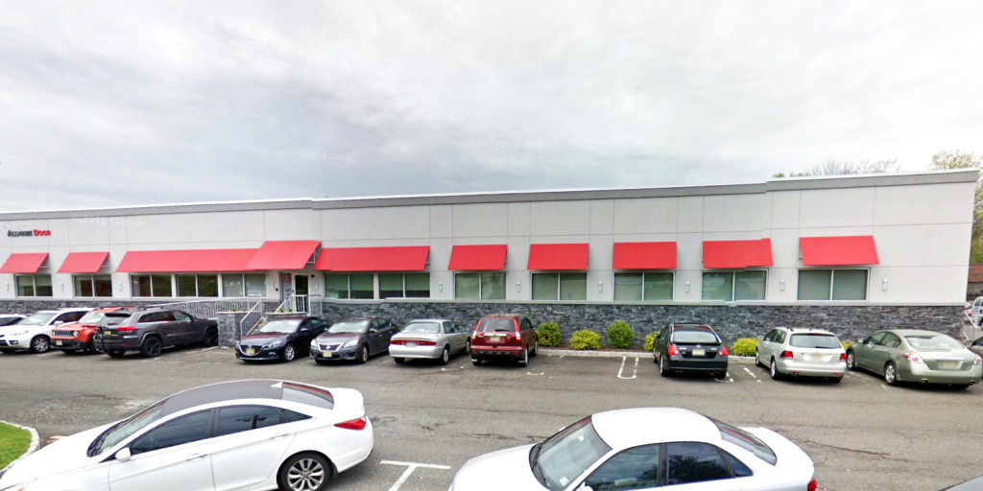
Our Mission
Our Mission
To provide innovative and quality-backed solutions to our select clients from a responsive and supportive team.
To provide innovative and quality-backed solutions to our select clients from a responsive and supportive team.

Slide 148
Who We Are
With 25 years of industry experience, a track record of over 200,000 successful installations across the Northeast, and dozens of satisfied Fortune 500 clients, Allmark Door is a leading provider of high performance industrial and commercial doors and docks.
We combine state-of-the-art equipment and technology with rigorous safety measures to deliver proven solutions that ensure peak efficiency for clients who take pride in the strength and quality of their facilities.
As a regional service provider, we operate out of our NY, NJ, PA, and MD offices, and partner with premier industrial door equipment manufacturers to give you the very latest in product excellence and innovation.
We are recognized for our commitment to client success above all, and focus on addressing your unique challenges and objectives with unsurpassed speed. This means you can count on our industry specialists and certified technicians to deliver your project on time and on budget, while providing you with comprehensive maintenance and support.
True to our name, we have the specialized knowledge and expertise to deliver: All Doors. All Docks. All Service. All The Time.

Slide 149

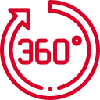

Why Choose Us?
Industry specific focus and credentials help us address your unique needs and guidelines
Our project based approach helps us manage and deliver a hassle-free end-to-end experience
Our client responsiveness and support services are second to none in our industry

Slide 150
A Few Clients Who Trust Us

Slide 153
Can We Help With Your Unique Situation?
Let’s have a friendly chat to find out
GIVE US A CALL: 1-833-438-9400
Or
GET A FREE CONSULTATION

Slide 154
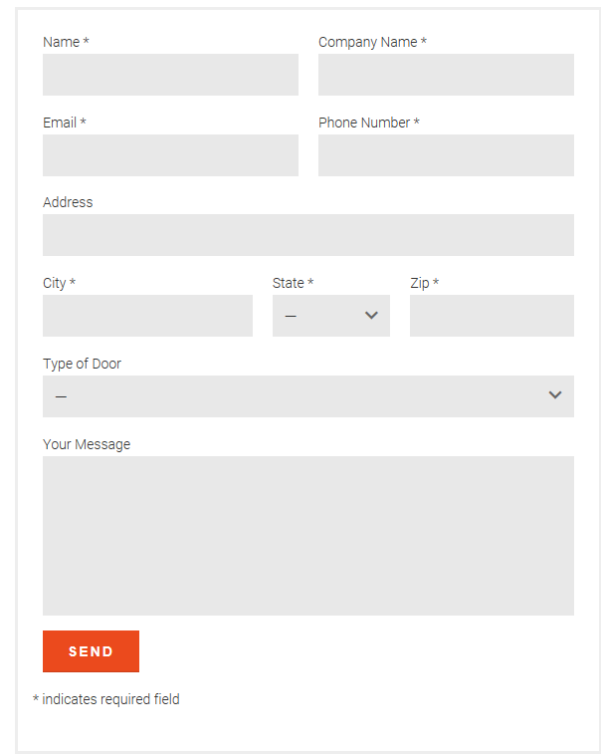
Careers
Join Our Team
A Winning Culture
With aggressive growth plans and an unwavering commitment to client success, the future at Allmark Door is bright. However, we rely on our employees to get us there. That’s why we aim to provide them with a comfortable work environment and equip them with the tools they will need to succeed in their career.
Does This Sound Like You?
Allmark Door is open to job seekers with diverse professional backgrounds and experience. While previous commercial door experience is helpful, we value team players with a proven work ethic and strong communication skills.
To find out more about our available opportunities please fill out the form and upload your resume. We will review your information and contact you, should your skills and experience be a good match with our current openings. Thank you for your interest in Allmark Door!

Slide 155
Contact Us
Feel free to call any one of our locations or fill out the form and someone from our team will be in touch shortly.
Locations:
15 Stern Ave.
Springfield, NJ 07081
973-912-7200
5 Crozerville Rd.
Aston, PA 19014
610-358-9800
8265 Patuxent Range Rd.
Jessup, MD 20794
410-595-5031
105 Maxess Road
Melville, NY 11747
631-574-4480

Slide 156
Get A Demo
Let Us Show You What We Have In Store
We understand how valuable your time is, and getting out of the office isn’t always a possibility so let us bring our product demonstrations to you and your team.
Our on-site mobile showroom is a custom, fully functional product presentation. Whether it’s an introduction to our products and services or just to refresh you on our capabilities, make sure set up a demonstration with us today!

Slide 157
Get A Quote
We are dedicated to the success of your facility and look forward to providing you with the best solution for your needs.
Just fill out the form and a member from our team will be in touch with you shortly to address your unique situation.

Slide 158
Get Services
We are dedicated to the success of your facility and look forward to providing you with the best solution for your needs.
Just fill out the form and a member from our team will be in touch with you shortly to address your unique situation.

