Slide 1
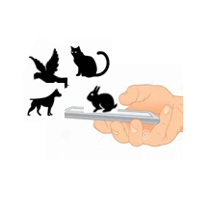
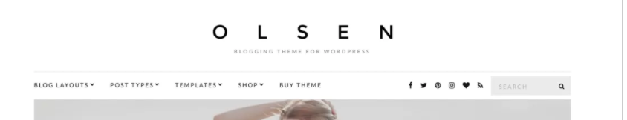
1
Paws N Wings
Swipe N Save
2
3
This is the current look and theme of the website that we are currently designing.
We are looking to have the logo sit in the top centre of the website. A clean minimalistic look that works against a white background is critical.
We would like 3 separate design files – one with the illustration (Box 1 above), a second one with the name (Box 2 above) and a third one (Box 3 above) with the tag line so that we are able to use these separately or together as needed.
We want to use the human hand on the mobile to show that with technology, humans can make an impact on the lives of animals. Could you please draw a human hand and mobile as an outline opposed to a photo. This will enable the logo to blend in against any background that we use.
We will be posting photos in Instagram and FB and are planning to add this logo in the bottom left of each photo we post. Hence, we would like the logo to be in black & white or in colours that can blend with any other background.
In the name, we would like the N to be in a separate colour to ”Paws” and “Wings” so that it is easy to read. The tagline of “Swipe N Save” should also be part of the logo design. The tagline “Swipe N Save” should be smaller than “Paws N Wings”
Font : We like clean and minimalistic fonds ( Pictures provided in the last slide)
We are open to a logo that shows paws on top of the “a” in “Paws” and wings in the ”W” of “Wings”
[CONTINUED IN NEXT PAGE]

Slide 2

Paws N Wings
Swipe N Save
Paws N Wings
Swipe N Save
We would also like to see a logo design that is encompassed within a shape such as a circle with the name and tagline appearing in the form of a circle
The colour of the circle can be based on your creative thoughts.

Slide 3
