Slide 1
Why do a Survey?
Gather more comprehensive and valid data on school conditions
Focus attention on quality of teacher-student relationships as well as peer relationships
Identify strengths as well as areas that need improvement
Measure progress toward school improvement goals

Slide 2
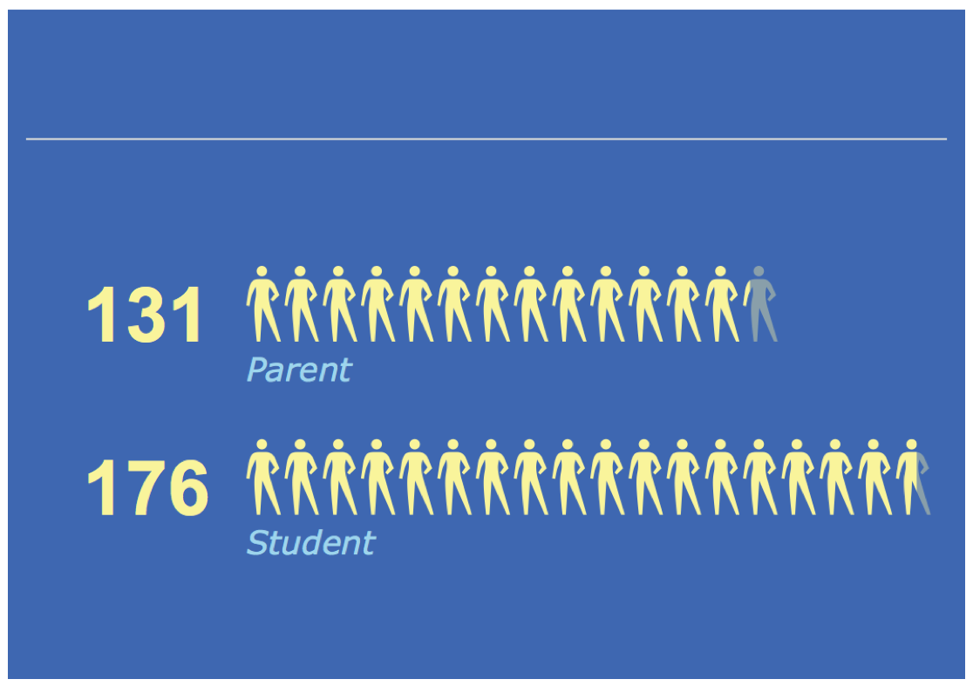
Who took the Survey- 307 Total Respondents

Slide 3
Survey Breakdown within Students

Slide 4
Student Survey Data

Slide 5
How do students feel they are treated?
46% of students believe boys and girls are treated differently
58% of students do not believe students are treated the same.

Slide 6
How do students feel about the discipline policy and school rules?
82% of the students felt like the teachers communicate effectively when they have misbehaved
However 45% believe that discipline is not fair and 53% believe that the rules are not applied equally

Slide 7
Do the Students feel that the teachers care about them?

Slide 8
Students and Social Needs. What happens beyond the classroom?
-36% to 38% of the students do not feel positive behavior while at school
-30% do not believe they are respected by adults
-30% do not believe they can talk about personal problems
-50% do not believe teachers understand their problems

Slide 9
Do Students respect one another and like one another.
64% of the students do not feel like students like one another

Slide 10
Is there a sense of belonging from the students?

Slide 11
Do students participate in School Activities?

Slide 12
Parent Survey-Summary

Slide 13
How do Parents Feel about the Communication at MCS

Slide 14
Do Parents feel connected emotionally?
On connecting to social needs of children, 38% do not believe they are getting what they need

Slide 15
Do parents believe their child is cared for and belongs at MCS?

Slide 16
Do Parents feel welcome at this school.

Slide 17
How do parents feel about Discipline?
-25% of the Parents do not like the Discipline Policy
-29% of the Parents do not feel like the Discipline Policy is Fair
-49% of the Parents do not believe the Discipline Policy is applied Equally

Slide 18
Contrasting how Parents feel about someone talking to their child versus Positive Behavior

