Slide 1




Notes:
The pace of work is greater today than it has ever been. We attempt to get more done, in less time, with more accuracy than ever in history.
Add to this, that customers/tenants are less and less likely to accept excuses for inefficiency, due to the widespread expectation that technology exists to solve longstanding issues, seemingly magically
And customer/tenant experience is paramount in this competitive world of changing work environments

Slide 2
Agenda

Slide 3
What is workflow management?

Slide 4
What’s happening/surprising today?

Slide 5
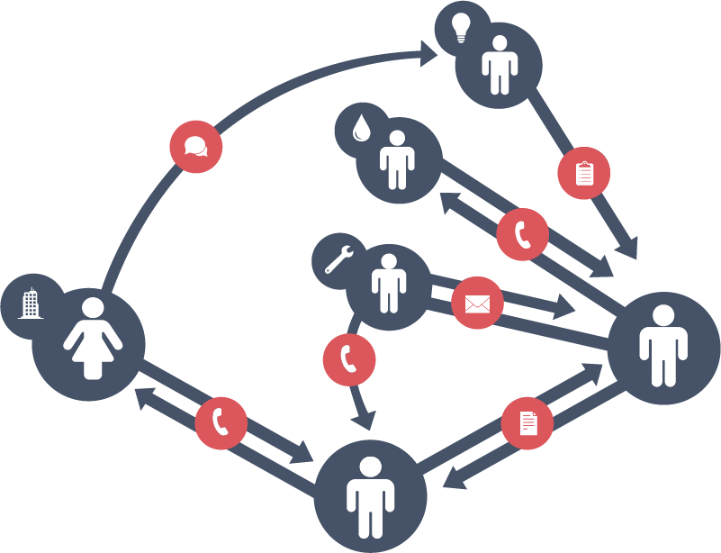


Desktop with ugly PC solution, laptop w/spreadsheet, post-its, notepad, text message, email, etc.
TOO OFTEN CHAOS REIGNS
Today companies rely on written reminders, conversations,
emails, &
texts
Notes:
Aside from the great change in workforce, today it’s true that,
Chaos is the word we most hear from our customers and prospects.
Too many people involved, too many communication channels, too much lost time & effort tracking activities, and
still no clarity as to what got done, what’s in process or what may have been lost in the shuffle.
There are more ways to communicate than ever, however tracking conversations through too many channels can be a fulltime job and increase, not reduce chaos.
The reality is, relying on inconsistent communications channels often leads to lost information, inefficiency and compromised quality.

Slide 6



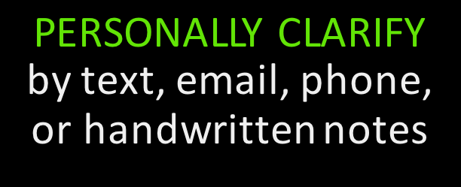
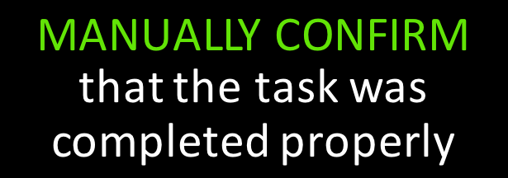
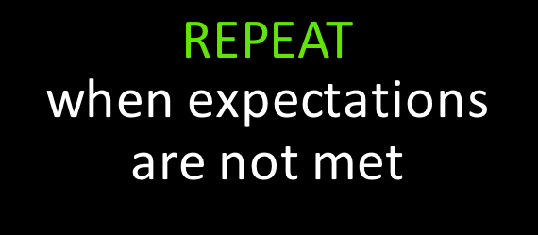
DELEGATED DOESN’T MEAN DONE
Notes:
A request should deliver all of the information needed to get a job done. When, who, and ESPECIALLY where and how!
Rarely the case today, a request is often just the beginning of a daunting process that requires juggling and tracking many tasks and people through an ever growing number of communication channels.
This leads to misalignment, unmet expectations, and expensive rework.
And because much knowledge of today’s processes is in the head of the current staff, who “just know” how to get it done, every day, you are losing critical knowledge of how your business operates and what makes it successful
the skills of the baby-boomers and Gen-Xers are largely undocumented. You don’t capture this knowledge now, it’s gone forever. This will be a huge setback in productivity and performance
Millennials don’t get their learning from past generations, they learn from technology. In any case, it is a big ask to get people who “just know” how they do things to communicate them to people who prefer to learn from technology

Slide 7
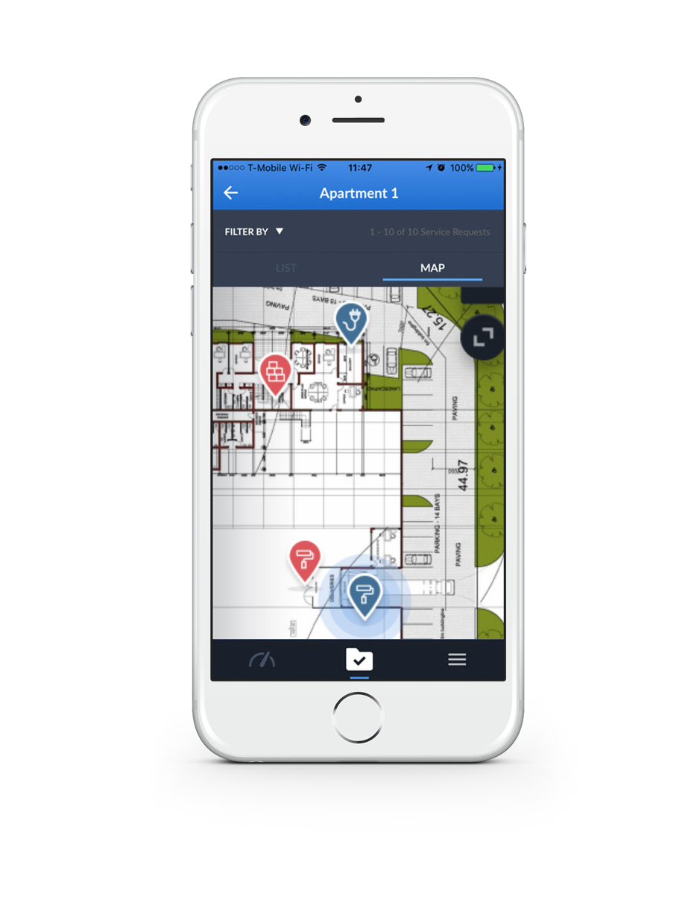
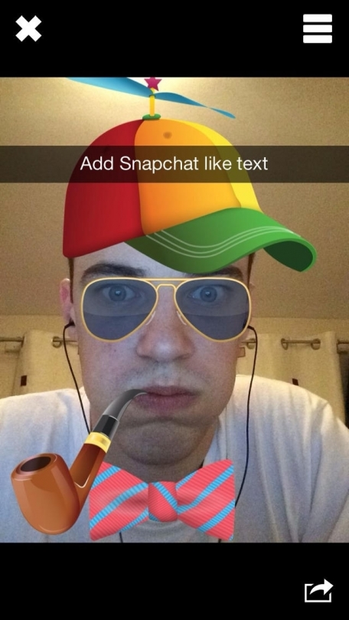
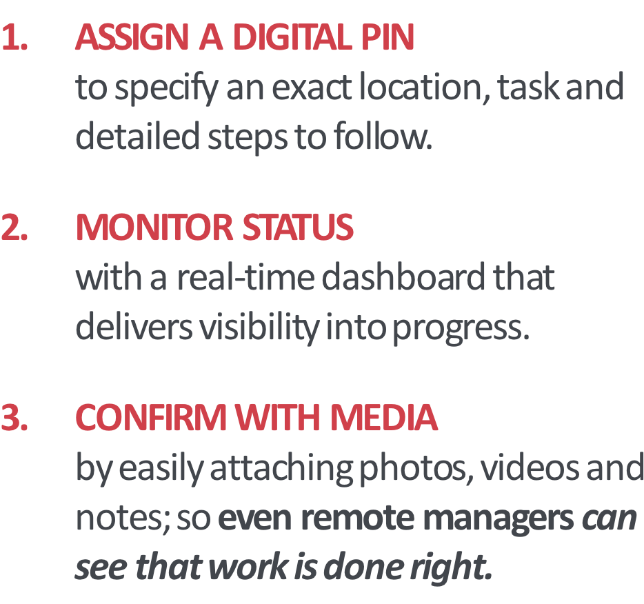
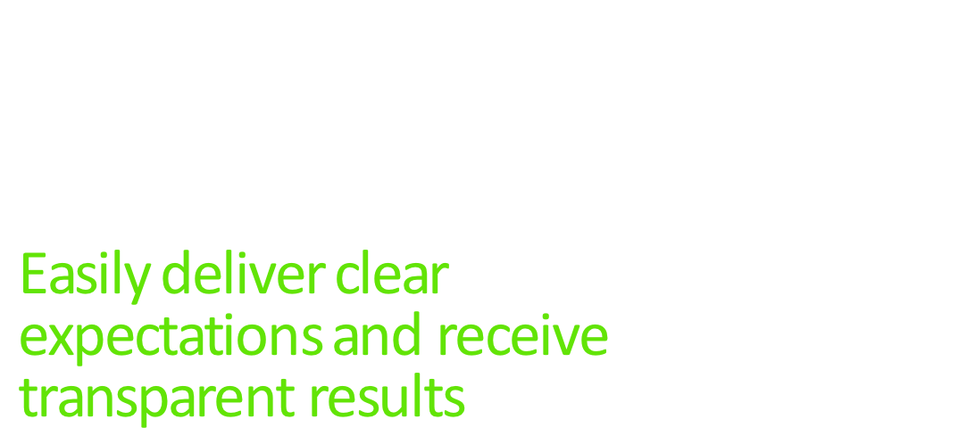

BOOMER BUST
  10k/day exit the workforce
EMPLOYMENT EXPANDING
  10 year high, 19% of employers will add to payrolls in all 13 sectors
SKILLS SCARCITY
  Mid to lower skilled resources are scarce, & entering workforce at lowest rate in decades
MILLENNIALS MOVE IN
  Currently 38% of workforce, 51% by 2020
ETHIC AND EXPECTATIONS
  Millennials work to live, 41% prefer electronic communication, and 75% believe tech makes them more effective
EFFICIENCY EMINENT
  wage expectations, laws and healthcare costs require reduced reliance on human labor
LIVING IN A MILLENNIAL WORLD
Employment, labor pool, skills, pay, and technology all
mean wholesale change
Notes:
And now we are on the precipice of a great generational change. The largest generation ever is leaving the workforce at the rate of 10,000/day. Millennials are the largest generation in the workforce (38%) and by 2020 they will be 51% of the workforce
Employment is at a 10 year high, 19% of employers expect to add to payrolls (also highest in a decade) and all 13 industry sectors will see an increase. 5% expect to decrease workforce
Mid to lower skilled labor resources are becoming more scarce, and those that are available (Milennials) have a different work ethic, and expectations of technology facilitating communication (41% prefer electronic communication) and tech assisting the work (75% believe access to tech makes them more effective. For instance, even programmers have much of their code written for them!)
Plus, wage expectations (and laws), and healthcare costs are forcing process efficiencies that reduce reliance on human labor

Slide 8
What do you need to do to fix it?

Slide 9
Why Curo?

Slide 10

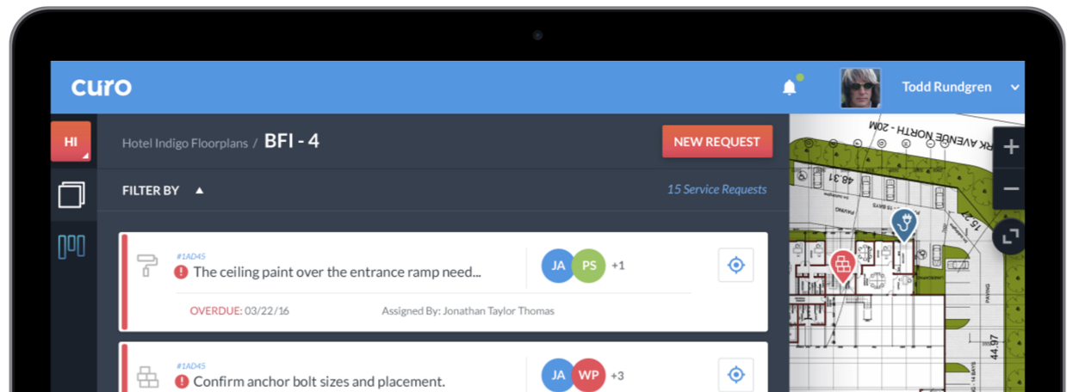
GPS location-based productivity platform that locates and
communicates activities, digitally reports progress, and enables
visibility & accountability to assure quality
Notes:
What if you could…capture every single activity, locate and prioritize every action, connect to the right people at the right time, and
assure that everything gets done right and right on time…
By being on-site 24/7 without ever leaving your office.
With the clarity and visibility provided by complete traceability

Slide 11
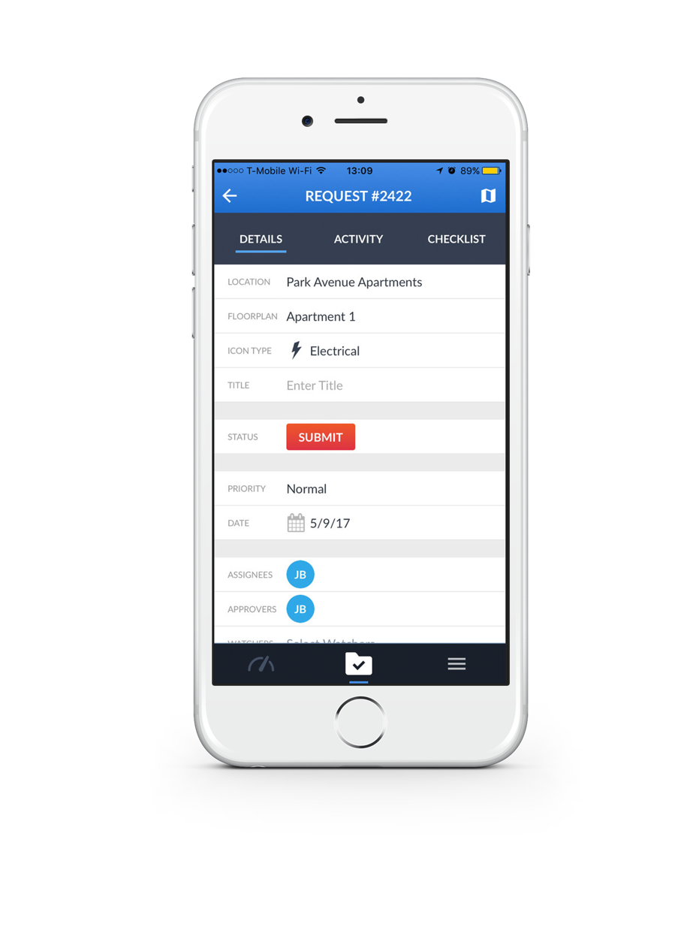
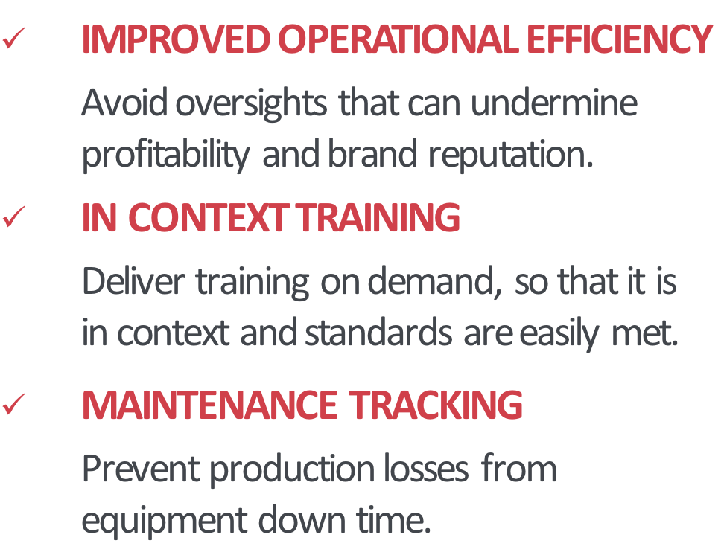
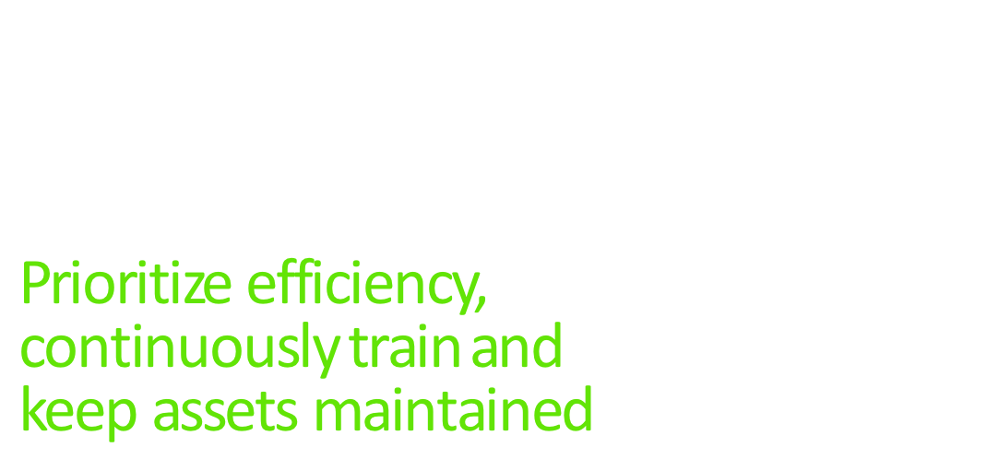

GUIDANCE
Notes:
Curo is not just for getting individual projects done. It is about improving the performance of your entire business.
In order to do this, our platform streamlines all operational activities and ensures everyone is trained to help the business run smoothly, grow and succeed.
Assuring expectations are clear, activities are defined and valuable knowledge is captured & transferred to new teams. It’s like a live playbook that players can reference will in the action.
Connect any participant, inside or outside of your organization to get all the information they need, and none they don’t.

Slide 12
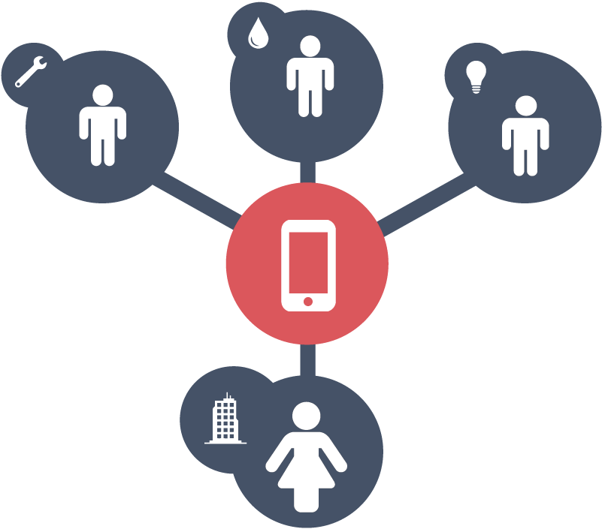
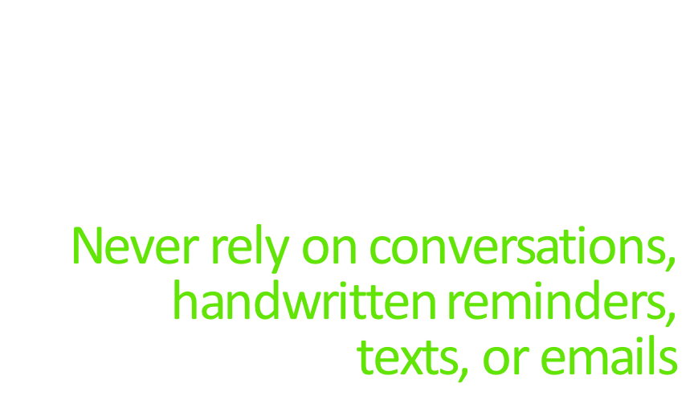
Notes:
Curo delivers powerful collaboration tools that locate the work, centralize conversations, and keep requirements readily accessible to make it easy to get work done correctly the first time.

Slide 13
Notes:
Construction solutions, phone calls, email, ticketing systems, cumbersome spreadsheets, & messy whiteboards don’t work.
And you can just forget about paper!
Curo eliminates guesswork and confusion; delivering location specific visibility into assignments, requirements and progress.
Taking the confusion, delay and rework out of every activity, to assure they get done right.
Easy and rapid to define, assign and approve tasks
Track exactly what needs to be done, where, when, by whom and HOW
Confirm proper and timely completion, provide guideposts and in-context training for conducting the work
Measure results for constant performance improvement
Assure adoption and performance improvement

Slide 14
Curo vs. the Old Way…

Slide 15
Traditional marketing automation software
doesn’t address your whole marketing funnel.

Slide 16






It only serves one or two
stages of the marketing funnel.
Noting
Tracking
Communicating
training
Strangers
Visitors
Leads
Traditional email marketing / marketing automation tools (like Eloqua or MailChimp)
Customers

Slide 17
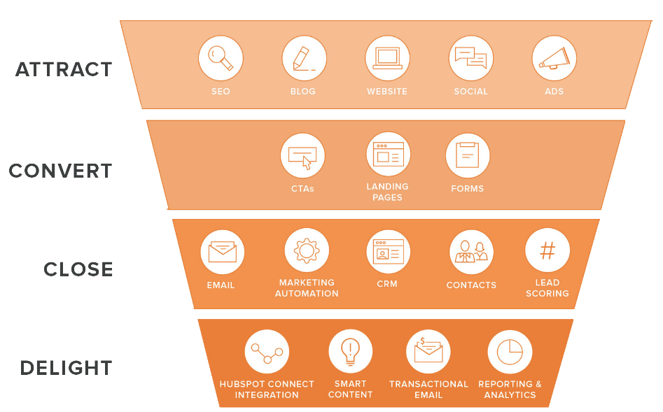
HubSpot is an inbound marketing platform
designed to generate more traffic, leads and customers.
It doesn’t help if your problem is here.
Email marketing automation helps here.

Slide 18
Expected ROI from Curo (over the other guys)

Slide 19
Customer Success Formula
Our Proven Process
Education
Certification
Communicating and Coordinating
Communicating and Coordinating
Operations / Property Mgmt., Maint.
Operations / Property Mgmt., Maint.
Projects
Projects
Inventory / Materials
Inventory / Materials

Slide 20
gettin’ ready…
gettin’ it done
Curo engages with your team
What’s Your World Look Like?
A look under the hood so we know how to help
Get/keep everyone trained up
We don’t drop the mike and walk off stage
What’s the work & How You Get it Done
Identifying your processes, policies and methods
Who’s Who? Who does the work, who oversees it and who approves
Get it done!
Get to work assigning, conducting, approving and measuring
Visual - Make it look like it’s happening on an iPad
Notes:
Curo Proven Success Formula

Slide 21



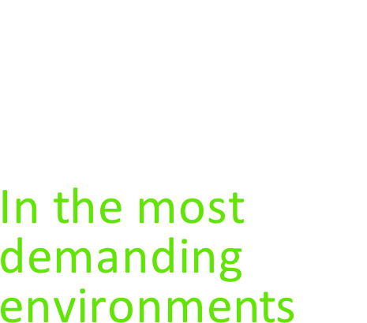



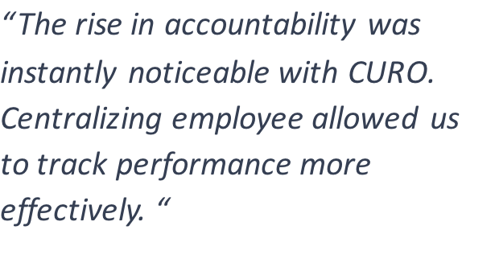
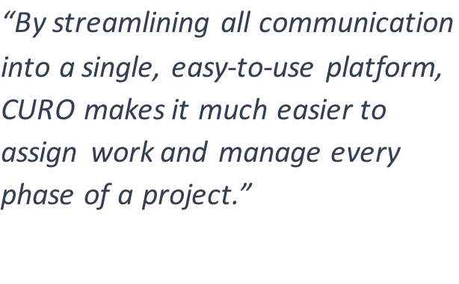
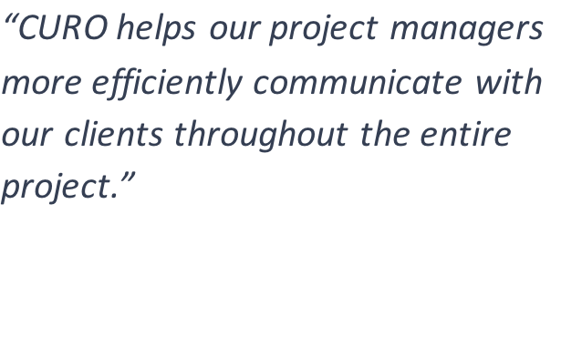
Notes:
Recently, companies have been capitalizing on a rapid, simple, yet robust solution that is required to assure complete management and full adoption.
Full adoption is the only way to the improved definition, prioritization, accountability and communication that provides assurance that tasks are done, done right, and right on time.
The completed connection of office mgmt., field mgmt., and field workers positions companies to provide more complete and consistent service, without excessive labor and asset costs.
For example, Amazon:
Reduced number of PM’s required for projects
Increased contract laborers’ throughput and done right, first time performance
Managed effective 7-month delivery of hundreds of facilities from walk-in to completely operational
CURO
Delivers efficiency (eliminate chaos, reduce site visits without compromising quality, while you streamline communication)
Improves customer experience
Amplify efficiencies
by enabling standards, processes and learning in our technology, you can communicate to the next generation of the workforce effectively and in their own language. Capture and encourage performance improvement, and improve customer experience.

Slide 22
Customer Success Stories
Amazon
NPSG
The Dewberry

Slide 23
Amazon
Built 88 facilities in 1 year in as little as 3 months to operational

Slide 24
NPSG
Established as premier services provider by assuring performance
“always on my hip”
“never doubt where we stand”

Slide 25
The Dewberry
Improved performance with in-context training
Video samples,

Slide 26
The Curo Platform & game-changing Features

Slide 27



Notes:
Manage the precise location with patented floorplan precision
The simplest and most complex activities can be conducted with the assistance of the application to assure quality and timeliness of work
Mobile media, monitoring and metrics enables you to be on-site 24/7 without the delay and cost of travel

Slide 28




Notes:
One means of communication on all activities. Consistent, comprehensive and traceable.
Front-end multiple solutions and share data across platforms
Assure that every party inside and out of your organization gets all the information they need, and none they don’t.

Slide 29



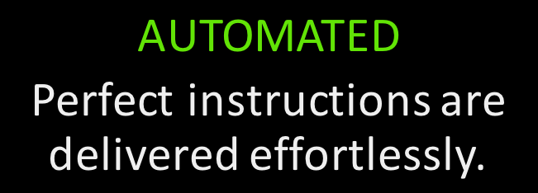
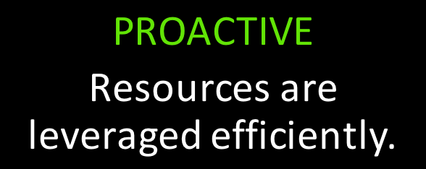
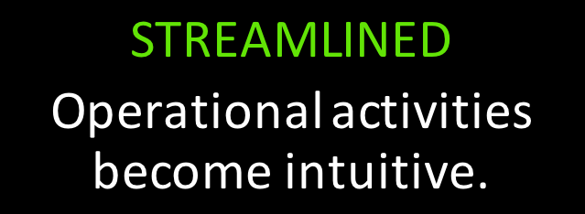
ASSURE RESULTS
Notes:
For recurring tasks users can create automated workflows that make delivering perfect instructions easy.
Curo makes proactive planning easier and allows our customers to get the most out of every resource, while establishing better visibility into dependencies, constraints and overall performance.
Our intuitive user experience makes streamlining operational activities painless.
Get your workforce what they need to be effective and assure the excellence and sustainability of your performance
Assure that you provide the greatest customer/tenant experience possible in this world of high expectations.

