Slide 1
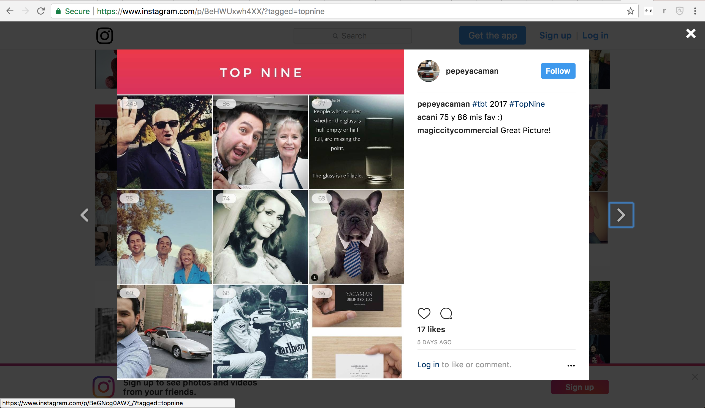
Ads
Facebook + UAC(Google) + Ad Networks
Track and optimize your lifestyle for maximum energy,
fitness, stress resistance and brain power.
Accurately track daily changes in cardio, stress
and cognitive levels with a single 3 minute test.
Find out how changes in your lifestyle affect you.
Buddy up and compete in global challenges with
friends from all over the world to win cash prizes.
Use hybrid AI + Crowd Intelligence to find the most
effective workouts for your personal profile and goals.
Influencers
Video challenges: influencer records himself doing
a challenge and posts his score and video to his Instagram.
“My VO2 Max is 45, top 10% world wide, just under Serena”

Slide 2
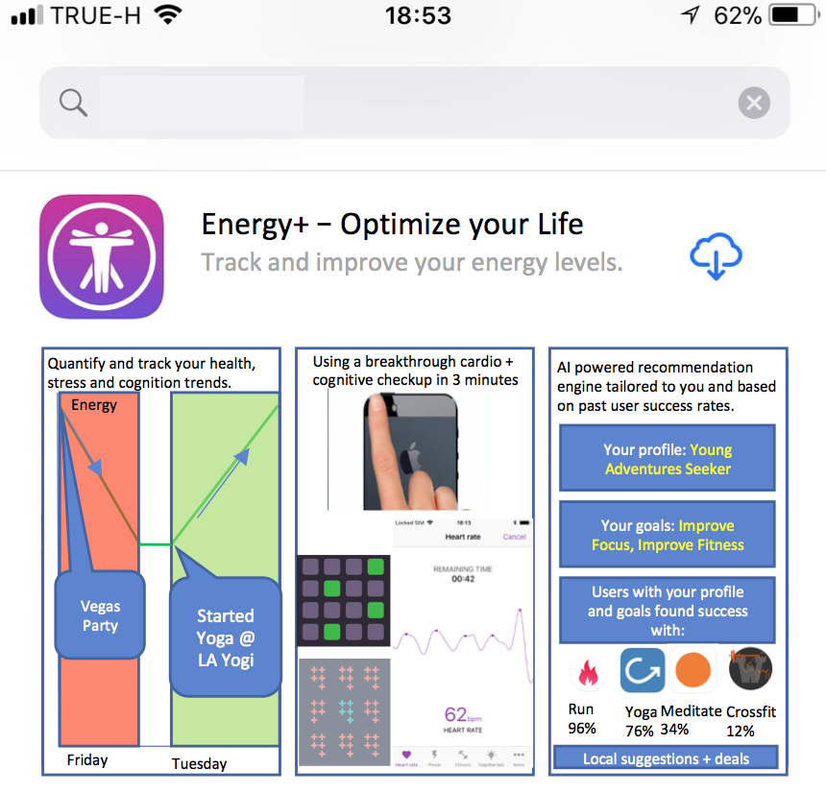
AppStore
Get more energy to hit your goals, fight stress and feel happier.
Energy+ helps you choose between thousands of exercise, diet routines and lifestyle plans to find an approach which works best for you.
Our AI engine accurately analyze your cardio fitness, stress and brain power through a quick check up on your phone (no external gadgets/sensors needed) and helps to choose the most effective action plan for their individual goals and profiles based on previous users’ successful experience.
The app analyzes resting + active heart rate, heart rate variance (HRV), hand tremor and pairs them with cognitive tests and other data points (i.e. sleep) to build a unique user profile, helping to make routines a positive habit and tracking your progress to success.
It is scientifically proven that exercise, reducing stress, good diet and higher cognitive skills help to avert Alzheimer disease. If you choose to contribute to the fight with this disease your anonymized test results will be shared with scientists.

Slide 3
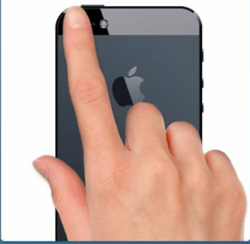
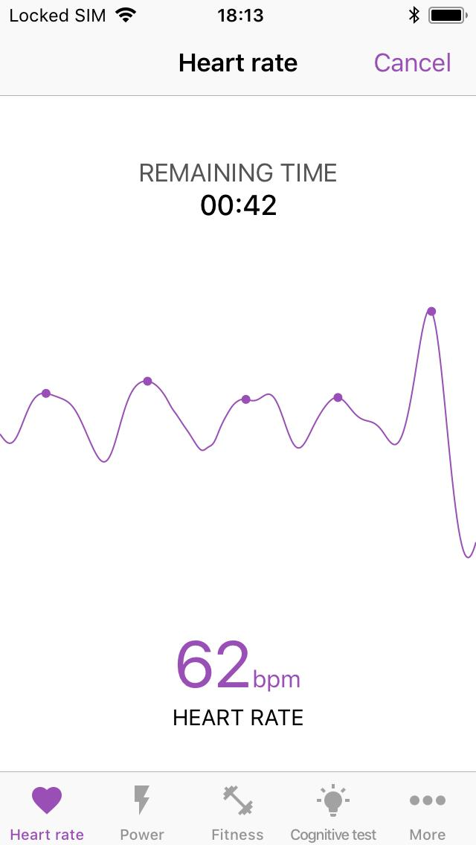
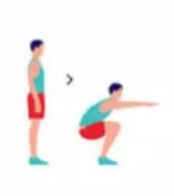



Habit Step 1: HINT (Monitor)
General check-up (daily)
HR, HRV, Hand Tremor, Cognitive
Fitness check-up
VO2Max (weekly)

Slide 4
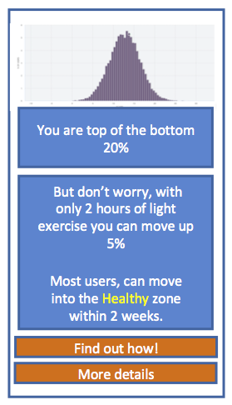
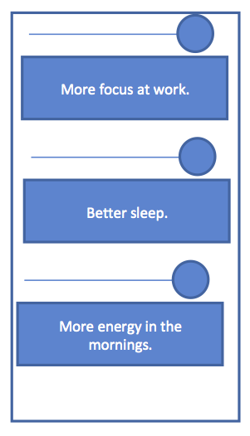
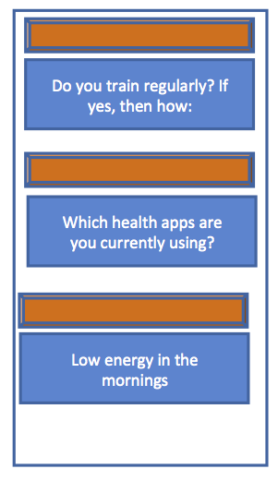
Habit Step 1: HINT (Continued)
You
RESULTS: histograms vs community: stress, basic cardio, cognitive, (VO2max), suggestion to build a base line over 5 days
GOAL SETTING: Questions re current lifestyle and goals to provide INFORMED recommendations in combination with scores from the checkups
CURRENT: lifestyle choices + activities. Using logic trees:
- exercise > running > app;
- exercise > crossfit > local gym;

Slide 5
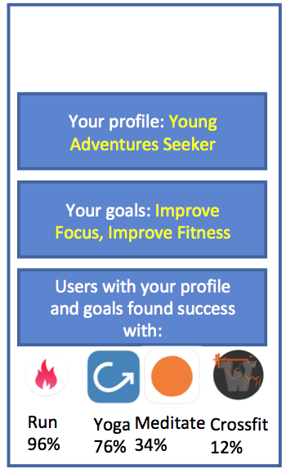
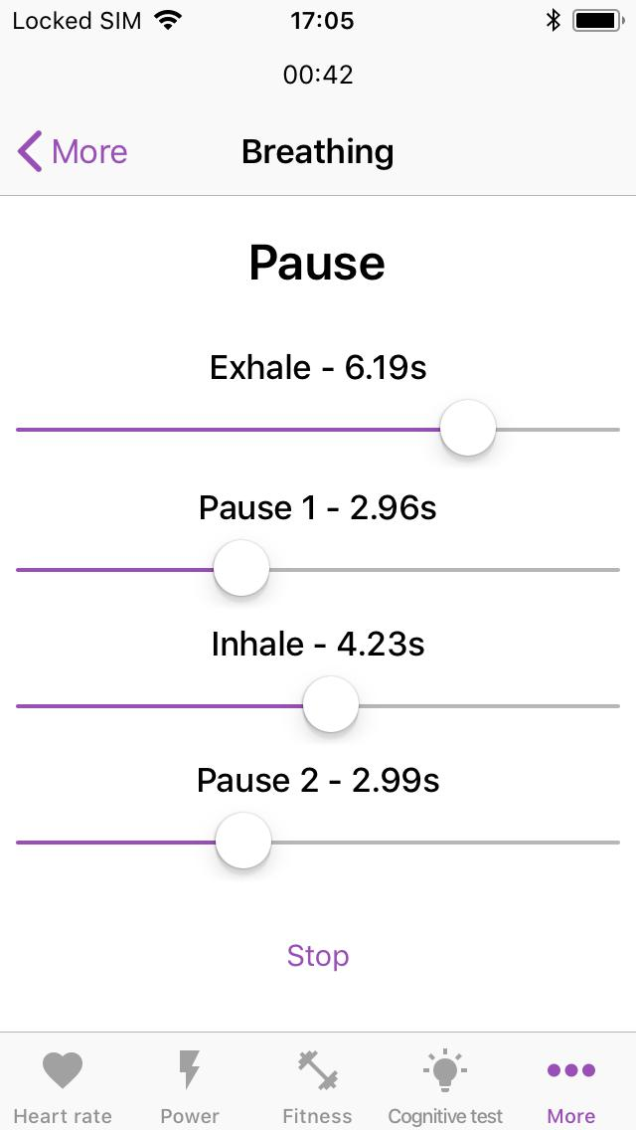
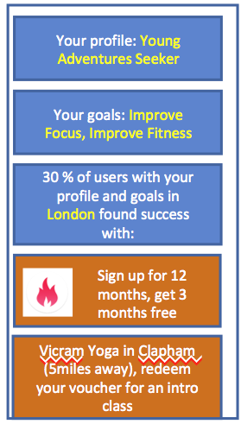
Habit Step 2: POSITIVE ACTION
CHECK-UP RESULTS + GOALS = USER PROFILE. ML matches user profile with other users to suggest plans which worked in the past
RECOMMEND quick fixes right within the app, i.e. breathing and positive thinking for stress reduction. Also diets, Vo2max improvement through intervals
RECOMMEND partner apps or local to user facilities for complex tasks, i.e. yoga, cross-fit, fitness plans

Slide 6
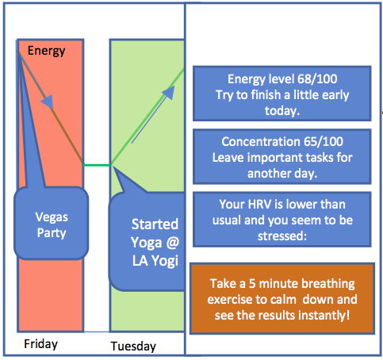
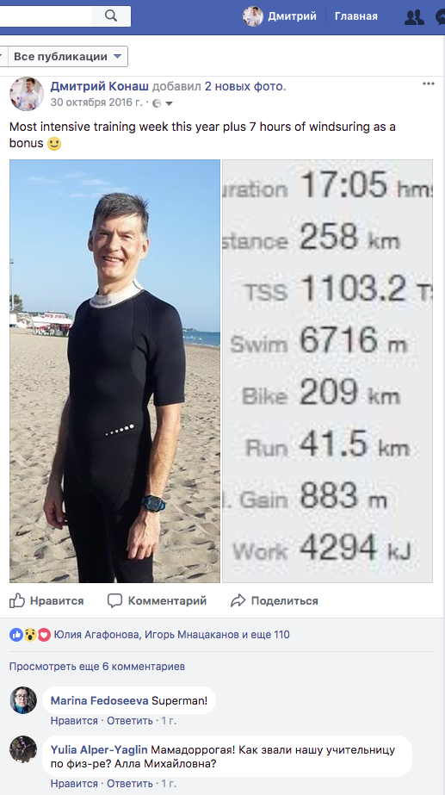
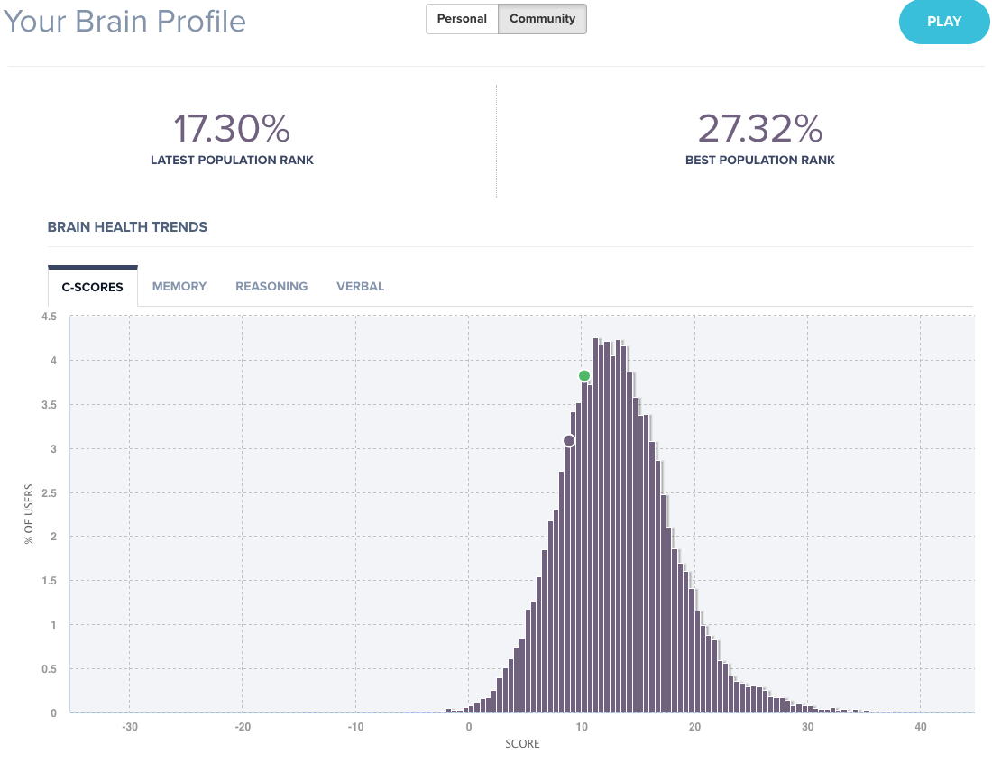
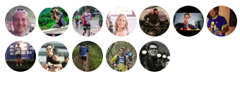
Habit Step 3: REWARD
MORNING REPORT for the day with recommendations and quick fixes, trends
FRIENDS/CLANS: Link with like minded users and get their support
LINK TO FACEBOOK

Slide 7
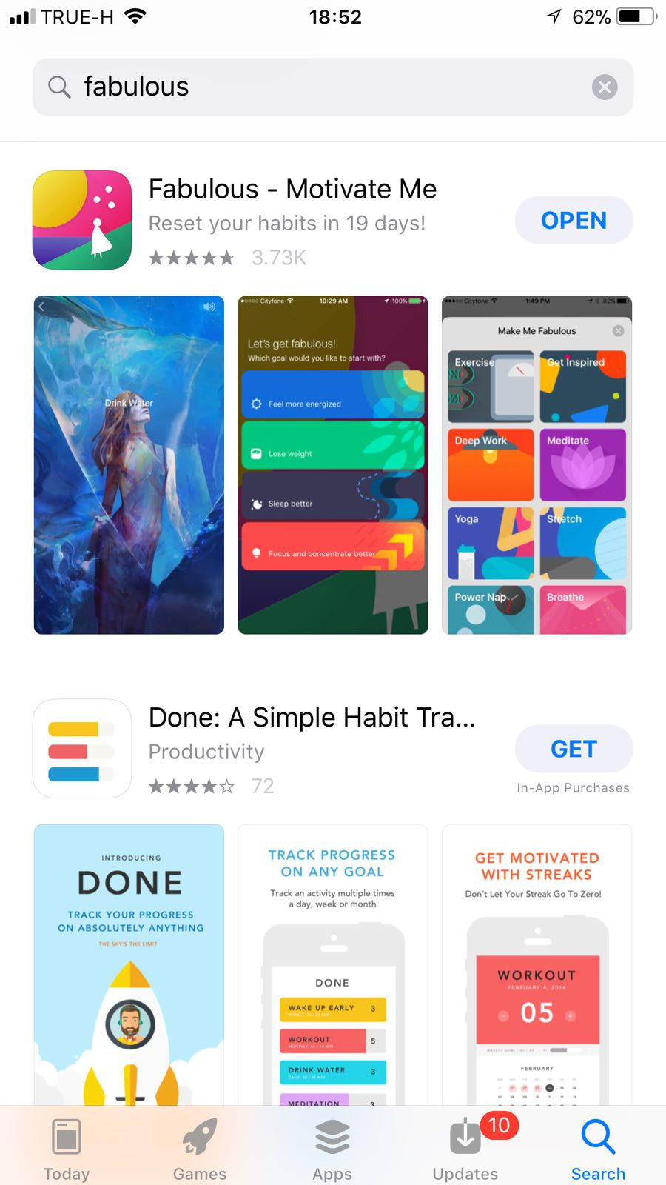
Our design style will take elements from the Fabulous app, Welltory and
Workflow
We will aim for a fairly gender neutral target, but will bright and colorful.
3rd party data collection will be enabled through Apple Health: sleep, steps,
Workouts
Achievements and gamified progression will be added to the flow of the app.

