Slide 1
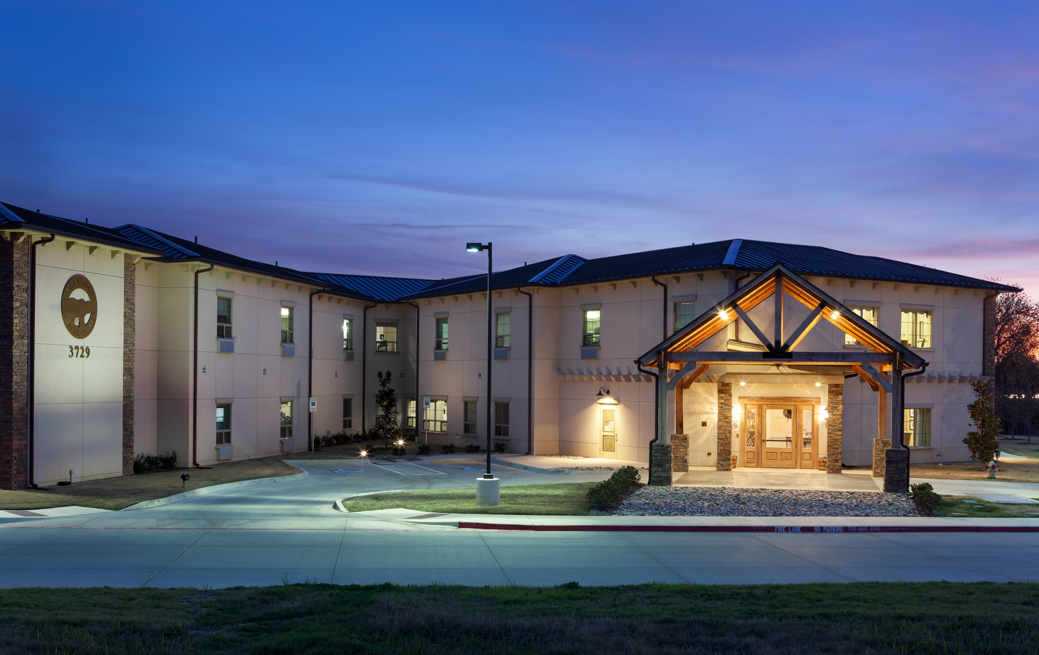
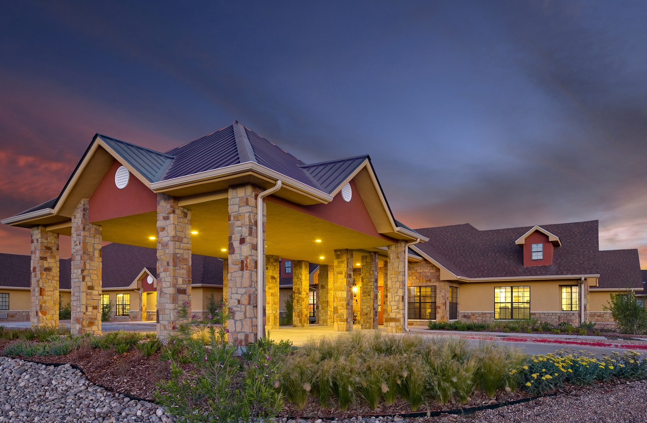
Cielo Facilities

Slide 2

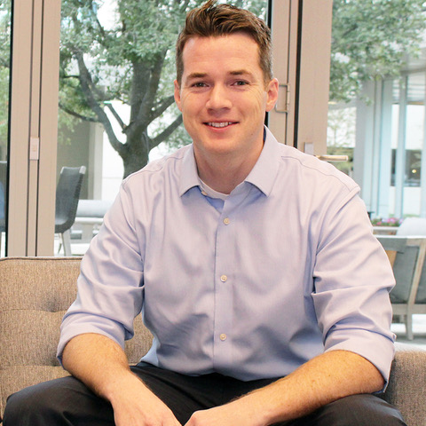
Eric Tanner, President/Chief Operating Officer
Eric Tanner came to OnPointe with more than 10 years of healthcare management and operations experience, progressing through roles as an administrator, district operator, and COO of diverse skilled nursing organizations.
Eric’s strengths lie in visualizing and articulating organizational paths forward – and getting the right people together to execute solutions. As President & COO at OnPointe, Eric leads an innovative team dedicated to developing systems of care that close the gaps in the traditionally disconnected post-acute process.
Eric graduated from Stanford University where he met his wife of over 12 years (a practicing physician) with whom he has three children.

Slide 3
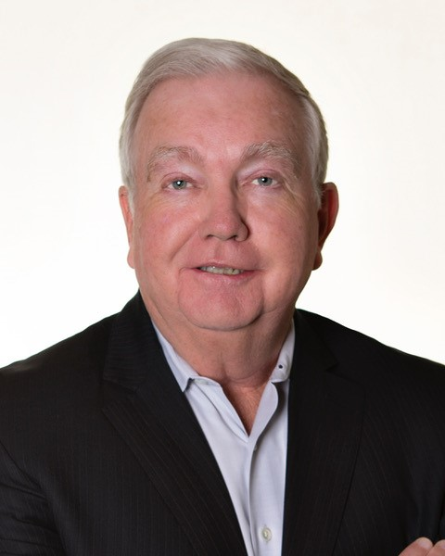
Rich Fitzpatrick, Chief Financial Officer
Rich joined OnPointe in October 2017 as Chief Financial Officer, with a history of financial expertise in the senior care sector.
He was Chief Financial Officer of and/or advisor to a number of public and private companies including The Forum Group, Inc., Omega Healthcare REIT, Transitional Care Management, and RSF Partners.
Prior to his work in healthcare, his financial background comprised of service businesses including Americana Hotels and Resorts, Bristol Hotels and Resorts, Tropicana Casino and Resorts, Houlihan's Restaurants, ISN Software and The Hampstead Group.
Rich earned a BS in Accounting and an MBA from DePaul University in Chicago.

Slide 4
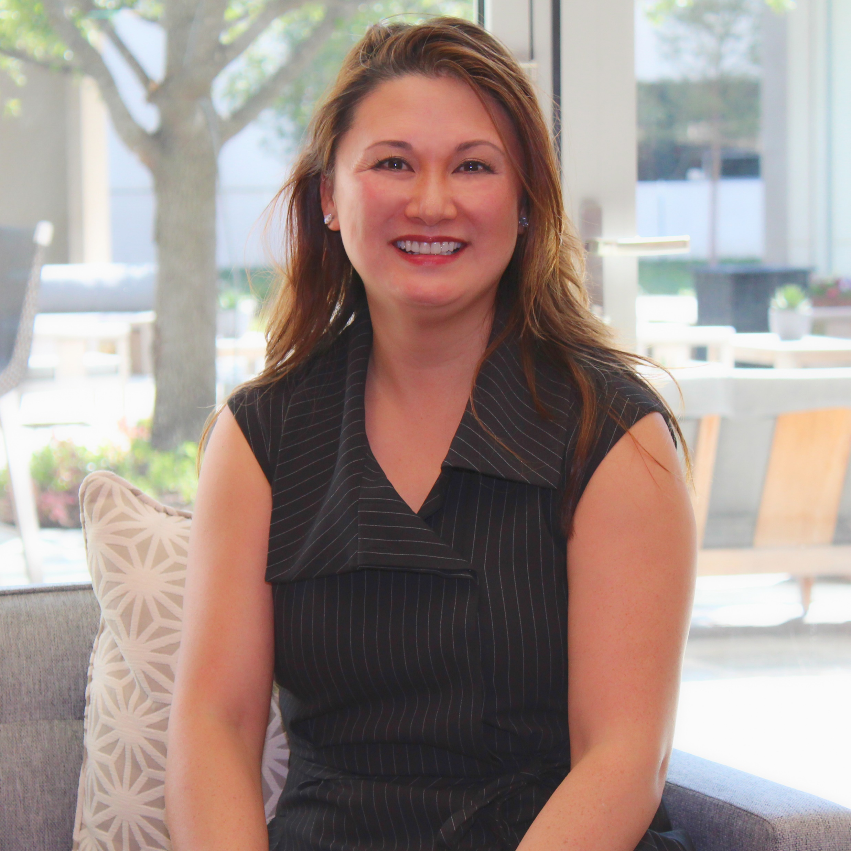
Selina Chao, SVP of Operations
Selina Chao joined OnPointe with 18 years in business operations and management with the most recent 9 years in healthcare. Selina’s healthcare experience includes administrator, operations leader, preceptor, regional director and operations director. In the most recent 3 years, Selina has facilitated in a variety of markets where challenged facilities required operational and clinical turn-arounds. Organizational execution of goals and building teams to achieve excellence are her forte.
Selina believes in the personal impact people can make through compassionate actions with a thoughtful and passionate heart. Her drive to improve quality and personalize patient experiences is grounded by fostering those she mentors.
Selina graduated from the University of Southern California. She is a mother of three children and married to an active duty serviceman who practices as a vascular surgeon.

Slide 5
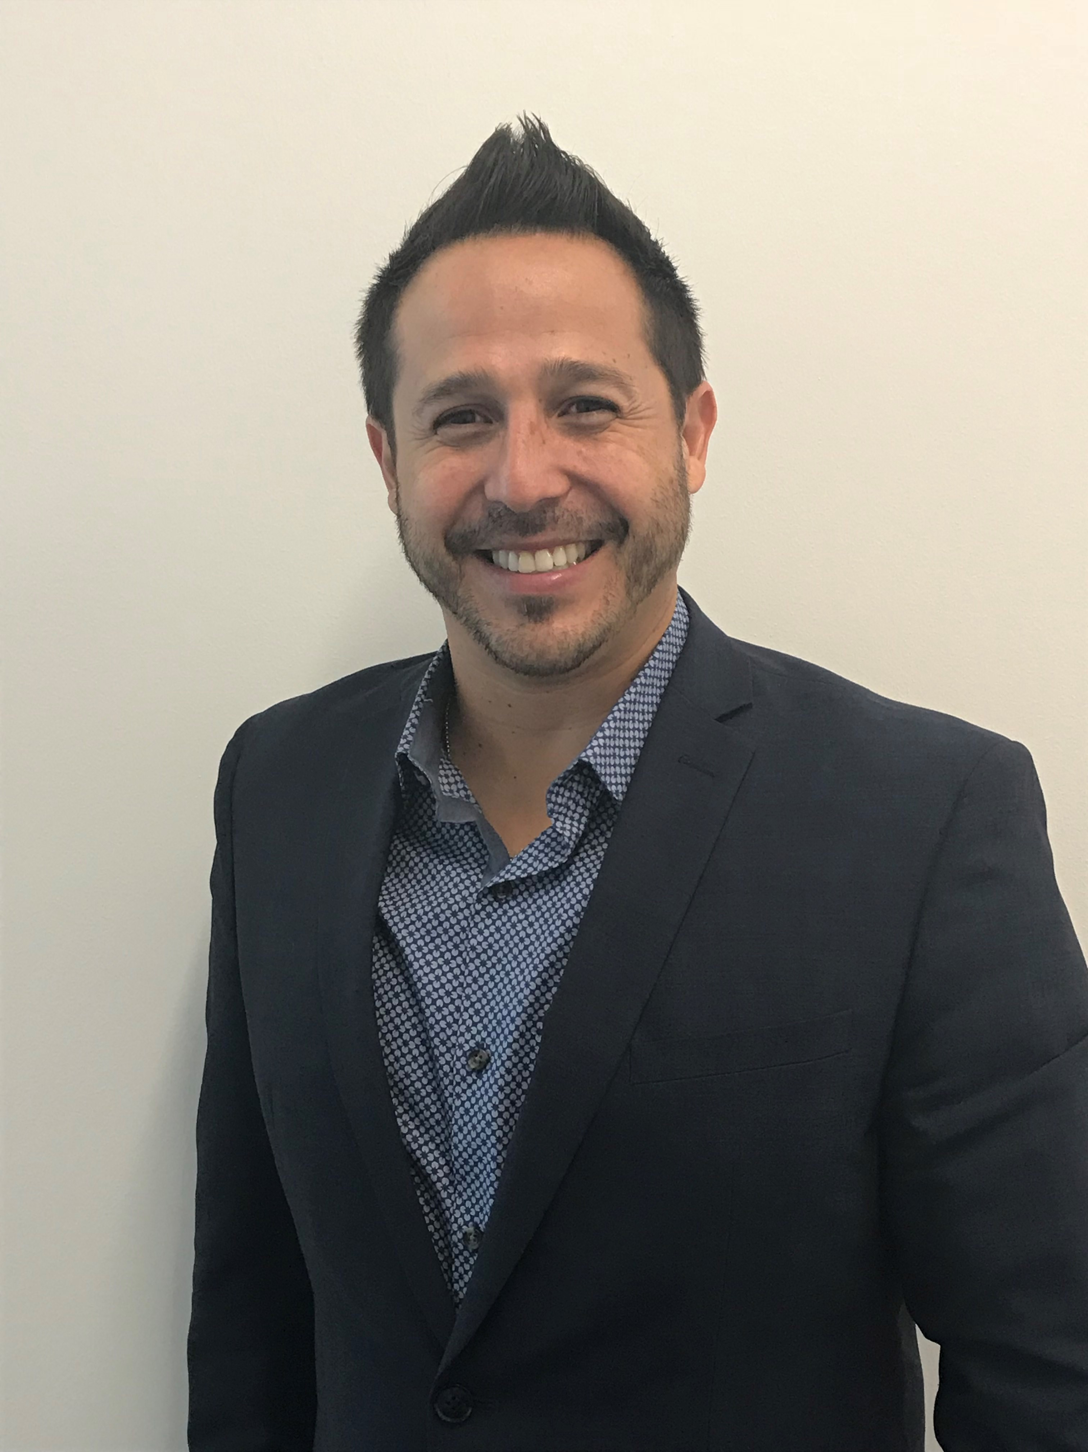
Dr. J. Paul Padilla DNP, RN, RRT,
Interim SVP of Clinical Services and Compliance Office
Dr. J. Paul Padilla is a forward thinking innovator who received his Graduate and Undergraduate degrees from Arizona State University. Dr. Padilla strives to lead and oversee integrated healthcare operations in a way that will impact and sustain exceptional outcomes. Paul began his healthcare career over twenty years ago, possessing vast experience in the Long-term, Acute, and Home Healthcare industry. Paul successfully provided leadership through clinical oversight and the mentoring of leadership staff to deliver exceptional quality patient care with positive patient outcomes.
As a doctor of Advanced Nursing Practice (DNP), Dr. Padilla acquired the knowledge of disease processes and management, understanding of patient care outcomes, and the overall affect of healthcare to significantly impact quality service. As the quality service team lead for a multi state clinical organization, Paul institutionalized a national and state metric system to bridge quality patient care pathways to provide economic sustainability.
It is with great honor, gratitude, and enthusiasm that Dr. Padilla joins the OnPointe team, an organization that centers on the ever-changing needs of the patient.

Slide 6
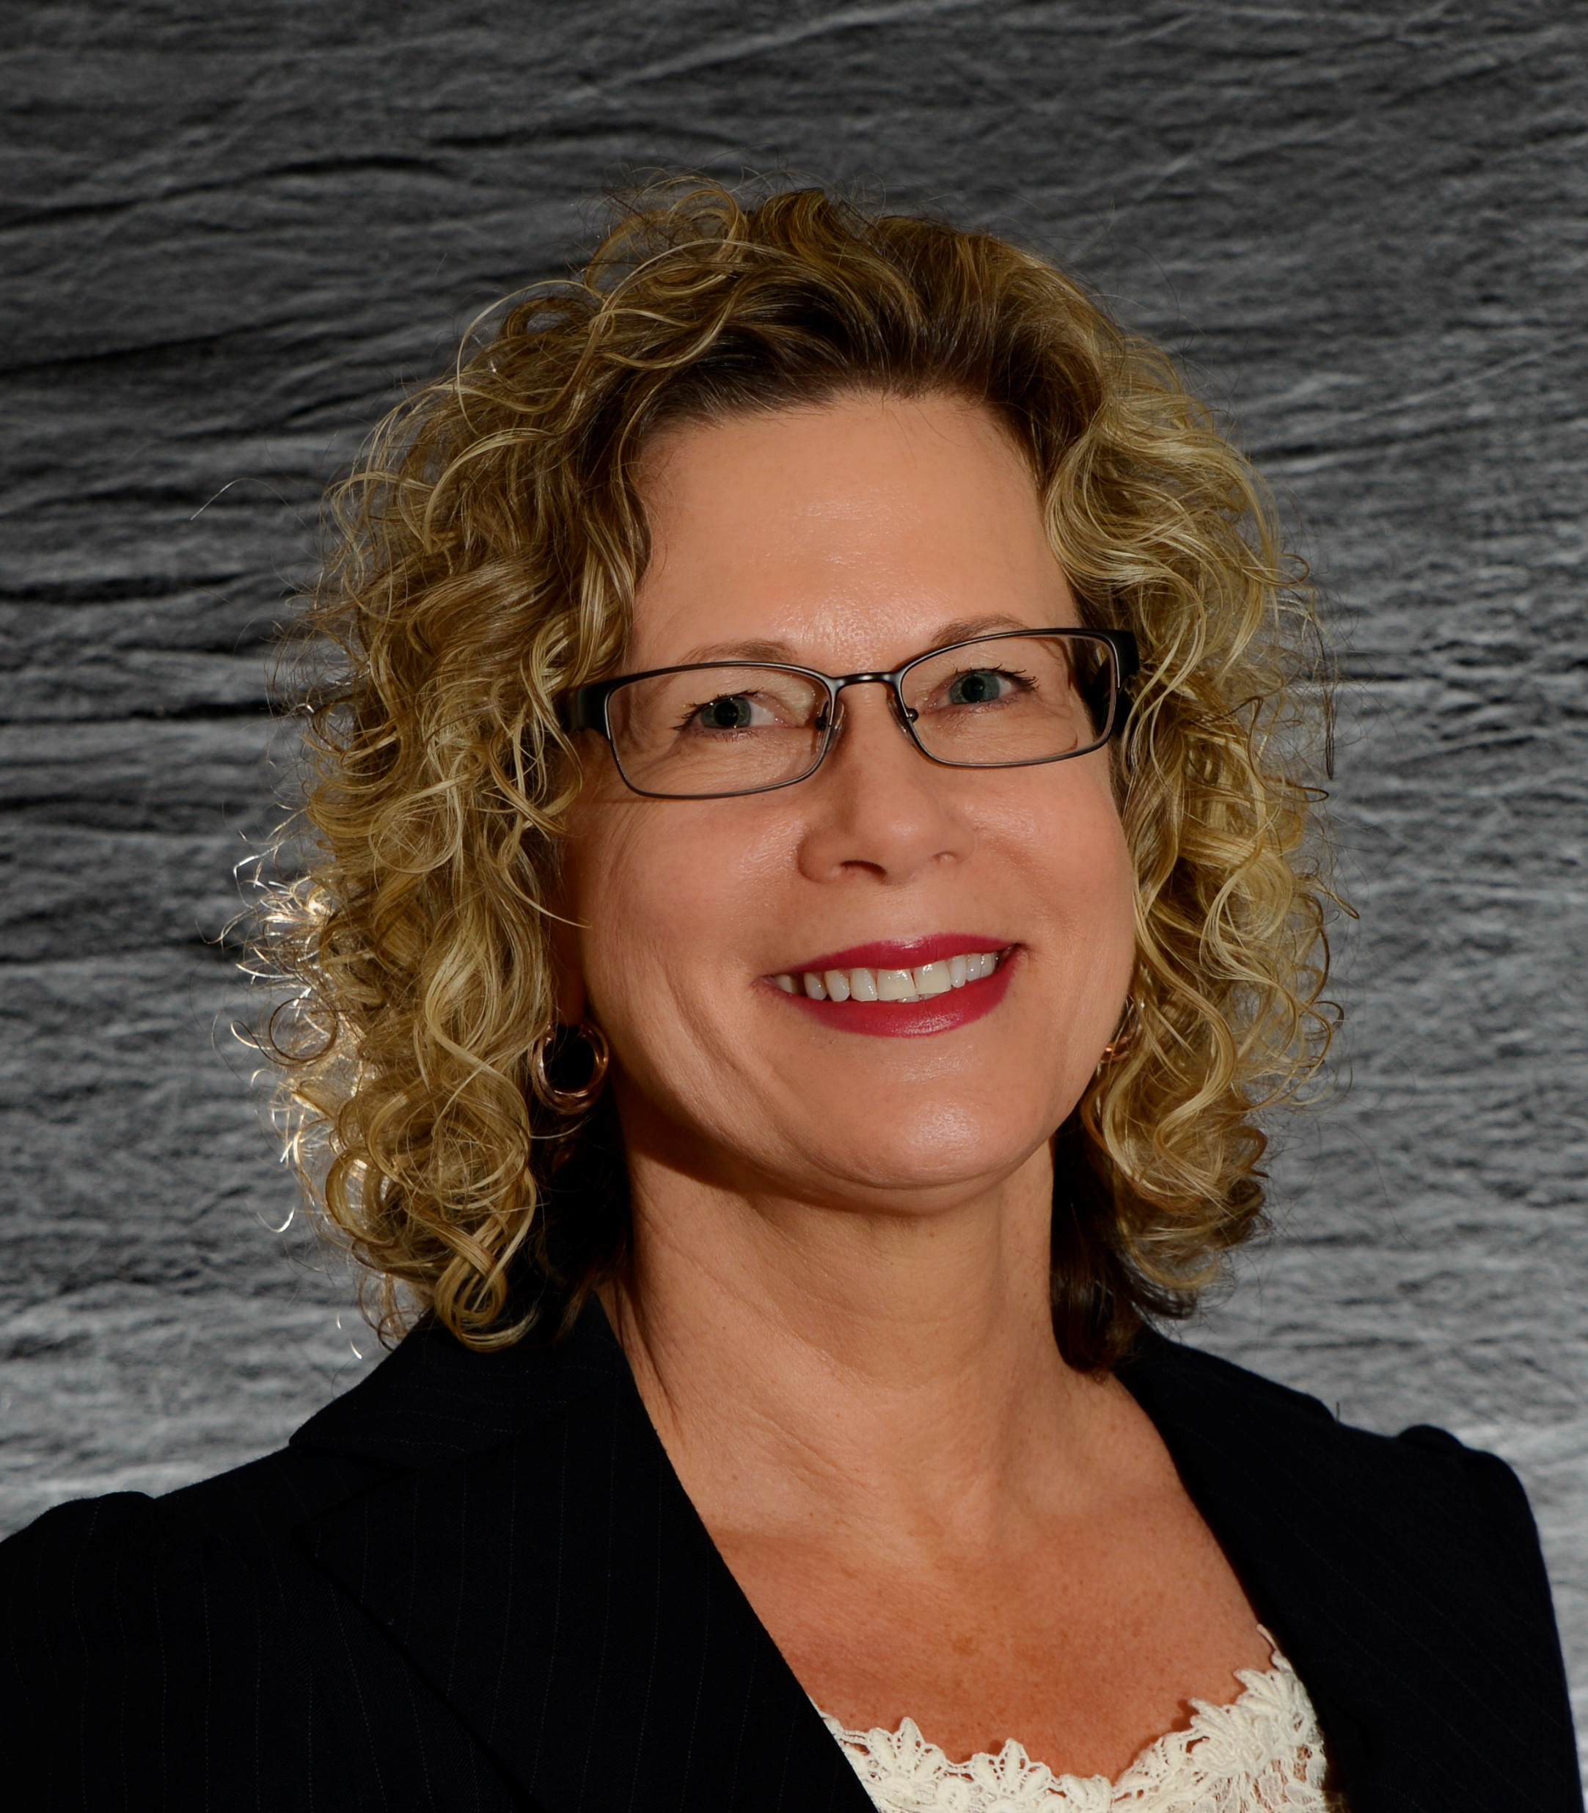
Deanne Smith, SVP Network Development
With over 20 years of healthcare experience and a background in nursing, care management, business development, and network strategy, Deanne joined the OnPointe team in 2015.
She has a comprehensive understanding of the changing landscape of healthcare and a strong desire to be a part of an innovative organization impacting the quality of care delivery. Starting her career as an ADON in a skilled nursing facility, her passion and strength was in serving others, team building, and program development. Optimizing her strengths in strategic development and implementation combined with her love for working with people, she expanded into regional business and network development roles.
Deanne has an Associate’s degree in nursing with a Bachelor’s degree in Healthcare Management. She has been married for 20+ years with two children and three grandchildren and enjoys the outdoors, any activity involving water, traveling, golf and reading.

Slide 7
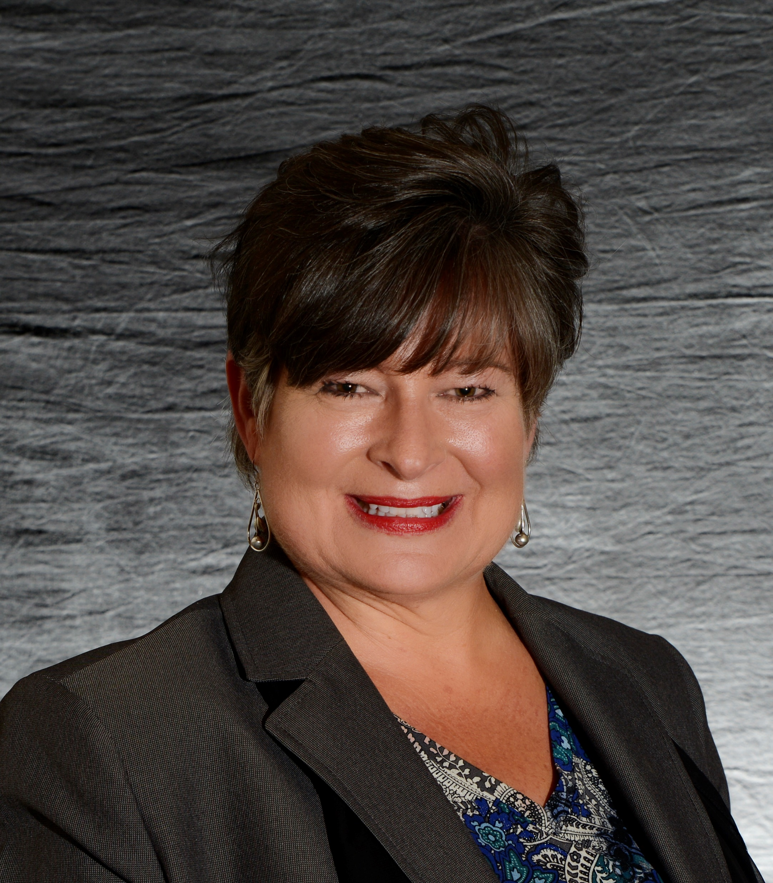
Leona Fink, VP Data & Analytics
Leona Fink came to OnPointe in July 2013 with 15 years’ experience in operations management and information technology, having worked as district manager, operations manager, and senior manager of information systems for several major organizations.
Leona’s strengths lie in transmission of vision into practice - with a passion for resolving business challenges through innovation. Leona met her husband of 30 years while attending Sam Houston State University; together they have three lovely children.

Slide 8

Jessica Hefner, VP of Operations, Bayou Triangle
With a progressive career in skilled nursing facilities, Jessica joined OnPointe in 2015 as a facility administrator. Her skills in delivering quantifiable financial and clinical results moved her quickly to the position of regional vice president in 2017.
Jessica’s strengths lie in team-building, implementing effective customer service systems, developing marketing action plans that significantly grow Medicare and managed care census, and ultimately, dramatically improving customer satisfaction.
She is an “outside of the box” thinker that pushes to be competitive and a leader in her market. Jessica graduated with a Bachelor of Business Administration from Averett University in Virginia and is a licensed nursing home administrator.

Slide 9
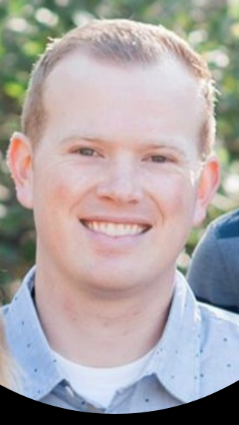
Ryan McCook, VP of Operations, Heart of Texas
Ryan McCook joined OnPointe in 2017 with more than 10 years of experience working in skilled nursing facilities. He progressed from administrator to operations team leader, and now leads OnPointe’s Dallas/Fort Worth/central Texas area as regional vice-president.
Ryan has an exemplary record of improving health inspection results, increasing Medicare census, and delivering strong profit margins. He is a skilled communicator and leads large teams with ease. Ryan graduated from Utah Valley University with a Bachelor of Science in Business Management. He is an active volunteer in his church and community.

Slide 10
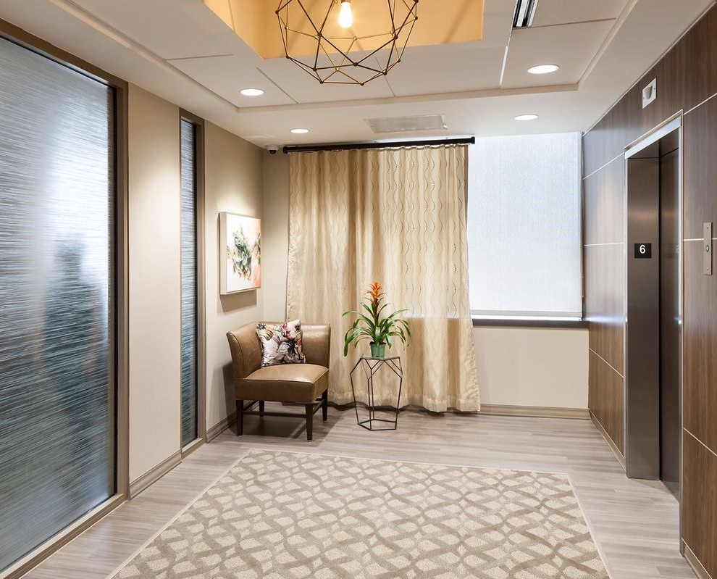
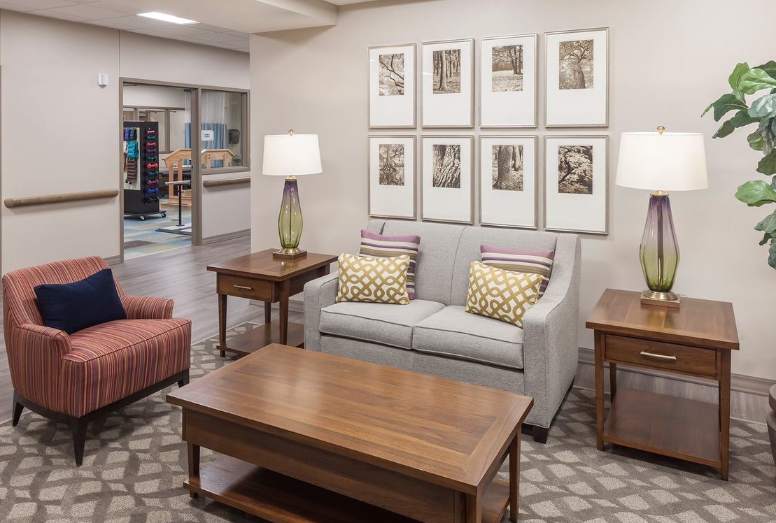

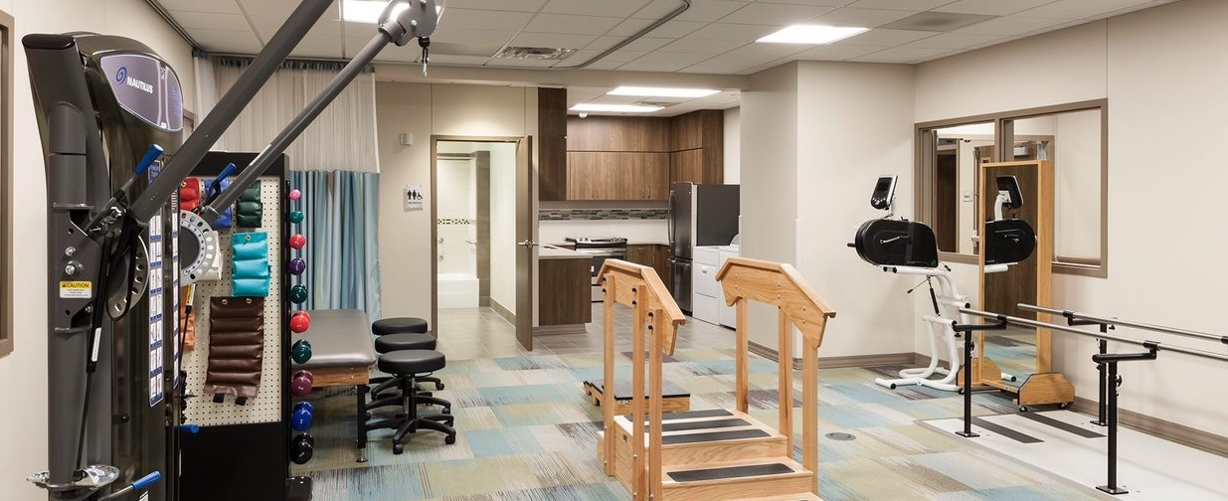
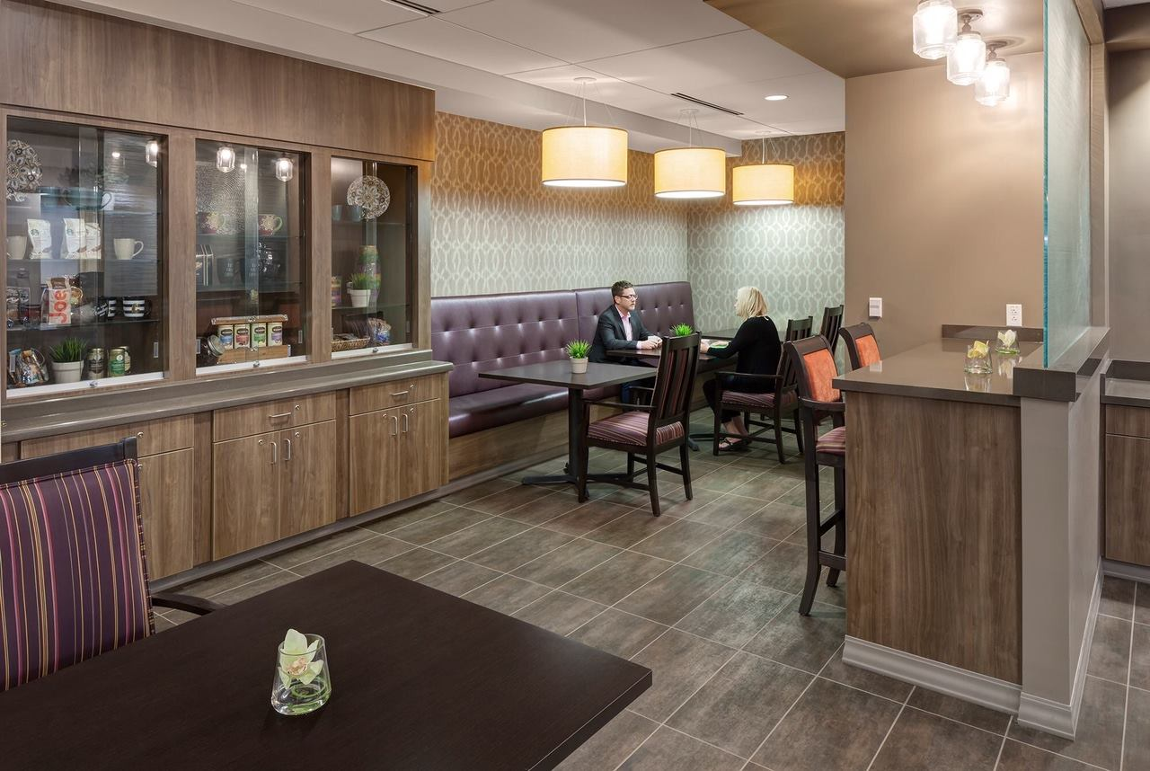


Transitional Care at Texas Health Arlington Memorial Hospital
Location/Capacity
800 W. Randol Mill Road, South Tower, 6th Floor
Arlington, TX 76012
Built in 2016
Licensed Beds: 54 - 49 Dual - 5 Medicare Only
Amenities
Starbucks Bistro
Private Suites / Private Baths
Hospitality Decor
Clinical Capabilities
Wound Program with WCC nurse & dedicated wound physician
Infusion therapy
Trach & Respiratory Care
Rehab Therapy Services & Modalities
Hospitalists, Specialists, & MD rounding
24/7 Admission access with 50% of admissions after hours & on weekends
Quality Metrics
30 Day RTA rate: 2%
Average LOS: 19 Days
CMS Star Rating: 5 Star

Slide 11

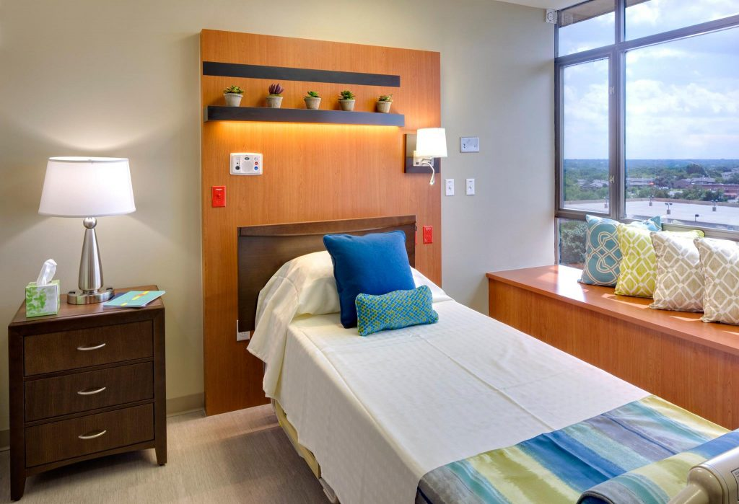

Transitional Care at Texas Health Presbyterian Hospital Dallas
Location/Capacity
8200 Walnut Hill Lane, Presbyterian Hospital Dallas, Main 5,
Dallas, Texas
49 Licensed Beds
Opened February 2017
Amenities
Starbucks Bistro
Private Suites/Private Baths
Hospitality Decor
Clinical Capabilities
Wound Program with WCC nurse & dedicated wound physician
Infusion therapy
Trach & Respiratory Care
Rehab Services & Modalities
Hospitalists, Specialists, & MD rounding
24/7 Admission access with 50% of admissions after hours & on weekends
Quality Metrics
30 Day RTA rate: 10%
Average LOS: 14 Days
CMS Star Rating: Pending annual survey – projections on track for 5 Star Rating

Slide 12
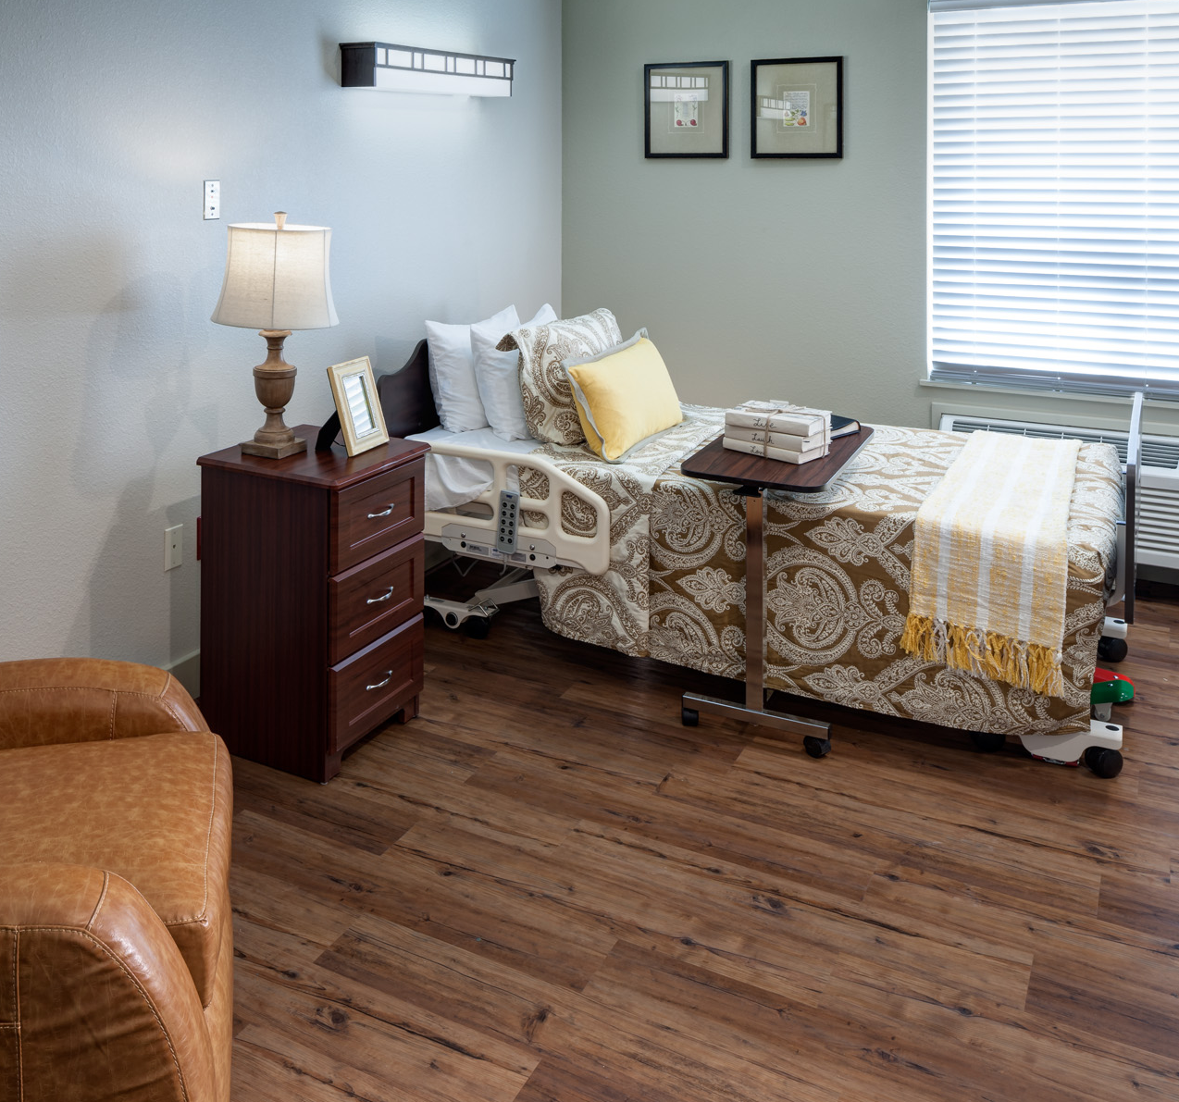

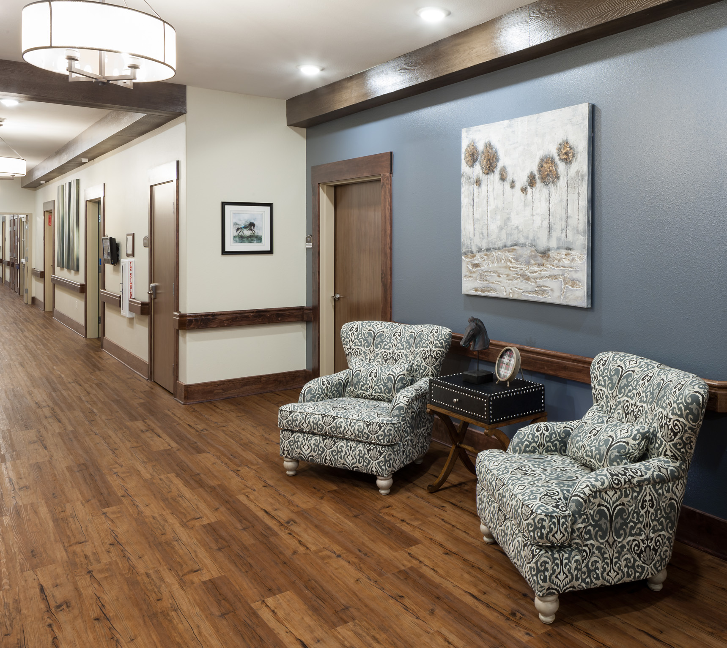
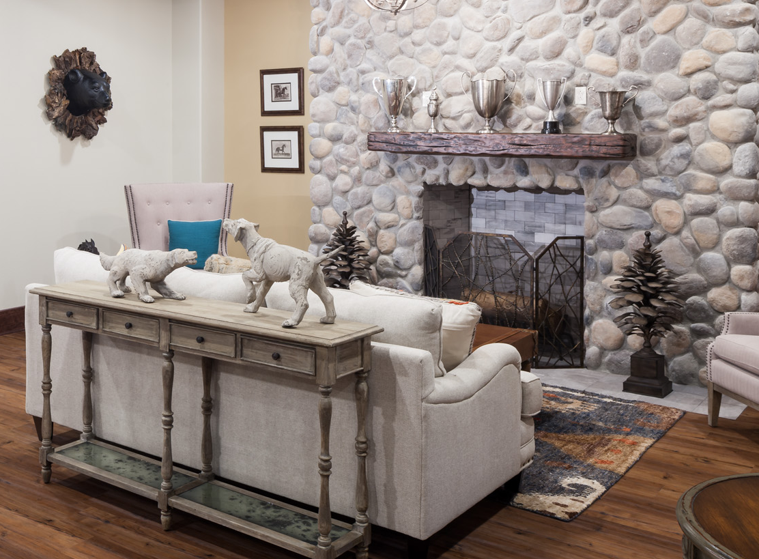
Location/Capacity
3729 Ira E Woods Ave Grapevine TX 76051
Licensed Beds: 100 - 88 Dual 12 Medicare Only
Built in 2016
Amenities
Private Suites / Private Baths
Separate Gym for Short-Term Rehab Guests
Clinical Capabilities
Wound Program with WCC nurse & dedicated wound physician
Infusion therapy
Trach & Respiratory Care
Rehab Services & Modalities
Hospitalists & MDs daily rounding
24/7 Admission access
Quality Metrics
30 Day RTA rate: 13%
Average LOS: 14 Days
CMS Star Rating: 5 Star

Slide 13

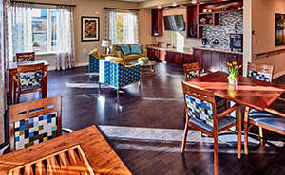
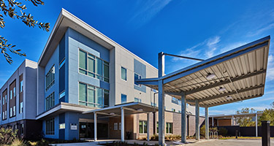


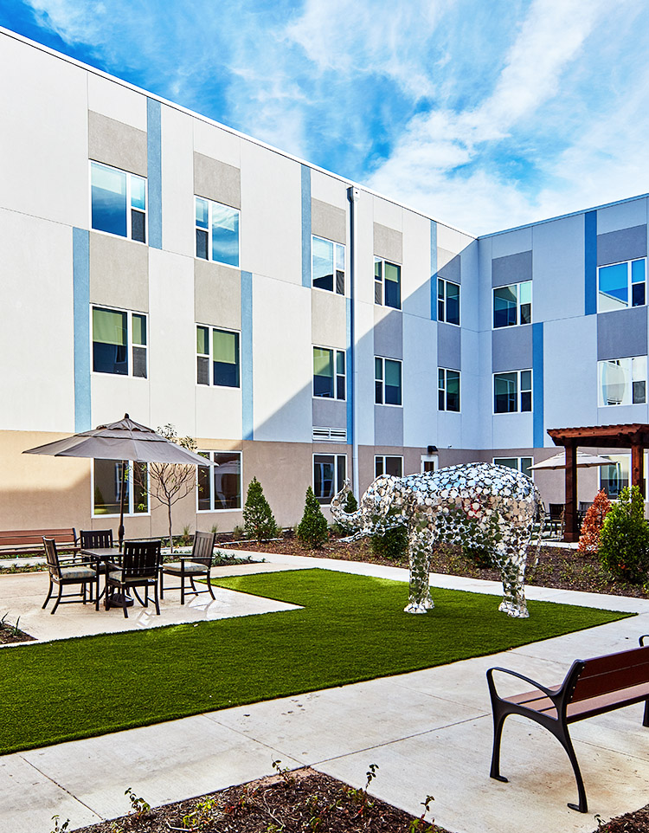
Location/Capacity
8130 Meadow Rd. Dallas, Texas
29 Assisted Living Beds
80 Skilled Beds
Amenities
Starbucks Bistro
Private Suites / Private Baths
Salon Services
Clinical Capabilities
Wound program
Infusion therapy
Trach & Respiratory Care
24/7 Admission access
Bariatrics
Outpatient therapy services
THR & Medical City physician leadership
Quality Metrics
30 Day RTA rate:
Average LOS:
CMS Star Rating:

Slide 14

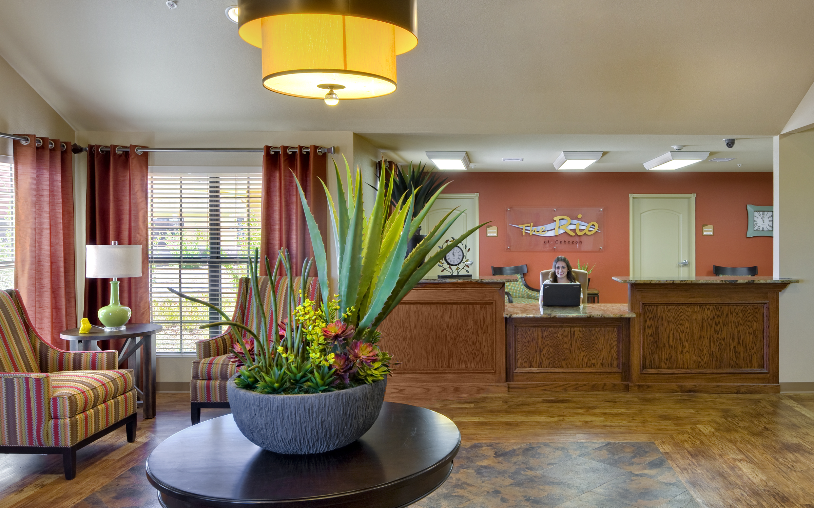
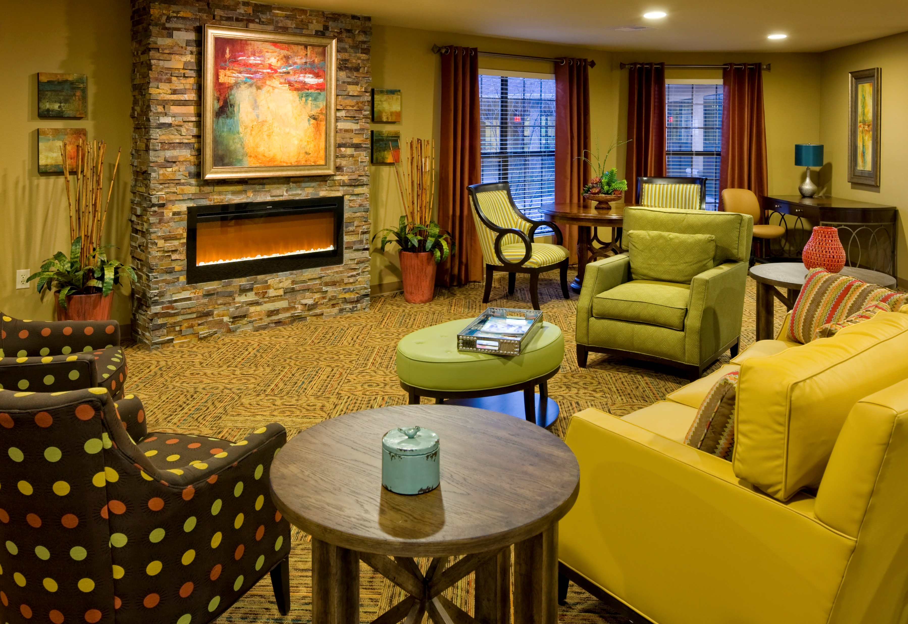
Location/Capacity
2410 19th St. SE
Rio Rancho, New Mexico 87124
136 Dually Certified Beds
Built in 2015
Amenities
Private Suites / Private Baths
Clinical Capabilities
Physical Therapy
Cardiac Recovery & Rehabilitation
Neurological Recovery & Rehabilitation
Orthopedic Rehabilitation & Recovery
Injury & Illness Rehabilitation
Post Hospitalization Care
Pulmonary Rehabilitation
Wound Care
Quality Metrics
30 Day RTA rate:
Average LOS:
CMS Star Rating: 3 Stars

Slide 15
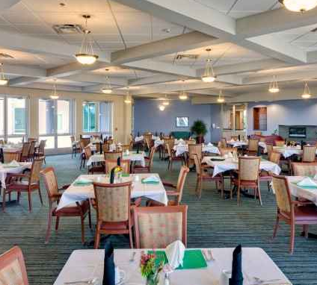
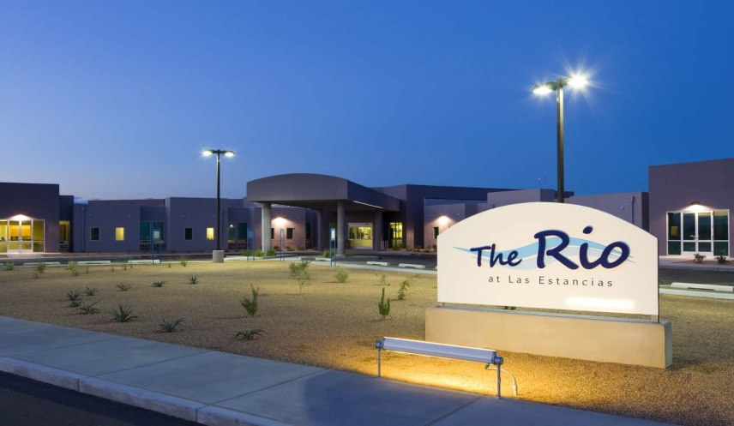

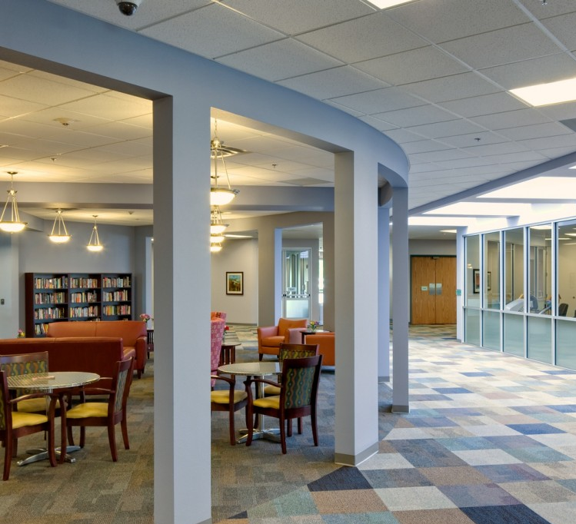
Location/Capacity
3620 Las Estancias Drive SW
Albuquerque, New Mexico 87105
Licensed Beds: 80 Dual Certified & 40 SNF Only
Built in 2014
Amenities
Salon/Spa
Starbucks café
Exterior patio
Clinical Capabilities
Physical Therapy
Cardiac Recovery & Rehabilitation
Neurological Recovery & Rehabilitation
Orthopedic Rehabilitation & Recovery
Injury & Illness Rehabilitation
Post Hospitalization Care
Pulmonary Rehabilitation
Wound Care
Quality Metrics
30 Day RTA rate:
Average LOS: 31 Days
CMS Star Rating: 1 Star

Slide 16

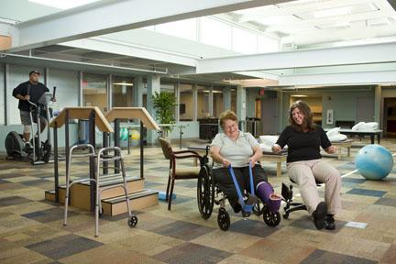
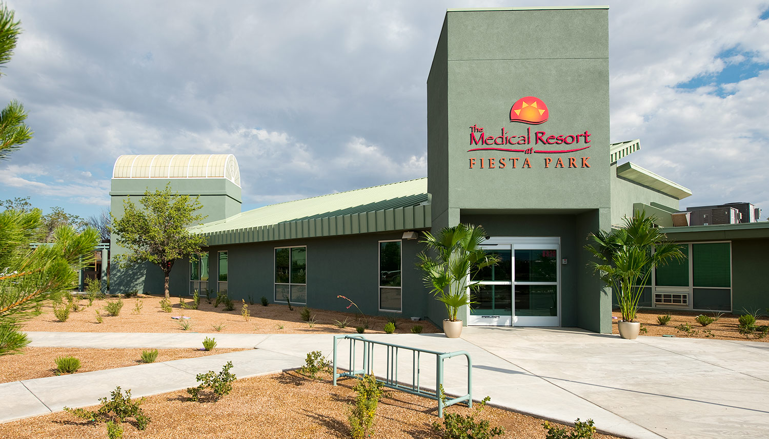
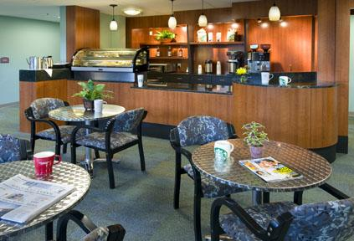
Location/Capacity
8820 Horizon Blvd NE
Albuquerque, NM 87113
Licensed Beds: 43 Dual Certified & 42 SNF Only
Built in 2012
Amenities
Starbucks Bistro
Private and semi-private luxury suites
Solaris Beauty Salon & Spa
Theater with fresh popcorn
Clinical Capabilities
Physical Therapy
Cardiac Rehabilitation
Neurological Recovery & Rehabilitation
Stroke Rehabilitation
Wound Care
Post Hospitalization Care
Orthopedic Rehabilitation
Quality Metrics
30 Day RTA rate:
Average LOS: 31 Days
CMS Star Rating: 4 Stars

Slide 17
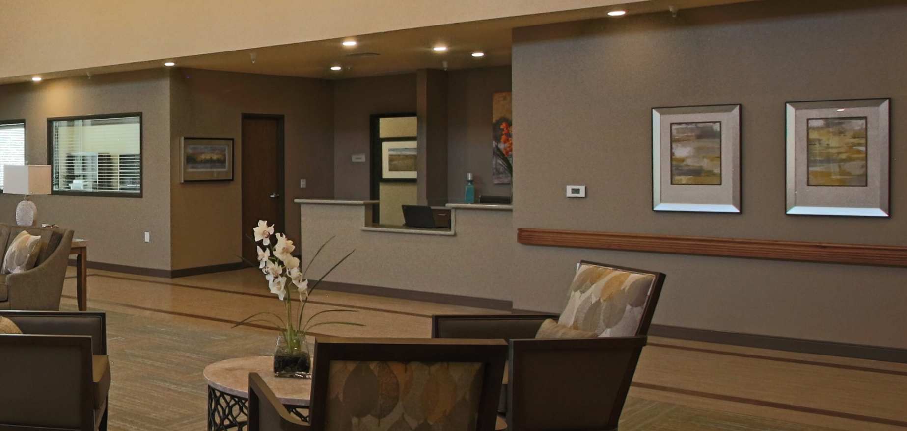
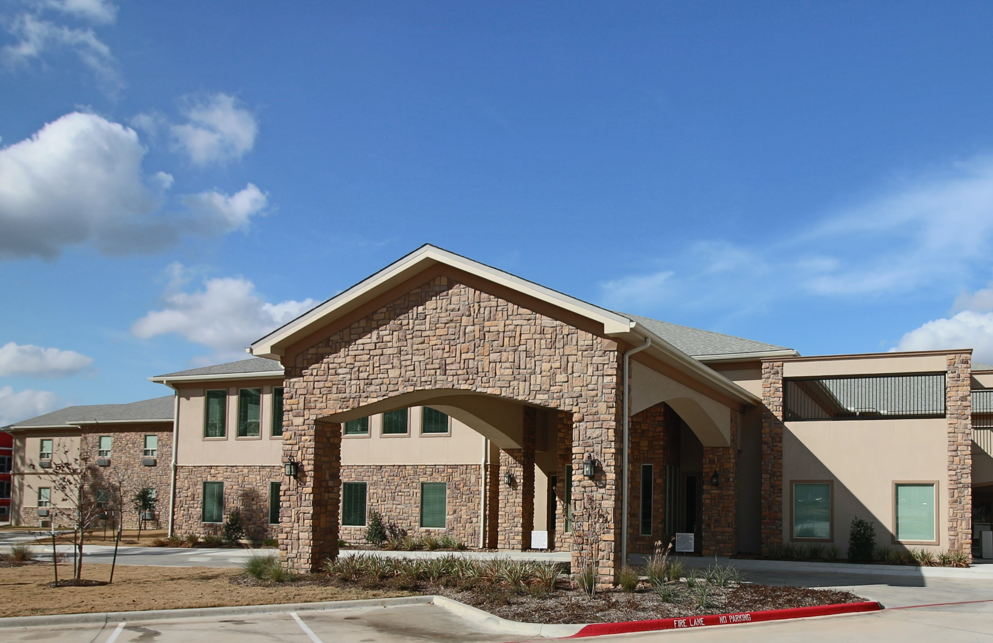

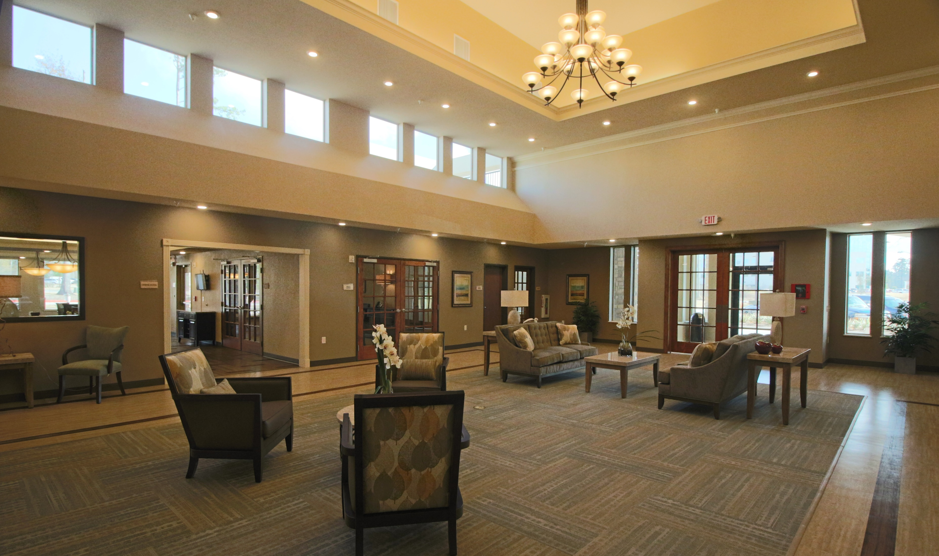
Location/Capacity
604 South Conroe Medical Drive
Conroe, TX 77304
Licensed Beds: 86 Medicare 64 Medicaid
Built in 2016
Amenities
Add info
Clinical Capabilities
Physical Therapy
Cardiac Recovery & Rehabilitation
Neurological Recovery & Rehabilitation
Orthopedic Rehabilitation & Recovery
Injury & Illness Rehabilitation
Post Hospitalization Care
Pulmonary Rehabilitation
Wound Care
Quality Metrics
30 Day RTA rate:
Average LOS: 26 Days
CMS Star Rating: Pending

Slide 18
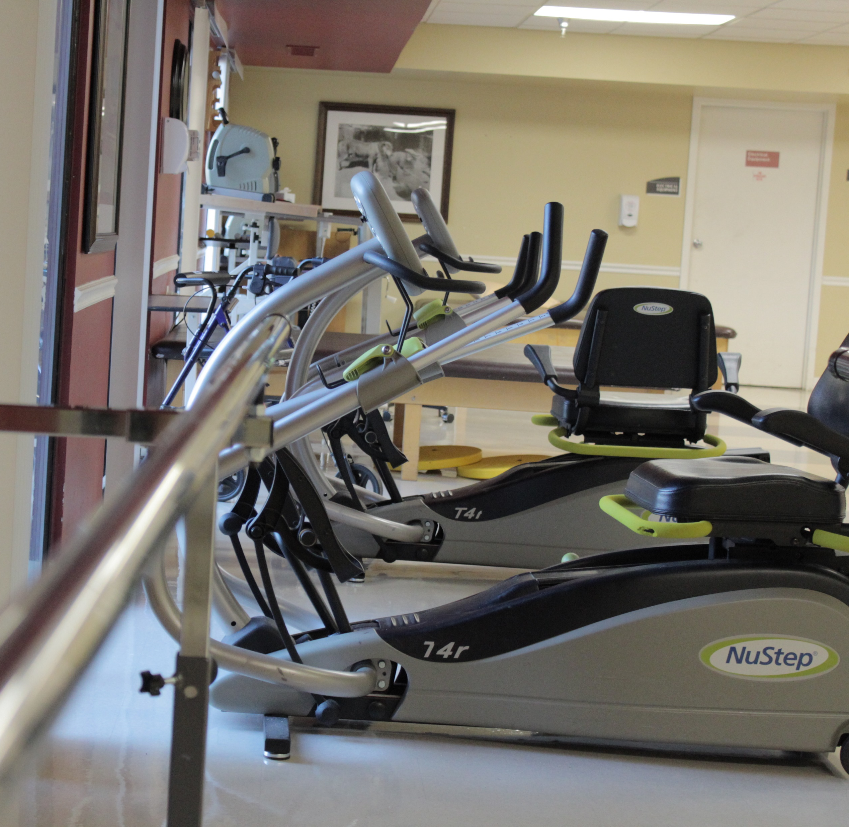
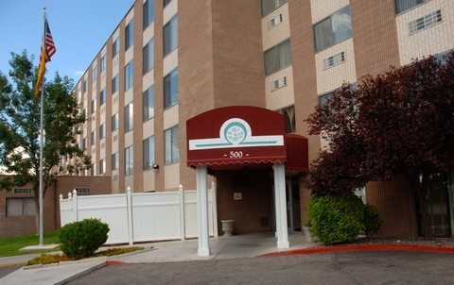

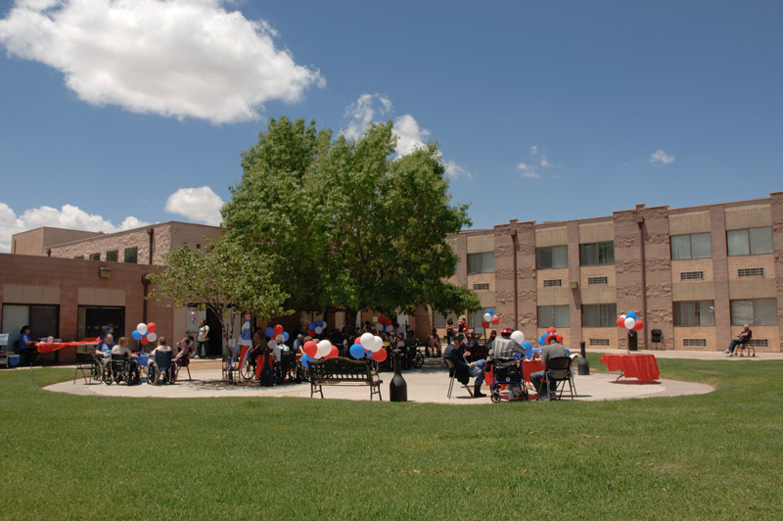
Location/Capacity
500 Louisiana Blvd. NE
Albuquerque, NM 8108
369 Beds
Built in 1984
Amenities
Daily social activities
Therapy gym
Exterior patio
Clinical Capabilities
Physical Therapy
Cardiac Recovery & Rehabilitation
Neurological Recovery & Rehabilitation
Orthopedic Rehabilitation & Recovery
Injury & Illness Rehabilitation
Post Hospitalization Care
Pulmonary Rehabilitation
Wound Care
Quality Metrics
30 Day RTA rate:
Average LOS: 31 Days
CMS Star Rating: 1 Star

Slide 19
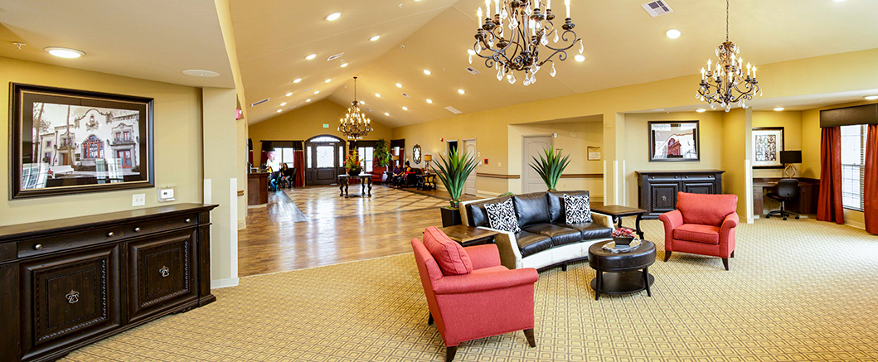




Location/Capacity
310 America Drive, Brownsville, TX 78526
Licensed Beds: 90 Medicare 36 Medicaid
Built in 2016
Amenities
Daily social activities
Therapy gym
Private Suites / Private Baths
Clinical Capabilities
Physical Therapy
Cardiac Recovery & Rehabilitation
Neurological Recovery & Rehabilitation
Orthopedic Rehabilitation & Recovery
Injury & Illness Rehabilitation
Post Hospitalization Care
Pulmonary Rehabilitation
Wound Care
Quality Metrics
30 Day RTA rate:
Average LOS: 100 Days
CMS Star Rating: 2 Stars

Slide 20
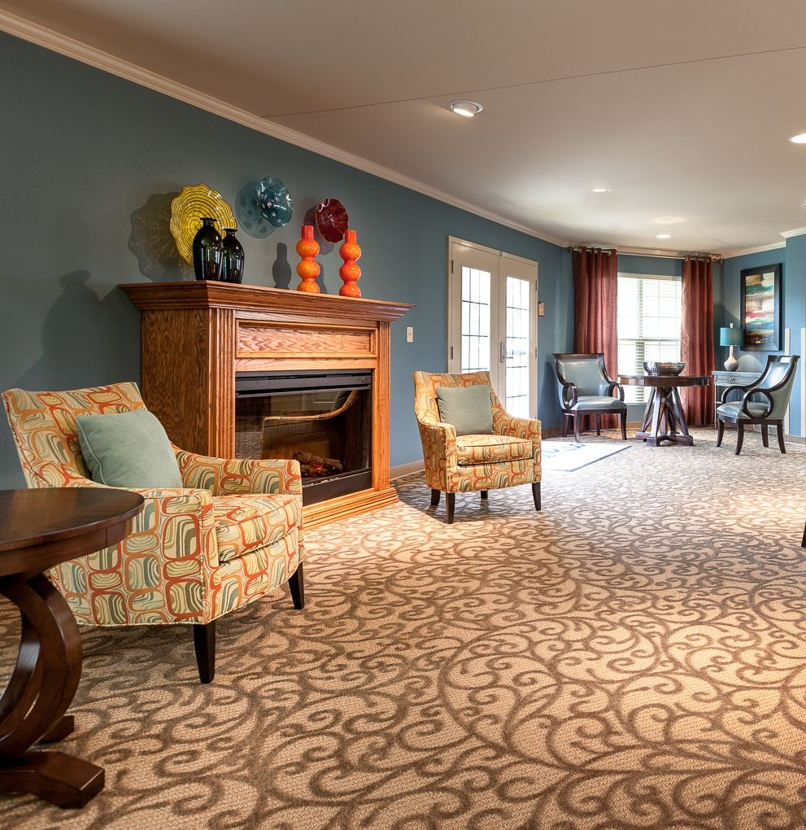
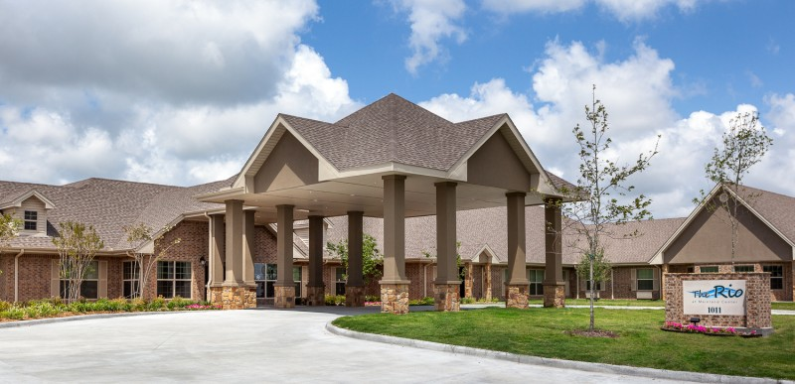

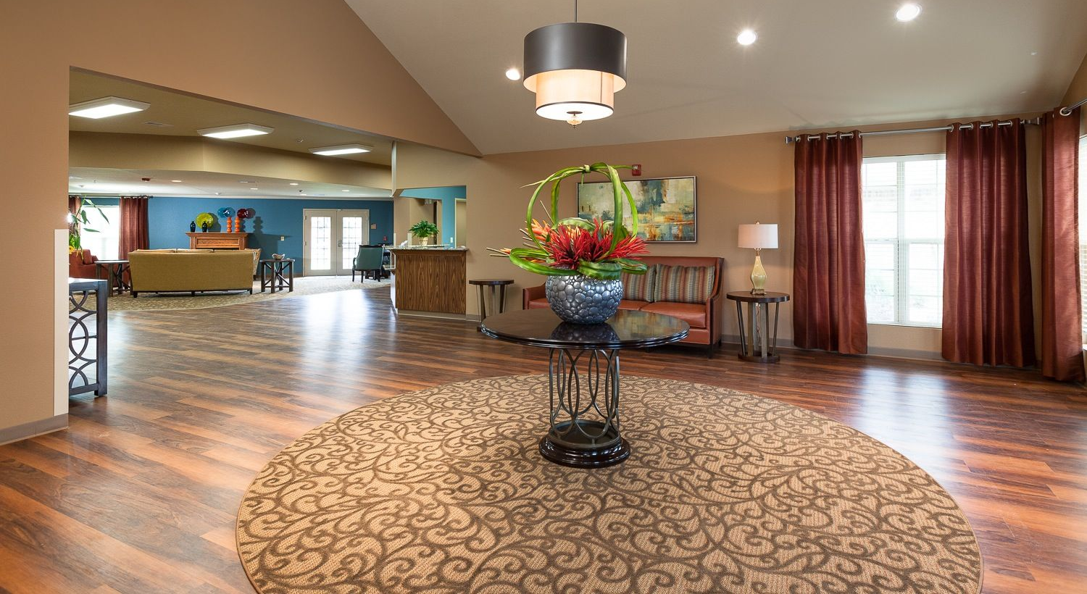
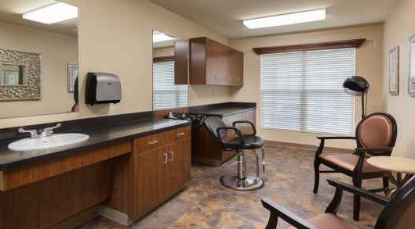
Location/Capacity
1011 Mainland Center Blvd.
Texas City, Texas 77591
Licensed Beds: 94 Dual Certified & 40 SNF Only
Built in 2012
Amenities
Salon Services
Private Suites / Private Baths
Clinical Capabilities
Physical Therapy
Cardiac Recovery & Rehabilitation
Neurological Recovery & Rehabilitation
Orthopedic Rehabilitation & Recovery
Injury & Illness Rehabilitation
Post Hospitalization Care
Pulmonary Rehabilitation
Wound Care
Quality Metrics
30 Day RTA rate:
Average LOS: 92 Days
CMS Star Rating: 1 Star

