Slide 1


What’s New
Our Menu
Order Now
Contact Us
Burger, Beer & Fries
THIRD PARTY
WILL LINK HERE

Slide 2
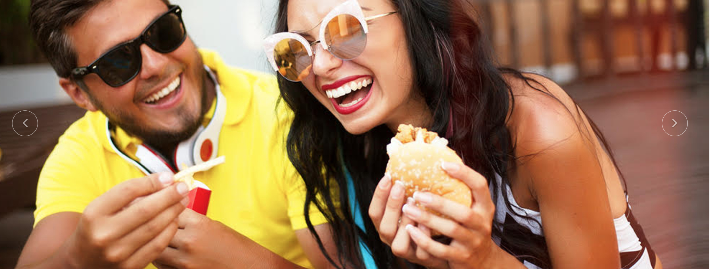
What’s New
Our Menu
Order Now
Contact Us
Burgers, Shakes & Fries
Burger, Beer & Fries

Slide 3
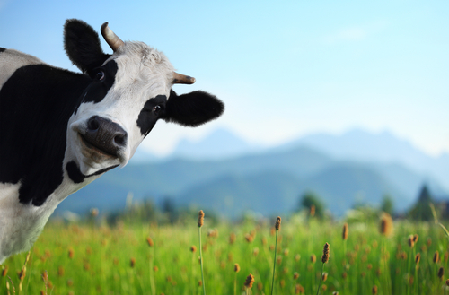
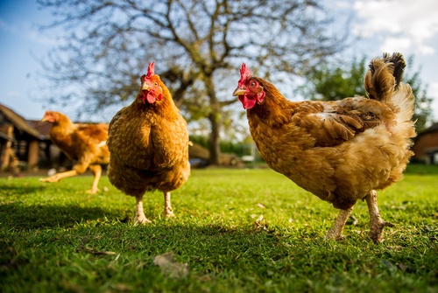
OUR BEEF
We use 100% grass-fed, free range Australian beef. Free from preservatives, antibiotics & all added hormones.
OUR CHICKEN
We use only Australia’s best free range chickens. Free from preservatives, antibiotics & all added hormones.

Slide 4
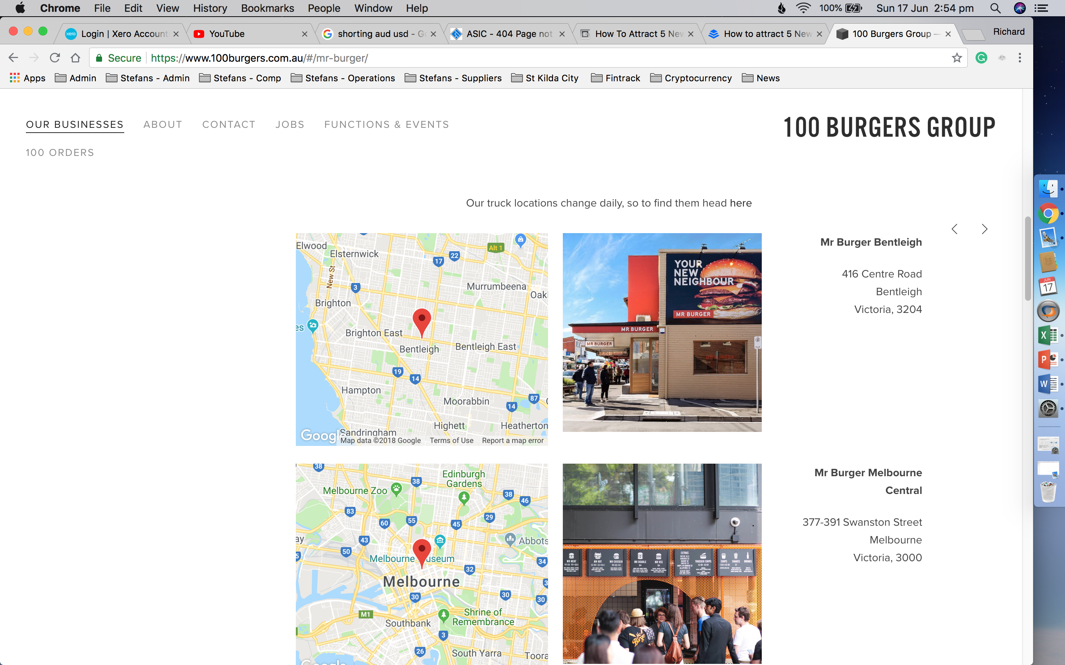
Contact Us:
Address: 107 Acland Street St Kilda Vic 3182
Email: help@Fintrack.com.au
Mobile: 0402 838 688
Copyright 2018 Stefans Shack St Kilda Pty Ltd. All rights reserved
Terms & Conditions
Privacy Policy
As per attachments

