Slide 1



Will be PDF
Slides 1 - 4 are 4 continuous slides
News Menu
Order Now Contact Us

Slide 2
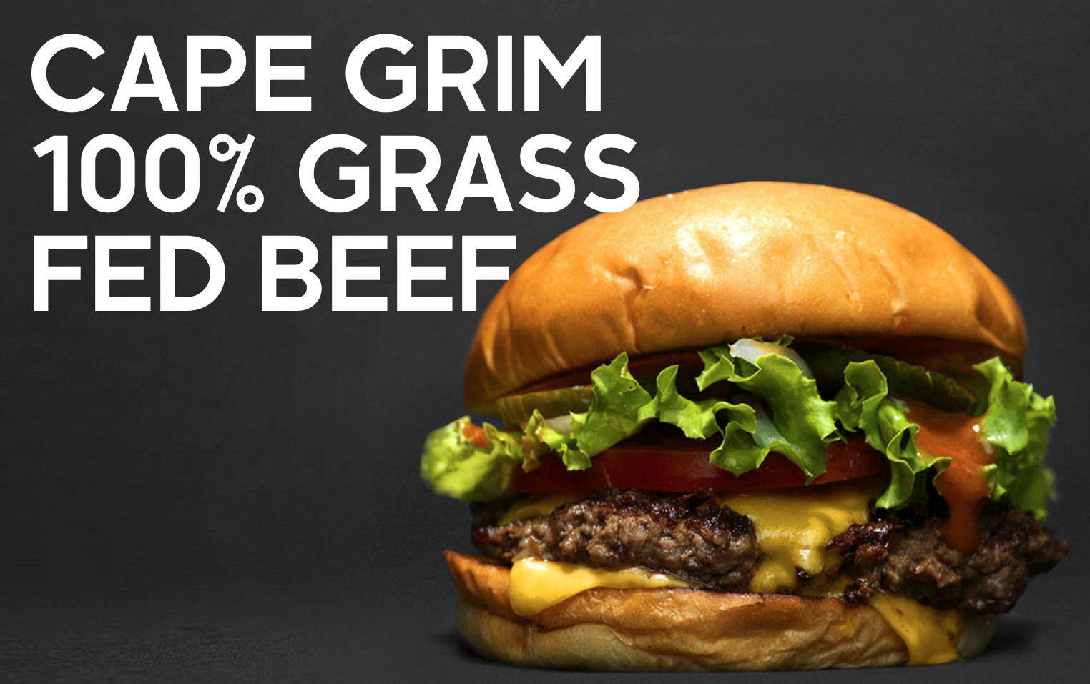
News Menu
Order Now Contact Us

Slide 3

News Menu
Order Now Contact Us

Slide 4

News Menu
Order Now Contact Us

Slide 5
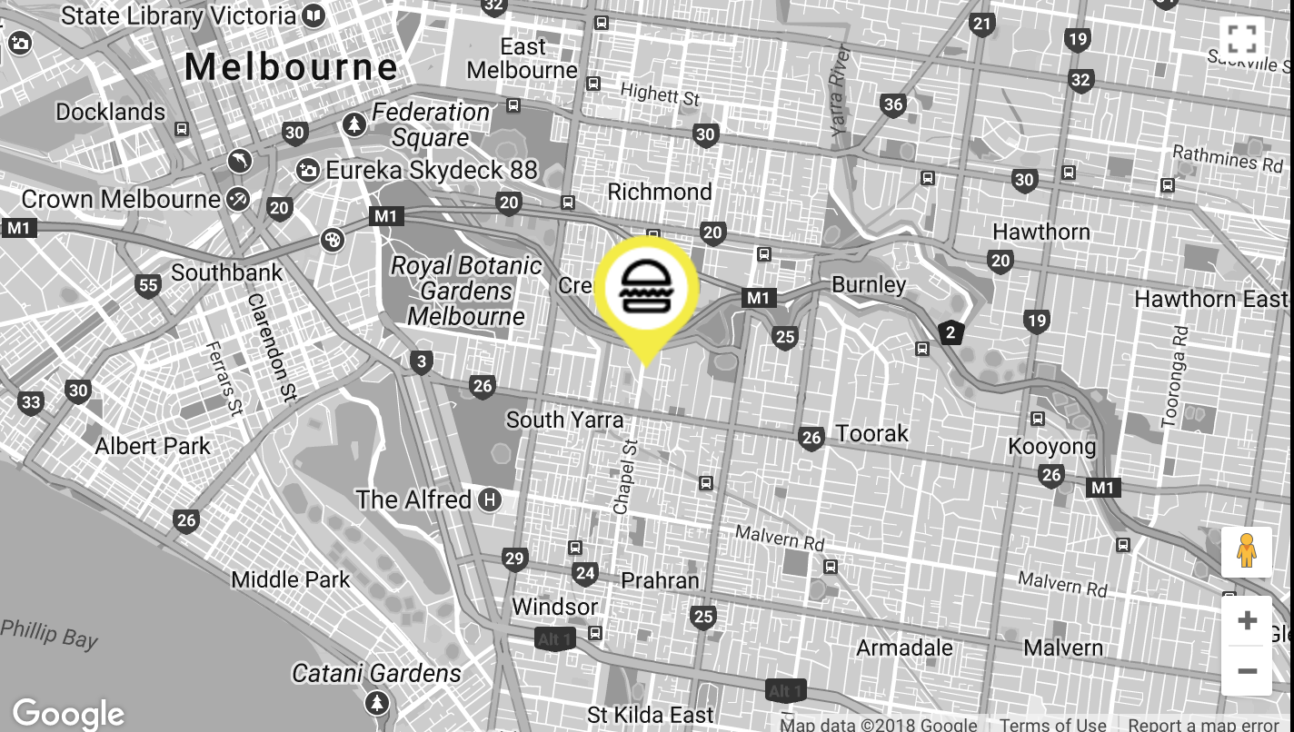
WHERE TO FIND US
107 Ackland Street St Kilda Vic 3182
OPENING HOURS
Monday to Sunday 7am to late
EMAIL
info@stefansshack.com.au
© 2018 Stefans Shack St Kilda Pty Ltd ACN 623 471 143
Privacy Policy Terms & Conditions

