Slide 1
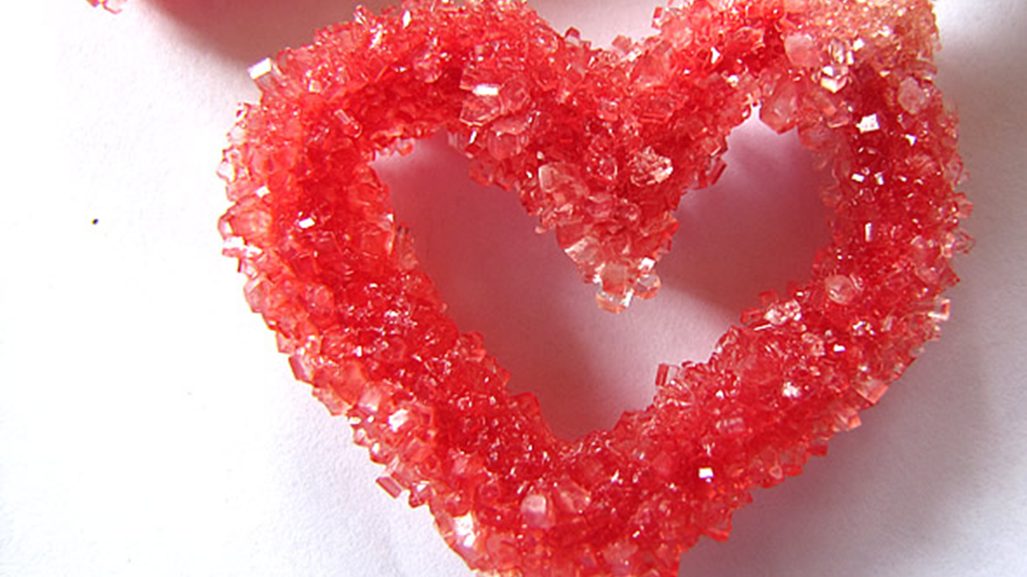
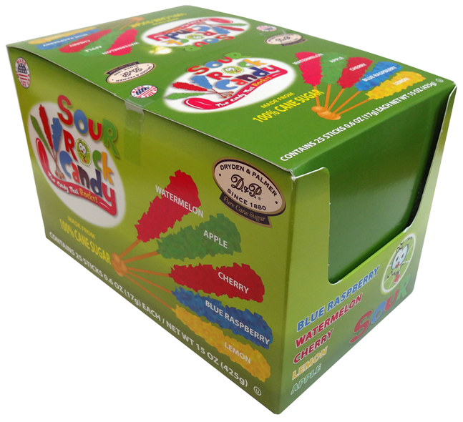
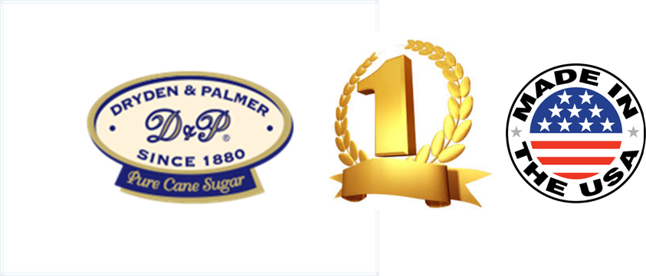
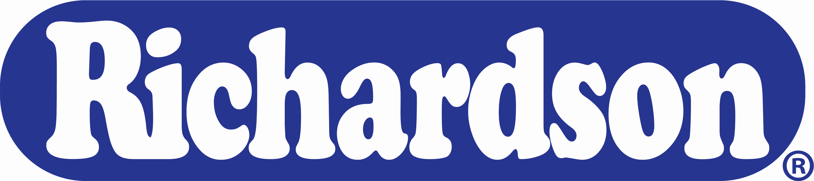
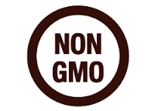
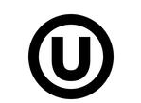
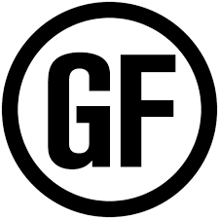
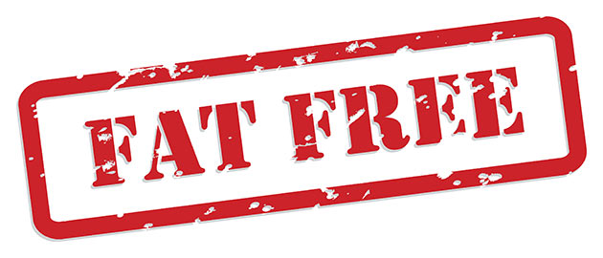
Sweet Love/ Share Love/The Gift of Love
Why Richardson’s Valentie’s Candies ?
From our fun Rock Candy Sticks and flavorful mints, to our crispy Bogdon® sticks dipped in rich chocolaty goodness, we have you covered for Valentine's Day!
Why Richardson?
A legacy of American Celebrations’ favorites
Proudly made in USA & NY
Dryden & Palmer are the #1 Rock Candy since 1880!
Our products can be found in all states across America, as well as in most countries worldwide.
Ingredients:
SourBlue Raspberry: Cane Sugar, Citric, Malic & Tartaric Acid, Hydrogenated Vegetable Oil,Artificial Flavor, Blue 1, Yellow 5
SourWatermelon: Cane Sugar,Citric, Malic & Tartaric Acid, Hydrogenated Vegetable Oil,Artificial Flavor, Titanium Dioxide, Yellow 5, Blue 1 SourLemon: Cane Sugar, Citric, Malic & Tartaric Acid, Hydrogenated Vegetable Oil,Yellow 5, Natural Flavor, Xanthan Gum, Citric Acid, Sodium Benzoate SourRedApple: Cane Sugar, Citric, Malic & Tartaric Acid, Hydrogenated Vegetable Oil, Natural & Artificial Flavor, Titanium Dioxide, Yellow 5, Blue 1 SourCherry: Cane Sugar,Citric, Malic & Tartaric Acid,
Product Information:
Case Pack : 6/25ct.
GTIN : 50011167437207
UPC :
SourBlue Raspberry 0 11167437127
SourWatermelon 0 11167437165
SourLemon 0 1116743713 4
SourCherry 0 1116743702 8
SourRed Apple 0 1116743705 9
Dimensions : Case:16.81 x 15.41 x 6.38”Cube : Case:.96Gross
Weight: Case:8.67Pallet
Will be updated
Richardson Brands Co.
101 Erie Boulevard Canajoharie, NY 13317
(800) 839-8938

Slide 2
Easter and Spring Giant Celebration
Why Richardson’s Christmas Candies ?
From our fun Rock Candy Sticks and flavorful mints, to our crispy Bogdon® sticks dipped in rich chocolaty goodness, we have you covered for Easter and spring Celebrations!
Why Richardson?
A legacy of American Celebrations’ favorites
Proudly made in USA & NY
Dryden & Palmer are the #1 Rock Candy since 1880!
Our products can be found in all states across America, as well as in most countries worldwide.
Ingredients:
SourBlue Raspberry: Cane Sugar, Citric, Malic & Tartaric Acid, Hydrogenated Vegetable Oil,Artificial Flavor, Blue 1, Yellow 5
SourWatermelon: Cane Sugar,Citric, Malic & Tartaric Acid, Hydrogenated Vegetable Oil,Artificial Flavor, Titanium Dioxide, Yellow 5, Blue 1 SourLemon: Cane Sugar, Citric, Malic & Tartaric Acid, Hydrogenated Vegetable Oil,Yellow 5, Natural Flavor, Xanthan Gum, Citric Acid, Sodium Benzoate SourRedApple: Cane Sugar, Citric, Malic & Tartaric Acid, Hydrogenated Vegetable Oil, Natural & Artificial Flavor, Titanium Dioxide, Yellow 5, Blue 1 SourCherry: Cane Sugar,Citric, Malic & Tartaric Acid,
Will be updated
Product Information:
Case Pack : 6/25ct.
GTIN : 50011167437207
UPC :
SourBlue Raspberry 0 11167437127
SourWatermelon 0 11167437165
SourLemon 0 1116743713 4
SourCherry 0 1116743702 8
SourRed Apple 0 1116743705 9
Dimensions : Case:16.81 x 15.41 x 6.38”Cube : Case:.96Gross
Weight: Case:8.67Pallet
Richardson Brands Co.
101 Erie Boulevard Canajoharie, NY 13317
(800) 839-8938

