Slide 1
The assay assessed total growth of microorganisms after exposure to a 10⁶ inoculum for 24 hours.
A 3 cm segment of an ETT is placed in a well of a 6 well plate. 7 mL of inoculum is placed in each well. The samples are placed on a rotary shaker and incubated at 37±2°C for 24 hours. At the end of 24 hours the bacteria in the inoculum as well as the adherent biomass on the ETT are determined.

Slide 2
Pseudomonas
Log₁₀ cfu/device
Greater than 99.9999% Reduction in microorganism growth.

Slide 3
Staph
Log₁₀ cfu/device
Greater than 99.9999% Reduction in microorganism growth.

Slide 4
Klebsiella
Log₁₀ cfu/device
Greater than 99.9999% Reduction in microorganism growth.

Slide 5
Acinetobacter
Log₁₀ cfu/device
Greater than 99.9999% Reduction in microorganism growth.

Slide 6
Candida
Log₁₀ cfu/device
Greater than 99.9999% Reduction in microorganism growth.

Slide 7
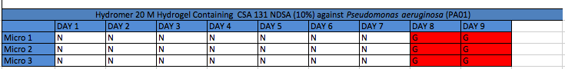
Duration of Activity
Antibacterial testing involved immersing 5mm tube segments in 10% TSB in PBS (1.0 mL) and inoculating with Pseudomonas aeruginosa (PA01) @ 10⁶ colony forming units (CFU). Samples were incubated for 24 hours, and bacterial growth in the medium was assayed visually (i.e., turbidity). After 24 hours of incubation, tube segments were immersed in fresh growth media (10% TSB in PBS, 1 mL), re-inoculated, and incubated. This procedure was repeated every 24 h until bacterial growth was observed in the growth medium for consecutive 24-hour periods.
The CeraShield ETT was able to suppress growth for 7 days.

