Slide 1
Company Overview
November 2017

Slide 2
What We Do
FinMkt lowers the cost of customer acquisition and unlocks new revenue sources for its partners by automating and consolidating the exchange of online loan inquiries and referrals.

Slide 3
FinMkt: Powering the Online Marketplace Ecosystem
Online Marketplace Transaction Volume
Data, Analytics & Reporting
Institutional Asset Management Tools
Underwriting
Data &
Analytics

Slide 4

The FinMkt Gateway Exchange Platform
1
Referring partners receive and forward to FinMkt unsuitable inquiries or merchants forward financing requests from customers.
2
Data from inquiries forwarded to matching lenders who make offers to borrowers.
3
Borrowers select lenders and finalize loans.
Gateway
Lenders
Matching
Lenders
Referring
Lender
$ $ $ $
Referring Merchant
4
Matching lenders pay fee to FinMkt which may be shared with referring lenders and merchants.
Gateway Exchange

Slide 5

7_24 10_24
The Need for Gateway is Becoming Increasingly Clear
“The recent groundbreaking announcement of the first multichannel, automated loan referral and allocation program by FinMkt would provide more options for borrowers and increase loan volumes for marketplace lending.”

Slide 6

All of the Hallmarks of a Unicorn Opportunity
An established marketplace platform and intermediary at the center of a $1.7 trillion B2B market opportunity.
A plug-and-play, no risk solution to the biggest problem in online lending validated by partnerships with virtually all key industry participants.
Multi-party exchange platforms are becoming the norm in finance. Companies like ICE are eliminating the need for complex, bi-lateral partnerships between single organizations. We are doing the same for online lending.
Clear “Network Effects” building competitive advantage and defensible moat based on technology, relationships and business model.
An elite team in place with the necessary expertise, experience and proven successes.

Slide 7
The Problems We Address in Online Lending
Customer acquisition is and will remain the critical challenge in lending. Lenders must efficiently drive prospective borrowers into the top of their funnel and monetize prospects at the lowest cost possible - but this is becoming more difficult to do.
It’s easy for both new entrants and traditional lenders to enter the online market and competition is exploding as user-friendly lending platforms and algorithmic technology for credit decisioning become plug and play.
Most lenders must focus and specialize on different product types, loan sizes, geographies and other market parameters in order to gain efficiencies and establish market presence.
Increased competition has driven up the cost of online lead generation and other marketing channels which in turn has driven the cost of acquiring prospective borrowers to historical highs.
Marketing and sales expenditures in most channels deliver poor returns because of noise and borrower confusion. Borrowers receive 10X-20X more irrelevant than relevant offers greatly increasing average customer acquisition costs.
To fix the problem, lenders have responded with inefficient and ineffective one-off partnerships and programs hoping to monetize irrelevant prospects by selling them to matching lenders and/or investors.
These efforts have not worked because they require lengthy negotiations and custom development of APIs and protocols to transfer loan applications and inquiries between the parties.
Vendors and merchants whose customers need financing must also navigate the complexity of online lending to optimize sales and customer satisfaction.

Slide 8
Problem: Lenders Must Specialize to Succeed
Lending Silos
BANK
NorthEast
borrower type consumer, Small Business , Millennial
credit quality prime, Subprime Etc.
loan size <$5K, $50K-$100K Etc.
geography local and regional markets
loan purpose auto, Student Lending , Etc.
company type bank, Online Lender
Prime Credit
Small
Business
Inventory
online
Autos
Equipment
$2k to $5K
Unsecured
Consumer
Vendor
Finance
Subprime
Chicago
Metro
Card
Advance
$50K +

Slide 9
This Leads to Borrower Confusion & Mismatches
?
?
BANK
Inventory
?
?
Prime Credit
Small
Business
online
Autos
Equipment
$2k to $5K
Unsecured
Consumer
Vendor
Finance
Subprime
Card
Advance
$50K +

Slide 10
The Problem
Lenders Get 10X-20X
Unsuitable / Suitable Applications
This Means a Huge Waste of Customer Acquisition Costs
On average, customer acquisition costs = 2.5% with EBITDA averaging less than 4% of loan amounts.
Customer acquisition costs are the most important line item in expenses.
Unsuitable prospects today deliver 0% return on a substantial part of customer acquisition costs.
LENDER

Slide 11
7_24 10_24
Partnerships Will Be Key
“Partnerships will be the key battleground to drive down the cost of customer acquisition and expand distribution. We expect to see more partnerships announced as lenders seek to build scale and lower costs.”

Slide 12
Bilateral Partnerships: 1-Off Referrals
THE PROBLEM
Partnerships Examples:
Chase announced a partnership with OnDeck to underwrite and fund small business loans.
Regions Bank partnered with Avant to offer loans to Region’s customer base (< $1mm in size).
Prosper partnered with Western Independent Bankers to offer loans to banking customers.
NorthEast
BANK
Prime Credit
Small
Business
online
Autos
$2k to $5K
Unsecured
Consumer
They don’t Work
Each deal is customized, costly and time consuming.
Bilateral deals provide access to one or two new loan types. Volume has been very limited.
Not scalable.
Vendor
Finance
Subprime
Card
Advance
Chicago
Metro
$50K +
Northern
California
Equipment

Slide 13
Solution
The FinMkt Solution
FinMkt’s industry partners avoid lengthy negotiations and custom development required for 1-off partnerships by connecting to our robust exchange network quickly at little or no costs.
FinMkt’s Gateway Platform automates and consolidates the exchange of online loan inquiries and applications among all the participants in online lending including lenders, investors and vendors providing financing to their customers.
Partners who refer to the platform are now able to monetize previously valueless online inquires. This lowers their overall acquisition costs and provides a new source of revenue.
Multi-party exchange platforms are becoming the norm in finance. Companies like ICE are eliminating the need for complex bilateral partnerships between single organizations. We are doing the same for online lending.

Slide 14
2063_84 131_84 2079_84 132_84 104_84 109_84 105_84 110_84 138_84
Center of Expanding $1.7 Trillion Lending Ecosystem
Banks
Referrals
GATEWAY
Investors
Marketplace
Lenders
Referral fees
Borrowers
$$$
$$$
Associations
Referrals
Depositors
Banks
$$$
Referral fees
$$$
Retailers
Asset Management
Referrals
Clients
$$$
Referral fees
$$$
Securitization Originators
$$$
Business and consumer products and services
Referrals
$$$
Institutions
Referral fees
Consumers or small businesses seek loans or financing.
Borrowers are automatically submitted to GATEWAY by referring partners.
If loan is funded,
GATEWAY pays fee to the referring bank/association/ retailer.
GATEWAY is the standardized and centralized platform aggregating all loan requests.
Multiple tech-enabled lenders provide offers to borrowers in real-time.
The potential exists for investors to buy and sell loans to each other in the future.

Slide 15



































Partners
Strategic
Referral
Lending
Consumer
commercial

Slide 16
FinMkt Gateway is Transforming Online Lending
SOLUTION
Today
With FinMkt Gateway
Benefit to Partners
Non-matching inquiries and applications are rejected incurring costs but producing no revenue.
Multiple individual bilateral agreements between parties.
Customer acquisition only through expensive traditional channels. ROI on marketing questionable.
Qualified borrowers are often rejected because they end up on wrong website.
Non-matching inquires are sent to exchange at no cost with fees paid to referring party.
Easy access to multiple counter-parties with one agreement.
Unique new channel for lenders to receive referrals from Gateway. ROI ensured.
Non-matching borrowers are immediately matched with appropriate lenders.
Ability to monetize turn-downs/ instant source of additional revenue at no incremental cost.
Time and costs of one-off deals avoided plus economies of scale.
Lenders/investors only pay for successful referrals.
Borrowers are able to find the right lender and the right loan and avoid unnecessary rejections.

Slide 17
Business Model & Market
Changing consumer behavior is being joined by new technologies to drive a new era in consumer and small business lending. The entire market is rapidly evolving and FinMkt is positioned to be at the center .
The Total Addressable Market (TAM) for our products and services is includes $4.7 Trillion in consumer and small business loans according to Goldman Sachs’ Research estimates of the U.S. Lending markets.
Goldman Sachs estimates that $1.7 trillion is the immediately addressable lending market that will be led by innovators and disruptors in the industry.
In our obtainable market, parties will spend $10 to $15 billion on marketing and customer acquisition annually. Our Gateway platform receives approximately 1% on average of the principal amount of the loans referred and closed.
The potential annual revenue for a centralized exchange for our market is approximately $6.5 Billion annually – 1% of loan originations.
We believe that our FinMkt’s potentially obtainable market could involve $500 Billion in annual loan originations based on Goldman’s estimates and assuming that 25-30% lenders/loans would be interested and applicable to an exchange network.

Slide 18
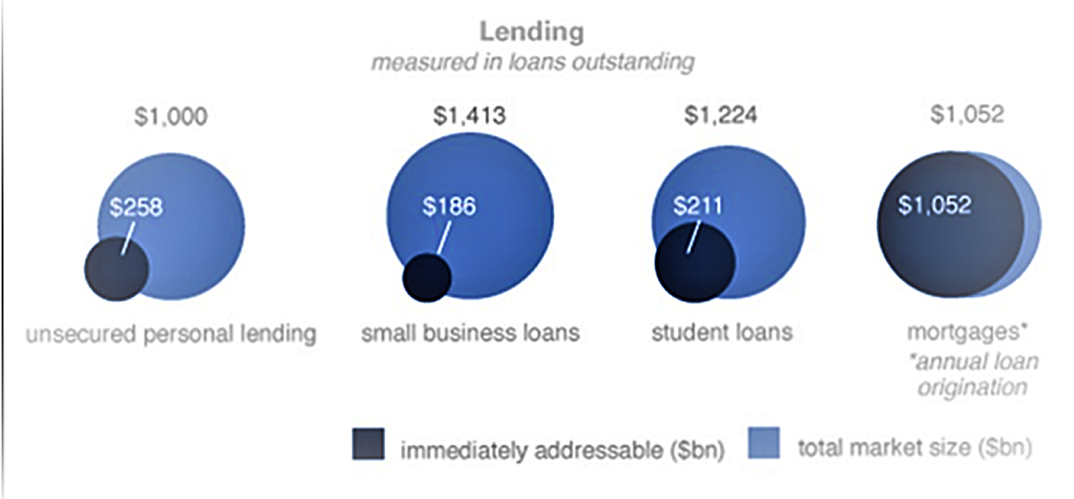

Business Model & Market
GS Addressable Market by technology “Disruptors” in US Consumer and SME Lending = $1.7 Trillion
GS Equity Research
The Future of Finance, 2015

Slide 19
Immediate Addressable Market
The Total Current Market Opportunity:
~$6.5 billion in Fee Revenue
on
~$655 Billion of Referred Loans
Revolving
consumer
credit
$258B
Small
business loans
$186B
Student
loans
$211B
*Based on total outstanding loan amounts able to be addressed by marketplace lending in each product.
+Represents the share of the existing $4 trillion of debt outstanding in the traditional lending system (excluding mortgages) that could be served more efficiently through online lending.
Source: Goldman Sachs Global Investment Research

Slide 20


10_89 11_89 12_88 13_88
Founders Have a Proven Track Record
Luan Cox, Co-Founder and CEO
Respected sales & marketing leader. Built multiple financial technology businesses leading to acquisition (Quote.com, Stockpoint, ScreamingMedia, Interactive Data Managed Solutions).
As general manager and founder of Interactive Data Managed Solutions, grew B2B technology licensing business client-base to 350 financial services clients and $40mm in ARR. Interactive Data Corporation was sold to Silver Lake and Warburg Pincus for $3.4 billion in 2010, now part of ICE.
Expert Advisor to the Springboard Accelerator program and Techstars mentor.
Advisory board member for American Banker’s marketplace lending events.
Srikanth Goteti, Co-Founder and CTO
Expert in data modeling, transformation & normalization of securities market data.
Designed, built & managed complex multi-tier architectures for real-time market data for Standard & Poor’s and Interactive Data.
As head of technology of Interactive Data Managed Solutions, built and led global teams in developing both advisor and investor-focused market data systems and front-end applications that are currently licensed by over 350 global financial institutions including: Wells Fargo, Citi, JPMorgan/Chase, Pershing, Bank of America and the NYSE.

Slide 21
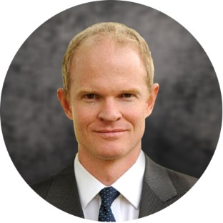

10_89 11_89 12_88 13_88
Strong Execution Team
Nathan Barber, CFO and COO
Manages financial, operational and compliance aspects for FinMkt including product development, business development, lender and referral partnerships, and strategic initiatives.
Prior to FinMkt, Nathan advised a number of financial technology companies with strategic, operational and capital raising activities and helped raise $12.5mm in Series A capital for a leading online construction lending platform.
Advised one of the largest online credit asset managers, Eaglewood Capital, on early capital raising efforts for its initial fund.
Began his career with JPMorgan’s Technology Investment Banking group focused on technology and Internet companies. Nathan has advised technology and other corporate clients on more than $15bn in M&A, capital markets and restructuring transactions.
Dheeraj Medikonda, Director of Client Solutions
Leads new partner implementation and customer account management for all partners. Key role in new product development and optimization.
Extensive knowledge in multiple programming languages and applications.
Critical bridge between technology development team and product development. Manages implementations for multiple products.
Has a master’s degree in business and science from Rutgers University and a bachelor’s in computer science from DAIICT in India.

Slide 22
APPENDIX

Slide 23

FinMkt Announces Groundbreaking DigitalLEND Partnership
Features
Multichannel, real-time loan referral with lower lender acquisition costs
Cloud-based, end-to-end back office lending technology
Digital transaction management services including secure eAsset® vaulting
Benefits
Reduces the cost and time to deploy technology with a turn-key, SaaS solution
Reduces the risk of borrower “stacking” & regulatory compliance issues
Provides loan-level data to investors for asset pools
DigitalLend
Offering
DigitalLEND allows lenders to increase their presence online and capture new customers while ensuring confidence in an end-to-end digital online lending technology.

Slide 24
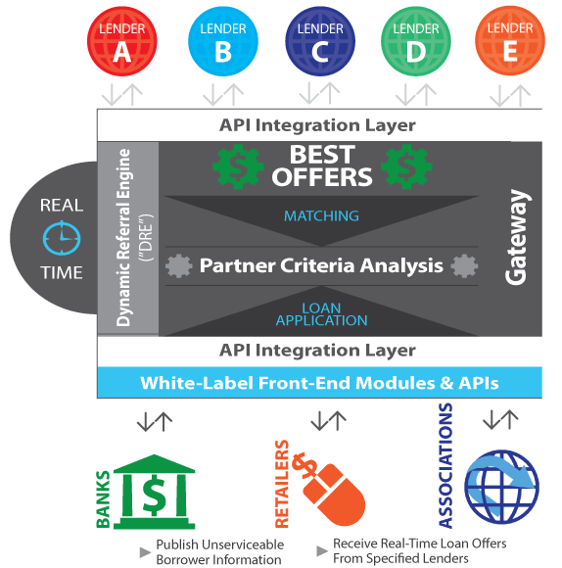
Turnkey Access To Online Financing
FM Gateway is a centralized technology platform that facilitates the submission of online loan requests and the delivery of competitive, pre-qualified loan offers from multiple lenders via a seamless online interface.
FM Gateway’s dynamic infrastructure allows banks, retailers, member associations and others to provide financing solutions to their online customers across multiple loan products, including consumer, small business, student and single-family mortgage loans. The FM Gateway platform matches prospective borrowers with selected online lenders quickly and efficiently. Customers receive competitive loan offers in a matter of seconds.
FM Gateway includes a white-label website with customizable “look and feel.” All customer data is transmitted safely and securely in accordance with industry standard security protocols.

Slide 25
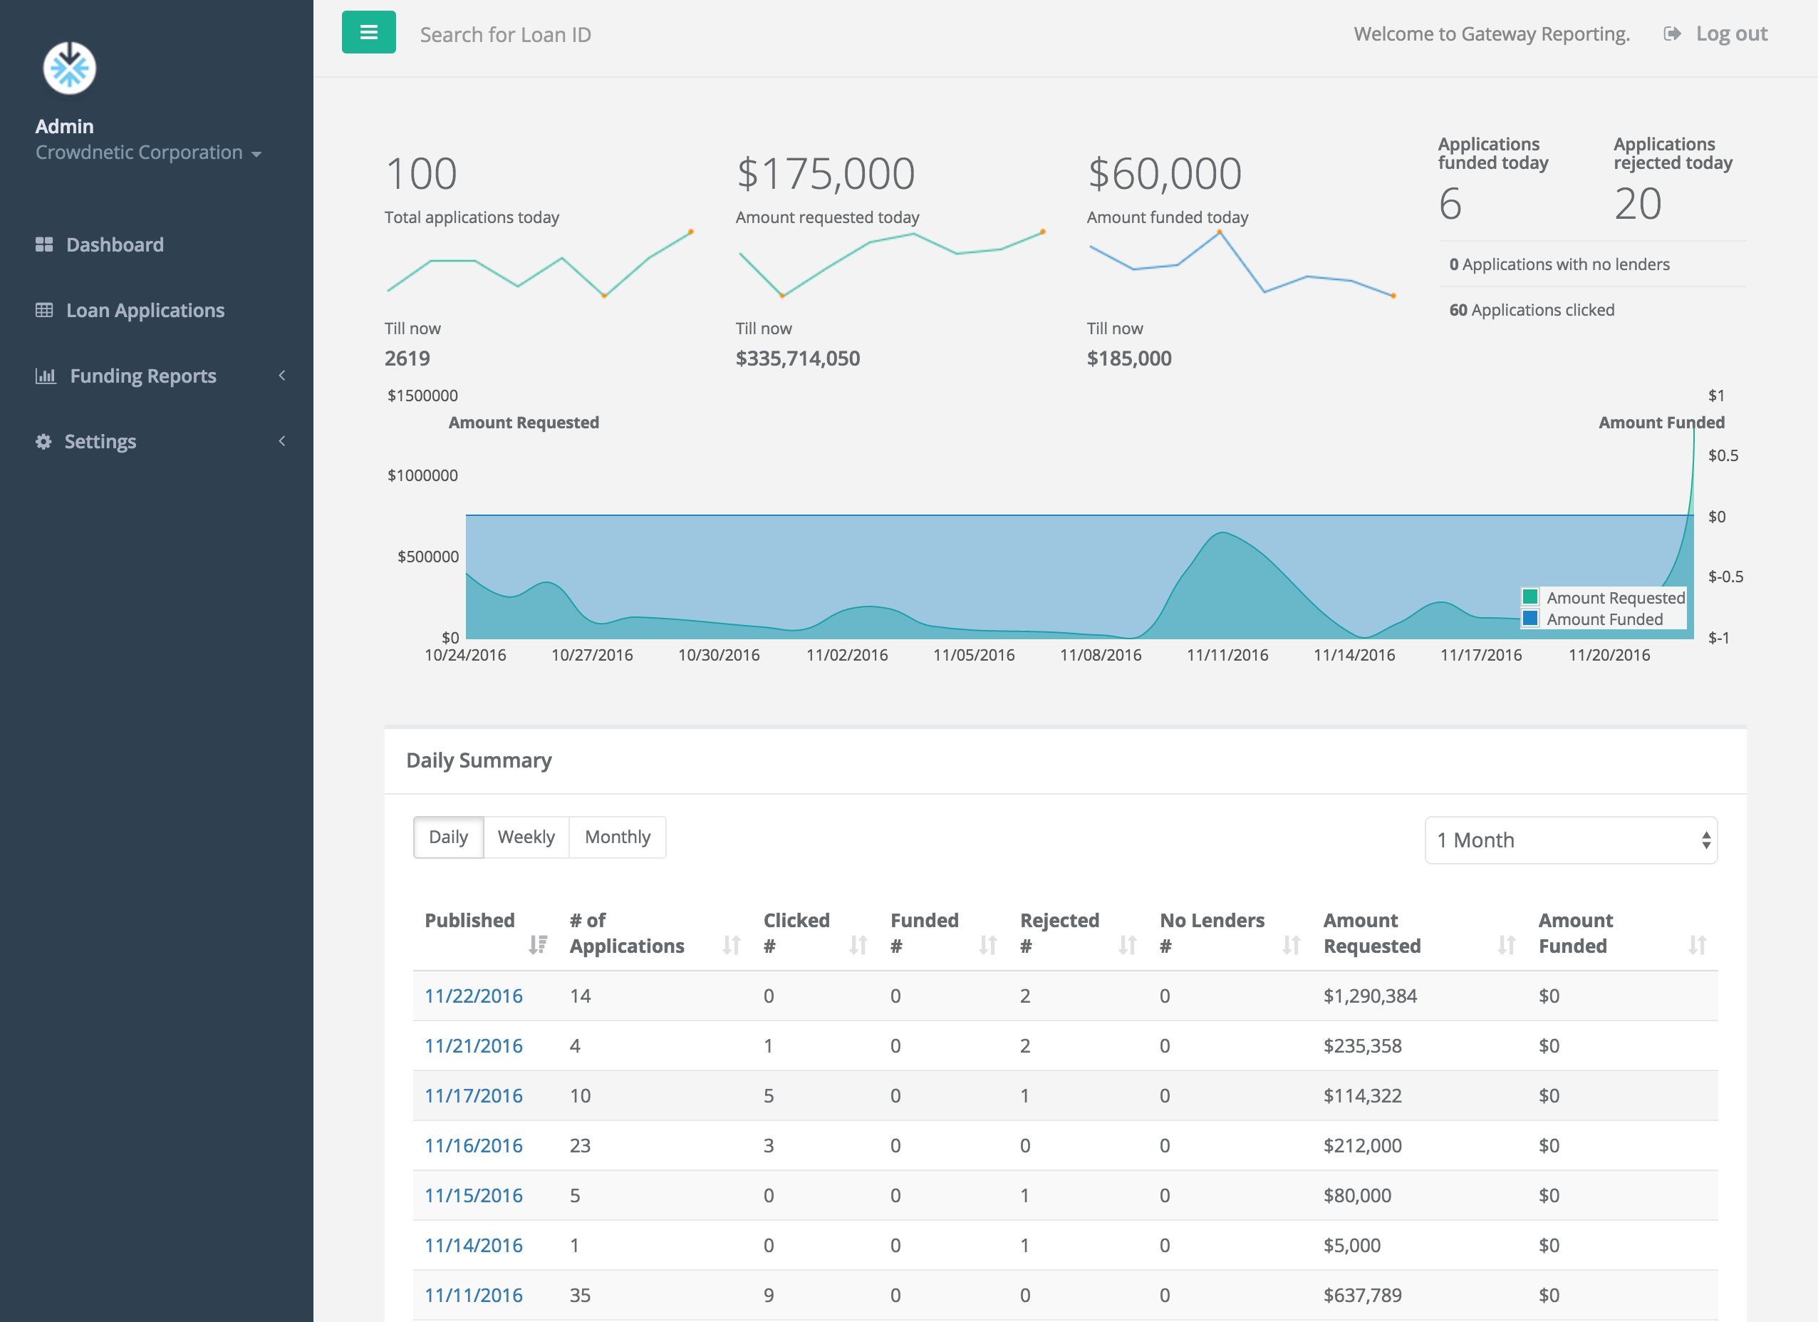
Detailed Reporting and User Tracking
FM Gateway’s sophisticated reporting platform allows users to track the status of individual loan inquiries across multiple lending partners. Monitor and evaluate conversion rates and numerous other metrics.

Slide 26
Gateway Features
GENERATES NEW OPPORTUNITIES FOR BANKS, RETAILERS, MEMBER ASSOCIATIONS AND OTHERS
Allows partners to provide access to loan products allowing them to maximize revenue from their existing customer base
Helps improve and retain customer/member relationships
FM GATEWAY OFFERS BENEFITS TO ALL MARKET PARTICIPANTS
Borrowers – Increases access to credit and saves time by providing competitive loan options from top providers
Banks, Retailers, Associations – Connects to a broad range of third-party loan products and monetizes loan turndowns or creates new revenue opportunities
Alternative Finance Platforms – Increases origination volume by accelerating awareness and providing a tighter integration with referring partners
SEAMLESS CONNECTIVITY FROM BORROWERS TO LENDERS
Links our partners' customers to a network of online lenders
Designed to support all loan types, including unsecured consumer, small business and auto
INTEGRATE ONCE AND PARTNER
WITH MANY
Removes technology integration hurdles
Drives relationships with chosen partners
Facilitates growth and expansion

Slide 27
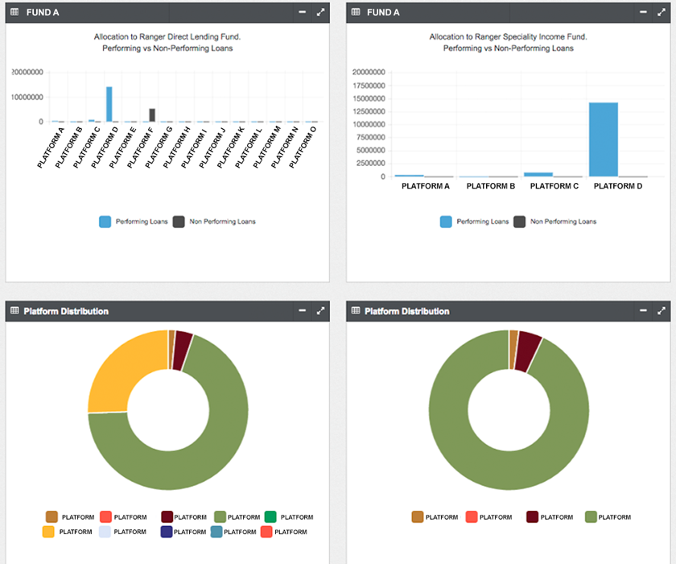
Sophisticated Portfolio Analytics & Monitoring
FM Portfolio is a highly customizable, institutional-grade dashboard that tracks aggregated portfolio and loan-level data, and provides detailed analytics enabling users to monitor their portfolios across multiple online lending platforms.
Developed in partnership with one of the world’s largest asset managers, FM Portfolio is a customizable data platform that tracks and reports the performance of individual loans originated by online lending platforms. It offers a robust analytical framework for institutional investors purchasing loans from multiple platforms.

Slide 28
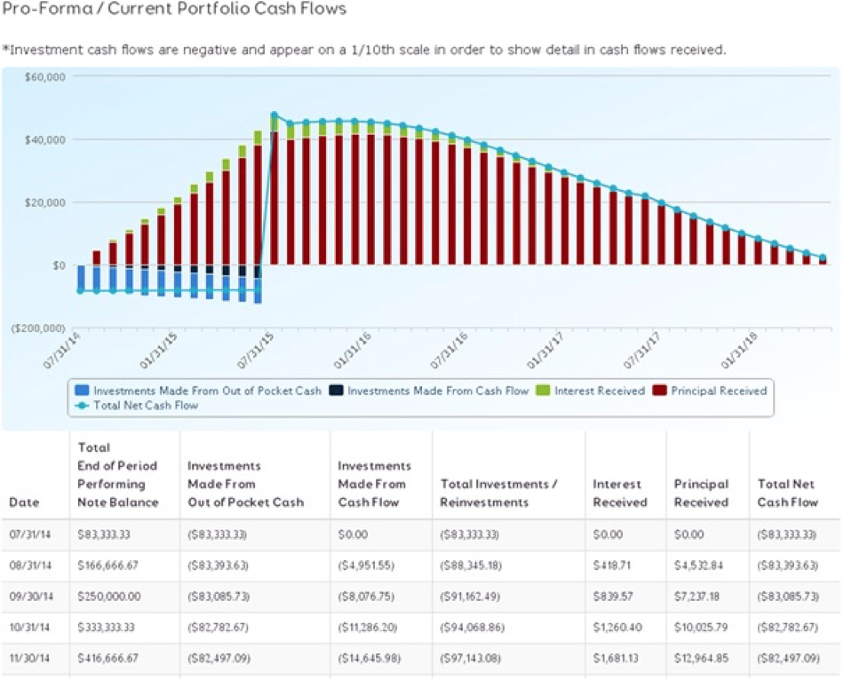
Sophisticated Portfolio Analytics & Monitoring
Standardized data publishing Application Programming Interface (API)
Aggregation and normalization of structured and unstructured data to visualize and perform critical analytics
View of all assets in aggregate across portfolios and alternative finance platforms
Monitor status of portfolios and analyze loan types including performing/non performing loans by asset class and loan performance by platform
Seamlessly create collateral reports across portfolios for liquidity providers
Identifies and aggregates specific information about the loans included in a selected portfolio
Allows users to track compliance to fund covenants and performance criteria
Enables users to perform proprietary analytics on portfolios to examine loss-adjusted cash flow projections

Slide 29

Technology Licensing
Customized Marketplace Solutions
FM Marketplace gives your organization the power of the FM Gateway platform in a highly customizable solution. Leveraging FM Gateway’s core technology, FM Marketplace can be utilized for any type of product, financial or non-financial, so that you can operate your own real-time online marketplace. Our patent-pending matching and tracking technology solutions allow you to deliver in-house or third-party product options in real-time to your customers. Like FM Gateway, FM Marketplace has a robust reporting capability that allows you to track the status of each transaction in real-time.

Slide 30
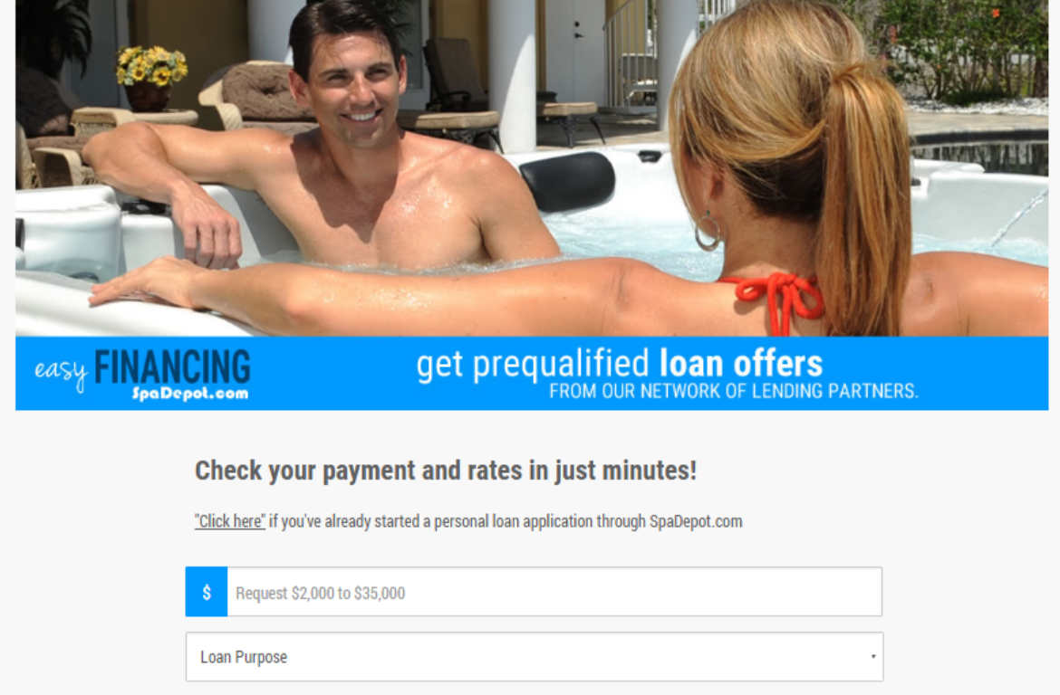
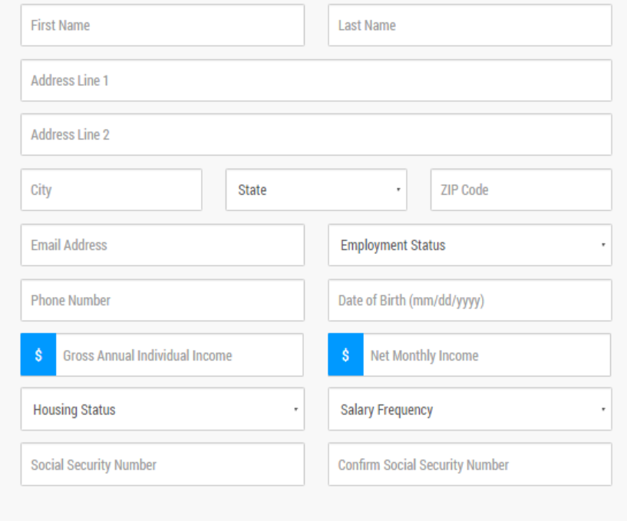
How It Works: Normalized Application Form

Slide 31
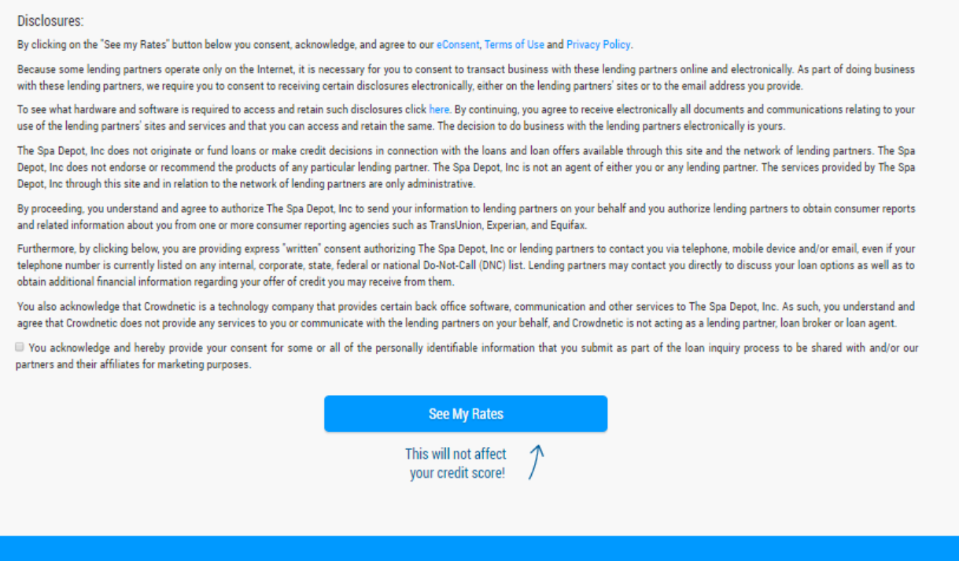
Standardized Disclosures

Slide 32
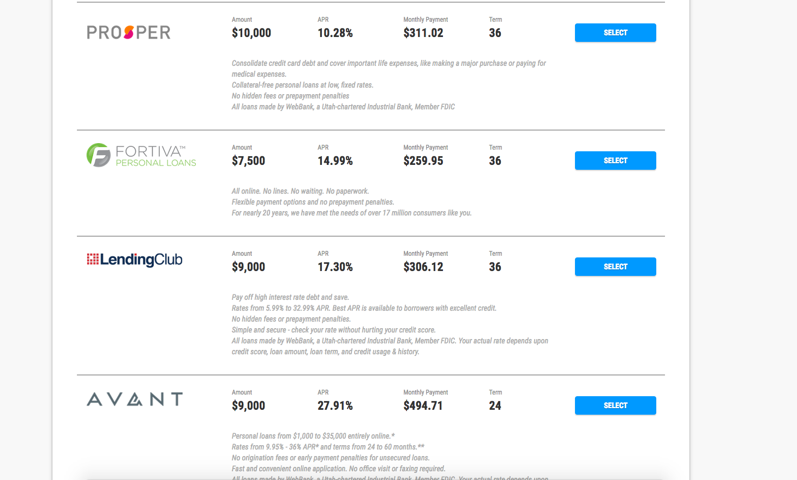
Multiple Offers

Slide 33

Contact Information
17_84
Luan A. Cox
President & CEO
FinMkt
luan@finmkt.io
37 W. 17th Street, Suite 4E
New York, NY 10011
917.633.4347

Slide 34
Forward-Looking Statements
12_88 13_88
Cautionary Note Regarding Forward-Looking Statements
All financial and other projections and forecasts contained herein are speculative in nature, and are not intended to represent actual future outcomes or performance. These projections and forecasts are forward-looking statements, based only upon our current beliefs, estimates, assumptions, plans and objectives, as well as extrapolation of current facts, conditions, and unaudited information. These forward-looking statements can be identified by words such as “potential,” “stealth,” “additional platforms,” and “financial projections;” graphic representation of projections of future revenues, expenses, EBITDA, and rolling cash balances; as well as references to future periods, such as “2017,” “2018,” “2019” and “2020;” and other words and references. These forward-looking statements are neither historical facts nor assurances of future performance. Actual results and outcomes may differ materially from those indicated in the forward-looking statements, due to market forces, economic conditions, legal and regulatory changes, volatility in the capital markets, competition, risks, uncertainties, changes in circumstance, or other important factors or conditions which, by their very nature, cannot be accurately predicted in advance, and many of which are outside of our control. Therefore, you should not rely on any of these forward-looking statements. Prospective investors are encouraged to conduct their own independent analysis and due diligence. These forward-looking statements are based only on information currently available to us and speak only as of the date on which they are made. We undertake no obligation to update any forward-looking statements as a result of new information, future developments or otherwise, except as may be required by law.

