Slide 1

John Franco
jfranco@jfrancomarketing.com
Office: 303 339 0103
Cell: 303 517 5066

Slide 2


Motivating Factors
After talking to our dealer partners, one of the major concerns they have is the relatively low conversion ratios of web traffic into contactable leads. With this in mind, we developed Quick2Credit to address this growing problem.
Quick2Credit gives the dealer’s web visitors their free credit score and a pre-qualification instantly via several key forms of media without providing their SS# or incurring a hard inquiry. The pre-qualification is displayed instantly on screen, via email, text, and first class direct mail.
The dealer gets a high quality lead that includes all contact data, pre-qualification tier, and preferred vehicle category and make.

Slide 3



Quick2Credit starts with our banners. We have 16 different banners created with color schemes to match any dealer’s needs. These banners will be strategically placed on the dealer’s current website to generate the maximum number of leads. Custom banners can be created or if the dealer has banners currently, they can choose to use those.

Slide 4
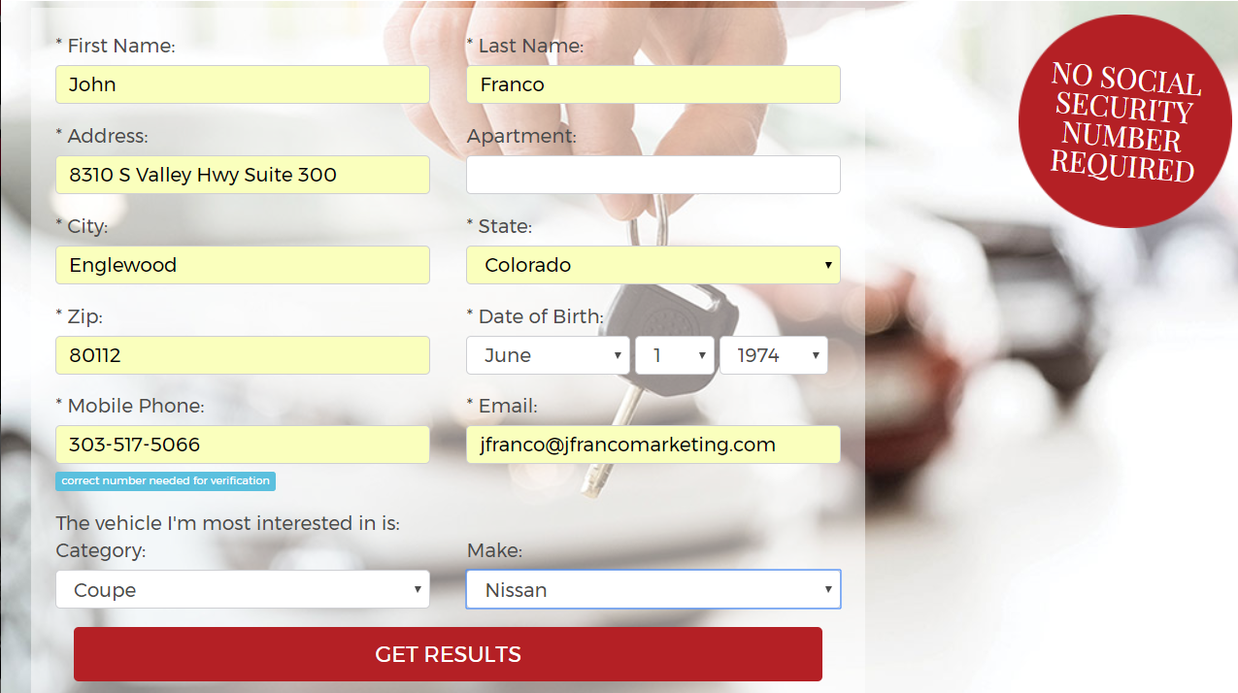
As soon as the banner is clicked Quick2Credit’s short form application appears as an overlay.
The applicant is prompted to provide basic contact information along with the make and vehicle category they are most interested in.
This application does not require a SS# and does not count as a hard inquiry.
Each dealer can control the options that appear under the “vehicles most interested in” drop down boxes.

Slide 5
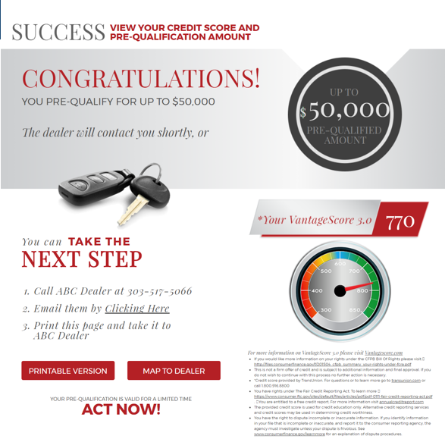
Customer Facing
After the “Get Results” button is pushed the applicant is matched with TransUnion data.
Instantly, a pre-qualification and the consumer’s VantageScore will appear on screen.
The pre-qualification is based on one of eight tiers set by the dealer.
At this point the consumer can contact the dealer via phone or email. They can also print the pre-qualification certificate and pull up a map with directions to the dealership.

Slide 6
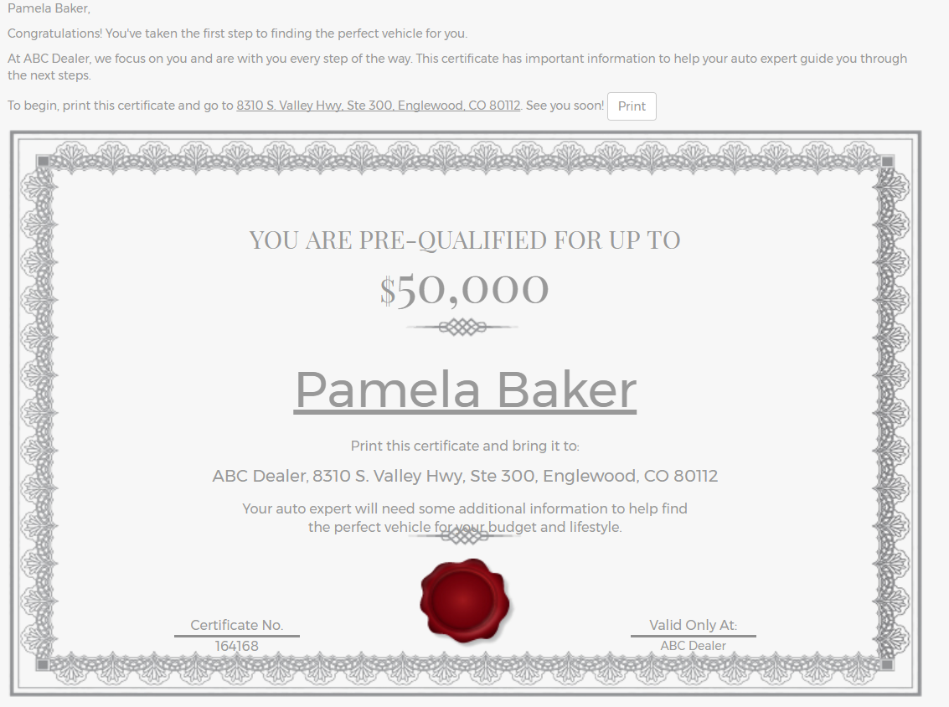
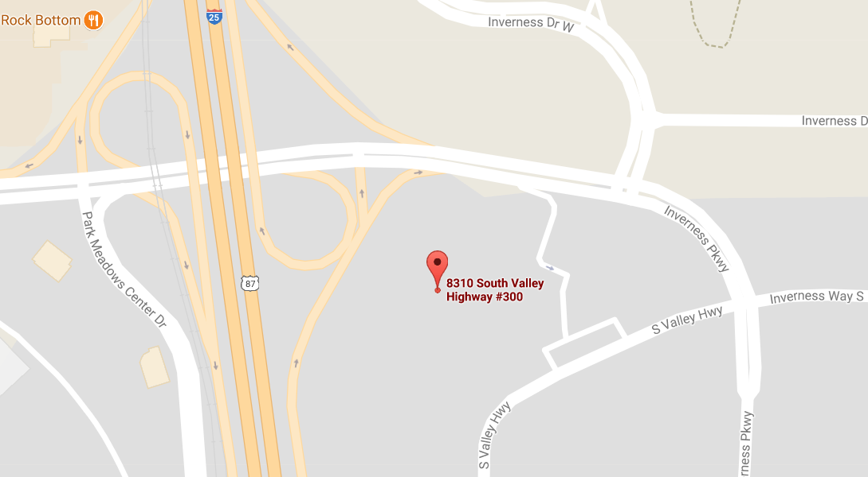
Onscreen Printable Certificate and Dealer Map Button Results

Slide 7
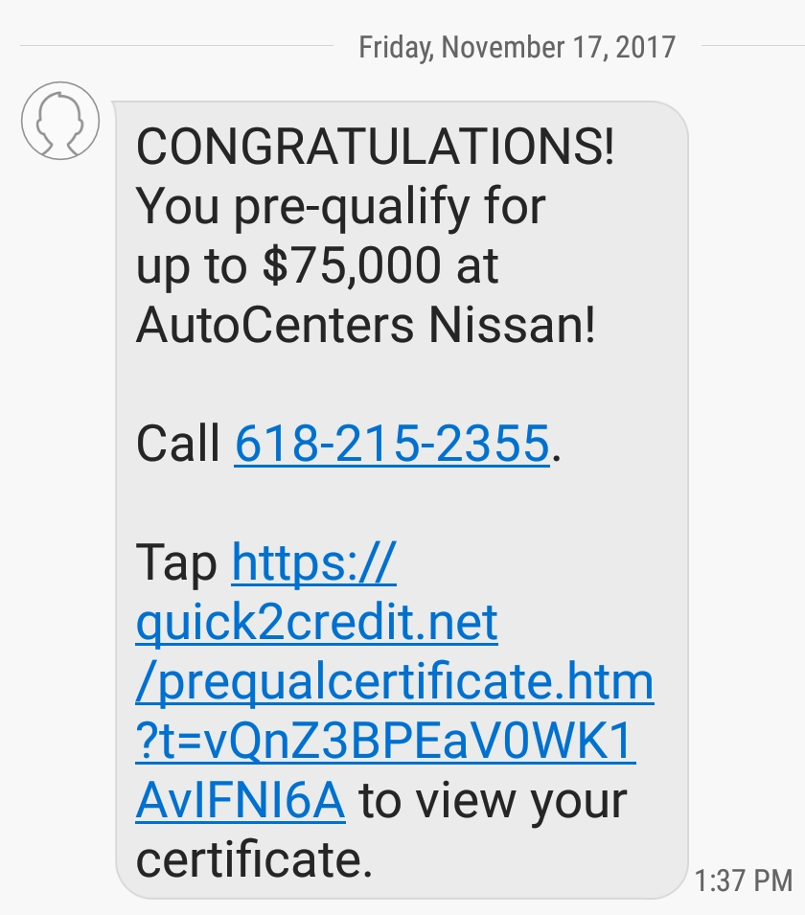
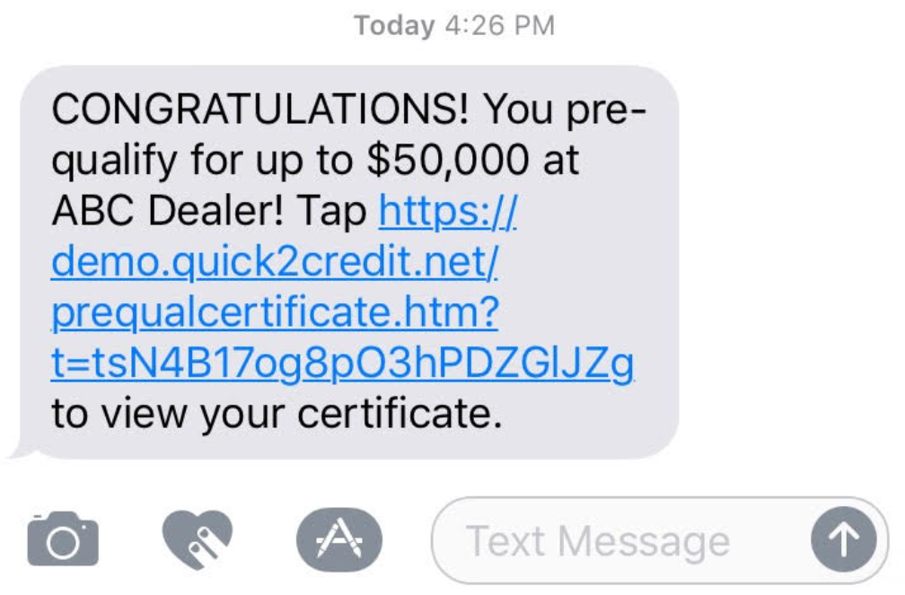
Text Pre-Qualification Sent To The Applicant
Simultaneously, the same pre-qualification is sent to the applicant’s cell phone via text. The applicant will have the ability to click a link to pull up their pre-qualification certificate. In addition, a click-to-dial phone number will be included.

Slide 8
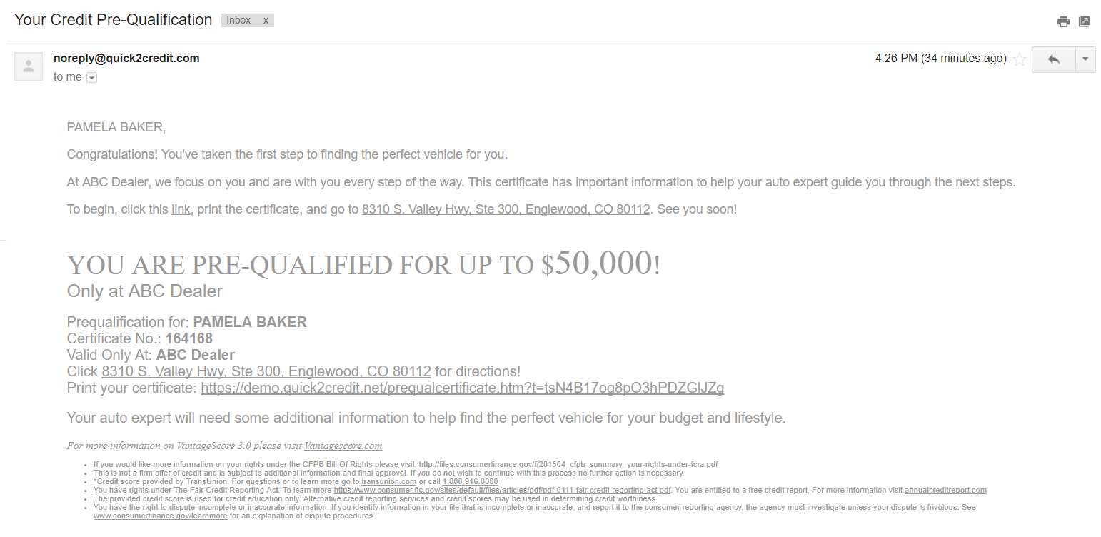
Email Sent By Quick2Credit To The Applicant
The pre-qualification is sent directly to the applicant’s email. They can click a link to access their certificate. Included in the email is a link that provides a map to the dealership.

Slide 9
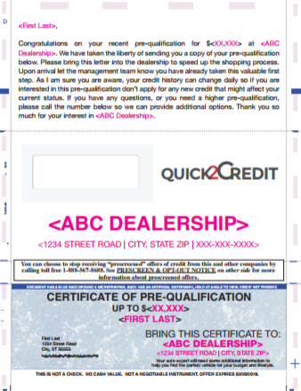

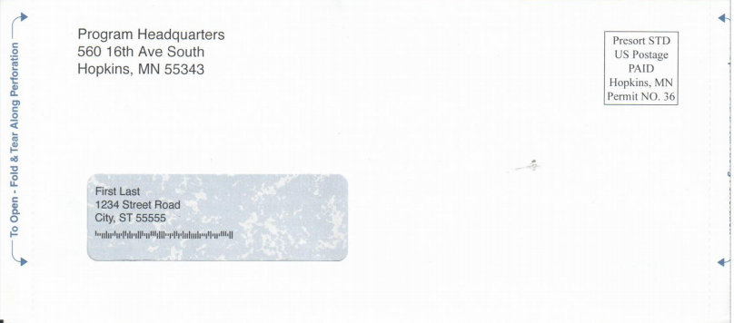
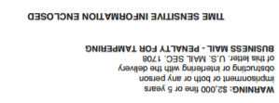
Triggered Direct Mail
3.75x8.5 Windowed Snap Pack
This Snap Pack looks just like a check in the mail resulting in extremely high open rates.
This provides a tangible reminder of the applicant’s pre-qualification.
Letters are sent first class.

Slide 10
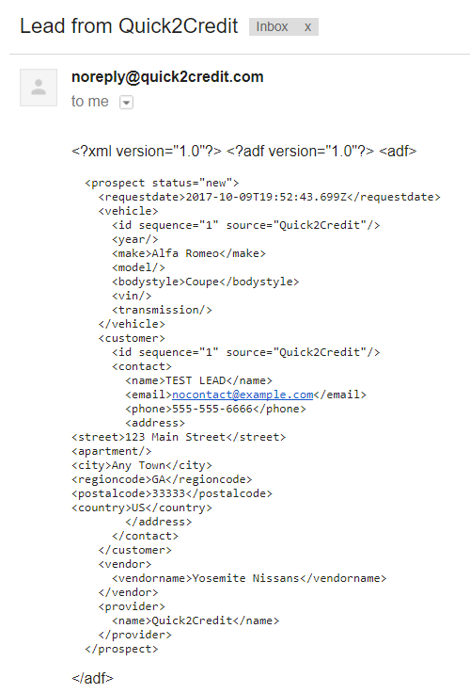
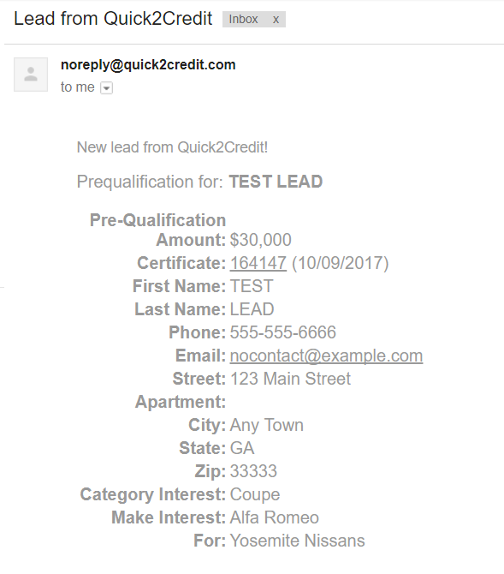
Dealer Facing
As soon as the applicant clicks “Get Results”, these emails are generated as notifications of a new lead to the dealership. The emails contain the contact information, vehicle style, make selection, certificate number, applicant’s tier, and pre-qualification amount. The first email can be sent to any dealership personnel. The second email is sent in ADF format directly to the dealer’s CRM.

Slide 11
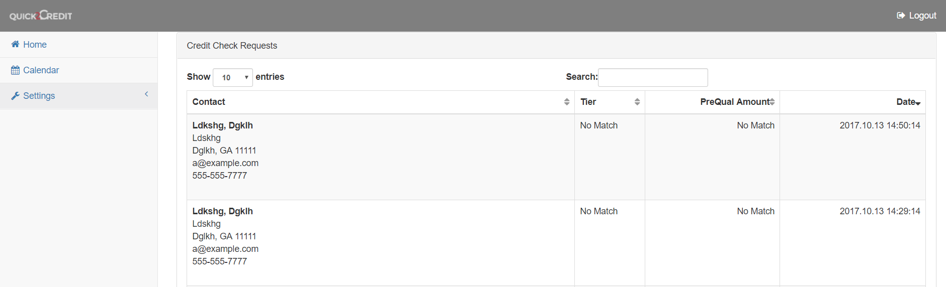
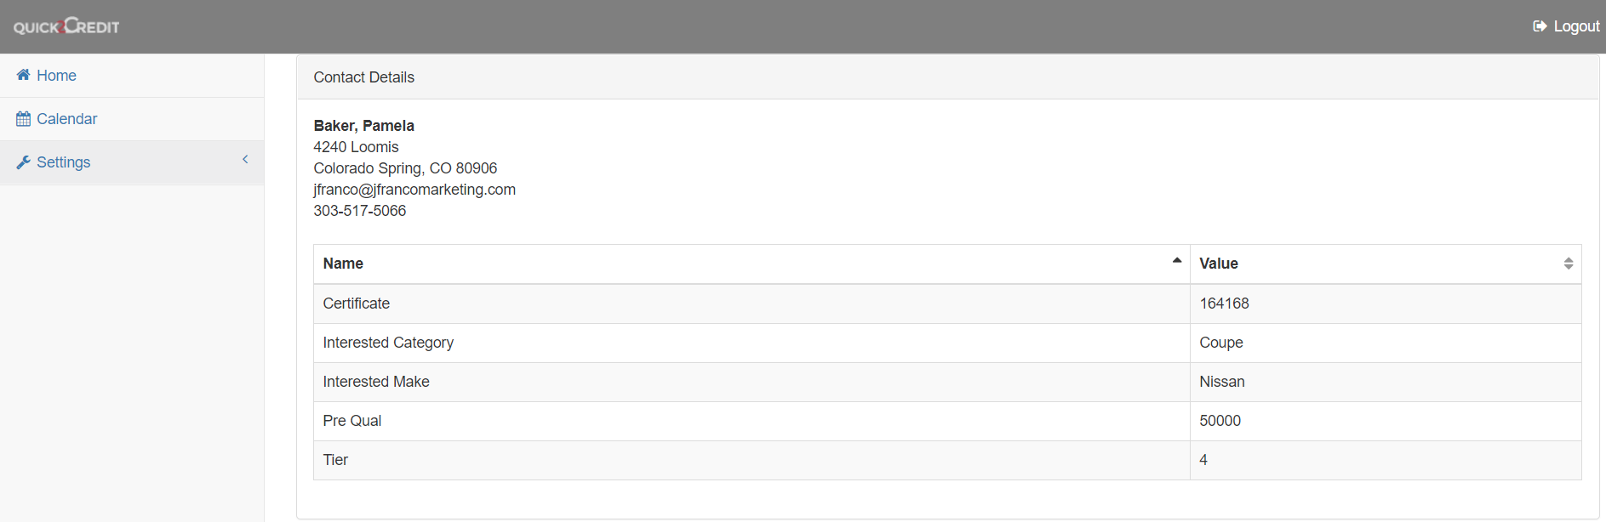
The dealer will have access to a Quick2Credit portal that will house all of the leads. Quick2Credit stores all of the contact information, vehicle style, make selection, certificate number, applicant’s tier, and pre-qualification amount. No sensitive personal data of the applicant’s is stored, eliminating the risk of confidential data being leaked.

Slide 12
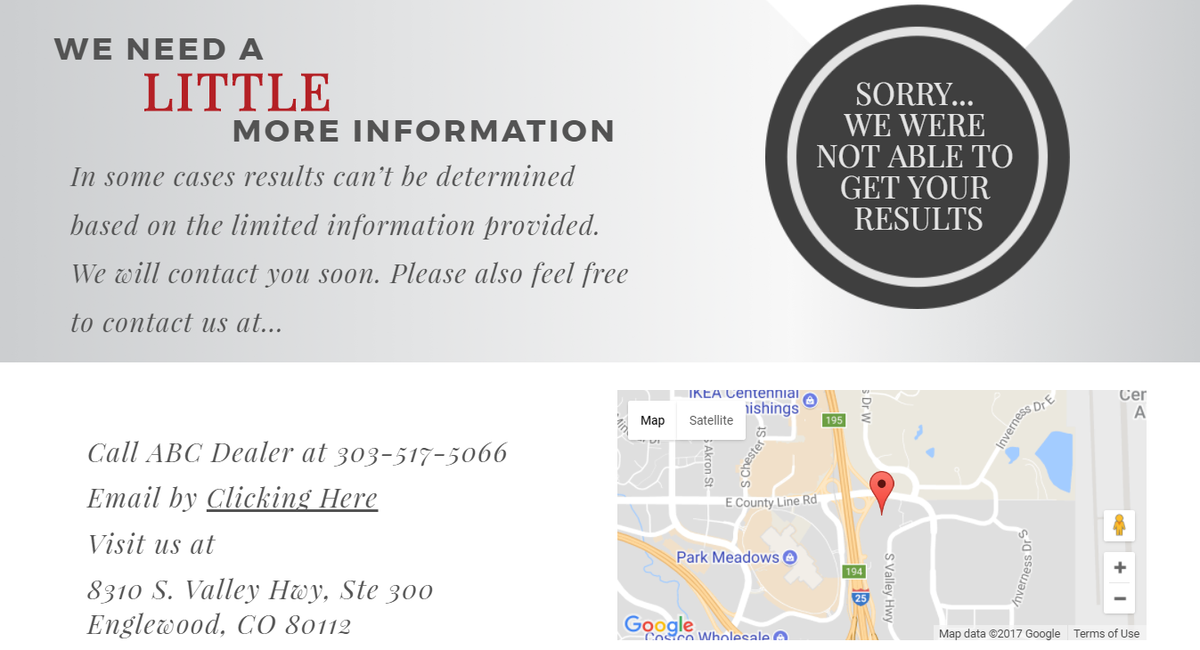
In a few cases TransUnion will not be able to match the applicant with a credit file without a SS#. If this occurs a request for more information will overlay onscreen. The dealer will still get all of the same lead data, including all contact information. Quick2Credit will give the applicant an option to contact the dealer directly at this point.

Slide 13
Offered At 1,095 Per Month
Instant on-screen pre-qualification using live TransUnion data
Links to certificate with dealer mapping
Pre-qualification text sent to all applicants
Pre-qualification email sent to all applicants
First Class letter sent to all applicants
ADF formatted leads sent to dealer’s CRM
Email leads sent to dealer’s BDC or management team
Access to live dashboard that houses all leads
Phone tracking for all phone calls
$495 one time set-up fee
*Custom Banner Art Sets Available

