Slide 1


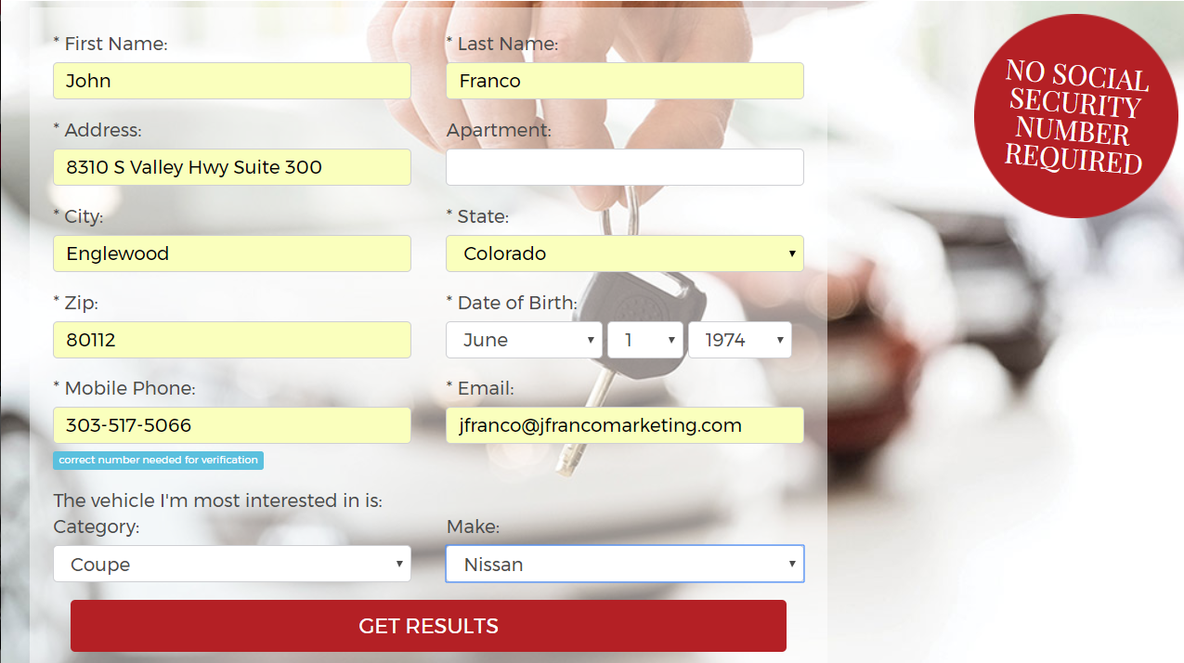
Easy as 1,2,3
Banners are placed in key locations with powerful hooks.
A one-page application layover appears once banner or finance page is clicked.
Pre-qualification with credit score and ranking appears instantly.

