Slide 1
Sample Projects on
Structural Vibration Solutions

Slide 2
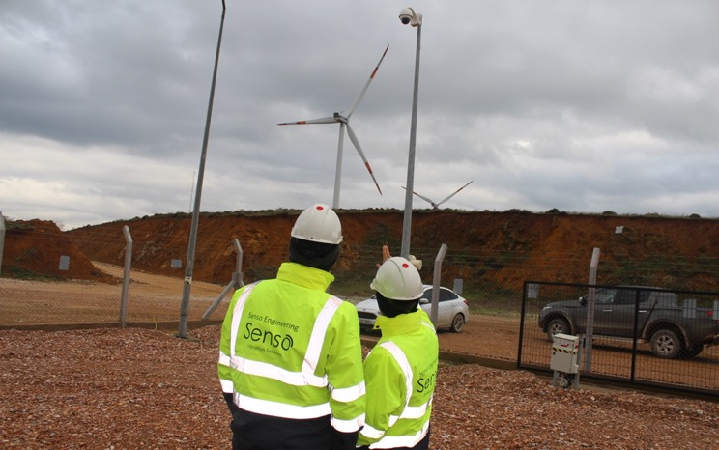
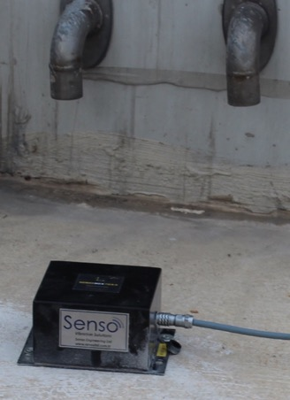
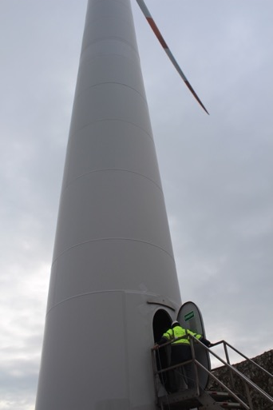
Selected Projects
Customer
Job Title : Structural Checks on Wind Turbines
Project Location : Turkey
Year : 2018
Customer : Akenerji, Turkey
Scope : Senso Engineering provided real-time displacement and acceleration measurements on the turbines, combining the measurements with high-end numerical analyses. The measurements and analyses were then used for approving the safety of the turbines.
[Turkey]

Slide 3
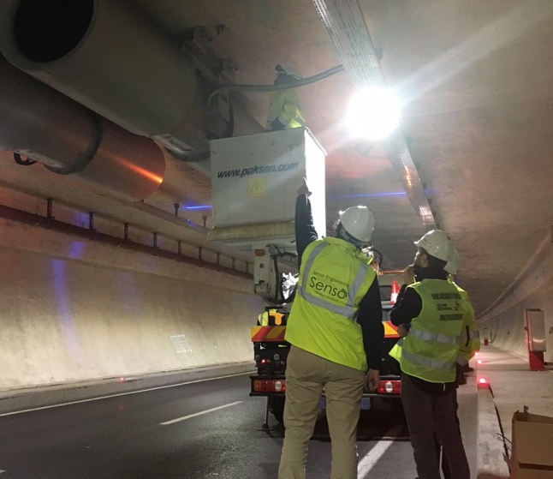
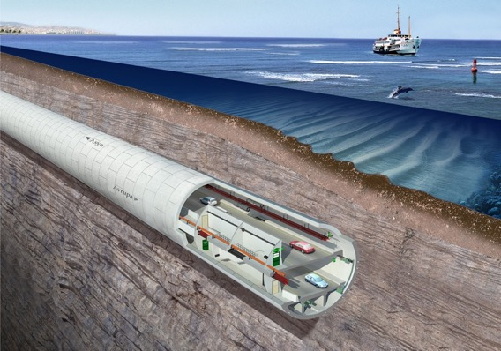
Customer
Job Title : Eurasia Tunnel | Jet Fans Vibration Control
Project Location : Istanbul, Turkey
Year : 2018
Customer : Egis Group
Scope : The vibrations in the jet fans of the tunnel are controlled by the vibration isolation system that is designed by Senso Engineering.
[Turkey]
Senso Engineering also installed a vibration montioring system on the fans, measuring the structural-fan vibration interaction.

Slide 4
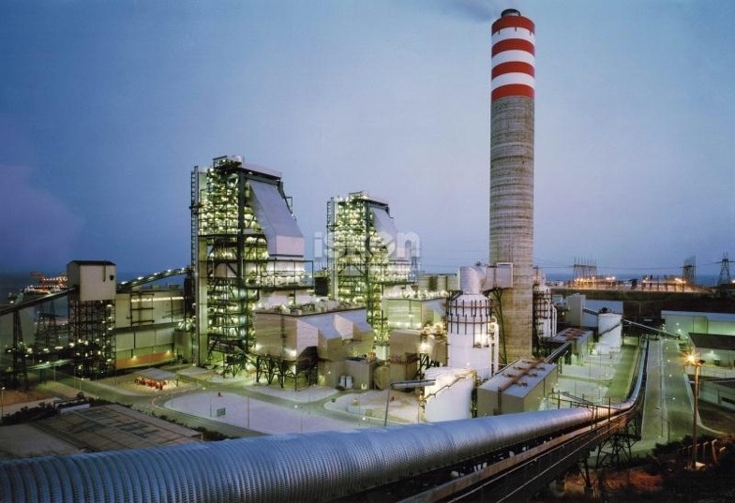
Selected Projects
Customer
Job Title : ISKEN | ID Fan Foundation Vibration Measurements
Project Location : Adana, Turkey
Year : 2016
Customer : Howden Axial Fans
Scope : Vibrations of a reinforced concrete foundation of an existing fan have been recorded for Howden Axial Fans at İSKEN Sugözü power plant in Eastern Turkey. The project is realized in a very short time with a fast mobilisation. The measurements of Senso Engineering provided insights on the rotational stiffness of the ID fan foundation. The measurements were taken with accelerometers that are suitable for detecting machine-induced vibrations, with a high sampling ratio.
[Denmark]

Slide 5
Sample Projects on
Structural Monitoring

Slide 6
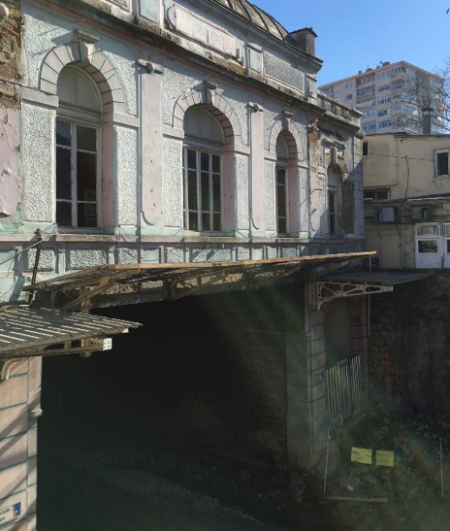
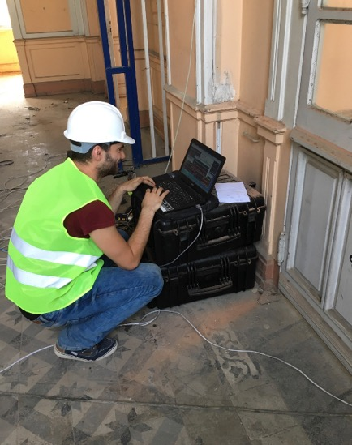
Selected Projects
Customers
Job Title : Marmaray Project | Göztepe Station SH Monitoring
Project Location: İstanbul, Turkey
Year : 2016
Customer : OBS Engineering & Obrascón Huarte Lain (OHL)
Scope : Ambient vibration testing, Operational Modal Analysis, seismic monitoring system design, installment & operation have been conducted.
[Turkey]

Slide 7
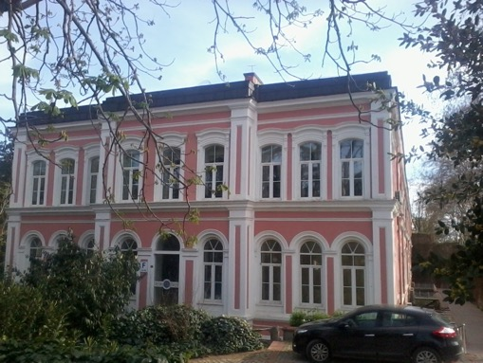
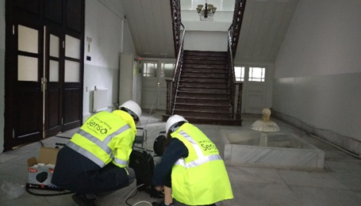
Selected Projects
Job Title : Yildiz Saray Buildings | OM Analysis
Project Location : Istanbul, Turkey
Year : 2017
Customer : Promim Restoration
Scope : Ambient vibration measurements & Operational Modal Analysis on 3 historical masonry buildings have been conducted. The results were used by the structural engineer to calibrate the numerical models.

Slide 8
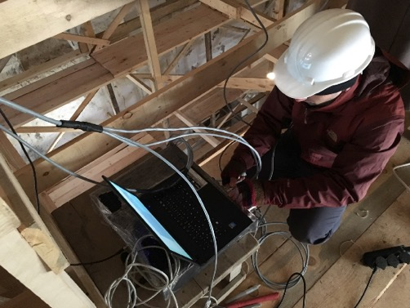
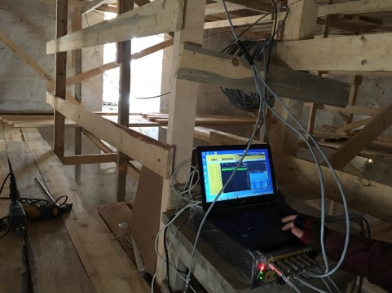
Selected Projects
Customers
Job Title : Barhal Church | OM Analysis
Project Location : Artvin, Turkey
Year : 2016
Customer : Gürsoy Grup Restorasyon
Scope : Ambient vibration testing and Operational Modal Analysis on a 9th century stone masonry church were conducted. The results were used calibrating the observed damage and the numerical model assumptions.
[Turkey]

Slide 9
Sample Projects on
Proof Tests

Slide 10
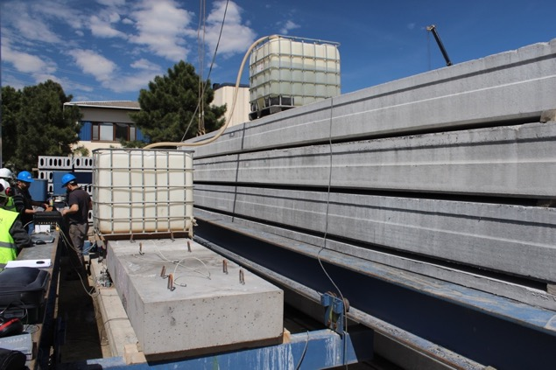
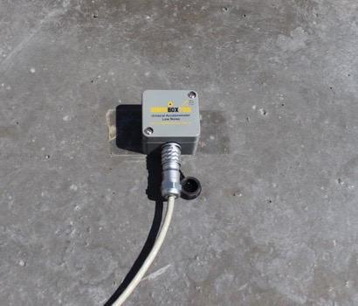
Selected Projects
Job Title : Eurasia Road Tunnel | Lower Deck Design Proof Tests
Project Location : İstanbul, Turkey
Year : 2015
Customer : Yapı Merkezi & SK
Scope : The construction method of the prefabricated lower deck of Eurasia (Avrasya) Tunnel required change in design of the deck. The new design needed to be checked in terms of deformations, response to cyclic loads and vibration characteristics. We have prepared the testing procedure, the construction of the full-scale specimens by Yapı Merkezi Prefabrik, and conducted the proof tests, approved by all parties, that the new design is suitable and safe.
Customer
[Turkey]

Slide 11
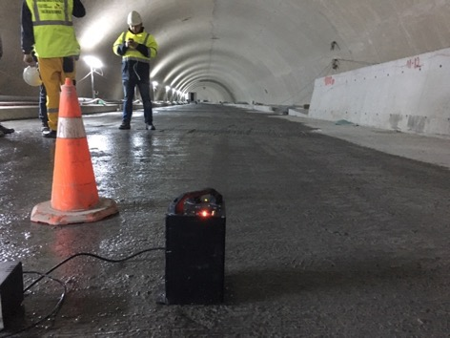
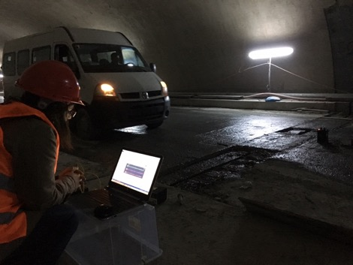
Selected Projects
Job Title : Eurasia Road Tunnel | Upper Deck Vibration Proof Tests
Project Location : İstanbul, Turkey
Year : 2014
Customer : Yapı Merkezi
Scope : Design of the rubber pads for the upper deck against traffic- induced vibrations were conducted by Senso engineers for Arsan. The main customer YMSK, then comissioned Senso for designing and running proof tests providing evidence that the upper deck vibrations are within the comfort limits. Senso conducted the job on the tunnel before the opening, by running vehicles with different speeds and by checking the induced vibrations on various deck locations.
Customers
[Turkey]

Slide 12
Sample Projects on
Structural Analyses

Slide 13
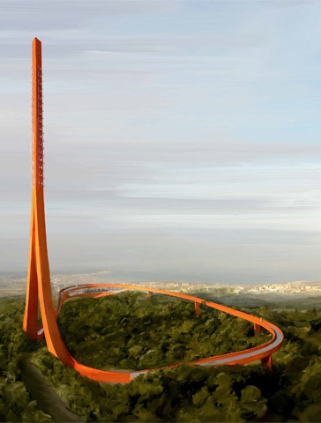
Selected Projects
Customer
Job Title : Çanakkale Digital Antenna Tower | Vibration Control
Project Location : Çanakkale, Turkey
Year : 2014
Customer : IND International Design
Scope : A steel box sectioned antenna tower is designed by the customer. The tower is 103m high and it is on a hill by a strait with strong winds. CFD analyses have been conducted, together with studies on damping of the system during wind induced vibrations. Wind loads along the height of the structure have been provided to be used in structural analyses. Comparison with American and European structural design codes under wind loading have also been provided.
[Netherlands]

Slide 14
Selected Projects
Customer
Job Title : Qabala Stadium | Wind and Seismic Induced Design
Project Location : Qabala, Azerbaijan
Year : 2013
Customer : İntaç Construction & Engineering
Scope : A football stadium is designed in city of Qabala, Azerbaijan, by the customer. Wind load analyses by using computational fluid dynamics (CFD) approaches have been conducted and a wind load report is prepared to be used as base in structural analyses. The wind load results provided by Senso are used in suitable design of facades, structural and non-structural components against wind loads.
[Turkey]

Slide 15
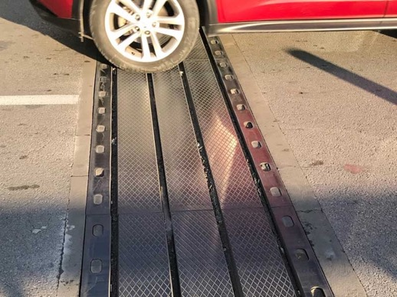
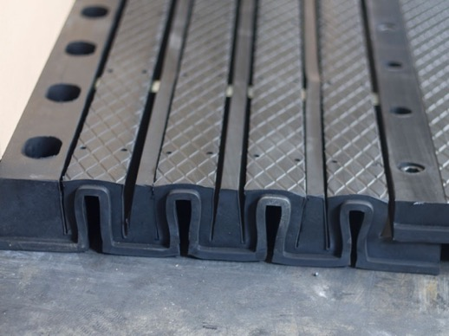
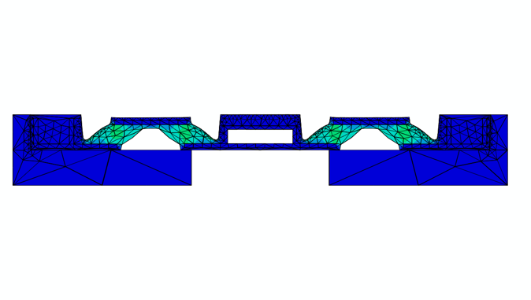
Selected Projects
Customer
Job Title : Road Bridges | Expansion Joints Numerical Analyses
Project Location : Istanbul, Turkey
Year : 2017
Customer : Arsan, Turkey
Scope : Arsan produces structural expansion joints for road bridges. These joints open and close within pre-designed limits, allocating the thermal-induced length changes in the bridge decks. The joints should be able to safely bear the loads of the vehicles passing. Senso engineers provided complex scenario analyses for all expansion joint products to find the safety limits. The designed joints are applied to several highway bridges in Turkey and also in Europe.
[Turkey]

