Slide 1
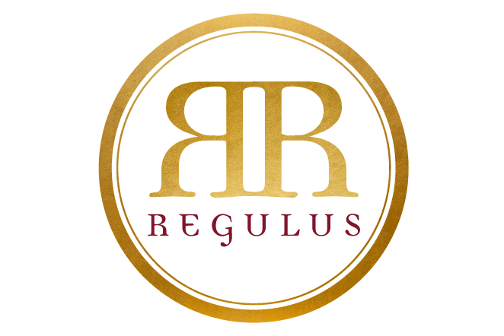
Corporate Presentation
Regulus Asset Management Limited
January 2018

Slide 2

“Ensuring that your prosperity is secure and building it is our mantra.”
Shailesh Dash
2

Slide 3
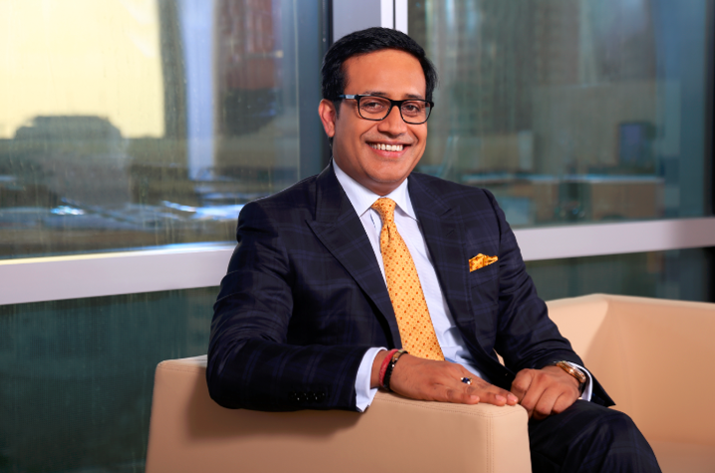
MESSAGE FROM THE CEO
“It gives me great pleasure to present our group’s corporate profile. This year we celebrate 8 years of operations - accomplishing a very important milestone. The success and growth we have achieved over the years is built on the hard-work of our team; which has delivered exceptional returns for our clients.”
Shailesh Dash
CEO & Founder

Slide 4
Corporate Overview
What We Do
Premier financial services firm offering a breadth of solutions across asset and wealth management, investment banking advisory, custody and research
Who We Are
Experienced professionals from varied financial services background across multiple geographies
Cumulative experience in excess of 150 years
Geographical Focus
Middle East and North Africa (MENA)
South East Asia (SEA)
Subsidiary
Offices
Regulus Investments LLC - Dubai
Regulus Financial Advisors Private Limited - Singapore

Slide 5

Table of Contents
1 | Introduction | 4
2 | Board of Directors | 5
3 | Senior Executives | 9
4 | Team Members | 10
5 | Solutions and Services Offered | 11
6 | Asset Management | 13
7 | Corporate / M&A Advisory | 17
8 | Research | 18
9 | Wealth Management | 19
10 | Private Equity Advisory | 20
11 | Life Insurance Policy Advisory and Custody Services | 21
Private and confidential

Slide 6
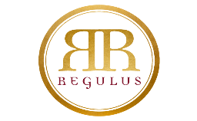
Regulus Asset Management Limited: Introduction
Group Structure Chart
Regulus Asset Management Limited
(“RAML”)
Cayman Islands exempted company
100%
70%
Regulus Investments LLC, Dubai
Regulus Financial Advisors Private Limited, Singapore (“RFAPL”)
Majority owned
Allied Investment Partners (“AIP”)
Financial Advisory licence
by Monetary Authority of Singapore
- Licensed by UAE Central Bank and ESCA for various financial services & products
Core philosophy to ensure our customers are offered tailored, innovative solutions across the wide spectrum of financial services offered across all our global entities

Slide 7





Regulus Asset Management Limited: Board of Directors
Over 23 years experience in Alternative Investments
More than 90 transactions executed with total transaction value of over US$ 1.7 billion
Founder of several financial services companies including Al Masah Capital, Regulus Capital and Regulus Asset Management Limited
Recognized amongst the top 100 Influential People in Dubai 2016-2017 by Arabian Business
Recognized amongst top 100 Indian Leaders in the Arab World 2016-2017 by Forbes Magazine
Awarded Global Visionary CEO of the year 2014 – Leaders Magazine International Malaysia and the Federation of GCC Chambers
Shailesh Dash, CFA
Founder, CEO
& Board Member
YEARS OF
EXPERIENCE
EXECUTED TRANSACTIONS
TOTAL CLIENTS
90+
23+
90+
DOLLAR VALUE OF
TRANSACTIONS
EXITS
OUTSTANDING ACHIEVEMENT BY AN INDIVIDUAL 2013
MENA Fund Manager
BEST STRATEGIC VISION AWARD 2017
Banker Middle East
BEST CEO FOR ETHICAL INVESTMENTS 2016
World Finance
$1.7bn
19
INVESTMENTS INNOVATION 2017
Entrepreneur Middle East
14 IPO’s and 5 trade sales

Slide 8
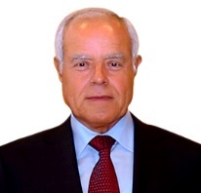
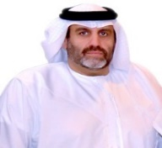
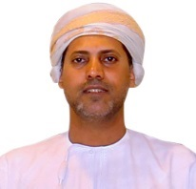
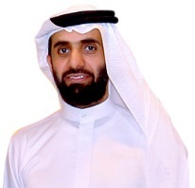

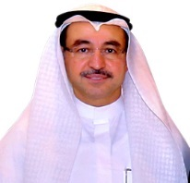
Regulus Asset Management Limited: Board of Directors
Mr. Najjad Ahmad Zeenni
Former CEO of NPCC Abu Dhabi
President, Valentine Maritime NAZCO Marine and Al Maha Productions
Chairman, Horizon Survey & Horizon Geotechnical
Mr. Hamad Jassim Al Darwish
CEO, Al Hail Holding
Chairman, Global Development Group
Chairman
Vice-Chairman
Sheikh Khalid Al Mashani
Chairman, Bank Muscat
Vice Chairman, Al Salam Bank
Chairman, Dhofar International Development
Deputy Chairman, Al Omaniya Financial Services
Sheikh Saqer Humaid Abdulla Al Qassimi
Chairman & Head of Remuneration Committee, Planet Pharmacy
Board member & Head of Audit committee, Julphar Pharmaceutical
Former Board Member of RAK Petroleum Company
Board Member
Board Member
Mr. Shailesh Dash, CFA
Shailesh is the founder and CEO of Regulus Asset Management Limited. For further information, please refer to page 5
Mr. Jassem Zainal
Chairman and CEO, Arzan Financial Group
Deputy Chairman and acting CEO for Addax Investment Bank
Board Member of Bank of Bahrain and Kuwait, Kuwait International Bank, Miami International Securities Exchange (MIAX)
Founder, CEO
& Board Member
Board Member

Slide 9
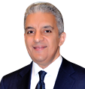
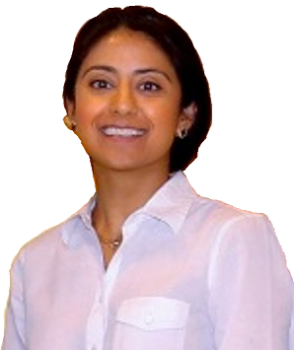
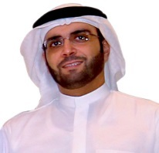
Regulus Asset Management Limited: Board of Directors
Mr. Sadek Ahmed Elsewedy
Chairman and CEO, El Sewedy Industries
Chairman and CEO El Sewedy Cement Co
Chairman El Sewedy Electric Co
Ms. Dipti Dhingra
11 years of experience at JP Morgan, London, from where she resigned as Executive Director
Board Member
Board Member
Mr. Mohammed AlShaiba Al Mazrouei
Vice Chairman, Habib Exchange Company
Director, Al Hail Holding
General Manager, Al Towaissa
Board Member
Strong corporate oversight through diverse and experienced Board of Directors

Slide 10
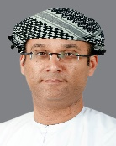

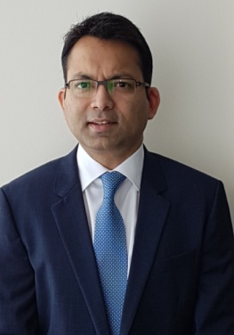
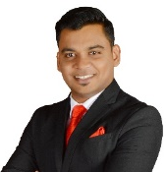
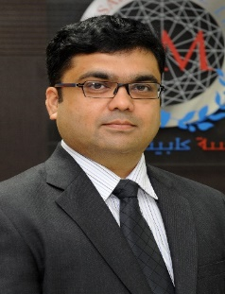

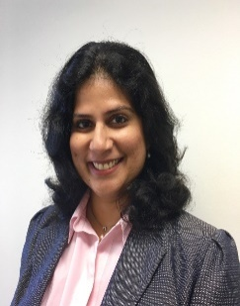
Regulus Asset Management Limited: Senior Executives
TARIQ AL AUJAILI
PARTNER
KARAN BANSAL
CO-HEAD, MEZZANINE FINANCING
CYRIL SAMSON
COMPLIANCE OFFICER - HEAD OF COMPLIANCE & RISK
17+ years of experience - Board member in listed and unlisted companies in Oman: Bank Dhofar, Dhofar Insurance, Dhofar Investment and Development International and Oman Investment and Finance Co.
Extensive exposure to implementation of strategic initiatives, business development, risk committees, audit committees, executive/management committees, transformation processes and corporate restructuring
BSc. in Accounting and Finance from the London School of Economics and Political Science, U.K.
Investment Banker with 17 years experience at HSBC – based in London (7 years) and MENA (10 years)
Worked in Leveraged & Acquisition Finance, Debt Advisory, Corporate Finance, Credit Ratings, M&A and Risk Advisory
Raised/advised on financing transactions in excess of c. USD50bn across various sectors and geographies
Left HSBC in 2H2017 as Regional Head of Corporate Finance and Debt Advisory, MENA
MSc. Management with Distinction, London School of Economics and Political Science, U.K.
A Certified AML/Compliance & Risk Management professional with over 9 years of experience in the BFSI industry in India and UAE with multinational banks such as JP Morgan Chase, Northern Trust
Has strong experience in Regulatory Compliance and AML/CFT. Central Bank of UAE Authorized Compliance Officer and Money Laundering Reporting Officer
Holds an MBA and Certified AML Specialist from ACAMS organization, Miami, Florida. His forte is fraud investigation, sanctions screening, risk management, world compliance checks – Client On boarding
CHARUDUTTA JOSHI
CEO, RFAPL
DEEPTI SAGAR
DIRECTOR, RFAPL
AMIT BAGRI
DIRECTOR, RFAPL
Charudutta Joshi has more than 19 years of experience in Wealth Management and Business Development. Before joining Regulus, he was with Al Masah Capital in Dubai. Prior to that Charudutta was Country head of ICICI Bank Qatar; and worked with ICICI Bank for more than 12 years in various positions and locations.
In last 5 years, he and his team raised in excess of USD175m across various businesses in healthcare, education and logistics sectors.
Charudutta has Bachelors in Commerce and a Post graduate certification in Management
Deepti has over 16 years of experience in managing Individual and institutional client relationships across the asset class spectrum ranging from investment mandates to private equity funds.
She has previously worked with Coutts & Co. and ICICI Bank located in London and Singapore
Amit has more than 21 years of experience in Wealth Management and Business Development. Before joining Regulus Advisors, Amit was a Private Banker with ABN AMRO, Singapore. He has also worked on Business Development with IIFL and was heading ENAM Securities, Chennai.
Amit has Bachelors of Science in Business Administration (Finance) and Bachelor of Arts (Economics) from Boston University, USA.
Flags indicate the location of the respective team member

Slide 11
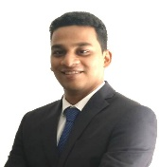
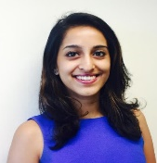
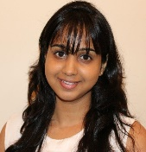
Regulus Asset Management Limited: Team Members
COLM PRESTON
DIRECTOR
MAJD KHODR, CFA
SENIOR VICE PRESIDENT
NEERAJ SAVANT
ASSOCIATE
Corporate finance professional with 11+ years of experience in Leveraged Finance and Corporate Banking across the UK, Ireland and Asia-Pacific regions
Worked on providing debt structuring and corporate finance advisory to a range of mid-market and large corporate entities in the UK and across Europe, with particular focus on PE and leveraged transactions
Master’s Degree in International Business and a PG Diploma in Business Studies from UCD Michael Smurfit Graduate School of Business in addition to BA, Economics from University College, Dublin
Worked with Malaz Capital, a SAR 600 million Mezzanine Fund in KSA with experience of having worked on 8 transactions with ticket sizes of SAR 20 - 50 million
Prior experience includes having worked with MEFIC Capital based out of KSA and Corporate Finance House based of Beirut and Dubai
Earned the CFA charter in 2015 and completed his BBA in Finance from the American University of Beirut, Lebanon
c. 4 years of investment banking experience at HSBC based in Bangalore, India
Worked primarily in M&A and Leveraged & Acquisition Finance related transactions
Worked on financing transactions in excess of c. USD10bn primarily across the MENA region
MBA in Finance from Symbiosis Centre for Management and Human Resource Development (SCMHRD) and Bachelors in Engineering from Mumbai University
KEITH TOH
VICE PRESIDENT, RFAPL
NANDITA JACOB
SENIOR ASSOCIATE, RFAPL
RACHAEL JAICHANDRAN
HUMAN RESOURCES
MEETU LOHIYA
DIRECTOR, LEGAL AFFAIRS
Over 10 years of experience in Wealth management, Client Portfolio Management and Business Development
Worked with various major banks such as Standard Chartered Bank, HSBC, DBS, UOB and Maybank
Holds several Financial certifications and a Diploma in Building and Real Estate Management
Serves as a key member to support Investor Relation duties at RFAPL
Previously worked with Barclays Bank PLC as a Premier & Wealth Service Specialist at the Global Client Service Centre
Holds a Bachelor in Business Management (Major in Finance & Psychology) from Singapore Management University
Rachael has more than 10 years of experience in Human Resources and Administration in the IT & Financial Services industry
Prior to joining Regulus Investments LLC, Rachael worked at Morgan Stanley supporting the Global Wealth Management Team
Rachael graduated from Osmania University
Meetu has more than 15 years of experience in Legal, Audit and Accounting
Prior to joining Regulus Investments LLC, Meetu worked at BMI Bank B.S.C.(c) Bahrain for eight years
Besides being a Lawyer, she is also a Chartered Accountant
Flags indicate the location of the respective team member

Slide 12
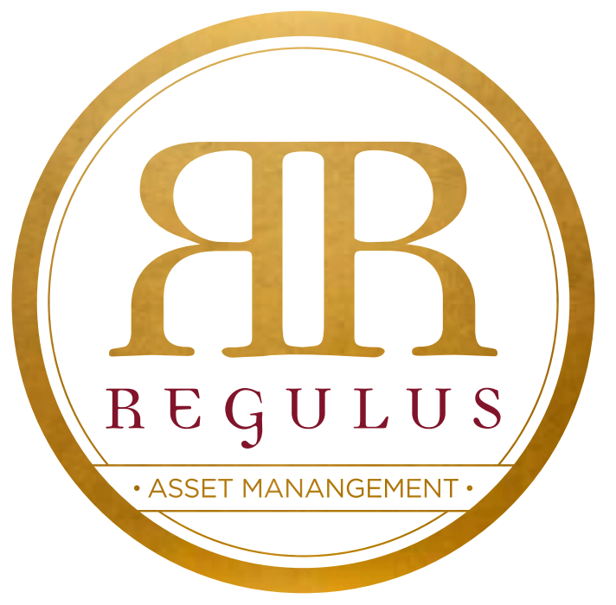
Option 1
Regulus Asset Management Limited: Solutions and Services Offered
Wide Array of Services Offered
1
ASSET MANAGEMENT
2
CORPORATE/ M&A ADVISORY
This division manages assets and investment portfolios on behalf of others, whether individuals or companies, in addition, to managing our own proprietary capital
RAML is the Investment Manager for Tad’eem Capital, a Cayman Islands exempted company established with the purpose of making investments in the private funding space across the MENASEA (Middle East North Africa and South East Asia) region
Aims to address the lack of flexible tailored capital for mid-market businesses, and invest across a variety of sectors and use of proceeds
RAML provides advice in relation to mergers and acquisitions, arranging or underwriting/participating in syndicated finance or debt capital markets, issuing of shares, private placements, and other related financial consultancy services. We also advise directly, in writing or through publications, the value of securities or other financial instruments, banking services and products.
We aim to offer a one-stop shop experience to our clients across all these advisory and capital raising services
3
RESEARCH
4
WEALTH MANAGEMENT
Our research underpins all our decision making processes and we extend our abilities to our clients through specific mandates as well as sectoral analysis
Some of our research is made available to public through our website
Our Wealth Management platform is set up to open investment accounts and provide financial solutions to grow, preserve and transfer wealth of our clients
We focus on established and trusted investment vehicles, in addition to active risk-management, to ensure both preservation and accumulation of wealth, and best devise strategies for each client’s specific financial objective
Flags indicate the location(s) offering the respective service

Slide 13
Regulus Asset Management Limited: Solutions and Services Offered
Wide Array of Services Offered
5
PRIVATE EQUITY ADVISORY
6
LIFE INSURANCE POLICY ADVISORY
From early stage concept development to transaction closure & post acquisition support, our Private Equity Advisory services are deployed throughout the transaction life cycle
Capturing growing demand in Asia for legacy, succession planning and intergenerational transfer of wealth. Our Financial Advisors will identify the need for and arrange life insurance contracts for our clients
7
CUSTODY SERVICES
At RAML, we establish and/or manage investment funds and private equity funds, and hold funds on trust on behalf of beneficiaries. We aim to provide high–quality, high–value–added trust and custody services to customers, including large institutional investors
Flags indicate the location(s) offering the respective service

Slide 14
Option 2
Regulus Asset Management Limited: Solutions and Services Offered
ASSET MANAGEMENT
CORPORATE/ M&A ADVISORY
WEALTH MANAGEMENT
PRIVATE EQUITY ADVISORY
LIFE INSURANCE POLICY ADVISORY
CUSTODY SERVICES
RESEARCH
1
2
3
4
5
6
7
Manages assets and investment portfolios on behalf of others, whether individuals or companies, in addition, to managing our own proprietary capital
Advices on M&A, arranging or underwriting/participating in syndicated finance or debt capital markets, issuing of shares, private placements, and other related financial consultancy services
Underpins all our decision making processes and we extend our abilities to our clients through specific mandates as well as sectoral analysis
Some of our research is made available to public through our website
Set up to open investment accounts and provide financial solutions to grow, preserve and transfer wealth of our clients
Focus on established & trusted investment vehicles, in addition to active risk-management
From early stage concept development to transaction closure & post acquisition support, our Private Equity Advisory services are deployed throughout the transaction life cycle
Capturing growing demand in Asia for legacy, succession planning and intergenerational transfer of wealth. Our Financial Advisors will identify the need for and arrange life insurance contracts for our clients
Aim to provide high–quality, high–value–added trust and custody services like incorporation across different jurisdictions to customers, including large institutional investors
Note: Flag(s) indicate the location(s) offering the respective service

Slide 15
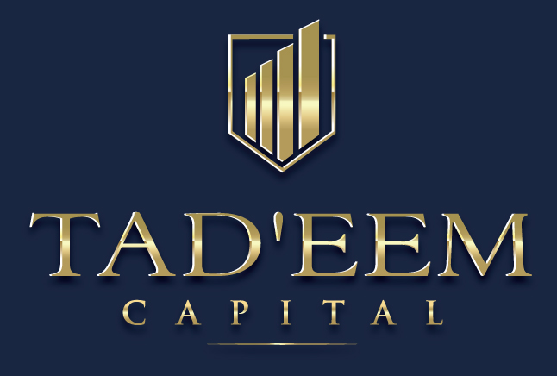
1
Asset Management: At a glance
RAML Investment Approach and Strategy
A
Established with the purpose of making investments in the private funding space across defensive sectors in MENA and SEA regions
Regulus Asset Management Limited (“RAML”)
B
Provide mezzanine financing solutions to mid-market companies looking to fund: 1. Growth / expansion 2. Acquisitions & bolt-ons 3. Recapitalize balance sheets 4. LBOs
Investment Manager
C
Invest across key defensive sectors such as healthcare, education, logistics; in addition to “opportunistic” sectors
D
Deliver healthy risk-adjusted returns with contractual income and downside protection, while participating in the upside through equity warrants
E
Targets gross returns in excess of 15% with an average annual 7-8% dividend yield
15
Flags indicate the location(s) offering the respective service

Slide 16

Mezzanine Financing: Key Investment Highlights
MENA is an emerging economy with domestic credit reported as 85% of GDP, as opposed to developed markets credit ratios of between 100% and 200%, despite positive demographics, private consumption and improved credit rating
SEA region is the fastest growing economy in the world with a GDP growth of 6.7% and moderate credit risk rating
Attractive macro fundamentals in MENA and SEA
Consumer- focused sectors; need for tailored growth capital
RAML team has extensive experience of financing and investment/advisory experience across defensive consumer-focused industries, growing between 4% and 12% annually
Limited access to bank financing for companies looking for growth highlights an opportunity for bespoke private capital solutions
Target returns
Target IRRs above 15%, intended average dividend payout of 7-8%
Fixed-income payouts plus potential upside through equity warrants and structuring
10+ investment professionals
Experienced professionals from private equity, investment banking, consulting, audit and investor relations backgrounds
Cumulative experience >150 years in financial services
Excellent ability to price/structure risk and attract enhanced yield
Raised/advised on financings in excess of c. USD 50 billion globally; across both mid-market and large “elephant” deals
Deployed c. USD500 million¹ across mid-market transactions over the period 2011-2017;
AUM of c. USD850 million as of 2017
Backed by a large number of institutional and corporate investors from emerging and developing markets
Group’s investment track record
1. Team has deployed c. USD1.1bn prior to this period and in another professional capacity
16

Slide 17
RAML and Tad’eem Capital: Investment Strategy
USD 5 million to 50 million dollars in revenue
Companies with recurring cashflows
Defensive and growing companies – niche offering
4
Structuring and downside protection
Creditor friendly jurisdictions
Minimum contractual returns
Conservative opening leverage and adequate stress testing of operating drivers
1
Target Mid Market
Structuring and Downside Protection
2
5
Sponsored and non sponsored
On the ground presence and coverage
Proactive origination via multiple partners and channels
Sourcing
Annual Yield and Returns
Intended annual dividend between 7% to 8%
IRRs in excess of 15% - combination of cash pay periodic return, PIK return and/or equity upside
3
INVESTMENT STARTEGY
6
MENA and South-East Asia as primary focus
Sub-Saharan Africa as “opportunistic” focus
Geography
Governance
Board seat or Observer rights
Monitoring of financial covenants
Investor reporting
Illustrative List of sectors we aim to invest in:
Healthcare
Education
Logistics
Defensive
Retail
Facilities Management
17

Slide 18
Robust Operating Framework
Origination and Screening
Investment Approval and Due Diligence
Closing
Portfolio Monitoring
Proprietary origination
Regular pipeline management
Initial screening based on investment strategy and structure
Analysis of financials
Preliminary investment memo
Assessment of industry, risk
Repayment, cash flow modelling
Appointment of independent due diligence team
Final investment approval
Transaction closing and legal documentation
Company becomes a portfolio company upon closing
Regular dialogue with management
Board seat/observer rights - monitor performance, reporting, covenant compliance
Disciplined Investment Process
Investment Committee
Portfolio Review
Compliance Process
Investment committee comprised of 5 team members
Responsible for investment and disposition policy
Investment approval based on super majority
A dedicated team with deep operational expertise
Portfolio management done in alignment with covenants
Ensures compliance with the deal’s risk management policy
Dedicated in house compliance team
Independent compliance officer
Strict AM L/KYC policies
Reputable service providers and/or advisers
Robust Corporate Governance
Manager Commitment
Investor Reporting
Service Providers
Sizeable commitment by principals towards paid up capital
Dedicated investor relations team
A structured investor reporting process to include quarterly reports, annual financial statements
Leading accountancy and legal firms as service providers
Strong Alignment with LPs
18

Slide 19
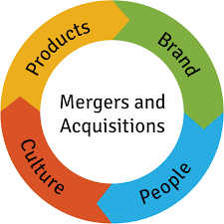
2
Corporate / M&A Advisory: At a glance
Our corporate / M&A advisory professionals work alongside our clients to provide transaction, financing and restructuring services
BUY SIDE ADVISORY
Strategic Expansion Evaluation
Target Identification & Valuation
Due diligence coordination
Assessment of possible synergies
i
ii
ii
iv
CAPITAL
STRUCTURE ADVICE & RESTRUCTURING SUPPORT
SELL SIDE ADVISORY
Review of future cash flow needs
Balance sheet restructuring
Recommendations on optimal capital structures and negotiations with capital providers
Transaction Structuring
Identification of potential buyers
Deal Sourcing
iii
FUND RAISING
iii
Assessment of capital needs & capital raising process
Fund raising preparation and identification of potential lenders and/or investors
Negotiation & closing
19
Flags indicate the location(s) offering the respective service

Slide 20
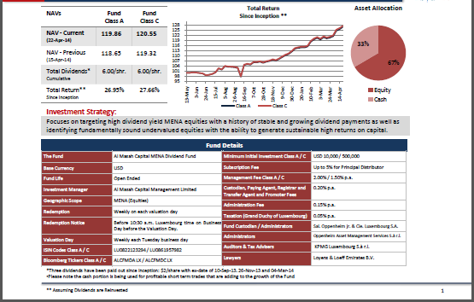
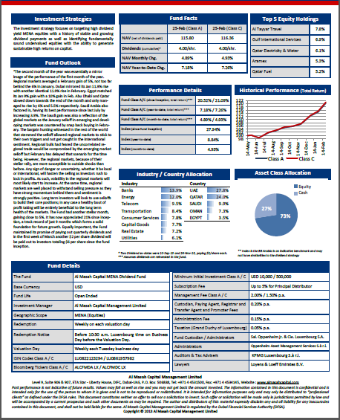
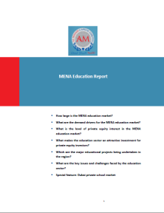
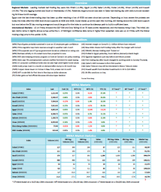
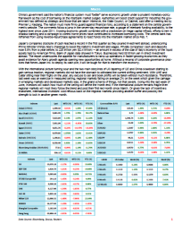
3
Research: At a glance
We recognize the importance of fundamental research as the basis for each and every investment
The research department follows a dynamic approach to data gathering, analysis and reporting
INVESTMENT RESEARCH
Business & Investment review
Feasibility Studies
Financial Modeling
ONGOING
INVESTMENT
REPORTING
BESPOKE
INVESTMENT
ANALYSIS
INDUSTRY RESEARCH
Industry coverage across multiple asset classes
Identification of industry trends
Geographical & Sectoral studies
Assessment of local dynamics
CUSTOMIZED INDUSTRY RESEARCH
REPORTS
DAILY MENA
MORNING
REPORT
WEEKLY
INVESTMENT
REPORT
DAILY SEA
MORNING
REPORT
20
Flags indicate the location(s) offering the respective service

Slide 21


4
Wealth Management: At a glance
We offer the convenience of professionally selected offerings within each asset class which allows the investor to build value and safeguard returns
High Liquidity
Short Term Bonds Strategies
Medium Liquidity
Mutual Funds
Multi-asset Portfolio
Money Market Funds
Fixed Maturity Fund
IPO Fund
Structured Equity Products
REITS
Sovereign Credits
Index Funds
ETF’s
Long Term Annuities & Bonds
Dividend Fund
Discretionary Portfolio
Long term Equity Strategies
Growth Fund
Private Equity
Mezzanine Funds
Low Liquidity
Real Estate
ART
21
Flags indicate the location(s) offering the respective service

Slide 22
5
Private Equity Advisory: At a glance
We offer customized financial solutions to our private equity clients
Our industry experts work closely with our customers to understand their needs and provide them practical and execution focused advice
From deal initiation to asset acquisition & optimization, we leverage on our capabilities and focus on critical aspects that help our clients enhance their enterprise value
STRATEGIC SUPPORT
TRANSACTION SUPPORT
OPERATIONAL SUPPORT
Market & Investment Research
Equity Placement Advice
Debt Placement Advice
Deal Origination
Synergy Identification
Asset/ Portfolio Valuation
Financial & Commercial Due Diligence
Transaction Structuring
Transaction Negotiation & Closing
Post-acquisition Planning
Synergy Implementation
Performance Optimization
Operational risks Advice
22
Flags indicate the location(s) offering the respective service

Slide 23
6
Life Insurance Policy Advisory: At a glance
Capturing growing demand in Asia for legacy, succession planning and intergenerational transfer of wealth
Our Financial Advisors will identify the need for and arrange life insurance contracts for our clients
7
Custody Services: At a glance
At RAML, we establish and/or manage investment funds and private equity funds, and hold funds on trust on behalf of beneficiaries. We aim to provide high–quality, high–value–added trust and custody services to customers, including large institutional investors
23
Flags indicate the location(s) offering the respective service

Slide 24
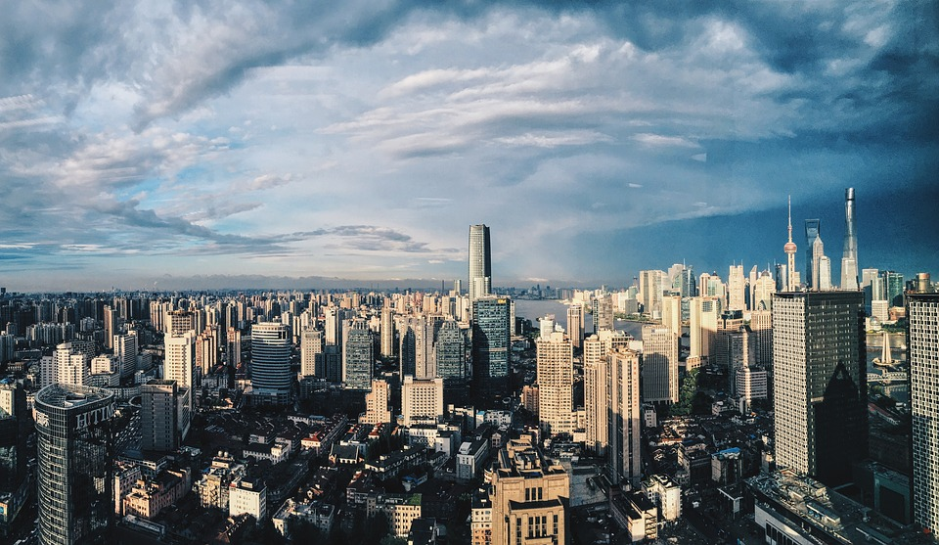
THANK YOU

Slide 25
Regulus Asset Management Limited
c/o Walkers Corporate Limited, Cayman Corporate Centre, 27 Hospital Road, George Town, Grand Cayman KY1-9008, Cayman Islands
UAE
Singapore
Regulus Investments LLC
Suite 1502, Khaled Al Attar Tower, Millennium Tower and Hotel,
Trade Centre 1st,
Sheikh Zayed Road
P.O. Box 414702
Dubai, UAE
Allied Investment Partners PJSC
Al Neem Tower
Khalifah Street
3rd Floor, Office 301
109248
Abu Dhabi, UAE
Regulus Financial Advisors Private Limited
6 Shenton Way, #44-01 OUE Downtown 1,
Singapore 068809

