Slide 1
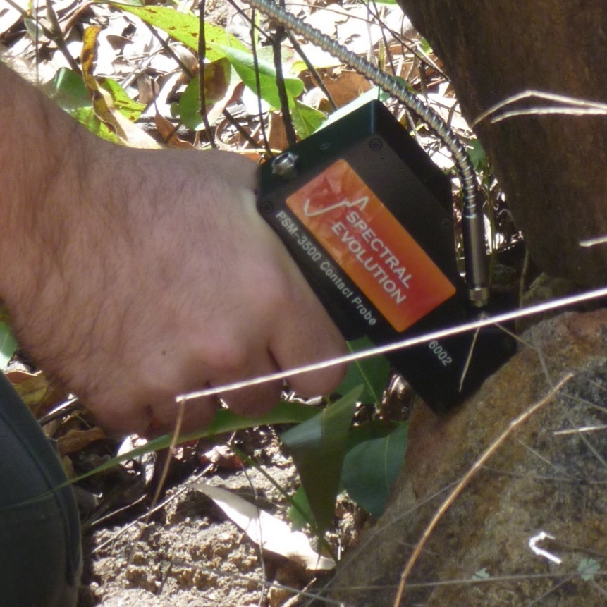
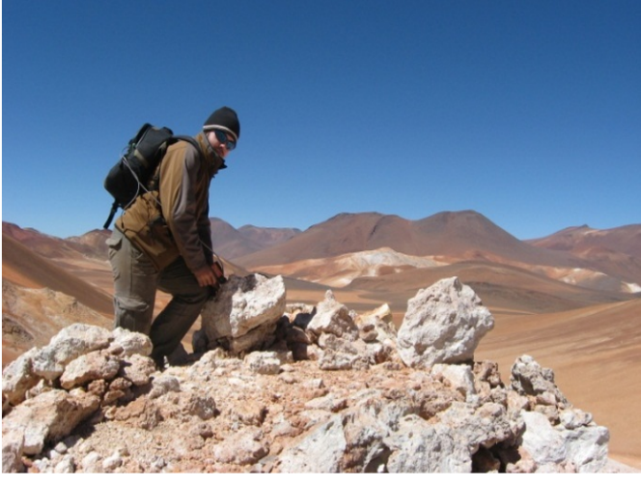
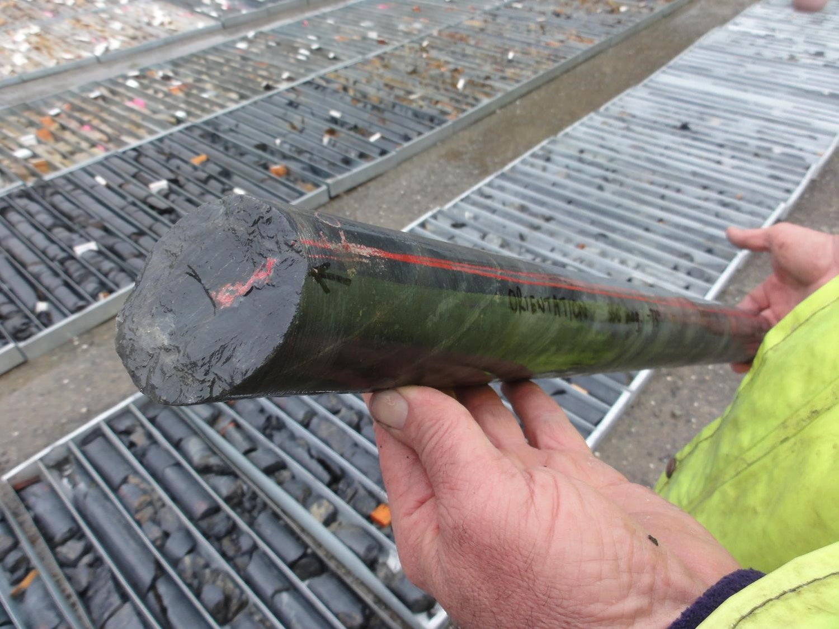
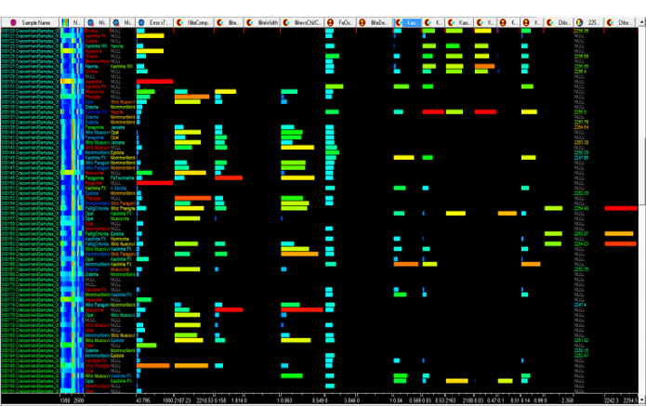
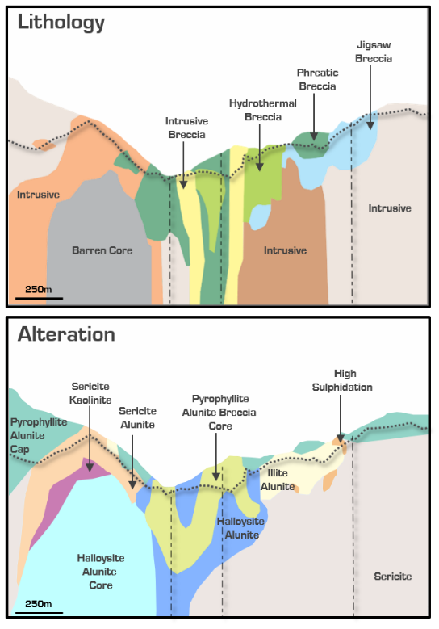

Global Ore Discovery Spectral Geology
Support and insight to make breakthroughs
Global Ore Discovery provides a complete spectral geology service.
Equipment hire, licencing and logistics to Asia, Africa, Australia, Canada, Europe, Pacific Rim Nations and South America
PSM / ASD specialists to acquire and validate spectral data from soil, rock chip and downhole samples (chips and core)
GIS geologists to interpret spectral signatures, develop alteration models and identify mineralisation vectors
Senior geologists that integrate spectral data with drilling, false-colour imagery (satellite data), lithology, geochemical assays (geochemistry/ assays), geochron, geophysics, radiometrics and structure to generate high-quality exploration targets
Generative consultants that integrate alteration models and mineralisation vectors with tectonic models, field mapping, mineral distribution intensity and abundance maps, grade shell models and geophysical models to produce new exploration concepts
New Targets

Slide 2

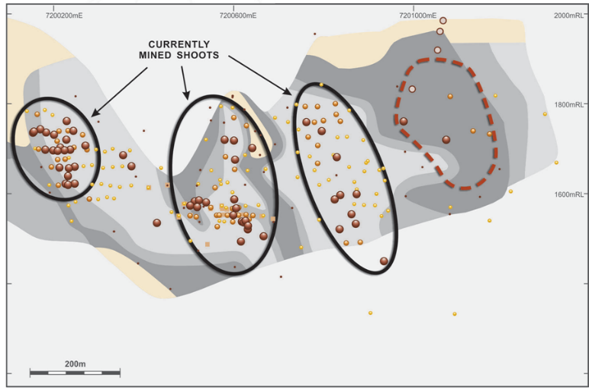

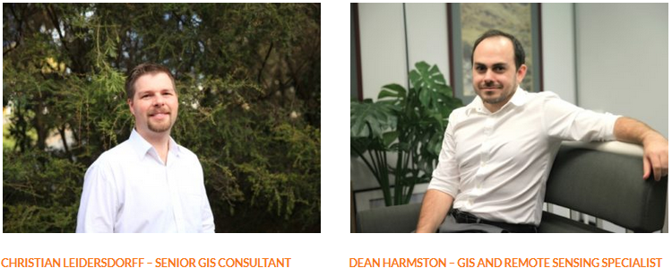
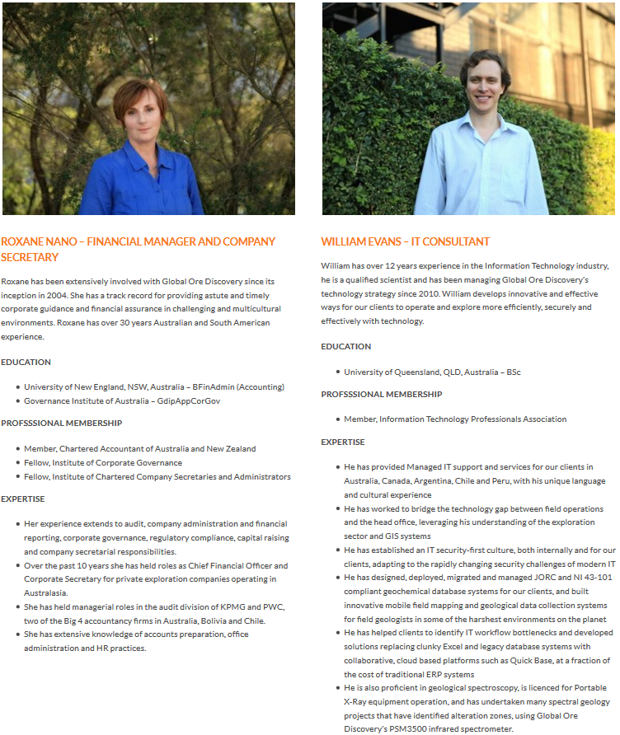
Global Ore Discovery Spectral Geology and Earth Imagery
Support and insight to make breakthroughs
Marketing and promotions specialists to draft high impact graphics for public release and to communicate PSM results to investors
Competent Persons and QAQC systems to report PSM results in accordance with JORC and NI43-101 standards
--------------------------------------------------------
And did you know, Global Ore Discovery also acquire, process and interpret earth imagery … you can ask us to produce ASTER, HYMAP, LANDSAT, High-resolution drone-acquired Thermal Infrared, Worldview 3, LIDAR and RADAR products for you.
Need an airborne magnetics, radiometrics and topographic surveys… call or email Global Ore Discovery +61 7 3613 88 00
New Discovery

Slide 3
Global Ore Discovery Spectral Geology and Earth Imagery
Trained teams make breakthroughs
Global Ore Discovery provides a complete SPECTRAL GEOLOGY TRAINING service.
Courses on equipment use, licencing and data interpretation are available to early career geoscientists, senior geologists and exploration managers across Asia, Africa, Australia, Canada, Europe, Pacific Rim Nations and South America
Learn how PSM / ASD specialists acquire and validate spectral data from soil, rock chip and downhole samples (chips and core)
Understand how Spectral Geologist’s interpret PSM / ASD strip logs, develop alteration models and identify mineralisation vectors
Meet senior geologists that integrate spectral data with drilling, false-colour imagery (satellite data), lithology, geochemical assays, geochronology, geophysics, radiometrics and structure to generate high-quality exploration targets
Participate in a case-study where generative consultants integrate alteration models and mineralisation vectors with field mapping, mineral distribution intensity and abundance maps, grade shell models, geophysics and tectonic models to produce new exploration concepts
See how marketing and promotions specialists incorporate PSM data into high impact graphics for public release and to communicate investment opportunities to market participants and senior management
Ask our Competent Persons and QAQC experts how to report PSM results in accordance with JORC and NI43-101 standards
And did you know, Global Ore Discovery also acquire, process and interpret earth imagery … you can ask us to produce ASTER, HYMAP, LANDSAT, High-resolution drone-acquired Thermal Infrared, Worldview 3, LIDAR and RADAR products for you.
Need an airborne magnetics, radiometrics and topographic surveys… call or email Global Ore Discovery +61 7 3613 88 00

Slide 4
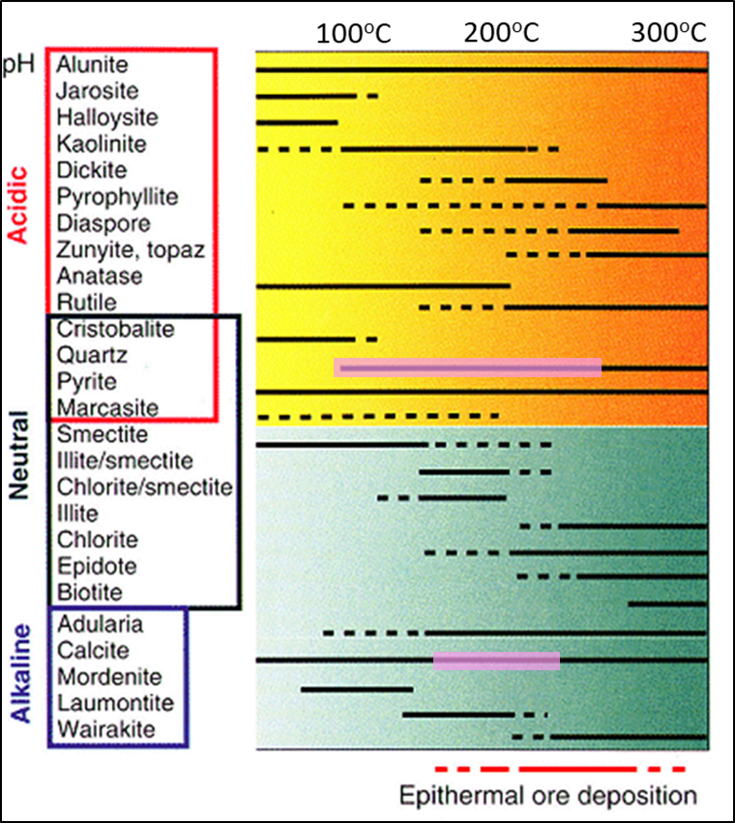
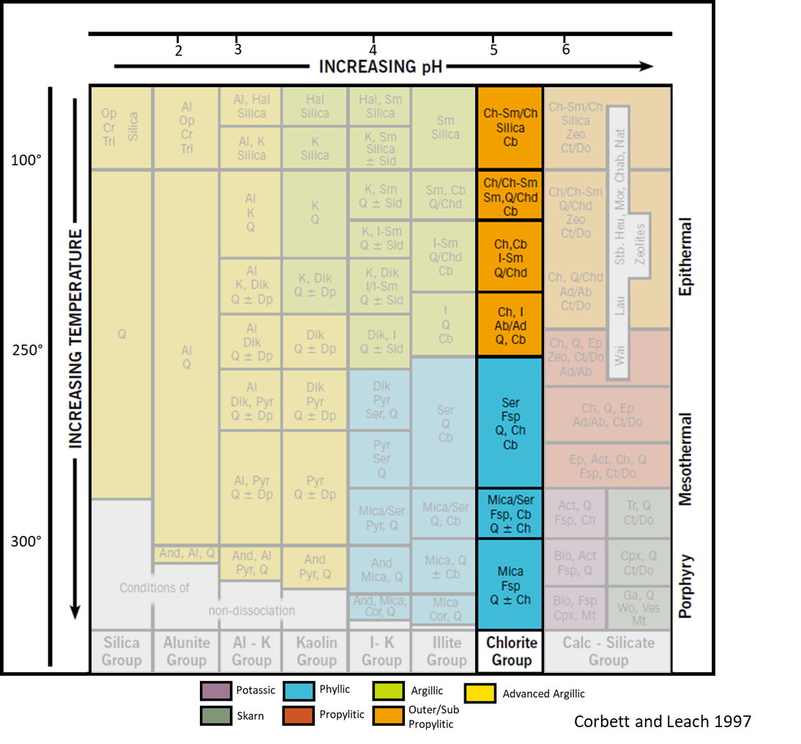
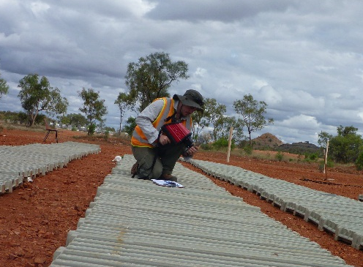
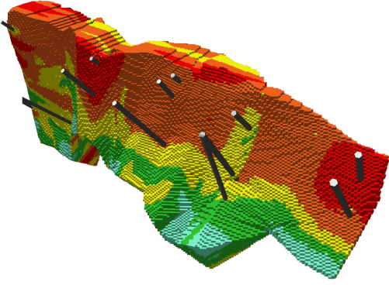
Global Ore Discovery Spectral Geology and Earth Imagery
Trained teams make breakthroughs
Global Ore Discovery provides a complete SPECTRAL GEOLOGY TRAINING service.
Courses on equipment use, licencing and data interpretation are available to early career geoscientists, senior geologists and exploration managers across Asia, Africa, Australia, Canada, Europe, Pacific Rim Nations and South America
Learn how PSM / ASD specialists acquire and validate spectral data from soil, rock chip and downhole samples (chips and core)
Understand how Spectral Geologist’s interpret PSM / ASD strip logs, develop alteration models and identify mineralisation vectors
Meet senior geologists that integrate spectral data with drilling, false-colour imagery (satellite data), lithology, geochemical assays, geochronology, geophysics, radiometrics and structure to generate high-quality exploration targets
Participate in a case-study where generative consultants integrate alteration models and mineralisation vectors with field mapping, mineral distribution intensity and abundance maps, grade shell models, geophysics and tectonic models to produce new exploration concepts
… call or email Global Ore Discovery +61 7 3613 88 00

Slide 5
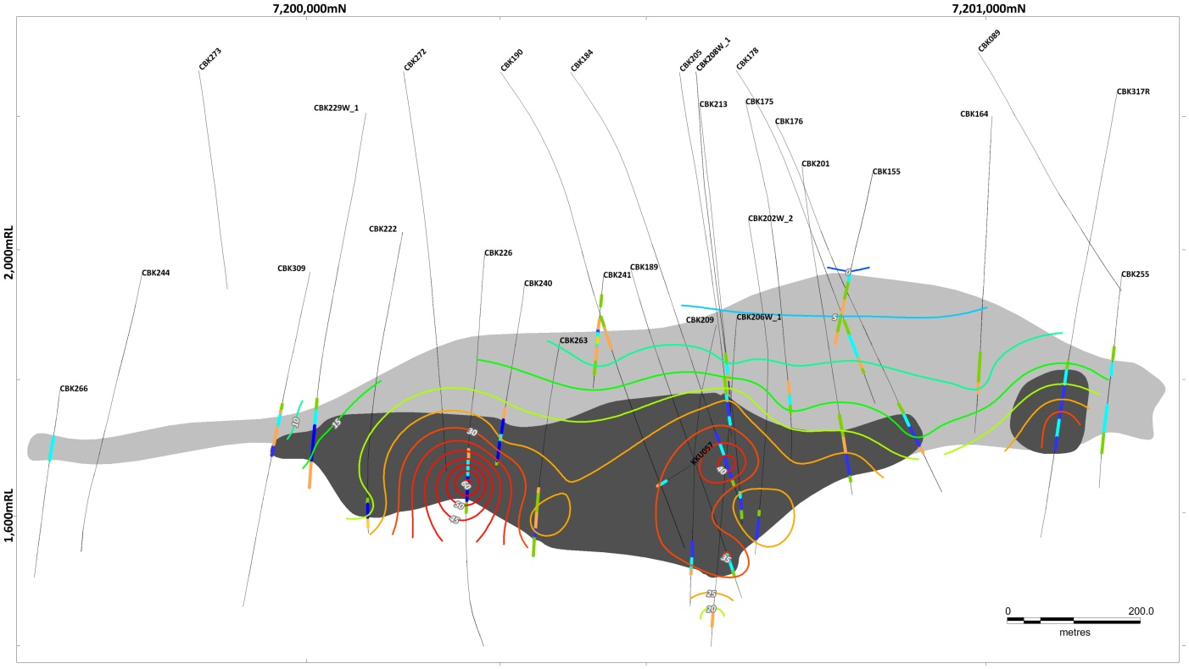
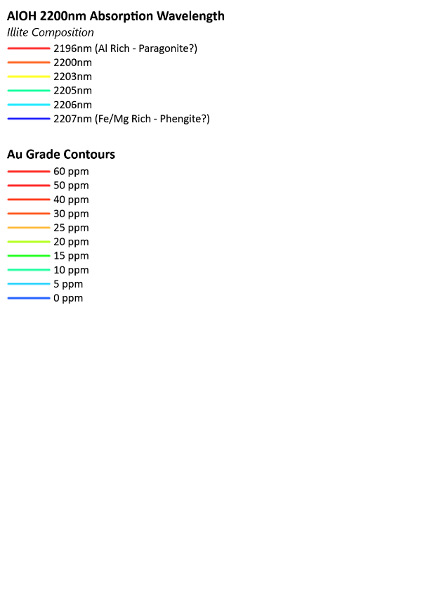
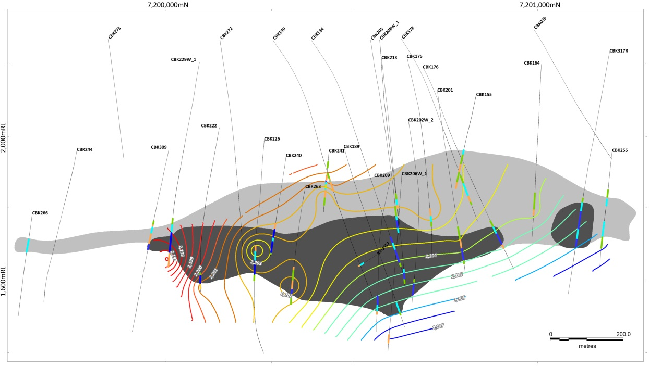
Global Ore Discovery Spectral Geology and Earth Imagery
Trained teams make breakthroughs
Global Ore Discovery provides a complete SPECTRAL GEOLOGY TRAINING service.
See how marketing and promotions specialists incorporate PSM data into high impact graphics for public release and to communicate investment opportunities to market participants and senior management
Ask our Competent Persons and QAQC experts how to report PSM results in accordance with JORC and NI43-101 standards
And did you know, Global Ore Discovery also acquire, process and interpret earth imagery … you can ask us to produce ASTER, HYMAP, LANDSAT, High-resolution drone-acquired Thermal Infrared, Worldview 3, LIDAR and RADAR products for you.
Time to train your team and make an exploration breakthrough… call or email Global Ore Discovery +61 7 3613 88 00
Vein Long Section - Operating Mine
Global Ore acquired, analysed and interpreted PIMA spectra to build alteration model
Top of ore shoots defined by
change in kaolinite crystalinity
New Target
Grade Thickness
Contours
Temperature vectors interpreted from mica composition indicate fluid source location
outflow
New
Target
Mica compositional
contours

