Slide 1


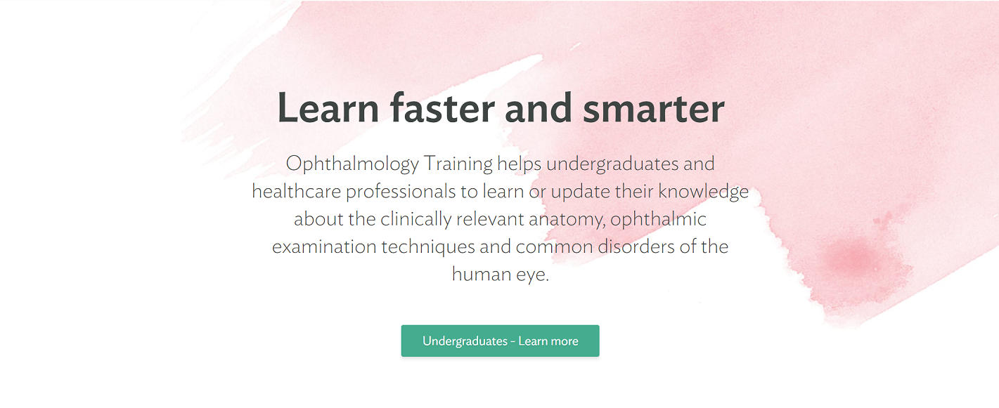





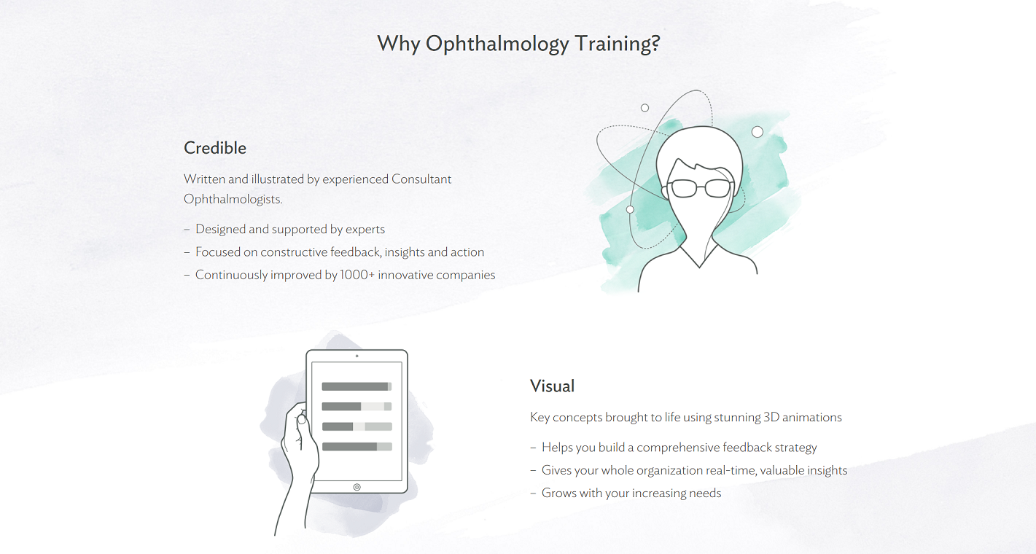
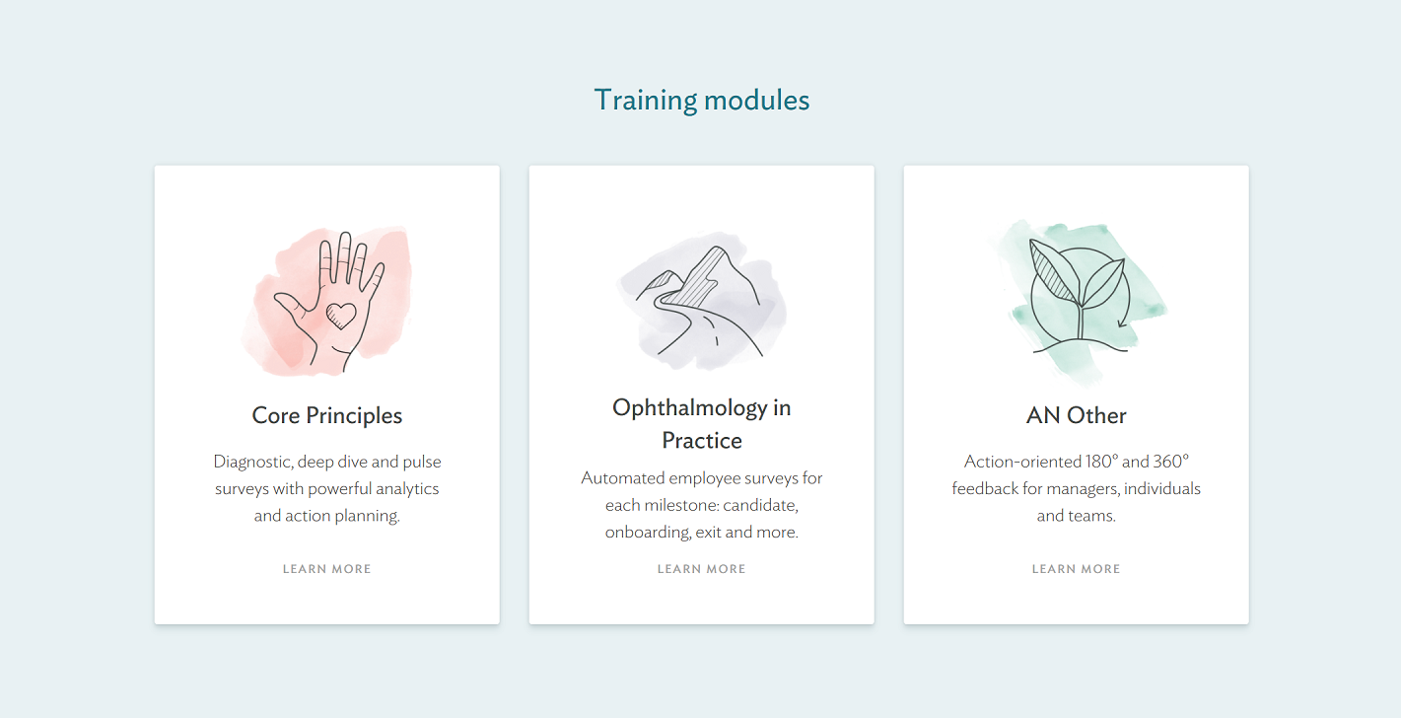





HOME PAGE
New Ophthalmology Training Logo
Video Panel
Learn faster and smarter
Ophthalmology Training helps undergraduates and healthcare professionals to learn or update their knowledge about the clinically relevant anatomy, ophthalmic examination techniques and common eye disorders of the human eye.
Button
“Undergraduates – Learn more”
Button
“Healthcare Professionals – Learn more”
Logo
e.g. Medical School
Logo
e.g. Medical School
Logo
e.g. Medical School
Icon/Image
Icon/Image
Icon/Image
Icon/Image
Icon/Image
Meet the team
Icon/Image
/Founder Bio
Icon/Image
/Founder Bio
Icon/Image
/Founder Bio
Icon/Image
/Founder Bio
Icon/Image
Icon/Image
Image
Notes:
Cultureamp.com

