Slide 1
Logo creative direction for
SECOND LEVEL PARTNERS

Slide 2
Colors/Logo should represent these words:
Strength.
Diligent.
Thoughtful.
Credible.
Trustworthy.
Red, Orange, Blue and/or Green

Slide 3



Slide 4
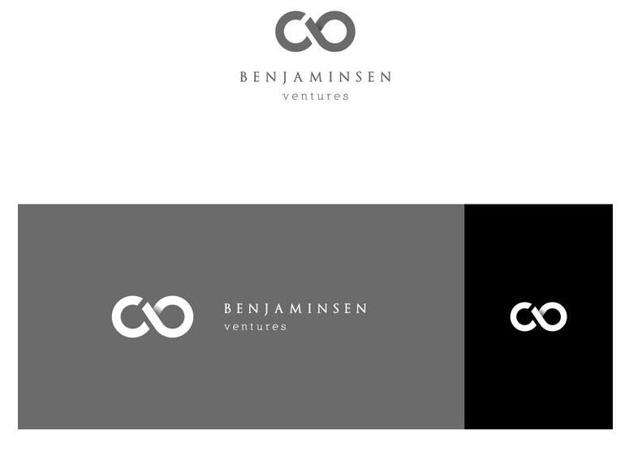

Slide 5

Creative direction idea for the initials “SLP”

Slide 6


Slide 7


Slide 8

I liked this logo that we had done for Virool

Slide 9


Slide 10


Slide 11


Slide 12


