Slide 1



Slide 2



Simple Ideas Help the Industry Take Off…
After acquiring Shakeproof Screw and Nut Lock Company in 1923, ITW engineers developed the Shakeproof twisted tooth lock washer which had numerous applications on the Ford Model-T to resolve issues caused by uneven road conditions.
Notes:
Byron Smith - When ITW acquired Shakeproof Screw and Lock company in the 1920s, the timing could not have been better. Americans’ demand for mass-produced automobiles was rising at an incredible rate. The automotive industry was struggling to keep the screws in their vehicles from jarring loose on the nation’s very bumpy new roads.
Enter ITW Shakeproof’s twisted tooth lock washer. A simple device, the washer was placed under the head of a screw to keep it from loosening. This seemingly small innovation improved the quality and durability of vehicles, not to mention the reputation, of the burgeoning auto industry. From that new product many others have been created, including plastic fasteners that serve a wide range of industrial applications. ITW Shakeproof continues to revolutionize the stampings industry with a diverse and uniquely tooled product line. Their retainers and washers, like the lock washer of 1923, are among the finest state-of-the-art, anti-vibration, anti-loosening, mechanical fastening devices available.

Slide 3

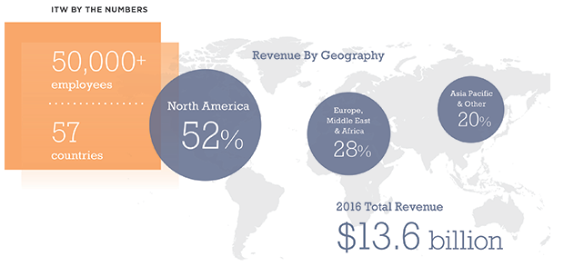
Illinois Tool Works A Global Company
Notes:
ITW Businesses operate in nearly every corner of the globe, with significant presense in developed as well as emerging markets. In fact, half of our revenue is generated outside of the United States. Strategic, global expansion offers significant opportunity for our customers, shareholders and our talented employees.

Slide 4




Slide 5
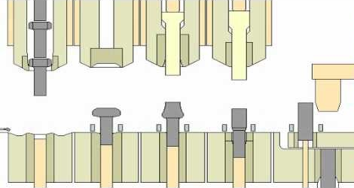
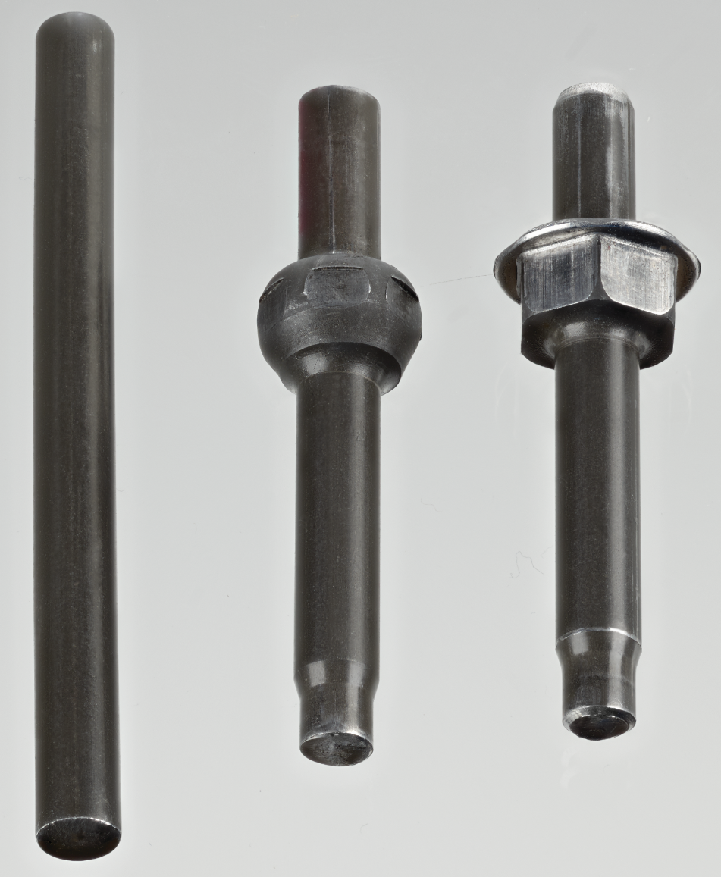
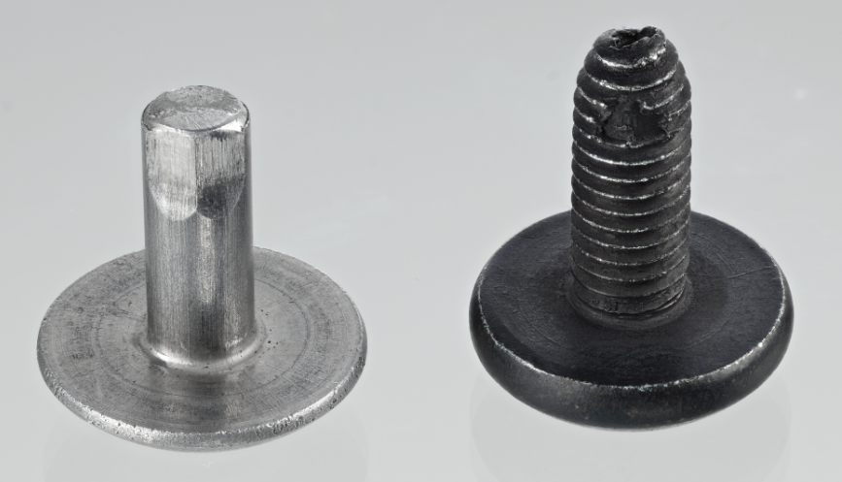
Domestic Cold Forging
Manufacturer
Cold Heading
Cold Rolling

Slide 6


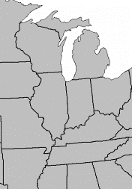
Domestic Engineering
Manufacturing and Engineering Facilities
Milwaukee, WI – Mellowes Lock Washers & CNC
Watertown, WI – Alpine Threaded, Bee Leitzke Pins
Iron Ridge, WI – Shipping Warehouse
Broadview, IL – ITW Shakeproof Stampings
Galatin, TN – CIP Stampings, clips, Internal Threaded

Slide 7
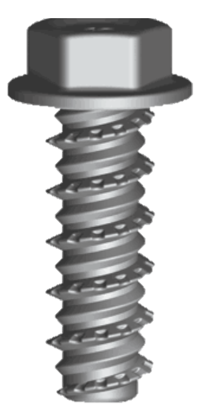

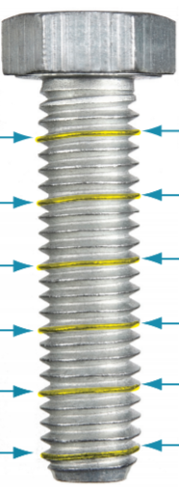
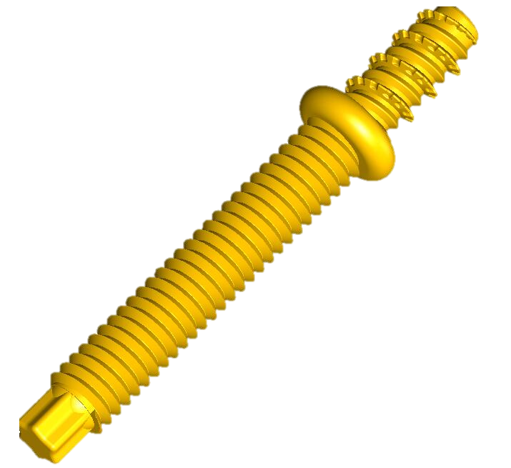
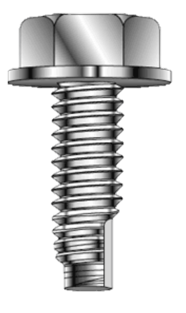
Unique Challenges… Solved
Deck Attachment
ITW BosScrew and TAP-R
Clutch Assembly
Various Thread forming issues in plastic and metal … Solved!
ITW BosScrew
Plastic joint challenges
Vibration, loosening,
heat… Solved!
Blade Bolt
Shakeproof Thread
Unique locking issue that required no adhesives… Solved!
Headlight Assembly
ITW BosScrew
Loosening challenge
Taptite replacement
need… Solved!
Engine Mount
ITW TAP-R
Loosening challenge
Taptite replacement
need… Solved!

Slide 8
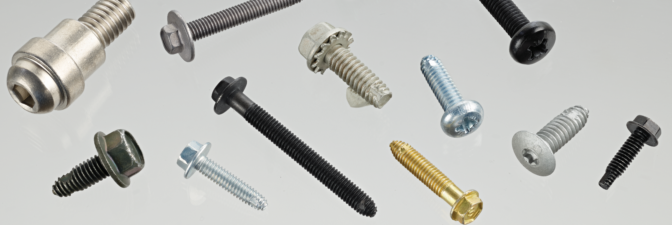
Threaded Product
Thread Size | Min. Length | Max. Length
#6 | .1750 | 1.50 | in
#8 | .1750 | 1.50 | in
#10 | .1750 | 1.50 | in
M5 | 4.45 | 38.10 | mm
#12 | .4375 | 1.63 | in
M6 | 11.11 | 41.28 | mm
1/4 | .4375 | 1.63 | in
5/16 | .4375 | 2.13 | in
M8 | 11.11 | 53.97 | mm
3/8 | .5000 | 3.70 | in
M10 | 12.70 | 93.98 | mm
7/16 | .5000 | 4.75 | in
M12 | 12.70 | 120.65 | mm
1/2 | .5000 | 4.75 | in
Single and Multi Die Cold Headers
Thread Forming
Thread Cutting
Teks Self-Drilling
SEMS
#2 to 1” diameter, up to 8” Lengths
Ferrous (Carbon & Alloy)
Stainless - Brass

Slide 9
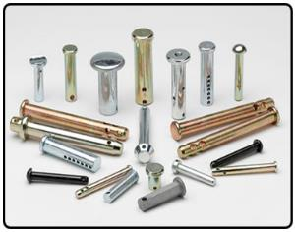
Pins (Bee Leitzke)
Single and Multi Die Cold Headers
Clevis Pins
Cotter Pins - Hairpins
Hitch Pins - Lock Pins
Lynch Pins
CNC Turned Products
3/16 – 1” Diameters to 8” in Length
Ferrous (Carbon & Alloy) - Stainless

Slide 10
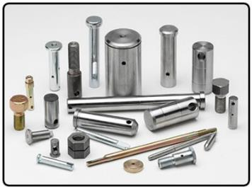
CNC Machining
Mazak – Haas
Single – Multi Spindle
Headless
Grooved
Cross - End Drilled
Tapped
Threaded
To 2-1/2” Diameter
Ferrous (Carbon & Alloy) - Stainless

Slide 11
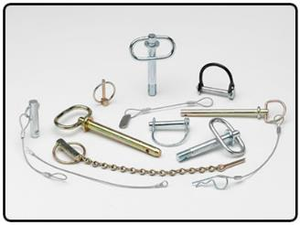
Assemblies (Bee Leitzke)
Preventive Loss
Lanyards
Wire Forms
Handles
Aircraft Cable
Nylon Coated
Stainless - Galvanized

Slide 12
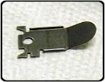
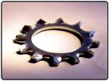
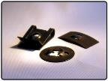
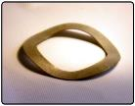
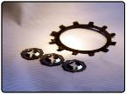
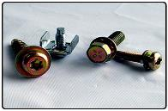
Stampings
SEMS Washers / Over Thread Washers
Twisted Tooth Washers
Square Cone / Crest Cup
Conical
Wave
Retainers
Specials
#4 – 2” Thickness .008-.129”
Ferrous – Non Ferrous

Slide 13
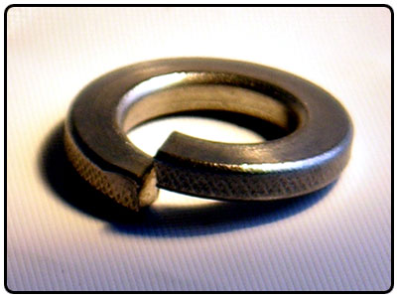
Helical Lock Washers (Mellowes)
Standards
Heavy/Extra Duty
Hi-Collar
Double Coil
SEMS
#4 to 3” Diameters
Ferrous – Non Ferrous – Kmonel

Slide 14
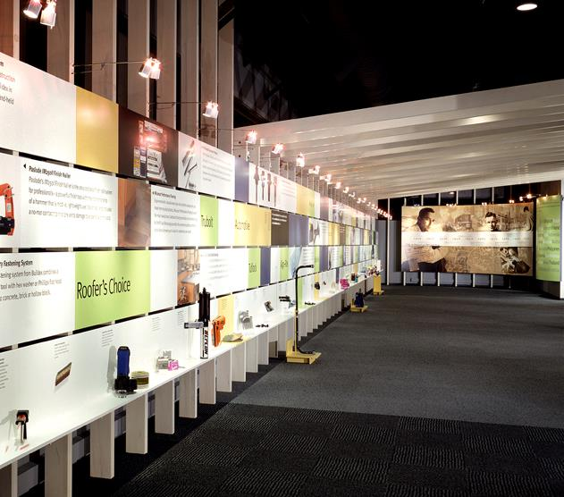
ITW Shakeproof Innovations

Slide 15
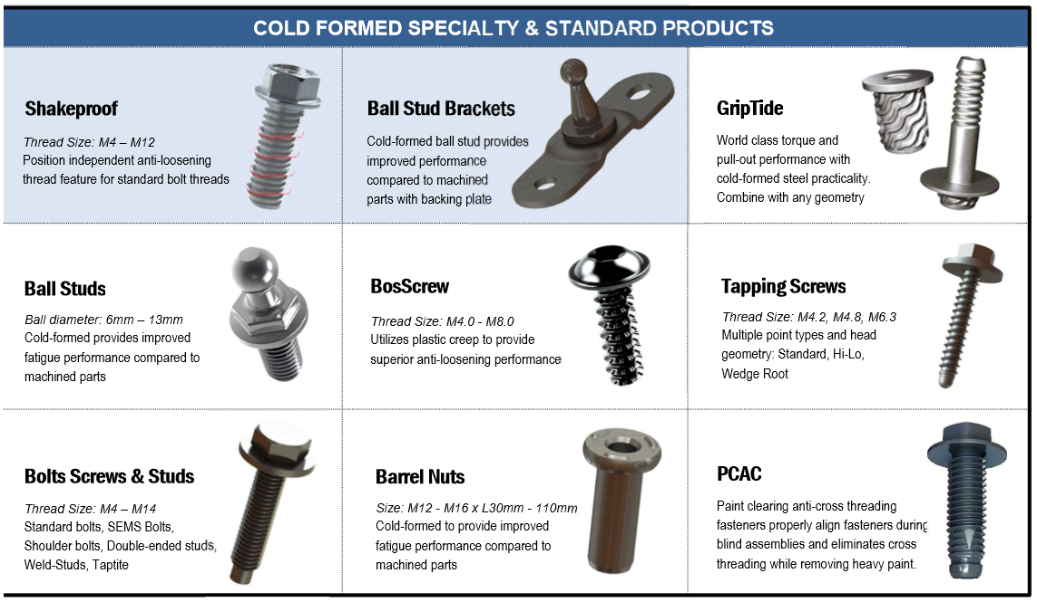
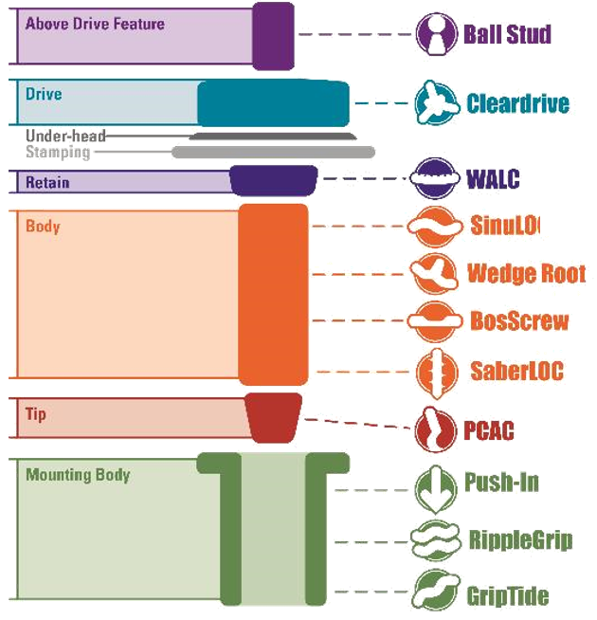
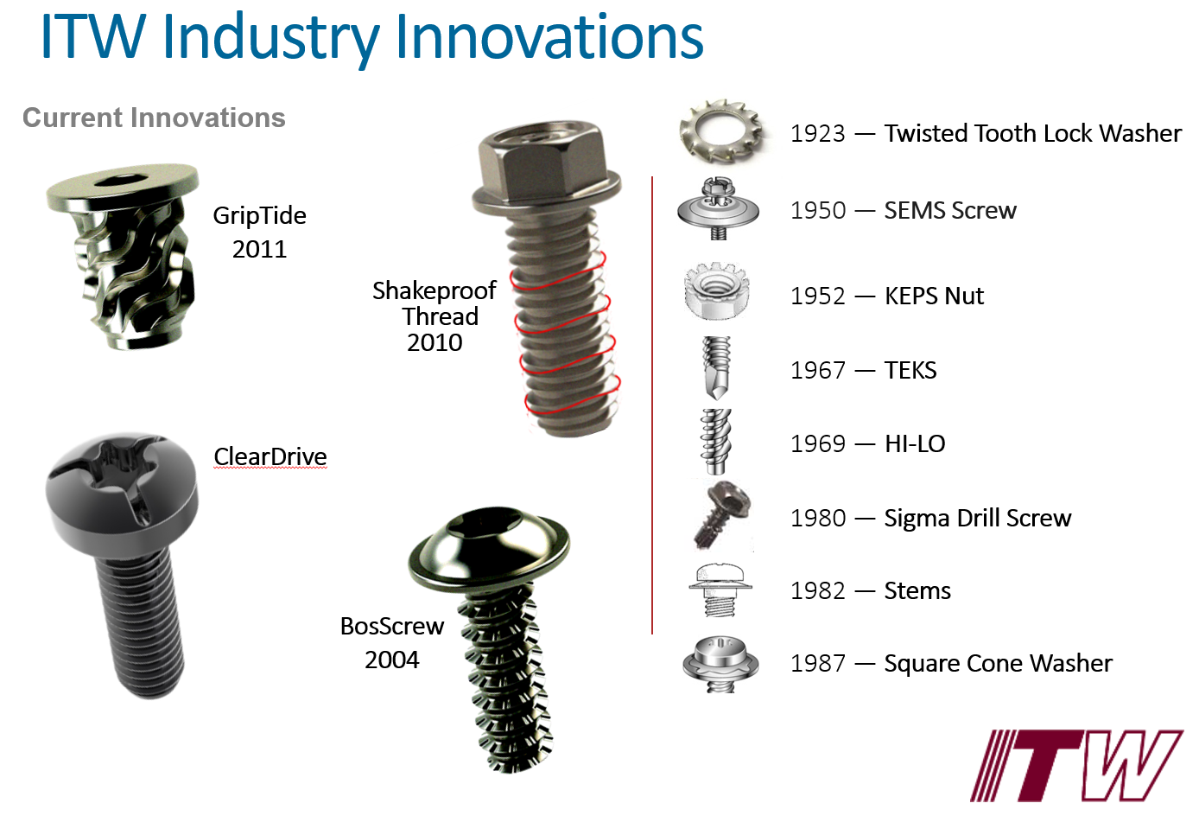

Slide 16
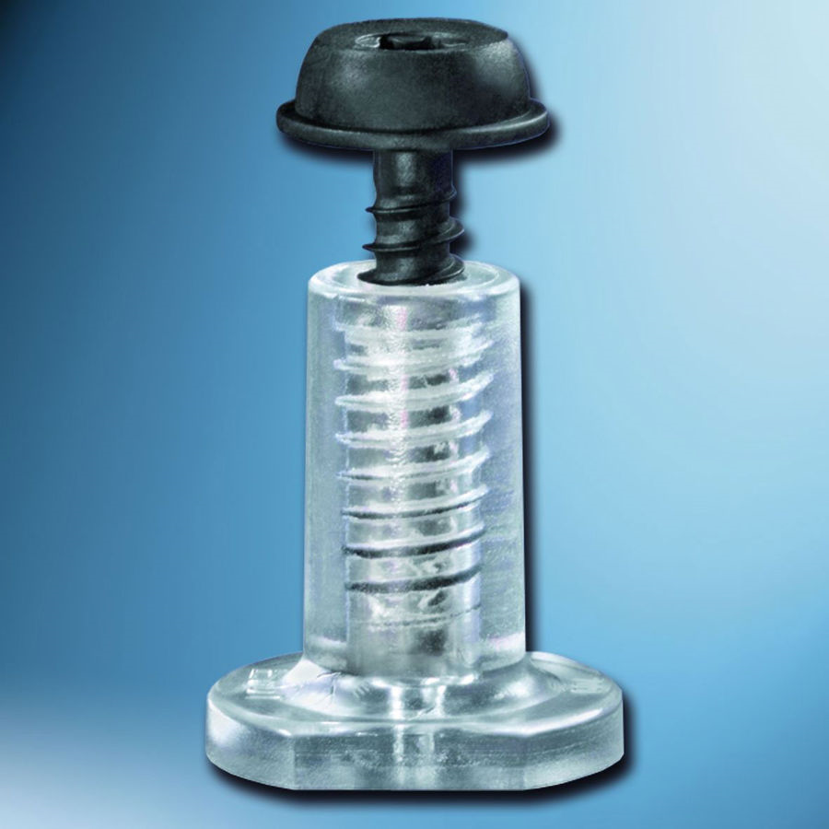
Thread Forming Screws into Plastic

Slide 17
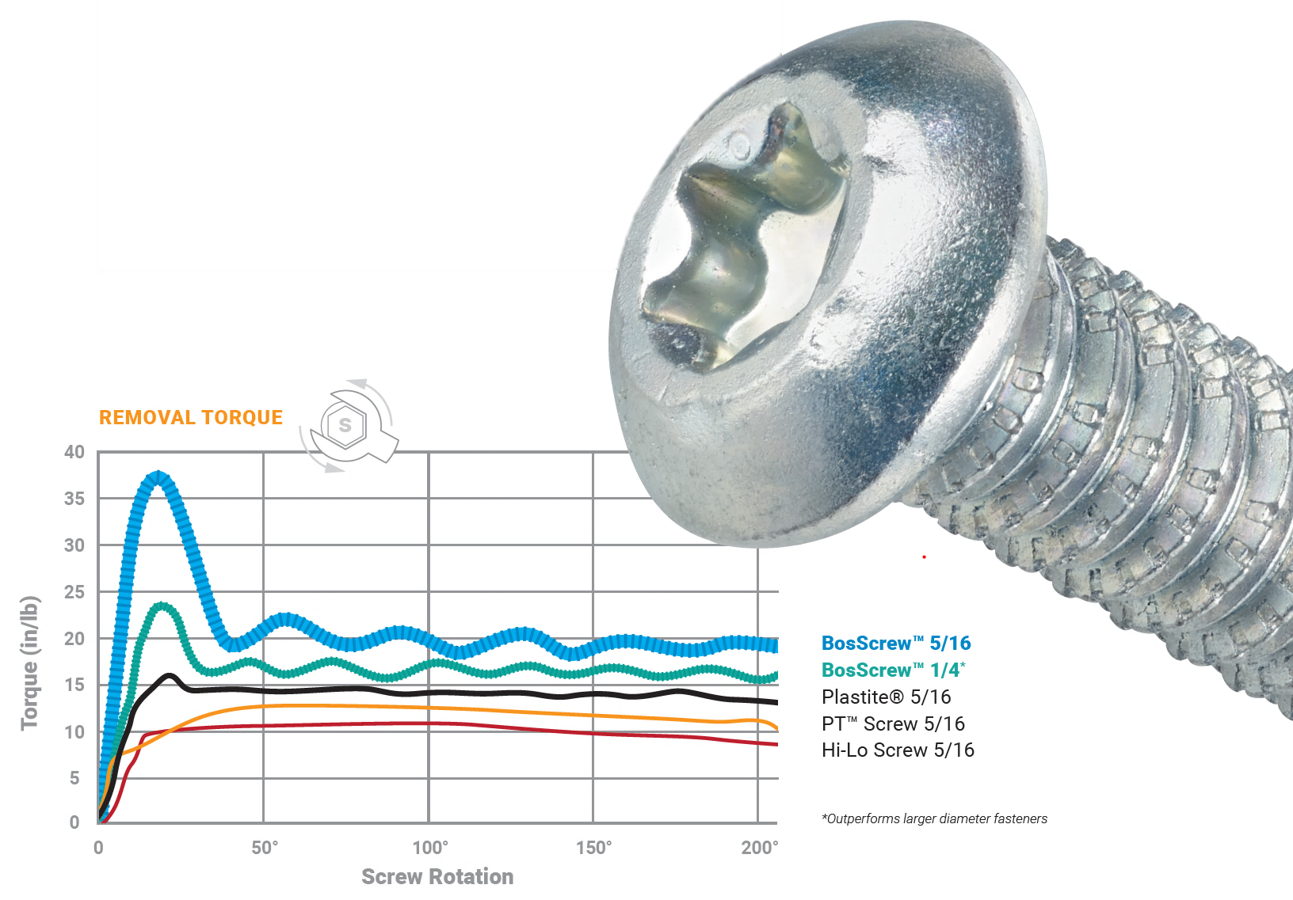
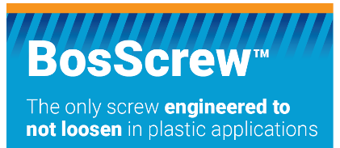
Notes:
- BosScrew exploits plastics natural tendency to creep over time, temperature and vibration.
It says DRIVEN.
This eliminates the need for metal inserts
Pressure wells are formed down into the tightening flank (top) of the thread allowing excellent reusability

Slide 18

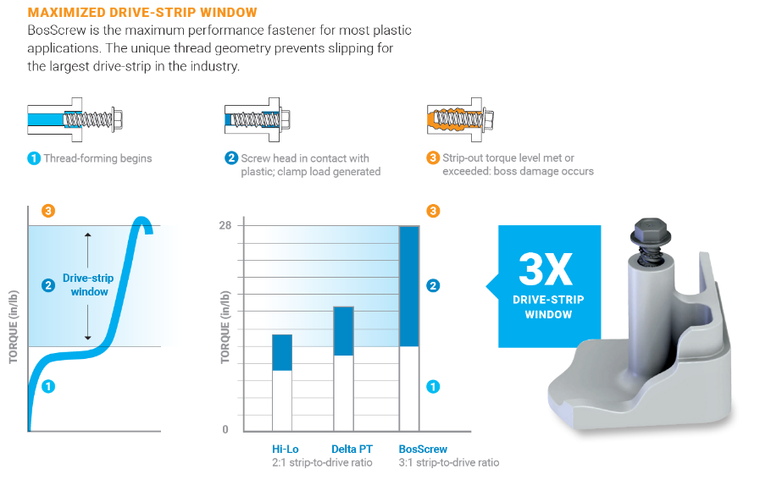

Slide 19


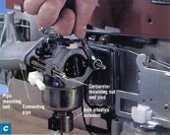
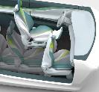
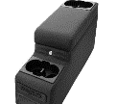

BosScrew Successes – Various Markets
Weatherstrip
To Door
The plant was having issues with Hi-lo screws stripping exisiting bosses. Quick prototypes were created to fit the non-standard boss design.
Truck Air Deflector
Chosen for increased performance, the BosScrew design worked well in testing for the new application.
Small Engine Carburetor Stud
Chosen for increased performance, engineering specificially liked the application’s resistance to loosening in high critical safety application.
Front End Module
Facia Brackets
BosScrew was chosen for this new application after presented opportunities for higher drive-to-strip ratio
Seat Tracks
The use of BosScrew was suggested by Automotive engineering for the application. The teir needed a safety critical anti-loosening alternative.
Center Console
VAVE efforts were conducted to consolidate existing plastic tapping screws into one specific size and length BosScrew.

Slide 20

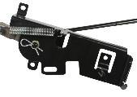
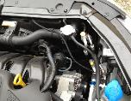



BosScrew Successes Continued…
Door Zone Module
Assembly issues at the plant (alignment, stripping, loosening) required the switch to BosScrew after engineer recommended testing.
Lawn Mower Clutch Assembly
Chosen for increased performance, the BosScrew design worked well in testing for the new application.
Relay Harness Attachment
Chosen for increased performance and resistance to loosening. Also, the engineers required changes to the head design to accommodate new application.
Lawn Mower Handle Assembly
Various Joint Assemblies chosen for superior performance in testing.
Grab Handle Attachment
The use of BosScrew was suggested by Automotive engineering for the application. The teir needed a safety critical anti-loosening alternative.
Intake Manifold MAP Sensor
Chosen for increased performance for next generation application.

Slide 21
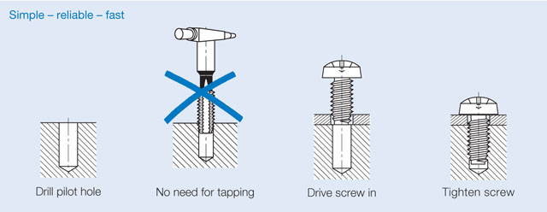
Thread Forming Screws into .Steel.

Slide 22

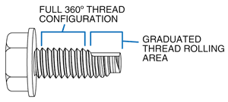
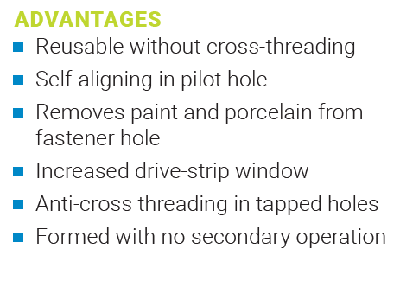
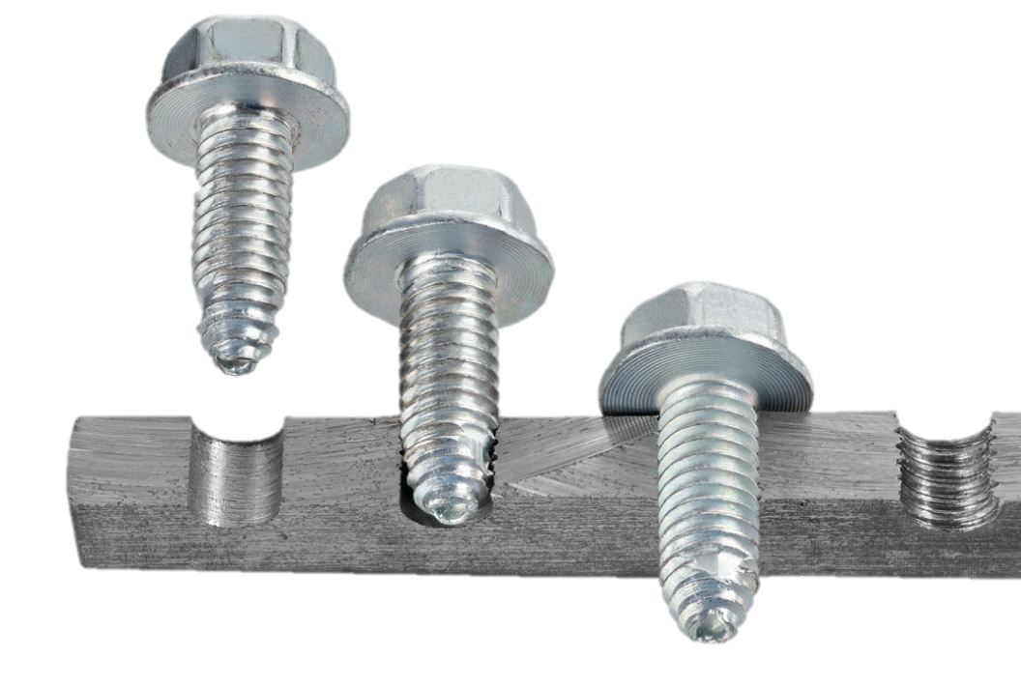
Steel Thread Former

Slide 23
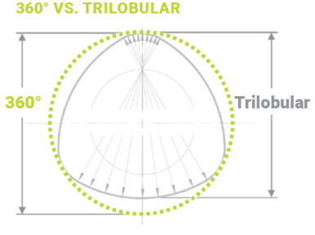
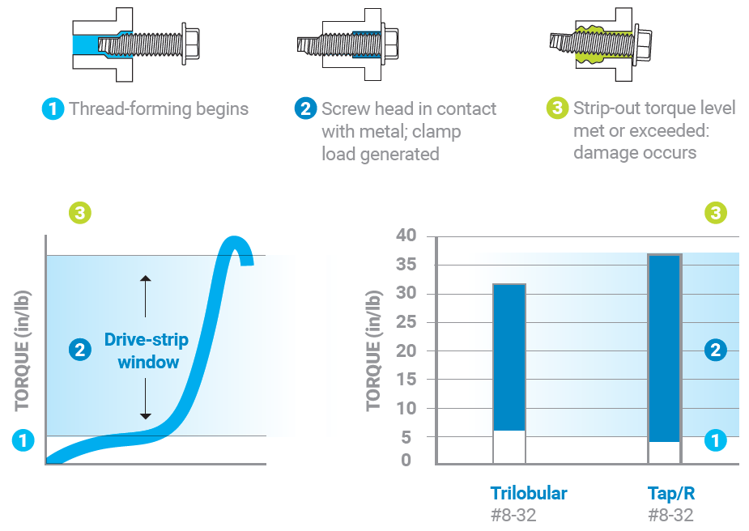
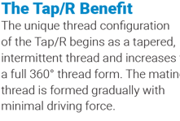
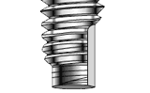

Slide 24
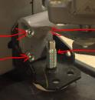


TAP/R Successes – Various Markets
Door Hinge Assembly
Trilobular issues within this appliance assembly plant lead to the use of TAP/R with its 360 degrees of thread engagement.
Chassis Frame Joints
Recreational vehicle chassis frame joint variability lead to the consolidation and overall use of ITW’s TAP/R threadformer
Kitchen Appliance Handles
TAPR chosen for increased performance, engineering specificially liked self aligning & paint clearing features

Slide 25
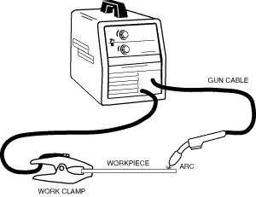
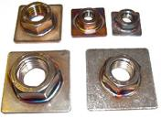
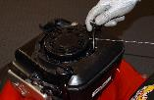
TAP/R Successes – Various Markets Continued…
Engine/ Transmisson Mount Bracket
Shakeproof Thread was chosen after presented opportunities for higher torque control and anti-loosening
Welding Equipment Grounding
The use of Shakerpoof Thread was verified for safety critical anti-loosening design in small & medium sized engines.
Nut Plate Stripping
Assembly had issues with paint clogging. TAP/R chosen for engagement, anti-crossthreading and paint clearing feature

Slide 26
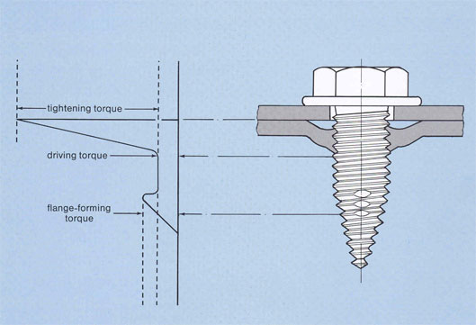
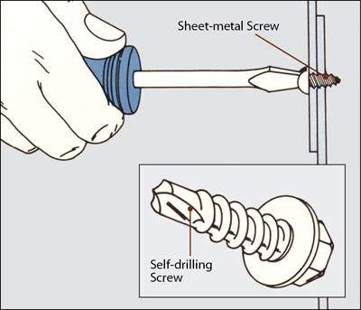
Sheet Metal Anti-Loosening

Slide 27
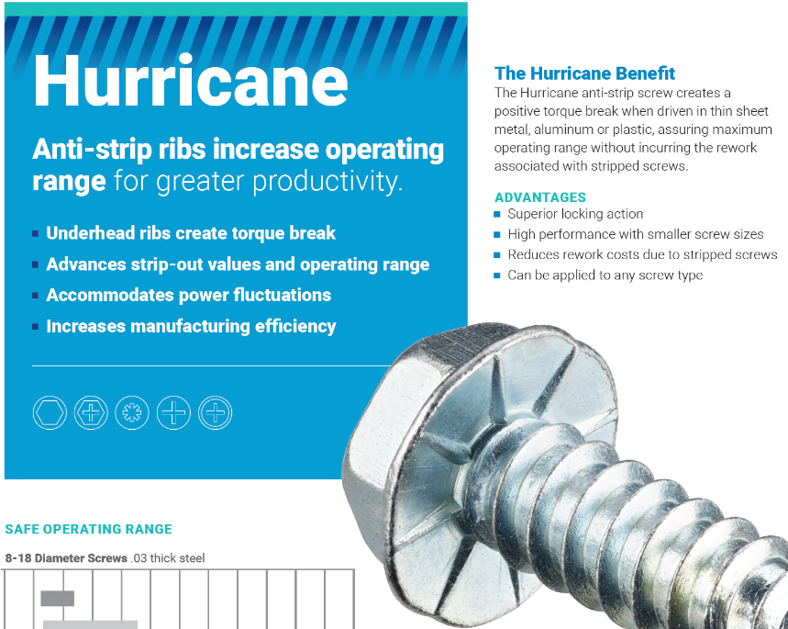

Slide 28
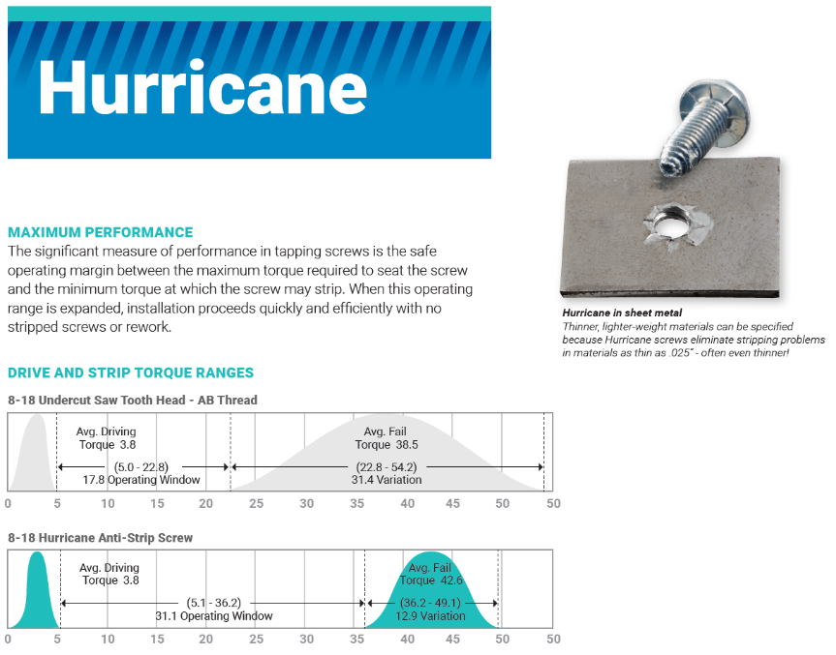

Slide 29
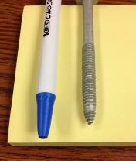


GX Self-Extruding Commonly known as the GXCA point

Slide 30


Advantages
Increases area for thread engagement
Paint & coating removal
Combine several assembly steps
360 Degree thread engagement
Common Problems Solved…
Non-100% Thread Engagement
Stripping out in thin sheet metal
Assembly / Operator issues
High cost customer competitor screw

Slide 31


Anti-Loosening

Slide 32


Double click here to watch video

Slide 33





Slide 34

Shakeproof Thread

Slide 35






Shakeproof Thread Successes – Various Markets
Truck Chassis Fasteners
The plant was having torque control issues with existing specialty chassis designs. Shakeproof Thread chosen for superior performance
Stainless Handle Assembly
Chosen for increased performance, the Shakeproof Thread worked well in the existing application.
Military Door Hinge Assembly
Chosen for increased performance, engineering specificially liked the application’s resistance to loosening in high critical safety application.
Lower Handle to Deck
Shakeproof Thread was chosen after presented opportunities for higher torque control and anti-loosening
Small/Medium Engine Rocker Stud
The use of Shakerpoof Thread was verified for safety critical anti-loosening design in small & medium sized engines.
Muffler Motor Attachment
Chosen for increased performance when testing against high heat & vibration stresses.

Slide 36




Licenses
TORX® / TORX PLUS®
TAPTITE® / TAPTITE 2000®
MAThread® / MATPoint®
MORTORQ®
ClearDrive™
PT / Delta PT Screw
ACRII – Phillps Square Drive
Quadrex

Slide 37

Work With Us and We’ll Offer…
Timely Quotes
Competitively priced while offering cost savings
alternatives with a 1-2 day turnaround.
Application Engineering Support
Our experts provide recommendations, design guidelines, and custom solutions to solve issues with performance, cost, weight and ergonomics.
Testing
In-house testing and validation to prove parts and provide comparison.
Prototypes
Samples of new products are typically available within 6-8 weeks.

Slide 38


Thanks!
Any questions?
ITW Shakeproof Group www.shakeproof.com
Mike.Ricciardi@ITWShakeproof.com
(224)875-1234
https://www.linkedin.com/in/michaelgricciardi/

