Slide 1
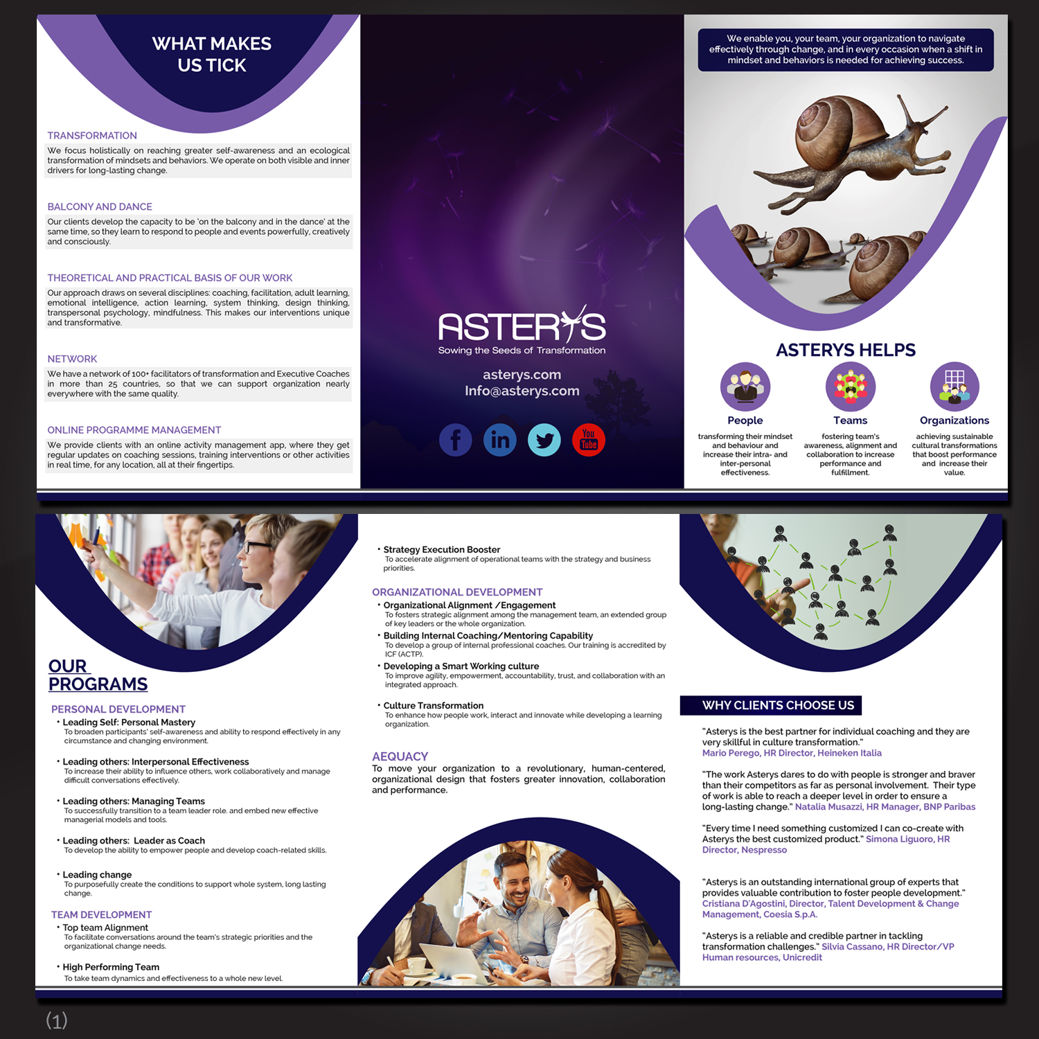
There are inconsistencies re: the titles. They are all different. In the cover the title is white text in a rounded-corner rectangular background and not in capital. The title “Why clients choose us” is white text on a rectangular background and all capital. “Our programs” is all capital underlined with white background…” What makes us stick” is yet another style.
Can you make the titles more congruent?
I don’t like that one of the programs goes to another page. Can you make an effort amd keep all the programs of the same “family” in the same page? Reduce or enlarge the pictures as needed…. Or move “Our Programs” in the picture (like you did with “what makes us tick)
The spaces between the statements are different, please make them consistent.
Would you please reduce the social icons a bit? They are very large…

