Slide 1



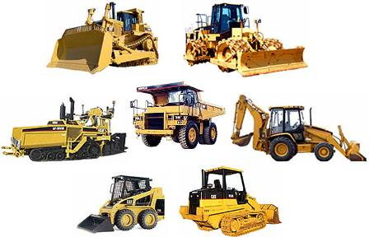
I need you to add this "sort of" mock up OF ENGINEERING to the building enviroment.
Choose any of this kind of machines and add it to the buildings. You might replace 1 or 2 buildings for this kind of machines. Remember to keep the style

Slide 2
Instructions: We need to highlight a guest contributor, who talks about eCommerce: Patricio Ossandón T. Please find a way to add it to the front cover
Text says:
Sección especial de eCommerce, por Patricio Ossandón T.
Text of the spine should be written in the upward direction

