Slide 1
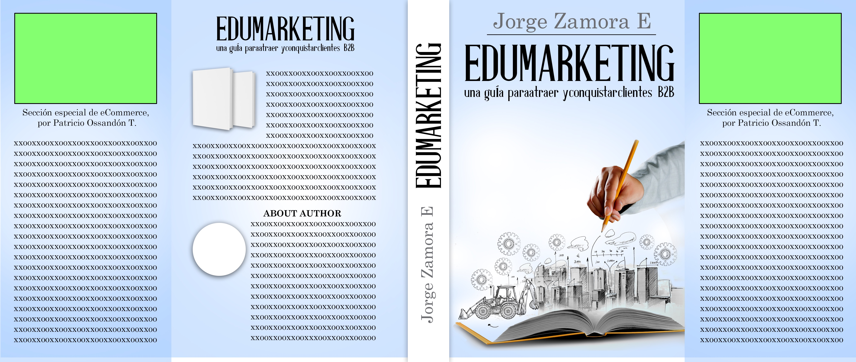
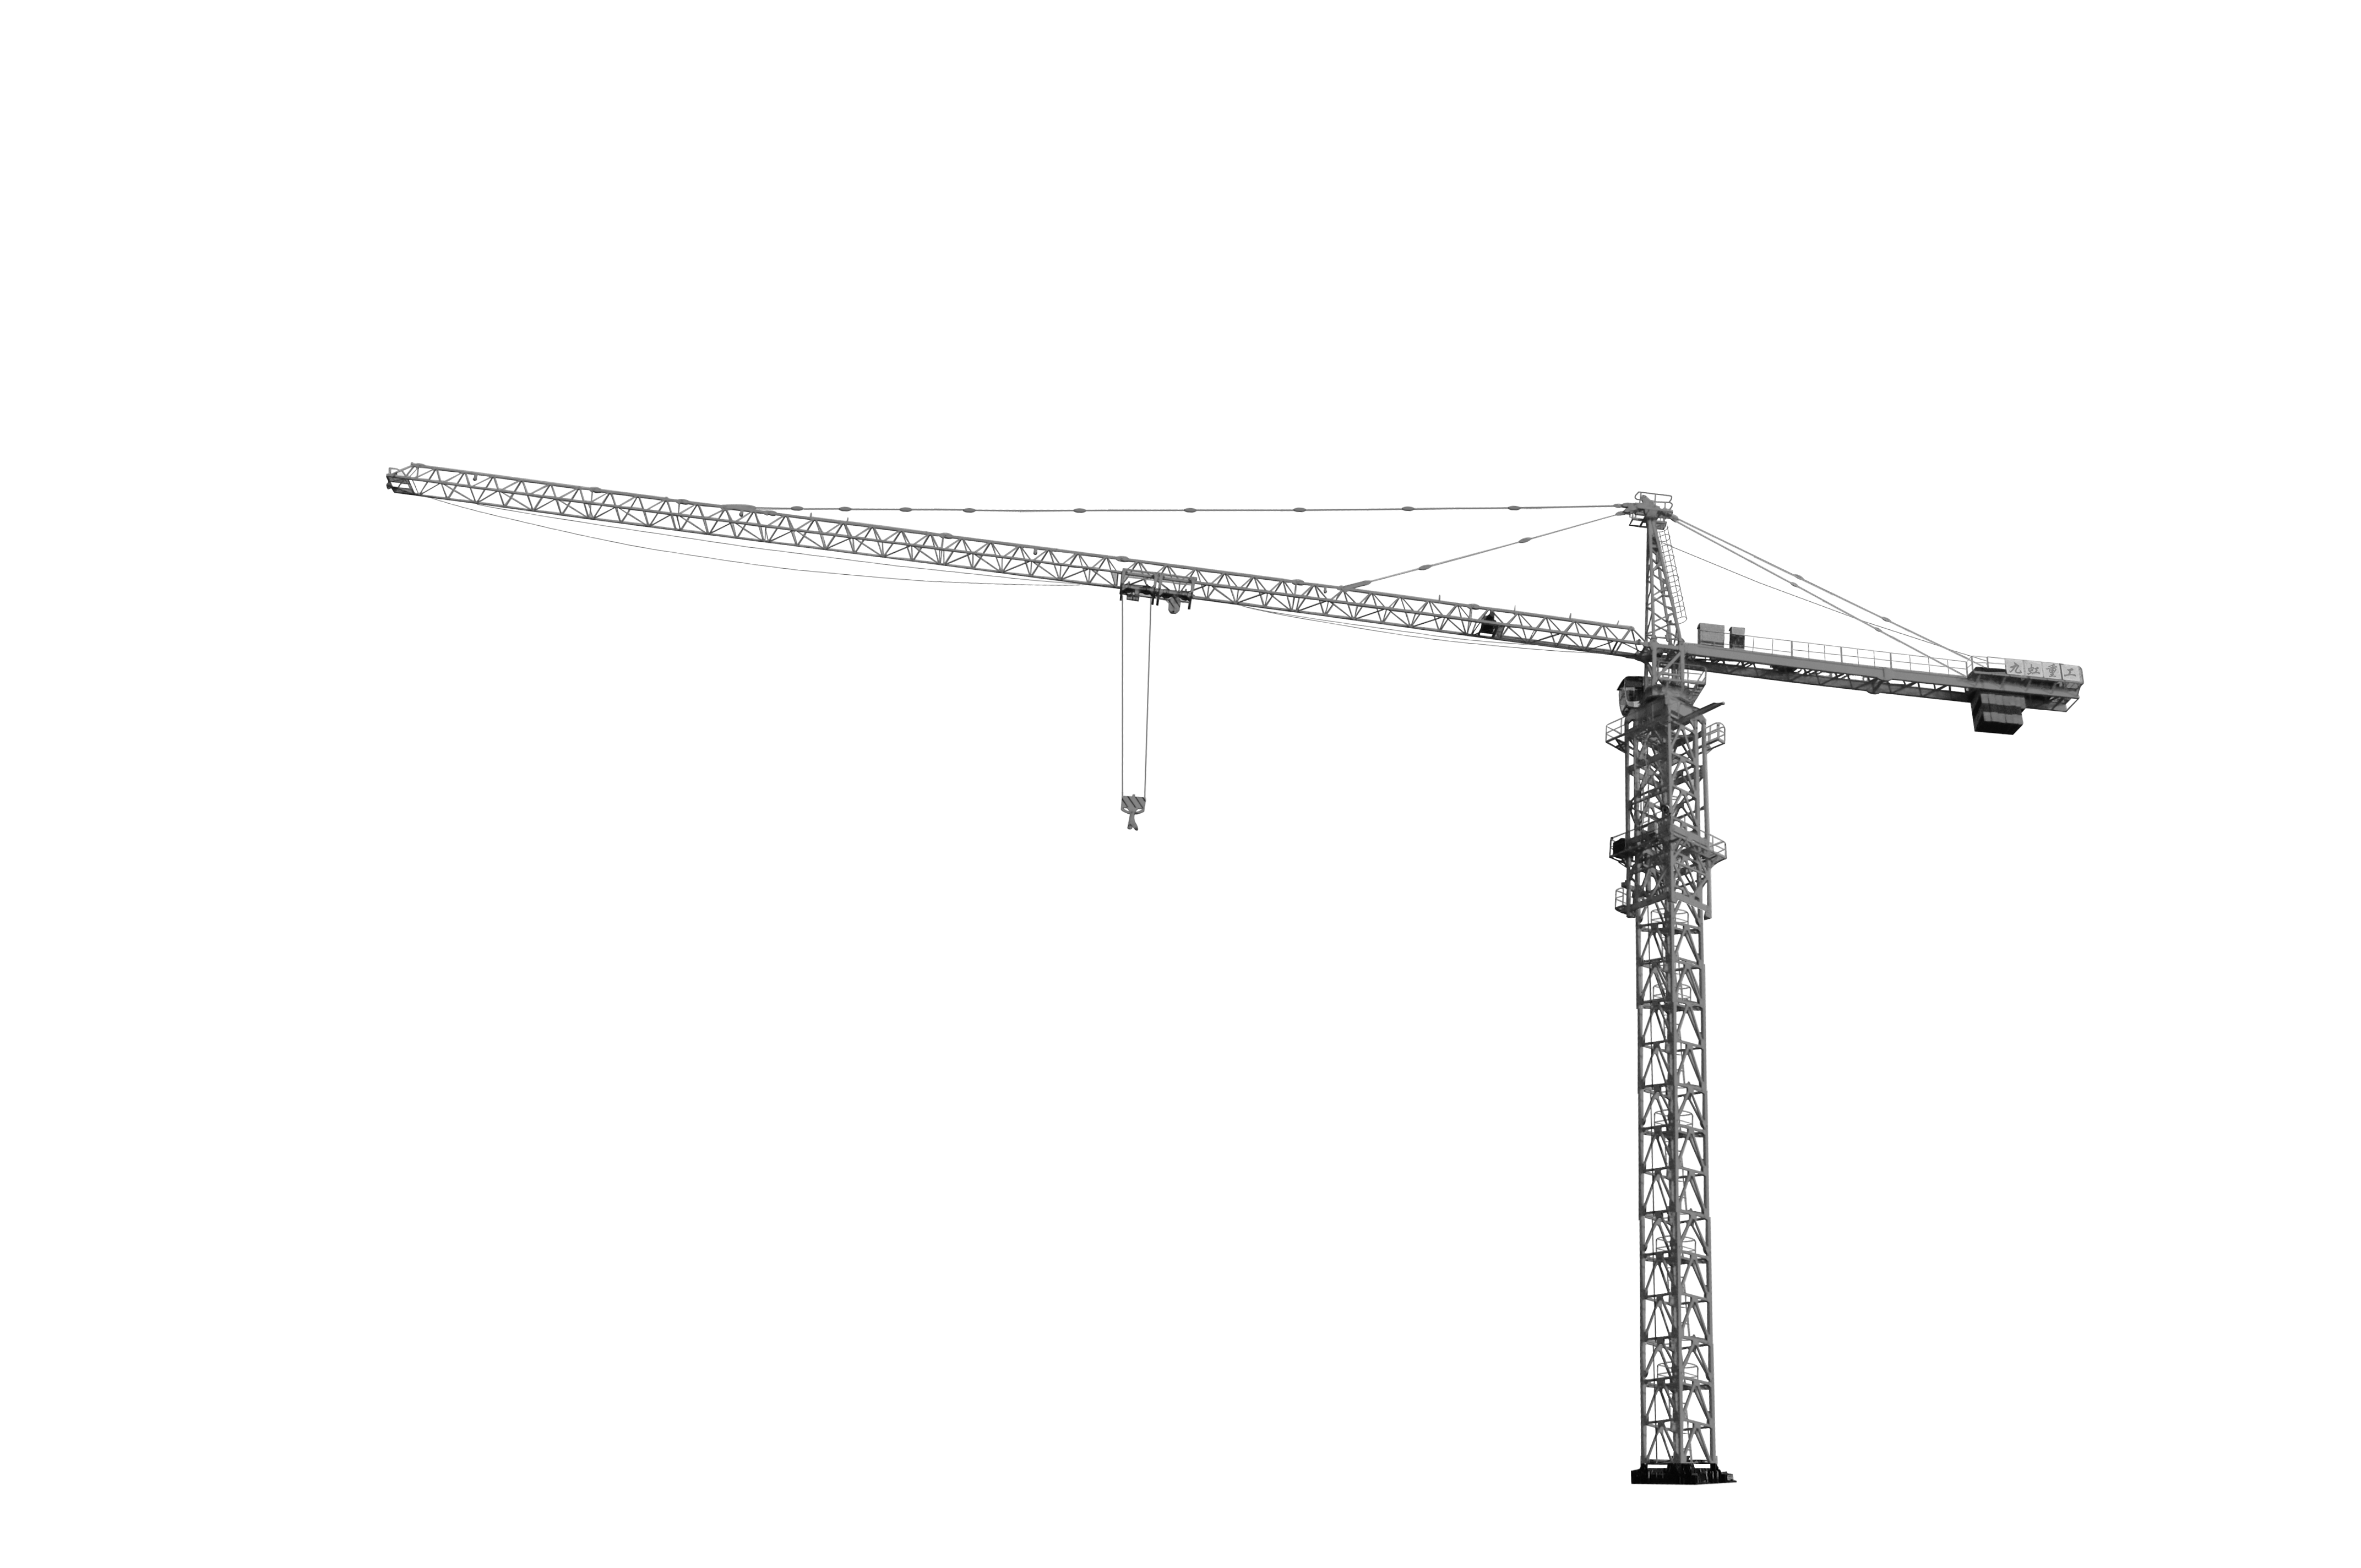
This text should be: una guía para atraer y conquistar clientes B2B
Text has a missing point: Zamora E.
We need a modern FONT for the TITLE, subtitle and author's name. Please send me options with:
Qontra
Kollektif
Radnika
Or may be another one you suggest
Please add a construction crante. You decide the exact position
Please remove 2 gears.
https://www.canva.com/learn/modern-fonts/
Notes:
https://www.canva.com/learn/modern-fonts/ -> Take a look

