Slide 1
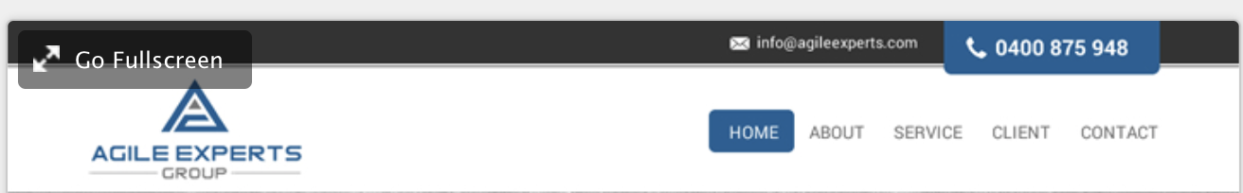


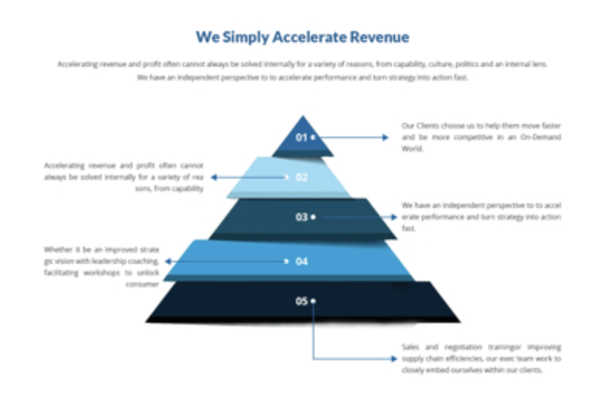
Trust in Proven Experts

Slide 2






Proven Experts, Proven Industry Results
FMCG
Building Industry
Medical

Slide 3
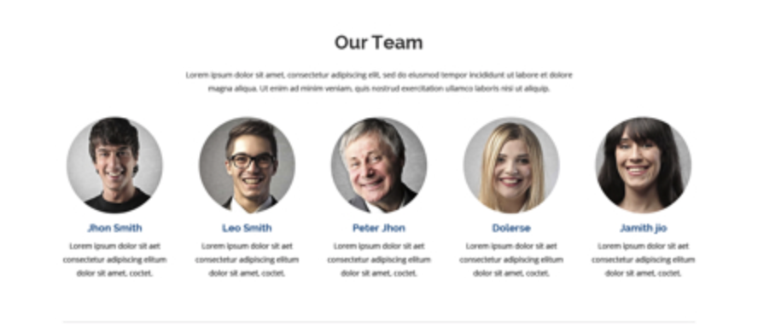


On this selection we would have video content
FMCG

Slide 4

Example of Our Servioces Page

Slide 5
