Slide 1
Logo Creative Brief
Design Crowd

Slide 2
Meddler
Swiping. With a little help from your friends.

Slide 3

Dating has always been social.
Your friends want to help.
Now, Meddler lets them.
Meddler lets you outsource the work of finding a partner to the people who know you best.
Meddler
Swiping for love
With a little help from your friends.

Slide 4
How it works.

Slide 5
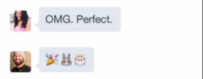
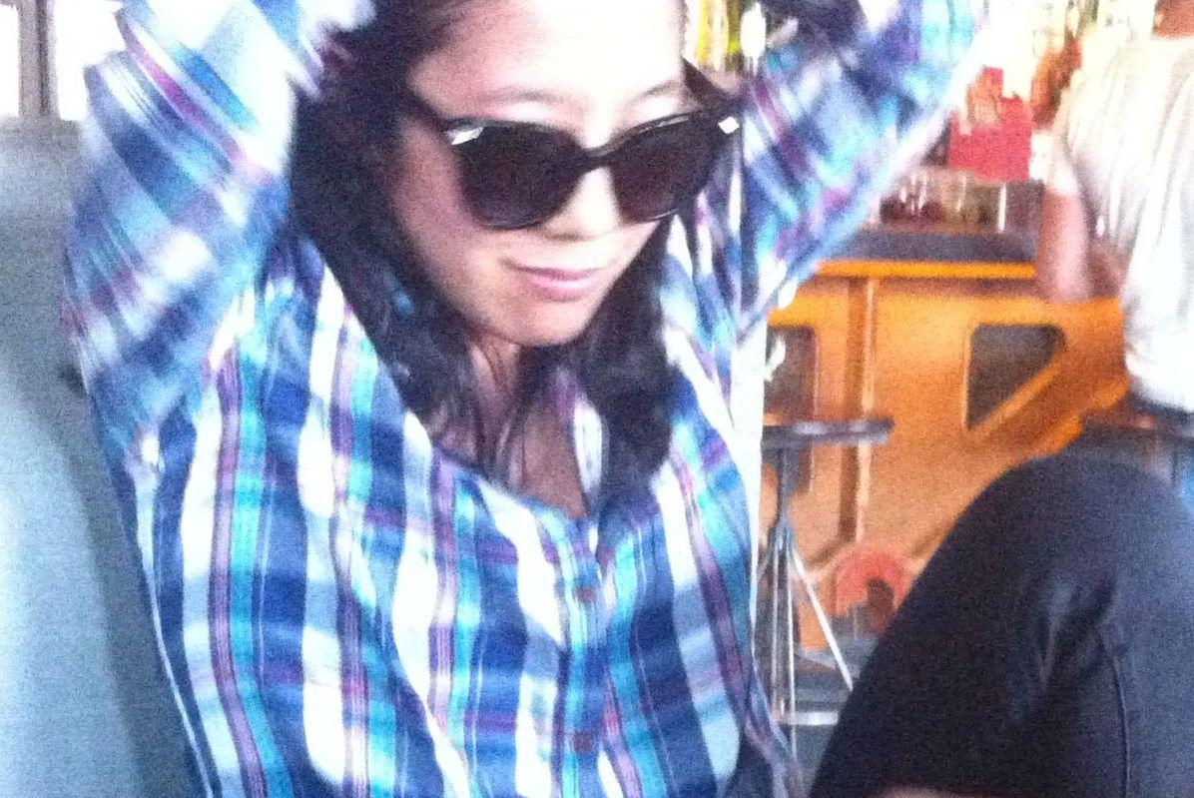
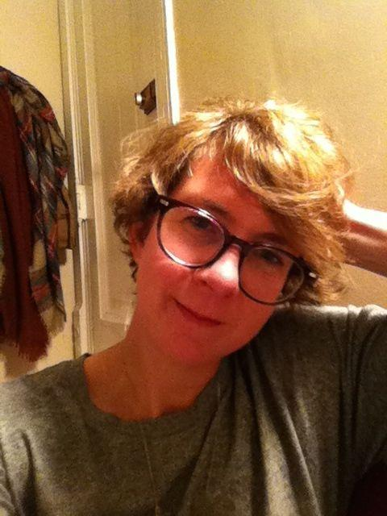
For the Dater.
Meddler
Jay Found You a Match!
Setup your profile with Facebook
Invite FB Friends to be your Meddlers
Meddlers swipe on your behalf
Get notified when they’ve found you a match
Message with your Meddler about a match
Accept or decline their matches
Message with your Match!

Slide 6
For the Meddler.
Meddler
You found Jill a Match!
Invite your single friends to set-up profiles
Swipe on their behalf to find matches
Get notified when you’ve got a match
Get notified when they accept/decline your match
Message with the dater to see how matches are going!
Did you message??
What do I say??
Invite him Friday!!

Slide 7
Customer Persona

Slide 8
The Dater.
28-42 years old
Well-educated. Professional that has reached some success in career.
Lives in big city with high early tech adoption: NY, Chicago, Los Angeles, SF, Seattle
Tired of the tedious, repetitive and time consuming online dating scene.
Still believes in finding love, but starting to feel jaded, has better things to do.
Very busy, hard to keep in close touch with married friends with different lifestyles.
Progressive, culturally aware, hip.
Used to spend about 90+ minutes a day on social dating apps, but now more like 20.

Slide 9
The Meddler.
28-42 years old, in a relationship
Still connected to the single world - has plenty of single dating friends. Loves to listens to stories about their dating life and give advice.
Wants a better way to feel connected to them and their lives.
Enjoys setting up friends, networking and connecting people.
Warm and gregarious
Progressive, culturally aware, hip
Reached a comfortable stage in life. Confident. Responsible. Knows herself.
Spends 60+minutes a day on social apps like Instagram, Pinterest and FB.

Slide 10
The Meddler Brand
Brand Promise: Bond with your friends and make dating social and fun again.
Tagline: Swiping With a little help from your friends. // Your friends want to help. We let them.
Emotional Benefit: Make the tedium of online dating more fun. Give your single friends hope of finding love.
Functional Benefit: Don’t have to spend time swiping, higher quality matches pre-approved by your friends (Dater); Get to peek into dating life in a safe setting (Meddler)
Reasons to Believe: Matches selected by your friends, Keep your friends involved and get their advice along the way, Allows meddlers to meddle!
Personality: Playful, gregarious, and full of life. Confident and responsible. Cares deeply about friends and prioritizes friendships. Likes to tease friends playfully. A good listener. Trustworthy. Sophisticated taste. Progressive, culturally aware and inclusive.
Differentiation: We are the only dating app built for coupled friends to play matchmaker
Notes:
Other text (long, tried to cut down) : Bond with your friends over the trials and tribulations of the impersonal and repetitive dating world today. Make dating more personal and social with matches selected by your friends.

Slide 11
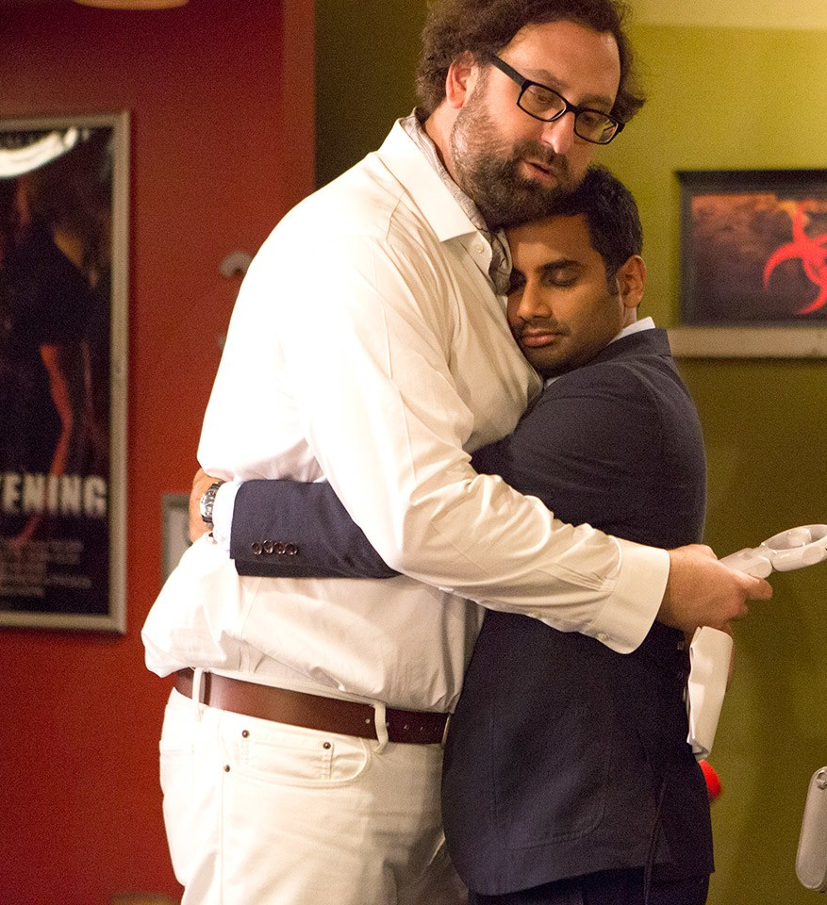
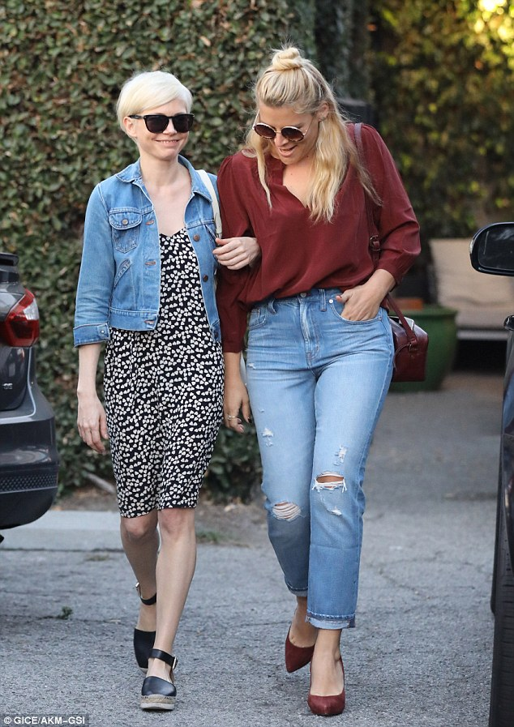
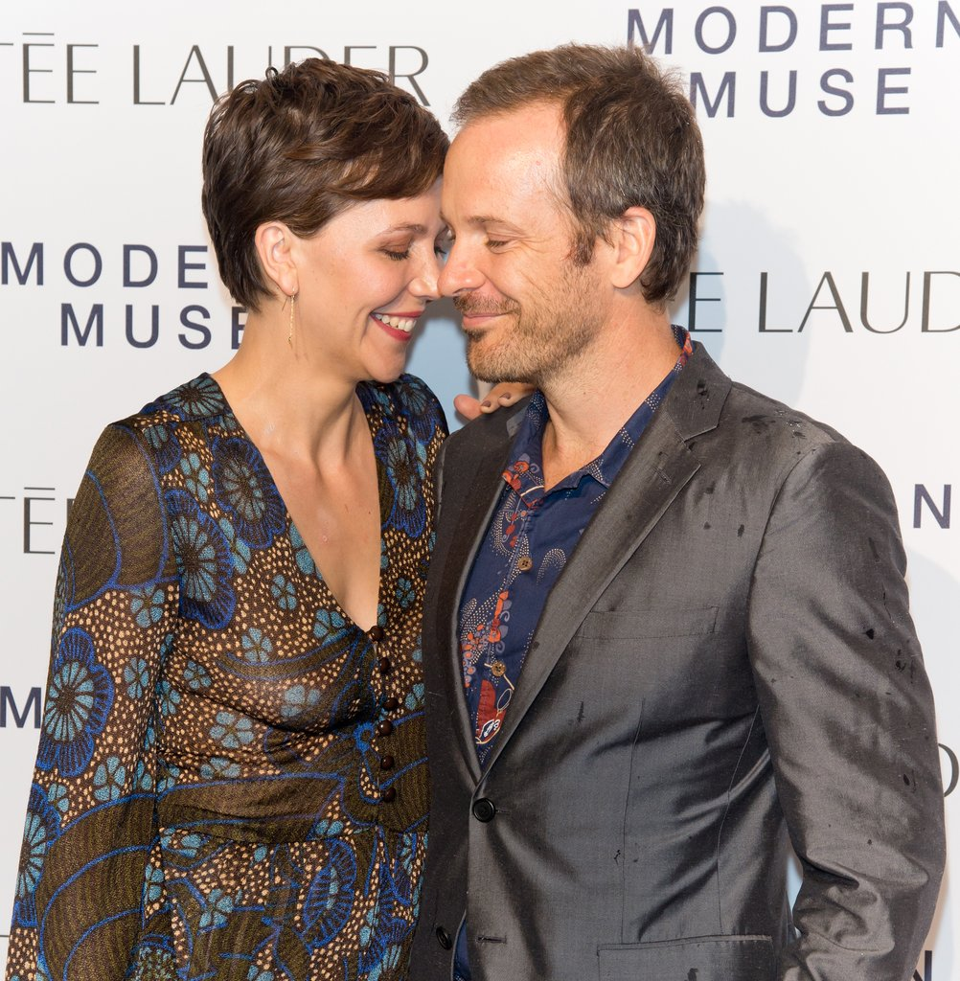



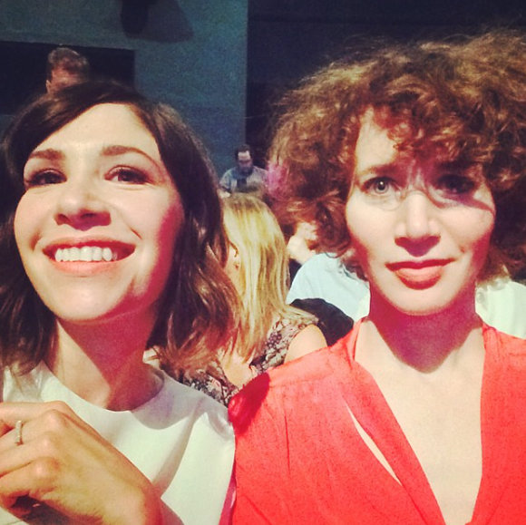

Meddler Personality

Slide 12






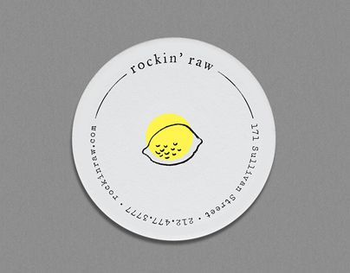

Logos that visualize meaning

Slide 13
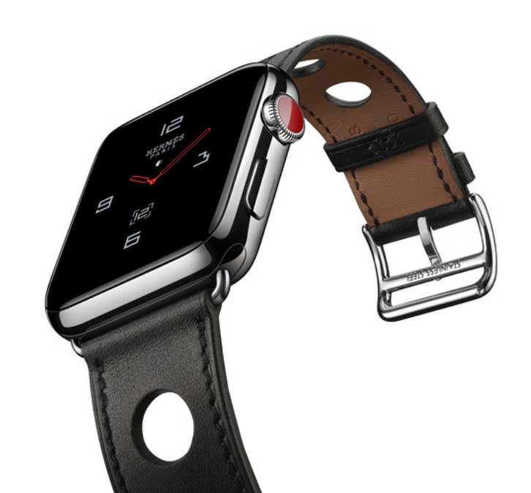

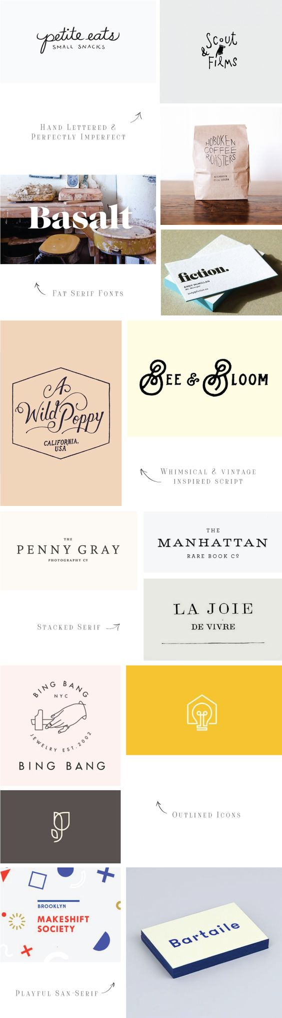
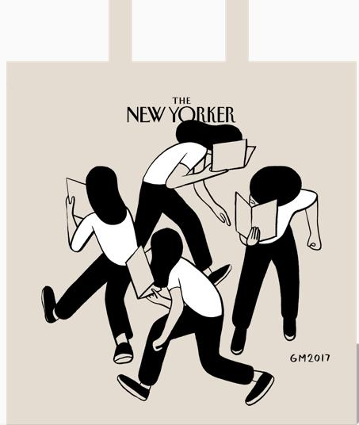
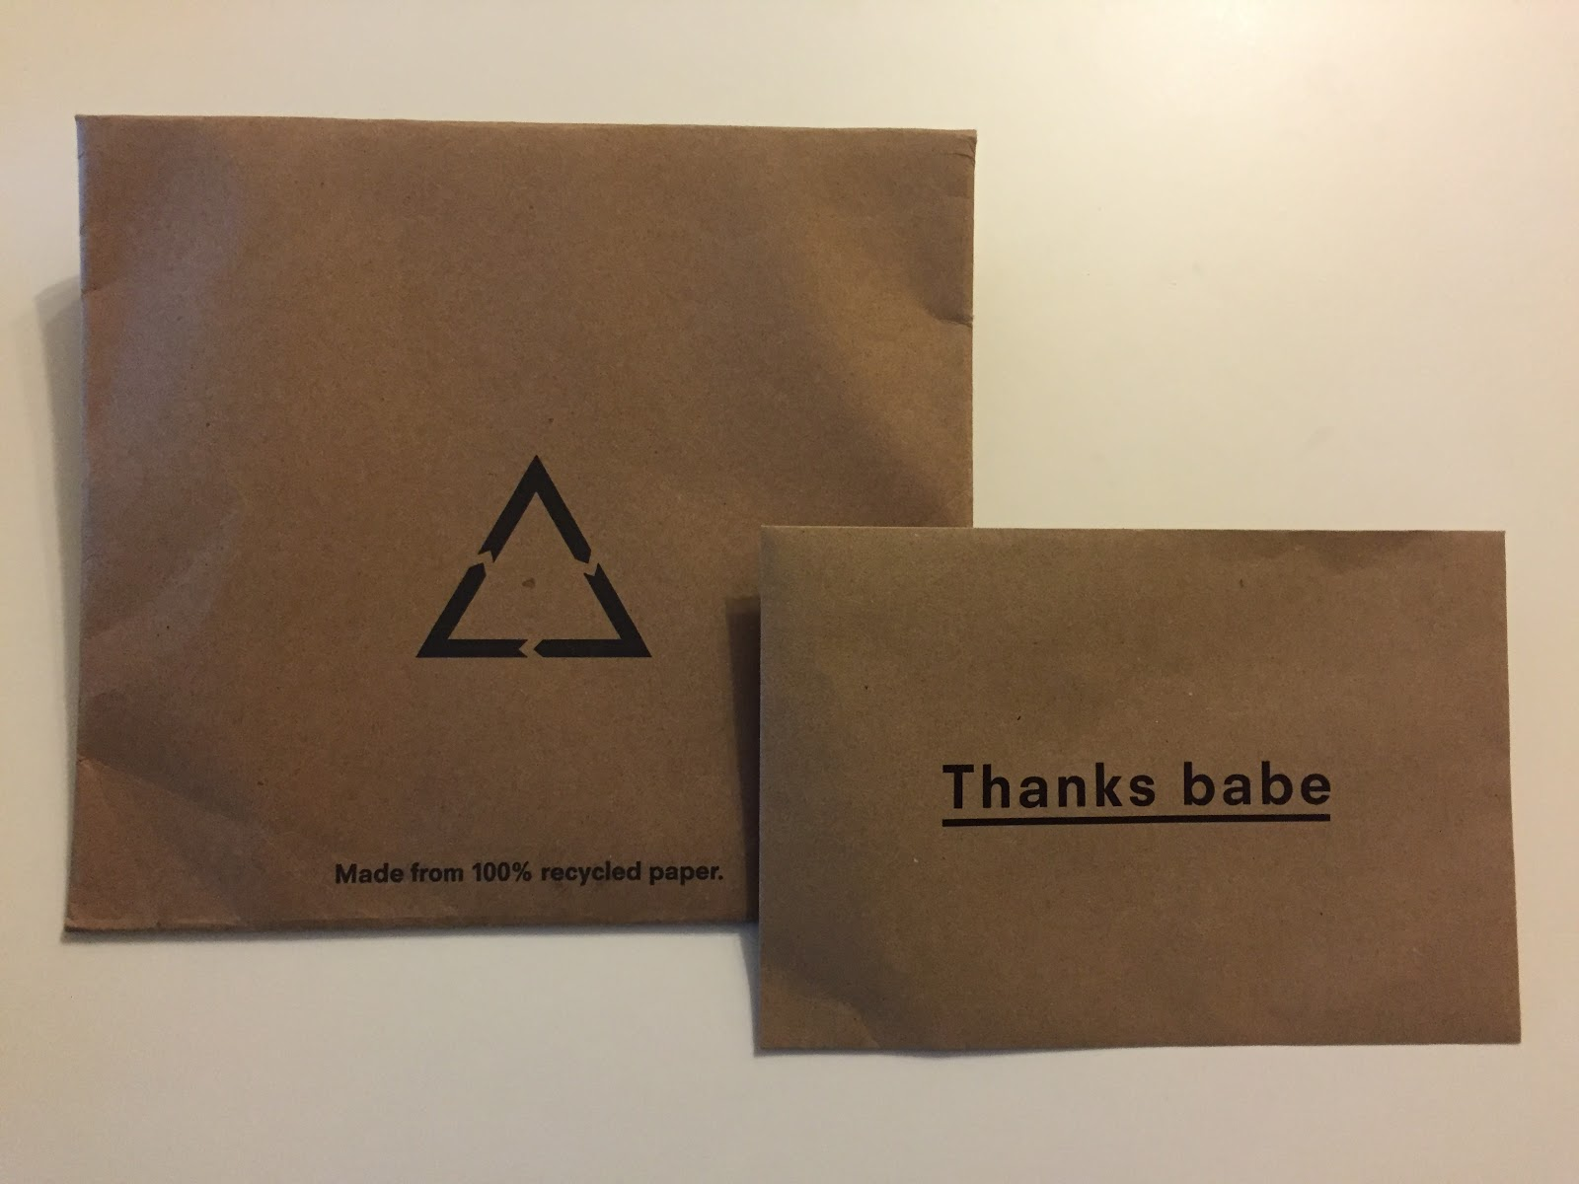
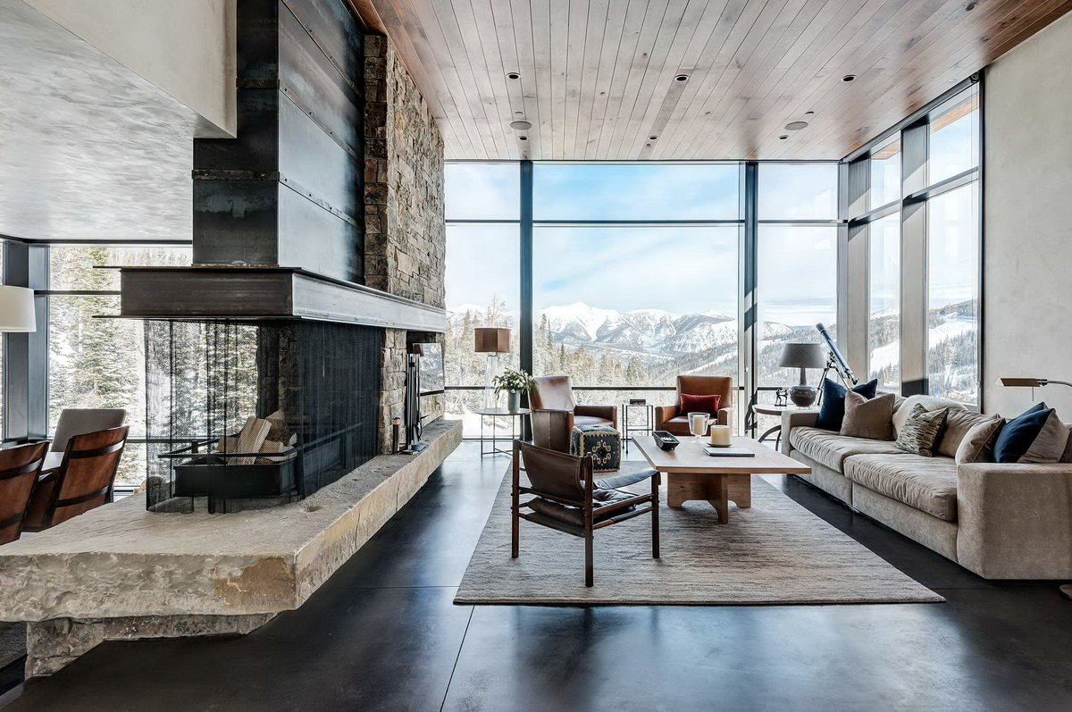
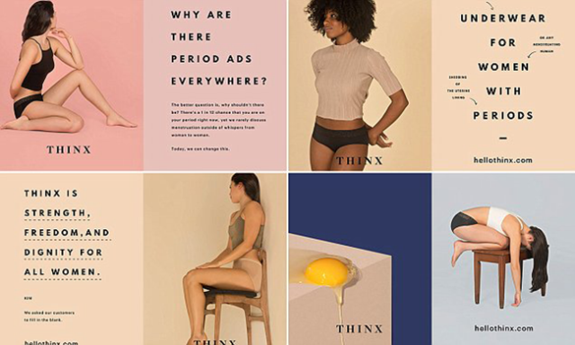
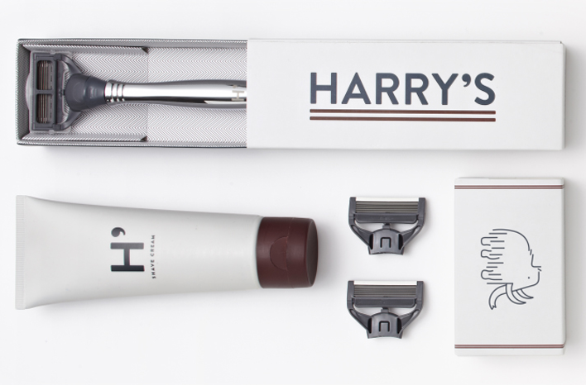
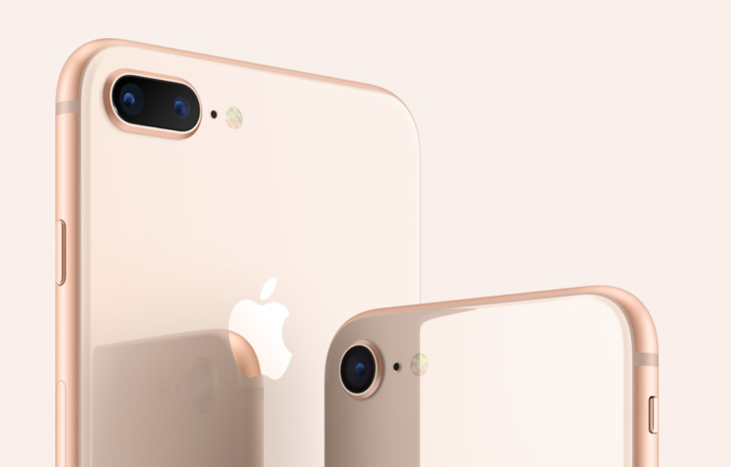
Mood Board

Slide 14



Competition
 |  |  |  | Meddler
Target Users | 85% 18-34 | 60% 18-24 55% Women | Skews older 25-34 50% M/F | 28-42 even older 55% women More professional, educated audience
Social Features | Pioneered swipe GPS based | Only women can make the first move | $7/mo paid “relationship app”, Instagram-like profile Friend-network based matching | Allows coupled friends to play matchmaker Friend-network based matching

Slide 15
Task
Develop a logo and color pallet that brings the Meddler Brand to life.
Logo that clearly communicates the concept of Matchmaking.
One design with “Meddler” in the logo
One stand-alone icon (likely part of the above logo)

