Slide 1
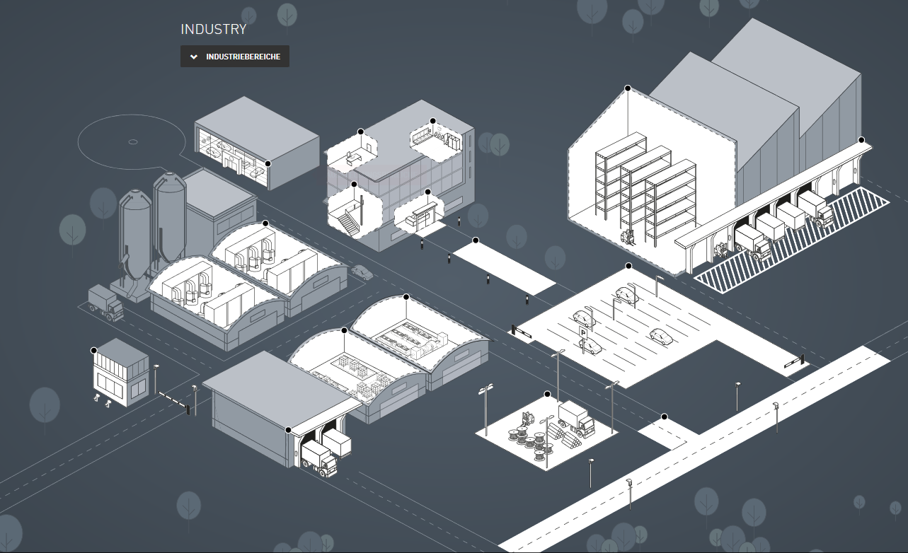
https://www.trilux.com/en/applications/industry/lighting-for-industry/

