Slide 1
Brief
Who we are
What we are looking for
Wicklund-Hansen International is a company founded in Oslo, Norway.
We sell personality tests.
New owners is aiming to turn the business around with a more compelling design, new features and an active sales offensive.
Designelements for our website, our client reports (the test results) and powerpoint presentations.
  Redesign of logo that works for web and in SoMe as well as ppt og printed surfaces.
  Illustrations that can make our story understandable.

Slide 2
Brief
Target group
Our service
Top management as well as mid-management.
  Men and women: age 30-50
  More private service companies than industrial production
  Focus area Oslo, capital in Norway.
  Might very well be in an International environment.
Management hire (and fire) people in order to bring the business forward. But, strive in keeping the team focused and work effective together.
We offer a personality test originally derived from Meyers and Greenberg’s studies in the US market in the 70’ies.
From answering 120 questions any candidate will be ”measure” to fit a set of specific required traits. Basically ego-drive and empathy.

Slide 3
The story
Why do we need ”a story”
The way we want it
Personality tests tend to be very accurate and not very practical oriented/easy to use.
A compelling story makes it easier to remember and use the different terms for workstyles, social capabilities etc
All business’ feel that they are very special. We need a more objective narrative that can work across businesses.
A maritime metaphor = the voyage on which the clients business create their value: All employees need to participate – we are all in the same boat!
Mission is defined as bringing the ship with it’s cargo to the next port fast and safe.
Challenges: the shifting elements - the wind and the tide.
Many very specialised task on-board with equal importance
  Chef
  Captain
  navigation
  ...

Slide 4
Personality test
4 different Working styles
Archetypes - W I N D
In an effort to simplify we downscale the never ending diversity in 4 architypes.
All 4 styles have equal importance
Everyone can have more than one style, but not at the same time!
A Metaphor can be the 4 wind (north, south, east and west)
W (west): ”worker” is effective, focused on production, he is critical and concerned about things that can occur that can delay production. Can be too critical in the eyes of others. When W is dominating the workplace you get “martyr cultur”.
I (east): ”Integrator” is like a Sheppard dog – keeping the team together. He involve many people in solving tasks. Can be too dependant on others and their support. When I is dominating the workplace “fair-weather culture”.
N (north): ”Navigator” is looking to the horizon, bringing change to the workplace. He believe everything is possible. Can be too broad in his approach missing out on (important) details. When N is dominating the workplace you get “arsonist culture”.
D (south): Discipline is predictable and comply on all his responsibilities. Repeating tasks to with precession seems not to tire him. Can be too dependant on stability. When S is dominating you get “bureaucratic culture”.

Slide 5
Social Integration
Context should guide workstyle
Send & receive
Because people choose one of four workstyles for solving tasks at any time, we need to be able to choose the most fit workstyle in any situation.
To work more efficient together and avoid conflicts and misinterpretation the ability to communicate and adjust within the team is important. Specially when conflict of interest is present.
WHI measure dialogue capabilities – ability to send and receive ”signals from colleagues / environment.
Megaphone: your ability to speak your mind, demand attention, let yourself be heard (in social and professional settings).
Radar: ability to pick up on signals from others. Verbal and clear signals as well as more implicit and non verbal communication. And act on this information.

Slide 6
Tone of voice
Businesslike
Playful
Professional and trustworthy
Our tools bring profit to the clients business
Modern >> bringing the company with all it’s employees to the next level of performance
Pedagogic
Enjoyable
Energetic

Slide 7
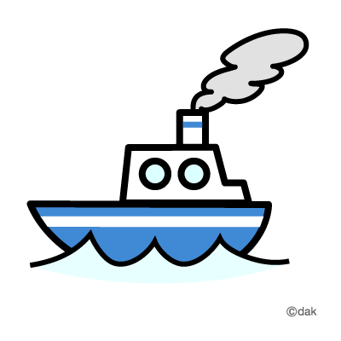
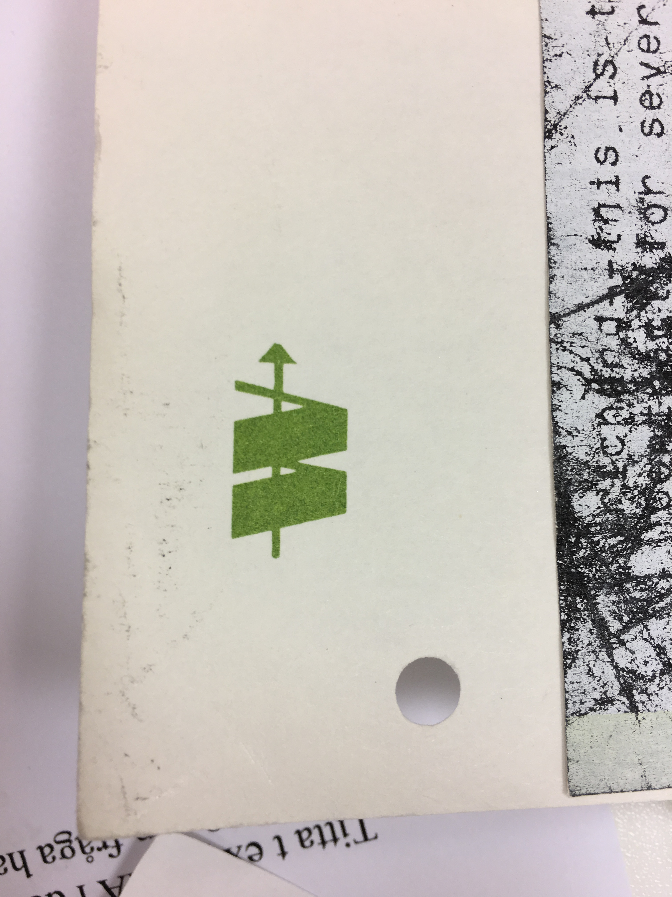
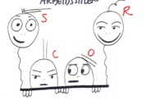
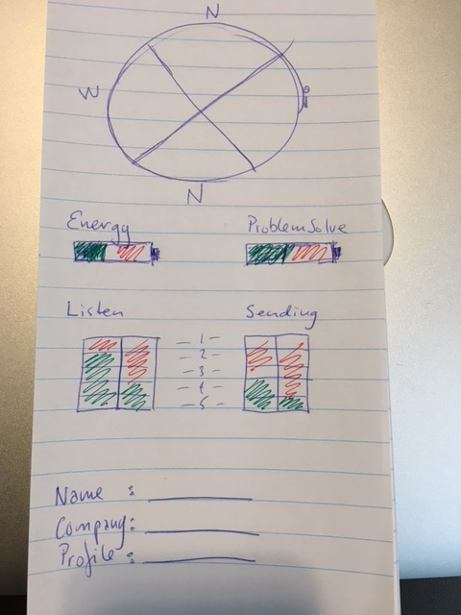
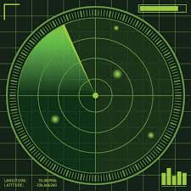


We ask for webdesign (wix*) and the following 7 elements:
Logo: redesign of this one, please
Symbol for clients business: the ship
The 4 coworkers / personas (individuals and onboard the ship)
Symbol for listening: the radar
Symbol for sending: the megaphone
Symbol for social adaptillity: the compass with 4 dimensions
Profile: Testresults report
*We will set up the page ourself using wix.com
What we will need for this is design elements in pictures an graphics reflecting on our 7 elements listed up above

Slide 8
About the profile
Format: html/css. Parameters controllable with css by changing 10 variables from 0-100%)
You can take our test by answering 120 questions and receive your profile articulating:
Four different workstyles (WIND). You can have more than one.
Energy/vitality
Intellectual interest
Social adaptillity
  Listen to others
  Listen to self / selfcontroll
  Send: Persuasiveness
  Send: Natural authority
The results should be identified by name, name of company and the results coded in letter according to the 10 possible scores mentioned above.

