Slide 1

WorldCapital.co
Your voice to reach the founder community

Slide 2
Trend
World
Capital
Helps you to reach startup founders to
9 out of 10 Companies are struggling to connect with startups
Make announcements
Sell your services
What if the startups came to you?
Spread your events
Images here
We are inviting you to join our partner program

Slide 3

Trend
World
Capital
“We're only really at the stage where people are learning to walk”
“Large corporates are realizing they need to engage on a formal basis and have someone at the organization whose job or part of their job is to engage with emerging tech and startups”
Jamie Qiu - founder and lead of the EY Startup Challenge in London

Slide 4
Opportunity
World
Capital
Be a driving force on the platform that startup founders love
People naturally trust parties that support the communities they are a part of.
What if we could help you to build that trust and
help you spread your companies voice at the same time?

Slide 5
Solution
World
Capital
World Capital is an online tool to find venture funding that is supported by
companies that want to reach startups
We help startup to find venture funding for free based on stage, industry and country
We help companies to reach this highly targeted audience by sponsoring website real-estate
In
Short,
By supporting World Capital
you support your local startup community

Slide 6
Why now?
World
Capital
Traditional strategies to reach startups fall short
Become a World Capital Partner and unlock the ability to:
Efforts limited by:
Increase trust startup founders have
in your brand
Increase your overall brand awareness with in the startup community
The lack of trust startups have in corporates
Spread your message to startups on a steady and predictable basis
A lack of value that you bring when spreading
your message

Slide 7
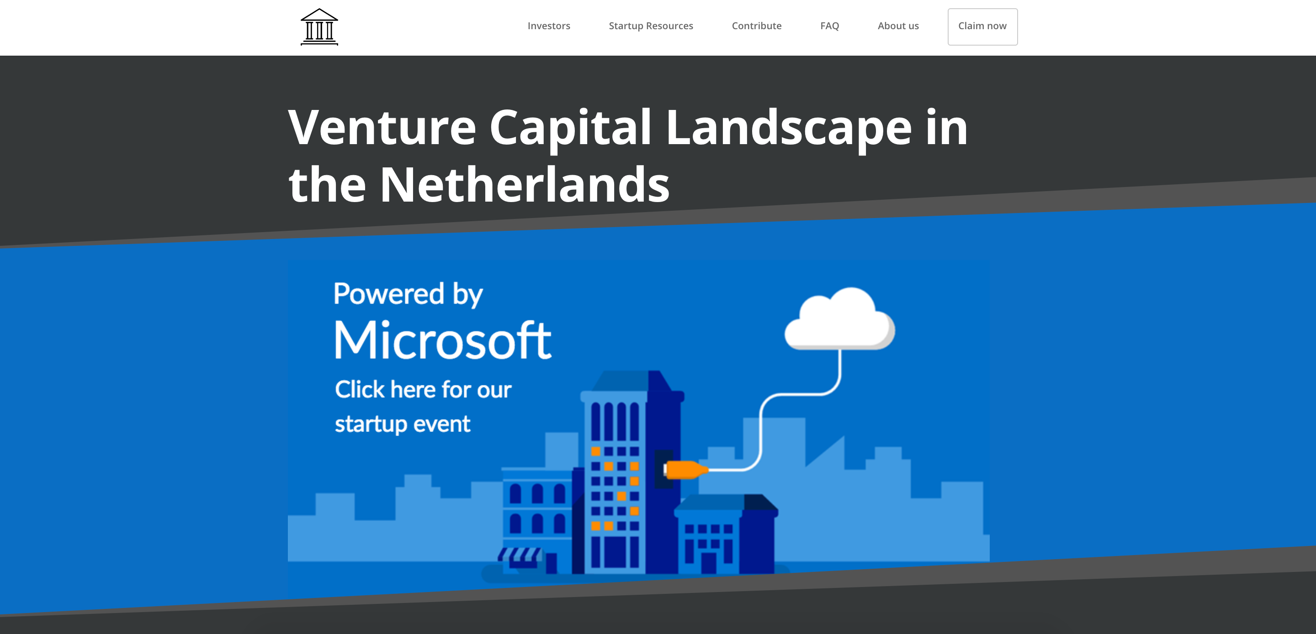
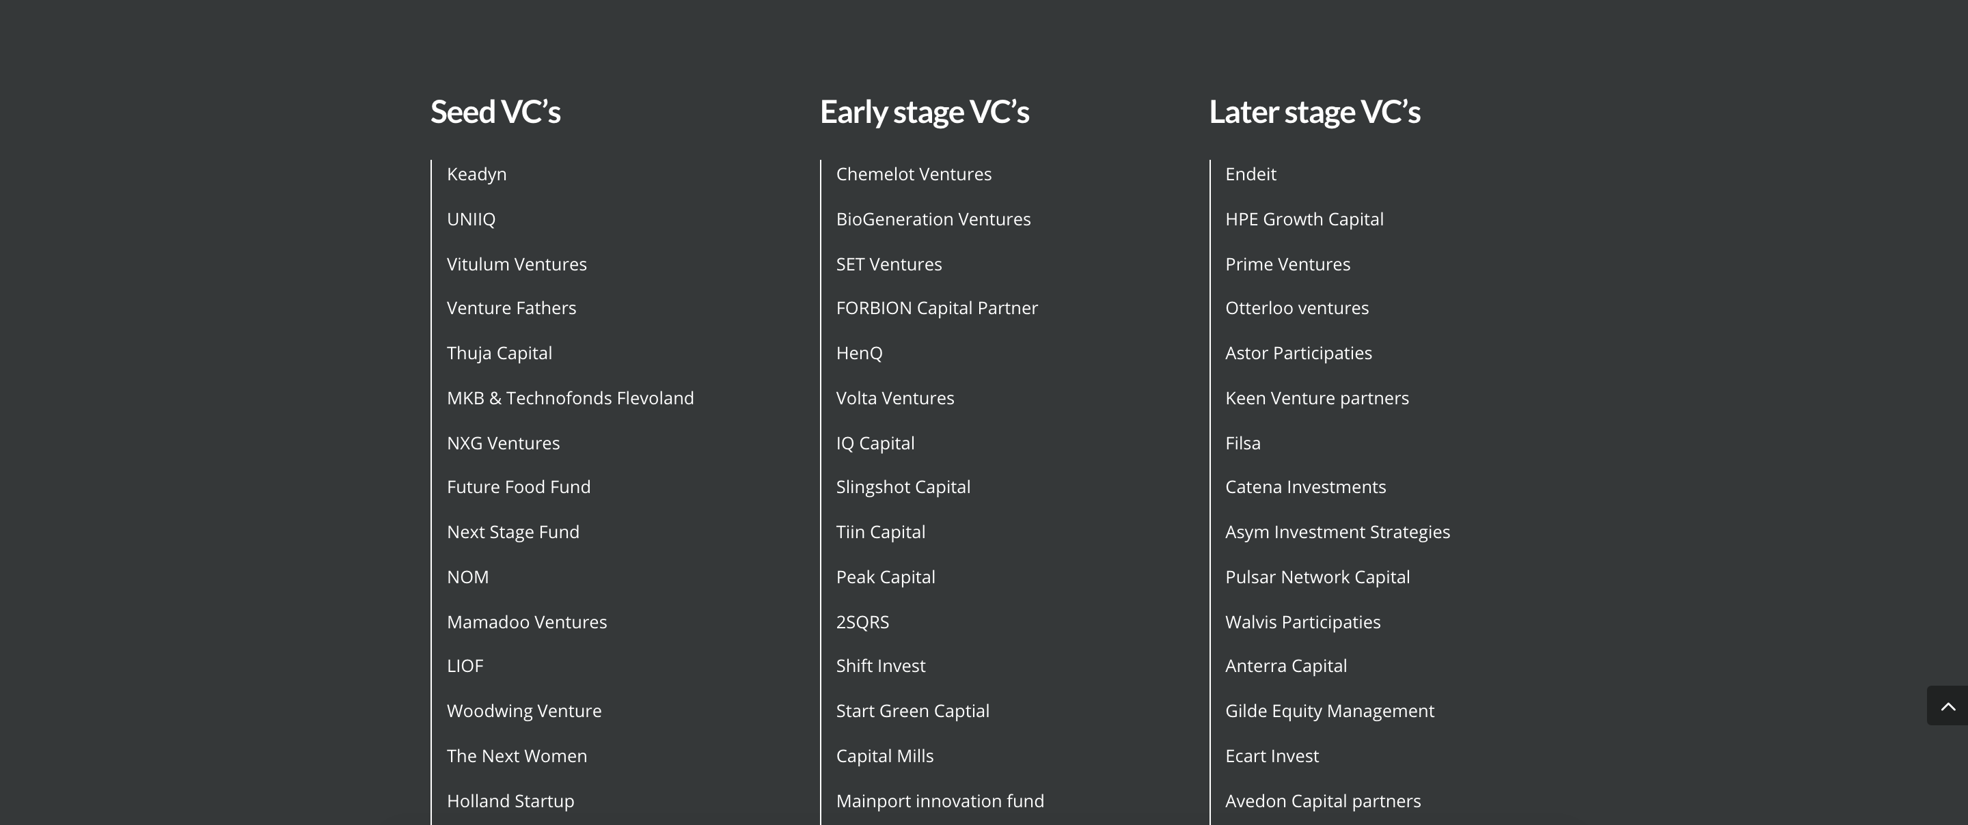
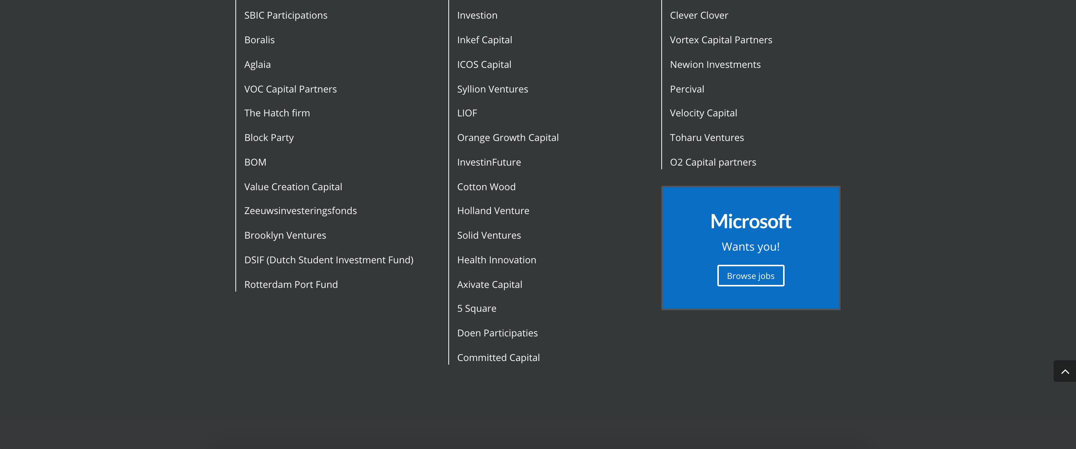
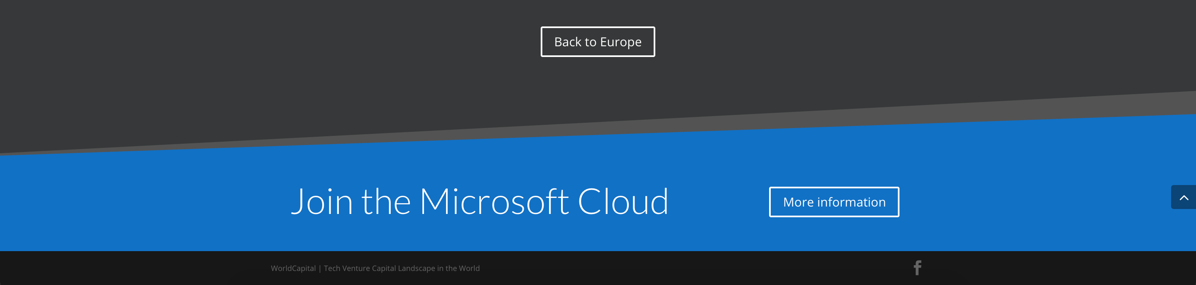
World
Capital
How does it work?
Startups visit World Capital to find investors per country
On the country page they see that you’re a country partner
Startups get massive value
from the free database “you” provide
Provide targeted call2actions and get startup leads on the country and investor pages

Slide 8

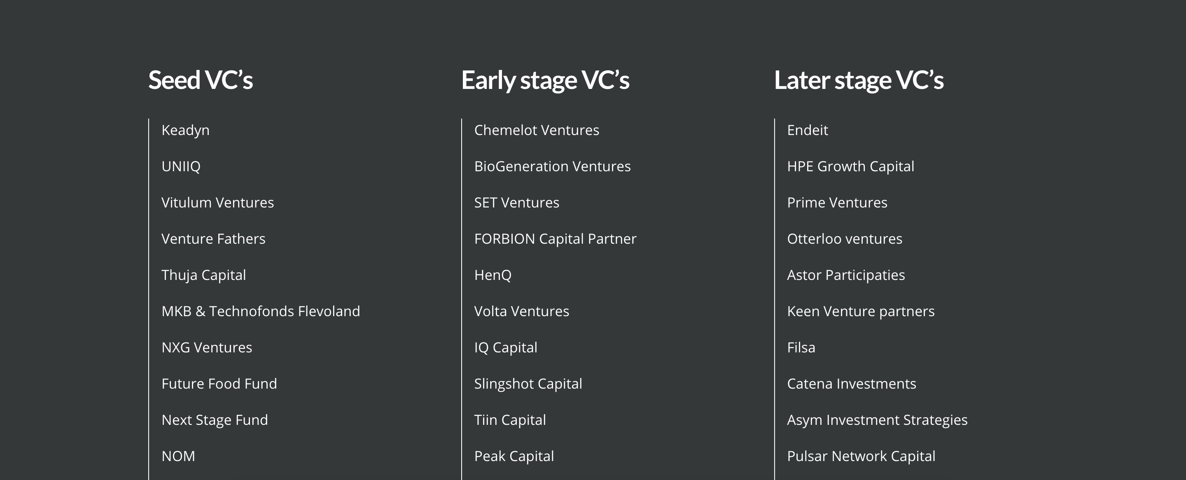
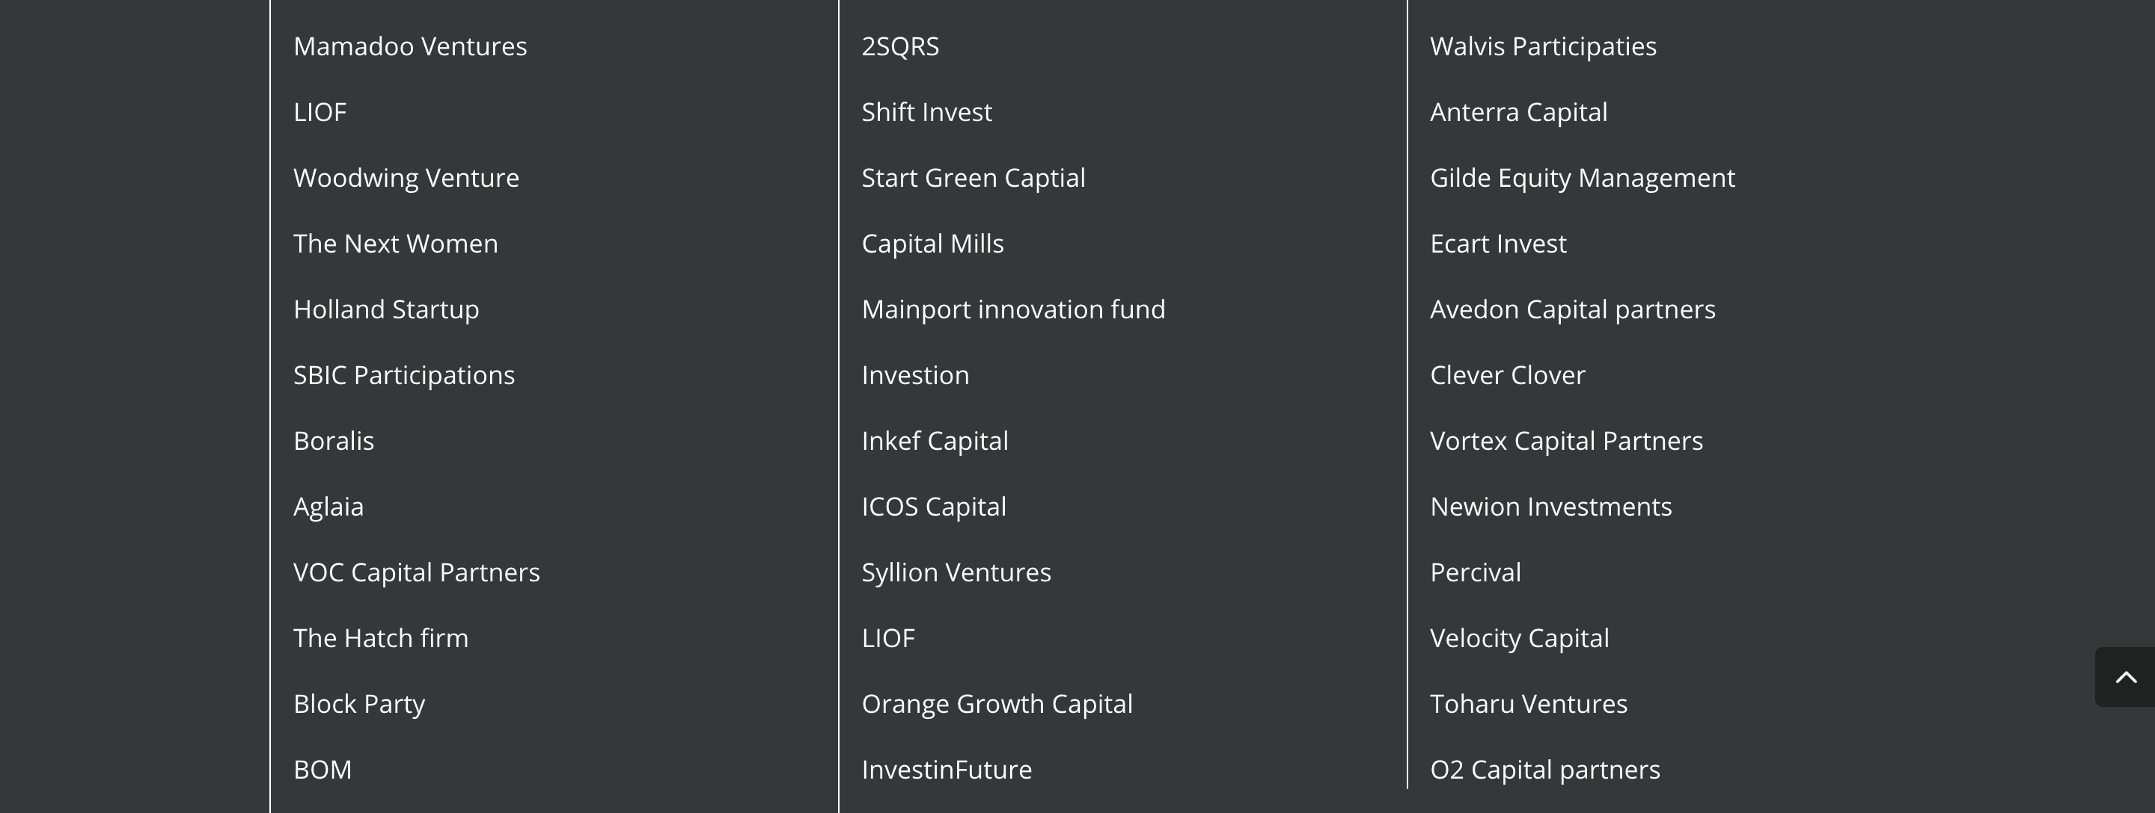
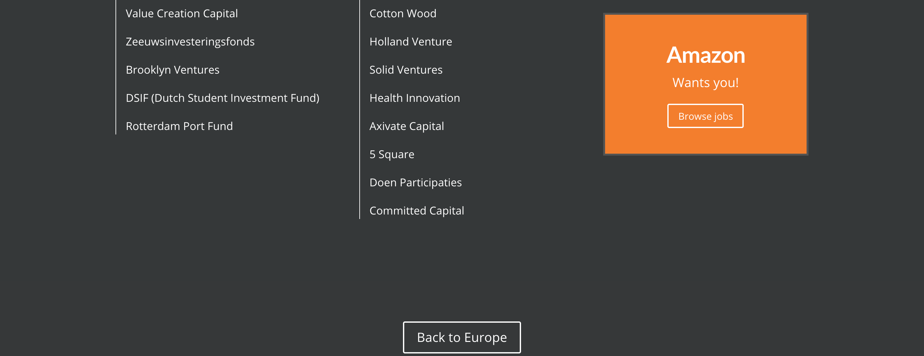
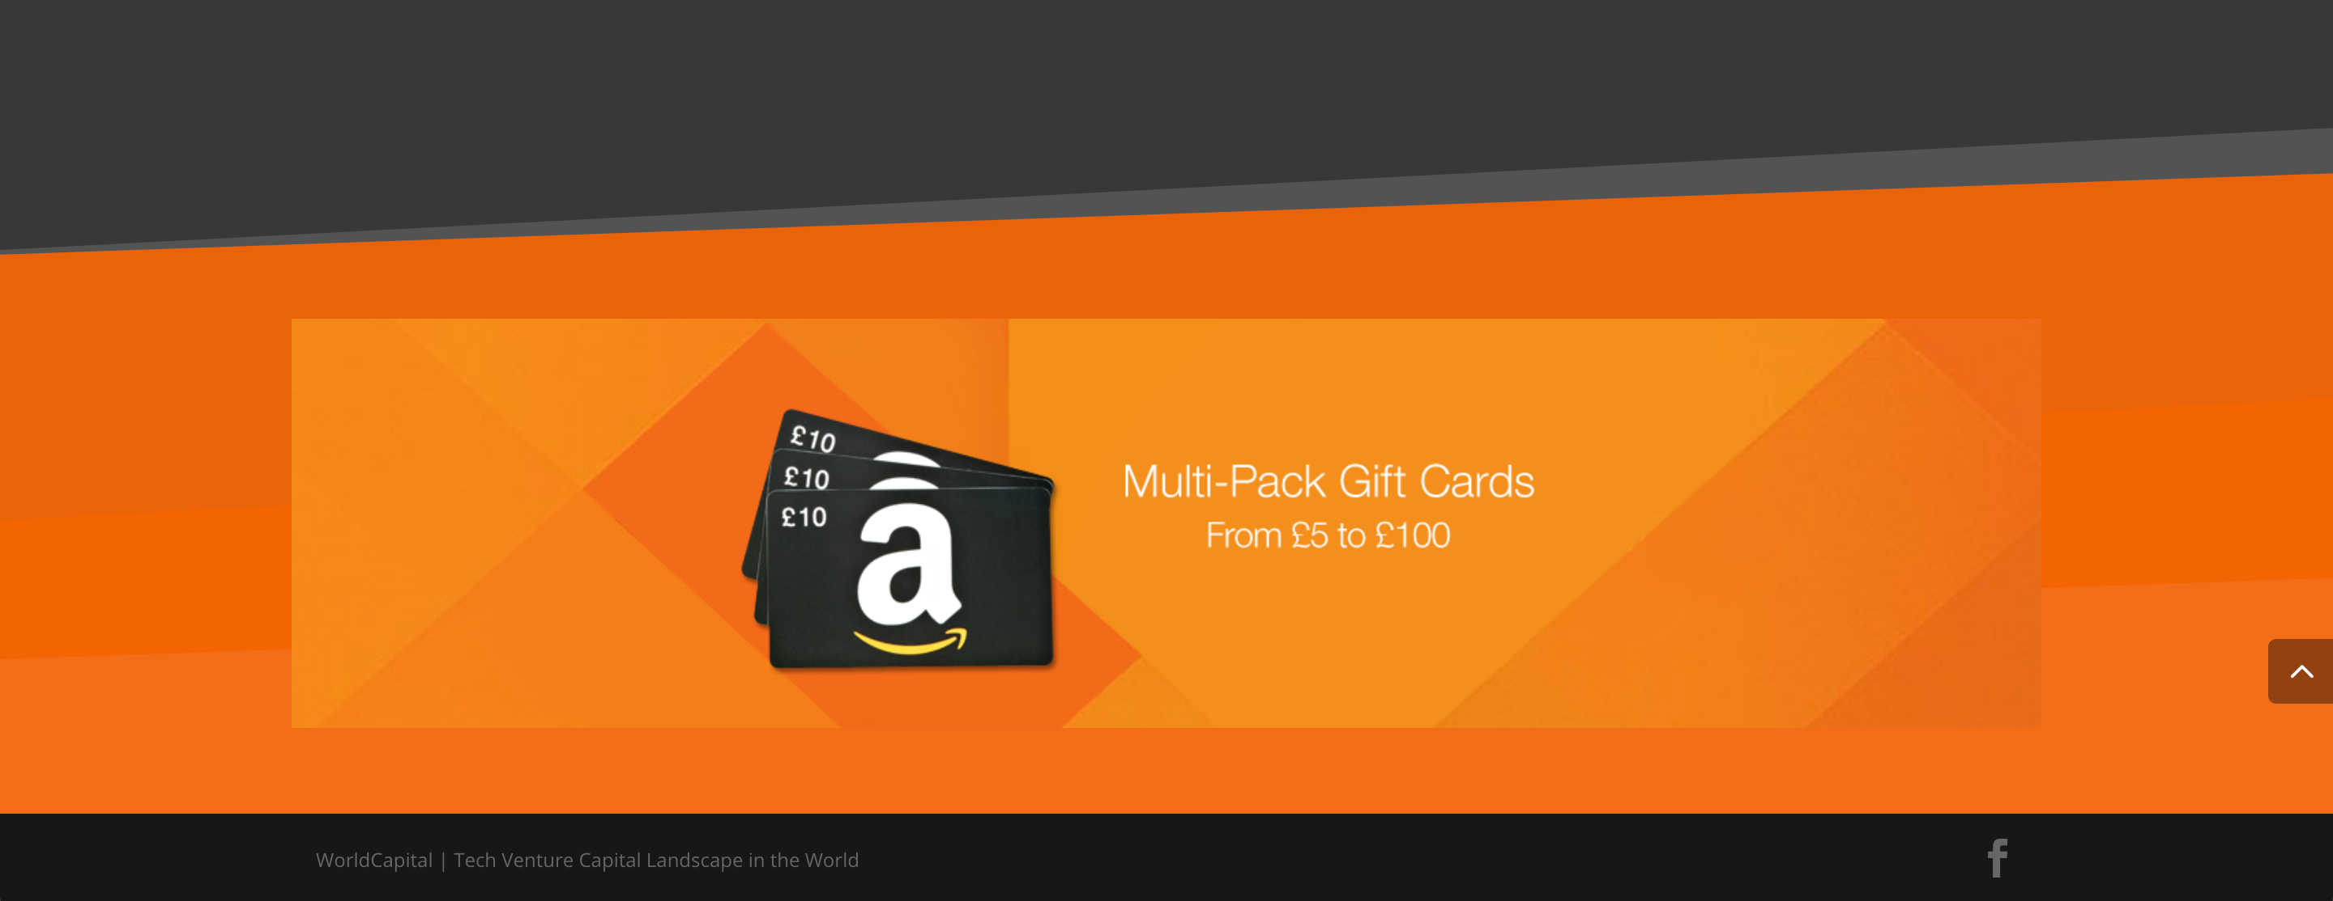
World
Capital
Reach your startup audience
Bring value to your startup audience
Support the startup ecosystem
Spread your personal message
Use your custom call2actions

Slide 9
World
Capital
Click for live demo >

Slide 10
I want to become a partner
FAQ
What is WorldCapital.co?
Follow three simple steps
Why was WorldCapital.co built?
Why should I support World Capital?
1.
Go to this link and pick the countries you want to sponsor
What is the mission of World Capital
2.
At the bottom of the page tell us which countries you would like to support and we will send you the price list for those countries
How can I use world Capital to reach startups?
Why do startups love World Capital?
We agree on the partnership and we go into
the proces of incorporating your branding and your call2actions into the countries
you choose to support
3.
When will it go live?
How do you differ from
Cruchbase, AngelList and index.co?

Slide 11
World
Capital
Support startups by bringing them true value

