Slide 1
BRIEF

Slide 2
We want your help for a really exquisite project.
We are to launch a traditional weissbier with very noble Mitteleuropa pedigree.
Name: JFK
...from Joseph Franz Kaiser, the last Austro-Hungarian emperor.
https://en.wikipedia.org/wiki/Franz_Joseph_I_of_Austria
We want to play on the letters JFK (with their dual meaning) and the iconic figure of the emperor.
Illustration skills are absolutely critical.
We want this to look like 1900-1914 avant-garde. See furtherreferences for the emperor figure and some look & feel references for the epoque.
This beer is a traditional Weissbier born in Schönbrunn, in a craft Bavarian brewery that dates from 1853.
Practicalities:
It will be packed in traditional NRW 0.5L bottles and in even more traditional 1L swingtop bottles.
The labels will be printed on craft paper. For inks, we could use max 1 special Gold folio, the rest should be normal stuff.
We need Front labels and Neck labels. The backlabels - we'll take care of them.
The NRW 0.5L label shape is the classical both body and top.
For the 1L we are flexible to use also a die cut if it's better suited. See attached for dimensions.
Info on the labels in the order of importance:
JFK
Joseph Franz Kaiser
Craft Weissbier
Schönbrunn, 1853
Born in Schönbrunn, Bavaria, in a craft brewery that was established in1853.
Alc. 5.1%, OE 12.6°, EBU 15

Slide 3
JFK – the Emperor

Slide 4
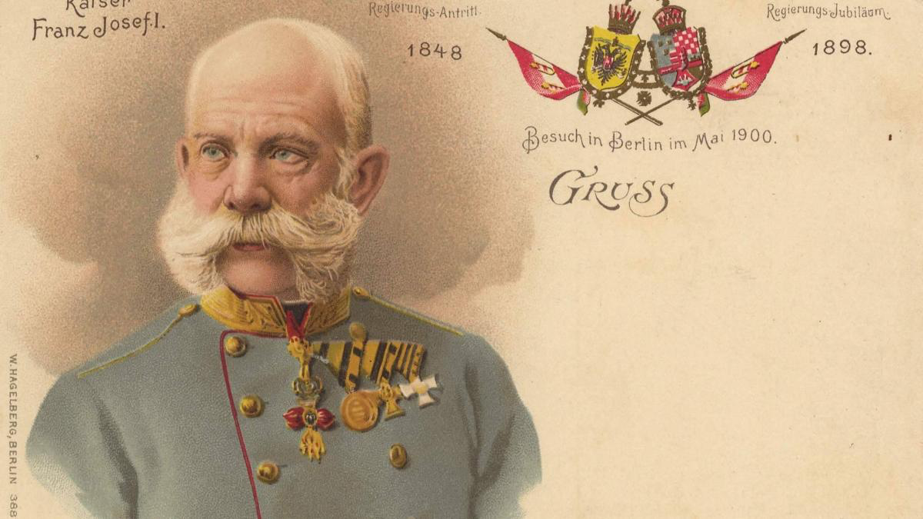

Slide 5
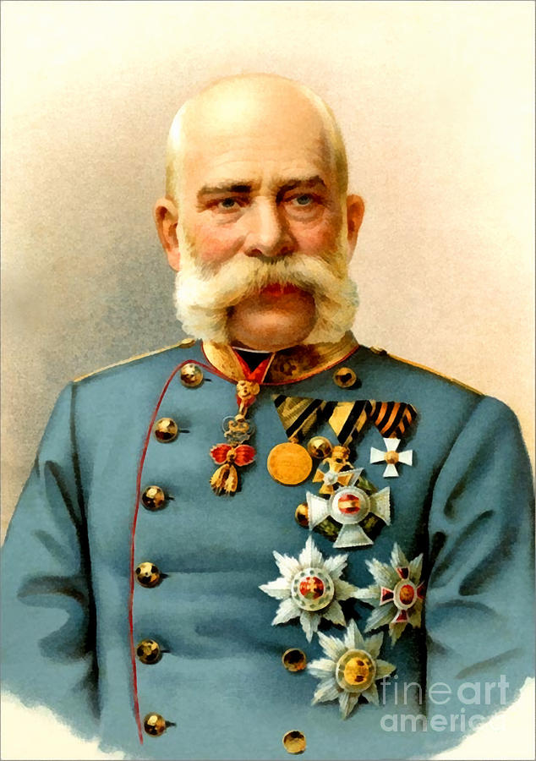
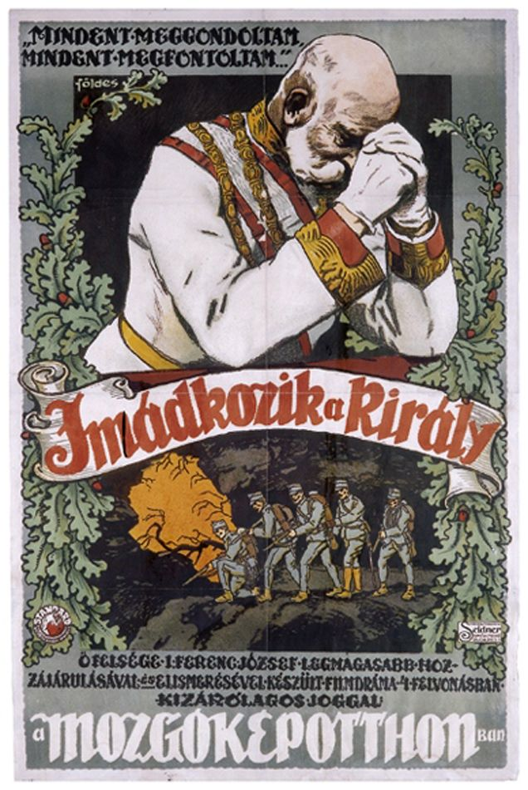

Slide 6
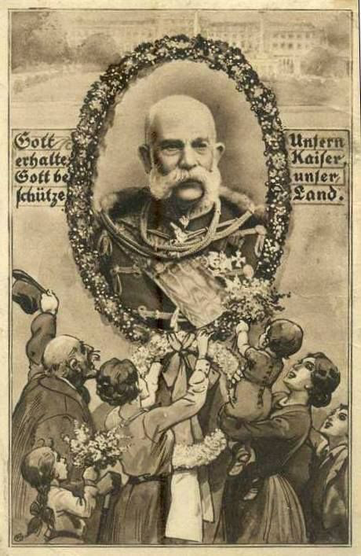
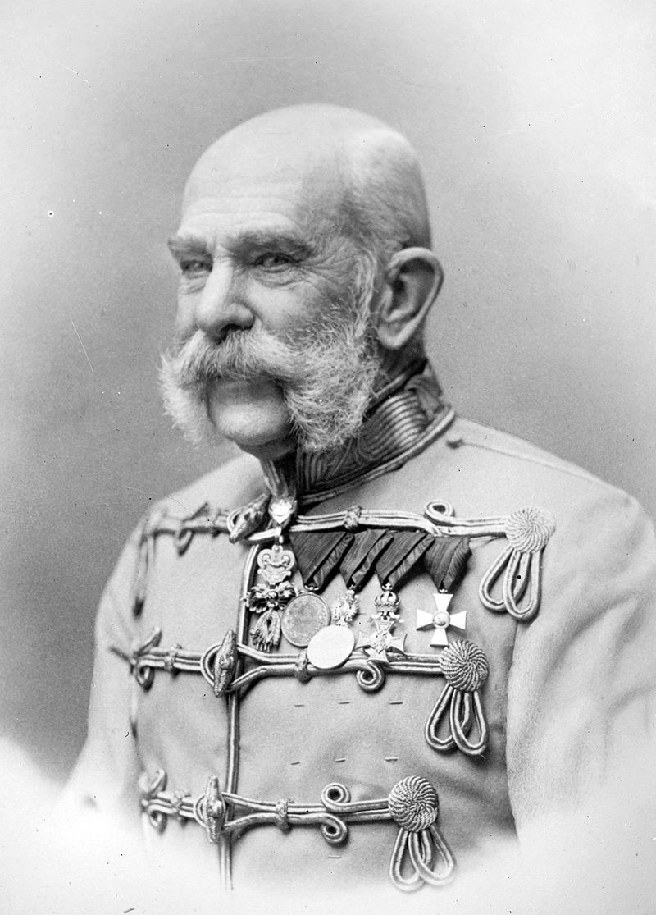

Slide 7
Style references

Slide 8
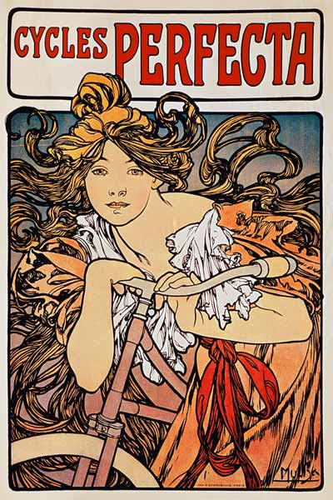
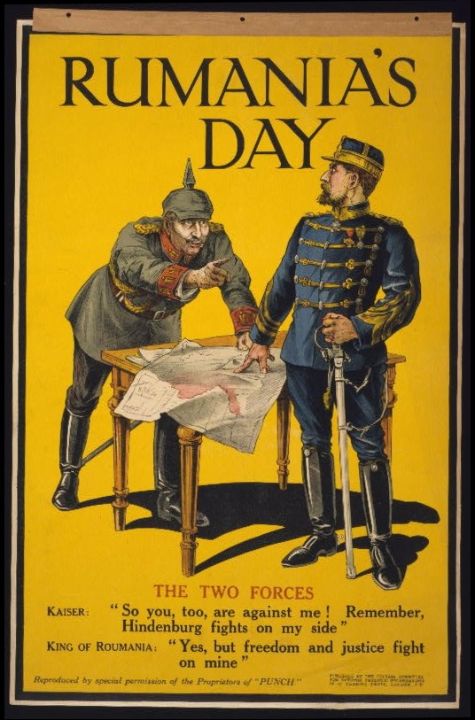

Slide 9
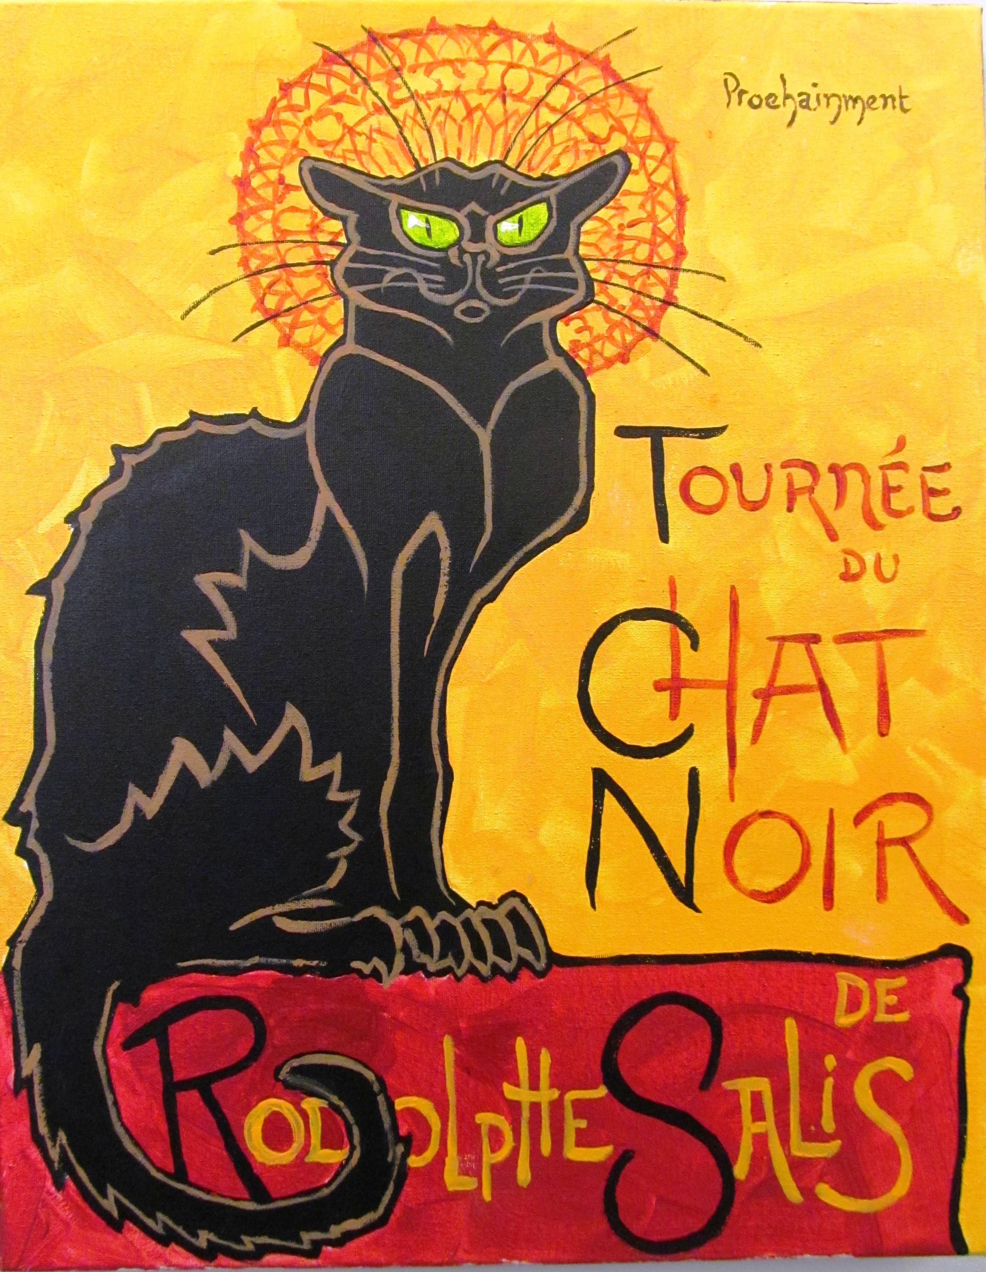
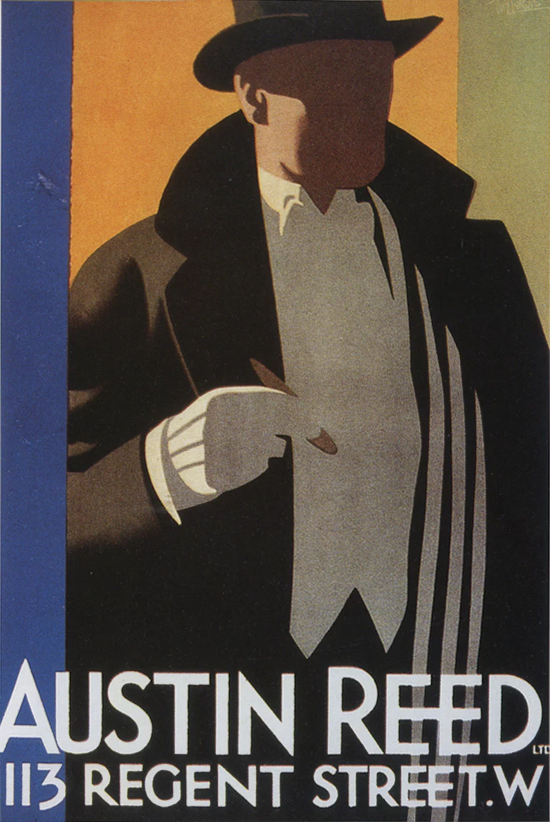

Slide 10
Practicalities

Slide 11
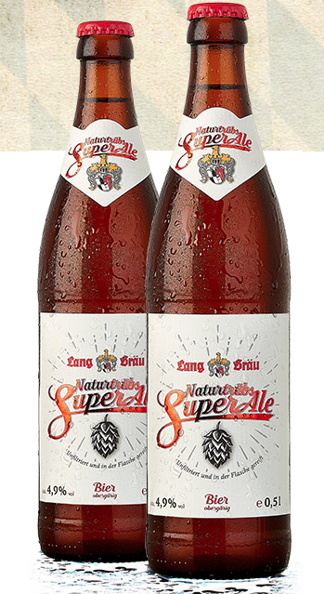
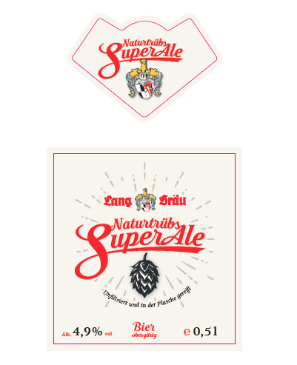
0.5L NRW Bottle
Front and necklabel shapes exactly as below – see attached PDF

Slide 12
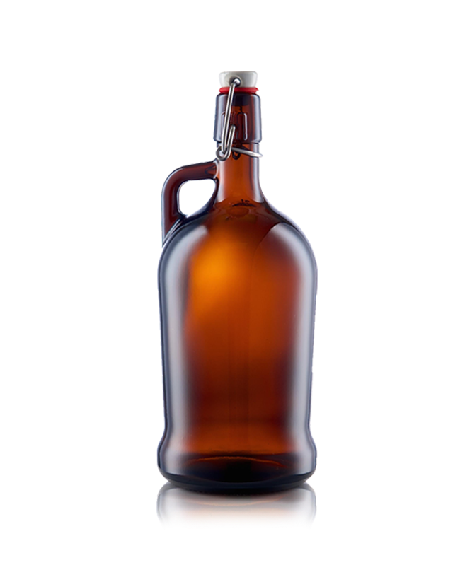
1L Bottle
Just one front label.
Label shapes and dimensions can vary.
The glass height is 25cm and the diameter is 10.5cm.

