Slide 1
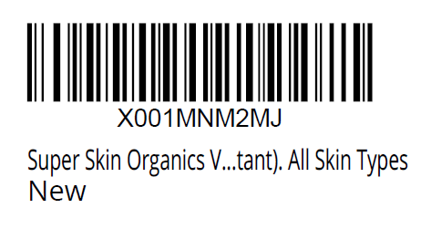


Made in the USA. Distributed by:
Super Skin Organics. Spokane, WA.
www.superskinorganics.com
info@superskinorganics.com
DIRECTIONS: Apply three to four drops twice
daily to face and neck. Follow with daily moisturizer.
Avoid contact with eyes.
INGREDIENTS: Water (Aqua), Ethylhexyl Palmitate,
Glycerin, Stearic Acid Isodecyl Neopentanoate,
DEA-Cetyl Phosphate, Isostearyl Stearoyl Stearate,
Ethyl Ascorbic Acid, Ascorbic Acid, Simmondsia
Chinensis (Jojoba) Seed Oil, Aloe Barbadensis Leaf
Juice, Alchemilla Vulgaris Extract, Vitis Vinifera
(Grape) Seed Extract, Saccharomyces Lysate Extract,
Phytic Acid, Sodium Hyaluronate, Superoxide
Dismutase, RNA, Sodium DNA, Serine, Salicylic Acid
Squalane, Dimethicone, Cetyl Alcohol, Citrus Grandis
(Grapefruit) Peel Oil, Disodium EDTA, Butylene Glycol,
Carbomer, Sodium Metabisulfite, Sodium Citrate,
Citric Acid, Triethanolamine, Methylparaben,
Propylparaben, Imidazolidinyl Urea
S-38501
C
Vitamin Serum
+ Hyaluronic Acid
REJUVENATE
1 fl Oz / 30 ml

