Slide 1
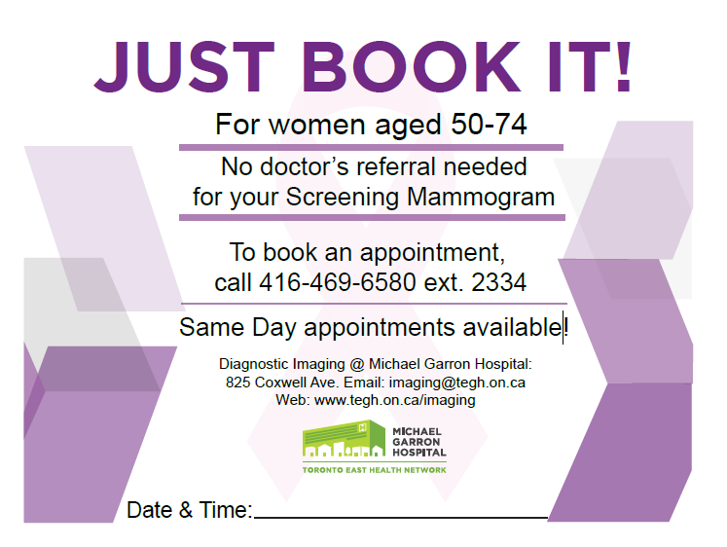

Your appointment’s
This is the current version of the flyer, which we would like to update and improve.
Please consider it just as a source of key information – there’s no need to follow this design.
Information/context changes needed:
Update email with: imaging@tehn.ca
Update Web with: www.tehn.ca/imaging
Add “Early Detection Saved Lives” logo (on this page, top right corner)
Add the line about the ‘Ambassador Program’: “Join the MGH Mammo Ambassador Program to help save lives!”

