Slide 1
Introduction
Application to categorize stretching and strength routines for triathlon.
The design of the application should be compliant with the last version of the IOS Mobile.

Slide 2
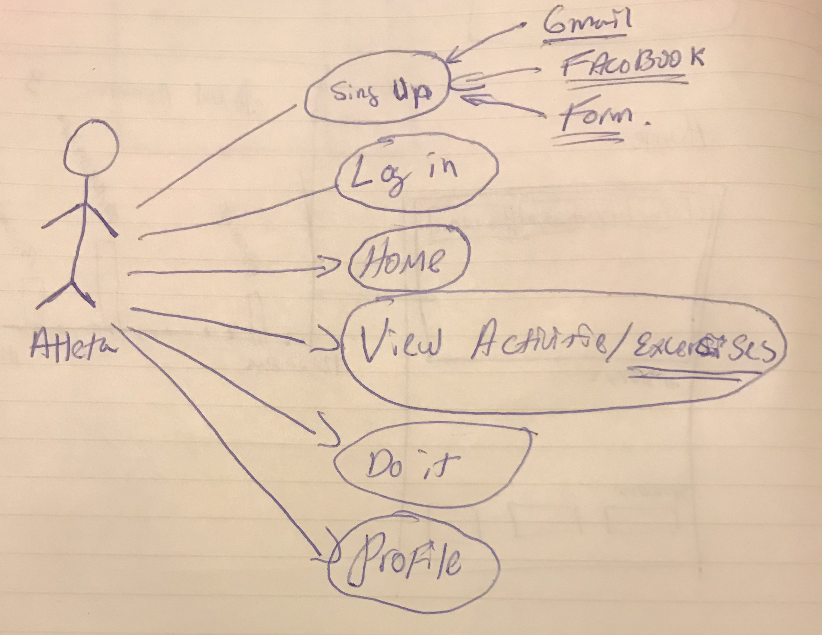
User
The application only have one user.
The user is a Athlete. The User is a Runner, Cyclist, Swimmer or Triathlete.

Slide 3
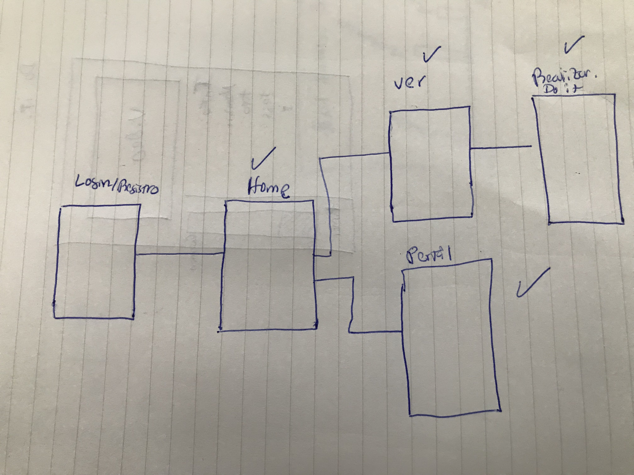
Application Map
The application only have 5 screens:
Loading Page
Login or Sign Up
Home Page
View Activities
Do it
Profile

Slide 4
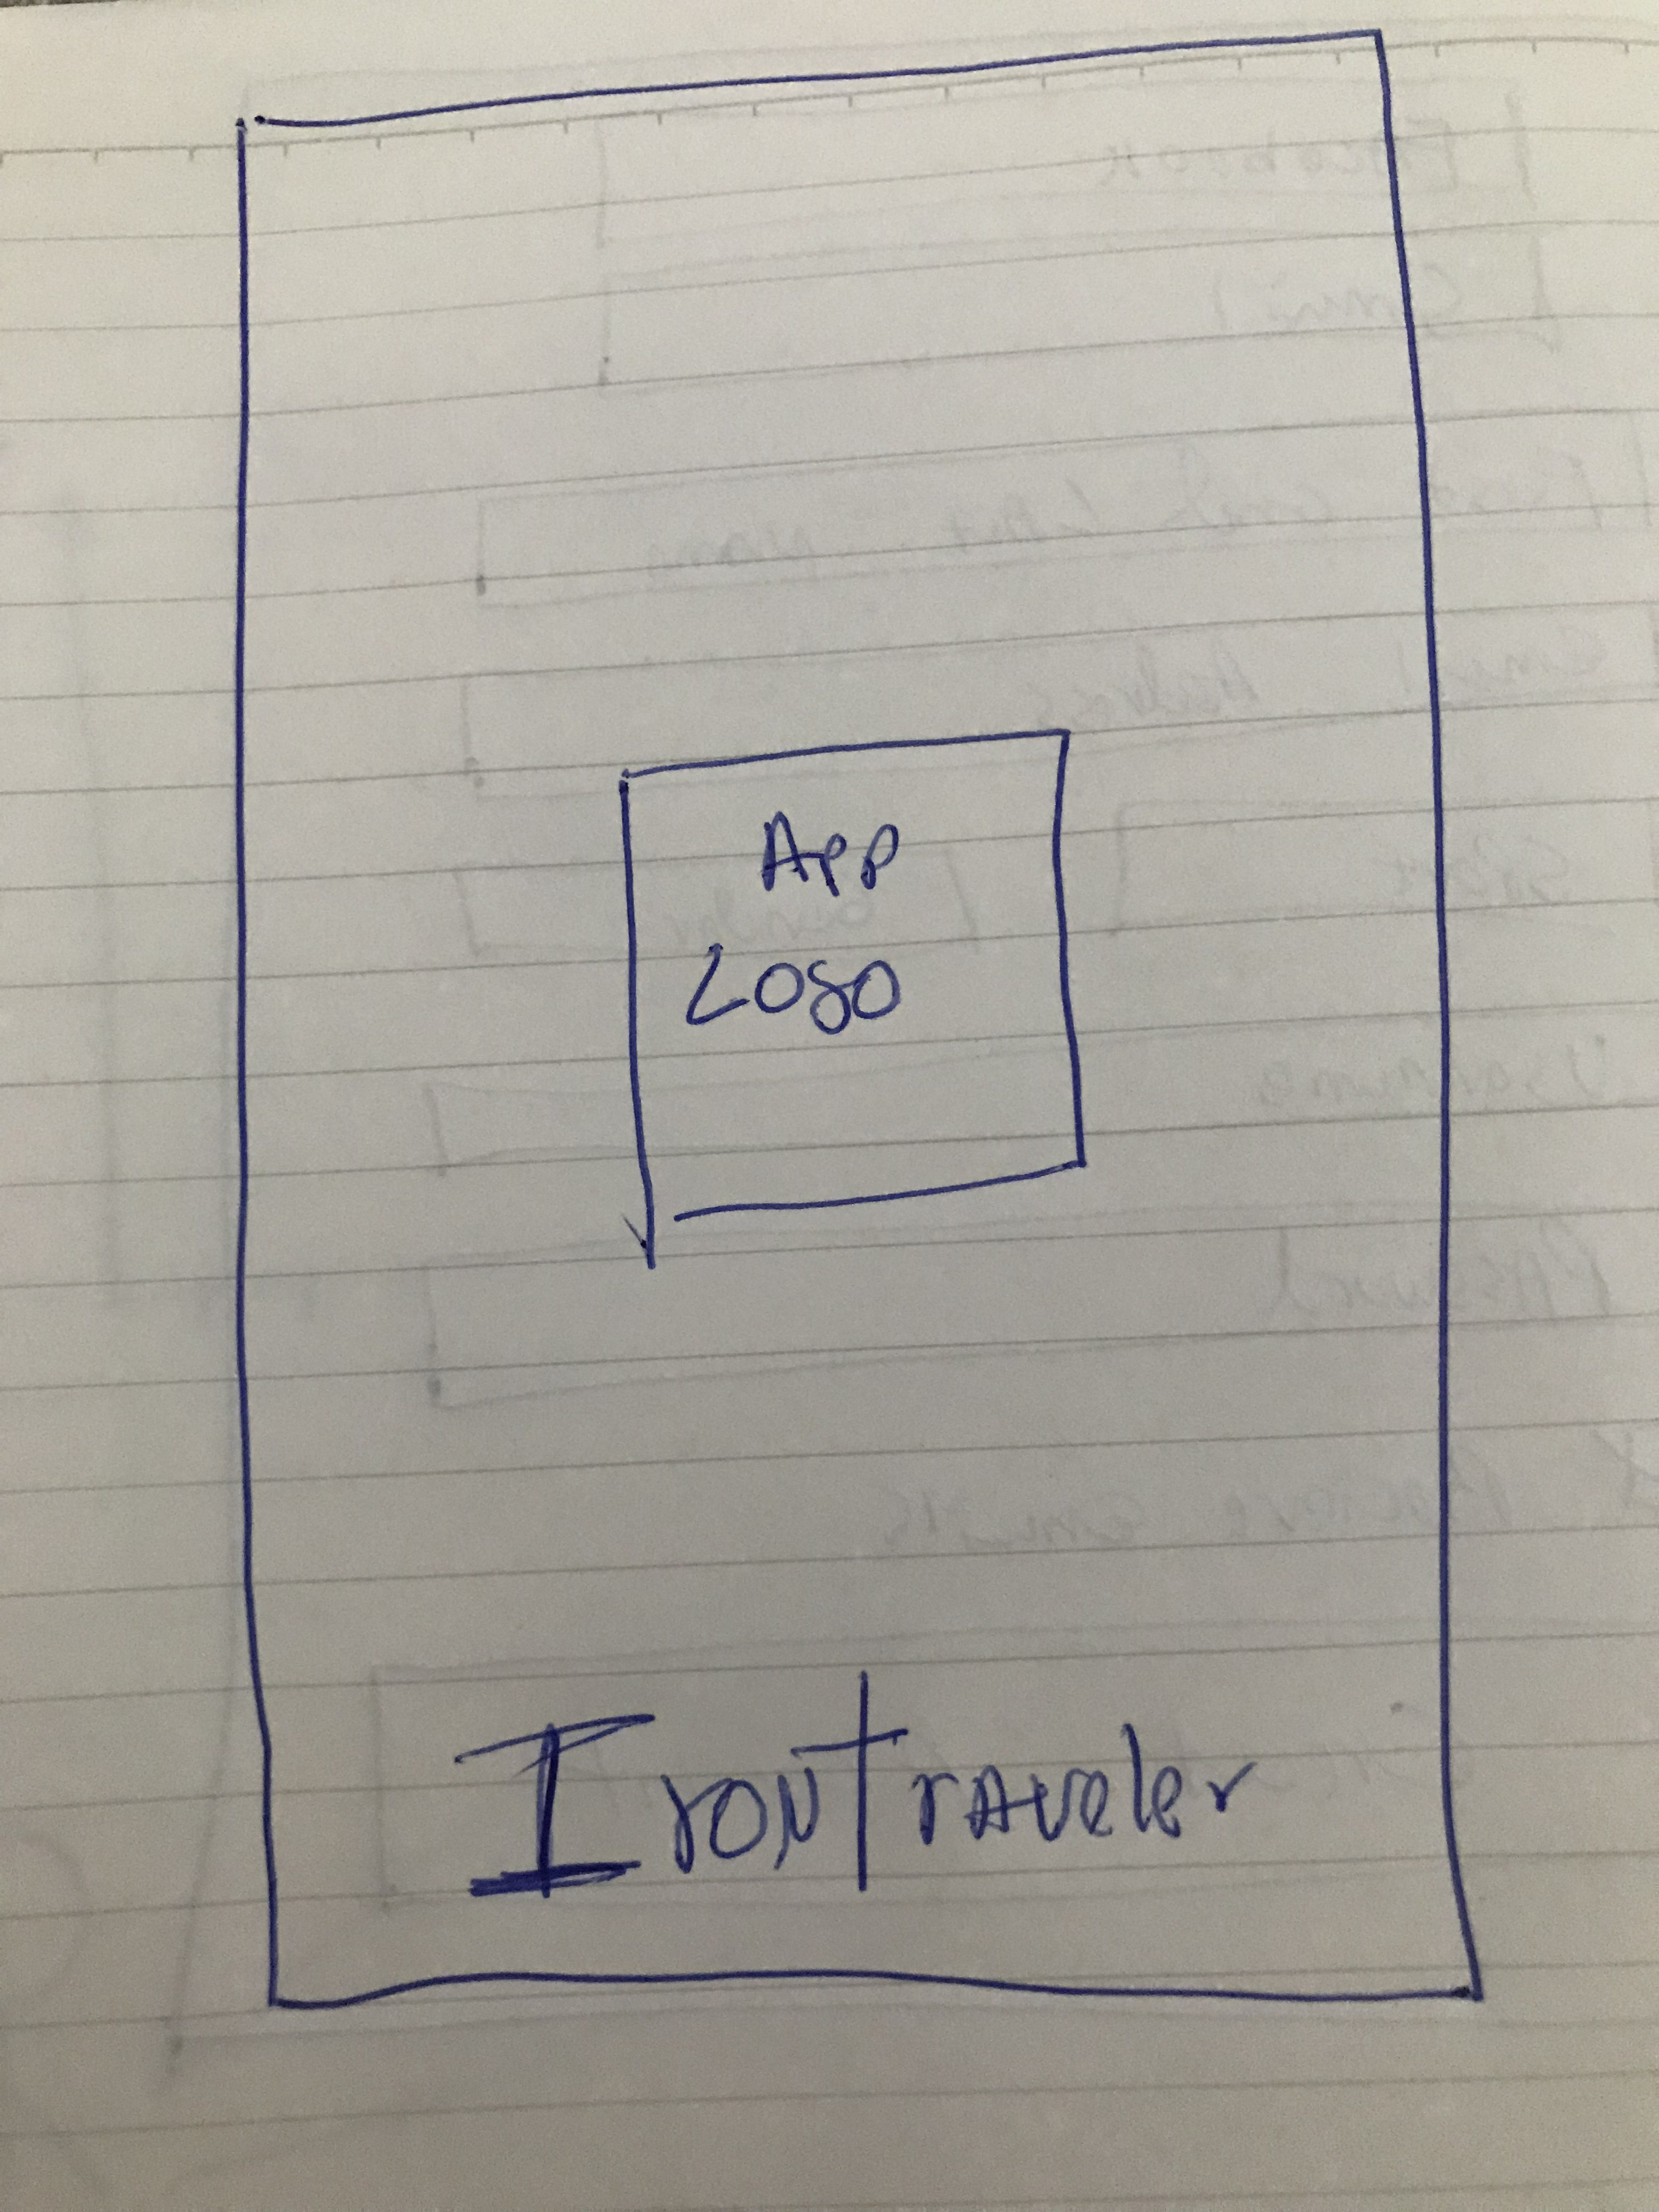
Loading Page

Slide 5
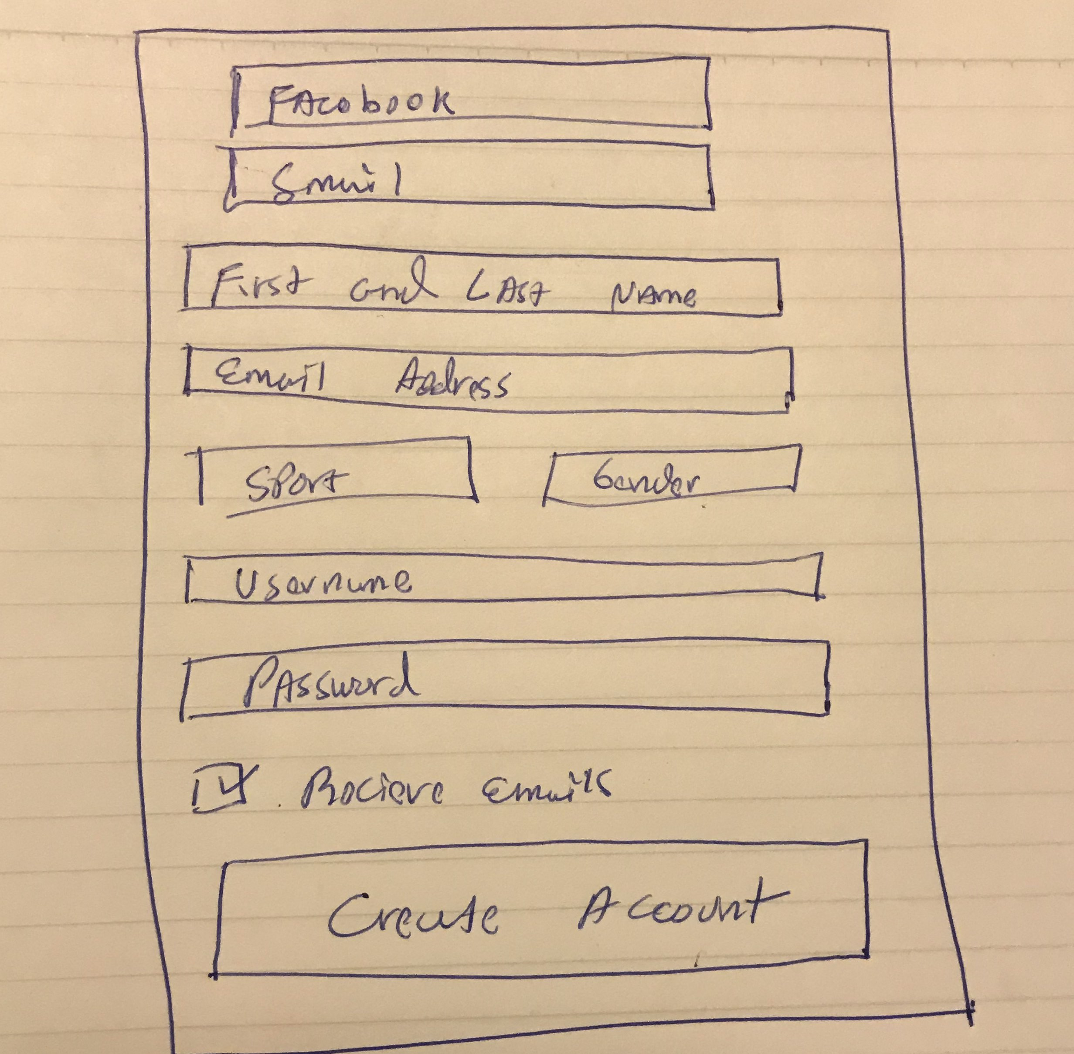
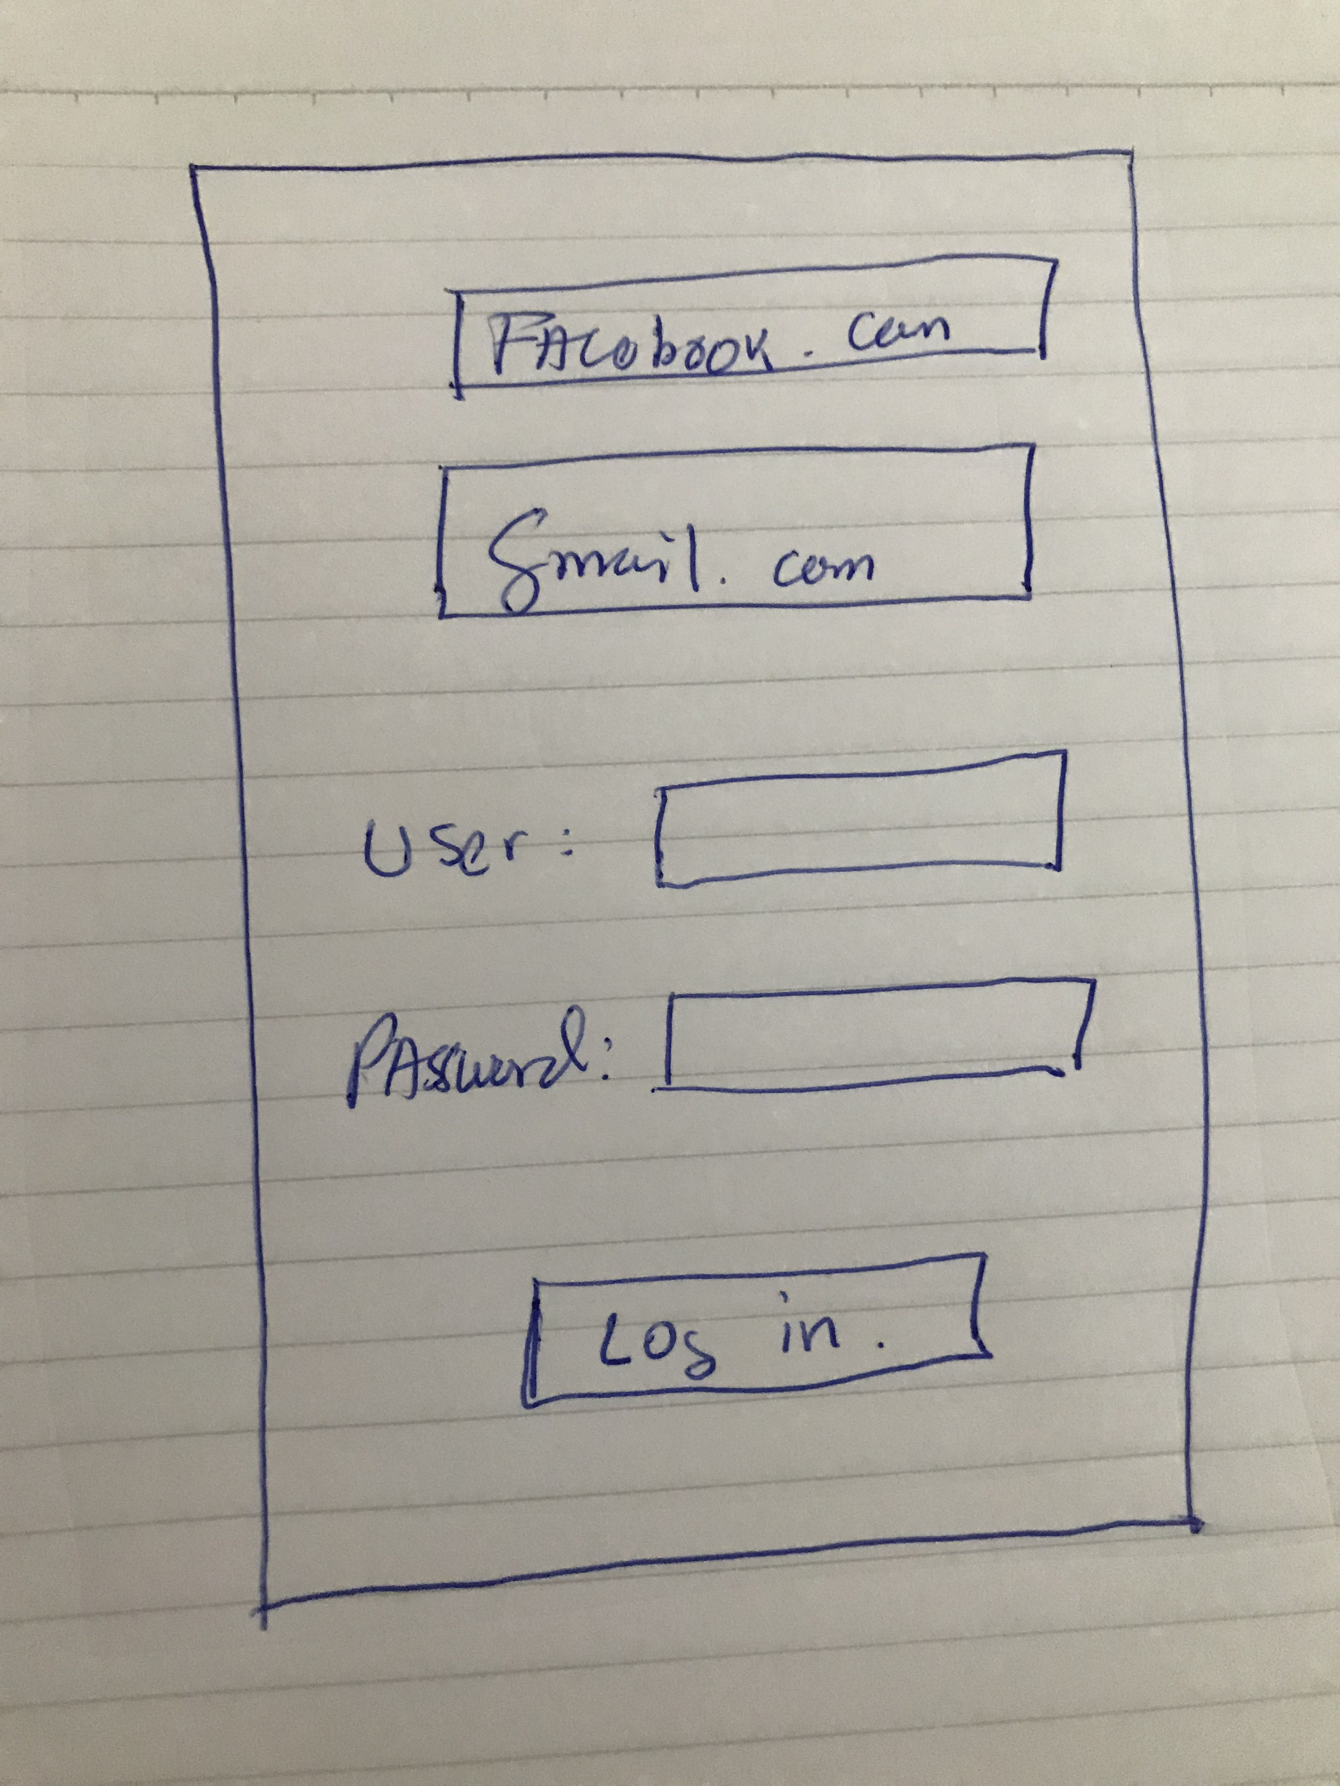
Login and Register
The application allow sign up or log in with facebook or gmail.
Log In-Data Entry:
User
Password
Sing UP -Data Entry:
First and Last Name
Email Address
Sport: Swimming, Bike, Running, Triathlon.
Gender
Username
Password

Slide 6
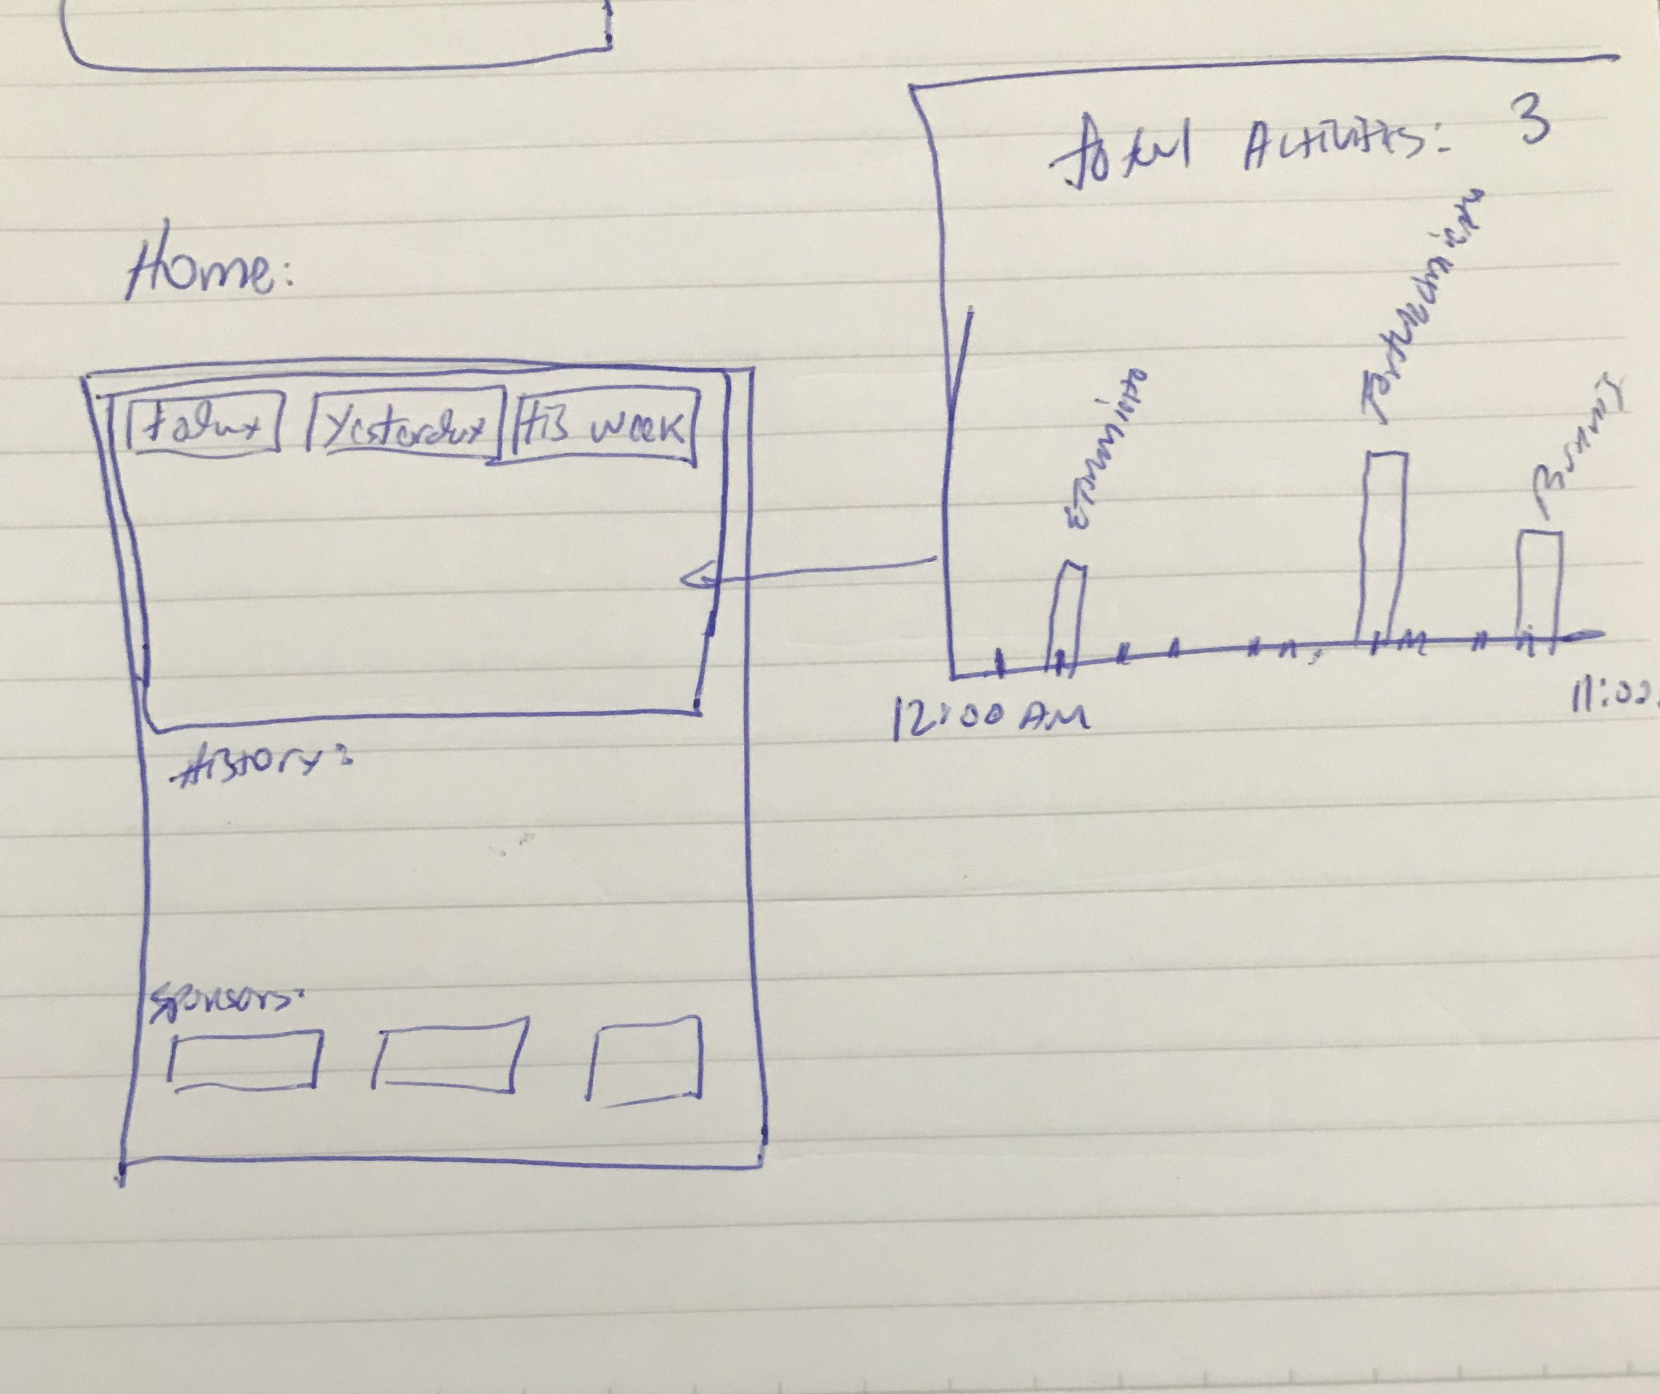
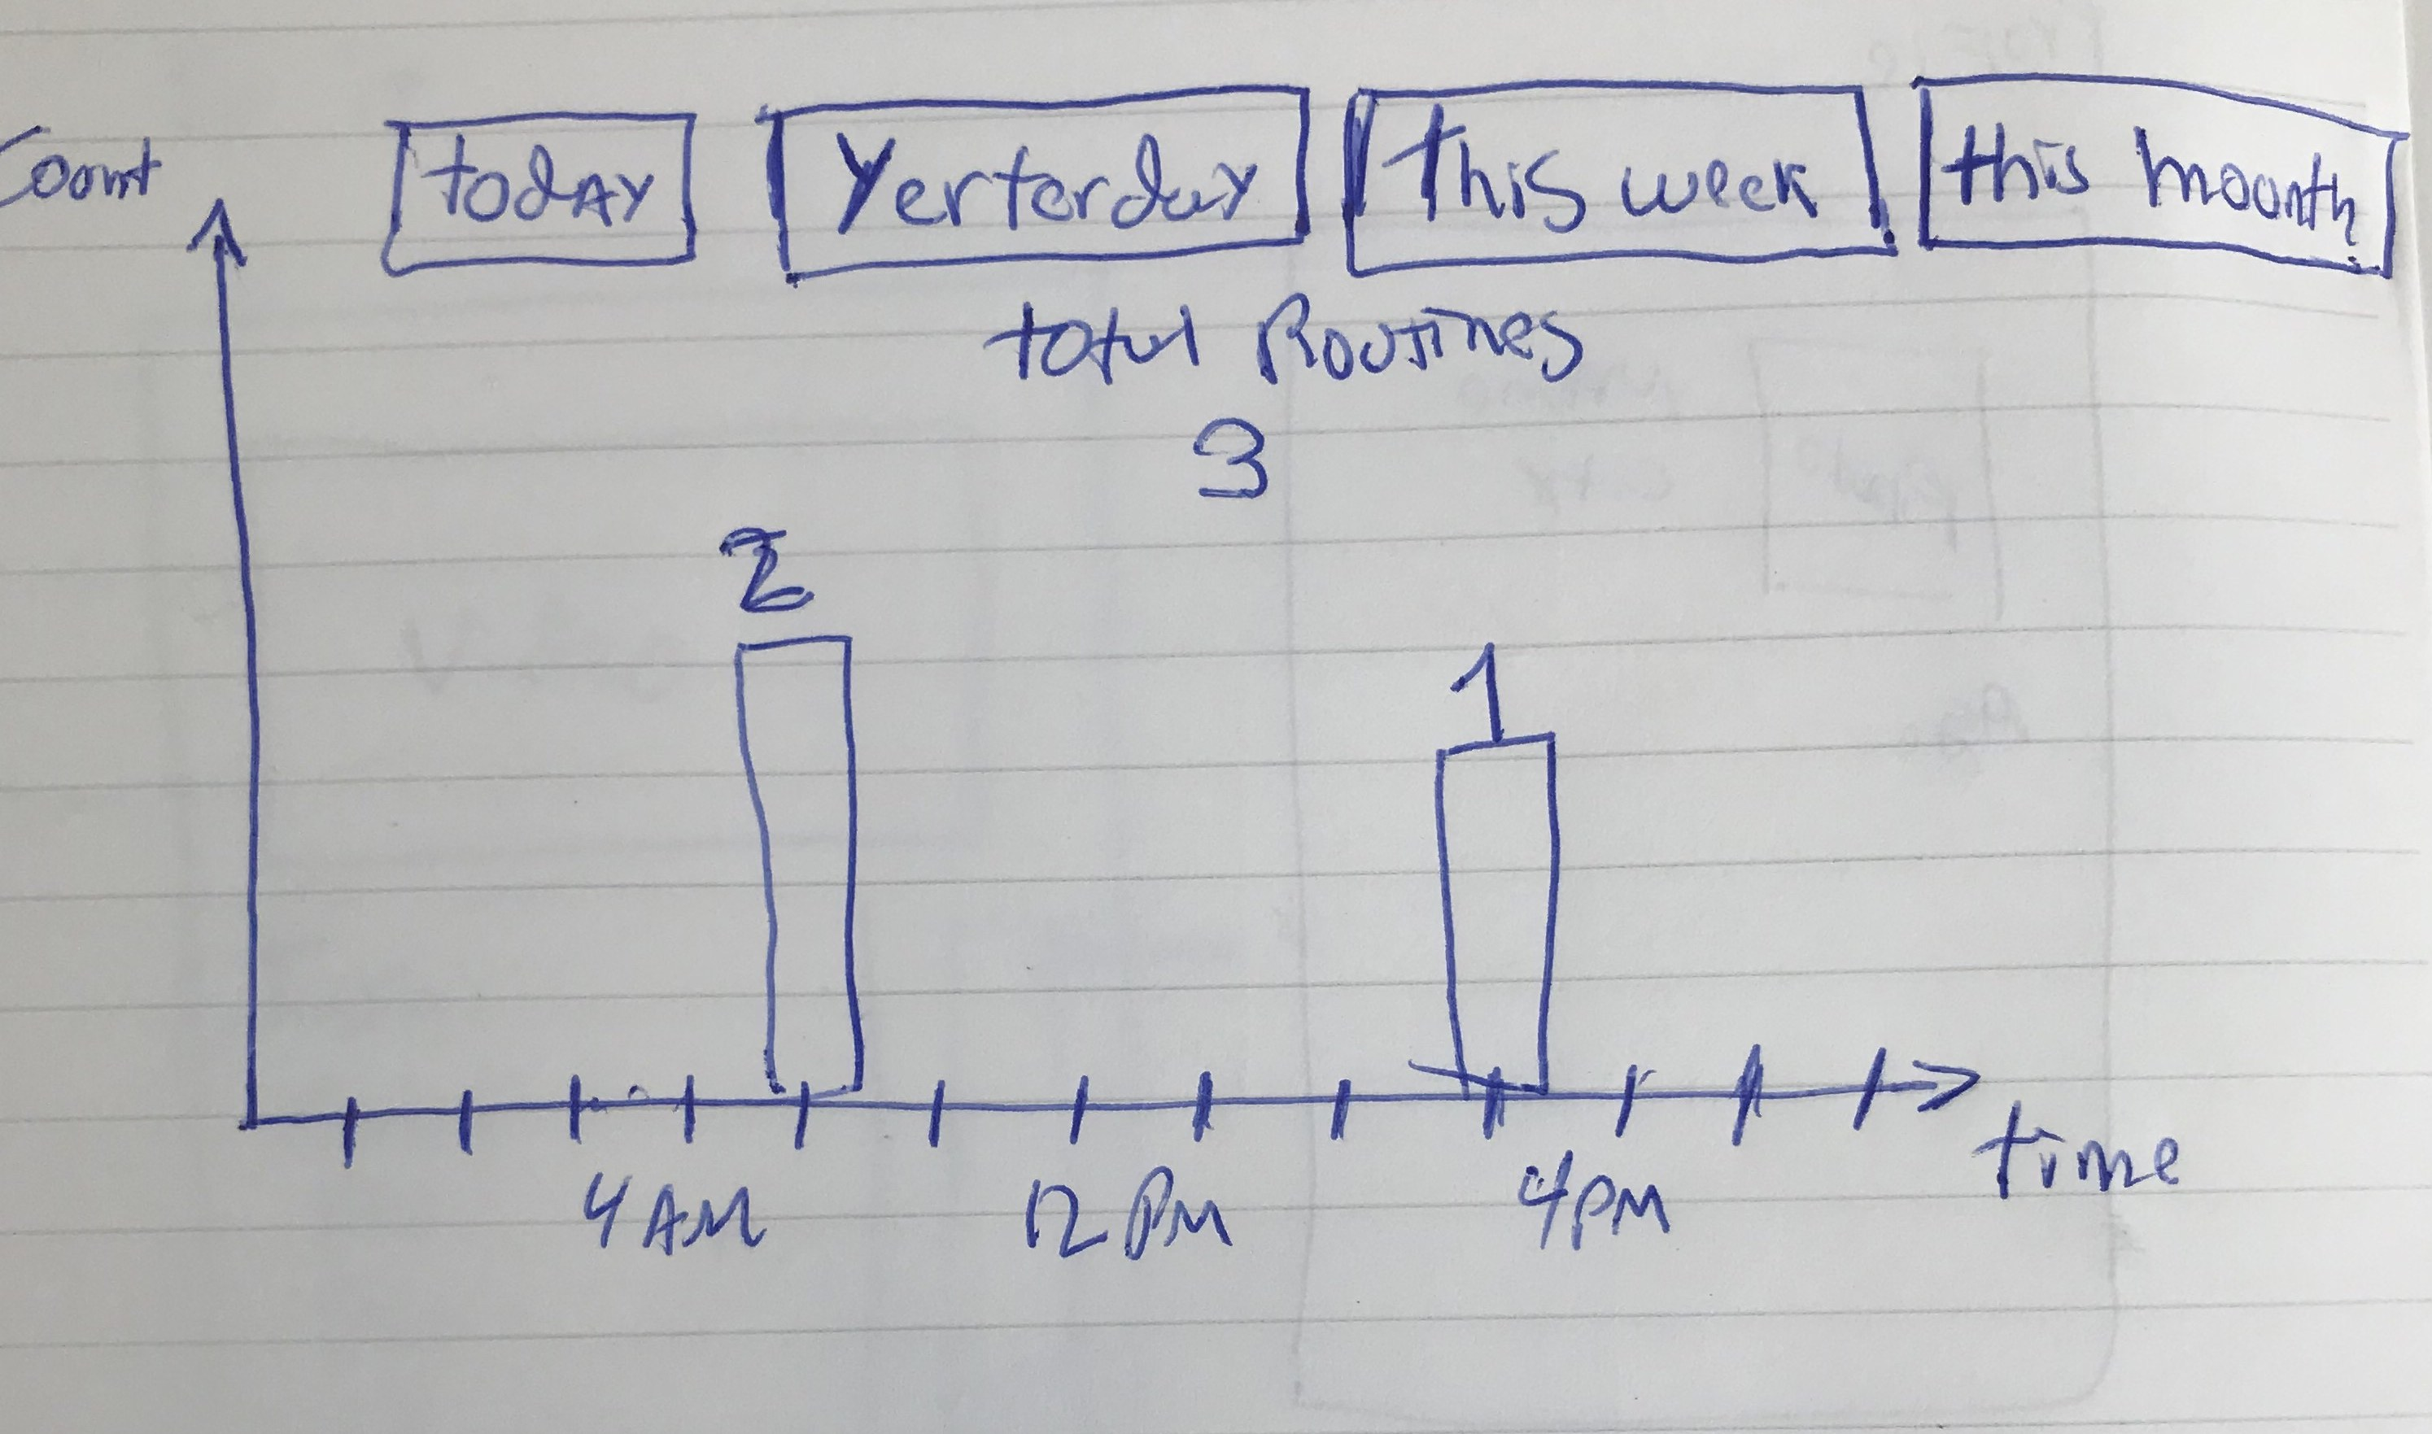
Home
Data Entry:
Statistics Area
Last exercises and routines
Sponsors Area.
Statistics Area

Slide 7
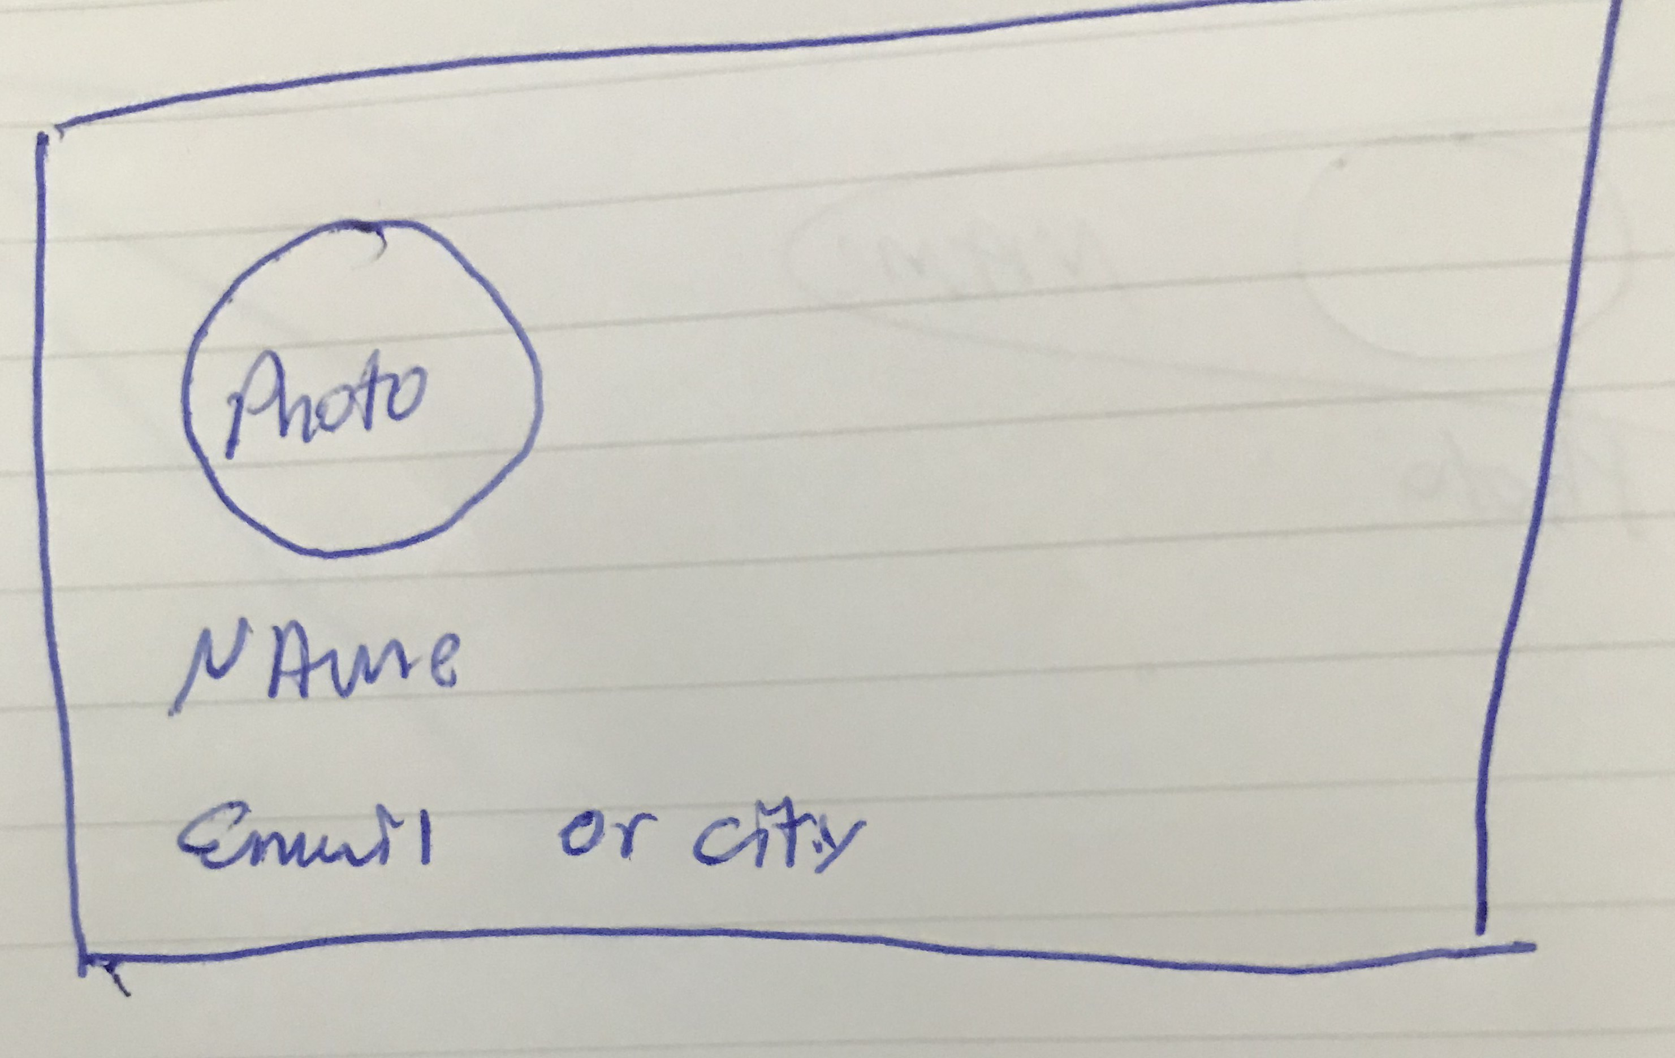
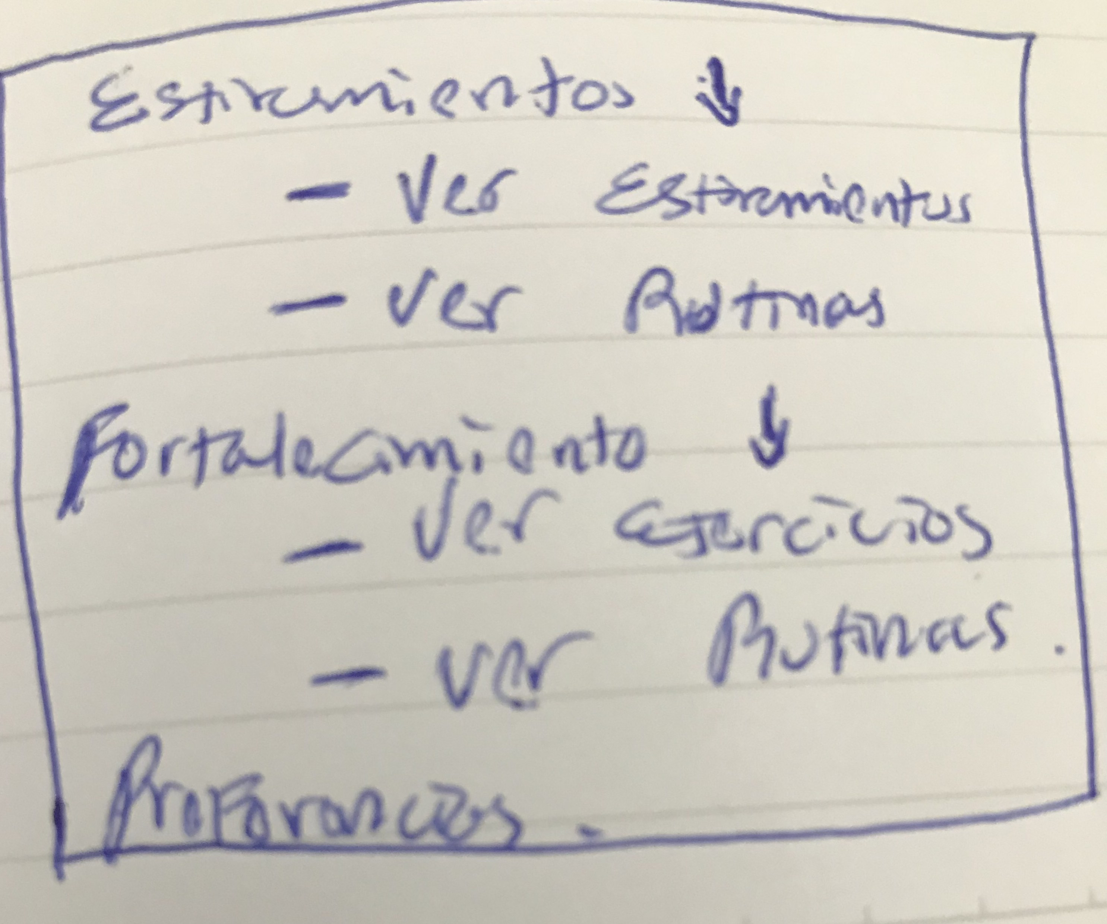
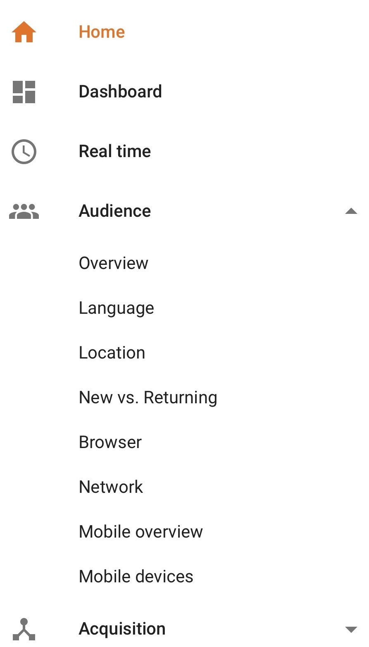
Menu
Data Entry:
Profile Area
Home
Stretching
  View Stretch
  View Routines
Strength
  View Exercises
  View Routines

Slide 8
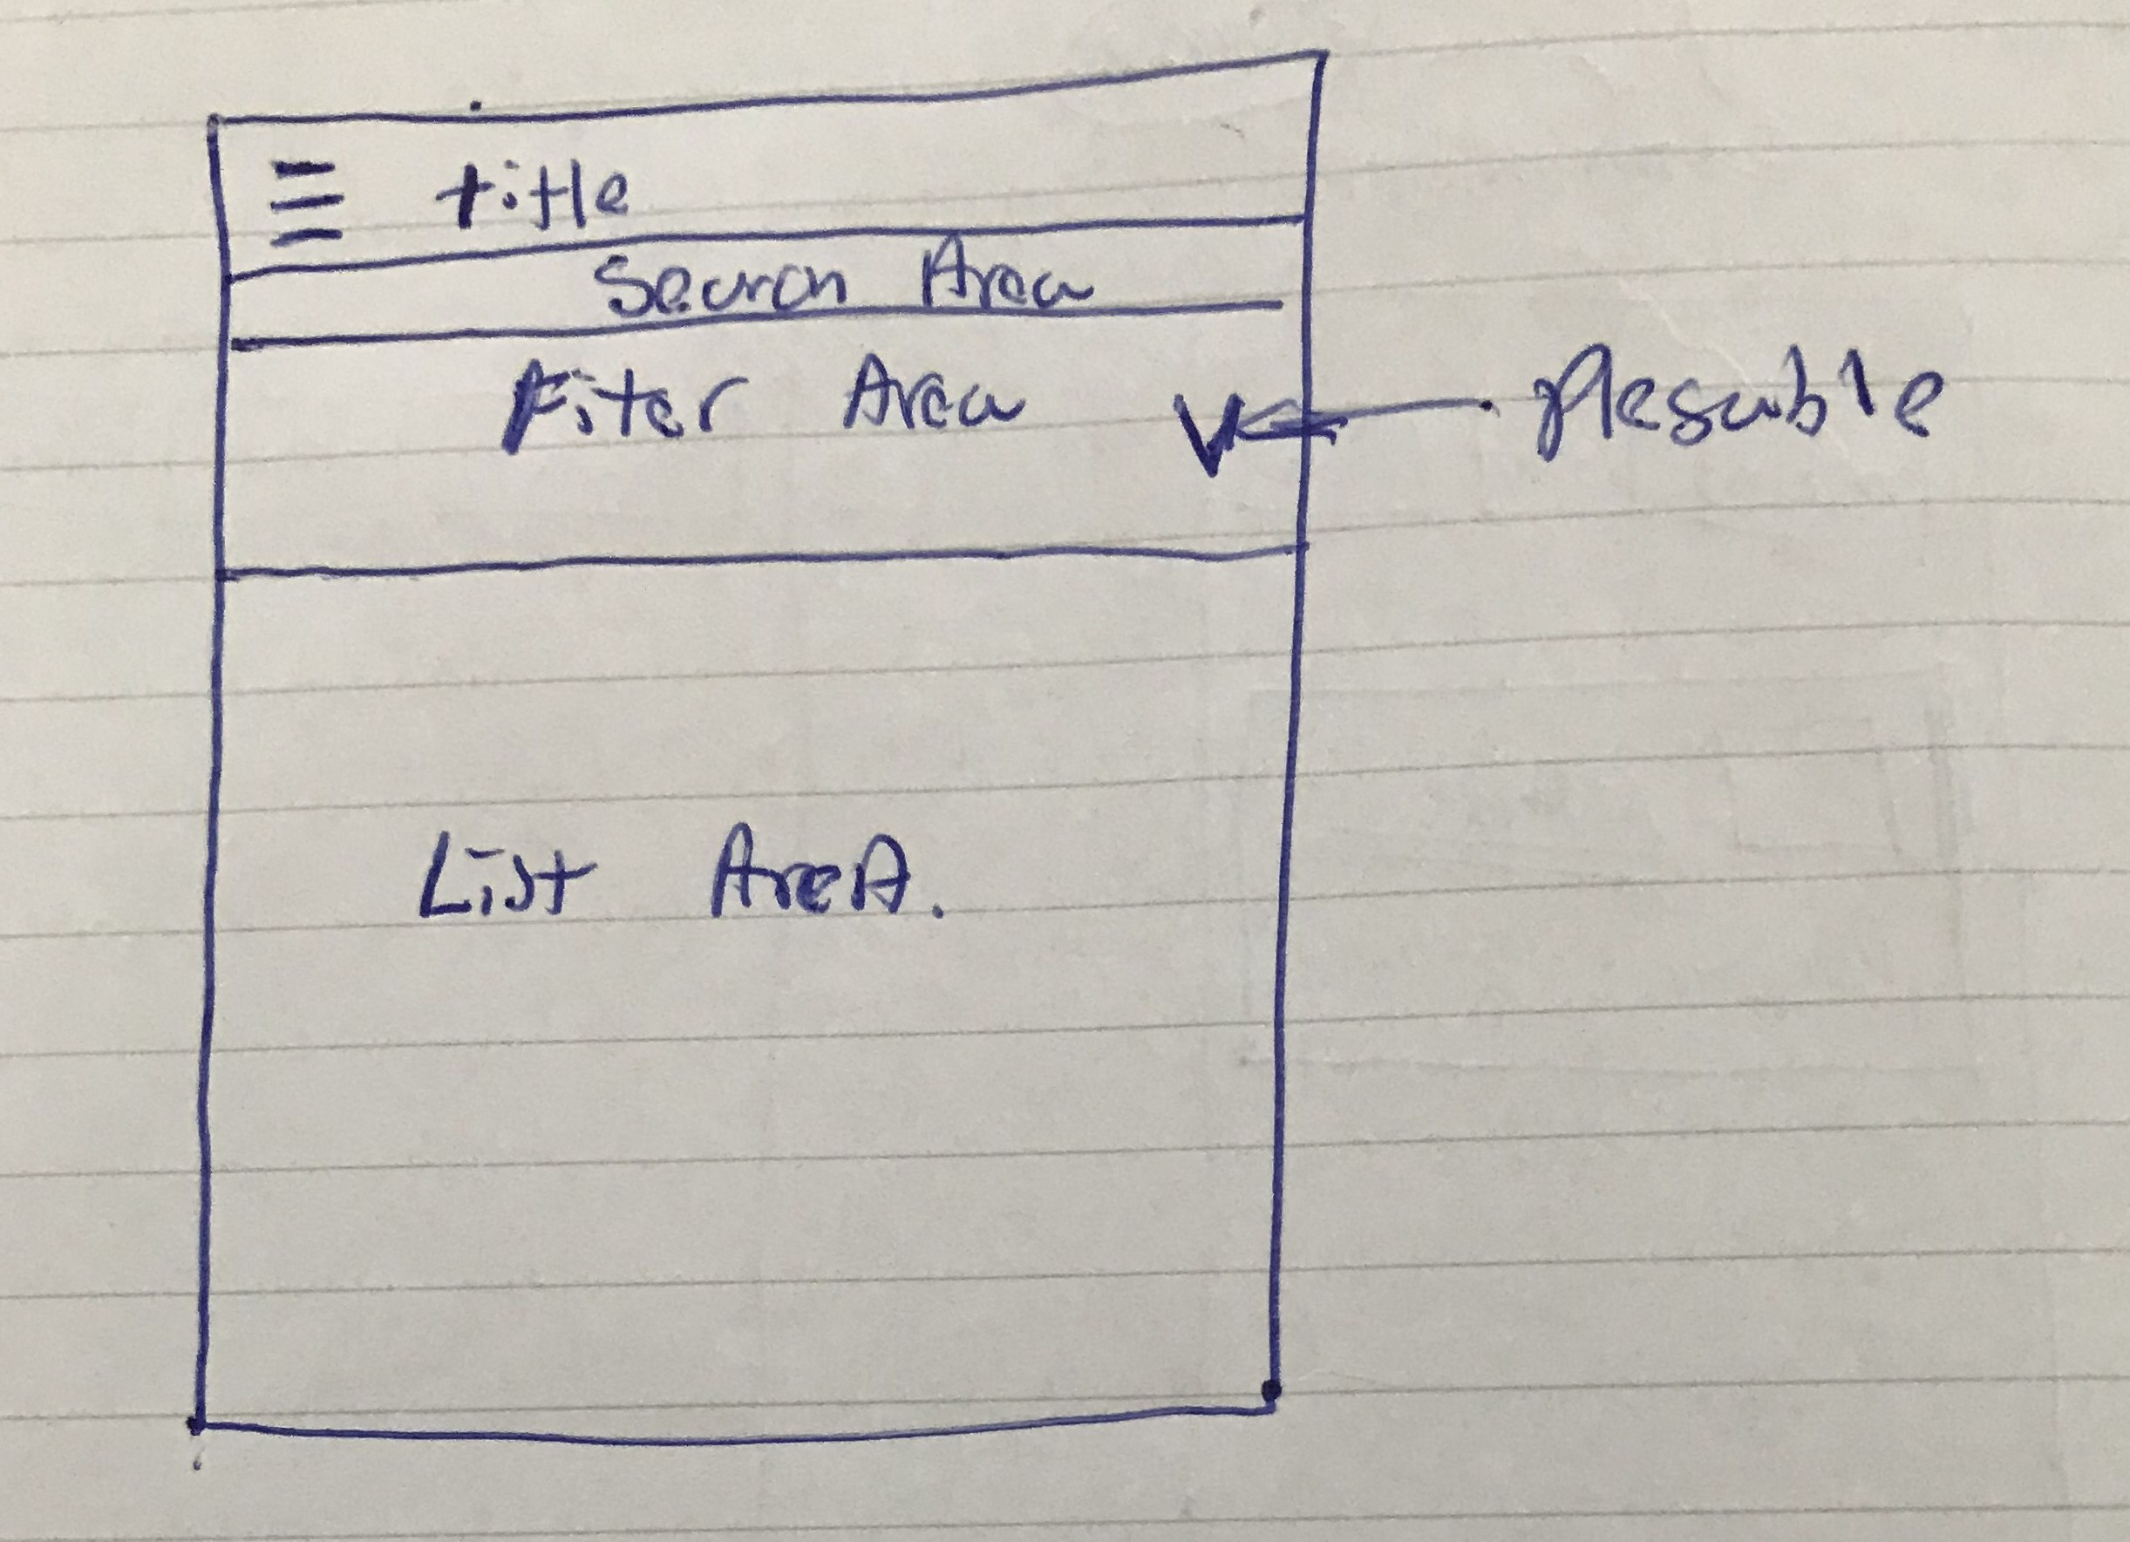
View Activity
Data Entry:
Title: Example: Stretching exercises, Strength exercise, Workouts
Search Area: its just a textbox
Filter Area: the user can filter the list with (The filter area is foldable):
  Tags: Flexibility. Pain Relief, Leg, Shoulder.
  Sport: Running, Bike, Swimming
  Time: Approximate time of exercise or routine.
  Level: Easy, Moderate, Advanced.
List Area: list of exercises or workouts, elements of one item insede the list:
  Photo Preview
  Name
  Tags
  Small description
  Time
  Level

Slide 9
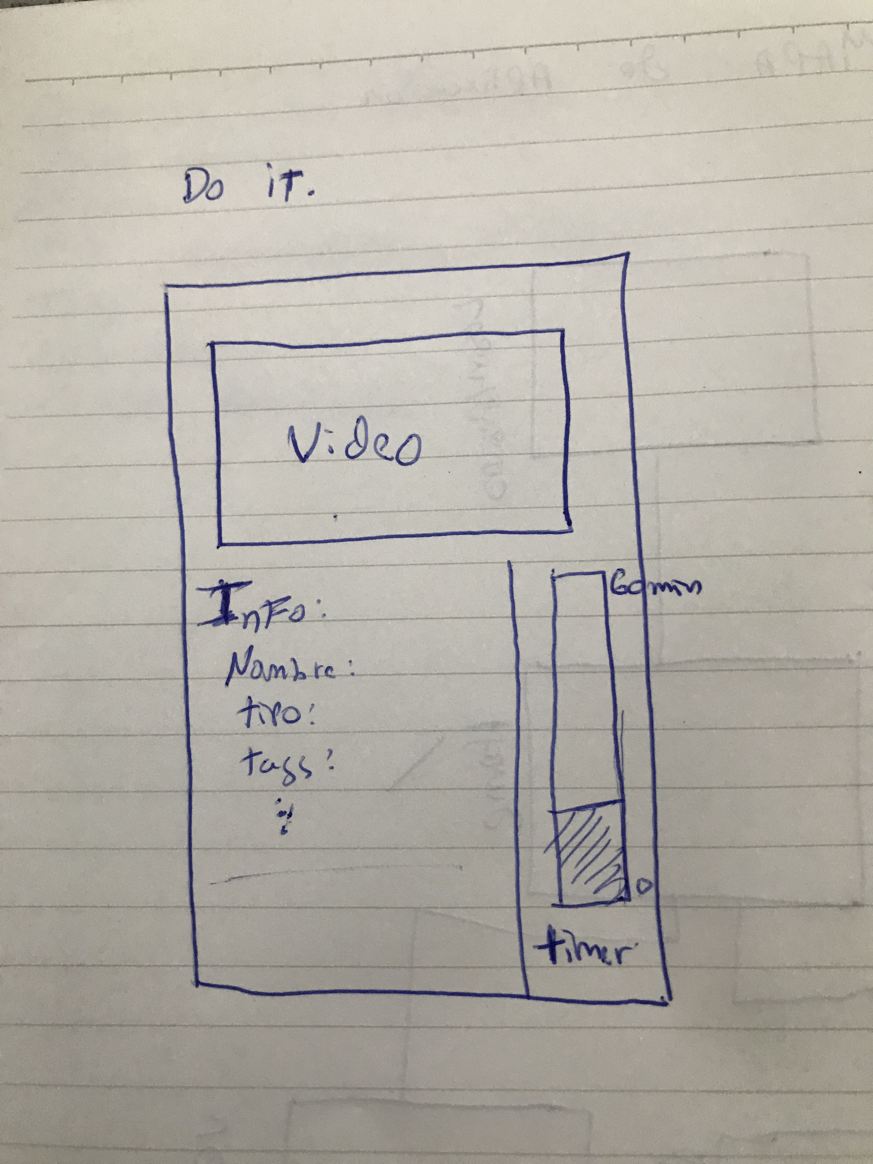


Do it
Change Video or Image visor
Data Entry:
Video Area or Image Area
Info Area:
  Name
  Tags
  Description
  Time
  Level
Start Button: button to start or stop de routine or exercise
Timer: Bar that is filled as the time of the routine advances, the design should considerer how mark the current repetition because some routines has .

Slide 10
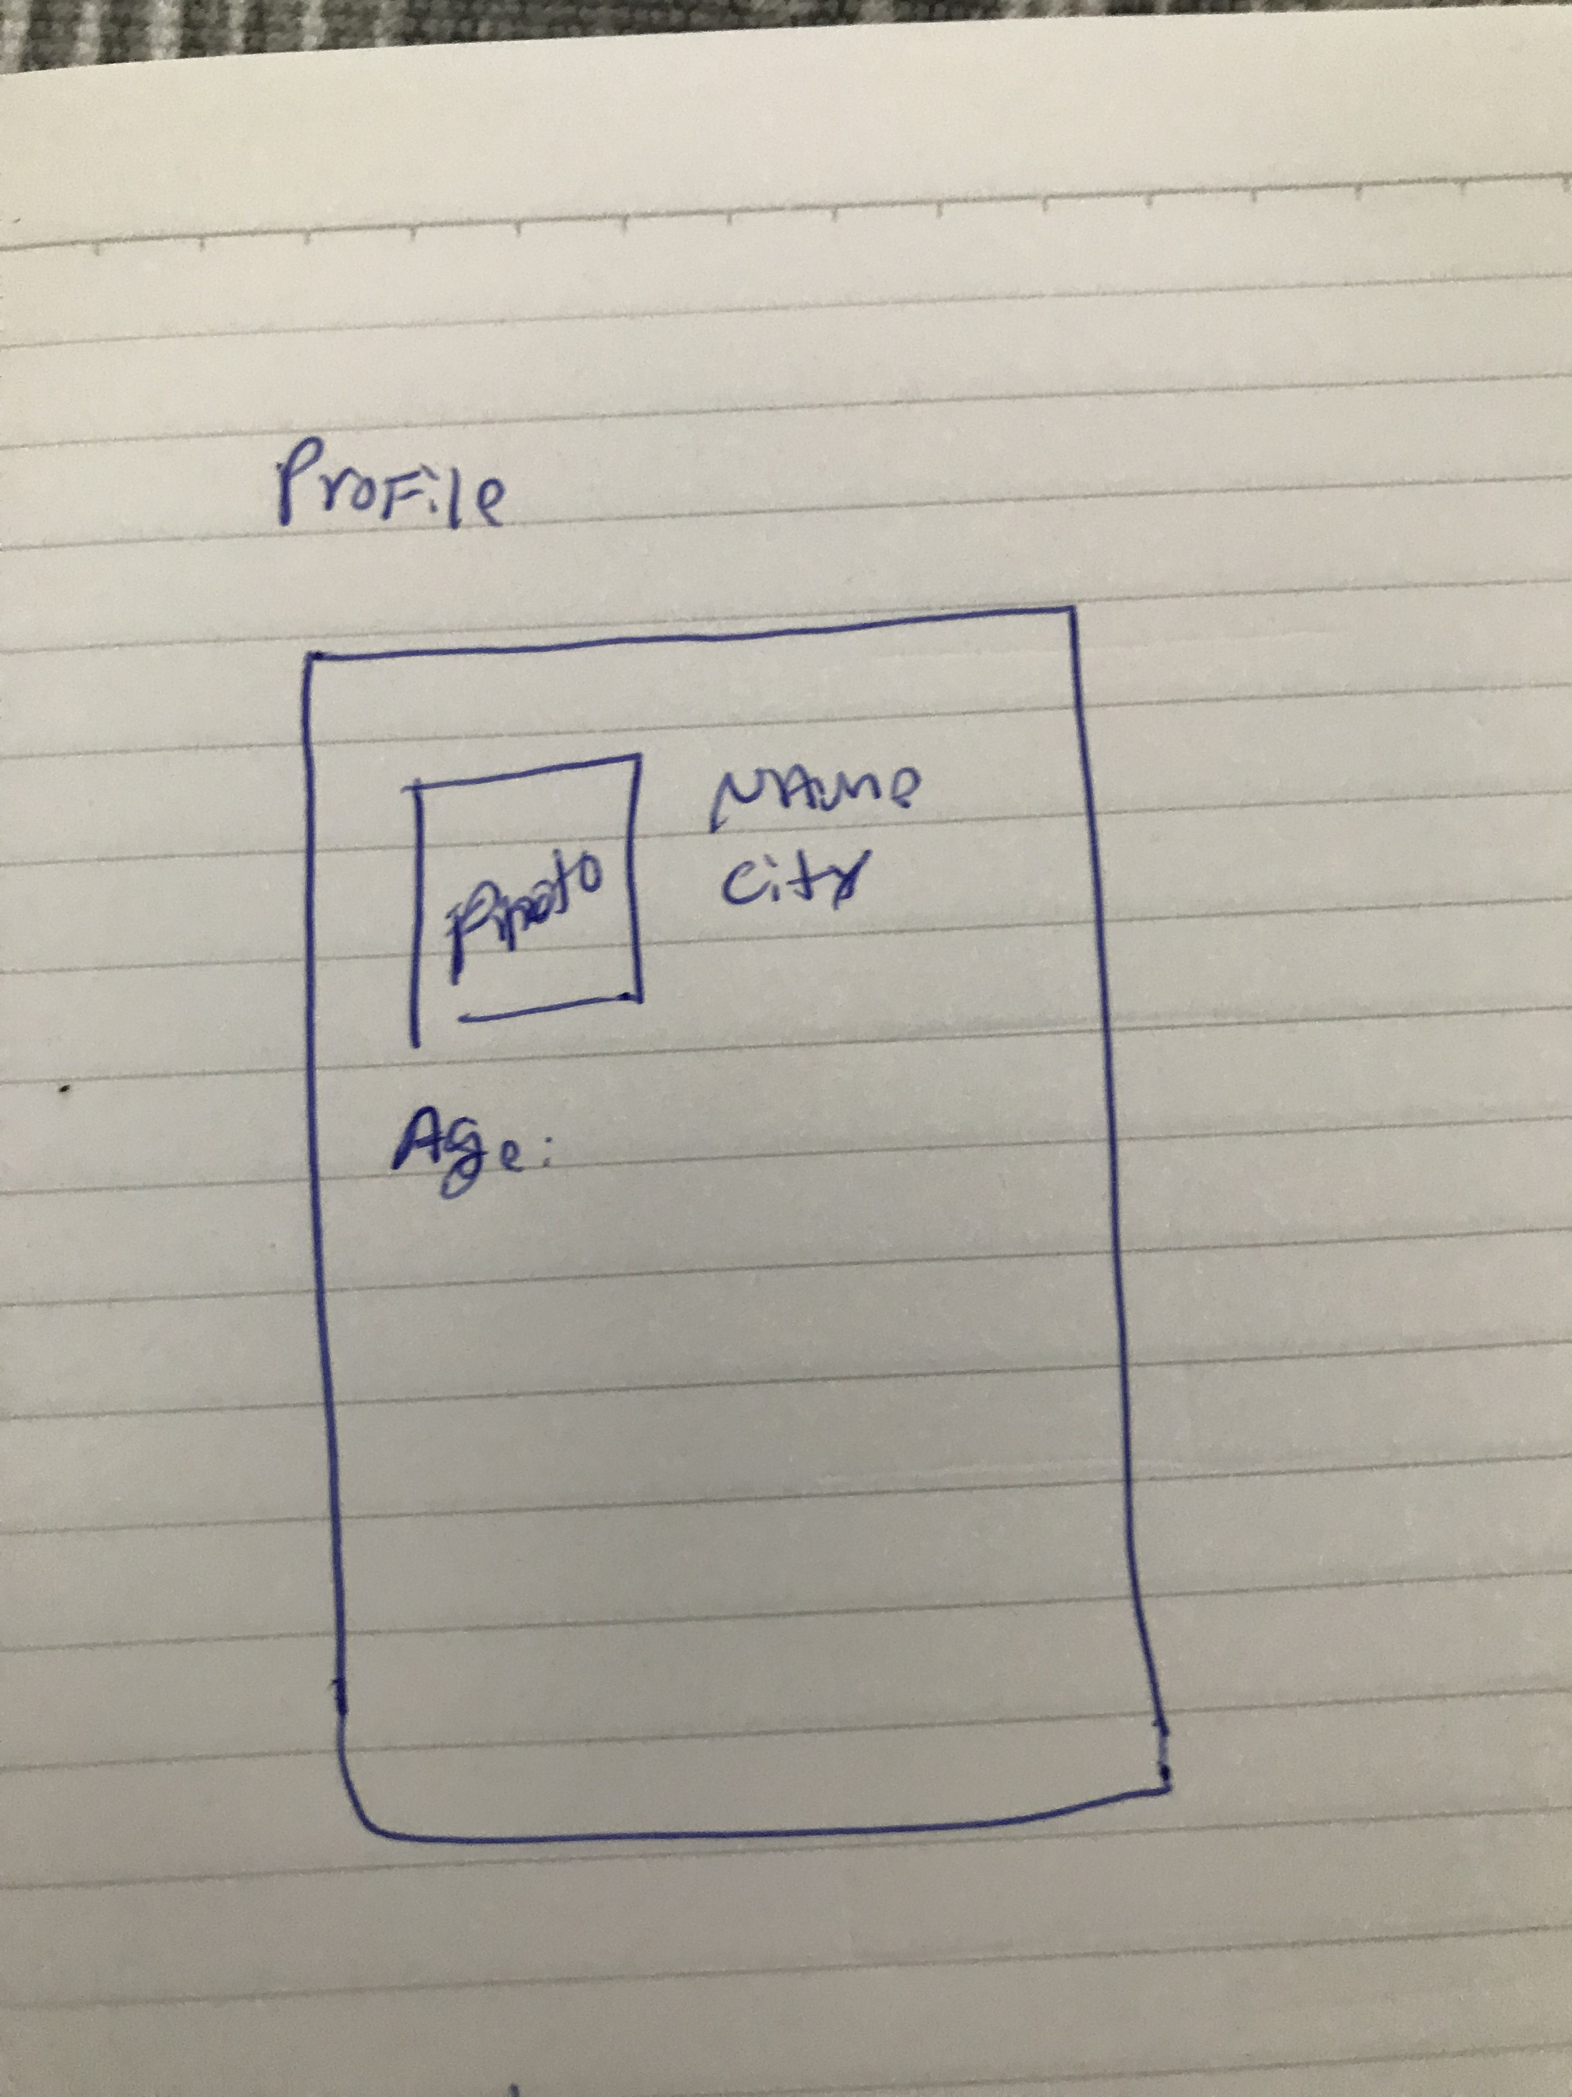
Profile
Data Entry:
Photo
Name
City
Age

