Slide 1
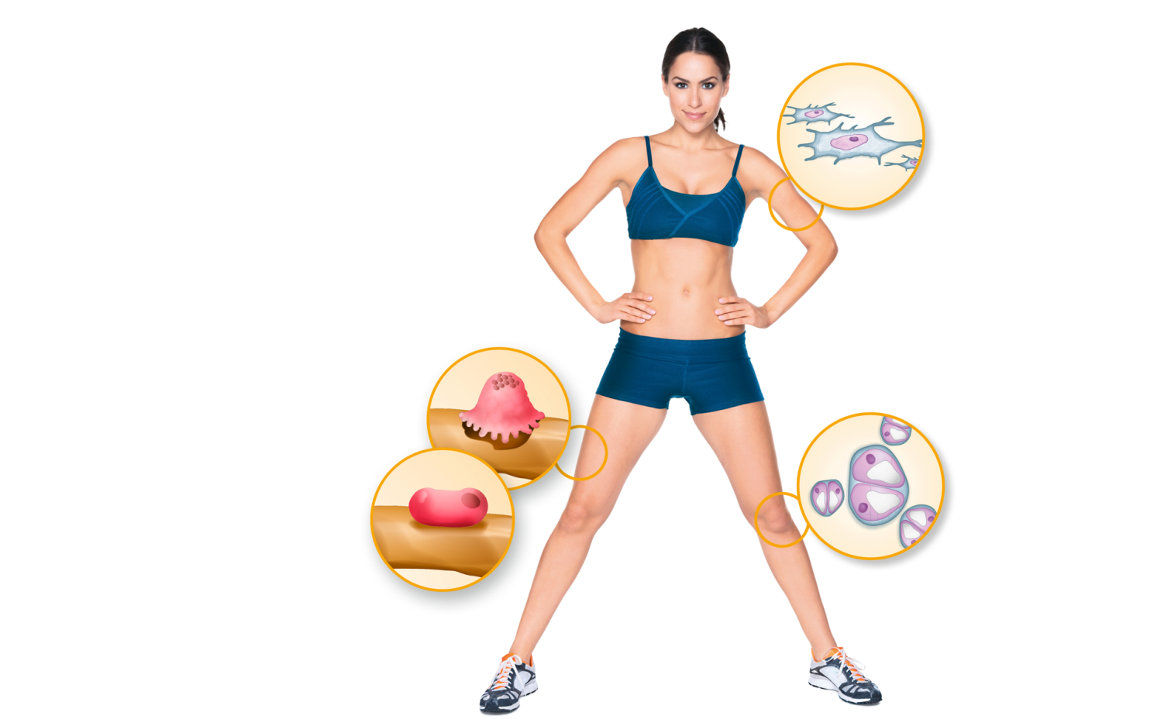
Human Cells Responsible for Collagen Metabolism 负责胶原代谢的人类细胞
Remove this part but you can direct copy the others at the bottom with added
Chinese text.
4 types of cells responsible for constant collagen turnover
持续负责胶原蛋白生产的4种类型的细胞
Continues anabolic & catabolic balance
持续合成代谢和分解代谢平衡
Fibroblast
Synthesis of collagen extracellular matrix in connective tissue (skin, fascia, ligaments, tendons
成纤维细胞 在结缔组织（皮肤，筋膜，韧带，肌腱）中合成胶原细胞外基质
Osteoclast
Degrading bone matrix
破骨细胞
降解骨骼基质
Chondrocyte
Production and maintenance of cartilaginous matrix
软骨细胞 生产和维护软骨基质
Osteoblast
Synthesizing bone matrix
成骨细胞
合成骨基质

