Slide 2
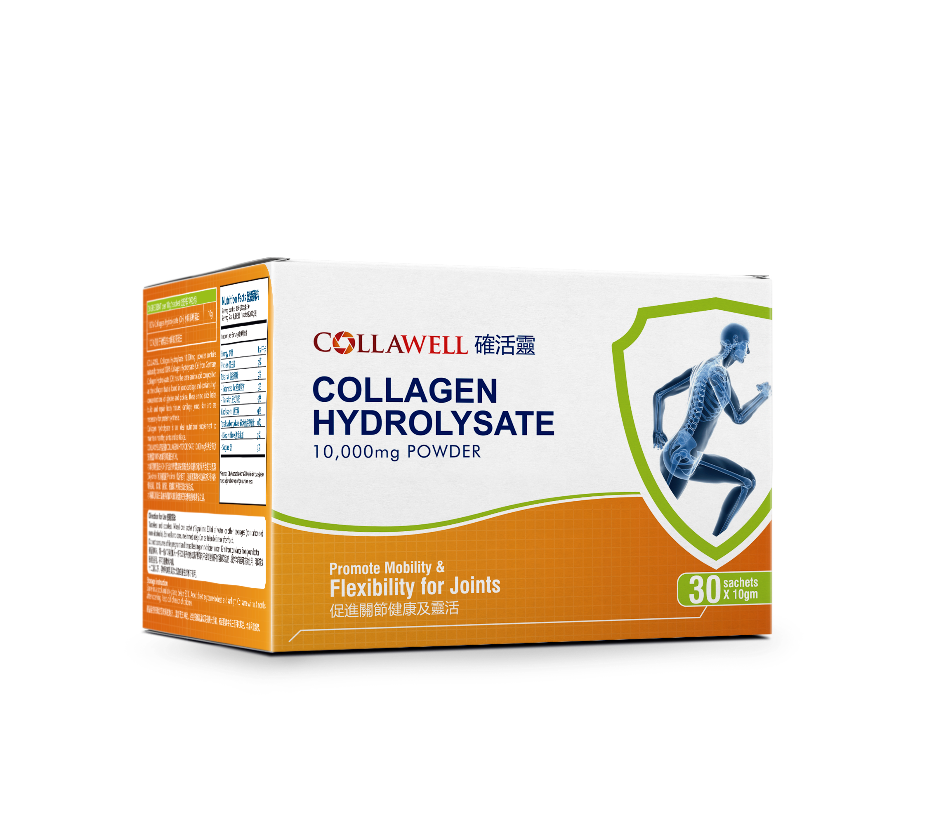
This is the product to be sold in Hong Kong Hospital channel.

