Slide 1
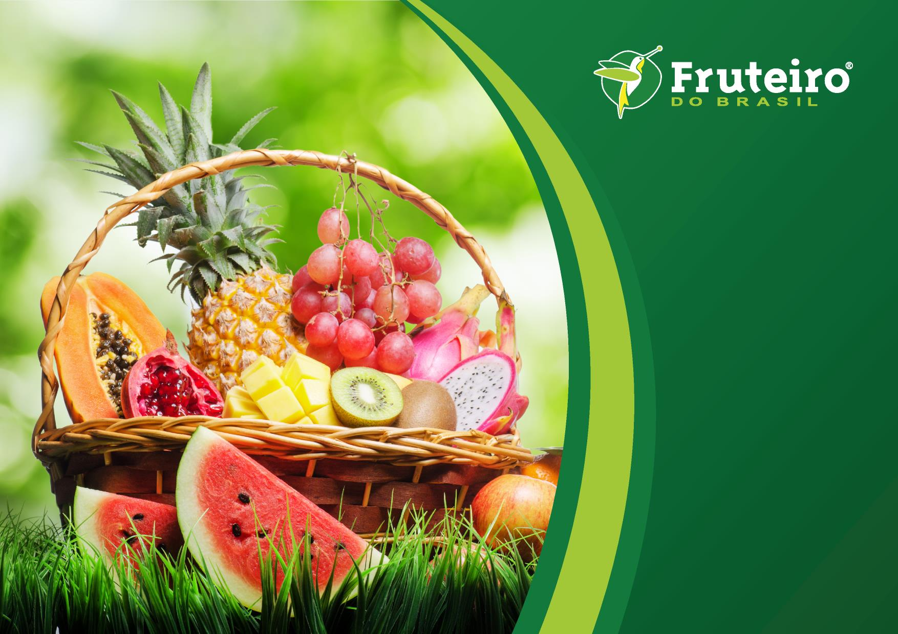

Concept Brief
Dubai International Airport DXB
May 2017

Slide 2
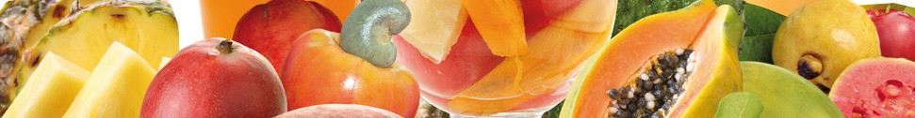
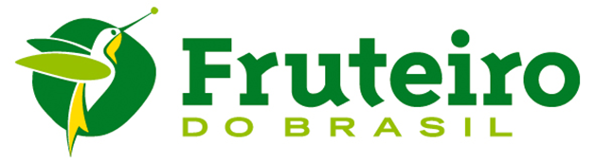
About Frutiero Do Brasil
Fruteiro® fruit pulp is 100% made of selected tropical fruit, processed at the optimal stage of ripeness according to a simple, but accurate production process.
No sugar, preservatives or colorings are added …
… the exceptional nutritional qualities of Brazilian fresh fruits are maintained almost unchanged. Thus all drinks, sorbets, and power bowl based on Fruteiro’s pulp are ideal to prepare excellent juices and vitaminas (typical Brazilian smoothies), a daily complement to everybody’s diet.

Slide 3
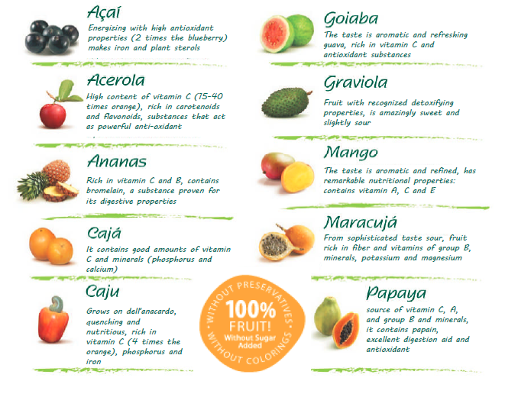
The fruits of wellness
Discover the unique taste of the best tropical fruits from South America: Amazons of Brazil. With pulp Fruteiro Do Brazil Smoothies, Vitamins and all the fruit specialties can be enjoyed with the new and fascinating exotic varieties that contains numerous and extra ordinary healing properties.

Slide 4
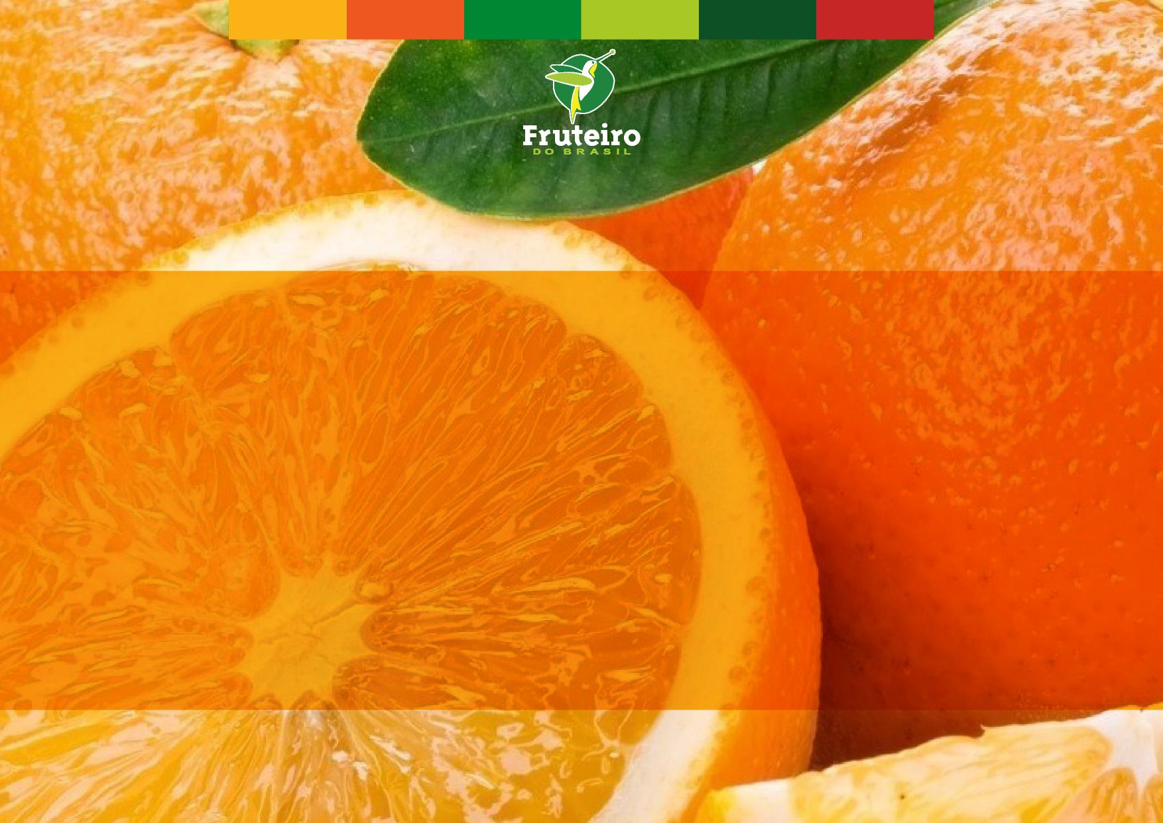
Frutiero Do Brasil was brought to the Middle East by R&S Holding Ltd, as Master Franchisors with the objective of availing of Frutiero products to ME customers through shops and retailing of the pulps.
The first rights to open shop in the ME was granted to Yasmin and Yasmina Trading LLC, registered in Dubai.
Yasmin and Yasmina Trading L.L.C. opened their first Fruteiro Do Brasil Dubai in February 2014 which is an Italian franchise with locations in Milan and Mallorca. The concept of Fruteiro lies in using Brasilian frozen exotic fruit pulps which are %100 natural without preservatives or colorants in preparing tasty vitaminas, sorbetti, and the famous Brasilian meal substitute acai na tijela.
This wide variety of fruit pulps are unavailable anywhere in the MENA region. These Brasilian fruit pulps have premium characteristics, nutritional value and highest quality in terms of consistency of flavour and color.

Slide 5
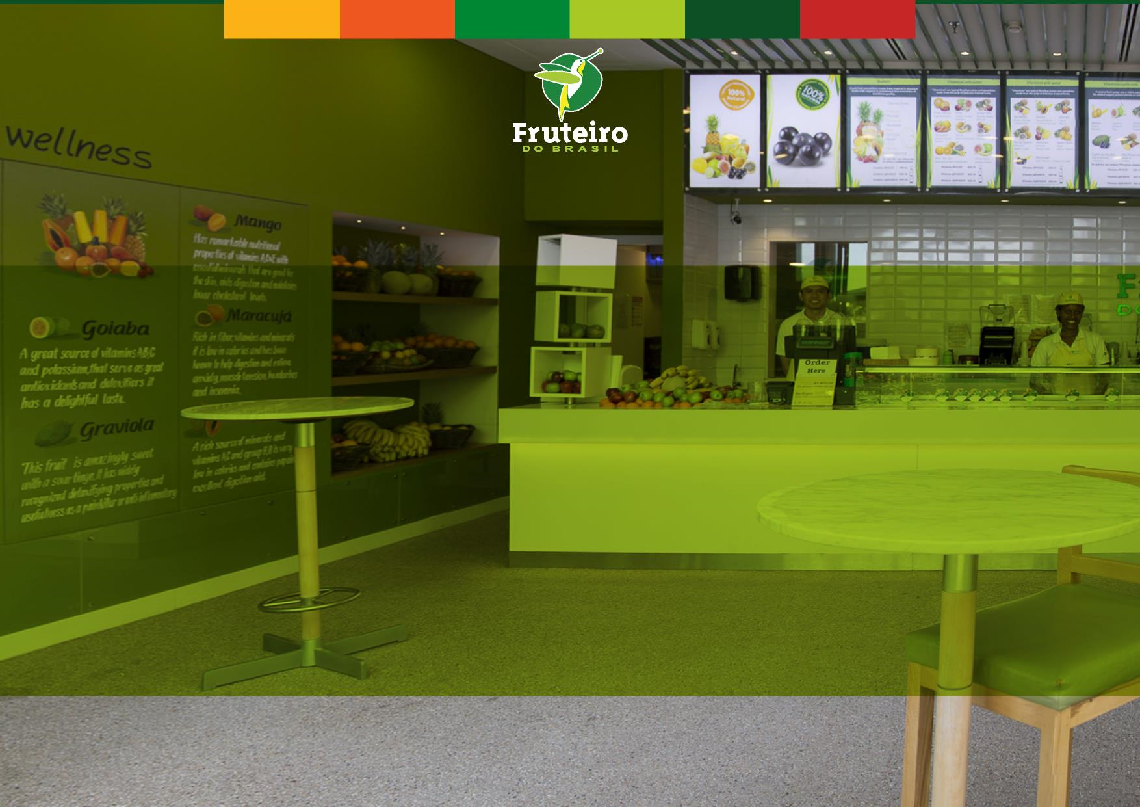
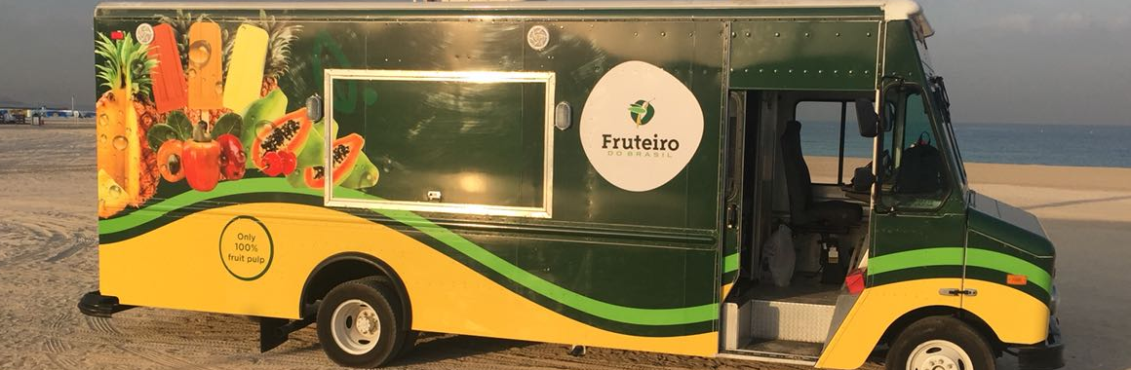
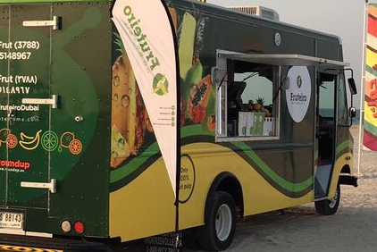
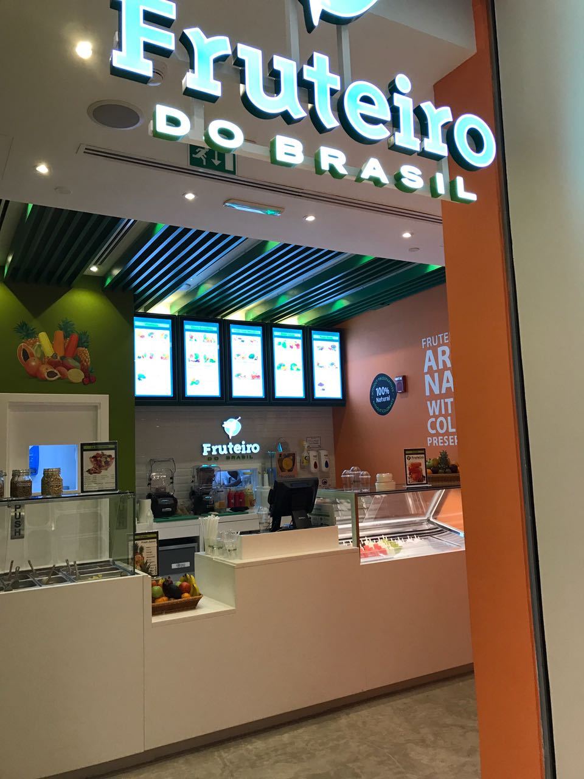
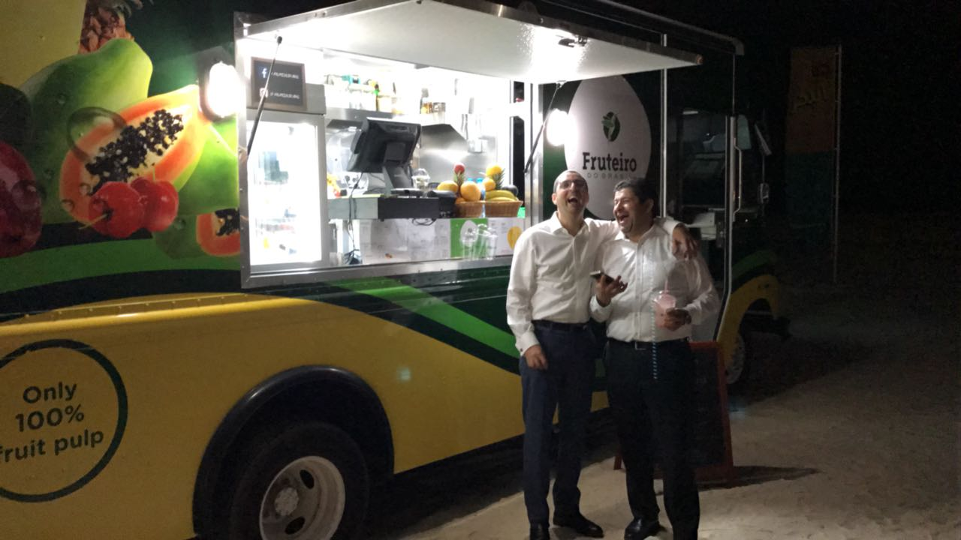
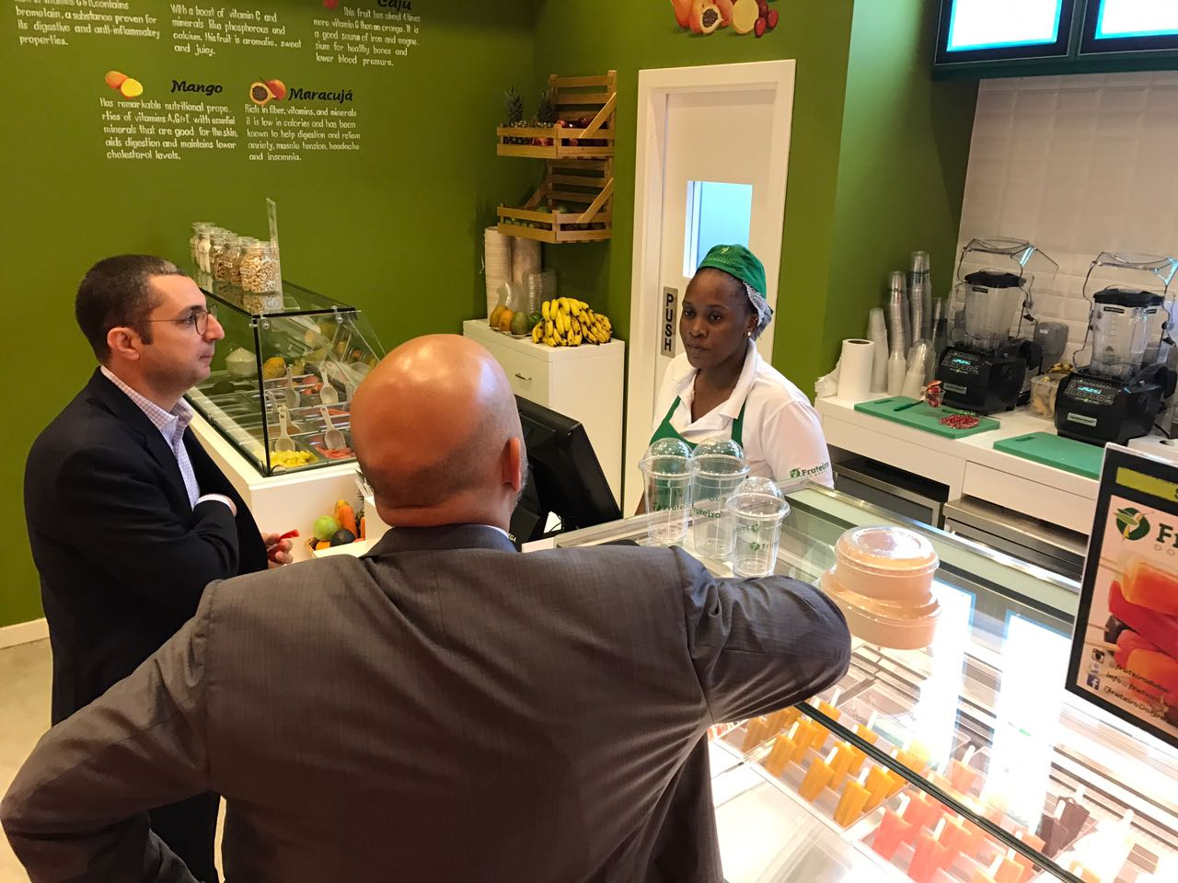
Our Locations
We are located in the prestigious area of The Beach JBR close to reel cinemas with a view of the majestic beachfront of Jumeirah.
We also have a food truck in Kite Beach.
Our Newest shop is in the iconic Cleveland Clinic Hospital in Abu Dhabi.

Slide 6
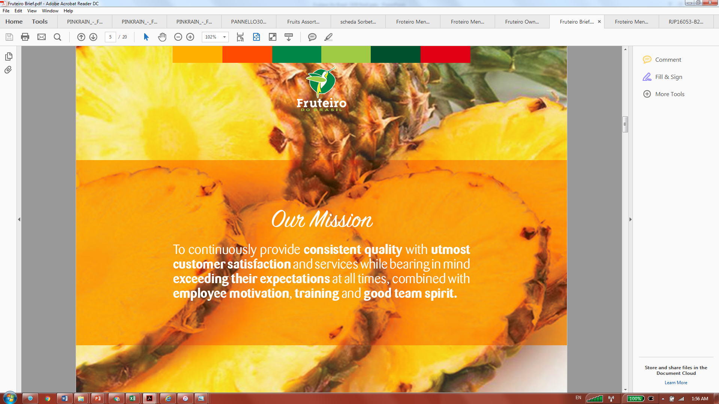

Slide 7
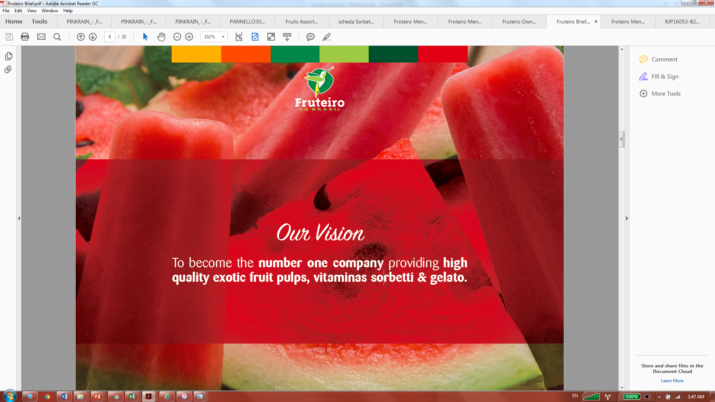

Slide 8
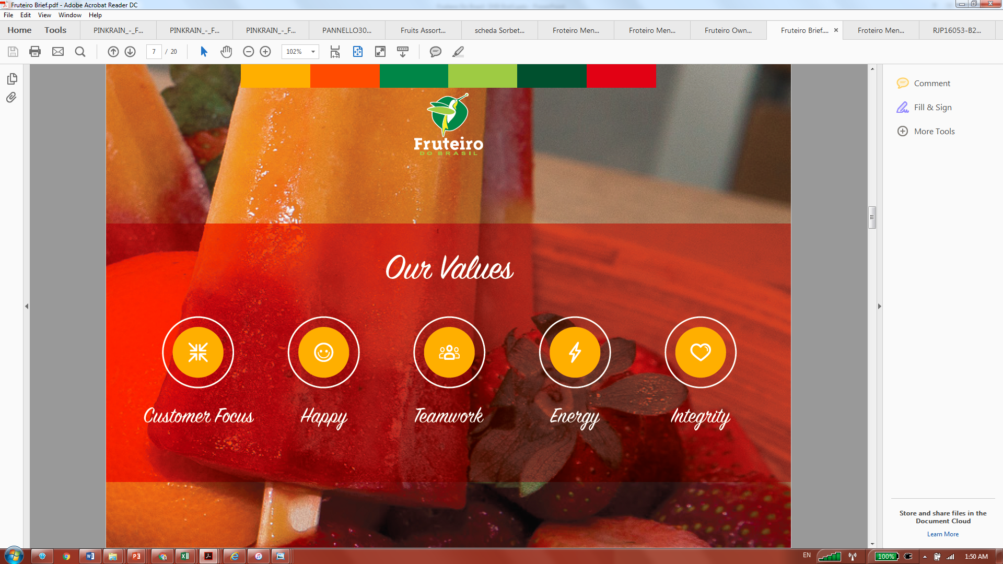

Slide 9
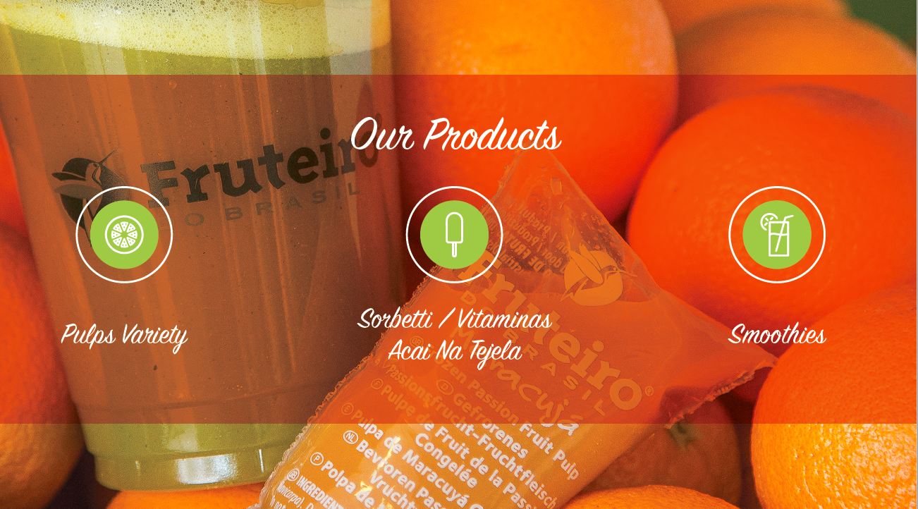

Slide 10
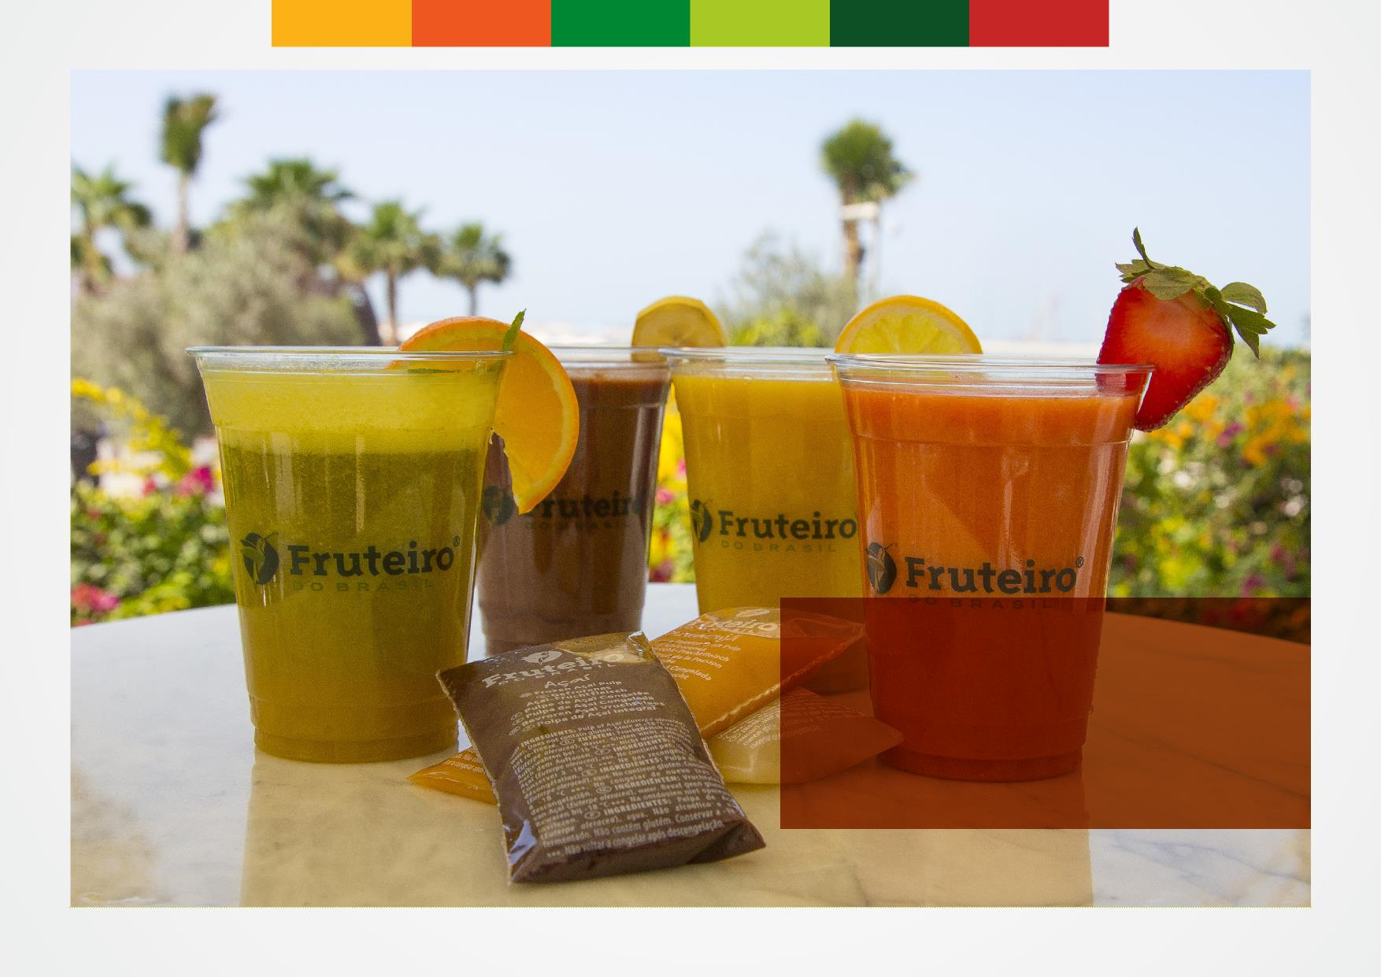
Pulps are produced and packed without any preservatives or colourings or any sugar added thus it is 100% fruit available at any time of year day or month with consistent flavour and quality unlike market seasonal fruits.
These pulps can be used in smoothies, mocktails, and cocktails therefore serving your customers high quality and better tasting drinks and a wider array of juice selection and or combinations.
No Sugar ..
No Coloring ..
No Preservatives ..

Slide 11
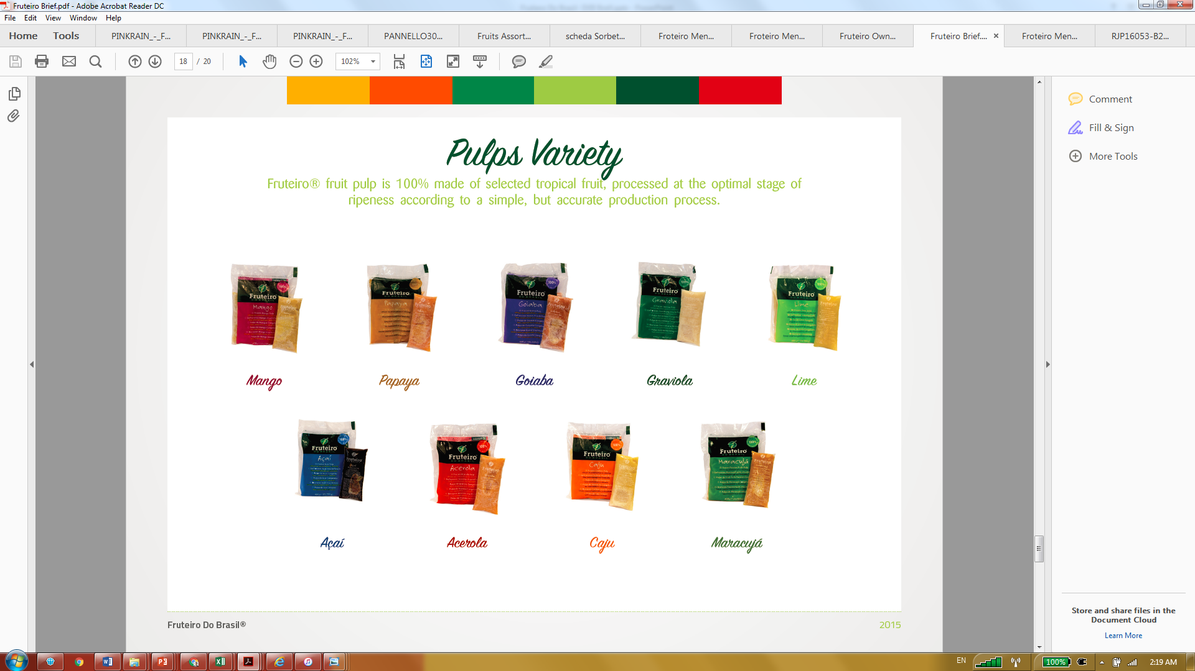

Slide 12
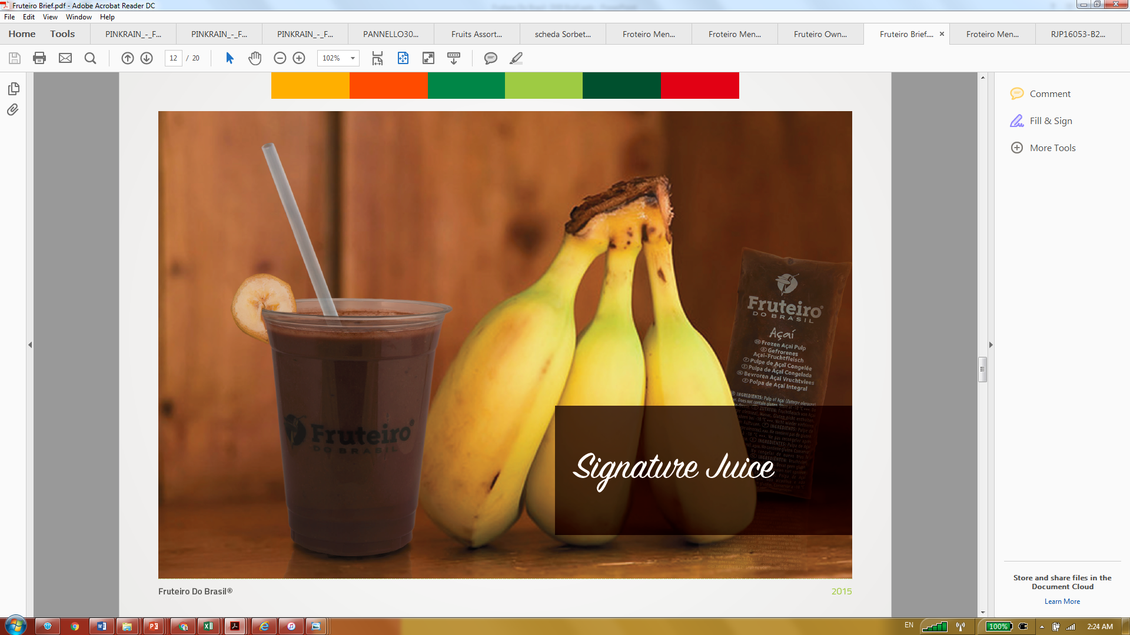

Slide 13
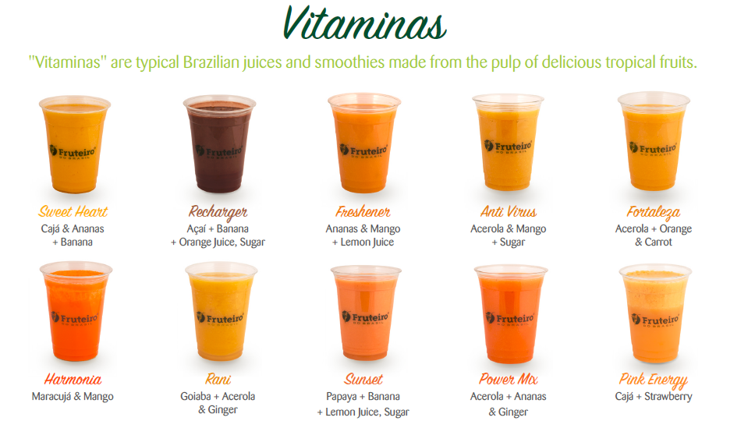
Relax
Maracujá & Banana

Slide 14
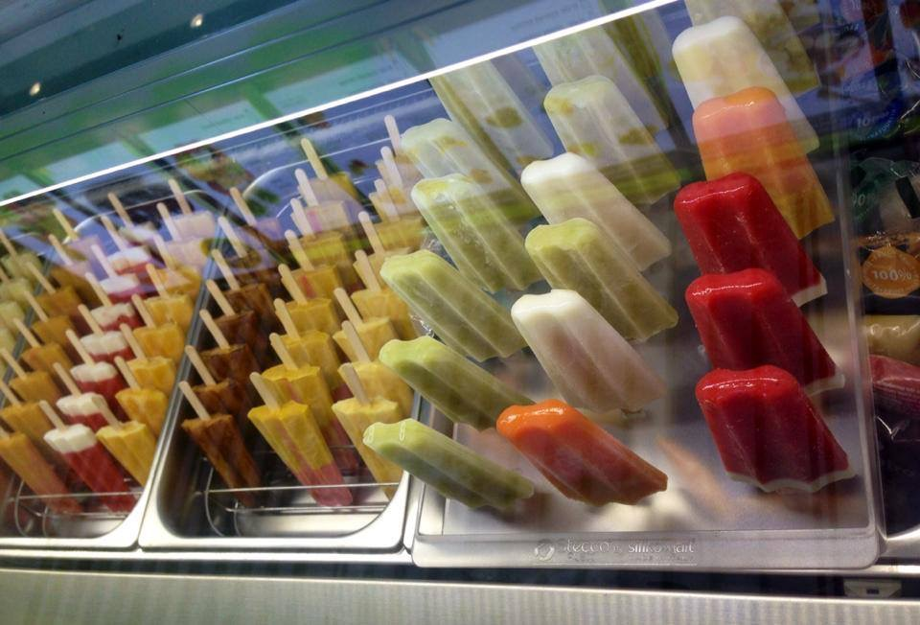
Sorbettis
Sorbettis are tropical & seasonal fruit ice lollies with no artificial coloring or preservatives. This "fruit on a stick" is a fun, healthy dessert / Snack

Slide 15
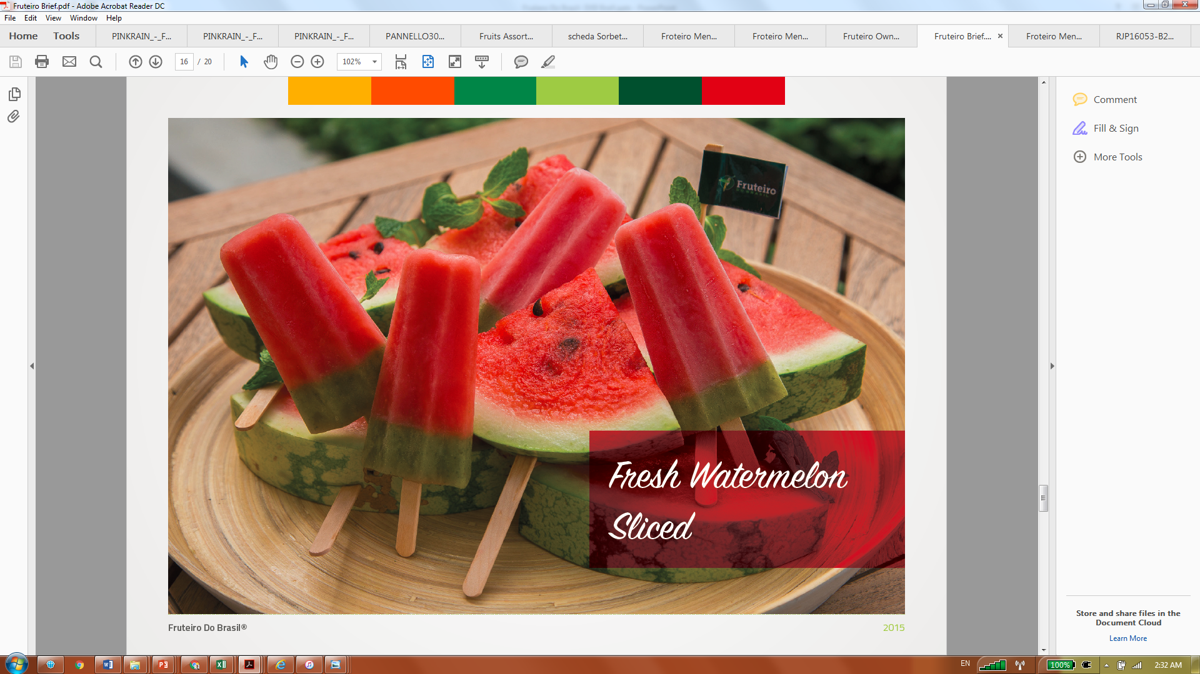

Slide 16
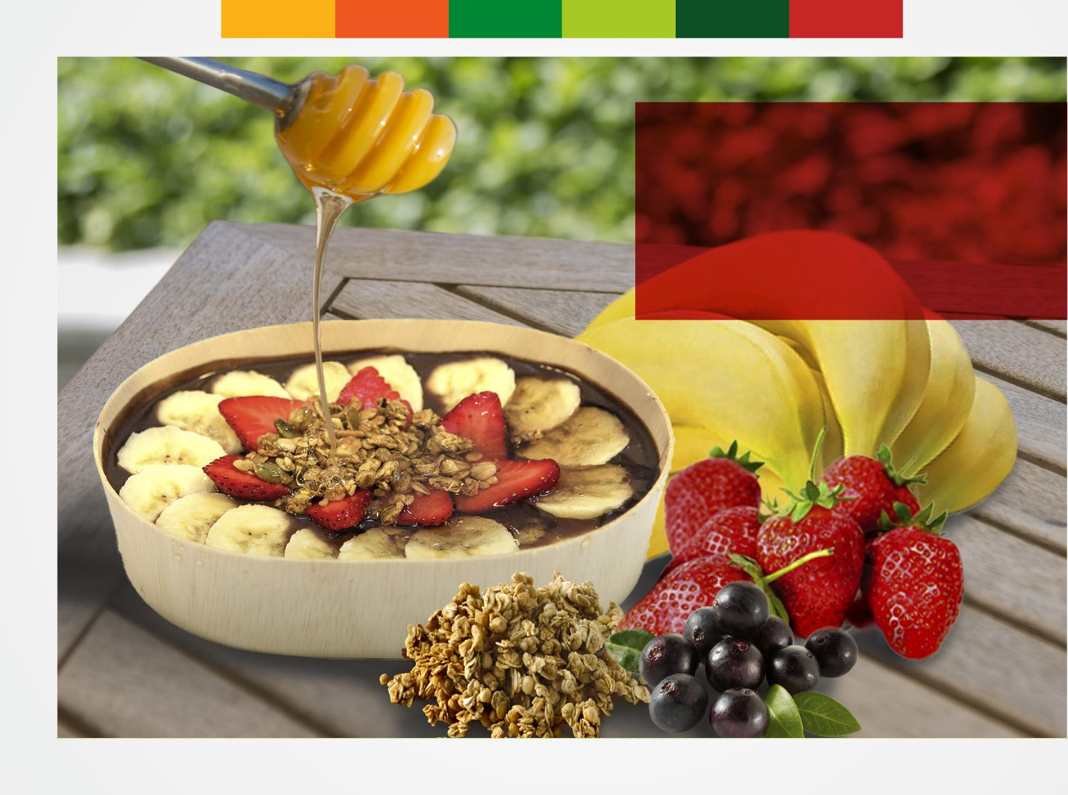
Super Bowls - Frutta acai na tigela
A Brazilian specialty made from açaí, banana
and cereals, which is a meal substitute. Choose
to add honey along with two toppings from peanuts, cashews, walnuts, almonds or chocolate.

Slide 17
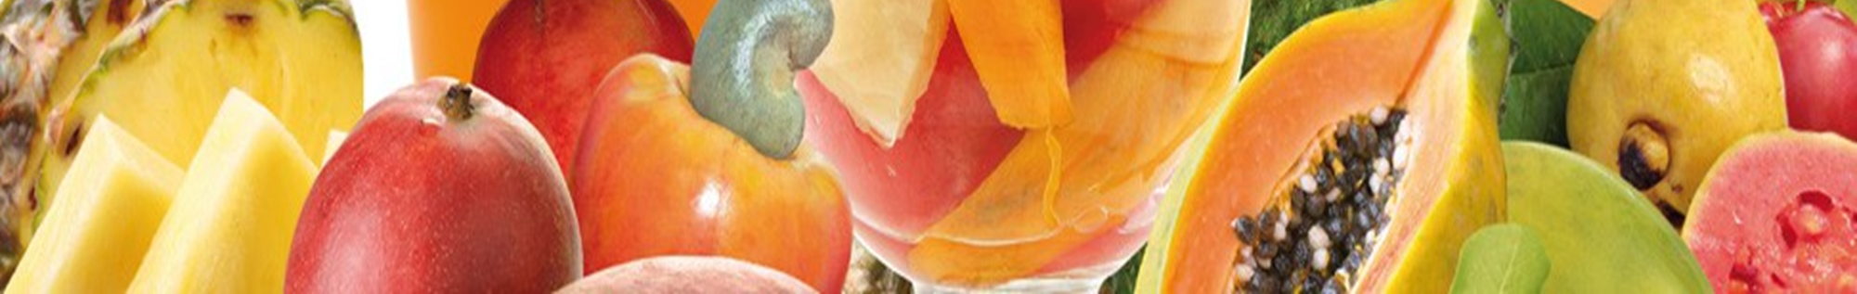
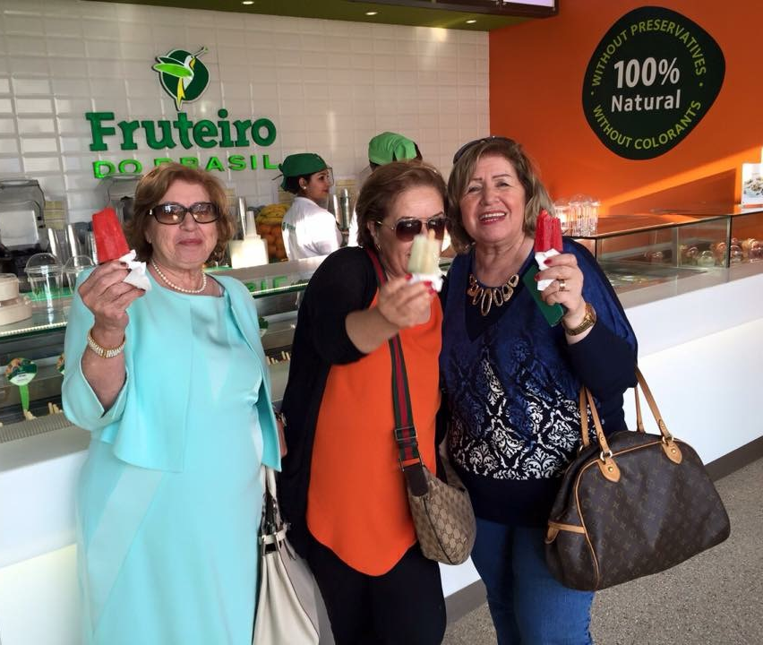
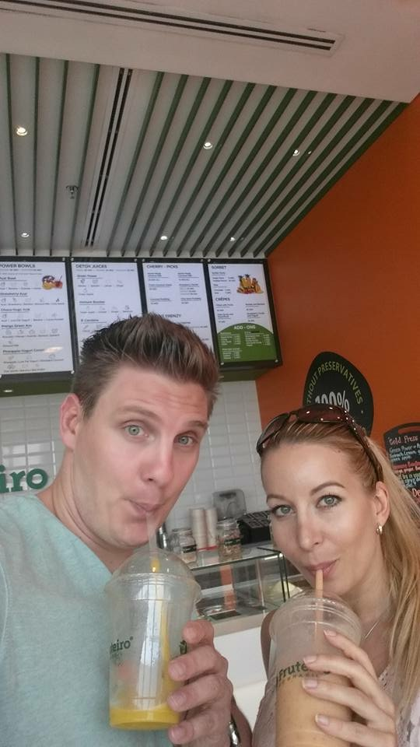
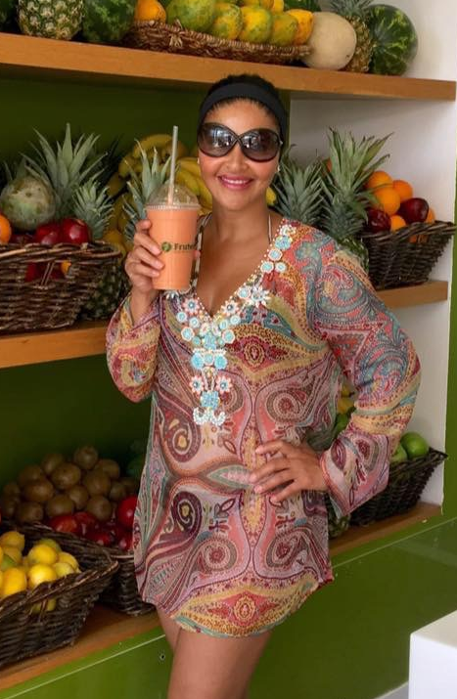
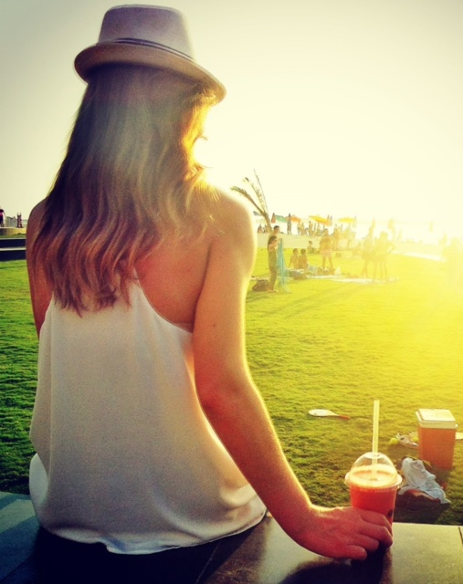
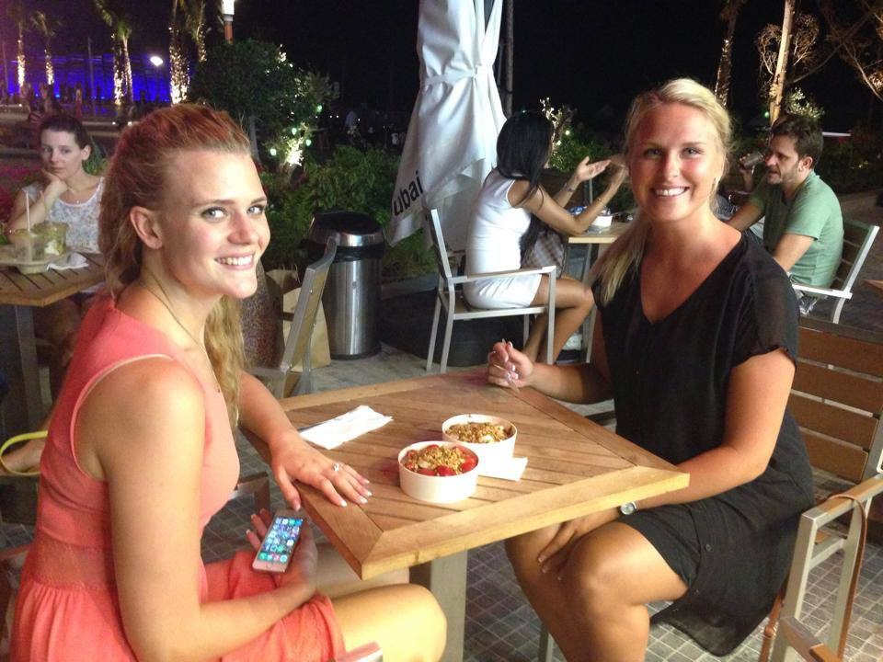
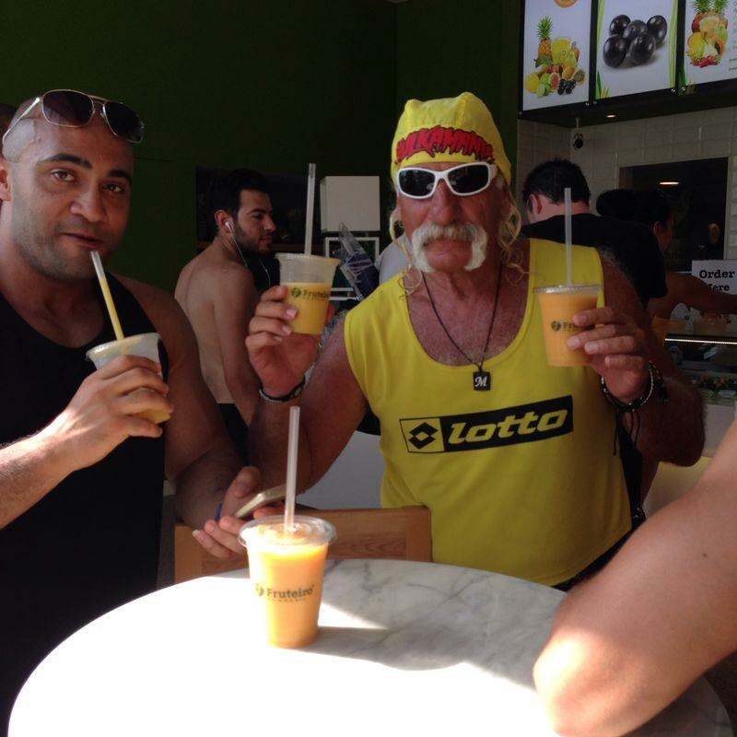
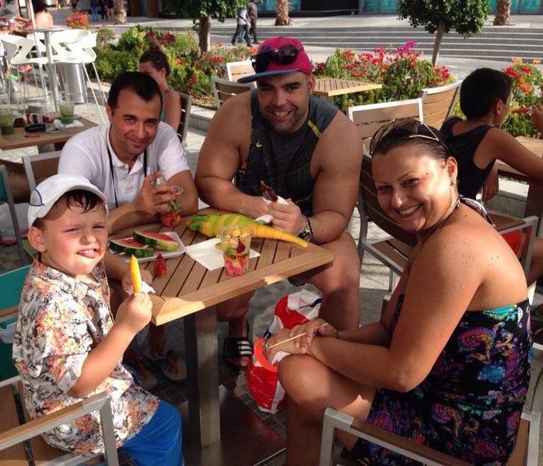
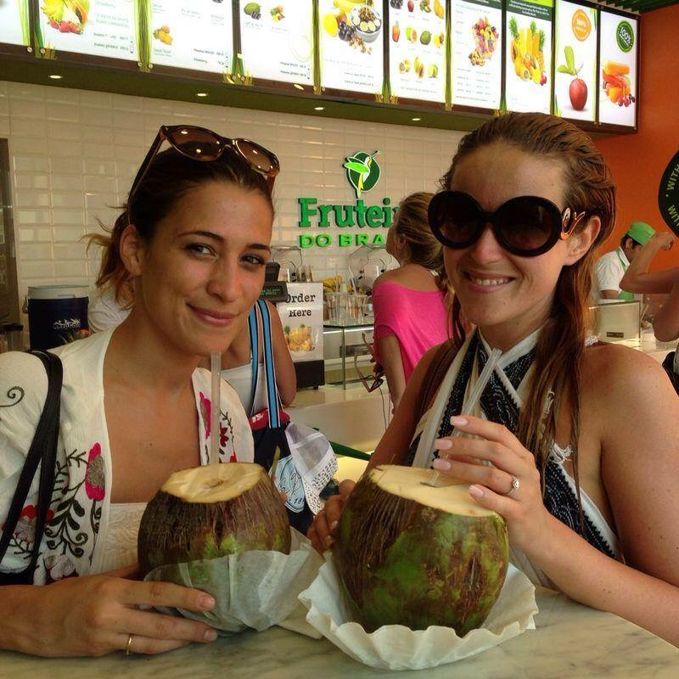
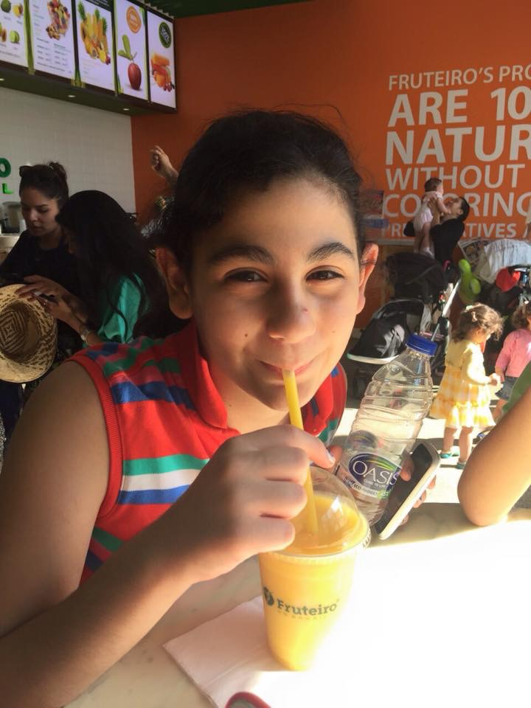
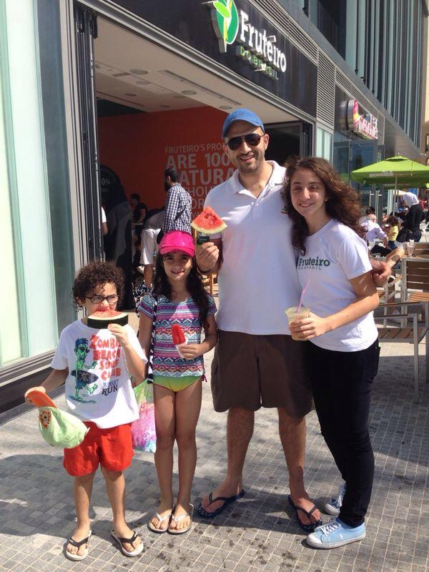
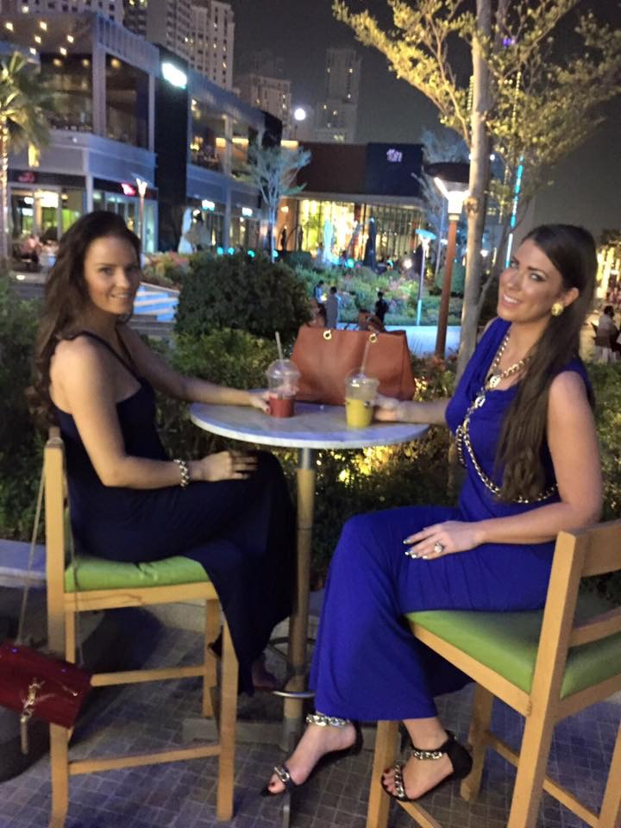
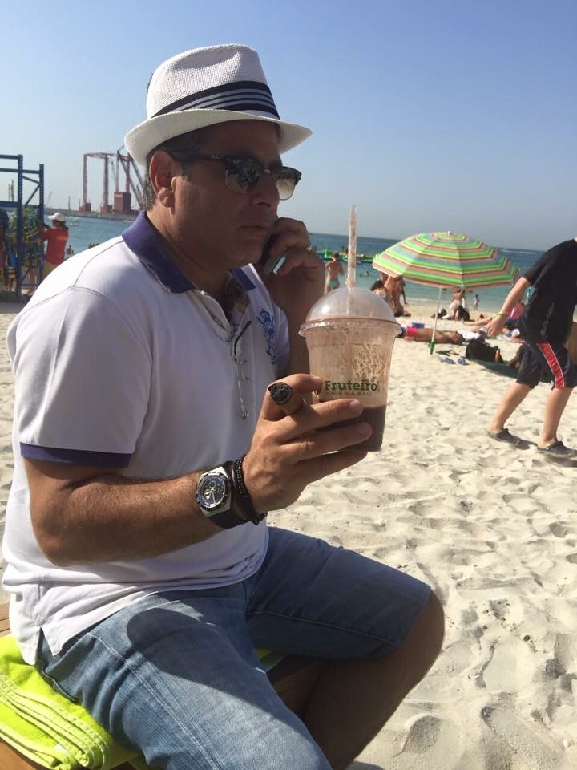
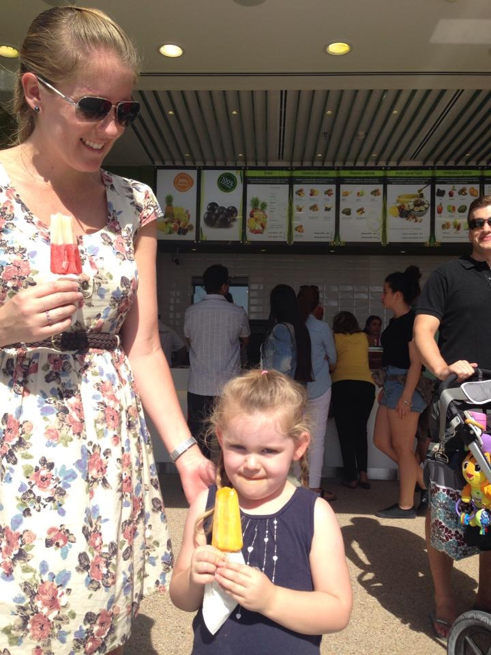
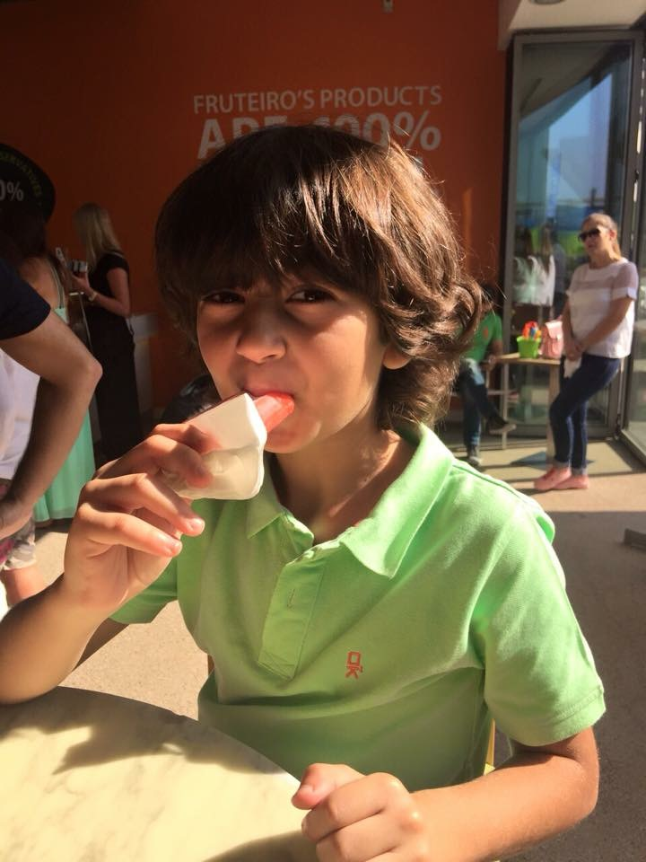
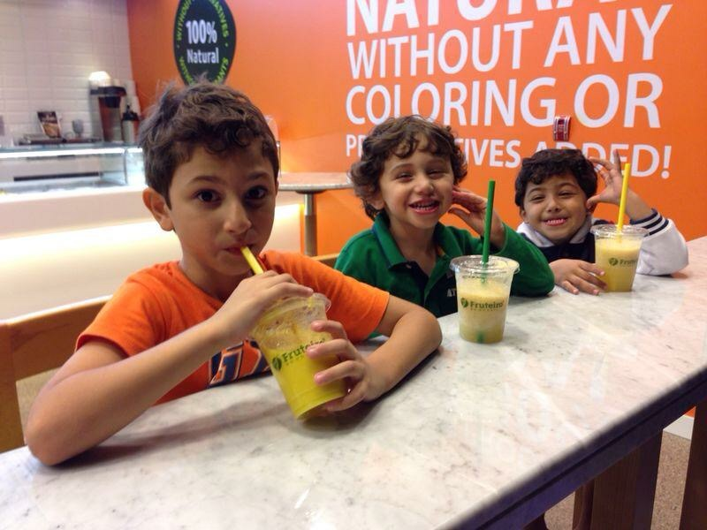
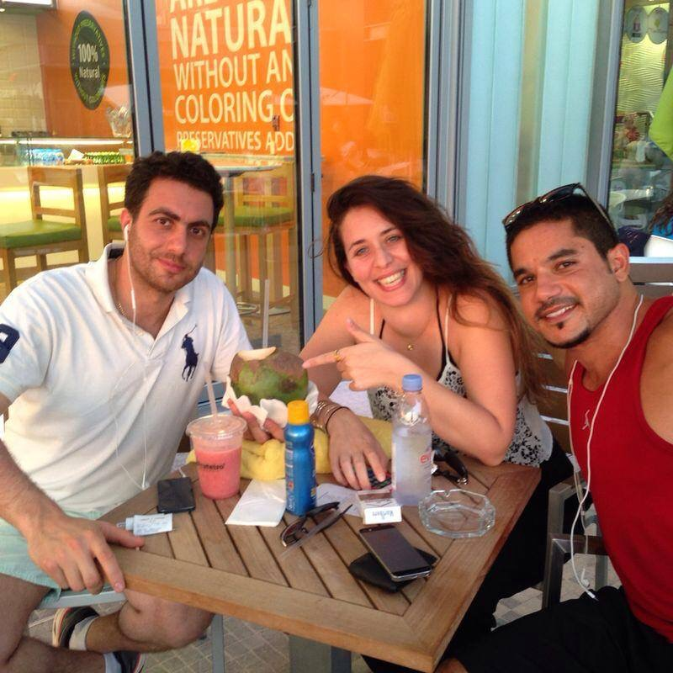
Our Customers
Happy
Trendy
All ages
Healthy
Athletes
Curious

Slide 18
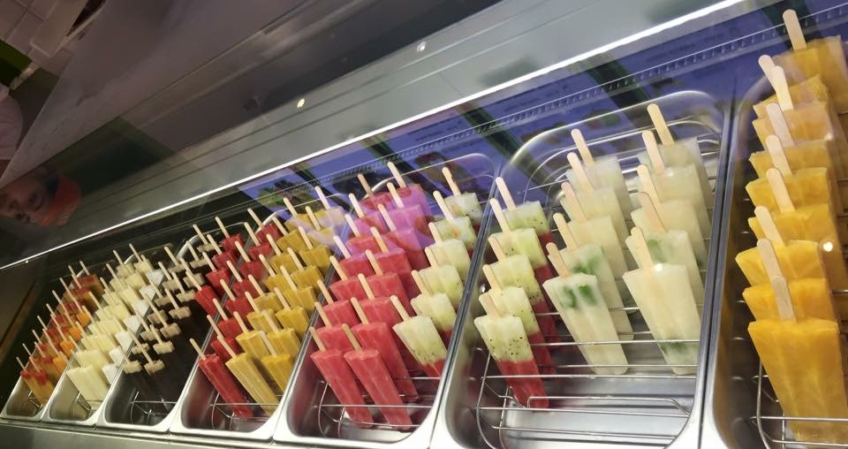
Dubai International Airport Concept

Slide 19
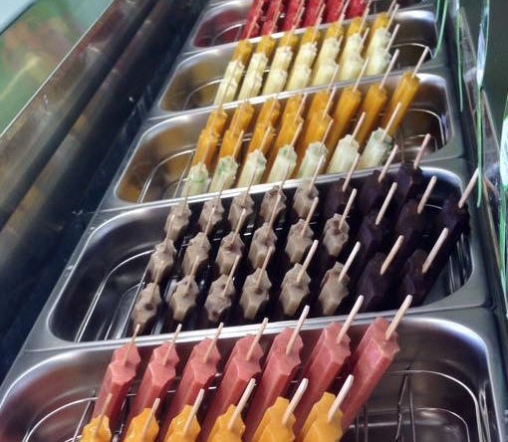
Sorbetti Cart – Option One
Simple
Attractive Display
Quick Service – On the Go
Appeal to all ages

