Slide 1
12 LIFEEXEC.COM BADGES
I would like a series of badges in the style of traditional outdoor badges. The idea is to deliver a adventure-based feeling for our software company.
Each graphic must include: “LifeExec.com” and our logo. LifeExec.com needs to be highly visible. The logo can be integrated creatively to fit the design—small, big, background, or predominant. The logo can be any color(s).
I would like a variety of designs with different shapes and featuring different outdoor activities: General Nature (Mountains, River, Trees, Animals), Skiing, Golfing, Hike/Backpack, Fish/Fishing, Biking, Mountain Biking, Running/Jogging
A few items you can use but not required:
LifeExec.com was Founded in 2017
We are located in Bend, Oregon (OR)
Slogan: Be prepared to live your best life
Alternate Slogan: Keep Going
Feel free to use activity words like Ski, Bike, Outdoors, Mountain, Team, etc. whenever appropriate
Have fun with it. We will be turning the badges into stickers and patches. We want cool designs people want to use.
I have provided our logo and some examples of outdoor badges in the associated PPT. The examples offer a perfect metaphor for the images I’m looking for. There are a lot of examples of Outdoor Badges online.
12 is the number of total badges I’m looking for.
PROJECT

Slide 2


LOGOS
The color logo is the primary logo we use on our site. You can use any solid color in the design.
BRANDING
LifeExec.com
LifeExec.com is always spelled with a capital L and E. You can use all caps if it fits the design. Choose a font that best fits the design.
LifeExec.com LIFEEXEC.COM

Slide 3
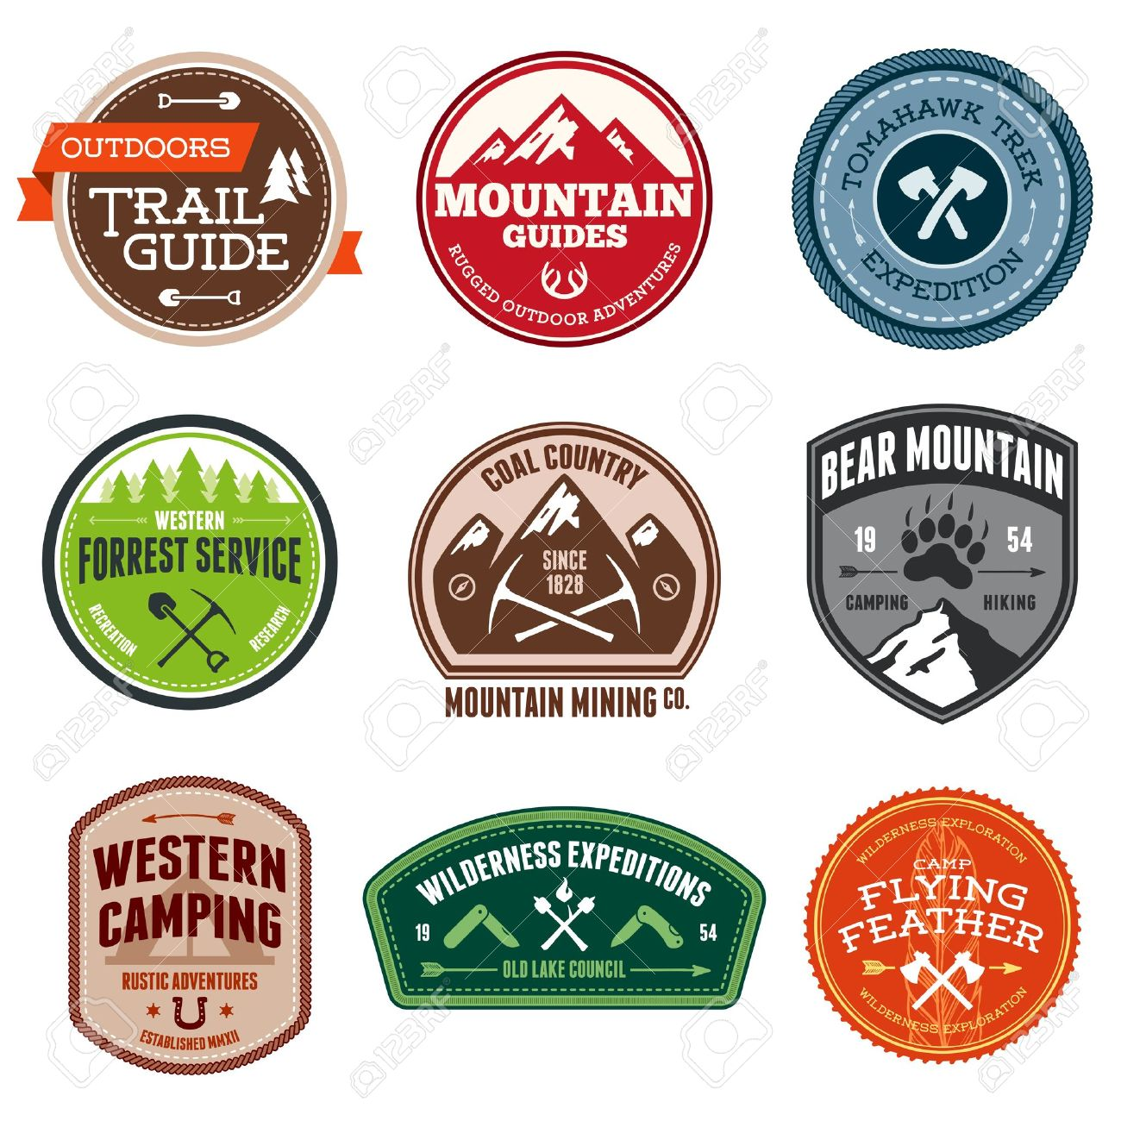
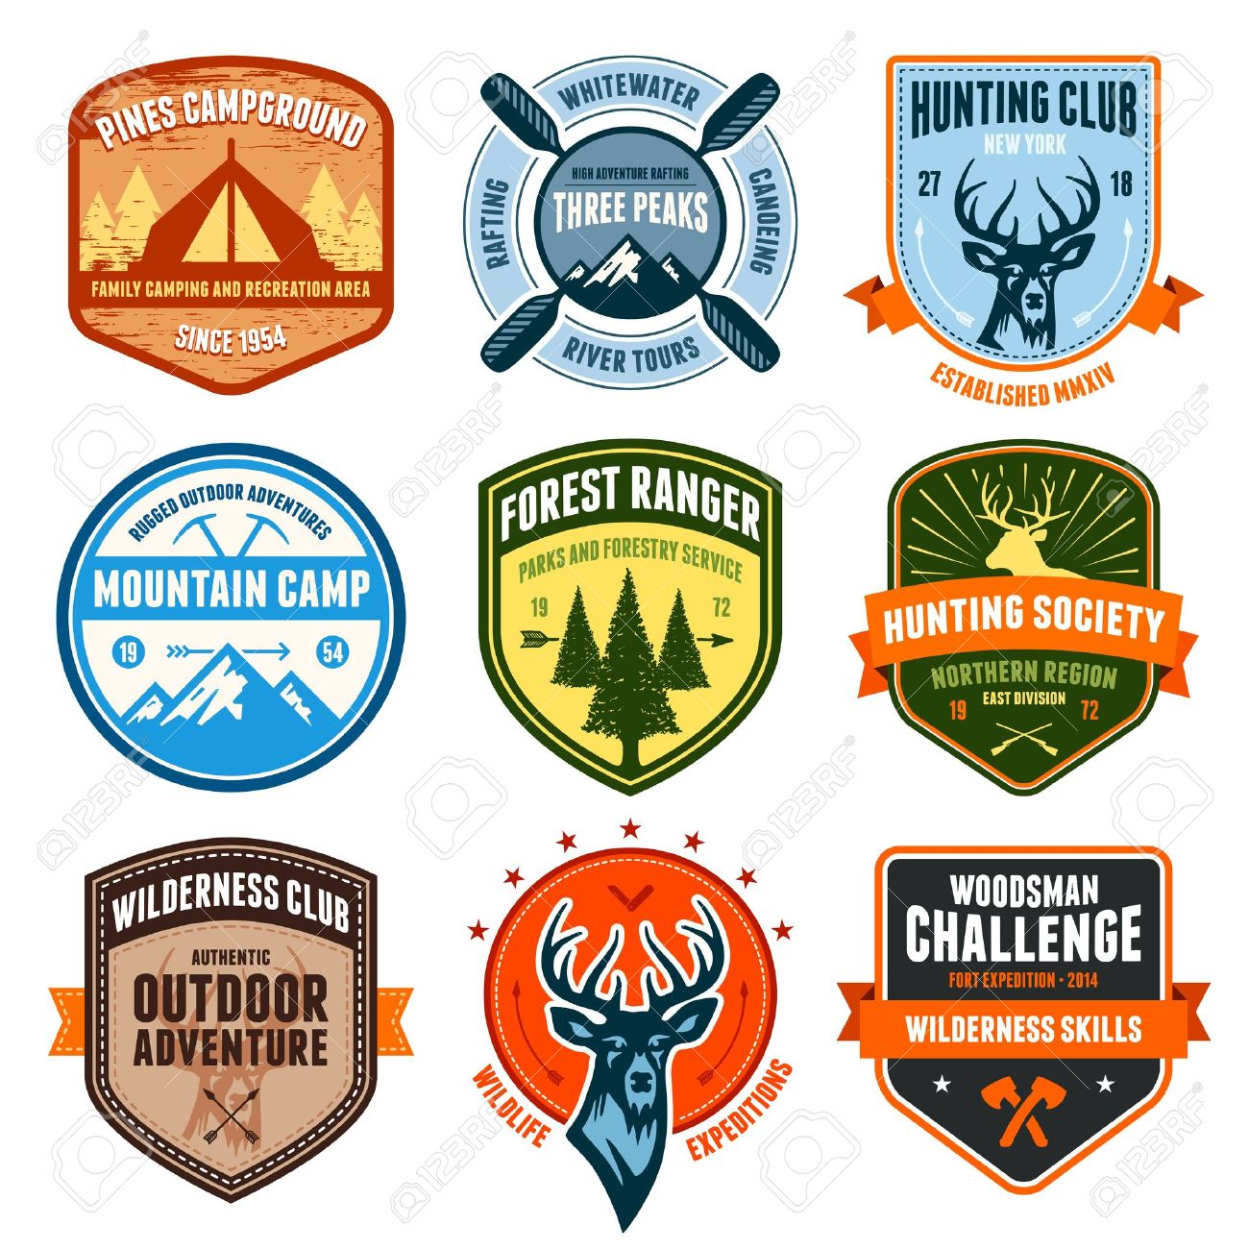
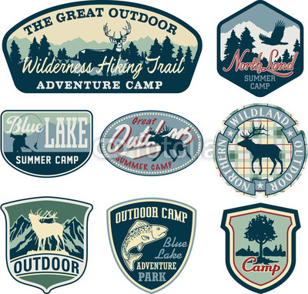
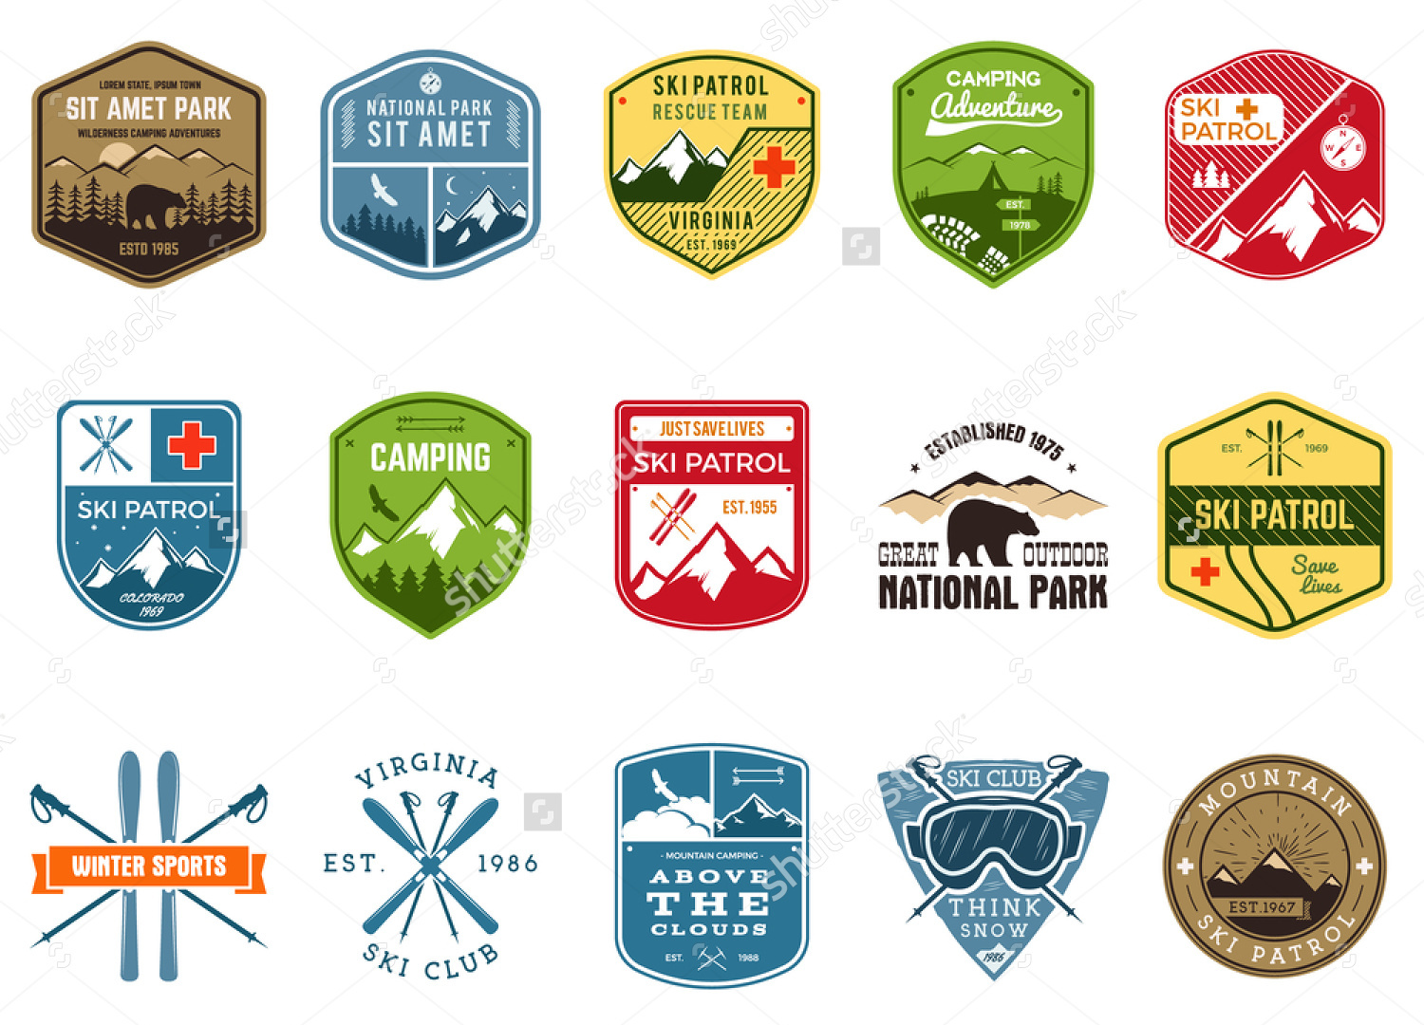
Unique-Cool-Memorable
Use color and shapes. LifeExec.com is about living life to the fullest and in a responsible way. Each badge should tell a different story about adventure.
EXAMPLES

