Slide 1
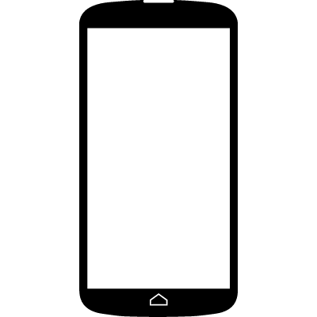


$$$$ Cost per call
$$ Cost per chat
Chat Agents
Telephone Agents
Smartphone callers choose immediate
text chat
instead of
wait for
telephone
agent
Calls
Traffic Pivot
Chats

