Slide 1

Phyto Core®
Microbial Products
Change from the root.

Slide 2

Phyto Core®
Phyto Core specializes in the odorless organic material fermentation, recyclable poultry bedding and microbial soil improvement fertilizer.
Our products combine cutting-edge technology with proven biological core nutrients to serve many customers from the conventional farming, organic farming, Hydroculture and poultry.
Our research and development team has over 20 years of experience in microbial research and real world operations. We provide our customers with the best customized solutions for their needs, and assist them in overcoming their challenges, and doing expert scientific analysis to help them create a profitable and productive agribusiness.

Slide 3
Products
CMF-1 Soil Enhancement
CMF-2 Hydroculture Growing Medium
CMA-1 Aerobic Fermentation Booster
CMA-2 Poultry Bedding Enhancement

Slide 4
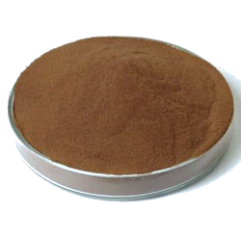
CMF-1 Soil Enhancement
CMF-1 Soil Enhancement is a futuristic green bio-fertilizer which promotes plant growth. It contains soil improvement substance, suitable microbe, and with carefully selected mineral nutrients.
Nature: Brown Powder
Packing: 20kg / barrel
Benefit:
  Promote plant growth
  Improve root development and function.
  Improve crop resilience to the impact of pathogenic, monocroping and extreme weather conditions.
  Improves bio-balance in the root zone.

Slide 5
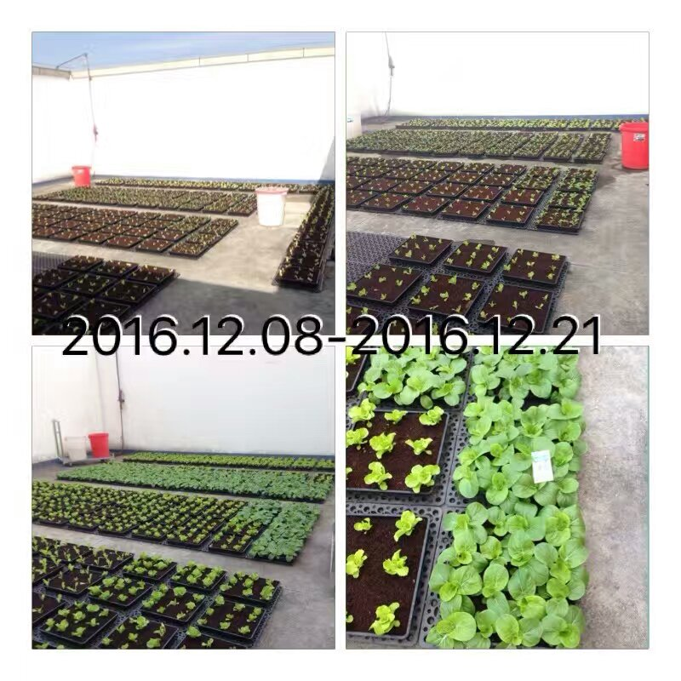
CMF-2 Hydroculture Growing Medium
CMF-2 HYDROCULTURE GROWING MEDIUM is a coco coir based soilless growing medium, with selected microorganism to go through the ammonification and nitrification processes to support plant growth.
Nature: Fine coco coir
Packing: 40kg, 70kg
Benefit:
  Contains symbiotic bacteria to supply nutrient in organic way.
  Urban gardening medium for both outdoor and indoor planting.
  Agrochemical-free growing medium for both organic and convention farming.
  Recycled growing medium to achieve sustainable farming.

Slide 6
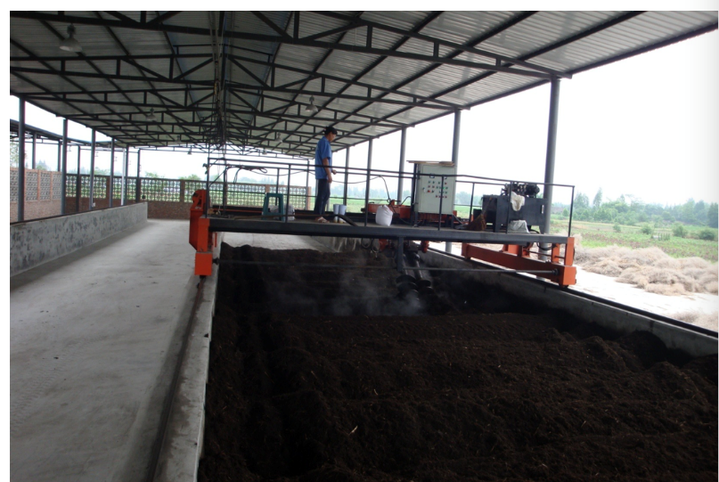
CMA-1 Aerobic Fermentation Booster
CMA-1 AEROBIC FERMENTATION BOOSTER consists of microbial additives which is able to decompose a wide range of organic matters, and is odorless during the fermentation process.
Nature: Brown Powder
Packing: 20kg / barrel
Benefit:
  Enable the suppression of foul odors.
  Shorten the production period.
  Recycle wastes in a cost effective way.
  Produce high quality compost with beneficial bacterial for promoting growth and bio-balancing.

Slide 7
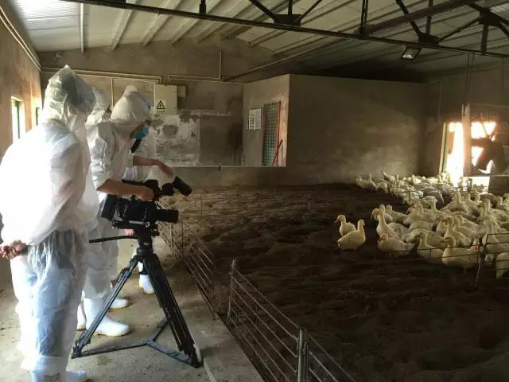
CMA-2 Poultry Bedding Enhancement
CMA-2 POULTRY BEDDING ENHANCEMENT consists of microbial additives, that functions in poultry bedding which improves the animal health and the quality of animal produces.
Nature: Brown Powder
Packing: 20kg / barrel
Benefit:
  Enable the suppression of foul odors.
  Improve bio-balance in barns.
  Long effective period up to 2 years.
  Bedding material can be recycled as bio-fertilizer for plants.

Slide 8
Phyto Core Private Limited
Tampines Industrial Park, Singapore
Phone: +65 8518 9027
Email: customerservice@phyto-core.com
Website: www.phyto-core.com
Disclaimer: Any recommendations provided by Phyto Core Private Limited are advice only. As no control can be exercised over storage, handling, mixing, application or use, or weather, plant or soil conditions before, during or after application (all of which may affect the performance of our program), no responsibility for, or liability for any failure in performance, losses, damages, or injuries (consequential or otherwise), arising from such storage, mixing, application, or use will be accepted under any circumstances whatsoever. Phyto Core recommends you to contact an Agronomist prior to product application. The Buyer assumes all responsibility for the use of any Phyto Core products.

