Slide 1

Production Capabilities
Bagging – both preformed gusset bags and pillow pack bags
Panning
Volumetric filling and sealing
Center making – Mogul Machine
Liquid filling glass, quarts and gallons
Label and film making
Flow wrapping
Box filling
Bulk Pack

Slide 2
QA Capabilities
Full service quality department
Microbial, analytical, physical and organoleptic testing capabilities.
Full graphic design review including regulatory to meet FSMA requirements.
Nutritional panel and ingredient statement supplied.
COA’s/COC’s per lot/shipment.
Certified food scientist on staff.
HACCP based facility.

Slide 3
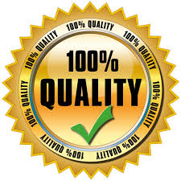
Highest Quality Standard
A wide array of certifications available including:
Certified NOP Organic, Gluten Free, Vegan, Orthodox Union, Vegan, GMO/GE Free to name a few.
safety certified by Merieux Nutrisciences.

