Slide 1
Richardson brands
Production Capabilities

Slide 2
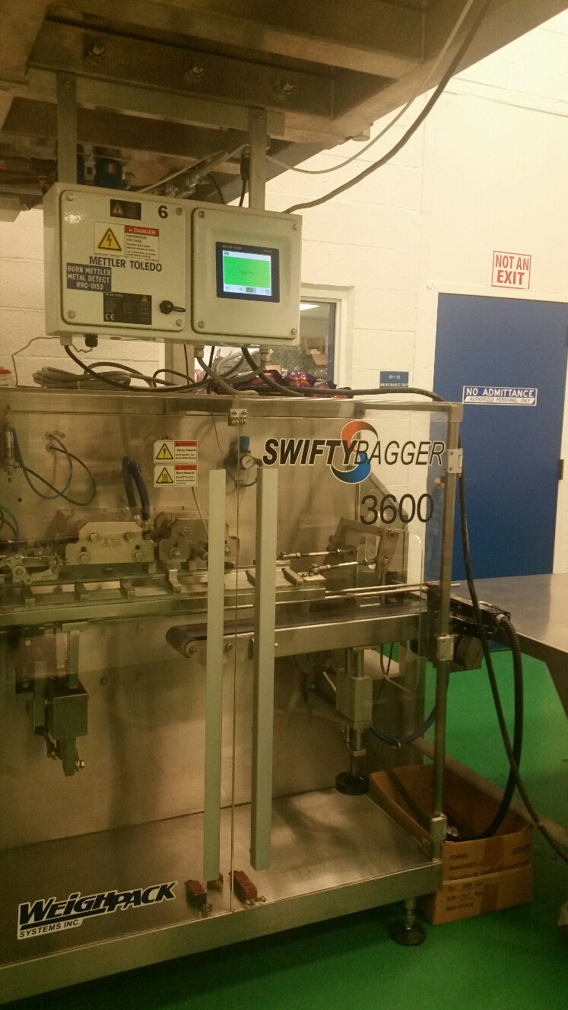
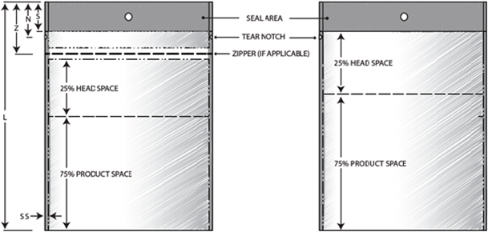
Bagging Capabilities
Swifty Bagger
Will Handle a 3.5” to 8” wide x 6” to 11” long
Must be a preformed gusset, pillow flat bottom with zipper
Must have 25% head space in bag to seal
Prefer bags without a hole punch machine will do this for us
Bottom gusset max 3”
Zipper to top of bag 2.5” ideal
Film Thickness for best results 2 to 3 mil
With Zipper
No zipper

Slide 3
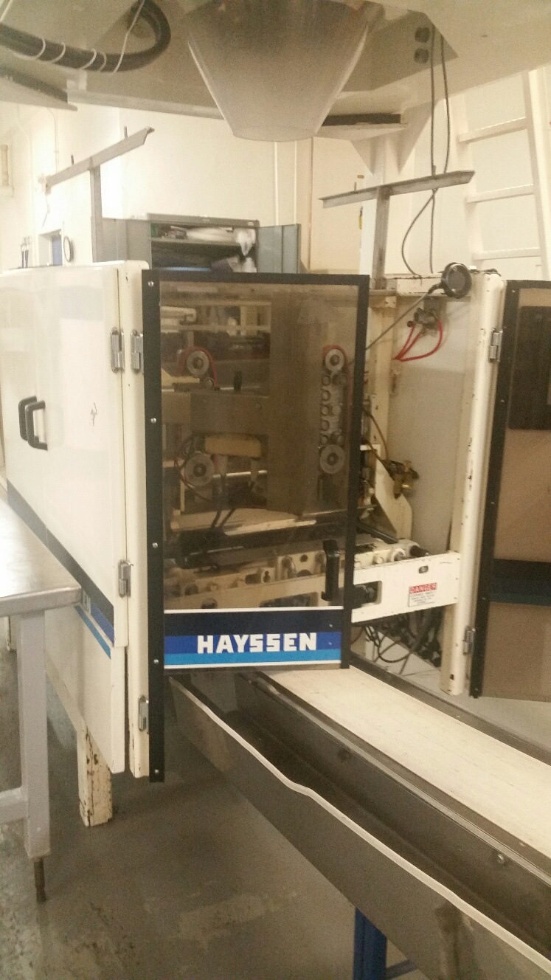
Bagging Capabilities
Hayssen Ultima Super CMB 12-16 HR
Make bags in line
Can make a 2.5” to 12” wide (measured Flat) x 3” to 16” long pillow bag
Forming tubes we have
6.00” Circumference
10.0” Circumference
18.62” circumference oval
Can not put a zipper in the bag

Slide 4
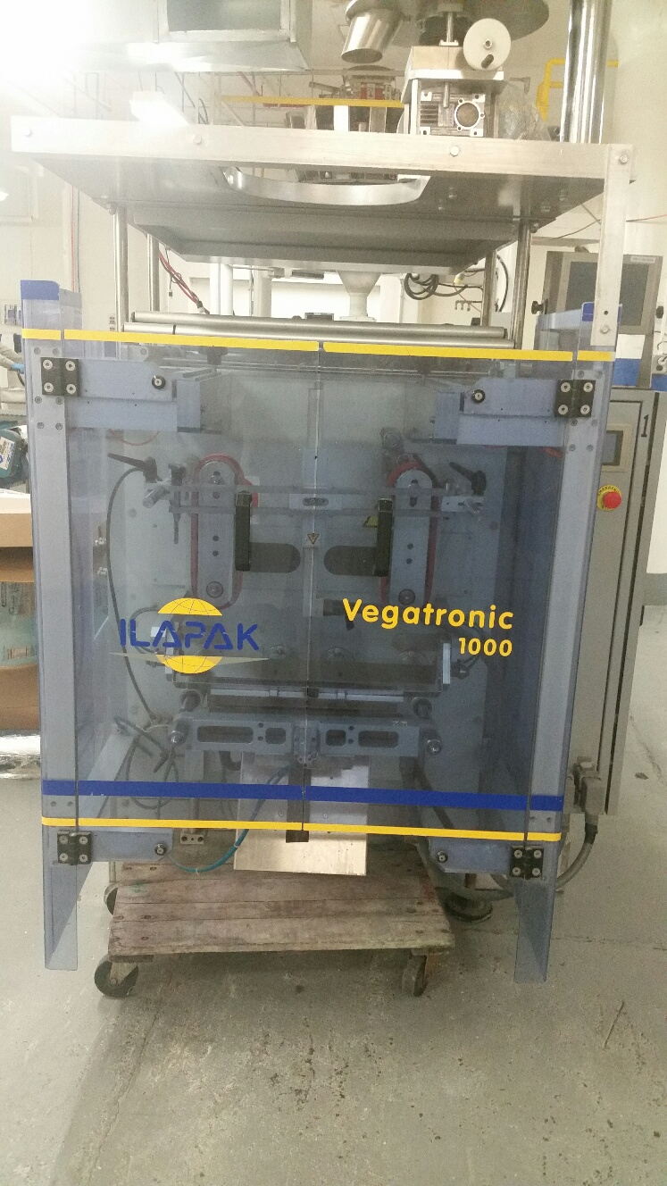
Bagging Capabilities
IIapak Vegatronic VT 1000s
Make bags in line
Will Only make a pillow bag 2”-14” wide x 3” – 15” long
Forming tubes we have
10.00” Circumference
11.50” Circumference
11.75” Circumference
18.00” Circumference
Can not put a zipper in the Bag

Slide 5
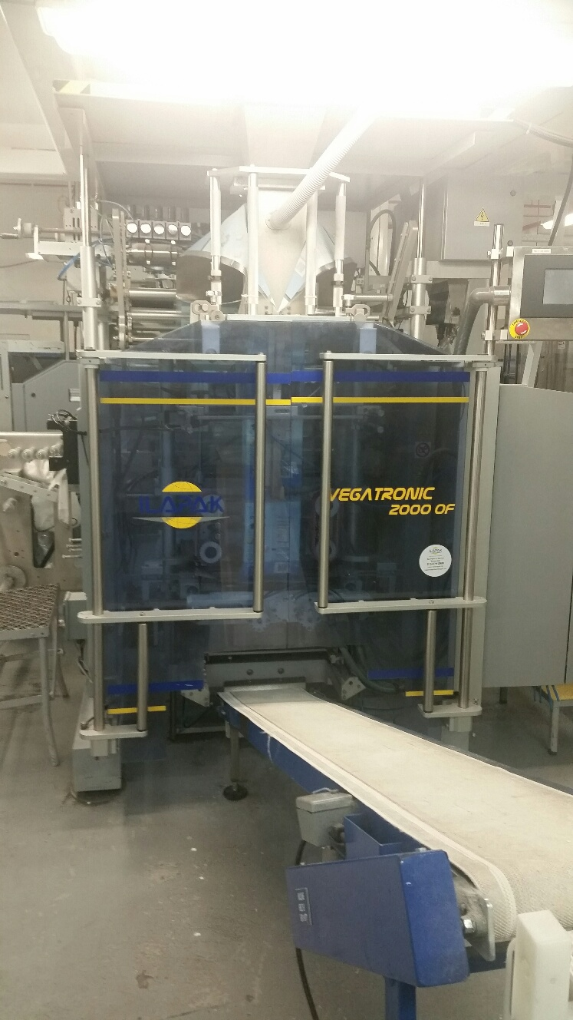
Bagging Capabilities
IIapak Vegatronic VT 2000 OF S
Make bags in line
Will make a flat bottom bag 2”-16.5” wide x 2” – 10.83” long
With a zipper bag size 2” – 9.4” wide x 2” – 10.83” long
Pillow Bag 2” – 16.5” wide x 2” – 22.44” long
Forming tubes we have
3.88” x 7.25” rectangular
4.00 “ x 9.25” rectangular

Slide 6
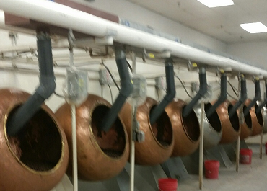
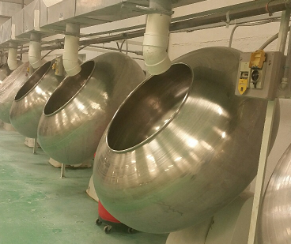
Panning
We have over 70 pans
Pan sizes range from 36” to 60”
Pan sizes based on weight range from 40 lbs. to 600 lbs.
We have panned the following
Almonds
Pretzels
Yogurt Balls
Peanut Butter Balls
Raisins
Jelly center – Brookside
Rock Candy – decors
Peanuts

Slide 7
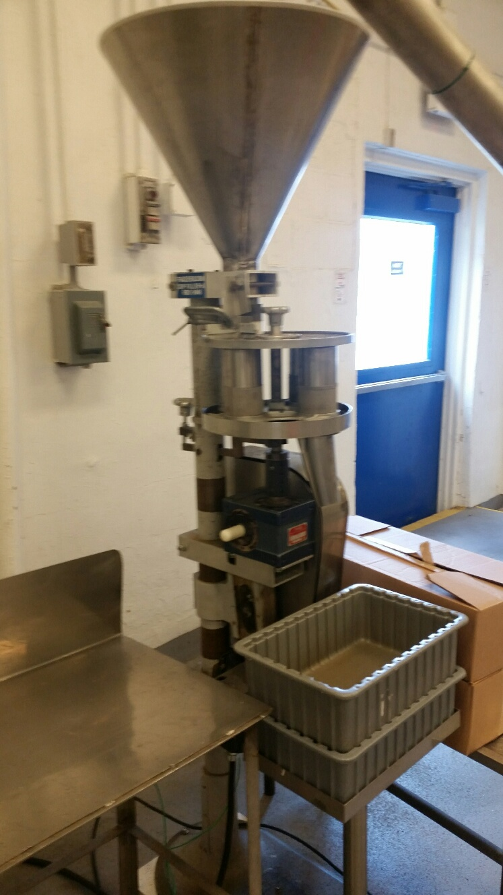
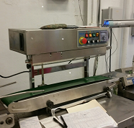
Volumetric Filling and sealing
We have 4 machines
At Present, we can do the following
2 lbs.
3 lbs.
4.5 lbs.
Cocoa Gems 2.2 oz. bags run with Ilapak machine
We have spare parts that can make different sizes we would need to know what someone else would need
Sealing machine are purchased from China at a cost of $400 each and can seal bags up to 13”
We retrofitted a sealing machine and can seal up to 18”

Slide 8
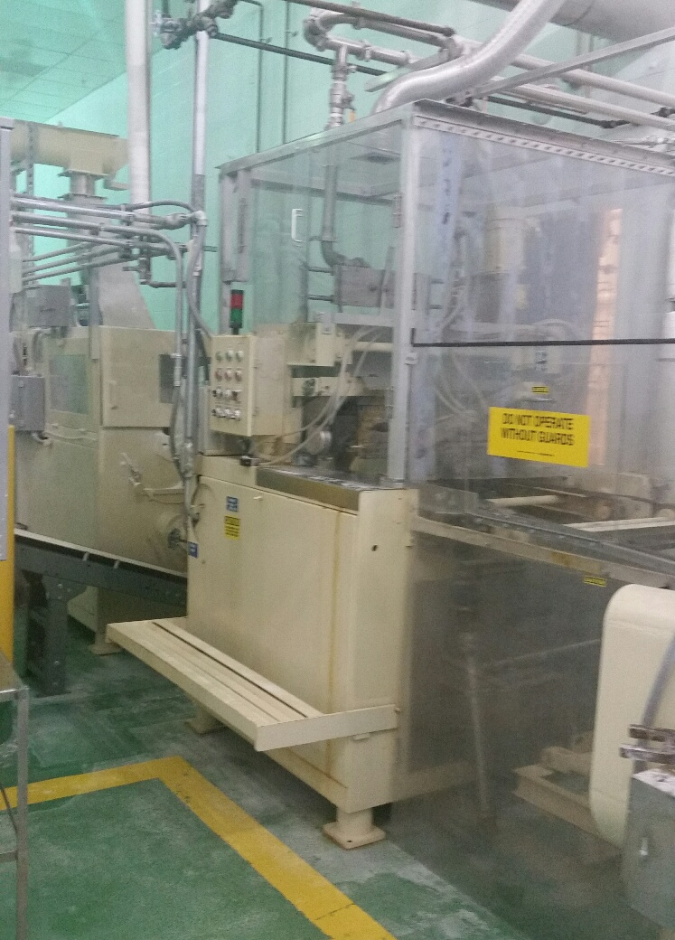
Center Making
Starch Mogul Machine
Can make the following items in a lentil form
A Pectin Center used for the BJ’s Jelly
A Sugar center used for our current Gourmet mints, can make them in any flavor
Size of lentil is based on impression board and can range from .3 grams to 2 grams
New Head On Order

Slide 9
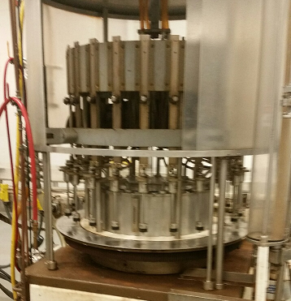
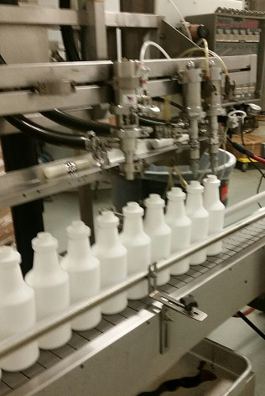
Liquid Filling machines
Gravy Master fill machines
Can fill
2 oz. Glass - retail
5 oz. Glass - retail
Quarts – food service
Gallons – food service

Slide 10
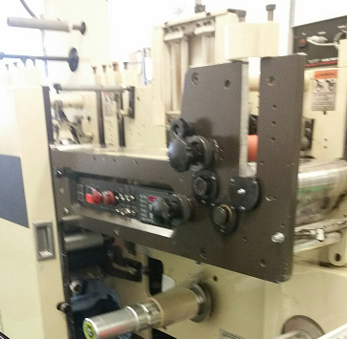
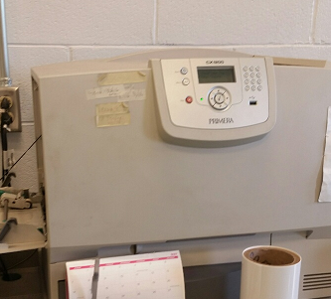
Label and Film making
Primera label making machine
No limit as far as colors are concerned
Will produce labels in house if quantity is under 20K. Rough cost is approx. .05/label
Marc Andy – film making machine
Can only do 3 colors. Do all Imprint film in house
We also print the beechies boxes

Slide 11
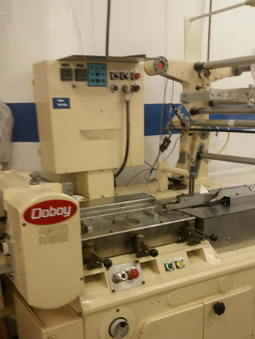
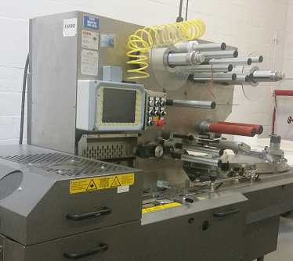
Flow wrapping machines
We have a total of 4 Doboys
Mostly used to put the Party City headers on the Rock candy and Bogdon lines
We have 3 flow wrappers used for Gourmet Mints
Can wrap two-fers and imprint business
Can wrap round gum balls
We also have a PFM flow wrap machine used to Wrap the Bogdon 4” stick. This can also be modified to do longer and wider sticks.

Slide 12
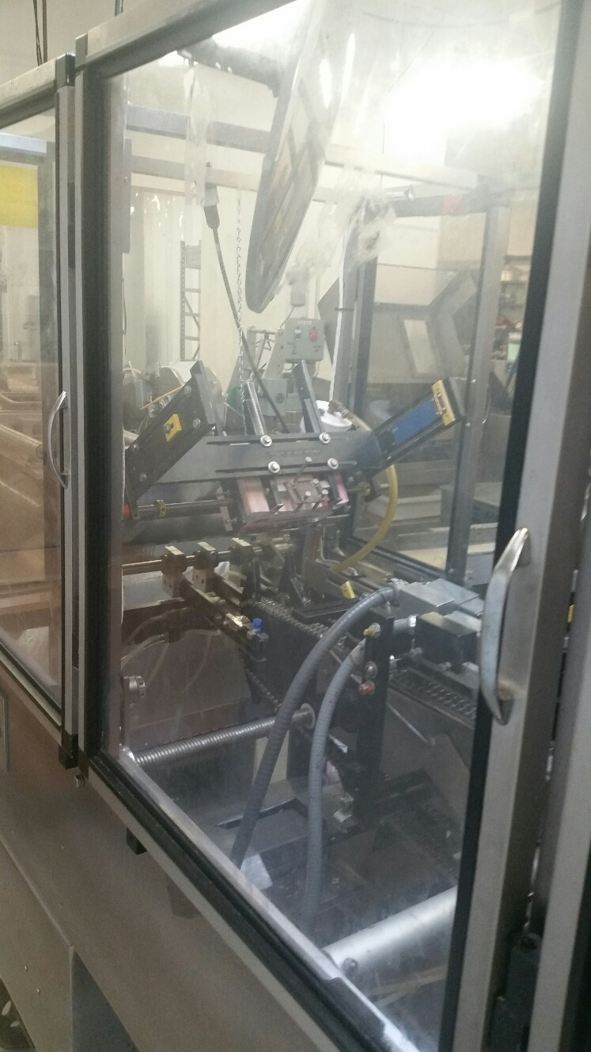
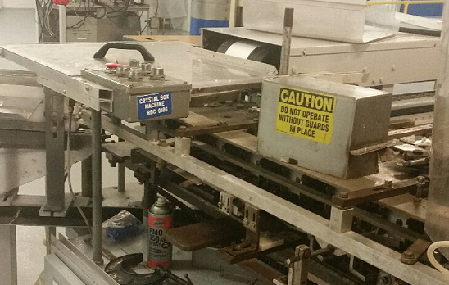
Box Machine
Adco Box line
Used in Bogdon can make a square box
6” h x 3” W x 1 ¼” H
Clybourn Cartoner
Used for Rock Candy 2.5 oz. crystals fills with a Volumetric filler. box size 4 ¼” L x 2” W x ¾ “ H
Adco box line in soft sugar mint room
Used for Soft sugar mints size of box is
5 7/8” L x 4 ½” W x 1 7/8” H

Slide 13
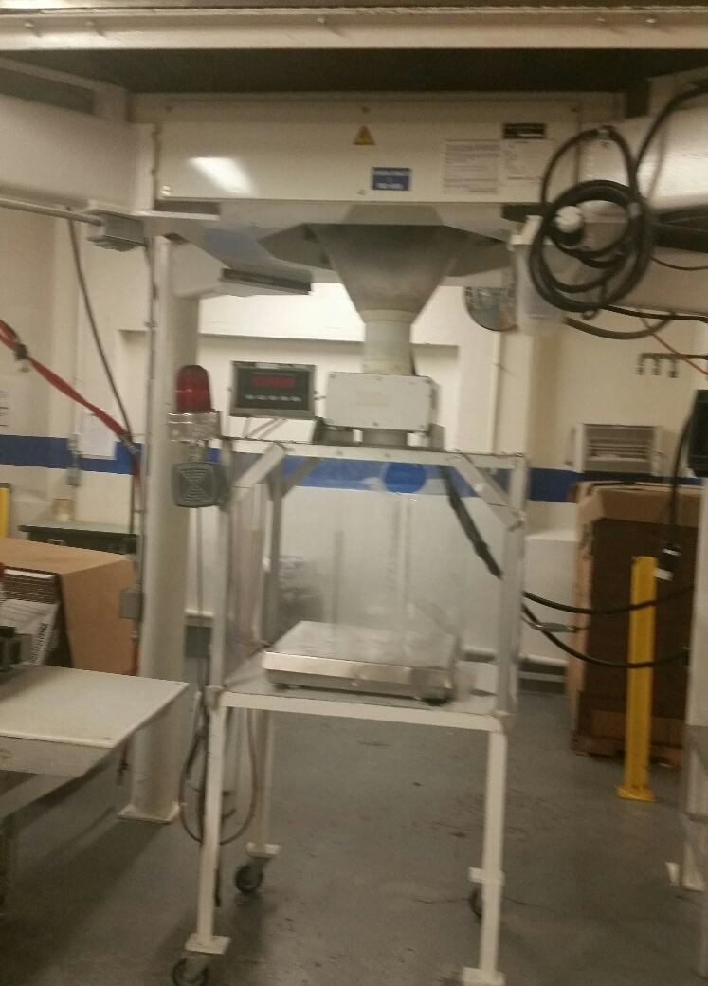
Bulk Pack Line
Can Bulk pack in a 25 and 30 Lb. box
44 oz. tub
32 oz. tub

Slide 14
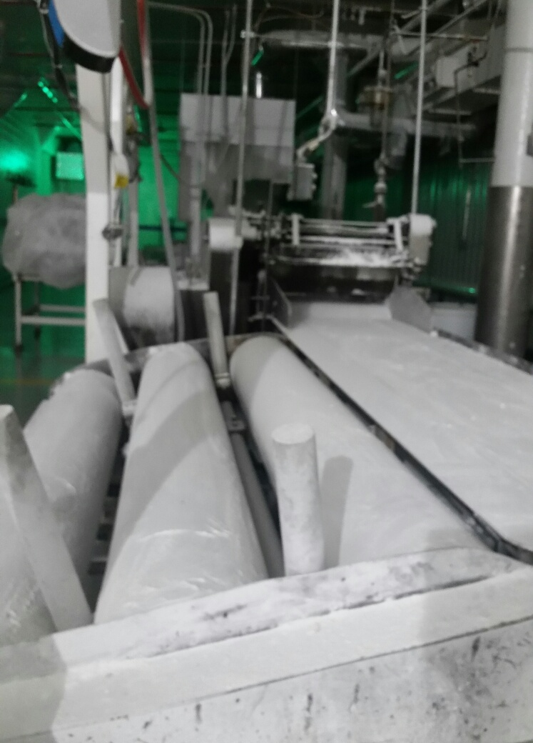
Pillow mints
We have rollers and Knives to do a large cut and a small cut pillow mint

Slide 15
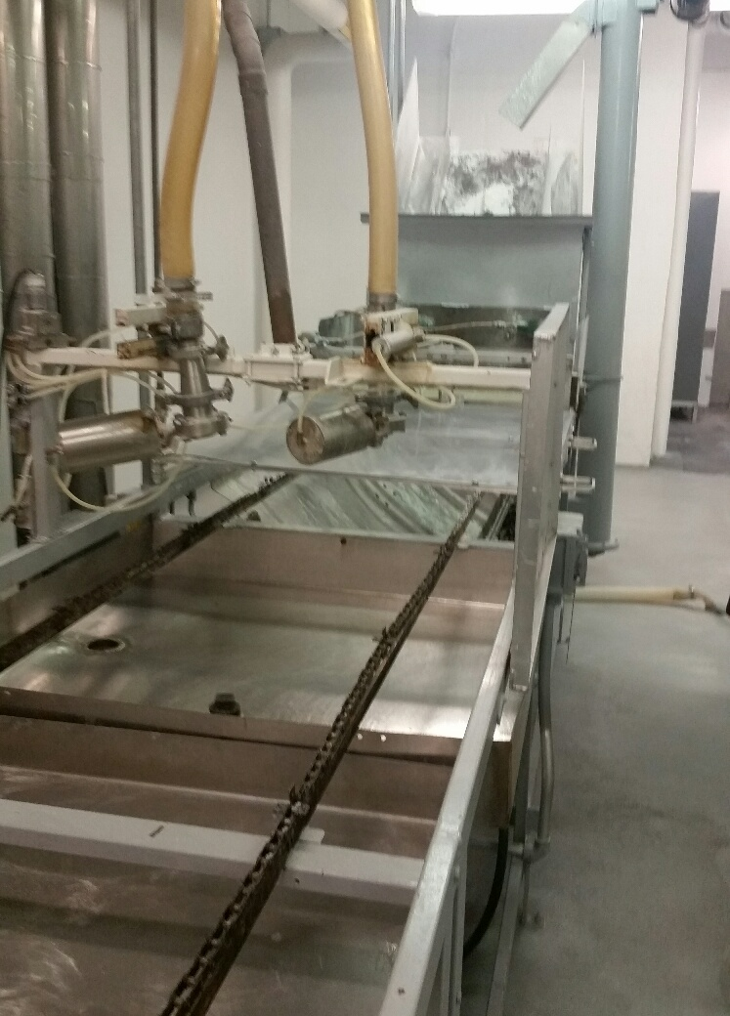
Starch Jelly Making
Can make a starch jelly
Cure time 5 to 10 business days in starch

Slide 16
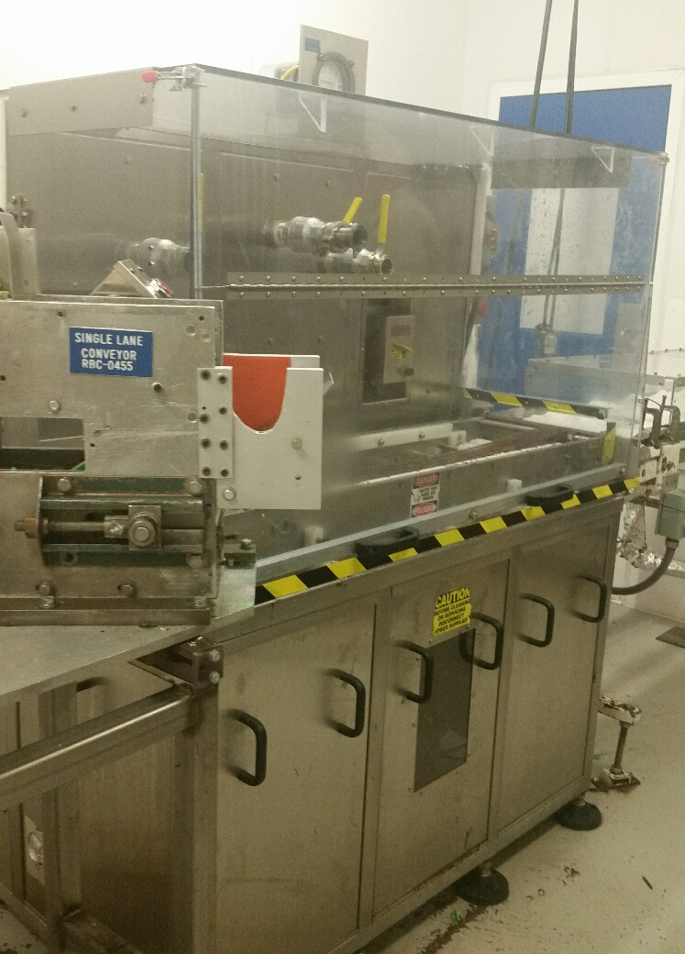
Enrobing
At Present we are enrobing a peppermint stick used for Bogdon
Can enrobe a 4” stick with a full coat, ¾ coat or ½ coat.
Attached to 110’ long cooling tunnel
Capable of doing 4 different color sticks and mixing them as they go thru the enrober.

Slide 17
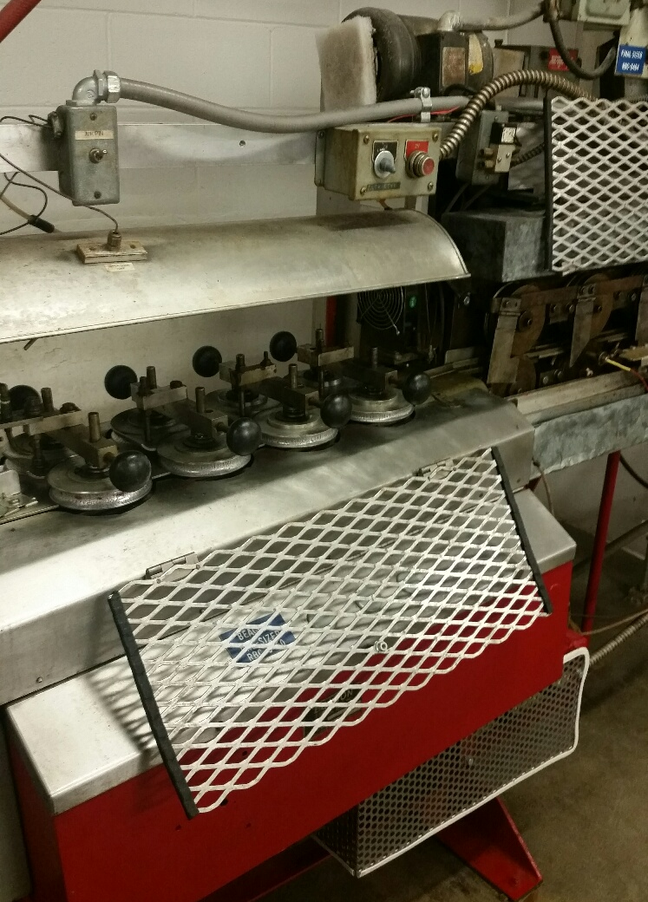
Pre size stick making
Current step up can make a hard stick 4” long by 3/16” thick
If we made a new cutting wheel we can make the stick longer

Slide 18
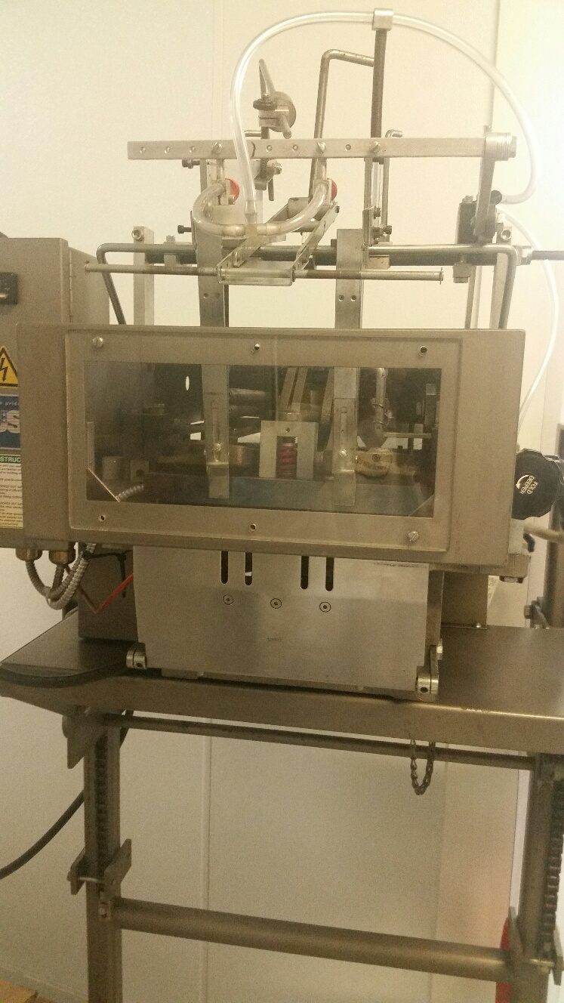
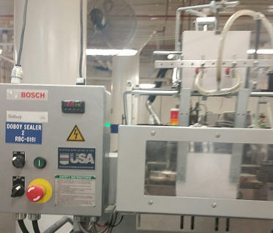
Sealer Crimper
JSL Doboy
Can put a header card on a bag
We have two of these
Machine capabilities can handle header size of 2“ to 10”

