Slide 1
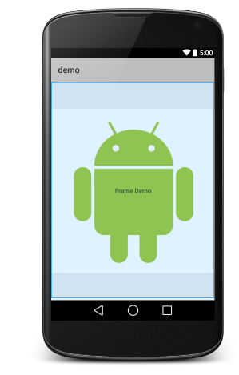

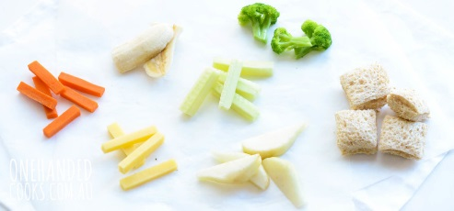
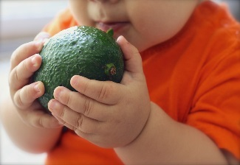
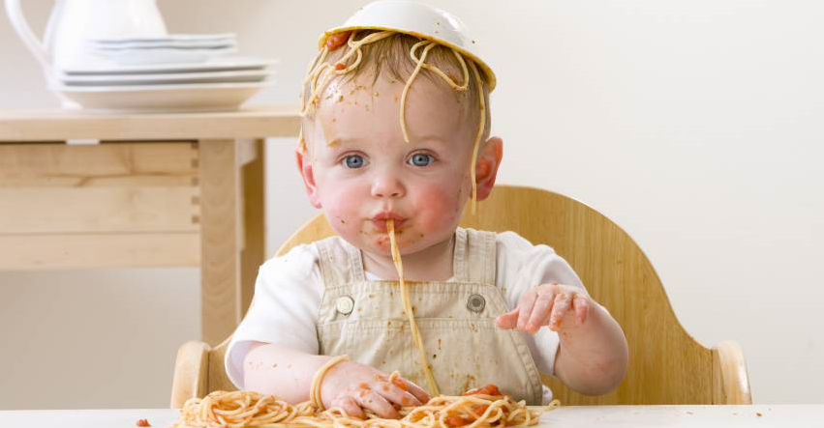
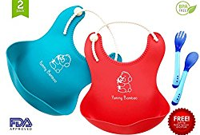

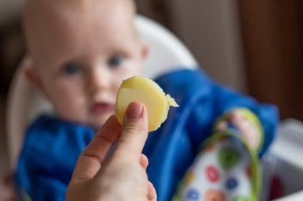
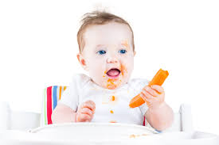
Dashboard
BABY LED WEANING
…
BABY LED WEANING
…
RECIPES
GUIDELINES
ACCESSORIES
FAQ
THEORY
HOW TO START
BLW Community Support
Upgrade to Full Version
RECIPES
GUIDELINES

Slide 2

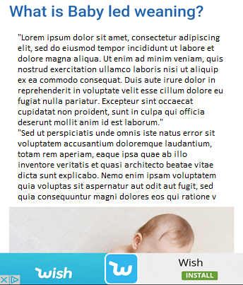
Theory
BABY LED WEANING
…
THEORY
ADVERT

Slide 3
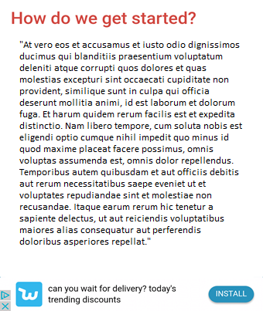
How To Start
BABY LED WEANING
…
HOW TO START
ADVERT

Slide 4
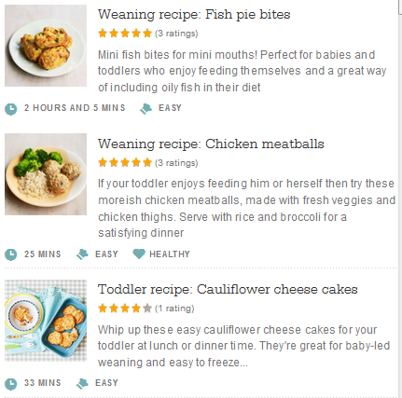
Recipes Popular
BABY LED WEANING
…
POPULAR EXPLORE
ADVERT

Slide 5
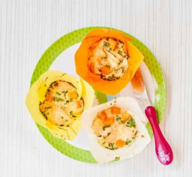

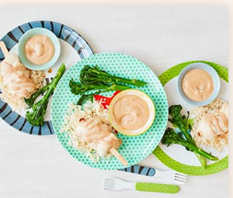
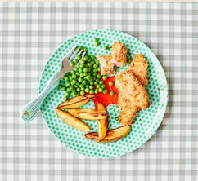
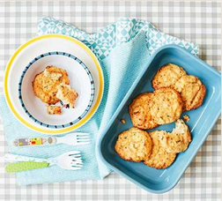

Recipes Explore
BABY LED WEANING
…
POPULAR EXPLORE
QUICK & EASY
SNACKS
LUNCH
DINNER
VEGETARIAN
TREATS
UPGRADE TO FULL VERSION TO SEE ALL THE RECIPES

Slide 6
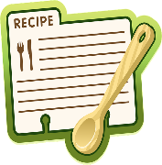

Recipes Explore
BABY LED WEANING
…
POPULAR EXPLORE
UPGRADE NOW
TO FULL VERSION
  You will be able to see all the recipes (more than 100 recipes)
  Remove advertisement
QUICK & EASY
SNACKS
LUNCH
DINNER
VEGETARIAN
TREATS
BUY NOW
UPGRADE TO FULL VERSION TO SEE ALL THE RECIPES

Slide 7
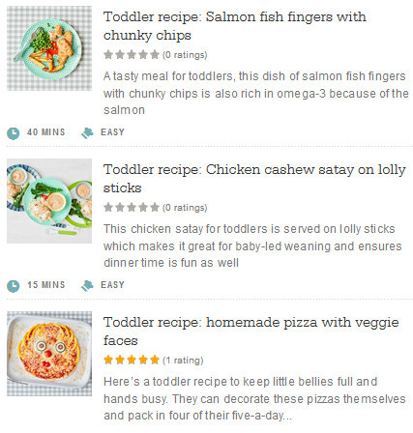
Recipes
- Quick & Easy
- Snacks
- Lunch
- Dinner
- Vegetarian
- Treats
BABY LED WEANING
…
QUICK & EASY
<
ADVERT

Slide 8
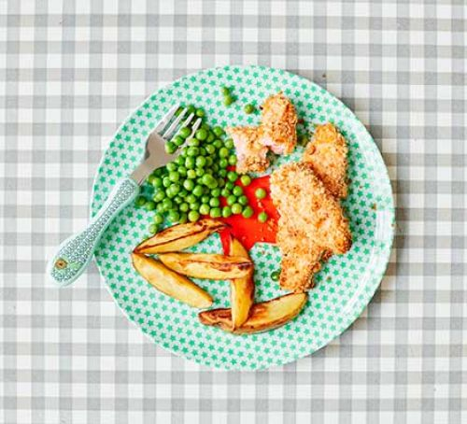

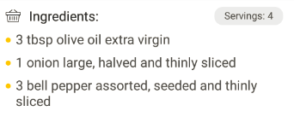
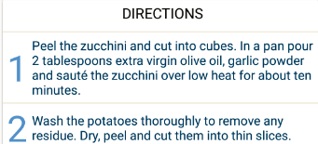
Recipes display recipe
To share recipes on social media
BABY LED WEANING
…
SALMON FISH FINGERS
WITH CHUNKY CHIPS
<
ADVERT

Slide 9
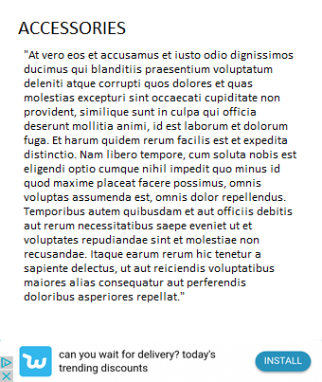
Guidelines
BABY LED WEANING
…
GUIDELINES
GUIDELINES
ADVERT

Slide 10
Accessories
BABY LED WEANING
…
ACCESSORIES
ADVERT

Slide 11
FAQ
BABY LED WEANING
…
FAQ
FAQ
ADVERT

Slide 12
Settings
BABY LED WEANING
…
Settings
Disclaimer

Slide 13
Disclaimer
Disclaimer
The information presented is for the sole purpose of supporting you in making an informed decision on how to feed your child. Although the authors of the app acknowledge and support WHO guidelines in respect to infant feeding and therefore encourage breastfeeding as an option, we also acknowledge that breastfeeding or breast milk is not always an option for mothers and their infants. For this reason, we have attempted to offer as much formula feeding information as we can to support those mothers who are unable to breastfeed or give breast milk to their infants.As this app contains text from reputable sources (e.g. WHO and scientific journals) as well as personal experiences, collectively the…
BABY LED WEANING
…

Slide 14
Dashboard
BABY LED WEANING
…
BABY LED WEANING
…
RECIPES
GUIDELINES
ACCESSORIES
FAQ
THEORY
HOW TO START
BLW Community Support
RECIPES
GUIDELINES

Slide 15
Theory
BABY LED WEANING
…
THEORY

Slide 16
How To Start
BABY LED WEANING
…
HOW TO START

Slide 17
Recipes Popular
BABY LED WEANING
POPULAR EXPLORE

Slide 18
Recipes Explore
BABY LED WEANING
POPULAR EXPLORE
QUICK & EASY
SNACKS
LUNCH
DINNER
VEGETARIAN
TREATS

Slide 19
Recipes
- Quick & Easy
- Snacks
- Lunch
- Dinner
- Vegetarian
- Treats
BABY LED WEANING
QUICK & EASY
<

Slide 20
Recipes display recipe
To share recipes on social media
BABY LED WEANING
SALMON FISH FINGERS
WITH CHUNKY CHIPS
<

Slide 21
Guidelines
BABY LED WEANING
…
GUIDELINES
GUIDELINES

Slide 22
Accessories
BABY LED WEANING
…
ACCESSORIES

Slide 23
FAQ
BABY LED WEANING
…
FAQ
FAQ

Slide 24
Settings
BABY LED WEANING
…
Settings
Disclaimer

Slide 25
Disclaimer
Disclaimer
The information presented is for the sole purpose of supporting you in making an informed decision on how to feed your child. Although the authors of the app acknowledge and support WHO guidelines in respect to infant feeding and therefore encourage breastfeeding as an option, we also acknowledge that breastfeeding or breast milk is not always an option for mothers and their infants. For this reason, we have attempted to offer as much formula feeding information as we can to support those mothers who are unable to breastfeed or give breast milk to their infants.As this app contains text from reputable sources (e.g. WHO and scientific journals) as well as personal experiences, collectively the…
BABY LED WEANING
…

