Slide 1
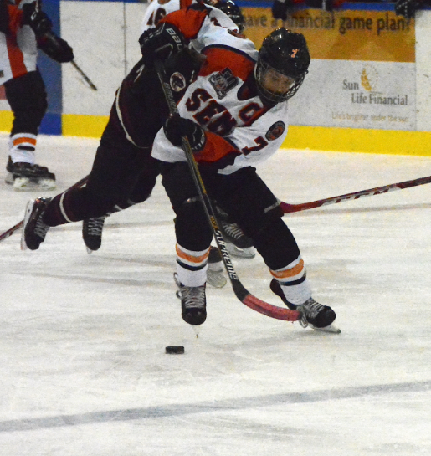

SEMIAHMOO RAVENS “ROAD TO QUEBEC” SPONSORSHIP OPPORTUNITY
PEEWEE A1 RAVENS

Slide 2
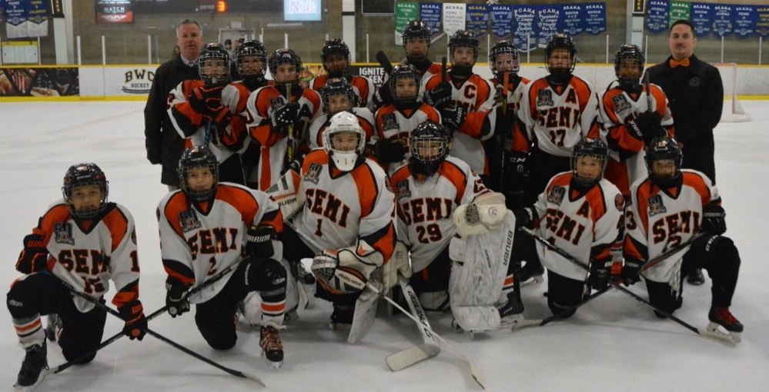
ABOUT THE SEMIAHMOO RAVENS PEEWEE A1 TEAM
Team features 17 of the best 11 & 12 year old hockey players from the White Rock/South Surrey area.
Season runs September – March.
All home games played at Centennial Arena at 7:30PM on Thursday nights.
Players and families are active members in the White Rock & South Surrey Community.
JOIN US ON OUR ROAD TO QUEBEC!

Slide 3

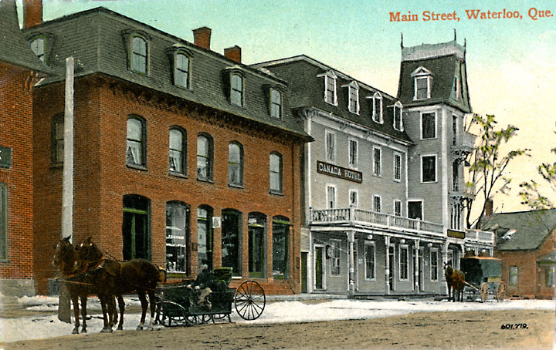

ABOUT OUR ROAD TO QUEBEC
We will be participating in the 44th Annual Waterloo National Pee-Wee Tournament.
Tournament will take place January 22nd – 28th, 2018 in Waterloo, Quebec.
Features top teams from all across Canada.
Exciting cultural experience as this will be the first time traveling to Quebec for almost all of the kids.
More information on this event can be found at tournoinationalpeeweewaterloo.com
How will we use sponsorship funds?
All sponsorship funds will go to help subsidize the substantial costs associated with participating in this event including flights, hotel and transportation.

Slide 4
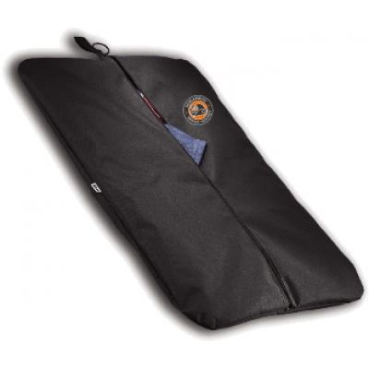
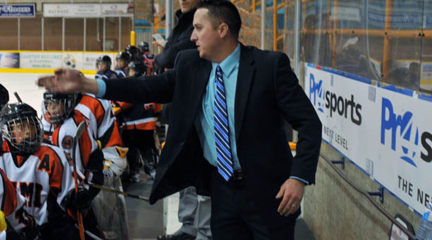
SPONSORSHIP PACKAGES
Gold - $5,000 (2 available)
  Banner displayed at all home games.
  Featured logo (12 in x 12 in) on garment bag.
  Logo & link to sponsor website on Semiahmoo Minor Hockey website.
  Promotion on Semiahmoo Minor Hockey social media accounts
  Team visit/event at place of business, if applicable.
Silver - $2,500 (5 Available)
  Primary logo (8 in x 8 in) on garment bag.
  Logo & link to sponsor website on Semiahmoo Minor Hockey website.
  Promotion on Semiahmoo Minor Hockey social media outlets.
Bronze - $1,000 (5 Available)
  Secondary logo (6 in x 6 in) on garment bag.
  Logo & link to sponsor website on Semiahmoo Minor Hockey website.
  Promotion on Semiahmoo Minor Hockey social media outlets.

Slide 5
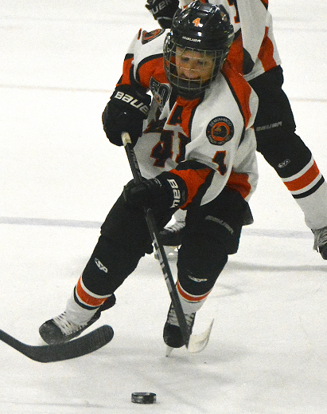
CONTACT INFORMATION
If you are interested in one of our sponsorship packages or would like to learn more about our “Road to Quebec” please contact:
Kevin Gavin
k_gavin77@hotmail.com
604.290.1480

