Slide 1
Corporate Presentation
October 5, 2017

Slide 2
Agenda
Dialog Semiconductor Overview
Our Strategy and Markets
Summary

Slide 3
Dialog at a Glance
HQ: London, UK | Founded: 1981 | Listing: Frankfurt (DLG)
Company Overview
Fabless supplier of highly integrated mixed-signal ICs, optimized for mobile computing, wearables, IoT, smart home and automotive applications
Manufacturing: fabless manufacturing model, with production, assembly and packaging fully outsourced
Employees: c. 1,880 (75% engineers)⁽¹⁾
One of the fastest growing global semiconductor companies
Best-in-class mobile PMIC platform with broad IP portfolio
New technologies for RF wireless charging and GaN
#1 PMIC market share for smartphones and tablets
# 1 in rapid(fast) charging for smartphone adapters
Industry largest custom mixed-signal design team
Track record of solid execution with strong revenue growth and strong cash generation
Accelerated Growth (US $Million)
Business Segments
Mobile Systems: Power management, charging and audio for mobile computing, portable and automotive electronics
Power Conversion: AC/DC conversion ICs and LED drivers for solid state lighting and TV backlighting
Connectivity, : Bluetooth® low energy for IoT and short-range wireless communication technologies
34%
CAGR
Note
As of June 2017

Slide 4
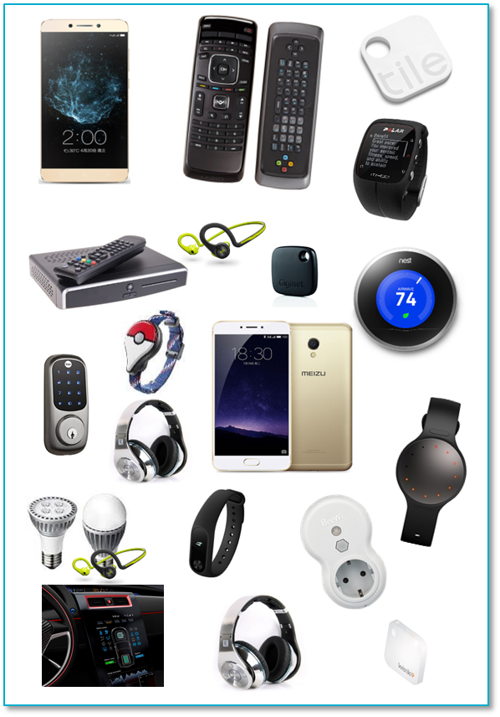
Technology Leadership
Leadership portfolio in power savings technologies
Best-in-class PMIC with broad IP portfolios
#1 PMIC market share for smartphones and tablets
#2 Bluetooth LE market share. ~100M units shipped
with industry’s lowest power
#1 in RapidCharge (fast charging ) market share for power adapters
Industry leading RF wireless charging and GaN offering

Slide 5





Diverse Product Portfolio
Powering efficient, smart connected devices
Power Management
Wireless Connectivity
Power
Conversion
Lighting
Audio
Products
PMICs, Chargers Wireless Charging
Bluetooth DECT
Codecs, Amplifiers, Processors
AC/DC Converters
LED
Drivers
Dialog Value
Integration, Efficiency, Size, Flexibility
Performance & Battery Life
Audio Quality & Battery Life
Power Efficiency, Size, BOM Cost
Power Efficiency, Size, BOM Cost

Slide 6
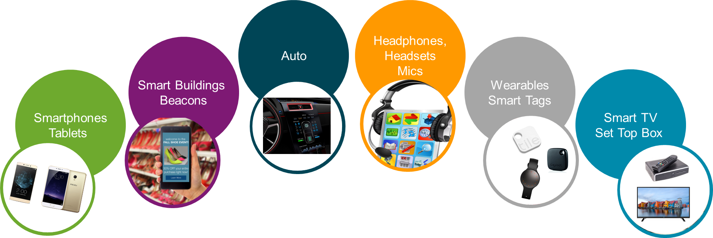
Focused on Growth Markets and Applications
Lowest power solutions available

Slide 7
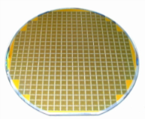

Commitment to R&D Investment
Sustained investment in R&D for future growth
Continued investment in new technologies
Full year
($million)
GaN
~ 900 Patents Issued

Slide 8



Corporate Structure
≈1880 Employees Today > 75% Engineering
R&D Centers
Sales Offices
Corporate Groups
Engineering
Finance
HR
Corporate Development & Strategy
Manufacturing, Operations & Quality
Sales, Marketing
Advanced Technology
Stuttgart & Munich, Germany | Taipei, Taiwan ROC
Swindon & Edinburgh, United Kingdom | Seoul, Korea
Den Bosch & Hengelo, Holland | Tokyo, Japan
Athens & Patras, Greece | Shanghai, Shenzhen, Hong Kong, China
Graz, Austria
Livorno, Italy | Singapore
Istanbul, Turkey | Reading, United Kingdom
Beijing & Tianjin, China | Stuttgart, Germany
Tokyo, Japan | Den Bosch, Holland
Hsinchu, Taiwan
Santa Clara, Campbell, CA & Chandler, AZ, US | Santa Clara, CA, US
Employee Breakdown
Asia
16%
United States
15%
Europe
69%
Distribution partners include:

Slide 9












Executive Team
Jalal Bagherli
Chief Executive Officer
Vivek Bhan SVP, Engineering
Christophe Chene SVP, Asia
Mohamed Djadoudi
SVP, Global Manufacturing Operations & Quality
Wissam Jabre
Chief Financial Officer
Udo Kratz
SVP & GM, Mobile Systems Business Group
Christophe Chene SVP, Asia
Davin Lee
SVP & GM, Power Conversion Business Group
Sean McGrath
SVP & GM, Connectivity, Auto & Industrial Business Group
Martin Powell
SVP, HR
Tom Sandoval
SVP, Worldwide Sales
Colin Sturt
SVP, General Counsel
Mark Tyndall
SVP, Corporate Development & Strategy

Slide 10
Strong Financial Position
$1.198 billion revenue for calendar year 2016
$271 million revenue for Q1 2017, +12% YoY
$723 million cash & cash equivalents balance at 31 March 2017
~$1.2 billion
2016 Revenue Breakdown
Connectivity
11%
Mobile Systems
82%
Power Conversion
7%

Slide 11

Dialog in the News
Dialog Semiconductor Ushers in the Bluetooth® 5 Era with Unrivalled Functionality
Mar 1, 2017
Apr 5, 2017
Dialog Semiconductor Provides Preferred Power Solution for Renesas’ Automotive SoCs
Dialog Semiconductor Enters Gallium Nitride (GaN) Market with First Integrated Devices Targeting Fast Charging Power Adapters
Jun 29, 2017
Dialog Semiconductor Extends its Bluetooth Low Energy Market Success to Automotive Tire Pressure Monitoring Systems
Sept 13, 2017

Slide 12
Agenda
Dialog Semiconductor Overview
Our Strategy and Markets
Summary

Slide 13
4 Pillars of Our Strategy
Diversifying Growth Drivers and Pursuing Further Innovation
1
Leverage product portfolio for portable devices and emerging IoT platforms
Providing high integrated system solutions combining power management, charging, audio and wireless connectivity across mobile computing, wearables, home automation, and other consumer electronics applications
Broader and deeper at our customer base
Continue to strengthen and develop our reach to the wider market through our newly established distribution channels
2
3
Continuous innovation
Innovation in differentiating power management, charging technologies as well as leading edge Bluetooth® solutions with advanced packaging development
Strategic focus on fast growing China consumer electronics and LTE market
Regional engagements using highly integrated analog and power technologies and establishing innovative partnerships and deeper engagements with local market leaders
4
Dialog Semiconductor ©2015
Dialog Semiconductor ©2015

Slide 14
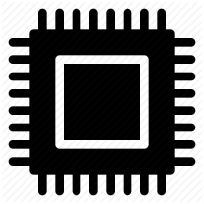



Pillars of our Strategy
TECHNOLOGY
ENTER NEW MARKETS
MANUFACTURING & SUPPLY CHAIN
Adding Dialog IP to expand
Silego portfolio
Leverage Dialog’s position in mobile, computing and IoT
Common manufacturing supply chain
SALES CHANNEL
EXPANDS FOOTPRINT
CUSTOMER RELATIONSHIPS
Combining sales and
distribution channels
Increases opportunities in
growing markets
Deepens existing key customer relationships and adds new customers
© 2017 Dialog Semiconductor
14

Slide 15



Pillars of our Strategy
+
NEW MARKET LEADERSHIP
ADDRESSABLE MARKET
PRODUCT SYNERGY
...establishes Dialog as #1 player in a new, high-growth Configurable Mixed-signal IC market.
…expands current addressable market by over $1.4Bn …solidifies Dialog’s position in IoT, mobile computing and automotive.
…complements Dialog’s power management, charging and connectivity products with programmable solutions.
CUSTOMER RELATIONSHIPS
ACCRETIVE TRANSACTION
…deepens core customer relationships with unique product offering while broadening customer base.
…accelerates revenue growth and accretive to gross margin and underlying EPS in FY18.
___________________________
Source: Addressable market estimates based on Gartner and Dialog (September 2017).
© 2017 Dialog Semiconductor
15

Slide 16
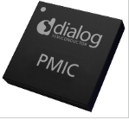
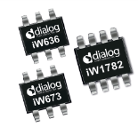
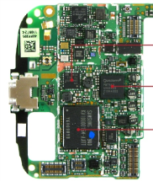
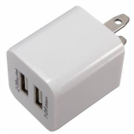
Strong Smartphone Value Proposition
The traditional smartphone
Many discrete analog components
The Dialog way AND
Integration: PMIC Faster Charging
≈30% Power
saving in Phone
60% Faster
Charge in adapter
#1 Market Share: smartphone PMIC, and smartphone adapter fast charging (>70%)
Highest level of integration; complete system approach with configurable power management
ASSP or ASIC Customization for our high volume customers
Digital approach to power conversion adapters, more efficient and faster charging

Slide 17
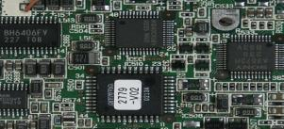
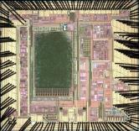







Technology Focus: Power Management
PMICs at the Core of Smartphones, Tablets and Wearables
2017
2007
PMIC
>55 mm2
Typical PMIC
2017
>35 Power sources
Application
processor
<10 mm2
Typical PMIC
2007
≈ 5 power sources
Configurable PMICs: changing how engineers design power management
Increasing levels of PMIC integration
High integration of advanced high efficiency power management functionality, with ARM® processor integration option
One time programmable by customer using Dialog software
Allows systems designers to simply make late changes in power tree
PMIC processor eco-system partners

Slide 18
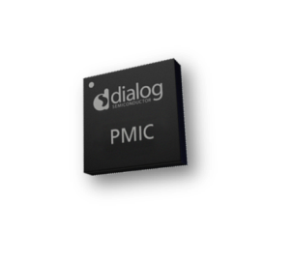

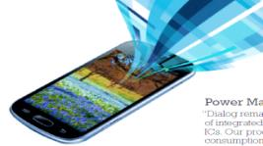
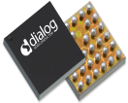

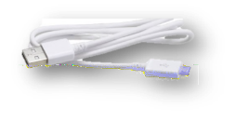





Technology Focus: Charging
Controlling both sides of the wire
AC-DC ICs for portable adapters
Smartphone Charger ICs
Communication
protocol
Slave
Master
Charger
Benefits of Dialog AC/DC RapidCharge™ technology
Reduced stand-by power, Smaller form factor with lower BOM cost
Improved longevity – no opto-coupler
Supporting multiple partner fast charging algorithms
Applications: Appliances, Networking, Set Top Box, Set Top Box & TVs

Slide 19

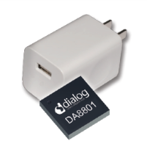
Technology Focus: Charging
Integrated GaN, targeting high power density adapters
Higher power density design = smaller power adapter
GaN
+
GaN
=
Fully Integrated Monolithic GaN
Half Bridge
Drivers
Level shifting
Logic
Protection
The world’s fastest power switch
SmartGaN integration means ease of use, lower cost, and higher performance

Slide 20

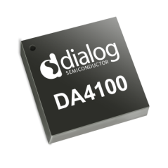
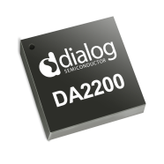
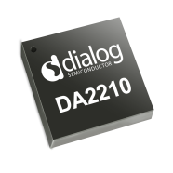
Technology Focus: Wireless Charging
Leading in RF Wireless Charging
Wire-Free Charging
New uncoupled (charging at a distance) wireless RF charging
Provides true wire-free mobile power charging experience
Exclusive partnership with Energous Corporation
Smallest footprint, miniature antennas on existing circuit board (no coils), cost effective
Targeting IoT, wearables, PC, smartphones, headphones, automotive

Slide 21


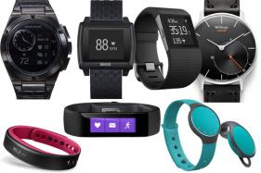
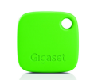


Technology Focus: Bluetooth® Low Energy
Wearable-on-Chip™ Targeting IoT Applications
Portfolio of Bluetooth SoCs
Industry’s lowest power, highest integration smallest size Bluetooth low energy SoC portfolio
Single chip solutions optimized for targeted verticals
Embedded Bluetooth SW stack, including embedded ARM® Cortex® M0 processor
Extensive set of reference design tools and local support community
Wide range of applications: wearables, consumer electronics, health and fitness trackers, asset tracking devices, proximity beacons, home automation, smart appliances

Slide 22

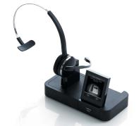



Technology Focus: Wireless Audio
Interference Free High Fidelity Wireless audio Solutions
Smartbeat™ Wireless Audio
Low energy single chip solutions at 1.9 and 2.4 GHz for wireless audio applications
Leveraging our leadership in professional wireless headsets to bring integrated solutions to consumer headsets
Lowest latency, long range wireless audio solutions, based on DECT technology
Integrated ARM® and Tensilica® DSP processors, coupled with broad DSP algorithm ecosystem partnerships, accelerating development time for consumer headset manufacturers

Slide 23
Agenda
Dialog Semiconductor Overview
Our Strategy and Markets
Summary

Slide 24
Why Dialog?
1
Leading power management ICs enabling lowest power system design
2
Leading Bluetooth connectivity solutions for emerging IoT applications
3
Innovating New Technologies, RF wireless Charging and GaN power ICs
Operational excellence in high volume, fast product ramp for smartphones
4
5
Ecosystem PMIC partnerships with leading application processor vendors
6
Strong pipeline of new products and technologies for 2017 and beyond

Slide 25


Why Dialog?
Leading power management ICs enabling lowest power system design
Leading Bluetooth connectivity solutions for emerging IoT applications
Innovating New Technologies, RF wireless Charging and GaN power ICs
Operational excellence in high volume, fast product ramp for smartphones
Ecosystem PMIC partnerships with leading application processor vendors
© 2017 Dialog Semiconductor

Slide 26

Powering the Smart Connected Future
www.dialog-semiconductor.com
…personal
…portable
…connected

