Slide 1
Brief
Design Packaging for a range of Supplements. There are 24 lines being produced, but we only need two concepts:
Pot Design
Box Design
See PrimalCure.com – Steve Bennett is about to launch his new health book and off the back of this will be launching a range of supplements.

Slide 2
Design to Include
LOGO & STRAPLINE
PRODUCT TITLE
BENEFIT OF PRODUCT
LOVE THE DIFFERENCE IN 30 DAYS, OR GET 100% OF YOUR MONEY BACK
Made in Great Britain
EXTRACTING NATURES GREATNESS:
NO ADDED COLOURING, NO ADDED SUGAR, NO GLUTEN
PACKAGING BPA FREE
VISIT: WWW.PRIMALSUPPLEMENTS.COM
NO ADDED COLOURING, NO ADDED SUGAR, NO GLUTEN

Slide 3


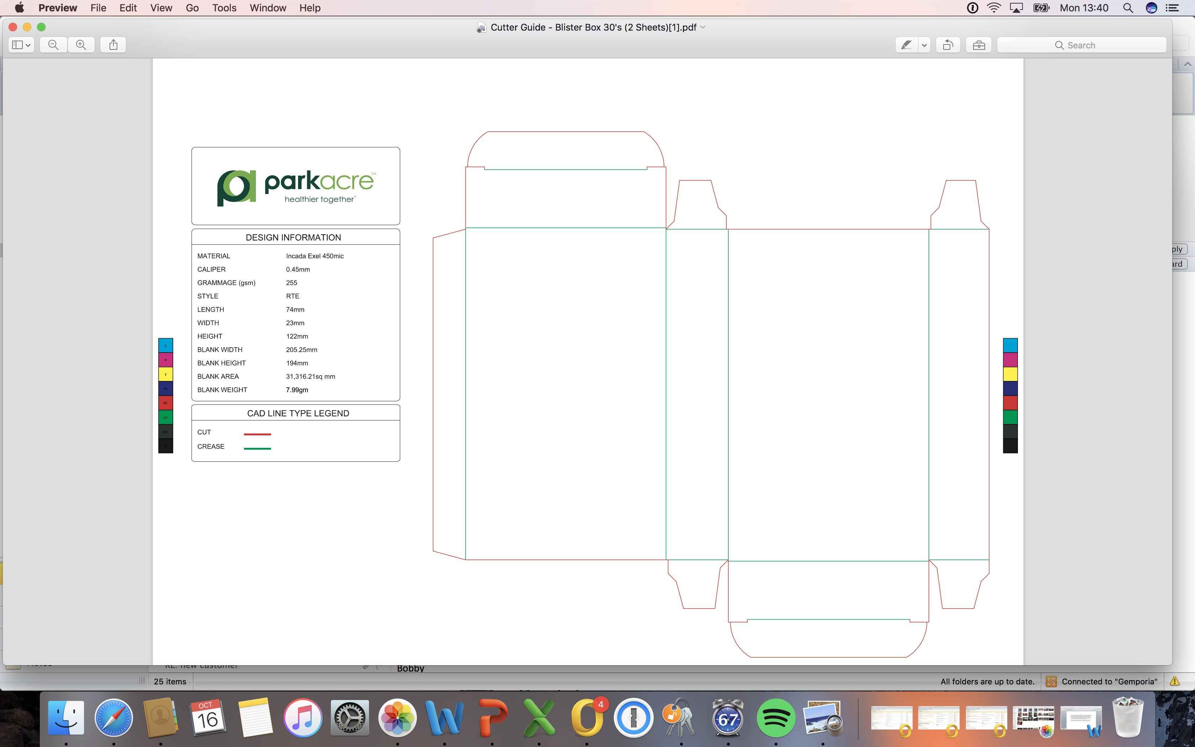
DESIGN 1: Size for Label
Product Format
Pack Type
Label Size
11mm Round
75ml
53mm x 135mm
DESIGN 2: Size for Box

Slide 4
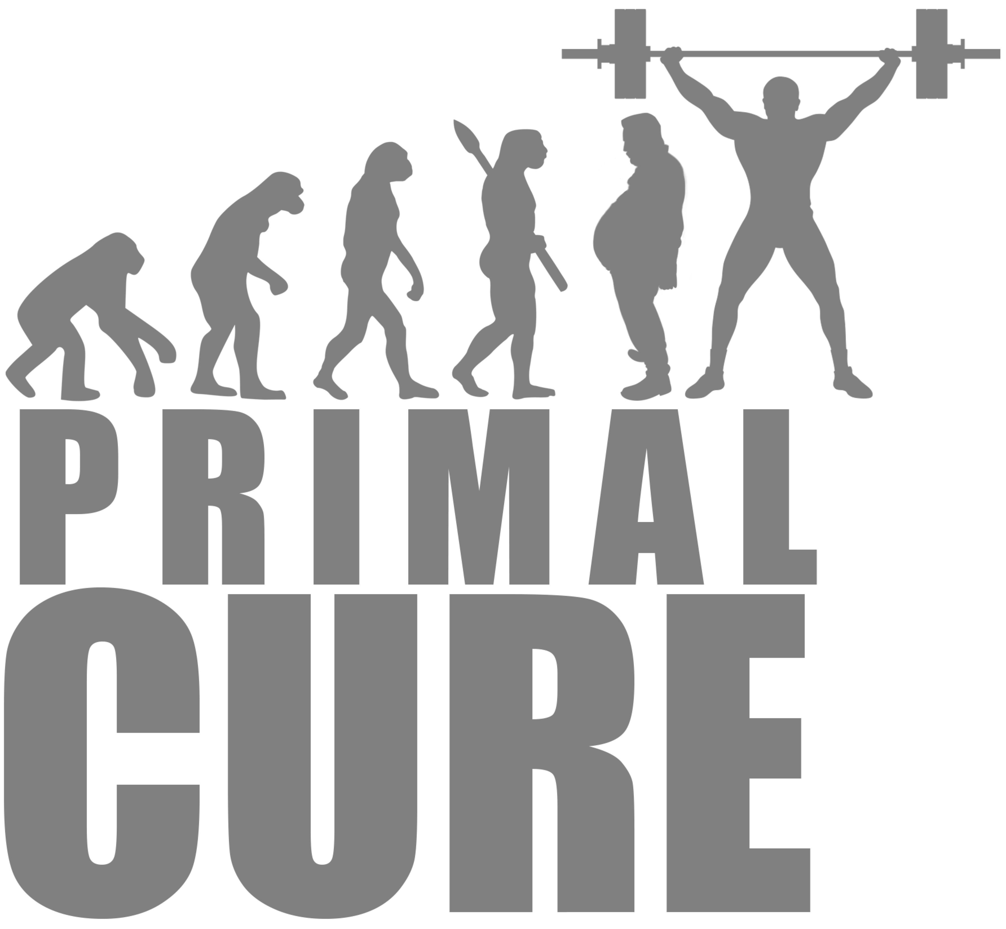

Brand Name
Strapline
LOVING LIFE NATURALY
Positioning
WHY?
In a world where so much has changed from the one our bodies were designed to thrive, at Primal Supplements we are driven by one global purpose; ‘to support health in the 21st century’. While the roots of our wellbeing supplements date back centuries, we embrace modern technology, research and science, to encapsulate powerful phytonutrients, herbs and other natural goodness, the essence of which is to promote health, happiness and longevity.
For every supplement we sell: £1 goes to the charity ‘Children In Need’ and in addition we provide one healthy meal to an under privileged child in India.

Slide 5
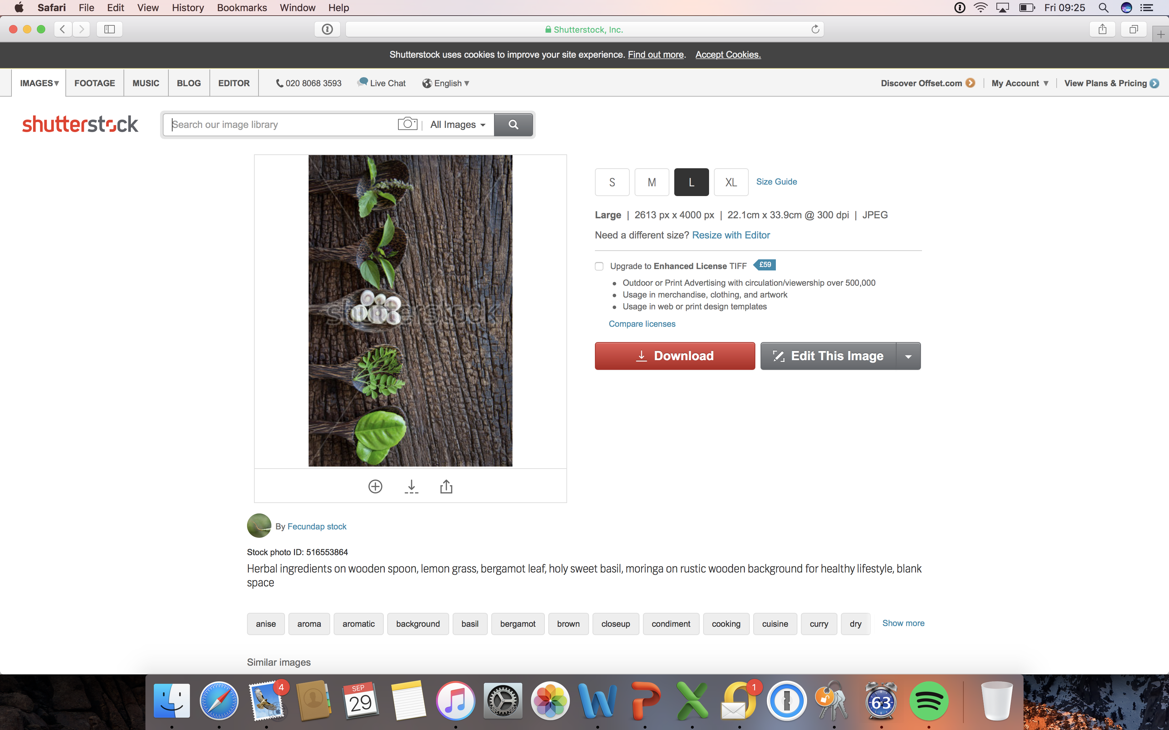

PRIMAL
EST^{D} 10,000 BC
I know this is rubbish, but it was just me messing about with a design for back of box!
Nutritional Information per 1 Capsule
Vitamin C 80mg (100% NRV), Black Soy Bean 1000mg (Glycinemax (L.)merr) (seeds) (from 50mg of 20:1 extract), Chitosan 50mg, Apple Cider Vinegar 17.5mg (Standardised to contain 35% Acetic Acid), White Kidney Bean Extract 1000mg (Phaseolus vulgaris L) (bean) (from 50mg of 20:1 extract), Chromium 40mcg (100% NRV). Vitamin C 80mg (100% NRV), Black Soy Bean 1000mg (Glycinemax (L.)merr) (seeds) (from 50mg of 20:1 extract), Chitosan 50mg, Apple Cider Vinegar 17.5mg (Standardised to contain 35% Acetic Acid), White Kidney Bean Extract 1000mg (Phaseolus vulgaris L) (bean) (from 50mg of 20:1 extract), Chromium 40mcg (100% NRV).
Room for 80 word disclaimer, Room for 80 word disclaimerRoom for 80 word disclaimerRoom for 80 word disclaimerRoom for 80 word disclaimerRoom for 80 word disclaimerRoom for 80 word disclaimerRoom for 80 word disclaimerRoom for 80 word disclaimerRoom for 80 word disclaimerRoom for 80 word disclaimerRoom for 80 word disclaimerRoom for 80 word disclaimerRoom for 80 word disclaimer
Primal supplements are created in Britain by leading nutritionists. Steve Bennett author of Primal Cure, ensures that each and every supplement is crafted in the most natural and Primal way possible.
In a world where so much has changed from the one our bodies were designed to thrive, at Primal Supplements we are driven by one global purpose; ‘to support health and longevity in an ever changing world’. While the roots of our wellbeing supplements date back centuries, we embrace modern technology, research and science, to encapsulate powerful phytonutrients, herbs and other natural goodness, the essence of which is to promote health, happiness and longevity.
For every supplement we sell: £1 goes to the charity ‘Children In Need’ and in addition we provide one healthy meal to an under privileged child in India.
LOVE THE DIFFERENCE IN
30 DAYS, OR GET 100%
OF YOUR MONY BACK

Slide 6
On the next pages are 5 example products

Slide 7

Primal Energy
EXAMPLE PRODUCT
Product Format
Pack Type
Serving Size
Weight
19.5mm x 8.2mm
30
1125mg
Why Choose This Product?
Product Claims
Vitamins from the B-Complex support 100% to 400% NRV
Includes Maca Extract, CoQ10, Alpha Lipoic Acid and Cinnamon Bark Extract
Loaded with ingredients contributing to normal energy yielding metabolism
Vitamin D3 provided at an exceptional 1000iu
Iron, Folic Acid, Vitamin C, B2, B6, B12, Niacin and Magnesium for the reduction of tiredness and fatigue
Vitamin C, B6, B12, Niacin, Thiamine and Biotin contributes to normal psychological functions
Magnesium, Iron, Iodine and Zinc contributes to normal cognitive and neurological function
Chromium contributes to the maintenance of normal blood glucose levels
Zinc contributes to the maintenance of normal serum testosterone concentrations

Slide 8
PRIMAL Energy
Suggested Labeling:
Nutritional Information per 1 Tablet
Magnesium 100mg (26.66% NRV), Vitamin B6 50mg (3571.45% NRV), Thiamine (Vitamin B1) 50mg (4548.69% NRV), Pantothenic Acid 50mg (833.56% NRV), Niacin 50mg (312.5% NRV), Riboflavin (Vitamin B2) 50mg (3571.43% NRV), Iron 10mg (71.55% NRV), Zinc 5mg (50% NRV), Alpha Lipoic Acid 10mg, Cinnamon Bark 300mg (Cinnamomum cassia Presl) (Bark) (from 10mg of 30:1 extract), Co Enzyme Q10 10mg, Vitamin D3 1000IU (500% NRV), Chromium 200μg (500% NRV), Folic Acid 200μg (100% NRV), Vitamin B12 50μg (2000% NRV), Biotin 50μg (100% NRV)
Ingredients:
Magnesium Citrate, Bulking agent (Microcrystalline Cellulose), Magnesium Oxide, Vitamin B6 ((Pyridoxine Hydrochloride), Thiamine Mononitrate (Vitamin B1), Pantothenic Acid (d-Calcium Pantothenate), Niacin, Riboflavin (Vitamin B2), Ferrous Fumarate, Glazing Agents (Hypromellose, Glycerin, Hydroxypropylcellulose, Talc, Miglyol (Medium chain triglycerides)) Colourant (Titanium Dioxide E171), Zinc Citrate, Anti-Caking Agent (Magnesium Stearate), Alpha Lipoic Acid, Cinnamon Bark, Co Enzyme Q10, Vitamin D3 (Cholecalciferol), Anti-Caking Agent (Silica), Chromium Picolinate, Colourant (Tartrazine E102*), Folic Acid, Vitamin B12 (as Methylcobalamin), Biotin (as d-Biotin), Colourant (Allura Red E129*)
Important Information
Food supplements should not be used as a substitute for a balanced diet and healthy lifestyle. If you are pregnant, breastfeeding, taking prescription medication or under medical supervision it is advisable to consult a GP prior to taking any supplements. Discontinue use and consult a GP if adverse reactions occur. Do not exceed stated dose. Store in a cool, dry place. Keep away from children at all times. Do not use if seal under cap is broken.

Slide 9
Primal Sleep
EXAMPLE PRODUCT
Product Format
Pack Type BOX
Serving Size
Weight
19.5mm x 8.2mm
30
1125mg
Why Choose This Product?
Product Claims
Created for this exciting new market segment
Includes Green Tea, Griffonia Seed and Chamomile Extract, L-Theanine and Montmorency Cherry Powder
5-HTP is the lead precursor to serotonin production
Vitamin B6, B12, Niacin, Thiamine and Biotin contributes to normal psychological functions
Pantothenic Acid contributes to normal mental performance
Selenium and Iodine contributes to normal thyroid function
Iron, Folic Acid, Vitamin B2, B6, B12, Niacin, and Magnesium for the reduction of tiredness and fatigue
Magnesium, Iron, Iodine and Zinc contributes to normal cognitive and neurological function

Slide 10
PRIMAL Sleep
Suggested Labeling: Nutritional Information per 1 Tablet
Magnesium 100mg (26.68% NRV), Vitamin C 80mg (100% NRV), Green Tea Extract 500mg (Camellia Sinensis) (Leaves) (from 50mg of 10:1 extract), Montmorency Cherry Powder (Prunus cerasus) (fruit) 50mg, Iron 10mg (71.43% NRV), Griffonia Seed 400mg (Griffonia Simplicifolia) (Seed) Providing L-5-Hydroxytryptophan (from 25mg of 16:1 extract), L- Theanine 25mg, Vitamin B6 10mg (714.29% NRV), Thiamine 10mg (909.1% NRV), Pantothenic Acid 10mg (166.67% NRV), Niacin 10mg (62.5% NRV), Riboflavin 10mg (714.29% NRV), Selenium 200μg (363.64% NRV), Folic Acid 200μg (100% NRV), Iodine 150μg (100% NRV), Biotin 50μg (100% NRV), Vitamin B12 10μg (400% NRV)
Ingredients:
Magnesium Citrate, Bulking Agent (Microcrystalline Cellulose), Magnesium Oxide, Vitamin C (as Ascorbic Acid), Green Tea Extract, Montmorency Cherry Powder, Glazing Agents (Hypromellose, Talc, Hydroxypropycellulose, Miglyol (Medium chain triglycerides), Titanium Dioxide E171), Ferrous Fumarate, Griffonia Seed, L-Theanine, Vitamin B6 (Pyridoxine Hydrochloride), Thiamine Mononitrate (Vitamin B1), Anti- Caking Agent (Magnesium Stearate), Pantothenic Acid (d- Calcium Pantothenate), Niacin, Riboflavin (Vitamin B2), Colourant (Anthocyanin or Grapeskin Extract E163), Anti- Caking Agent (Silica), Sodium Selenite, Folic Acid, Potassium Iodide, Biotin (as d-Biotin), Vitamin B12 (as Methylcobalamin)
Important Information
Food supplements should not be used as a substitute for a balanced diet and healthy lifestyle. If you are pregnant, breastfeeding, taking prescription medication or under medical supervision it is advisable to consult a GP prior to taking any supplements. Discontinue use and consult a GP if adverse reactions occur. Do not exceed stated dose. Store in a cool, dry place. Keep away from children at all times. Do not use if seal under cap is broken.
Storage
Store in a cool dry place.

Slide 11
Vitamin D3
EXAMPLE PRODUCT
Product Format
Pack Type
Label Size
Serving Size
Weight
8mm Round
75ml
53mm x 135mm
30
225mg
Why Choose This Product?
Product Claims
Each tablet contains Vitamin D3 at an exceptional 5000iu
Lack of Vitamin D can lead to bone deformities such as rickets in children and bone pain caused by a condition called osteomalacia in adults
The body creates Vitamin D from direct sunlight on the skin when outdoors but between October and early March we do not get enough Vitamin D from sunlight
Vitamin D contributes to:
Normal absorption and utilisation of calcium and phosphorus and the maintenance of normal blood calcium concentrations
Normal cell division
Maintenance of normal bone and teeth
Normal function of the immune system and healthy inflammatory response
Maintenance of normal muscle function

Slide 12
Magnesium
Product Format
Pack Type
Label Size
Serving Size
Weight
8mm Round
75ml
53mm x 135mm
60
275mg
Why Choose This Product?
Product Claims
Magnesium is a mineral that is important for the body to turn food into energy and for bone and teeth health
About 60% of the magnesium in your body is found in bone, while the rest is in muscles, soft tissue and fluids, including blood
Magnesium plays a role in exercise performance
Every cell in the human body contains magnesium and needs this to function
Magnesium contributes to:
Reduction of tiredness and fatigue
Normal psychological functions
Electrolyte balance
Maintenance of normal bone and teeth
Normal energy-yielding metabolism
Normal muscle function including the heart muscle
Normal nerve function
Protein synthesis
Normal cell division

Slide 13


Green Tea Extract
Product Format
Pack Type
Label Size
Serving Size
Weight
21.4mm
75ml
53mm x 135mm
30
551mg
Why Choose This Product?
Green Tea Extract tablets that are standardised to contain 95% Polyphenols
High purity 95% Polyphenols and 45% EGCG (Epigallocatechin Gallate), which provides Green Tea with its properties
Suitable for vegetarians and vegans
Specially coated, making them easier to swallow
Natural occurring plant extract sourced from China
Suitable for anyone looking to take green tea in a high quality concentrated form to ensure high levels of active ingredients
One a day formula

