Slide 2
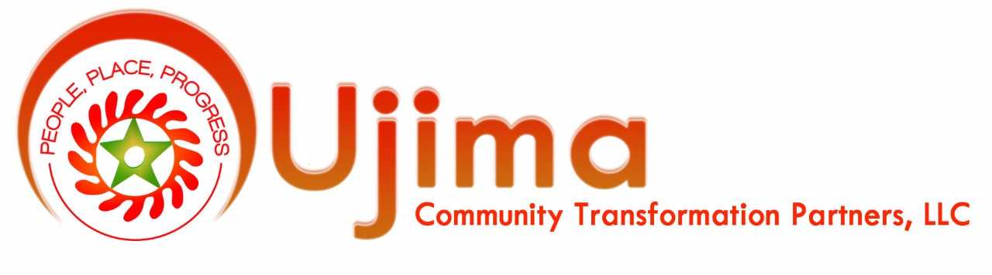
Leon D. Caldwell, Ph.D.
Managing Principal
Investing in Community Centered Social Impact Real Estate Development

Slide 3
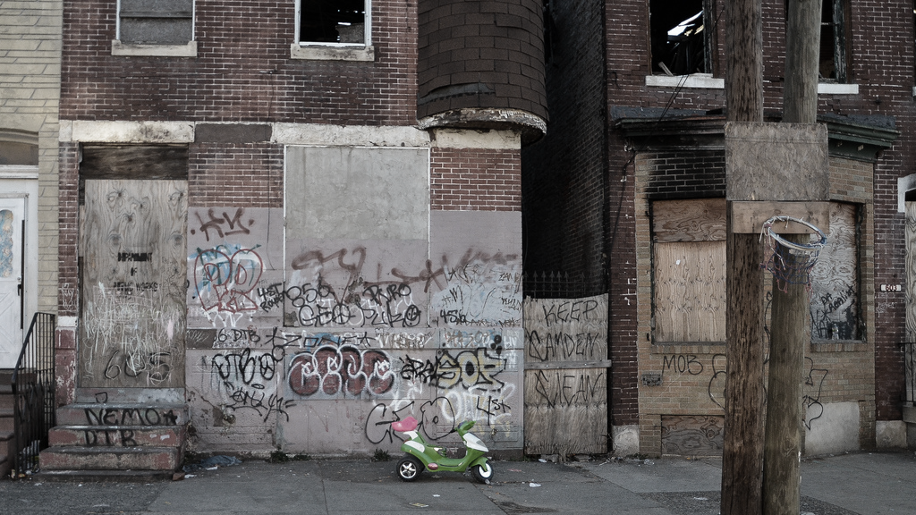
Mission
“To create profitable opportunities for investors of all levels to invest in real estate products that protect residents while transforming underinvested neighborhoods into vibrant communities that support an extraordinary quality of life with opportunities for economic mobility and wellness.”

Slide 4
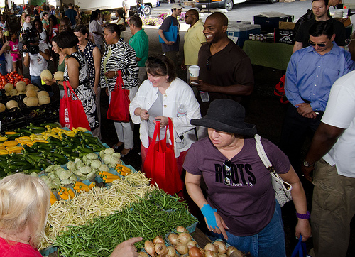

Vision
“We envision culturally and economically diverse communities where residents are living optimally. We envision neighborhoods that transform into a community where existing and new residents have opportunities for economic mobility and wellness.”

Slide 5
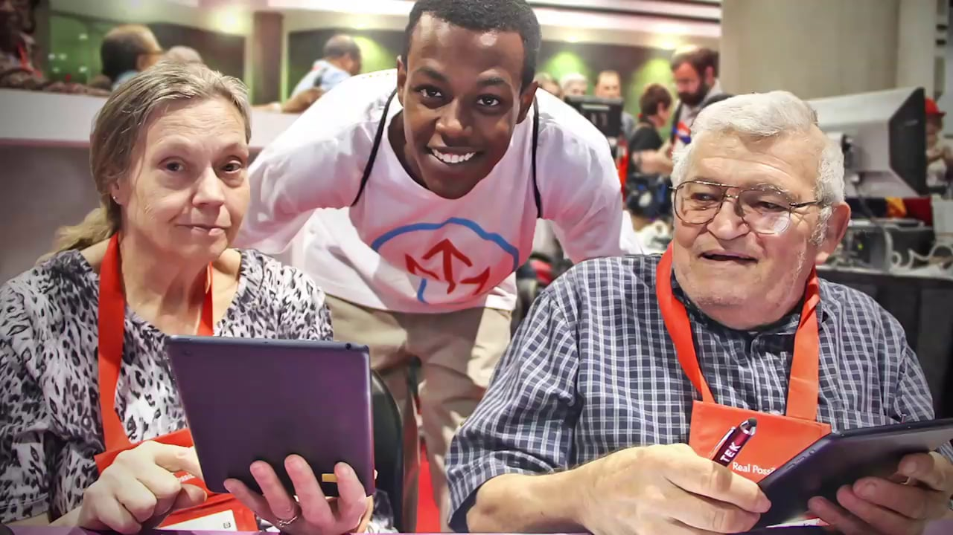
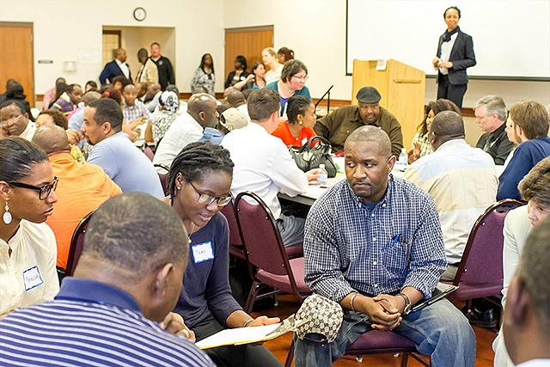
vision
“We envision intergenerational urban communities that provide for basic needs, spark innovation and create a since of purpose.”

Slide 6
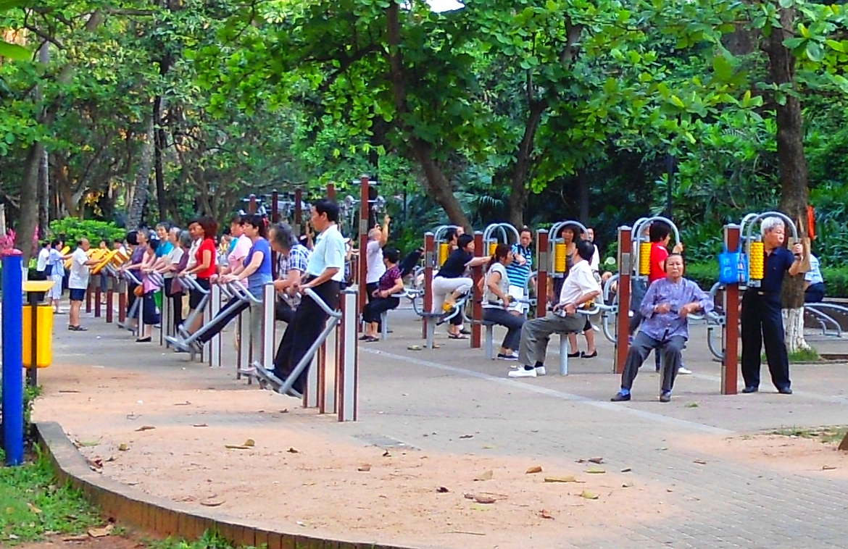
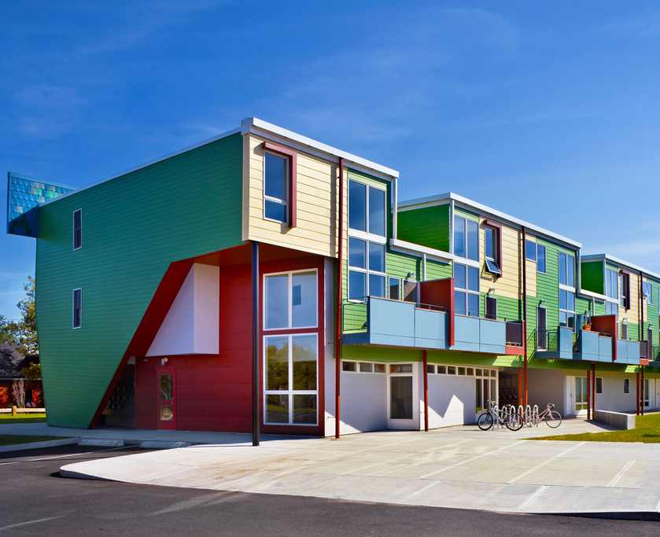
vision
“Housing is health thus we envision lived environments that integrate active living, enjoyable play and uplifting work.”

Slide 7
Community Centered Social Impact
Community centered social impact utilizes a process of Braided Alignment to guide existing residents in defining social impact in their terms and then co-designs development projects with City officials, real estate developers, financial institutions and interested stakeholders.

