Slide 1
Luxe Design Source

Slide 2
Whats in a name?
LuxeDesign.Source
Definition of luxe - (esp of products, articles for sale, etc) rich, elegant, or sumptuous; superior in quality, number of accessories, etc
1. Noun
richness, elegance, luxury, or the like
2. Adjective
luxurious, opulent, etc. and very expensive
deluxe

Slide 3
Our Business Model
Establish a “Destination” Design Center to serve the clients of Professional Residential Home Builders and Contractors, servicing New Home Communities, Custom Homes, Re-Models (strictly B2B, non retail)
Market, Sell and Install a full range of “Best in Category” Top Brand, Luxury Interior Finish Products
Provide a full range of Design and Selection Services
Provide customers a first class buying experience with “concierge style service”

Slide 4
Our Goals and Commitment
Provide our Professional Home Builder Clients with an asset resource.
A Destination – “One Stop Solution” Design Center Facility, purposefully designed and centrally located.
Provide essential Full Service Design and Selection Services with a knowledgeable, professional, well trained design, sales and facilities staff, to assist and guide customers through the options selection process.
Provide to our builder clients and their homebuyers a professional and comfortable environment in which to present and select their desired finish options.
Provide a full menu of interior finish choices, and “Lifestyle Centric Options”, the most exciting and up to date products, styles and finishes in the industry today.
Provide a well thought out innovative program of options, that will provide a range of “lifestyle solutions” and ensure customer satisfaction.
Provide a program and process that will enhance our builder client’s business model.
Provide an all around, “First Class” exceptional customer experience!
To be a valued partner you can trust and rely on to be the best!

Slide 5
Provide a Suite of Services
Beautiful New Conveniently Located “Destination” Design Center Facility
Full Spectrum “Builders Options” Selection Services
An Experienced Professional Design Staff fully trained with expert product knowledge that have all received “cultural training” and are ready to meet and assist your homebuyers in the options selection process.
Designer representatives will be assigned to exclusively serve your community and will be trained to be expert and knowledgeable with all aspects of your community and sales process.
A total organizational commitment to delivering a “First Class” Customer Experience from our first contact to last.
Customized Online Specialized Software Interface for your customers, allowing us to seamlessly present and maintain your companies marketing identities, community and project information, branding, logos, etc.
Ultimate convenience for your homebuyers, Project Specific Online Product Catalogs, floor plans, etc. for model and project specifications, finish options, “wish lists”, product knowledge and orientation.
Homebuyer friendly, selection software and design center process.
Professional project management team to communicate, interface and coordinate with your sales, office and field staff.

Slide 6
Featured Products
A Full Service Design Center and Selection Services (as noted above)
Cabinetry – “Precision Cabinets” full line of products, styles and finishes
Cabinetry “Lifestyle Collections”- Special Interest Modules, Chefs, Baking, Wine, Entertainment, Video Walls, Home Offices, etc.
Cabinetry – Furniture Style- Vanities, Hutches, Misc.
Closet and Storage Systems – Closets, Garages, Pantry’s, Special Apps. Concealed Storage Options
LED Lighting – Under cabinet, toe kicks, in cabinet, closets, accent specialty, etc.
Countertops – Natural Stone, Quartz, Synthetic
Flooring – Carpeting, Wood, Tile, Stone
Walls – Tile, Glass, Stone, Solid Surfaces
Window Coverings – Full Line of Blinds, Shades, Shutters, Drapery and Motorized Products
Trim Packages – Ceilings & Walls, Faux Beams and Wainscots treatments
Outdoor Living Options – Outdoor Cabinets for Kitchens, BBQ’s, etc.
Appliances – Sub Zero - Wolf
Plumbing Fixtures – Sinks, Faucets, etc.
Video Systems & Home Automation – Home Theater/ Video Wall Systems, Home Automation Products, Low voltage Lighting and Mechanized Window Coverings, etc.

Slide 7
Our Vendor Partners

Slide 8
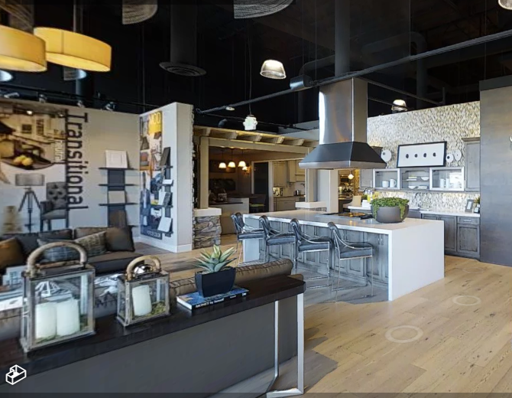
The Design Studio – Concept Ideas
Notes:
Open Concept where we have Points of interest and an inviting comfortable working space

Slide 9
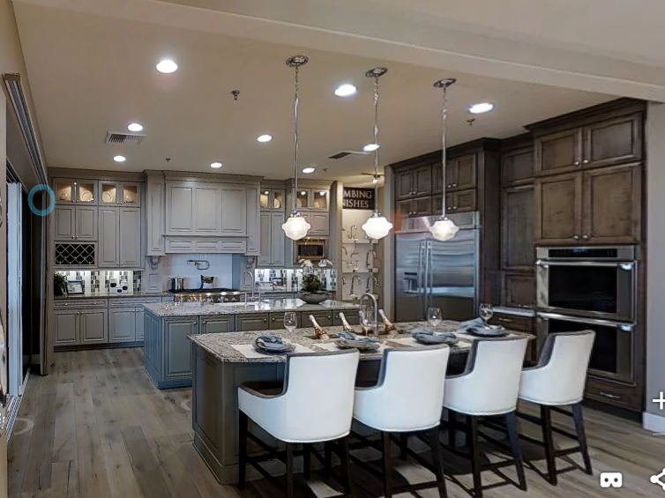
Kitchen Vignettes
Notes:
Various kitchen vignettes showing our Custom quality and various styles and finishes

Slide 10
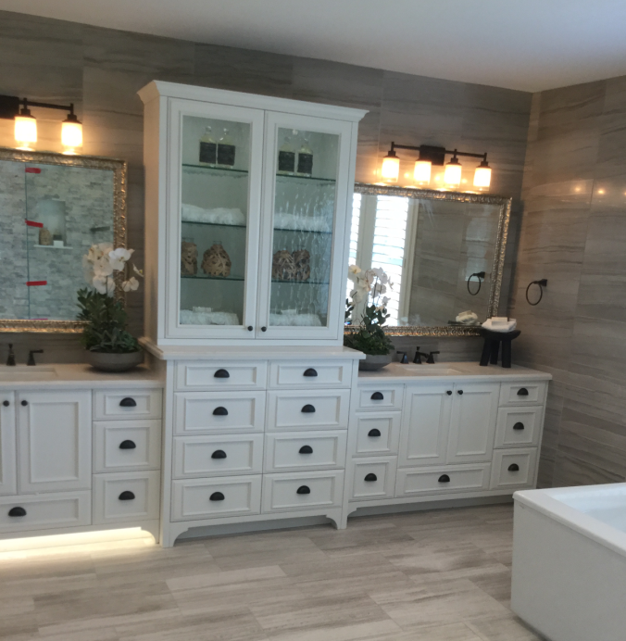

Bathroom Packages
Notes:
Our Bathroom lifestyle packages featuring the options and upgrades that we offer to our Builders and Clients

Slide 11
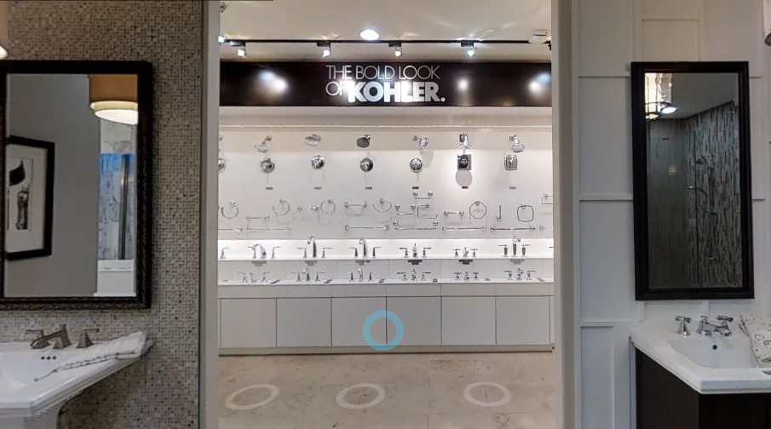
Plumbing Fixtures
Notes:
Plumbing options

Slide 12
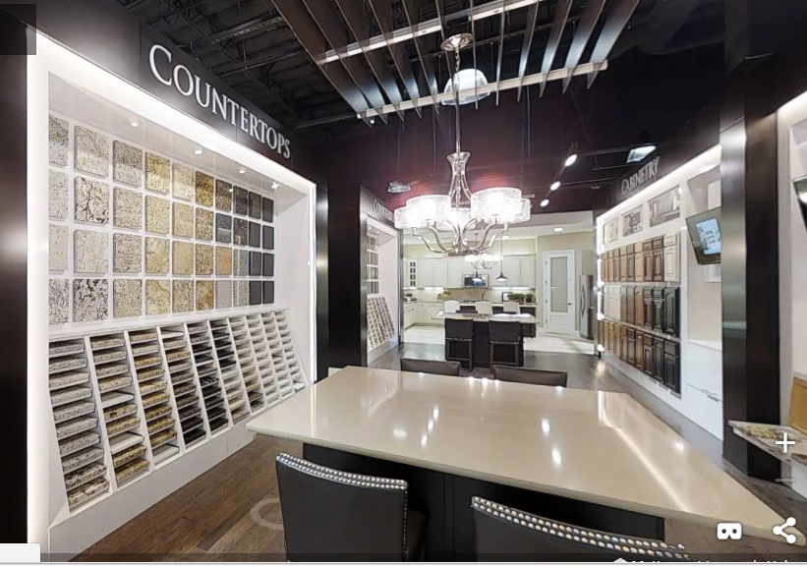

Countertops
Notes:
Solid Surface countertop options from Cambria, Azt, Dal,

Slide 13
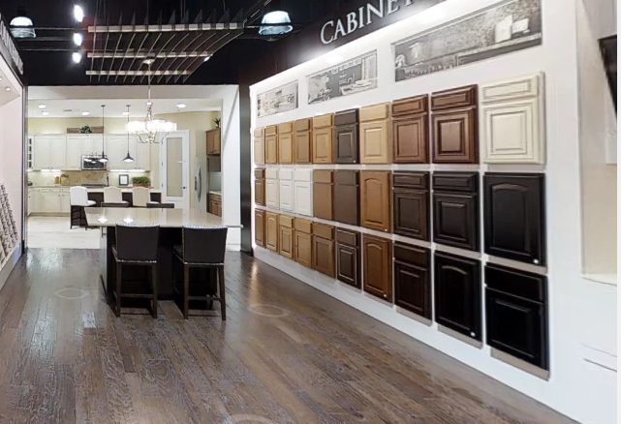
Cabinets
Notes:
Precision Cabinets featured throughout the design studio

Slide 14
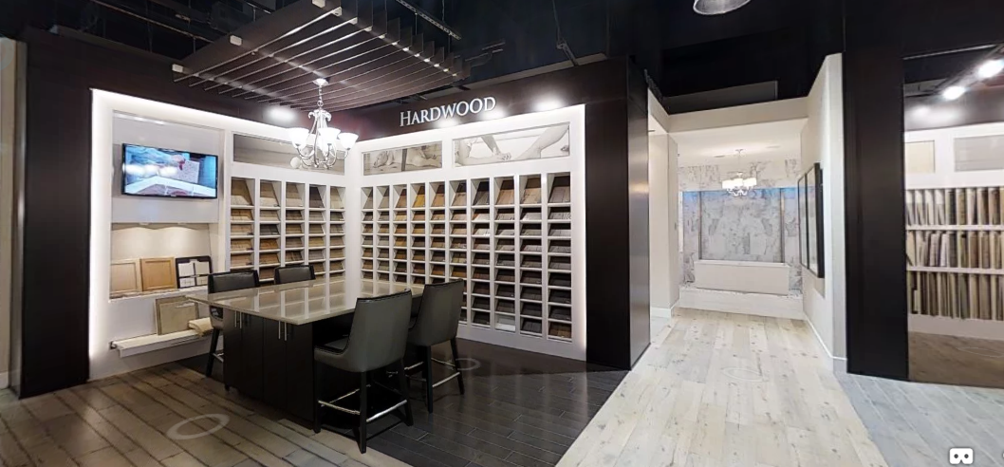



Hardwood
Notes:
Featured products from Carliisle, Du Chateau, Diamond W, Anderson, Stikwood, Mohawk

Slide 15
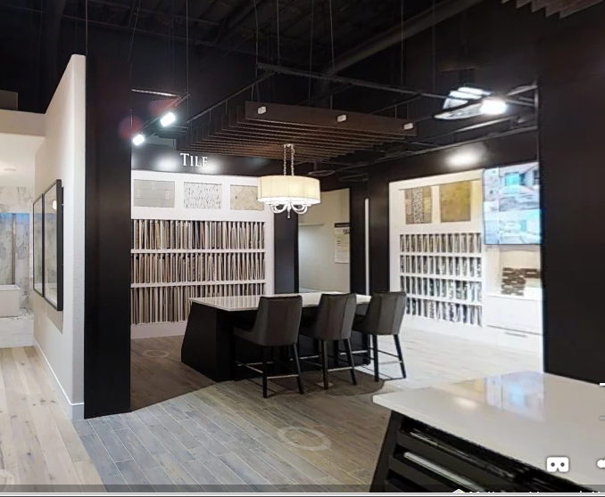



Tile and Custom Backsplashes
Notes:
Featuring Ann Sacks, Artistic Stone, Country Floors, Jeffrey Court, Walker Zanger, Arizona & Dal,

Slide 16
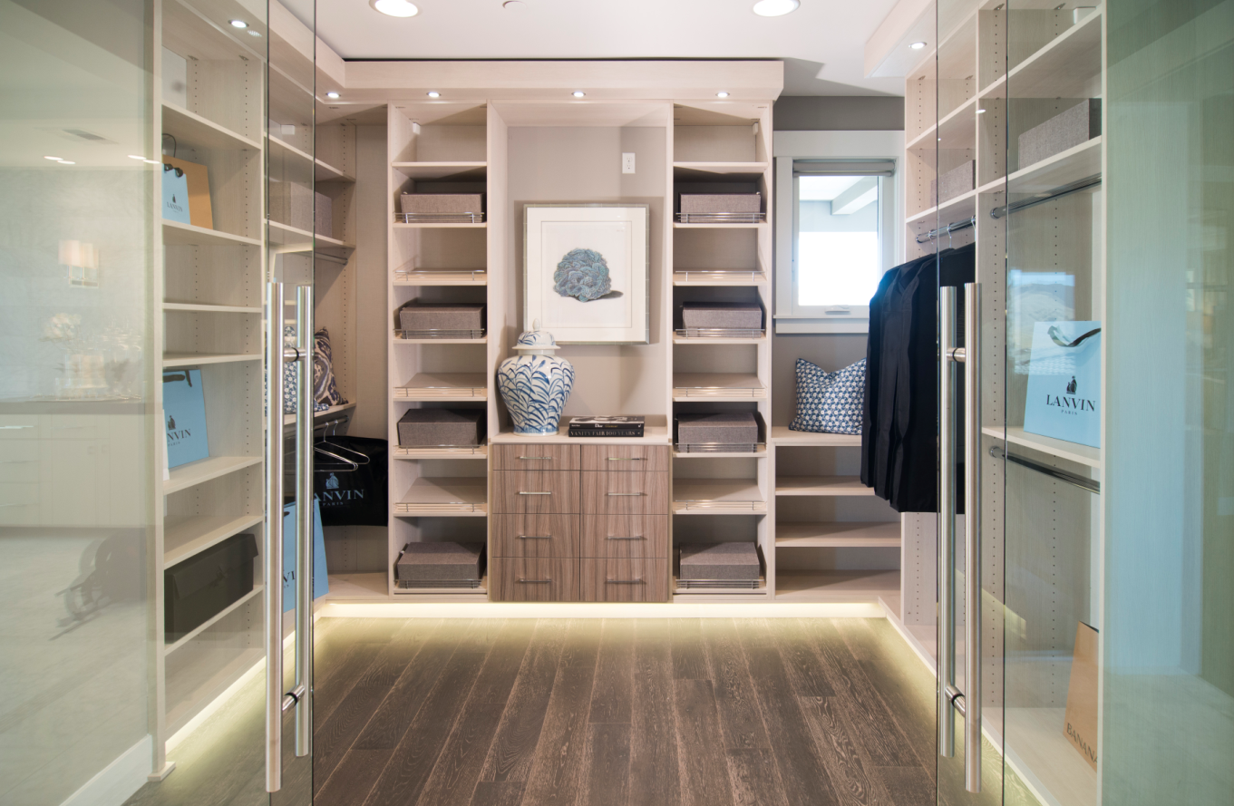
Closet and Storage
Notes:
Closet , Garage and pantry options

Slide 17
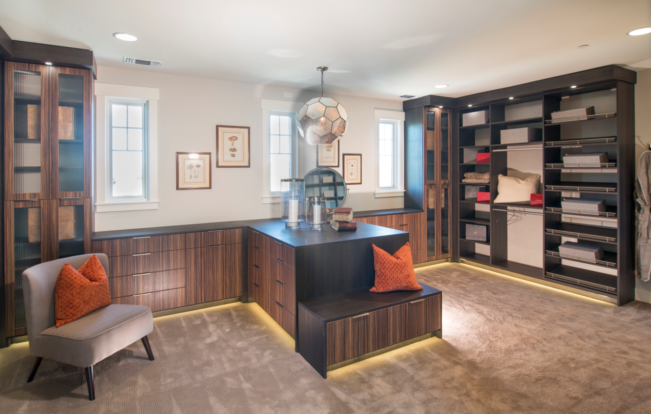
Custom Closets & Concealed Spaces
Notes:
Custom Closet showing concealed spaces

Slide 18
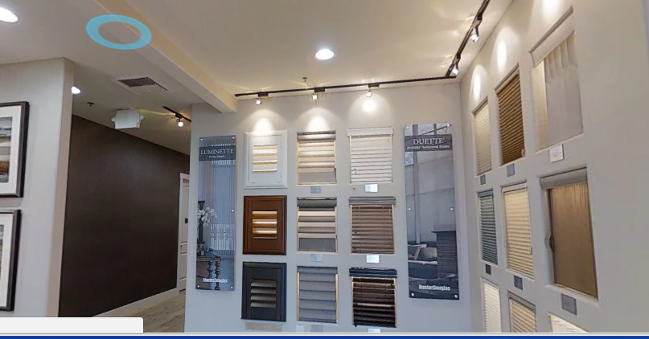


Window Coverings
Notes:
Featured Products Hunter Douglas, showing their Powerview and Q Motion automated window fashions

Slide 19
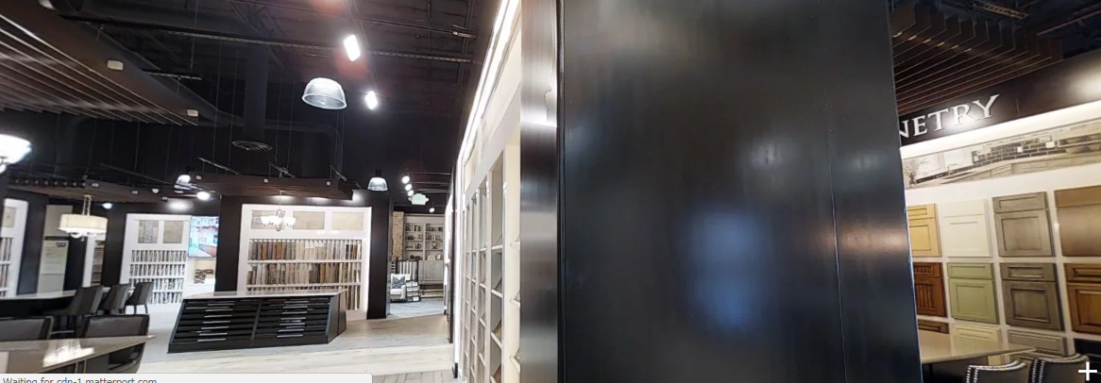
Full Service Design Studio
Notes:
One stop shopping experience to help customize their House to a home that is theirs.

Slide 20
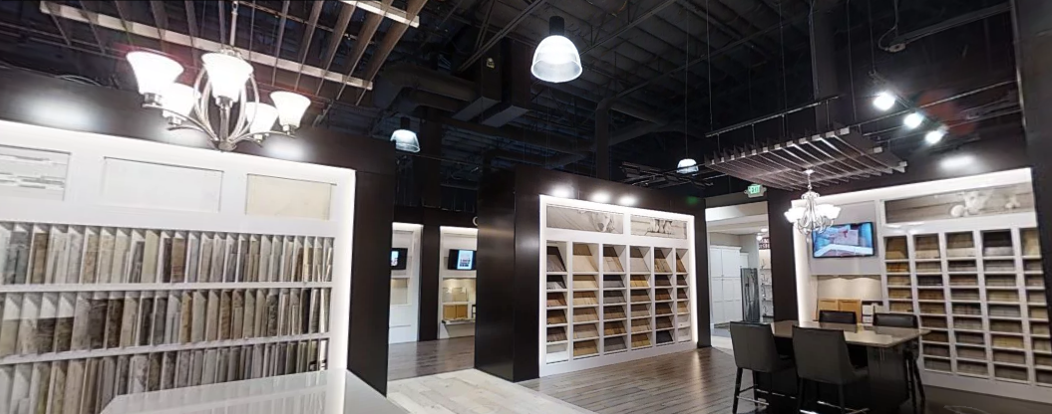




Floors, Counters
Notes:
Carpet by Masland, Fabrica, Stanton, Karastan, Ralph Lauren, Mohawk

Slide 21
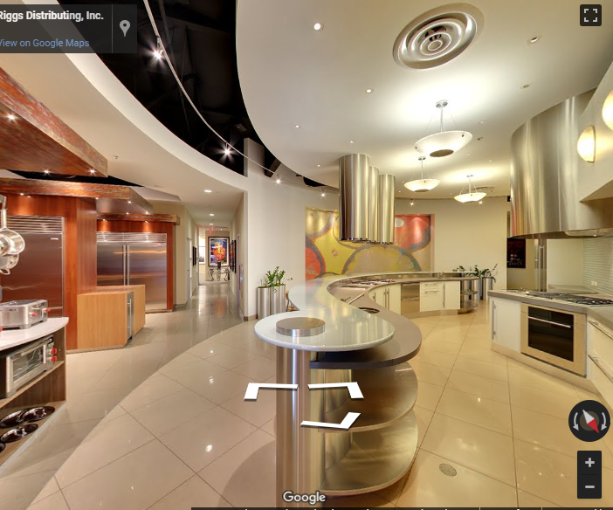

Living Kitchen
Notes:
Showcasing Sub Zero and Wolf appliances . Educating on the features and benefits of their products and benefits

Slide 22
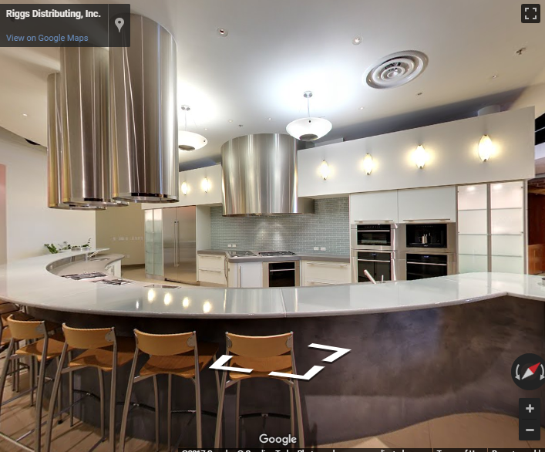
Events and Education
Notes:
Product Knowledge on all offerings in the Design Studio. Sponsored Events to help educate the “Target decision makers”.

Slide 23
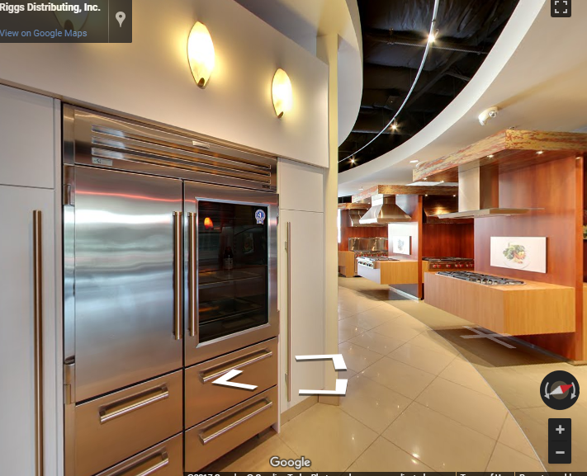
Sub Zero & Wolf
Notes:
Appliances featured throughout the Design Studio

Slide 24
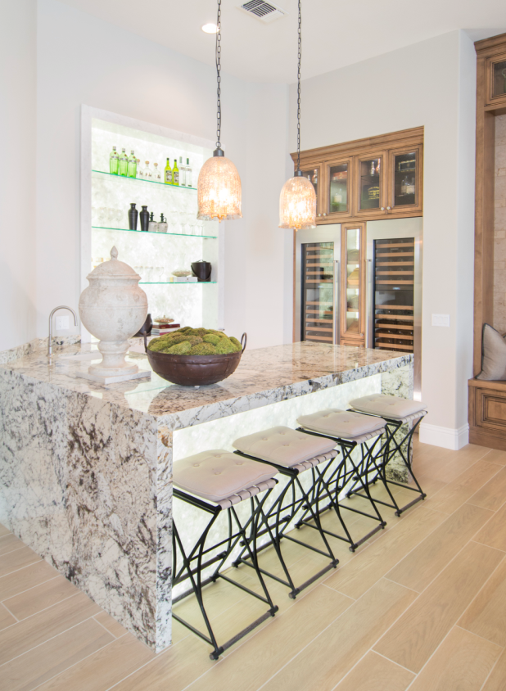
Custom Humidor/ Wine Storage
Notes:
Lifestyle product offerings including the Wine Maker, The Bakers Creation, Tap into how they live.

Slide 25
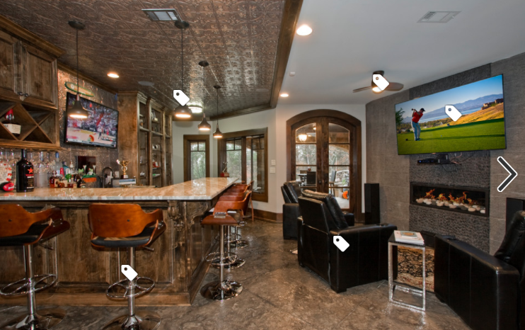
Sports Bar Themed Rooms
Notes:
Lifestyle Packages with Built ins & Audio Video walls,

Slide 26
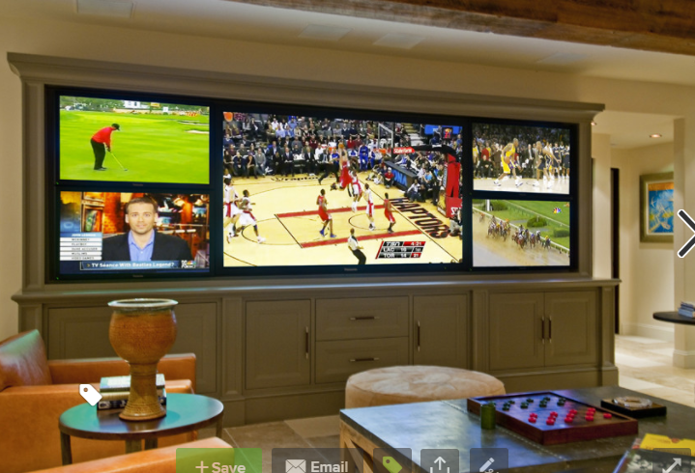
Built Ins / Video Walls
Notes:
Home Automation and Audio Video Concepts

Slide 27
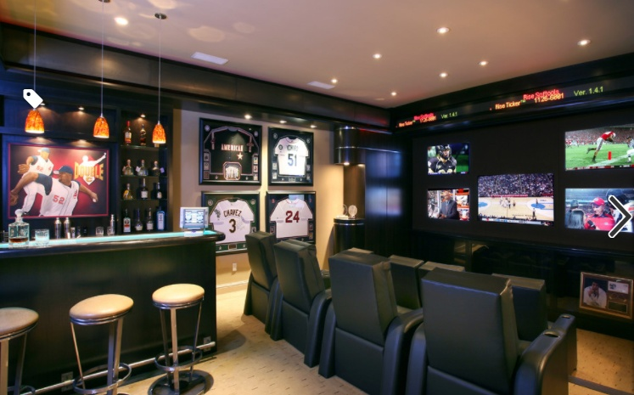
Audio Video / Smart Home
Notes:
Smart Home electronics for the sports enthusiast.

Slide 28
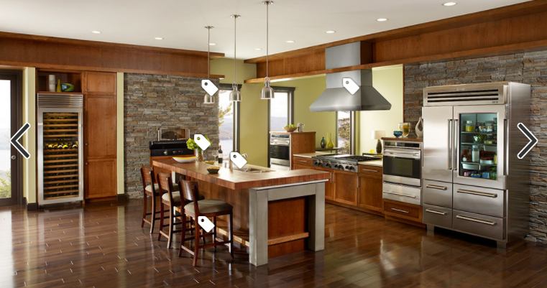
Appliances
Notes:
Sub Zero Wolf Appliances featured with Precision Cabinets

Slide 29
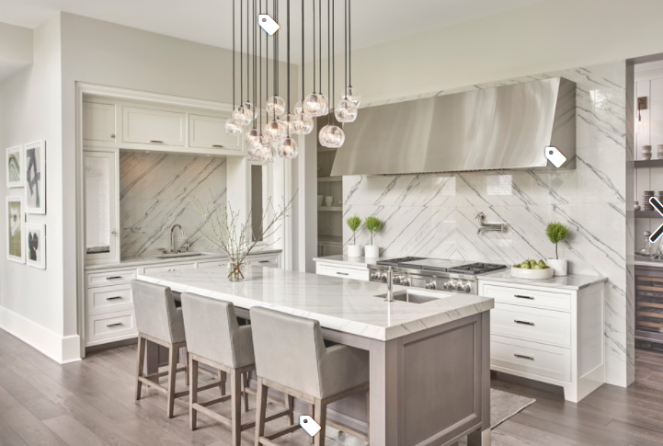
Custom Cabinet Design
Notes:
Keeping up on trends

Slide 30
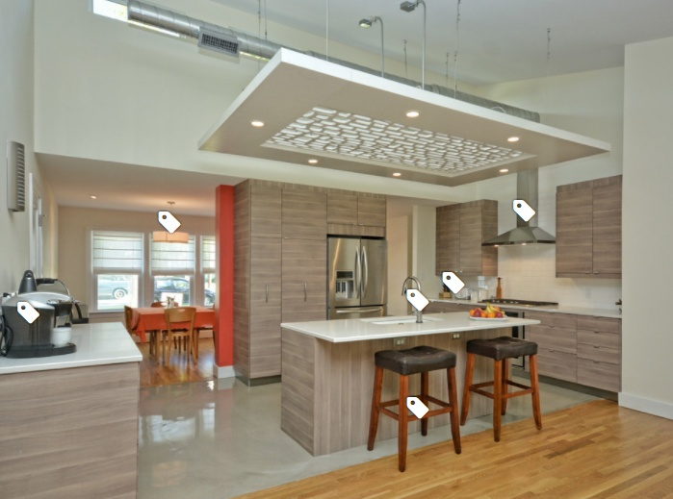
Integrated Cabinet Design
Notes:
We will be the Integrated Go to Kitchen Cabinet Source

Slide 31
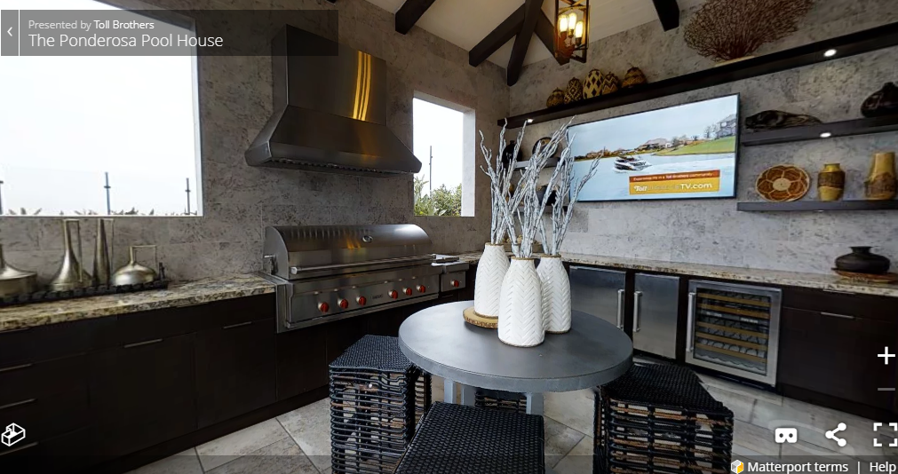
Outdoor Living
Notes:
Outdoor Living options to complete the Home

