Slide 1
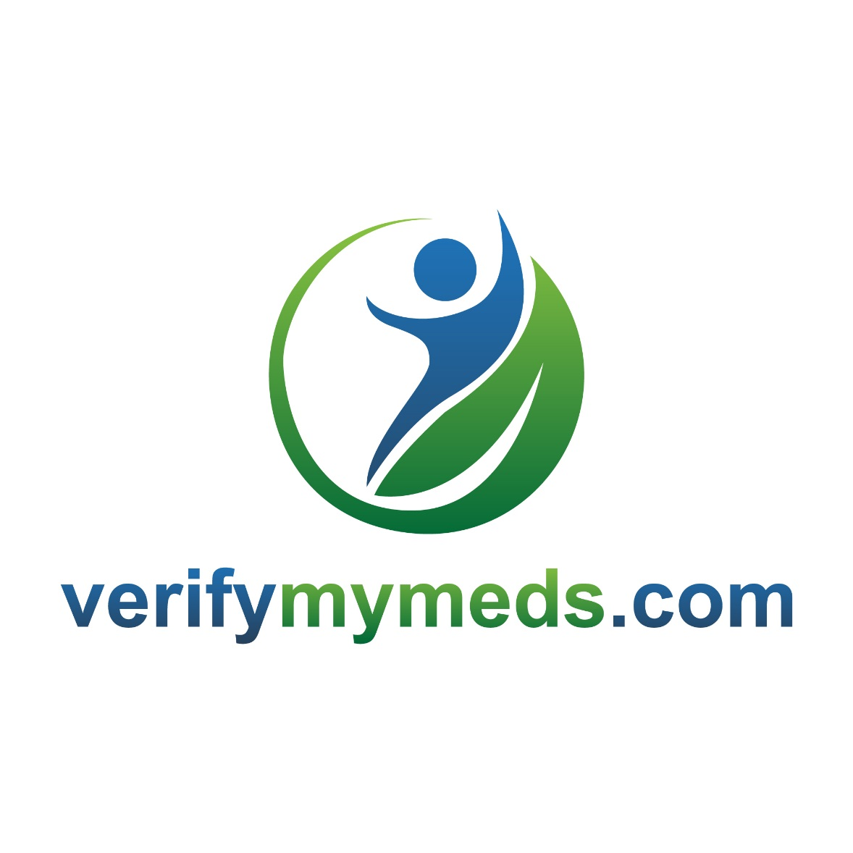
www.verifymymeds.com

Slide 2
The Problem
10% of the total world’s medicines are counterfeit
The counterfeit medicine trade is worth more than €110 billion annually
Over 1 million deaths per year are attributable to counterfeit medication
30% of medicines in developing countries are counterfeit
According to the OECD, 75% of global counterfeit medical products come from China and India and half these products transit through Dubai to mask their origins
In the past 5 years, proliferation of counterfeit medication has multiplied by 10 in the United States while increasing amounts of falsified medicines are seized in Europe
50% of medicine purchased through unregulated on-line sites are counterfeit; In 2015 an estimated 36 million Americans have bought drugs online without a valid prescription

Slide 3
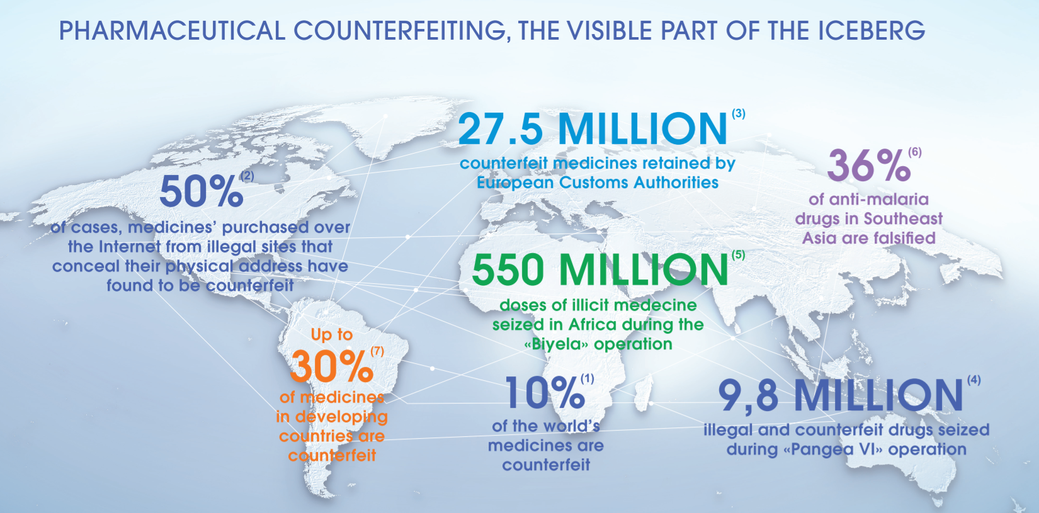

Slide 4
Anti counterfeit technologies used in branded pharmaceutical products
Pharmaceutical Company | Product | Active Ingredient | Authentication Mark
Pfizer Inc. | Viagra | Sildenafil citrate | RFID
Hoffmann-La Roche Ltd | Rocephin | Ceftrioxone sodium | Logo stamps inside vials
GlaxoSmithKline Pharmaceuticals Ltd | Trizivir | Abacavir/lamivudine/zidovudine | RFID
Purdue pharma L.P. | Oxycontin | Oxycodone HCl | RFID

Slide 5
2D Barcode v. RFID
Features | 2D BARCODE | RFID
Direct line of sight requirement | Yes | No
Difficult to duplicate or alter | No | Yes
Readability robustness (interference with liquids/metals) | No | Yes
Cost of tags | Low | High
Tag data storage | Low | High
Bulk tag reading | No | Yes
Initial technology set up cost | Low | High
Eco-system and/or standards maturity | High | Medium
Tag feature’s extendibility (ex. Tag with sensors) | Low | High

Slide 6
Patented anti counterfeit technologies
Company Name | Technology | Description | (Country) Patent Number
Microsoft Corporation | Labels using randomly-occurring features | Pattern unique to each label | (US) 7,878,398
Axsun Technologies | Taggants read using Raman spectroscopy | Can be made unreadable by chemical modification | (US) 7,875,457
CSEM SA (Centre Suisse d’Electronique et de Microtechnique) (Swiss firm) | Zero-order diffractive pigments (ZOPs) | Produce very pronounced colours that can’t be copied | (US) 7,864,424
AlpVision (Swiss firm) | Cryptoglyph invisible marking technology | Invisible signature on package | (India) 243454 (Indonesia) P0025514B
PANalytical BV (Dutch firm) | Use of angle-dispersive X-ray diffraction | Compared to reference signatures in data library | (US) 7,756,248

Slide 7
verifymymeds solution
Totally Integrated Seamless Product Authentication Solution
During manufacturing process, verifymymeds QR requested
Transaction recorded in Blockchain DB, assigning QR code to exact product
QR code printed across all layers of product packaging
Consumer receives item
Scans QR code with verifymymeds app
App unencrypts QR code and validates against database
If valid – Product Inventory data is displayed on the App; User confirms item status
Transaction recorded in Blockchain DB

Slide 8


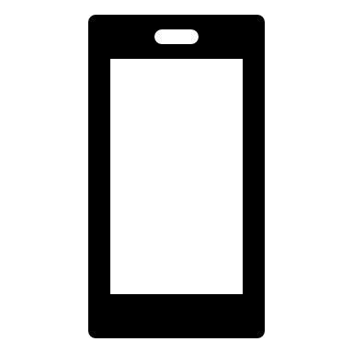



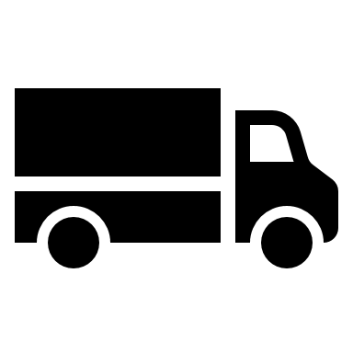





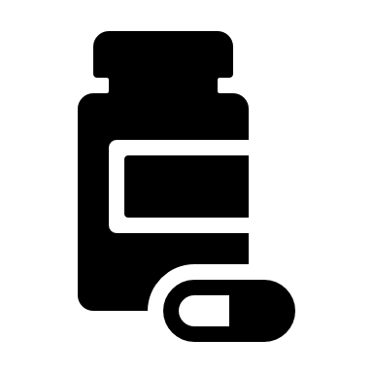
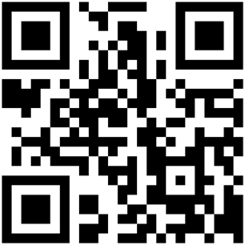
verifymymeds solution
Encrypted Blockchain Database
Holds all Inventory and QR events
Customer Scans QR Code
Valid – Product Information Displayed
Invalid – Warning and Information Collected
Encrypted PGP Process
Automated Manufacturing Process
Requests/Assigns QR Code to Item
QR Code Printed on Product

Slide 9
Why verifymymeds?
Seamless, fully automated solution integrated into the manufacturing process
Cost per item is virtually zero
Can be printed on anything and multiple times per inventory item
It’s free and very simple for customers to use
Offline or Online mode
Particularly important in developing countries
Counterfeit inventory detected – location, date, time
Inventory backtracking and analytics
Valid QR codes are impossible to reproduce
Billions of billions of QR codes available
State of the art encryption
Un-hackable Blockchain database

Slide 10
Wider solution scope
Counterfeit spare parts
Aircraft parts
Medical devices
Heavy industrial machinery / vehicles
Military equipment
Critical infrastructure
High value consumer products
Art
Consumer / Designer / Luxury products
Verified production / trackable items
Foodstuffs (baby food, non allergic products, meat products)
Animal food
Health supplement

Slide 11
verifymymeds.com
it’s simple; it’s secure; it’s free

Slide 12
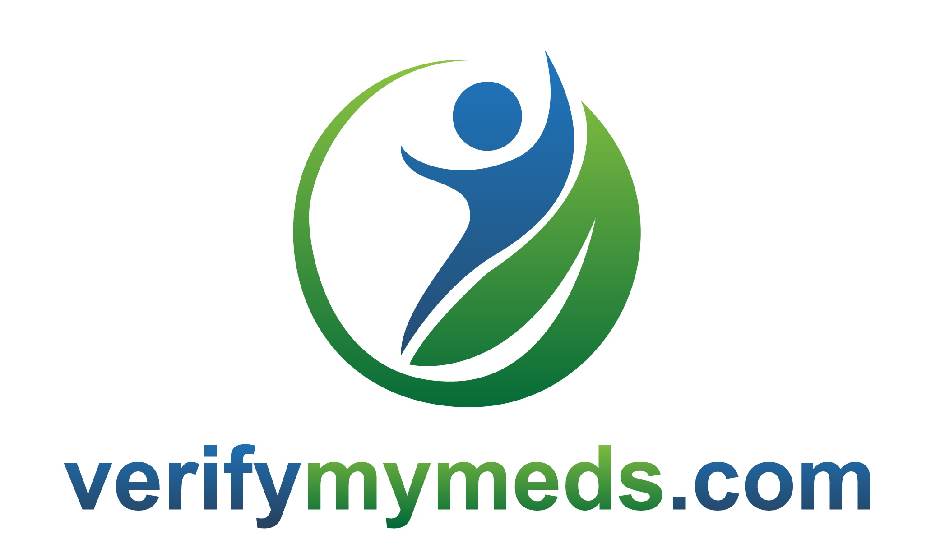
Charlie Sherlock
CEO
cs@verifymymeds.com
+353 87 857 6636

