Slide 1

Space 1: Activity void
Belay systems allowing free fall with deceleration
See picture 4
DRAFT PLAN OF ACTUAL SPACE
Space 2: Mega jump
Floors nets
See picture 3
Cone net
Jumping platform
28.6 meters
Double spiral
Nets. See picture 2
35 meters
Vertical net
walls
Floors
Double safety
Net for landing
Big tube net
See picture 1
Double safety
Net for landing

Slide 2
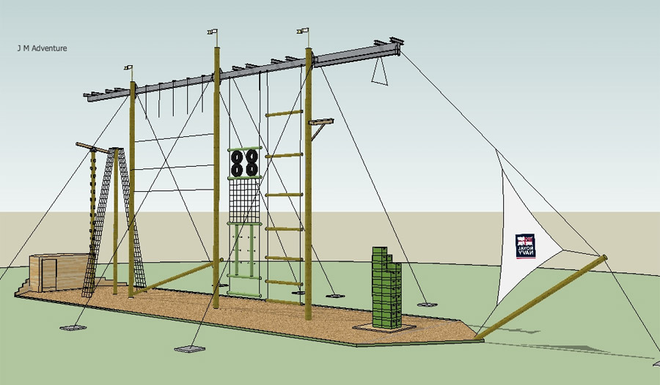
PREFERRED ILLUSTRATED STYLE

Slide 3
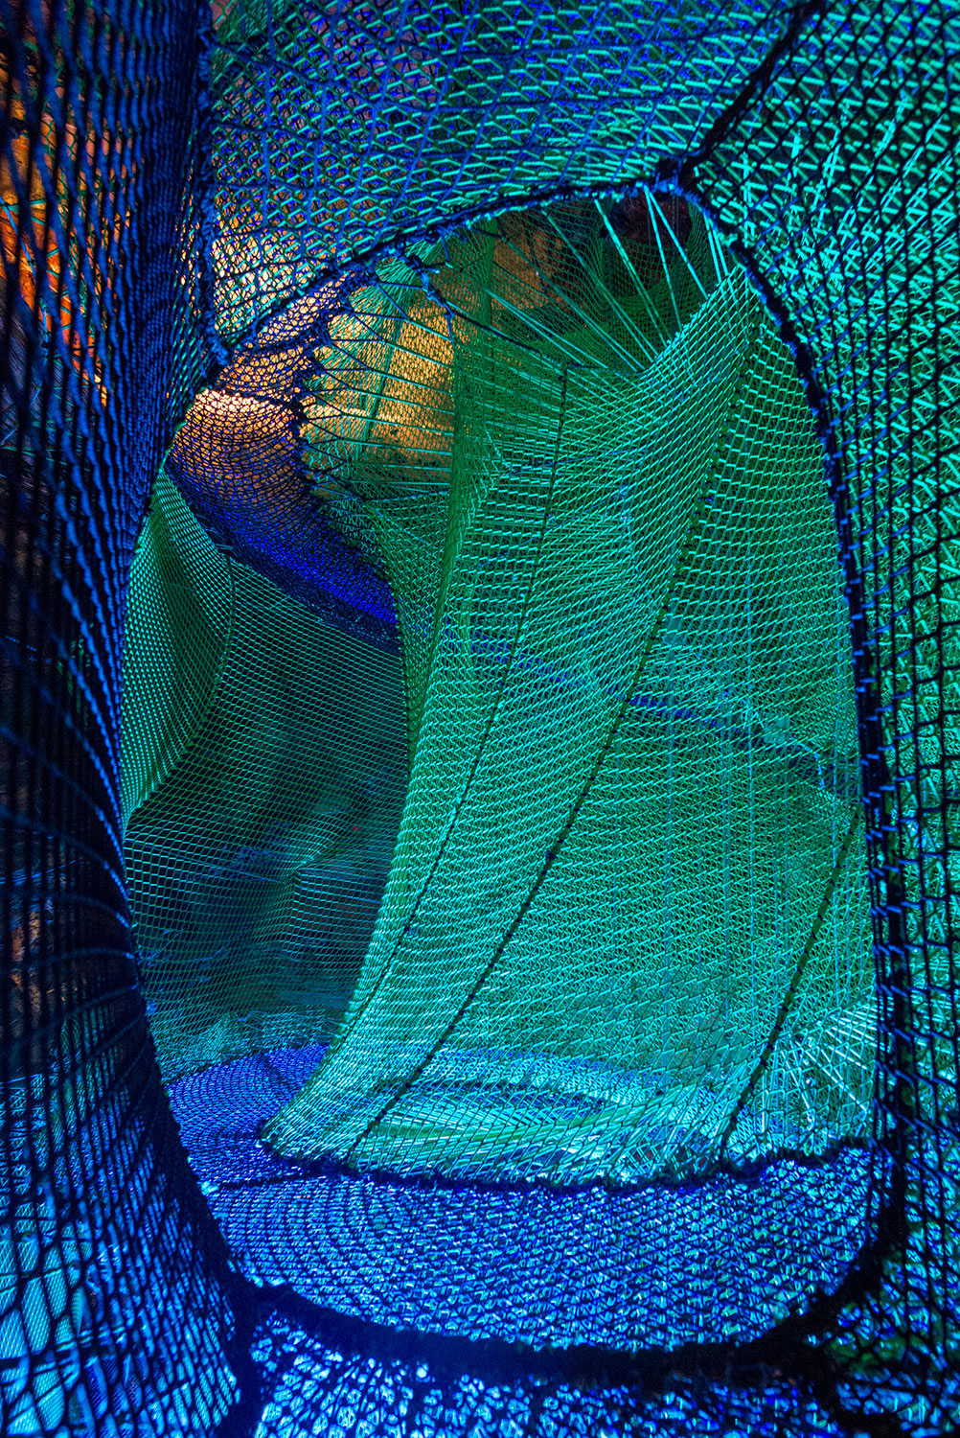
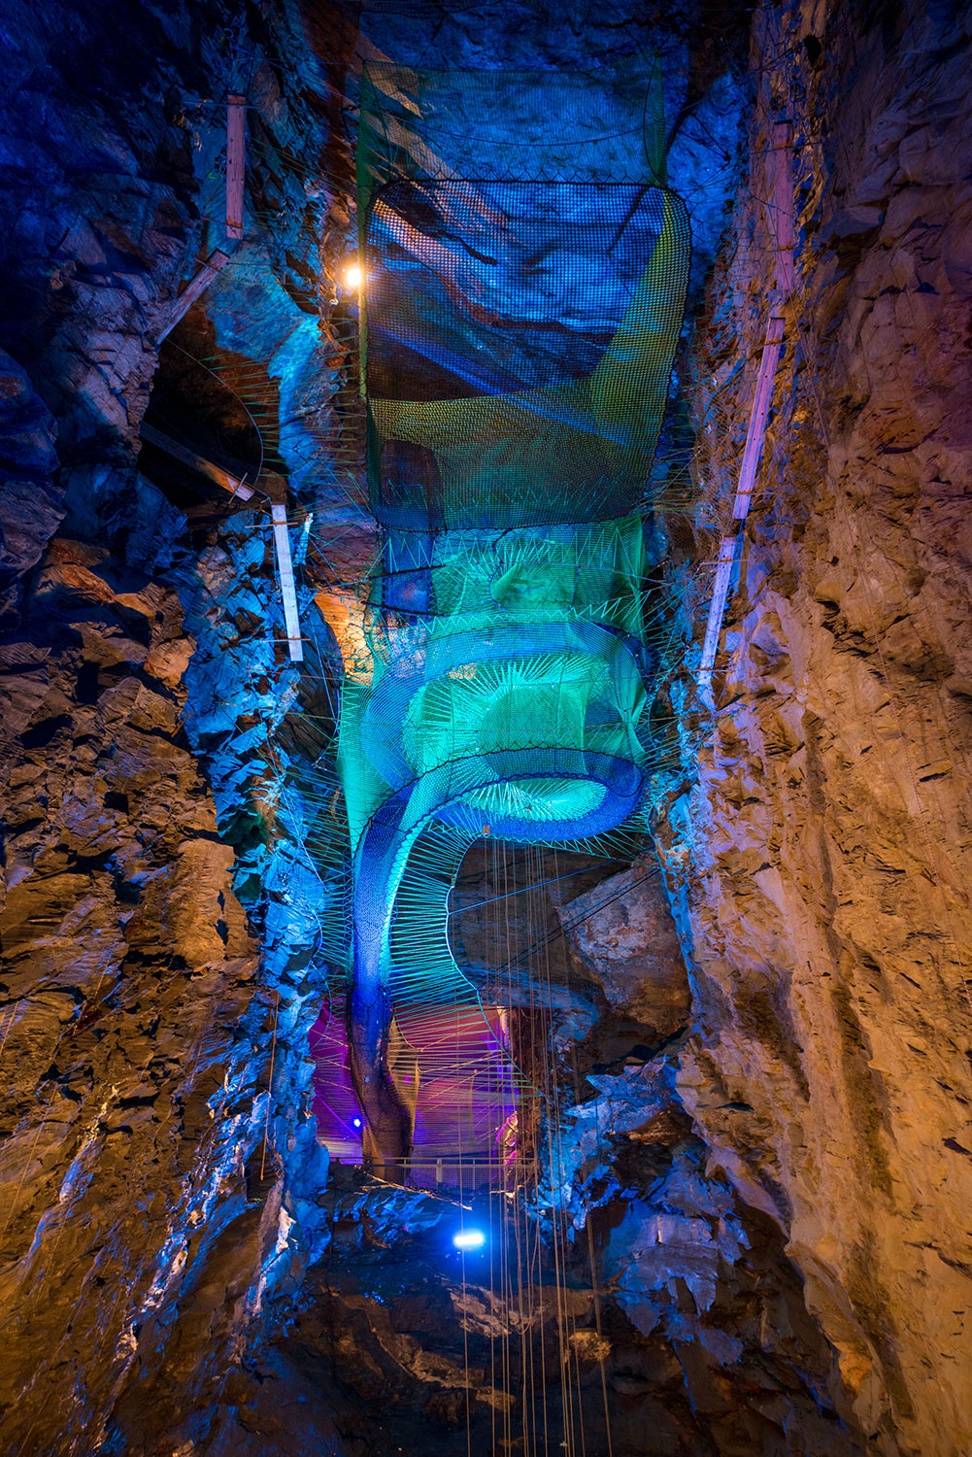
Picture 1: Actual sample of tube shaped net
Picture 2: Actual sample of spiral shaped net

Slide 4
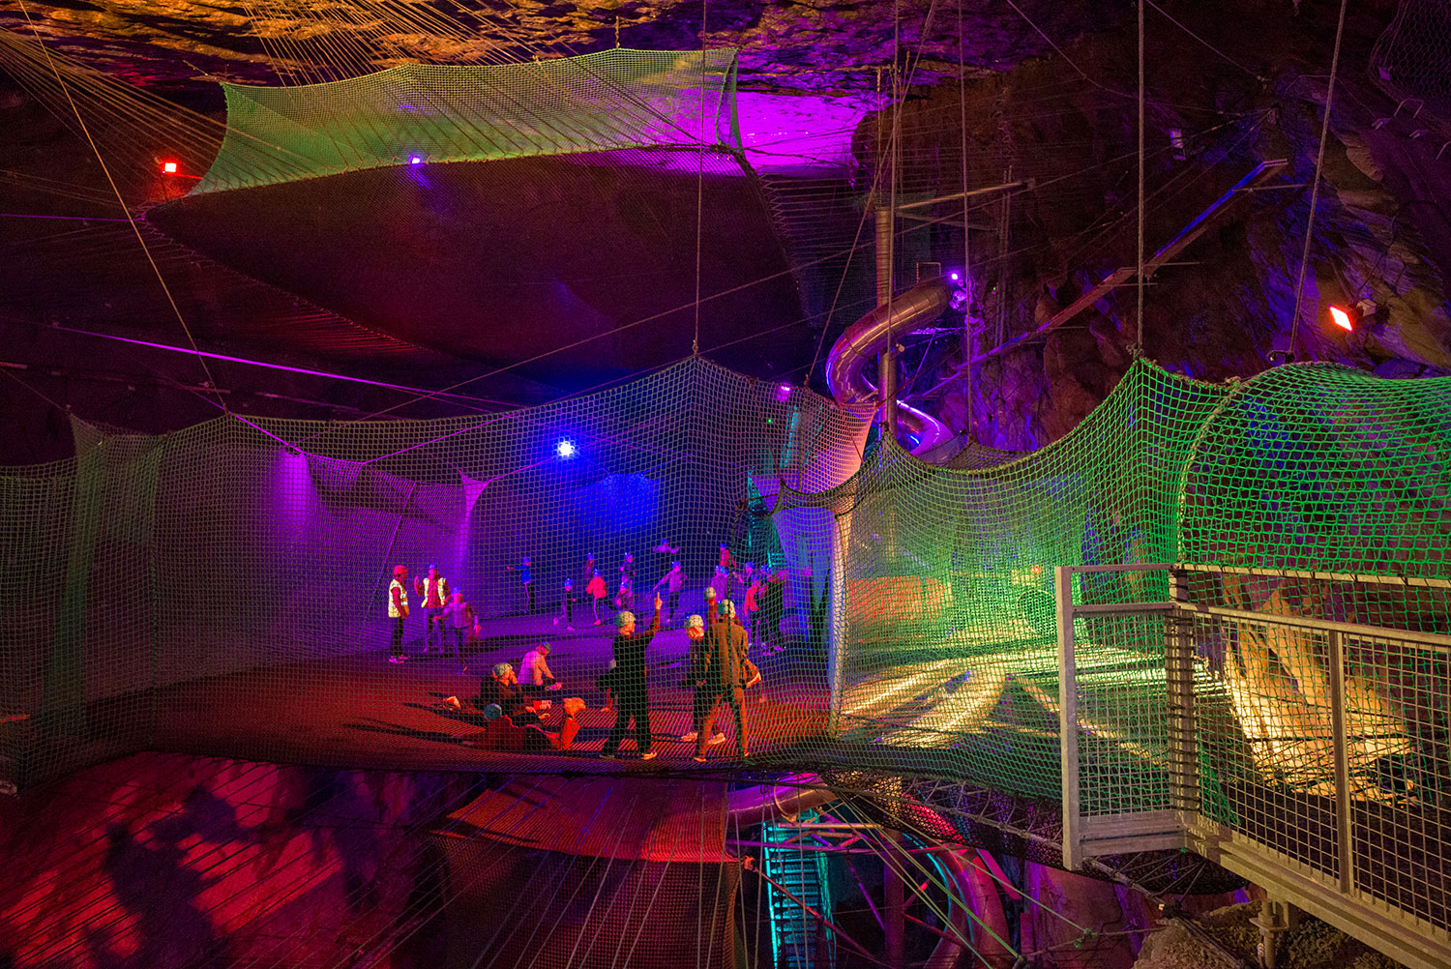
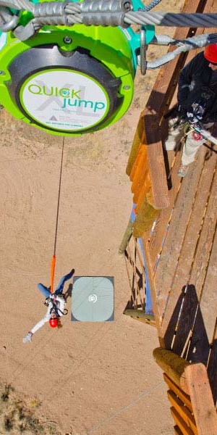
Picture 4: Actual sample of jump system
Picture 3: Actual sample of flat shaped net

